Slide 1
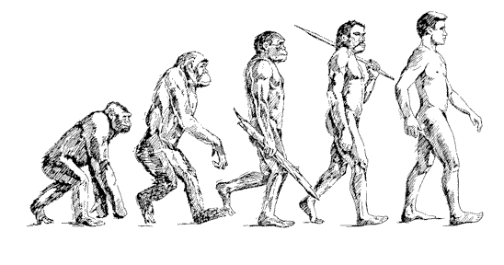
Age and Sex Related LV Remodeling in MESA: Longitudinal Changes.
João A. C. Lima, MD for the MESA RC Investigators
Johns Hopkins Hospital

Slide 2
MESA Investigators
● Wake Forest University – G. Burke, G. Hundley, J. Carr
● U. of Minnesota – A. Folsom and David Jacobs
● Northwestern University – Kiang Liu and Philip Greenland
● UCLA – A. Gomes, K. Watson, M Budoff, J. Rotter
● Columbia University – S. Shea, G. Bahr and M. Prince
● NHLBI – Diane Bild MD and Jean Olson MD
● U. of Washington – R. Kronmal and R. McClelland
● University of Vermont – Russell Tracy and M. Cushman
● Johns Hopkins – Moyses Szklo and Wendy Post
● Tufts – D. O’Leary and J. Polak

Slide 3
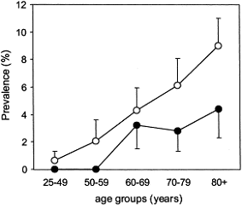
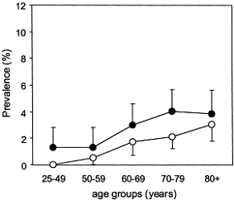
Heart Failure Increases with Age
Systolic Heart Failure
Prevalence
Diastolic Heart Failure
Prevalence
EPICA Study
women
men
Ceia et al., EJHF 2002;4:531

Slide 4
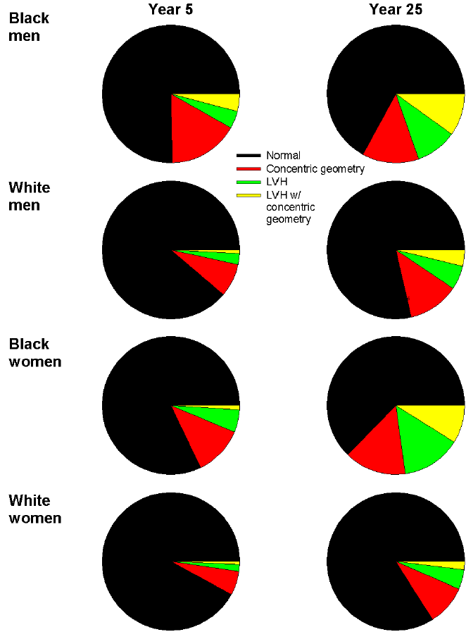
Age, Sex and Race Related
LV remodeling in the CARDIA Study
Y5
Y25
Y5
Y25
BM
BM
BW
BW
WM
WM
WW
WW
Gidding S, Lima J, Liu K, Jacobs D et al. Under Review

Slide 5
Results for LVM/BSA using FRS covariates
(n = 3,959, adjusted for race)
HR (95% CI) | AUC (p-value)† | NRI (p value)
1.18 (1.01, 1.38) | 0.80 (< 0.05) | 0.11 (0.02)
AUC for FRS covariates alone = 0.78. †p-value < 0.05 when comparing AUC between FRS alone and adding LVM index
Armstrong, Jacobs, Liu , Gidding, Lima et al., Under Review

Slide 6
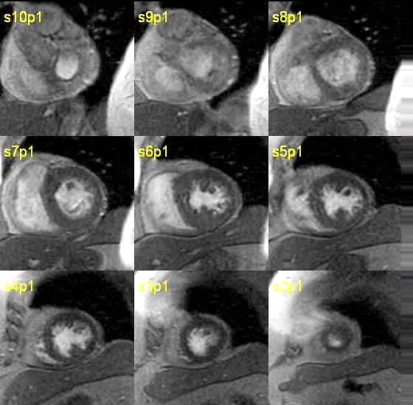
LV mass by MRI measured in 5004 participants in MESA

Slide 7

Age-Related Differences in Left-Ventricular
Structure and Function
The Multi-Ethnic Study of Atherosclerosis
Susan Cheng MD,^{1,2} Verônica RS Fernandes MD PhD,²
Robyn McClelland, PhD, David A Bluemke MD PhD,²
João AC Lima MD²
¹Brigham and Women’s Hospital, Harvard University
²The Johns Hopkins Hospital, Johns Hopkins University
Circulation CV Imaging, May 15, 2009

Slide 8
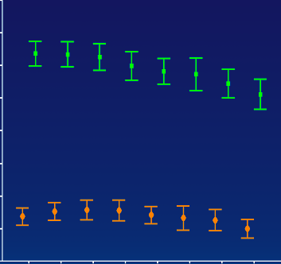
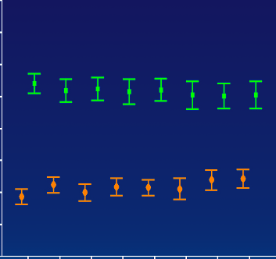
LV Mass and Age
Cheng, S., et al. Circ. CV Imaging, 2009.
(g)
(g/m²)
190
100
Mass
Mass Index
170
90
150
80
130
70
369
337
333
288
426
247
302
320
369
337
333
288
426
247
302
320
110
328
316
288
260
366
232
287
305
60
328
316
288
260
366
232
287
305
≤49
75+
(yr)
≤49
75+
(yr)
50-53
54-57
58-61
62-66
67-69
70-74
50-53
54-57
58-61
62-66
67-69
70-74
Age Group
Age Group
Men
Women

Slide 9


Calibration for Longitudinal Measurements of Cardiac Anatomy and Function in MESA Exam 5
John Eng, M.D.
MESA MRI Reading Center
Johns Hopkins University School of Medicine

Slide 10
Total calibration bias
(based on Monte Carlo simulation, 1000 iterations)
Reader calibration sample size

Slide 11
Calibration function
Y_{calib} = β_{1,pulse} (β_{1,reader} X_{uncalib} + β_{0,reader}) + β_{0,pulse}
Uncalibrated
Calibrated
Notes:
a4g05.eps and a5g05.eps

Slide 12
Calibration: FGRE to SSFP
y = 0.82x + 2.4
n=498
Notes:
a2g01.eps

Slide 13
Age-related remodeling (corrected EDM)
Notes:
a7g02.eps

Slide 14
Age and cohort effects, mass

Slide 15
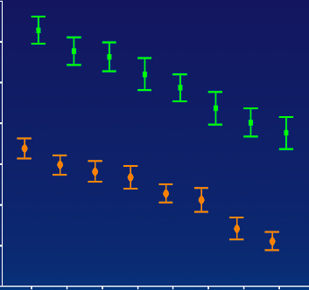
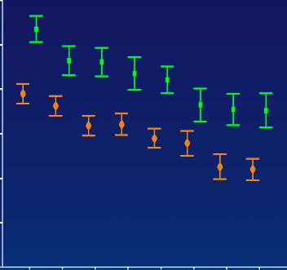
Results: LV Volumes
Men
Women
(mL)
(mL/m²)
160
80
LVEDV
150
LVEDV Index
140
70
130
120
110
60
100
369
337
333
288
426
247
302
320
369
337
333
288
426
247
302
320
90
328
316
288
260
366
232
287
305
50
328
316
288
260
366
232
287
305
≤49
75+
(yr)
≤49
75+
(yr)
50-53
54-57
58-61
62-66
67-69
70-74
50-53
54-57
58-61
62-66
67-69
70-74
Age Group
Age Group

Slide 16
Calibration: FGRE to SSFP
Notes:
a2g02.eps and a2g03.eps

Slide 17
Age and cohort effects, volume

Slide 18
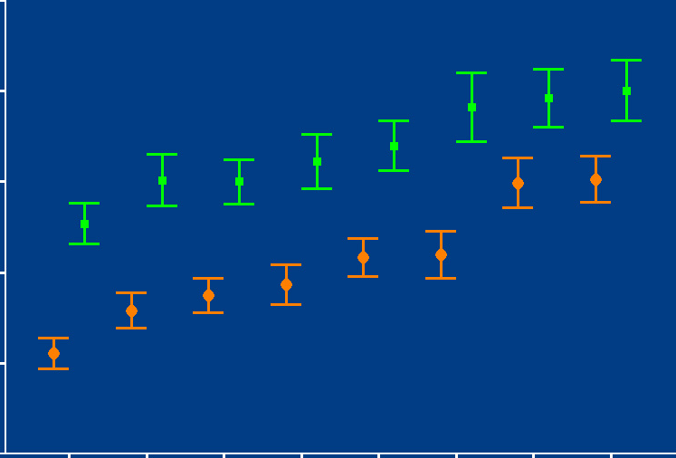
Results: Mass-to-Volume Ratio
1.4
M/V Ratio
1.3
Men
Women
1.2
1.1
1.0
369
337
333
288
426
247
302
320
0.9
328
316
288
260
366
232
287
305
≤49
50-53
54-57
58-61
62-66
67-69
70-74
75+
(yr)
Age Group

Slide 19
Age and cohort effects, M/V ratio

Slide 20
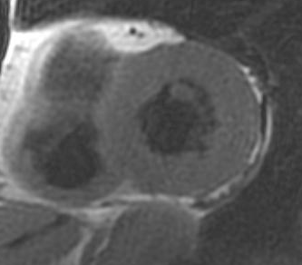
Concentric Remodeling
Increased LV mass/volume
Reduced SV
Normal EF

Slide 21
Concentric Remodeling Physiology
Cheng, S., et al. Circ. CV Imaging, 2009.
Stroke Volume
LVEDV
Ejection Fraction =
Volume
Stroke
Volume
LVEDV
LVESV
Age

Slide 22
Cardiovascular disease risk in relationship to concentric hypertrophy in MESA
18.5
20
N = 156 events
18
16
12.0
14
12
CVD Rate Per 1000 Person Years At Risk
CVD
Rate
10
5.47
5.81
8
6
2.92
4
2
0
1st
2nd
3rd
4th
5th
Mass to Volume Ratio (quintiles)
Cheng, S., et al. Circulation CV Imaging May 15, 2009.
Notes:
This work was presented by our study group in AHA scientific sessions last year. We know that concentric LV remodeling, expressed by increased M/V ratio, is associated with increased cardiovascular disease risk in MESA study

Slide 23
Calibration function applied
Notes:
a5g01.eps – a5g04.eps

Slide 24
Summary
Eng J. et al. Unpublished Data
Implementation of calibration of MRI cardiac parameters
LV mass increases longitudinally in males but not in women
LV volumes decrease with age for both males and females

Slide 25
N-terminal Pro-B-type Natriuretic Peptide, Left Ventricular Mass, and Incident Heart Failure: the Multi-Ethnic Study of Atherosclerosis
Eui-Young Choi, Hossein Bahrami, Colin O. Wu, Andre L.C. Almeida, Aditya Jain, Kihei Yoneyama, Anders Opdahl, Lori B. Daniels, Michael H. Criqui, Mary Cushman, Philip Greenland, Alan Maisel, David Siscovick, Christine Darwin, David A. Bluemke
and Joao A. C. Lima
(Circulation Heart Failure, 2013)

Slide 26
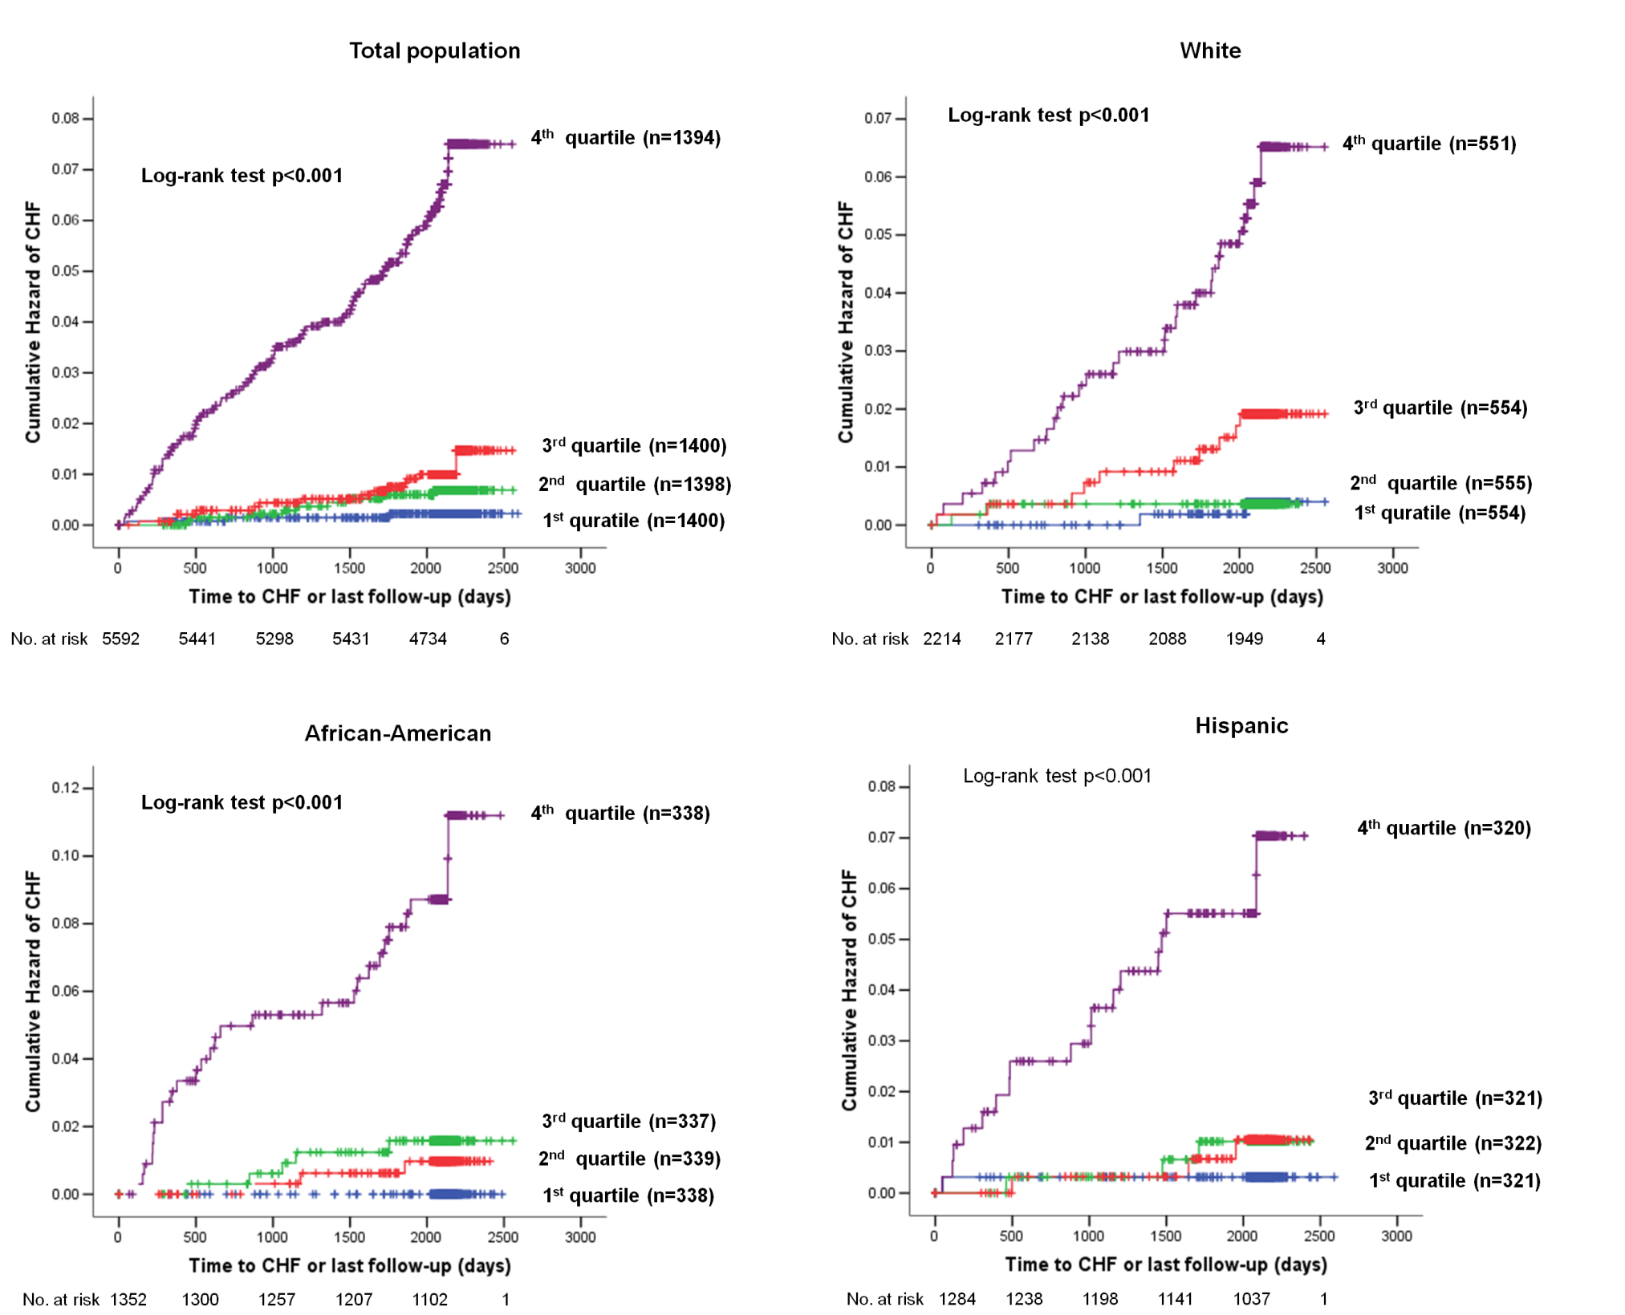

Slide 27
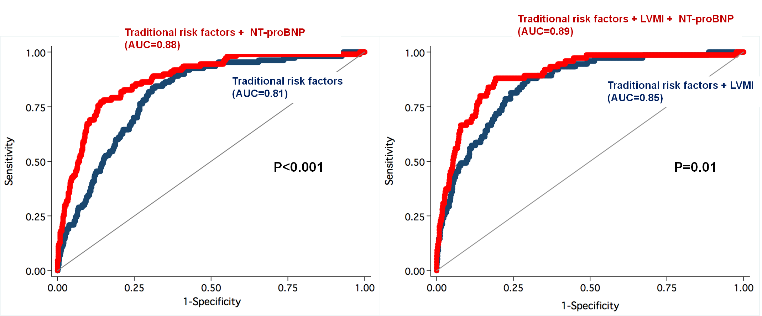
Discrimination
Comparison of model with C-index
95% CI (0.85-0.91)
95% CI (0.86-0.93)
95% CI (0.77-0.84)
95% CI (0.82-0.89)

Slide 29
Sugroup analysis for incident HF in lower NT-proBNP
(<112.5 pg/mL, n=4169) population with Model 3 covariates
Variables | HR | 95% CI | P-value
Age, per year | 1.08 | 1.02-1.14 | 0.013
Male | 1.06 | 0.30-3.77 | 0.93
Diabetes | 4.52 | 1.65-13.38 | 0.003
Current Smoking | 2.21 | 0.67-7.28 | 0.19
Systolic blood pressure, per mmHg | 1.01 | 0.98-1.03 | 0.67
GFR, per mLl/min | 1.00 | 0.97-1.02 | 0.86
Antihypertensive medication use | 1.48 | 0.54-4.09 | 0.45
Statin use | 0.53 | 0.12-2.38 | 0.53
LDL-cholesterol, per mg/dl | 1.01 | 0.99-1.03 | 0.28
HDL-cholesterol, per mg/dl | 0.98 | 0.94-1.03 | 0.43
LV mass index, per 1SD | 2.04 | 1.36-3.06 | 0.001
Log NT-proBNP, per 1SD | 1.46 | 0.77-2.75 | 0.24
Cox proportional hazard regression analysis

Slide 30
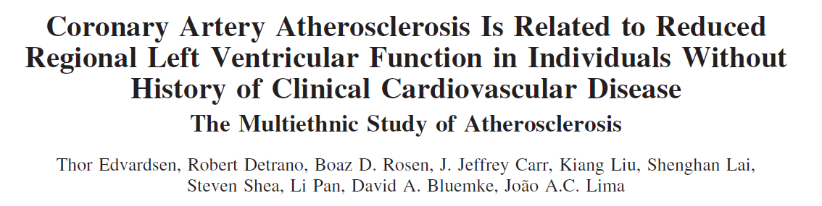
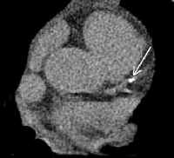
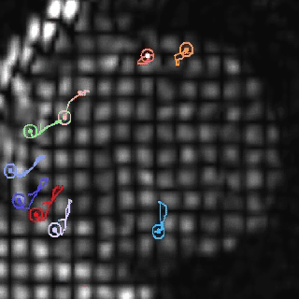
Atherosclerosis (Coronary Calcification) and Local Myocardial Function
Notes:
I’d like to give you just one example of the myriad of results that have come from this analysis.
For example, we have evaluated the relationship between atherosclerosis (measured by calcium) and regional myocardial strain

Slide 31

Regional dysfunction in the MESA baseline examination
Epicardial coronary atherosclerosis.
LVH, blood pressure
Traditional risk factors
Novel risk factors for CAD
Myocardial microvascular disease
These associations suggest that myocardial damage begins well before previously anticipated.

Slide 32
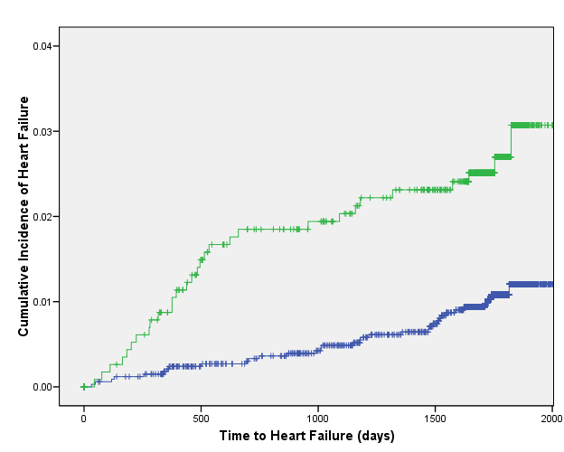
Regional Dysfunction and CHF
Yan R. et al JACC 2011

Slide 33
Hypertension, Age and Gender-related Remodeling Influences Left Ventricular Torsion Assessed by
Tagged Cardiac Magnetic Resonance in Asymptomatic Individuals: the Multi-Ethnic Study of Atherosclerosis
Kihei Yoneyama, M.D., Ph.D., Ola Gjesdal, M.D., Ph.D. Eui-Young Choi, M.D., Ph.D., Colin O. Wu, Ph.D. W. Gregory Hundley, M.D., Antoinette S. Gomes, M.D., Chia-Ying Liu, Ph.D. Robyn L. McClelland, Ph.D., David A. Bluemke, M.D., Ph.D., Joao A.C. Lima, M.D.
Circulation 2012;126:2481-2490

Slide 34
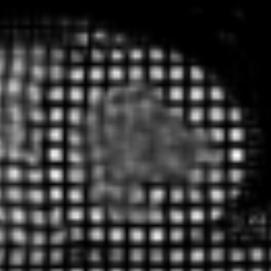
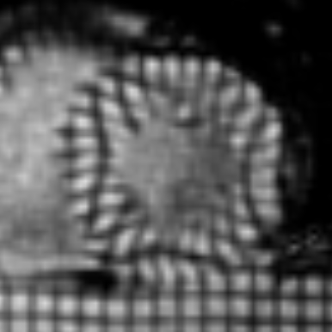
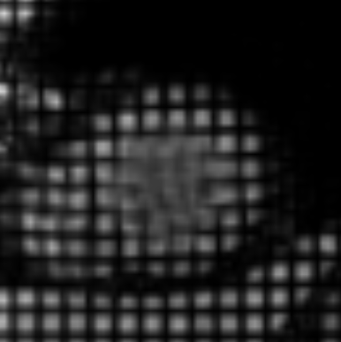
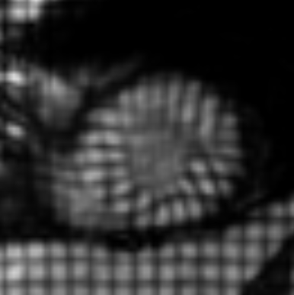
A
B
Rotation ( °) = Angular displacement
Peak twist
Peak apical rotation
Diastole
Systole
Peak torsion
Rotation, °
Torsion, °/cm
Base
Apex
msec
Peak basal rotation
Twist ( °) = Apical rotation – Basal rotation
C
Rotation, °
LV torsion (°/cm) = peak systolic Twist /h
mean ± SD
0
1.5
3.0
Slice gap, cm
Base
h
Mid
Apex
Fig. 1
Notes:
We defined angular displacement of the LV in each short axis slice as LV rotation (degree).
LV twist was defined as the net difference between the basal and apical rotation angle.
The result was then divided by the distance h (cm) between the two acquired sliced for normalization purposes.

Slide 35
*
*
*
*
†
†
Fig. 2

Slide 36
A
B
SV
0.2
LV MI
0.3
Torsion
0.1
0.2
CS
Standardized values
0.1
0
0
M/V ratio
Standardized values
-0.1
-0.1
LVEF
-0.2
-0.2
40
50
60
70
80
40
50
60
70
80
C
Age, years
D
Age, years
0.6
LVMI-HT
0.4
Torsion - HT
0.4
M/V ratio-HT
CS-non HT
Standardized values
0.2
Torsion-non HT
0.2
Standardized values
CS-HT
0
0
-0.2
-0.2
-0.4
M/V ratio-non HT
LVMI-non HT
-0.6
-0.4
40
50
60
70
80
40
50
60
70
80
E
Age, years
Age, years
0.4
SV-HT
0.2
LVEF-HT
Standardized values
SV-non HT
0
LVEF -non HT
-0.2
-0.4
Fig. 4
40
50
60
70
80
Age, years
Fig. 5

Slide 37
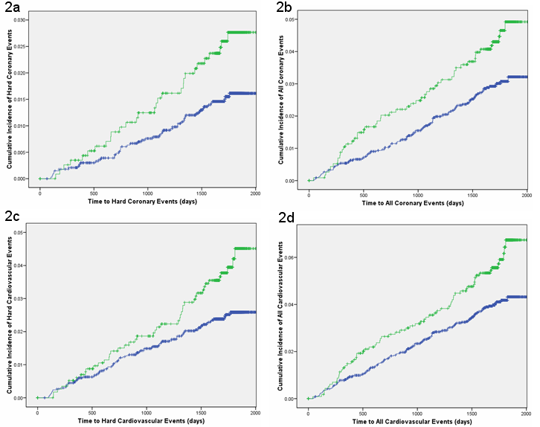
Retional dysfunction and Events
(Yan R et al JACC 2011)

Slide 38
Biomarkers for Fibrosis
Related to collagen turnover (synthesis and degradation); a number of options first developed in bone disease research; two particularly useful in heart failure (1)
  CITP: Collagen type I c-terminal telopeptide – collagen resorption
  PIIINP: Collagen type III n-terminal propeptide – collagen synthesis
Related to cartilage turnover, some evidence for usefulness in heart failure (2)
  YKL-40 – chondrocytes but also macrophage, neutrophils, SMCs
Related to functional changes: especially popular in liver research (and clinically), uncertain use in heart failure
  Fib-4, FibroScan, etc: multi-marker panels (3)
  Hyaluronic acid (4)
Others…..
Barasch et al., Circ Heart Failure 2:303-10, 2009; Circ Heart Failure, in press.
Bilim et al., J Cardiac Fail. 16:873-9, 2010
Bottero et al., J Hepatol 50:1074-83, 2009
Boulware et al., J Infect Dis. 203:1637-46, 2011
Laboratory for Clinical Biochemistry Research
University of Vermont

Slide 39
Conclusions
Established Risk Factors underlie concentric LV remodeling, regional myocardial dysfunction and NT-ProBNP increase as precursors of Incident Heart Failure early in adulthood.
In a population of individuals selected based on the absence of previous CV diseases LV mass increases longitudinally in men but not in women.
Left ventricular remodeling decreases with age and so does the left ventricular stroke volume

Slide 40
Conclusions (cont.)
Nt-proBNP and regional myocardial dysfunction are also predictors of HF in MESA.
Based on cross-sectional analyses, age related mechanical function also differs between women and men.
Left ventricular torque is greater in women than in men, and greater in MESA participants with hypertension than in those without hypertension.

Slide 41

Collaborators:
JONHS HOPKINS MESA
David Bluemke, MD, John Eng, MD
Colin Wu, Ph D, Moyses Szklo, MD
Wendy Post, MD Pamela Ouiang, MD
Boas Rosen, MD, Veronica Fernandes, MD
Susan Chen, MD, Khurram Nasir, MD
Thor Edvardsen, MD, Hossein Bahrami, MD
Marcelo Nacif, MD, Raymond Yan, MD
Sirisha Donekal, MD, Eui Young Choi, MD
Gustavo Volpe, MD, Kihey Yoneyama, MD
Anderson Armstrong, MD, Harjit Chahal, MD

Slide 42
Thank you

