Slide 1



Traffic-related air pollution and the right ventricle
MESA Steering Committee: April 25, 2013
MESA Air PI: Joel Kaufman, MD MPH
MESA RV PI: Steven Kawut, MD MS
Peter Leary, MD

Slide 2
Disclosures and funding
Received consultancy fees from Gilead Sciences, Inc.
Received honoraria from the Pulmonary Hypertension Association
Supported by the NIH:
T32-HL007287-33 (until June 30)
KL2-TR000421 (starting July 1)
Notes:
Kawut is not here so I’ll carry the torch.

Slide 3
Background

Slide 4
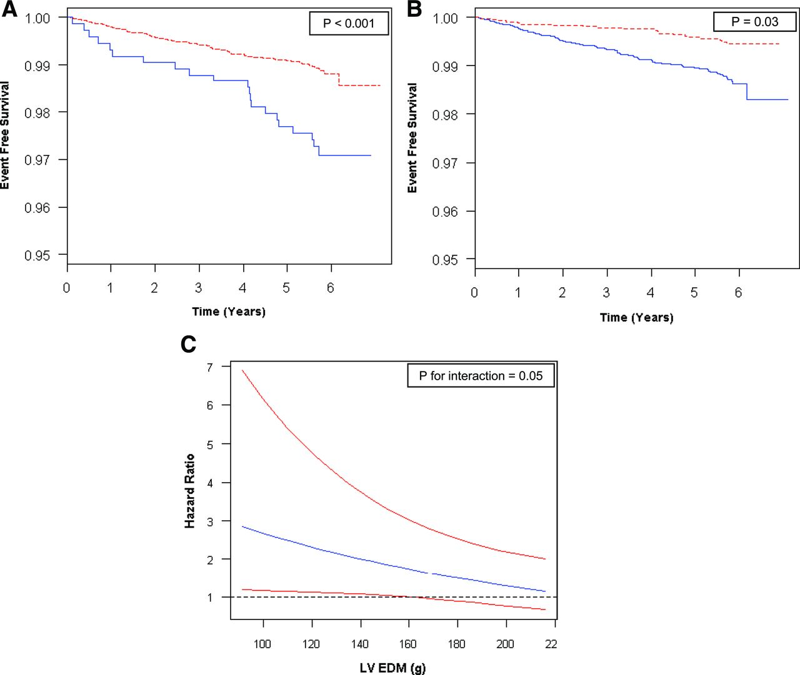
Why study the right ventricle?
Metrics of RV structure & function predict poor outcome
Event Free Survival
Increased RV Mass (>95%ile)
No increase in RV mass
Years
Kawut SM. Circ (2012) 126:1681-8.
Notes:
Kawut is not here so I’ll carry the torch. RV metrics also predict morbidity in COPD and death in left heart failure.
Is it a reflection of disease severity or a contributor to the burden of disease

Slide 5
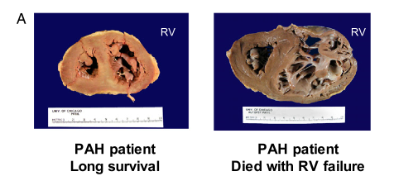
A tale of two right ventricles
A young woman with idiopathic pulmonary hypertension who was diagnosed, experienced rapid progressive decline in her symptoms until she died one year later at age 32.
The first woman had a dilated and thinned RV
The second woman had a muscularized RV
Both women had similar pulmonary vascular disease
A young woman with idiopathic pulmonary hypertension who was diagnosed and enjoyed relatively stable symptoms for the next 22 years until she died from colon cancer at age 53.
Rich S. AJRCCM (2010) 138:1234-1239.
Notes:
The RV may be more than just a marker of disease but also influence disease

Slide 6
Broad Objective
Identify modifiable exposures that alter the course of RV adaptation and improve outcomes in diseases complicated by right heart failure

Slide 7
Mechanistic exposures
Non-modifiable: Increasing age, race, family history
Modifiable: Can be treated, controlled or changed such as blood pressure, diet, exercise, smoking or air pollution

Slide 8
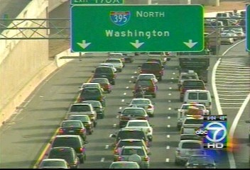
Traffic related air pollution is related to cardiovascular disease
Long-term traffic-related air pollution is linked to:
Heart failure/Cardiovascular Death
Endothelial dysfunction (MESA)
Left ventricular hypertrophy (MESA)
Samet JM. NEJM (2000) 343:1742-9; Miller KA. NEJM (2007) 356: 447-58; Krishnan RM. JACC (2012) 60:2158-66; Van Hee VC. AJRCCM (2009) 179:827-34.

Slide 9
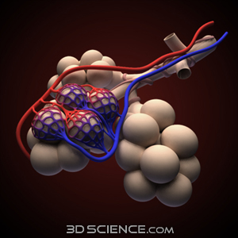
The RV may be quite sensitive to inhalational exposure
Lung injury/exposures may affect the right ventricle by:
Increasing pulmonary vascular resistance
Local RV-lung interactions (e.g. inflammation, angiogenesis, etc)
Notes:
The cardiac output of the RV goes though the lungs. PVR=well established. local intercation=less well established but widely speculated upon.

Slide 10
Methods

Slide 11
Study Design
Study Population: MESA participants from all 6 sites
Aim: To determine whether traffic related air pollution is associated with differences in right ventricular structure and function in individuals without clinical cardiovascular disease
Surrogate Exposure: Estimate of mean daily exposure to outdoor residential NO₂ over the year prior to cardiac MRI
Outcomes: RV mass, End Diastolic Volume & ejection fraction
RV mass
NO₂ Estimates
RV End Diastolic Volume
RV Ejection Fraction
Notes:
NO2 estimates for the true exposure of interest: air pollution or traffic related air pollution. This exposure represents a strength of the study and we believe an improvement over simpler “distance to roadway” analysis which fails to take into account the complex features of geographic distribution of TRAP and the variation in “major” roadway by region.
NO2 is one metric of spatial decay from the true exposure of traffic related air pollution

Slide 12
Exposure: NO₂ Models
A surrogate for traffic-related air pollution
Monitoring data from the EPA Air Quality System
Cohort specific monitoring as part of MESA Air
Geographical variables, such as:
Dispersion models integrating road position, traffic volume and patterns, meteorology
precise residential location
land-use
vegetative index
urban topography
population density
distance to major features (airports, truck routes, coastline, etc)
emissions sources
Notes:
Sophisticated spatio-temporal models maximized via maximum likelihood and including....

Slide 13
Exposure
~120ppb
~40ppb
Notes:
This is the end product of the exposure modeling. Each black dot is a MESA participant jittered to protect confidentiality. The map includes some features of the analysis including roadways, AQS monitoring sites, home monitoring sites, Snapshot campaigns, etc.

Slide 14
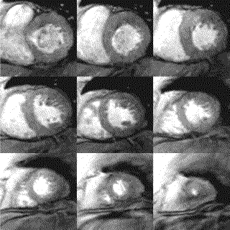
Outcomes
RV mass:
difference between epicardial and endocardial volumes at end diastole
RV end diastolic volume (EDV):
summation of areas on cross sectional slices
RV ejection fraction (EF):
The difference between RV end systolic and EDV divided by EDV
Notes:
cMRI at exam 1

Slide 15
Analysis
Statistical Approach: Multivariable linear regression of the cross-sectional association between NO₂ and RV parameters
Full model: age, gender, race/ethnicity, height, weight, study site, education, income, presence of diabetes or hypertension, smoking status and pack years, cholesterol and impaired glucose tolerance
Additional Models:
Limited: age, gender, race/ethnicity, height, weight
Full model + further adjustment for
1. Self reported roadway noise
2. LV pathology
3. Markers of inflammation (CRP & IL-6)
4. Lung disease (%emphysema CT/self reported disease)
Notes:
NO2 estimates for the true exposure of interest: air pollution or traffic related air pollution. This exposure represents a strength of the study and we believe an improvement over simpler “distance to roadway” analysis which fails to take into account the complex features of geographic distribution of TRAP and the variation in “major” roadway by region.

Slide 16
Results

Slide 17
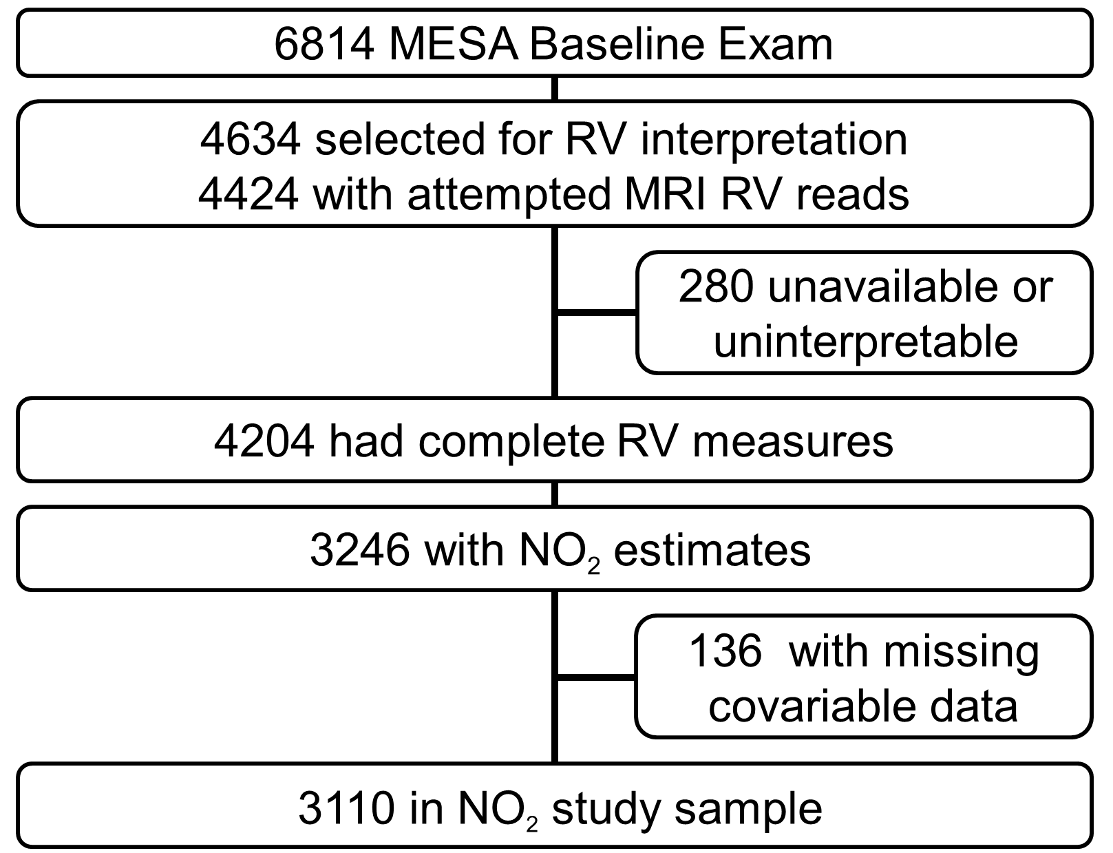
Study Sample

Slide 18
Our participants were slightly healthier
 | Study Sample | Non-Study Sample
 | (n=3110) | (n=3704)
Age (years) | 61.1 ± 10.0 | 63.0 ± 10.4
Female (%) | 52.8 | 52.9
Race (%)
White | 40.6 | 36.7
Chinese | 13.2 | 10.6
African-American | 24.4 | 30.6
Hispanic | 21.8 | 22.1
Body mass index (kg/m²) | 27.8 ± 5.0 | 28.8 ± 5.8
High school degree (%) | 18.6 | 17.9
Current cigarette smoking (%) | 11.8 | 14.1
Hypertension (%) | 41.8 | 47.7
Diabetes mellitus (%) | 11.6 | 15.2
NO₂ (ppb) | 22.1 ± 9.4 | 21.9 ± 8.8*
* 777 participants with NO₂ estimates not included because of missing MRI or covariables

Slide 19
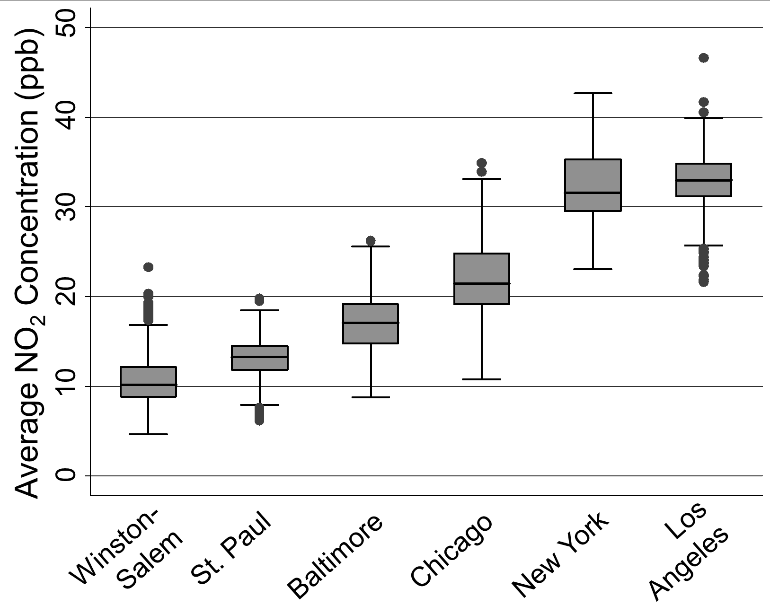
Difference in NO₂ between and within cities
Notes:
Broad inter and relatively broad intra. Intracity range from ~10-20. 10ppb chosen to describe the gradient across all cities. Could mention that NC is not well correlated.

Slide 20
Increased RV mass with increased NO₂
Model | For 10ppb increase in NO₂
 | difference | 95% CI | p-value
RV mass, g (Limited model)* | 0.2 | (0.1, 0.4) | 0.001
RV mass, g (Full Model)* | 0.5 | (0.1, 0.8) | 0.006
RV EDV, mL (Limited model) | 1.1 | (0.2, 2.0) | 0.02
RV EDV, mL (Full Model) | 1.7 | (-0.5, 4.0) | 0.14
RVEF, % (Limited model) | 0.0 | (-0.2, 0.3) | 0.95
RVEF, % (Full Model) | -0.2 | (-0.8, 0.5) | 0.58
Limited: age, gender, race/ethnicity, height, weight
Full: Limited + study site, education, income, presence of diabetes or hypertension, smoking status and pack years, cholesterol and impaired glucose tolerance
Notes:
Association was present before and after extensive adjustment. The model was relatively insensitive to most of the additions with the exception of adjusting for study site which led to magnified effect estimates.

Slide 21
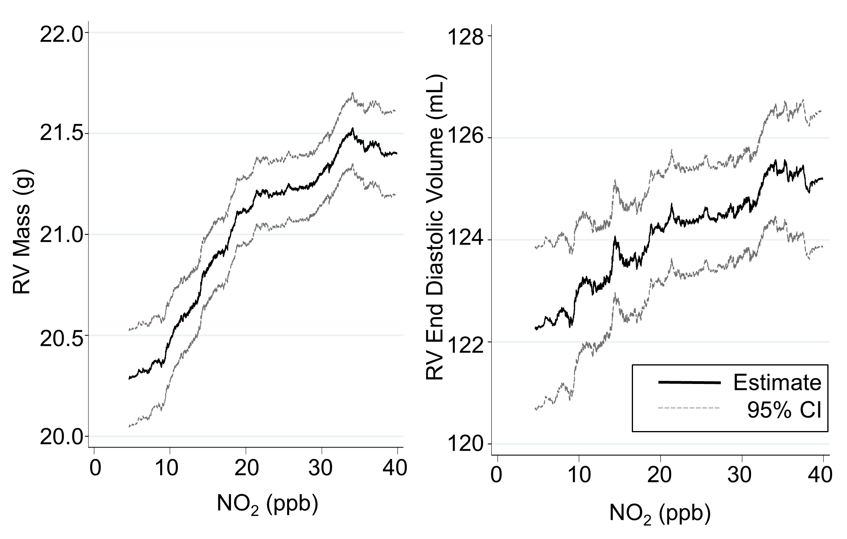
Comparison of NO₂ with other factors associated with RV mass
RV mass difference by NO₂ exposure (10ppb) about equal to:
RV mass difference in groups separated by 6 years of age
RV mass difference in groups with/without diabetes
RV mass difference between current smokers and never smokers
Notes:
Put is in context... Let’s focus on mass....

Slide 22
Adjusting for additional factors in the relationship between NO₂ and RV mass
Full Model
Traffic related noise
(n=3,106)
LV mass
(n=3,110)
Inflammation
(n=3,026)
Structural & self reported lung disease (n=3,106)
0.1 0.3 0.5 0.7 0.9
Difference in RV mass (g) per 10ppb difference in NO₂

Slide 23
Sliding exposure time window
2.5
2.0
1.5
1.0
0.5
0.0
-0.5
-1.0
RV mass difference per 10ppb of NO₂
Full Model
1 to 6
2 to 7
3 to 8
4 to 9
5 to 10
6 to 11
7 to 12
8 to 13
9 to 14
10 to 15
Number of years a participant lived in the index neighborhood
Notes:
This model is also adjusted for total duration of time in a neighborhood.

Slide 24
Effect modification by location
6
5
4
3
2
1
0
-1
-2
6
5
4
3
2
1
0
-1
-2
All participants
Participants in area
for >5 years
RV mass difference per 10ppb of NO₂
Full Model
Baltimore
Full Model
Baltimore
St. Paul
St. Paul
Los Angeles
Chicago
Winston-Salem
Los Angeles
New York
Chicago
Winston-Salem
New York
Notes:
Worth noting that that Chicago and Winston-Salem have the lowest correlation between models and measurements at AQS stations in the subset of participants who lived very closely.

Slide 25
Limitations
Misclassification: estimated NO₂ may not always represent “true” participant exposure to traffic-related air pollution
Traffic-related air pollution is a complex milieu of pollutants which may vary from city to city
Observational study: residual or unmeasured confounding may account for findings

Slide 26
Conclusions
Traffic-related air pollution is associated with right ventricular hypertrophy
The association is not dependent on road noise, left ventricular mass, CRP/IL6, or COPD
The relationship may take time to develop
A participants city modifies the relationship

Slide 27
Acknowledgements
Authors:
Steve Kawut
Graham Barr
Cynthia Curl
David Bluemke
Terri Hough
Adam Szpiro
Victor Van Hee
Joel Kaufman
Mentors:
Terri Hough
Noel Weiss

Slide 28
Appendix Slides
Sensitivity analysis using calendar year of NO2
NOx relationship with RV parameters
Decay in traffic-related pollutants by distance
Technegas lung retention of radiolabeled carbon
CO inhalation in the rat
Strict roadway distance analysis
Table: etiologic time window
Effect modification slides

Slide 29
Supplemental Table 1. Sensitivity analysis: difference in right ventricular structure and function in groups of differing NO₂ exposure by calendar year 2000, 2001 and 2002
Model | per 10ppb increase in NO₂
 | difference | 95% CI | p-value
Calendar Year 2000
RV mass, g (Full Model) | 0.4 | (0.0, 0.7) | 0.04
RV EDV, mL (Full Model) | 1.8 | (-0.5, 4.1) | 0.12
RVEF, % (Full Model) | -0.1 | (-0.6, 0.7) | 0.88
Calendar Year 2001
RV mass, g (Full Model) | 0.4 | (0.1, 0.8) | 0.02
RV EDV, mL (Full Model) | 1.9 | (-0.4, 4.2) | 0.11
RVEF, % (Full Model) | -0.1 | (-0.8, 0.6) | 0.86
Calendar Year 2002
RV mass, g (Full Model) | 0.4 | (0.0, 0.1) | 0.05
RV EDV, mL (Full Model) | 1.6 | (-0.7, 4.0) | 0.17
RVEF, % (Full Model) | -0.1 | (-0.8, 0.5) | 0.72

Slide 30
The relationship of NOx with the RV
Supplemental Table 2. Sensitivity analysis: difference in right ventricular structure and function in groups of differing NO_{x} exposure
Model | per 20ppb increase in NO_{x}
 | difference | 95% CI | p-value
RV mass, g (Limited model) | 0.1 | (0.0, 0.2) | 0.04
RV mass, g (Full Model) | 0.2 | (0.0, 0.4) | 0.03
RV EDV, mL (Limited model) | 0.5 | (-0.2, 1.1) | 0.16
RV EDV, mL (Full Model) | 0.6 | (-0.7, 1.8) | 0.39
RVEF, % (Limited model) | 0.1 | (-0.1, 0.3) | 0.48
RVEF, % (Full Model) | 0.1 | (-0.2, 0.5) | 0.46

Slide 31
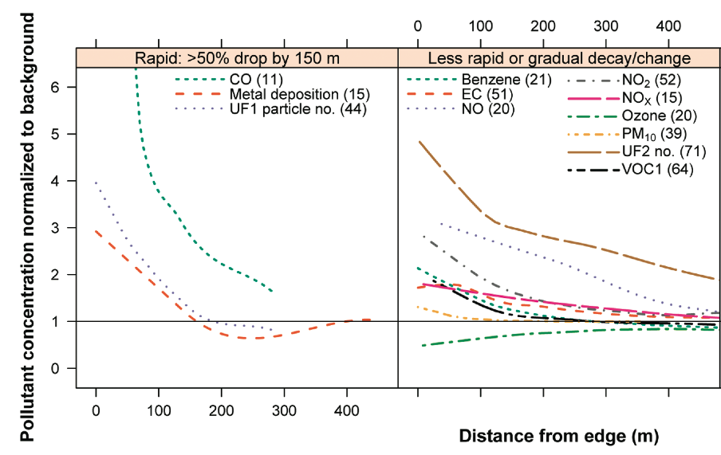
Variable Decay of pollutants in space^{a1}

Slide 32
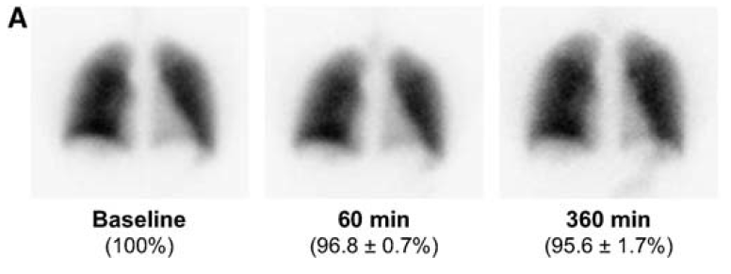
The lungs have a large exposure to traffic related air pollution^{a2}
Inhaled radiolabeled carbon nanoparticles:
lung retention (% + SD)
Notes:
%ages are retention (e.g. 95.6% of the inhaled labelled carbon particles “technegas” remain in the lungs at 6 hours… there is very little in the bladder or upper quadrants of the abdomen

Slide 33
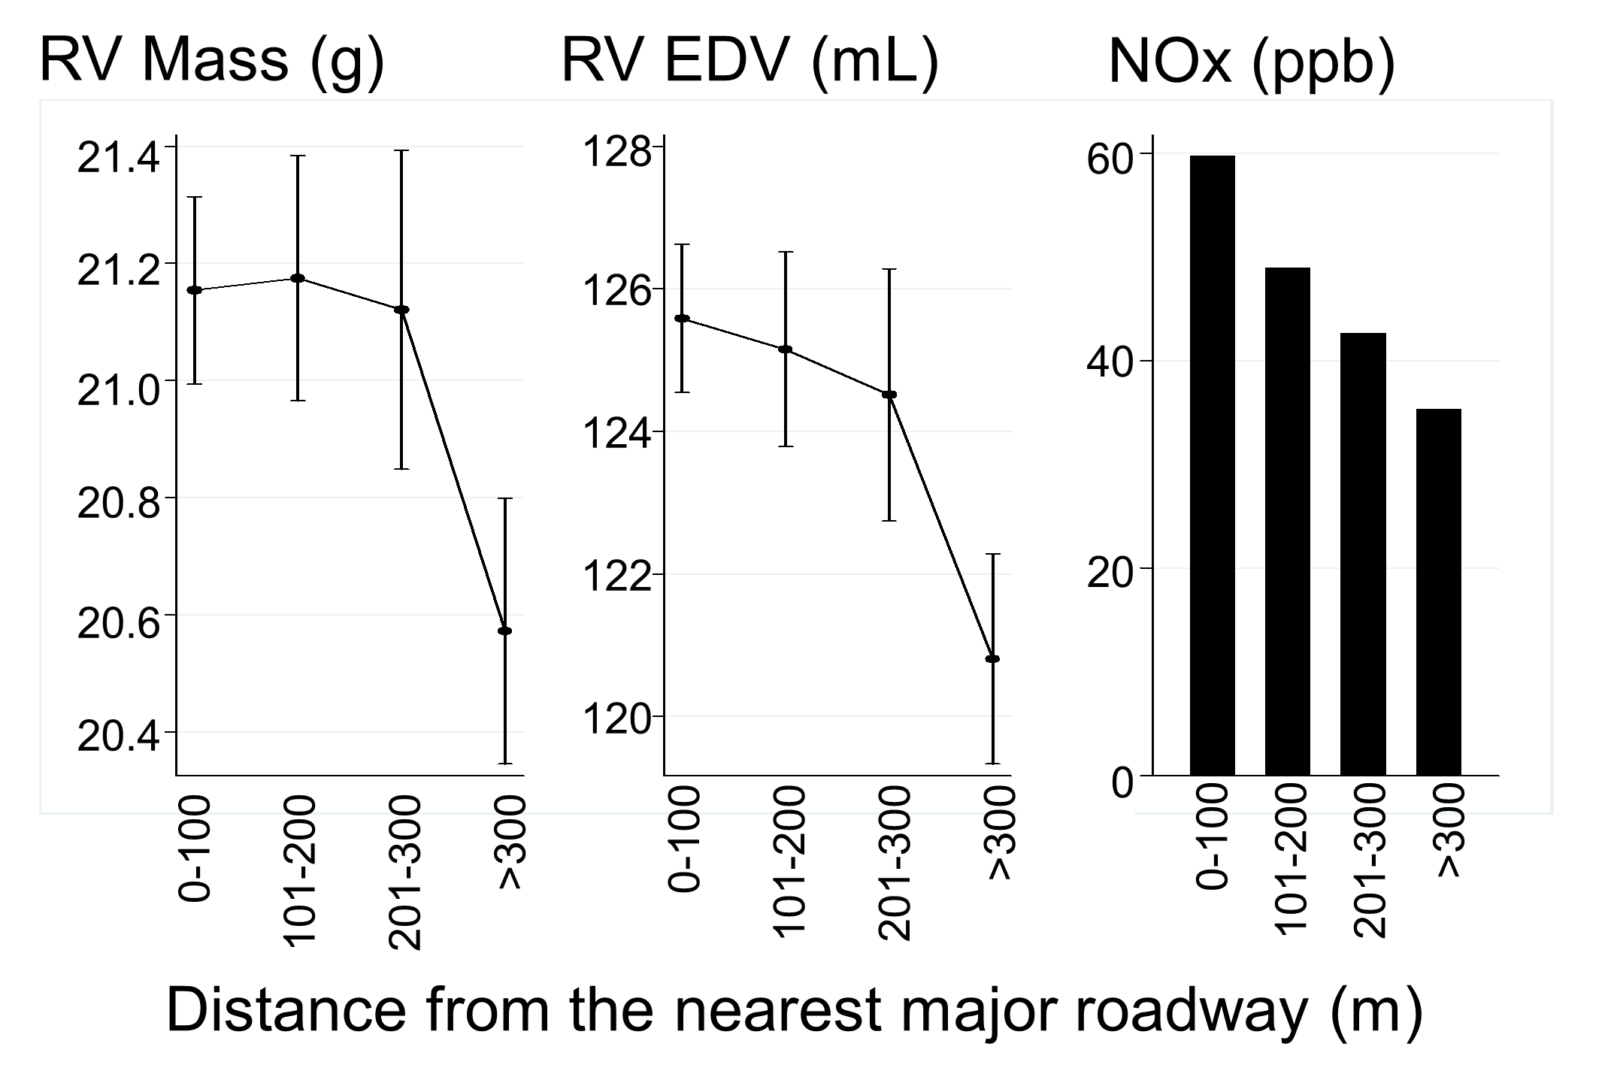
Increased RV mass, stroke & end diastolic volumes with proximity to a major road
RV EF (%)
70.8
70.6
70.4
70.2
70.0
68.8
0-100
101-200
201-300
>300
Distance from the nearest major roadway (m)
The difference in RV EDV between participants >300m & <100m from a major roadway is more than the difference in participants with/without diabetes and about equal to participants who differ in age by ~10 years. RV mass difference is about equal to the presence of diabetes or in groups that differ by 6.5 years.

Slide 34
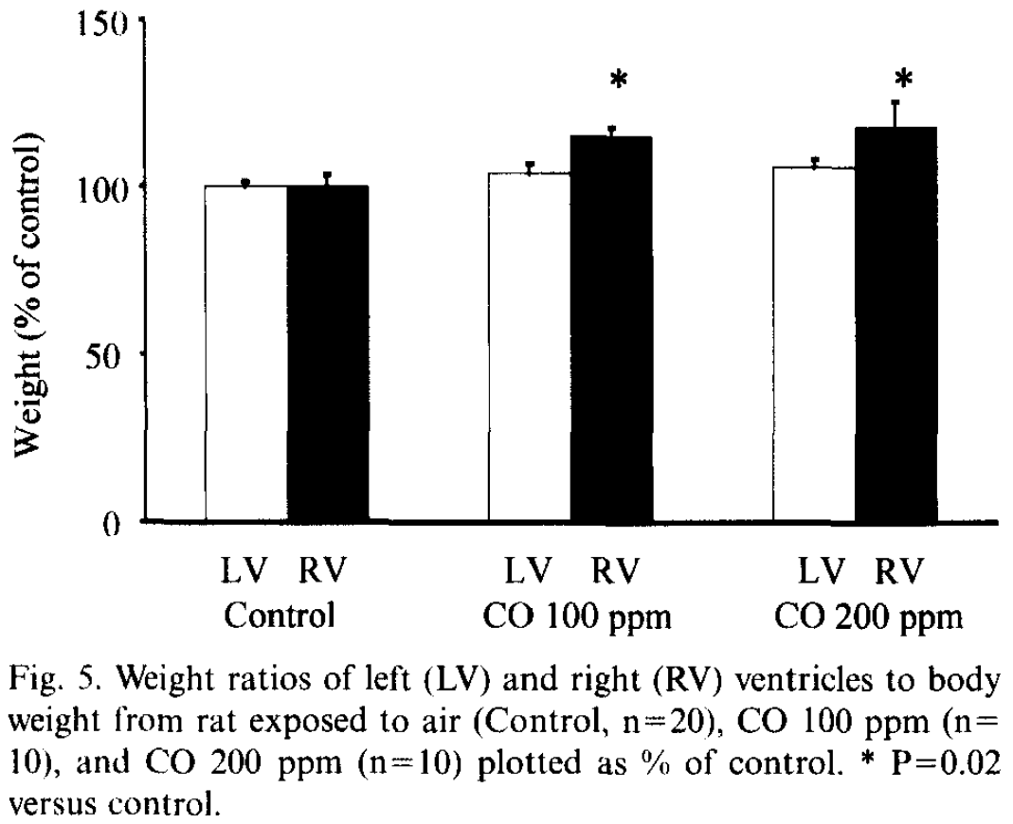
Increased tendency of the rat RV to hypertrophy with inhalants
Change in LV and RV mass in rats breathing air, 100ppm of CO, or 200ppm of CO⁷
Notes:
Theory seems to match reality... At least in rats

Slide 35
Residential stability as a proxy for the timing of exposure
Number of years lived in the same neighborhood | per 10ppb increase in NO₂
 | n | RV mass(g) | 95% CI | p-value
1 to 6 years | 679 | 0.2 | (-0.5, 1.0) | 0.57
2 to 7 years | 698 | 0.4 | (-0.4, 1.2) | 0.31
3 to 8 years | 682 | 0.7 | (-0.1, 1.4) | 0.1
4 to 9 years* | 618 | 0.9 | (0.1, 1.8) | 0.03
5 to 10 years* | 637 | 1.0 | (0.2, 1.8) | 0.02
6 to 11 years* | 611 | 1.1 | (0.3, 2.0) | 0.008
7 to 12 years* | 591 | 1.0 | (0.2, 1.8) | 0.02
8 to 13 years* | 551 | 0.9 | (0.1, 1.7) | 0.03
9 to 14 years | 533 | 0.8 | (-0.1, 1.6) | 0.08
10 to 15 years | 591 | 0.7 | (-0.1, 1.6) | 0.08
All models include full adjustment and further adjustment for total duration in which a participant lived in the neighborhood
Notes:
----- Meeting Notes (4/22/13 14:31) -----
Ditch slide. Appendix

Slide 36
Effect modification by city
City | per 10ppb increase in NO₂
 | RV mass (g) | 95% CI
St. Paul | 4.0 | (2.4, 5.6)
Los Angeles | 0.4 | (-0.4, 1.2)
Baltimore
African-American | 1.6 | (-0.3, 3.5)
White | -0.3 | (-1.2, 0.7)
Chicago | 0.1 | (-0.8, 0.8)
Winston Salem | -0.1 | (-1.3, 1.1)
New York | -0.2 | (-1.0, 0.5)
interaction by city: p <0.001 interaction by race in Baltimore: p = 0.02
Notes:
----- Meeting Notes (4/22/13 14:31) -----
Color divide (ditch it)

Slide 37
Effect modification by city?
Outdoor Residential
NO₂
Increased RV mass

Slide 38
Effect modification by city?
Indoor air quality
(age of homes, use of air conditioning)⁸
Traffic related air pollution (variable mixes of pollutants)
Outdoor Residential
NO₂
Increased RV mass
% Time at home/work or indoor/outdoor
Indoor/Outdoor non-residential air quality

Slide 39
Differences in RV structure and function in groups of differing NO₂ exposure
Model | per 10ppb increase in NO₂
 | difference | 95% CI | p-value
RV mass, g (Limited model)* | 0.2 | (0.1, 0.4) | 0.001
RV mass, g (Limited model + city)* | 0.4 | (0.0, 0.7) | 0.03
RV mass, g (Full Model)* | 0.5 | (0.1, 0.8) | 0.006
RV EDV, mL (Limited model) | 1.1 | (0.2, 2.0) | 0.02
RV EDV, mL (Limited model + city) | 0.8 | (-1.5, 3.0) | 0.51
RV EDV, mL (Full Model) | 1.7 | (-0.5, 4.0) | 0.14
RVEF, % (Limited model) | 0.0 | (-0.2, 0.3) | 0.95
RVEF, % (Limited model + city) | -0.2 | (-0.8, 0.4) | 0.55
RVEF, % (Full Model) | -0.2 | (-0.8, 0.5) | 0.58
Notes:
Give the data

Slide 40
Adjusting for additional factors in the relationship between NO₂ and RV mass
Model | per 10ppb increase in NO₂
 | RV mass (g) | 95% CI | p-value
Full Model | 0.5 | (0.1, 0.8) | 0.006
Accounting for traffic related noise (n=3,106) | 0.5 | (0.1, 0.8) | 0.01
Accounting for LV mass (n=3,110) | 0.5 | (0.1, 0.8) | 0.007
Accounting for CRP and IL-6 (n=3,026) | 0.5 | (0.2, 0.9) | 0.003
Accounting for structural and self reported lung disease (n=3,106) | 0.5 | (0.1, 0.8) | 0.01
Full model with further adjustment for the noted covariable

