Slide 1
The Use and Misuse of Quantiles
(‘bitiles’, tertiles, quartiles, quintiles, etc.)

Slide 2
Disclaimer
I have engaged in some of the practices that I describe as less than optimal in this talk.
I will likely do so in the future although with some feeling of guilt.
I’ve never used tertiles and never will.
I have only used ‘bitiles’ when there was a good medical or statistical reason to do so.
I am not trying to pick on the Framingham Study.
I have the highest regard for Circulation.

Slide 3
Summary of this talk
Define and illustrate how quantiles are computed.
Discuss why researchers use quantiles.
Provide an early example from the literature of the use of quartiles.
Use examples from MESA, CHS and from the medical literature to illustrate some of the issues that need to be considered when using quantiles.
All of the examples have as the outcome variable an event and involve Cox models.
Because of time constraints I won’t discuss the issues arising from the use of quantiles as outcomes or when the outcome variable is a continuous variable and quantiles are used for one or more predictor variables.
Relate the examples to the earlier discussion of why researchers use quantiles and make recommendation concerning their use.
Notes:
Standard deviation for

Slide 4
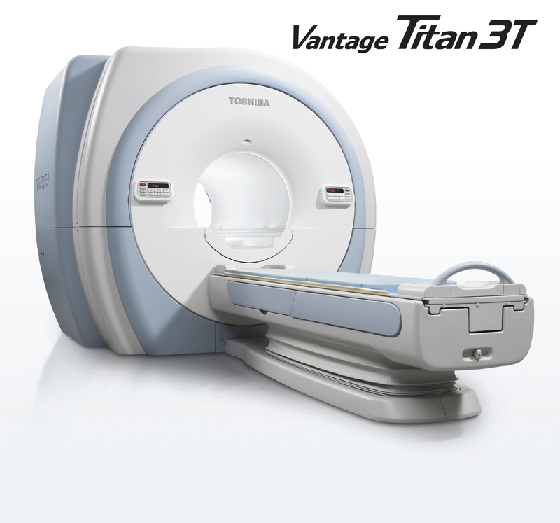
We collect datA
Example from MRI

Slide 5
Histogram of LVM%predicted

Slide 6
Histogram of Percentile of LVM%predicted

Slide 7
Why do reseachers use Quantiles?
They provide a good way of describing the findings.
The results using quantiles are understandable even if we have little or no understanding of the variable involved. It isn’t necessary to consider the shape of the regression function, e.g. linear, log linear, etc.
Results using quantiles are generalizable.
Quantiles are a good way of discovering and modeling non-linearities or dealing with non-normality.
Quantiles within subgroups provide a good way to adjust for the subgroup.

Slide 8
First (?) Use of Quartiles
Predictive Value of Lipoprotein and Cholesterol Determinations in Diabetic Patients who Developed Cardiovascular Complications
By ALEXANDER D. Lowy, JR., M.D., AND JOSEPH H. BARACH, M.D.
With the statistical assistance of Zdenek Hrubec, A.B.
Circulation, Volume XVII, January 1958
A follow-up study was performed on 690 white diabetic patients 2 to 5 years after their blood had been analyzed for lipoprotein and cholesterol to determine if these lipid measures had any predictive value for development of future cardiovascular complications.

Slide 9
First (?) Use of Quartiles
From the Statistical analysis description
“In drawing any specific conclusions from these data, it should be remembered that because of the large variability of the measurements the examination of differences between means tells nothing definite concerning a lipid determination for a single individual. In order to analyze the data more effectively, therefore, the percentage of patients with cardiovascular complications in each quartile of the distribution of the lipid measure was also examined.”

Slide 10
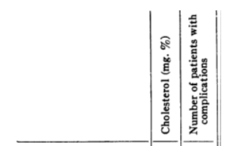
TABLE 5. The Number of New Cardiovascular
Complications by Sex and Age Groups as Categorized According to Quartile Values of Cholesterol

Slide 11
Conclusions from Framingham Paper
“When the analysis was performed by quartiles, more than 50 per cent of the complications occurred in patients whose lipid determinations were above the median. These differences were significant for the males 60 and over and for females 40 to 59.”
Actual tests of significance for each subgroup above gives p-values for Fishers exact test of 0.25 (males 60 and over) and 0.10 (females 40-59).

Slide 12
MESA – Risk of CHF as predicted by LV Mass percent predicted
Cox Models for Incident CHF
From MESA paper* (48 events, 4 years median follow-up)
Model | HR (95% CI) | Test Statistic (Z) | p-value
LV Mass % predicted (per 10%) | 1.4 (1.3, 1.5) | 9.77 | <0.0001
LV Mass % predicted Quartiles
≤25th percentile (≤91%) | 1.0 (Reference)
25th-50th percentile (91- 100%) | 11.2 (1.4, 86.7) | 2.31 | 0.02
50-75th percentile (100-114%) | 7.1 (0.9, 57.6) | 1.83 | 0.07
>75th percentile (>114%) | 30.5 (4.2,224.4) | 3.36 | 0.001
LV Mass % Predicted In Intervals
≤50th percentile (≤100%) | 1.0 (Reference)
50th-90th percentile (100-125%) | 1.7 (0.8, 3.7) | 1.27 | 0.21
90-95th percentile (125-133%) | 2.7 (0.6, 12.3) | 1.29 | 0.20
>95th percentile (>133%) | 13.0 (6.1, 27.7) | 6.61 | <0.0001
*The Relationship of Left Ventricular Mass and Geometry to Incident Cardiovascular Events – Bluemke, Kronmal, et. al. JACC 2008

Slide 13
MESA – Risk of CHF as predicted by LV Mass percent predicted
Our justification for not using the quartiles:
“Because only 1 CHF event occurred in the reference group (1st quartile of LV mass), the HR ratio estimates with this reference group were unstable. Most events occurred in participants with body-size adjusted LV mass greater than or equal to 90% of predicted based on height and weight. In order to examine the gradient of relative risk, 4 categories of LV mass index were compared: below the median (50th) percentile of LV mass index (reference category), the 50-89 percentile, the 90-94th percentile and greater than or equal to the 95th percentile of LV mass index (frequently taken to be the clinical definition of LV hypertrophy).”

Slide 14
GaM (Generalized Additive Model) Plot of Probability of CHF as a function of LVM%Predicted

Slide 15
MESA – Risk of CHF as predicted by LV Mass percent predicted
Cox Models for Incident CHF
Model | HR (95% CI) | Test Statistic (Z) | p-value
From paper (48 events, median 4 years follow-up)
LV Mass % predicted (per 10%) | 1.4 (1.3, 1.5) | 9.77 | <0.0001
LV Mass % predicted Quartiles
<25th percentile (<91%) | 1.0 (Reference)
25th-50th percentile (91- 100%) | 11.2 (1.4, 86.7) | 2.31 | 0.02
50-75th percentile (100-114%) | 7.1 (0.9, 57.6) | 1.83 | 0.07
>75th percentile (>114%) | 30.5 (4.2,224.4) | 3.36 | 0.001
From current data (112 events, median 7.6 years of follow-up )
LV Mass % Predicted Quintiles
<25th percentile (<91%) | 1.0 (Reference)
25th-50th percentile (91- 100%) | 1.3 (0.6,2.7) | 0.76 | 0.45
50-75th percentile (100-114%) | 1.7 (0.9,3.4) | 1.53 | 0.13
>75th percentile (>114%) | 4.9 (2.7,8.9) | 5.19 | <0.0001
Notes:
Linear coefficient misleading as is the quartiles. Note similar HR’s for middle two quartiles. Also, comment on early versus late events.

Slide 16
MESA – Risk of CHF as predicted by LV Mass percent predicted
Cox Models for Incident CHF
Model | HR (95% CI) | Test Statistic (Z) | p-value
From MESA paper* (48 events, 4 years median follow-up)
LV Mass % predicted (per 10%) | 1.4 (1.3, 1.5) | 9.77 | <0.0001
LV Mass % Predicted In Intervals
<50th percentile (<100%) | 1.0 (Reference)
50th-90th percentile (100-125%) | 1.7 (0.8, 3.7) | 1.27 | 0.21
90-95th percentile (125-133%) | 2.7 (0.6, 12.3) | 1.29 | 0.20
>95th percentile (>133%) | 13.0 (6.1, 27.7) | 6.61 | <0.0001
From current data (112 events, median 7.6 years of follow-up )
LV Mass % predicted (per 10%) | 1.4 (1.3, 1.43) | 12.72 | <0.0001
LV Mass % Predicted In Intervals
<50th percentile (<100%) | 1.0 (Reference)
50th-90th percentile (100-125%) | 1.6 (0.1.0, 2.6) | 1.91 | 0.06
90-95th percentile (125-133%) | 3.7 (1.8, 7.5) | 3.54 | <0.0001
>95th percentile (>133%) | 12.7 (7.8, 20.9) | 10.16 | <0.0001

Slide 17
MESA – Risk of CHF as predicted by LV Mass percent predicted
Cox Models for Incident CHF
Model* | HR (95% CI) | Test Statistic (Z) | p-value
From current data (112 events, median 7.6 years of follow-up )
LVM % predicted in intervals
<100% (32 events) | 1.00 (Ref.)
100-125% (36 events) | 1.5 (0.7,2.1) | 1.58 | 0.12
125-150% (28 events) | 6.0 (3.6, 9.9) | 6.90 | <0.0001
150-175% (7 events) | 11.0 (4.8,24.9) | 5.74 | <0.0001
≥175% (9 events) | 65.0 (30.1,136.2) | 11.05 | <0.0001

Slide 18
Another Framingham Example – Circ. 2011
Cardiac Dysfunction and Noncardiac Dysfunction as Precursors of Heart Failure With Reduced and Preserved Ejection Fraction in the Community - Circulation 2011, 124:24-30:
From statistical section:
“For each noncardiac function variable (including those found to be not significant), we initially examined generalized additive models with penalized splines to assess the potential nonlinearity of the association. None of the associations was found to be nonlinear. Therefore, we proceeded to model linear associations in Cox models. In the absence of any nonlinearity of the associations, we also used a priori cut points based on the lower 25th or upper 75th percentile of each continuous variable to create binary variables defining organ dysfunction for incorporation into a risk score.”

Slide 19
Another Framingham Example – Circ. 2011
Table 3. Noncardiac Risk Factors and Risk Score for
Incident Heart Failure
 | Hazard Ratio |  | Cutoff |  | Points
Characteristic | (95% Confidence Interval)* | P* | Percentile | Cutoff Value | Awarded
Serum creatinine | 1.21 (1.01–1.45) | 0.036 | >75th | >1.05 mg/dL (>92.8 mmol/L) | 1
FEV1:FVC ratio | 1.21 (1.02–1.43) | 0.029 | <25th | <91% predicted | 1
Hemoglobin concentration | 1.24 (1.09–1.40) | <0.001 | <25th | <13 g/dL | 1
*Hazard ratios are for a 1-SD increase in serum creatinine,
1-SD decrease in FEV1:FVC ratio, and 1-unit decrease in hemoglobin
concentration after adjustment for age, sex, … in 676 participants
without any missing variables (170 heart failure events).

Slide 20
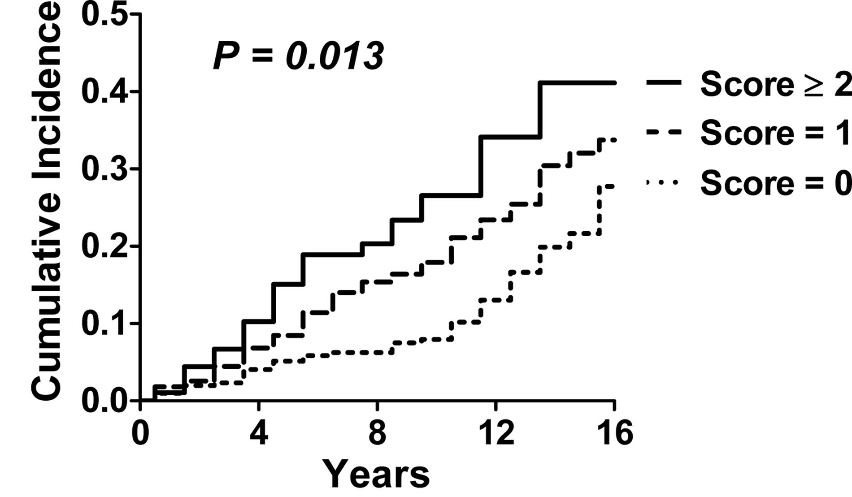
Another Framingham Example – Circ. 2011
Figure 2. Cumulative incidence of incident heart failure according
to noncardiac major organ system dysfunction risk score. …
Increasing noncardiac risk score at baseline was associated
with increasing risk of incident heart failure in our community based
sample (log rank P<0.013).

Slide 21
Framingham conclusions
After adjustment for cardiac dysfunction, higher serum creatinine, lower FEV1:FVC ratios, and lower hemoglobin concentrations were associated with increased HF risk (all P<0.05); serum albumin and white blood cell count were not. Subclinical dysfunction in each noncardiac organ system was associated with a 30% increased risk of HF (log rank P<0.013).

Slide 22
Cardiovascular Health Study - Creatinine as Predictor of CHF risk
Cox Models for Incident CHF (1120 Events, N=5613)
Model* | HR (95% CI) | Test Statistic (Z) | p-value
Creatinine in mg/dl | 1.48 (1.25,1.76) | 4.46 | <0.0001
Creatinine in Quartiles (limits, % in interval)
<25th percentile (0.4-0.7 mg/dl, 11%) | 1.00 (Ref.)
25th-50th percentile (0.8-0.9 mg/dl, 29%) | 0.86 (0.65,1.00) | -1.97 | 0.05
50-75th percentile (1.0-1.1 mg/dl, 28%) | 0.90 (0.69,1.07) | -0.34 | 0.19
>75th percentile (≥1.2 mg/dl, 32%) | 1.02 (0.81,1.29) | 0.20 | 0.84
*Adjusted for age, gender, race, history of MI, history of diabetes, use of
anti-hypertensive medications, systolic blood pressure, cholesterol and BMI.
Notes:
Highly significant linear term, non-significant for quartiles! Mention that quartiles are a transformation that has unpredictable effects on the relationship.
Note similar HR’s for middle interval due to small absolute difference in creatinine between people in these quartiles. Also, quartiles are not exactly quartiles because of discreteness of creatinine.
Last interval is much wider than other quartile intervals.

Slide 23
Cardiovascular Health Study - Creatinine as Predictor of CHF risk
P-value for non-linearity = 0.001
Note that 90.6% of the participants had creatinine values ≤ 1.4 and
of those in the top ‘quartile’ (actually 32%), 22% have values 1.2, 1.3,1.4 .
Notes:
GAM – generalized additive model! Winsorized fancy term for pulling in extreme values to a single value (>3.0 are set to 3.0, - 20 participants, .4 set to .5 (1 person who had a CHF event).
HR have a reference group of creatinine =1. Creatinine measured to one significant digit.
Note flattening of curve on left, possibly due to competing risk of death.

Slide 24
Cardiovascular Health Study - Creatinine as Predictor of CHF risk
Notes:
GAM – generalized additive model! Winsorized fancy term for pulling in extreme values to a single value (>3.0 are set to 3.0, - 20 participants, .4 set to .5 (1 person who had a CHF event).
HR have a reference group of creatinine =1. Creatinine measured to one significant digit.
Note flattening of curve on left, possibly due to competing risk of death.

Slide 25
Cardiovascular Health Study - Creatinine as Predictor of CHF risk
Cox Models for Incident CHF (1120 Events, N=5613)
Model* | HR (95% CI) | Test Statistic (Z) | p-value
Creatinine in mg/dl | 1.48 (1.25,1.76) | 4.46 | <0.0001
Creatinine in intervals (inclusive)
≤0.7 mg/dl | 1.10 (0.87,1.39) | 0.82 | 0.41
0.8-1.1 mg/dl | 1.00 (Ref.)
1.2-1.5 mg/dl | 0.92 (0.79,1.06) | -1.17 | 0.24
1.6-1.9 mg/dl | 1.67 (1.29,2.14) | 3.97 | <0.0001
≥2.0 mg/dl | 2.30 (1.60,3.30) | 4.51 | <0.0001
*Adjusted for age, gender, race, history of MI, history of diabetes, use of
anti-hypertensive medications, systolic blood pressure, cholesterol and BMI.
Notes:
In MESA only about 2.4% of participants have creatinine >1.4 mg/dl.
Framingham conclusions that: Thus, even mild functional derangement of a noncardiac organ system, which in itself is not severe enough to produce symptoms, may accelerate the manifestation of overt HF, particularly when other organ systems are also involved.

Slide 26
Reexamination of Why reseachers use Quantiles
Quantiles within subgroups provide a good way to adjust for the subgroup.*
  This will only be true if the relative position of the person within the subgroup is the best way to predict the outcome. This may or may not be true. In any event it shouldn’t be assumed.
  Standard regression methods based on the original scale or reasonable transformation of the scale (e.g. log) provide a better way to assess the need for subgroup adjustment and what form that should take.
*Coronary calcium predicts events better with absolute calcium scores than age-sex-race/ethnicity percentiles: MESA (Multi-Ethnic Study of Atherosclerosis).
by Budoff, Nasir, McClelland, Detrano, Wong, Blumenthal, Kondos, Kronmal
Journal of the American College of Cardiology (2009).
Notes:
Standardization within subgroups has the same problem and shouldn’t be done.

Slide 27
Reexamination of Why reseachers use Quantiles
Quantiles are a good way of discovering and modeling non-linearities or dealing with non-normality.
  The quantiles are a transformation of the data. As the examples showed it isn’t possible to tell from the quantiles whether the relationship on the original scale was linear or not.
  Generally using a limited number of intervals on the quantile scale will give an appearance of non-linearity even if the relationship on the original scale was linear. This is because the intervals (i.e. quartiles) will be of different sizes and distances apart on the original scale.
  Non-normality is not a concern for most regression situations. However, outliers may be important and quantiles may have limited usefulness in this situation. However, there are better methods for dealing with outliers than the transformation to the ranks.
Notes:
Standardization within subgroups has the same problem and shouldn’t be done.

Slide 28
Reexamination of Why reseachers use Quantiles
Results using quantiles are generalizable.
  Quantiles are dependent on the distribution of the variable in the population sampled. For example, for creatinine, the 75th percentile in Framingham was >1.05 mg/dl. For CHS it is about 1.2. Cohorts will differ in many ways that will affect the distribution of most variables and thus the quantiles.
  The discreteness of many biological measures will result in many ties and therefor the number of people in various percentile intervals will not correspond to the interval width. For example, the top quartile of creatinine for CHS actually includes 32% of the cohort and the 1st quartile has only 11% of the cohort.
  For these reasons it is difficult to generalize from the quanitle based results or to compare the results based on quantiles from different studies.

Slide 29
Reexamination of Why reseachers use Quantiles
They provide a good way of describing the findings.
The results using quantiles are understandable even if we have little or no understanding of the variable involved. It isn’t necessary to consider the shape of the regression function, e.g. linear, log linear, etc.
  Both of these are partially correct. If the reader has a clear understanding of the variable and it’s distribution, then 1 is reasonable. However, as the examples show the description based on quantiles may be misleading; implying linearity or non-linearity when the converse is true; misidentifying who is at increased risk because of the large range in the lowest or highest interval; providing highly unreliable estimates of effect sizes, etc.
  While 2 is true, the understanding based on the quantiles is superficial and shouldn’t be accepted as adequate or complete.

Slide 30
Recommendations
Quantiles should be used only for description, not for inference.
It isn’t necessary to restrict the intervals for the quantiles to equal numbers e.g. tertiles, quartiles, etc.
Consider using equally spaced intervals as an alternative to tertiles, quartile, etc.
Be wary of small numbers of events in any interval. Redefine the intervals to have sufficient events.
There is a loss of information when quantiles are used. Don’t dichotomize continuous variables, unless there is a sound medical reason. Usually, there will be a considerable loss of power when this is done.
Plot your data! Non-linearity is not uncommon and is often detectable by standard statistical methods.

