Slide 1
Risk Prediction,
Novel Biomarkers, and New and Improved (?)
Measures of Incremental Value
Kathleen Kerr
Department of Biostatistics
University of Washington

Slide 2
Outline
Evaluating the Incremental Value of a Biomarker
The Integrated Discrimination Improvement (IDI) Index
Net Reclassification Indices (NRI)
“Historical” context

Slide 3

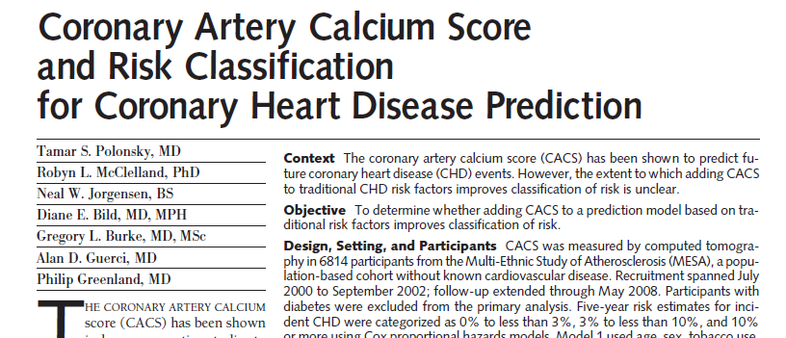
MESA example: Polonsky et al, JAMA 2010
Considered Coronary Artery Calcium Score (CACS) as a biomarker in addition to Framingham risk factors to predict risk for CHD events.

Slide 4
New Biomarkers
Incremental Value: the improvement in prediction from using a new marker in addition to existing markers.
Kattan (2008): “Markers should be judged on their ability to improve an already optimized prediction model.”
How exactly does one implement this?

Slide 5
A two-stage approach
Use a regression model to estimate P(D| X, Y ) where X is the established predictor(s) and Y is the new marker
e.g., logit P(D=1|X,Y)=β₀+β₁X+β₂Y
Test H₀: β₂=0
If the null hypothesis is rejected, then examine AUC_{X,Y}(∙) and test
  H₀: AUC_{X,Y}(∙) = AUC_{X}(∙)

Slide 6
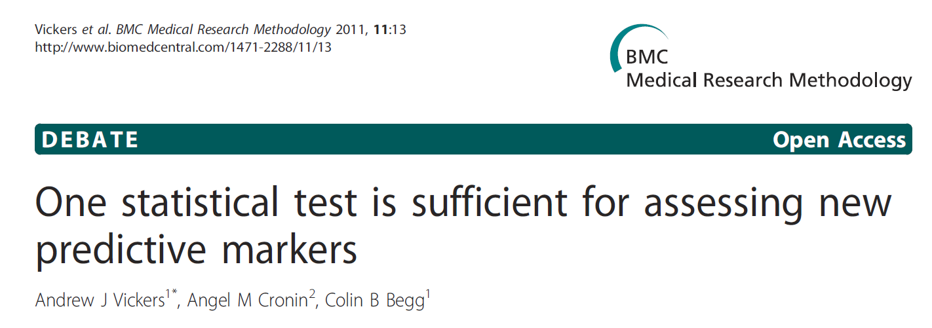
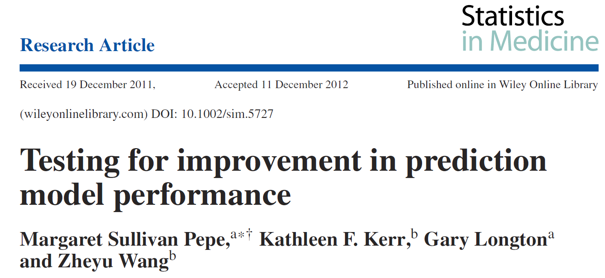
Empirical argument against the two-stage approach:
Theoretical argument:

Slide 7
Problem with the two-stage approach
Testing the same null hypothesis twice
  first, with a well-developed, powerful test
  second, with an under-developed test with poor power (p-value your software gives should not be trusted, may be excessively conservative)
  Illogical scientific approach
Hypothesis testing is of limit value anyway
  much more important to quantify the improvement offered by the new predictor
  the strength of evidence to establish whether a new predictor is useful far exceeds what is needed to establish statistical significance

Slide 8
Testing Vs. Estimation
A statistical test examines the evidence that a marker has any incremental value.
However, the real challenge is finding markers that offer a clinically important improvement in prediction.
Quantifying incremental value is much more important than hypothesis testing.

Slide 9
No consensus on how to quantify incremental value
  AUC_{X,Y} compared to AUC_{X} (Δ AUC)
  AUC_{Y|X} compared to null value (0.5)
  Proportions of cases and controls with risks in specific categories
  Improvement in the predictiveness curve
  Increase in sensitivity at fixed specificity
  Increase in specificity at fixed sensitivity
  Etc.

Slide 10
  ΔAUC (AUC_{X,Y} compared to AUC_{X}). Many investigators consider this metric to be “insensitive”
    This usually means their favorite biomarker produced a disappointing ΔAUC.
    “Sensitivity” of ΔAUC is probably not the problem. The real problems are
      it’s fundamentally hard to improve upon a risk model that has moderately good predictive ability
      p-values computed for ΔAUC are based on incorrect methodology that tends to produce too-large p-values
      The scale of AUC is such that an increase of 0.02 is “large”

Slide 11
A new approach: Reclassification
(Cook, Circulation 2007)
Proposes that a new marker is useful if it re-classifies lots of people
  reclassification table, next slide

Slide 12
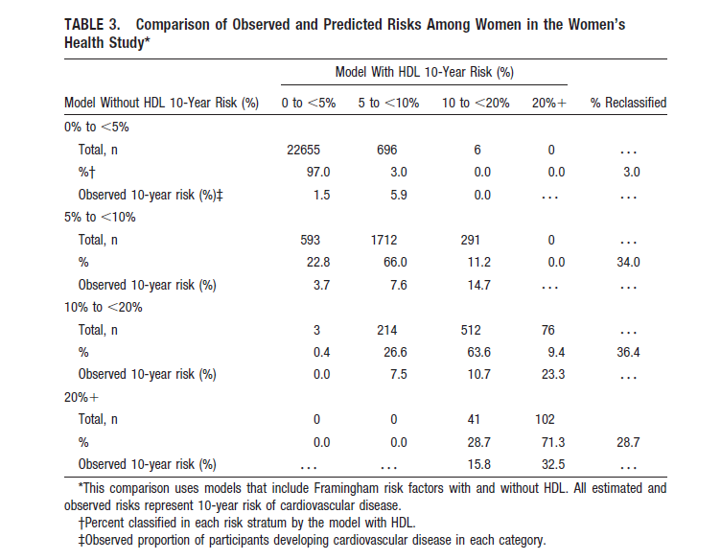

Slide 13
Integrated Discrimination Improvement (IDI) and Net Reclassification Index (NRI)
Proposed in 2008
Followed on the heals of Cook’s paper
NRI is really a family of statistics
  There are several NRIs

Slide 14
IDI and NRI terminology
event | Person with the condition or destined to have the condition (“case”)
nonevent | Not an event (“control”)
old | risk model with established predictors
new | risk model with established predictors and new predictor

Slide 15
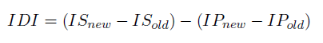
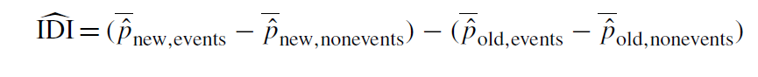
Integrated Discrimination Improvement (IDI)
“new” refers to the predictive model that contains the new marker
“old” is the model without the new marker
IS is the integral over sensitivity
IP is the integral over the false negative rate
Pencina et al provide the following estimator of the IDI:

Slide 16
“new” refers to the predictive model that contains the new marker
“old” is the model without the new marker
“event” is a case
“nonevent” is a control

Slide 17
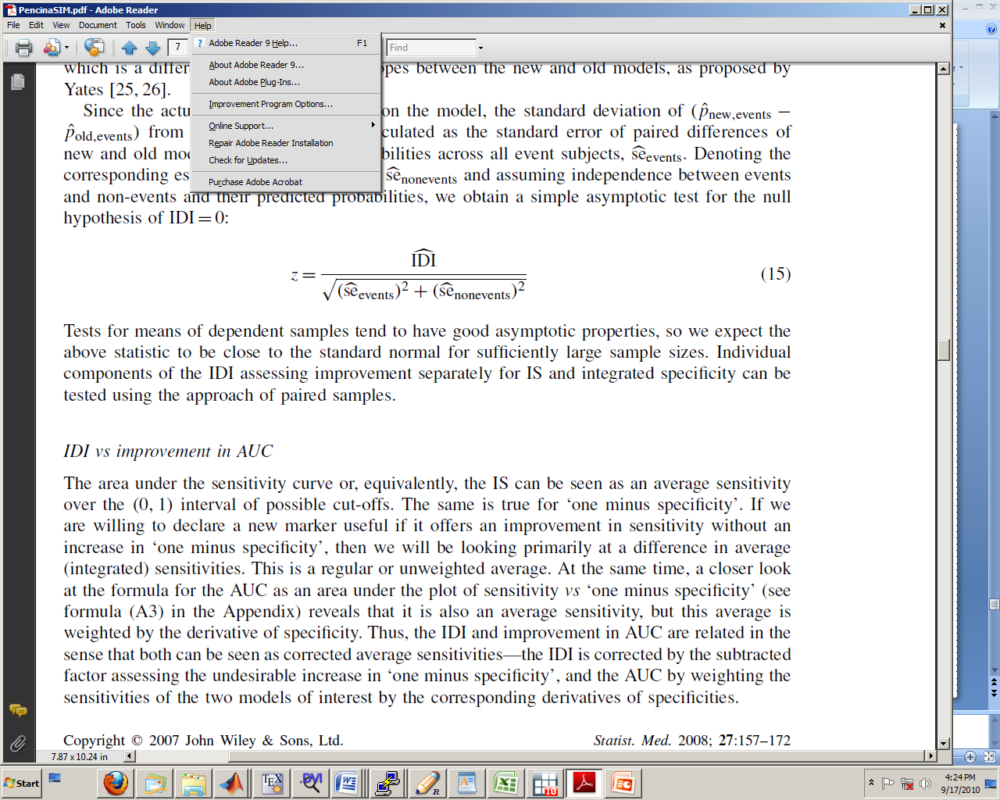
Proposed statistic to test H₀:IDI=0

Slide 19
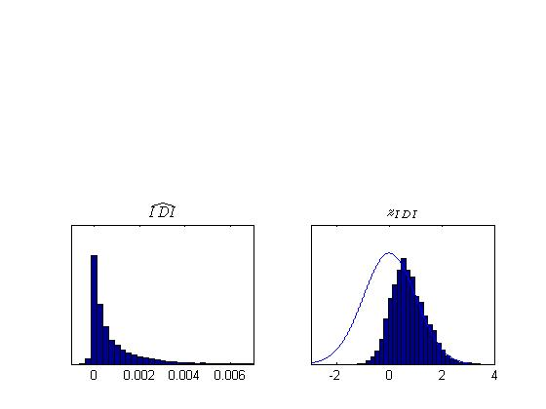
Null distribution of IDI and z_{IDI} from a simple simulation model

Slide 20
Simulation Model:
logit P(D=1|X,Y)= -6.2 + 0.5 ∙X + γ ∙ Y
X~N(65,10)
Y~N(0,1)
Simulate 10000 datasets of size n=1000
for γ =0, 0.1, 0.2, 0.3, 0.4, 0.6, 0.8 ….
Examine the sampling distribution of IDI estimates

Slide 21
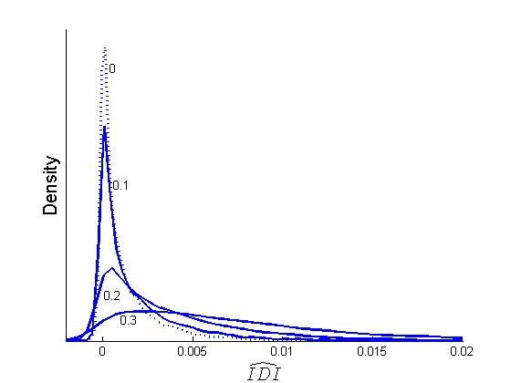
Sampling distributions of IDI for new marker of different strengths

Slide 22
IDI: Comments
The sampling distribution of IDI changes in shape and scale with small changes in predictive capacity
  problematic from a statistical point of view
Statistical Inference for the IDI is difficult
  bootstrapping OK as long as we are away from the null
Not every statistic is asymptotically Normal
  Don’t believe everything you read

Slide 23
Net Reclassification Improvement (NRI)
NRI = P( up | event ) - P( down | event ) + P( down | nonevent ) - P( up | nonevent )
“up” means an individual moves to a higher risk category
“down” means an individual moves to a lower risk category
Original Definition: apply this formula to fixed risk categories

Slide 24
Net Reclassification Improvement (NRI)
The NRI is the sum of the “event NRI” and the “nonevent NRI”:
NRI_{e} = P( up | event ) - P( down | event )
NRI_{ne} = P( down | nonevent ) - P( up | nonevent )

Slide 25
Fixed Risk Categories
Two Risk categories: Low Risk, High Risk
Three Risk categories: Low, Medium, High Risk
4 Risk categories: etc….

Slide 26
Net Reclassification Improvement (NRI)
NRI = P( up | event ) - P( down | event ) + P( down | nonevent ) - P( up | nonevent )
The ``category-free NRI’’ interprets this formula for any upward or downward movement in predicted risk. Denote NRI^{>0}

Slide 27
Interpreting NRI: NRI is not a proportion
NRI = P( up | event ) - P( down | event ) + P( down | nonevent ) - P( up | nonevent )
The NRI is a linear combination of four proportions.
Theoretical maximum value is 2.
Can be negative.

Slide 28
Interpreting NRI
In contrast to the NRI, the “event NRI” and “nonevent NRI” have straightforward interpretations.
NRI_{e} = P( up | event ) - P( down | event )
NRI_{ne} = P( down | nonevent ) - P( up | nonevent )
differences in proportions
NRI_{e} is the net proportion of events assigned a higher risk or risk category
NRI_{ne} is the net proportion of nonevents assigned a lower risk or risk category
“net” is an important word

Slide 29
Why the simple sum of NRI_{e} and NRI_{ne}?
NRI = P( up | event ) - P( down | event ) + P( down | nonevent ) - P( up | nonevent )
If they must be combined, then weighting by the population prevalence makes more sense.
… or a weighting that accounts for the costs of a misclassification
But why combine at all?
  NRI_{e} give information about events
  NRI_{ne} gives information about nonevent

Slide 30
CACS in MESA
Most of the subjects are nonevents, but overall NRI is positive.
Using the prevalence 3.6%, the weighted sum
is -0.020

Slide 31
Large and small values for NRI^{>0} are undefined
“Further research is needed to determine meaningful or sufficient degree of improvement” in NRI^{>0} – Pencina et al, American Journal of Epidemiology 2012

Slide 32
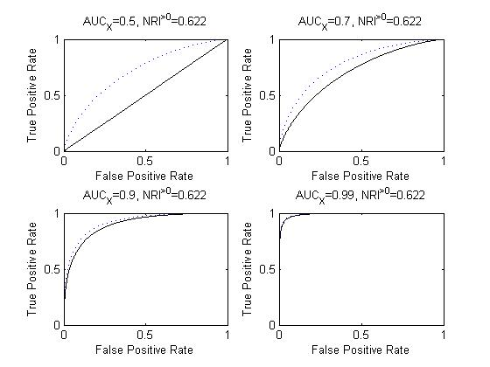

Slide 33
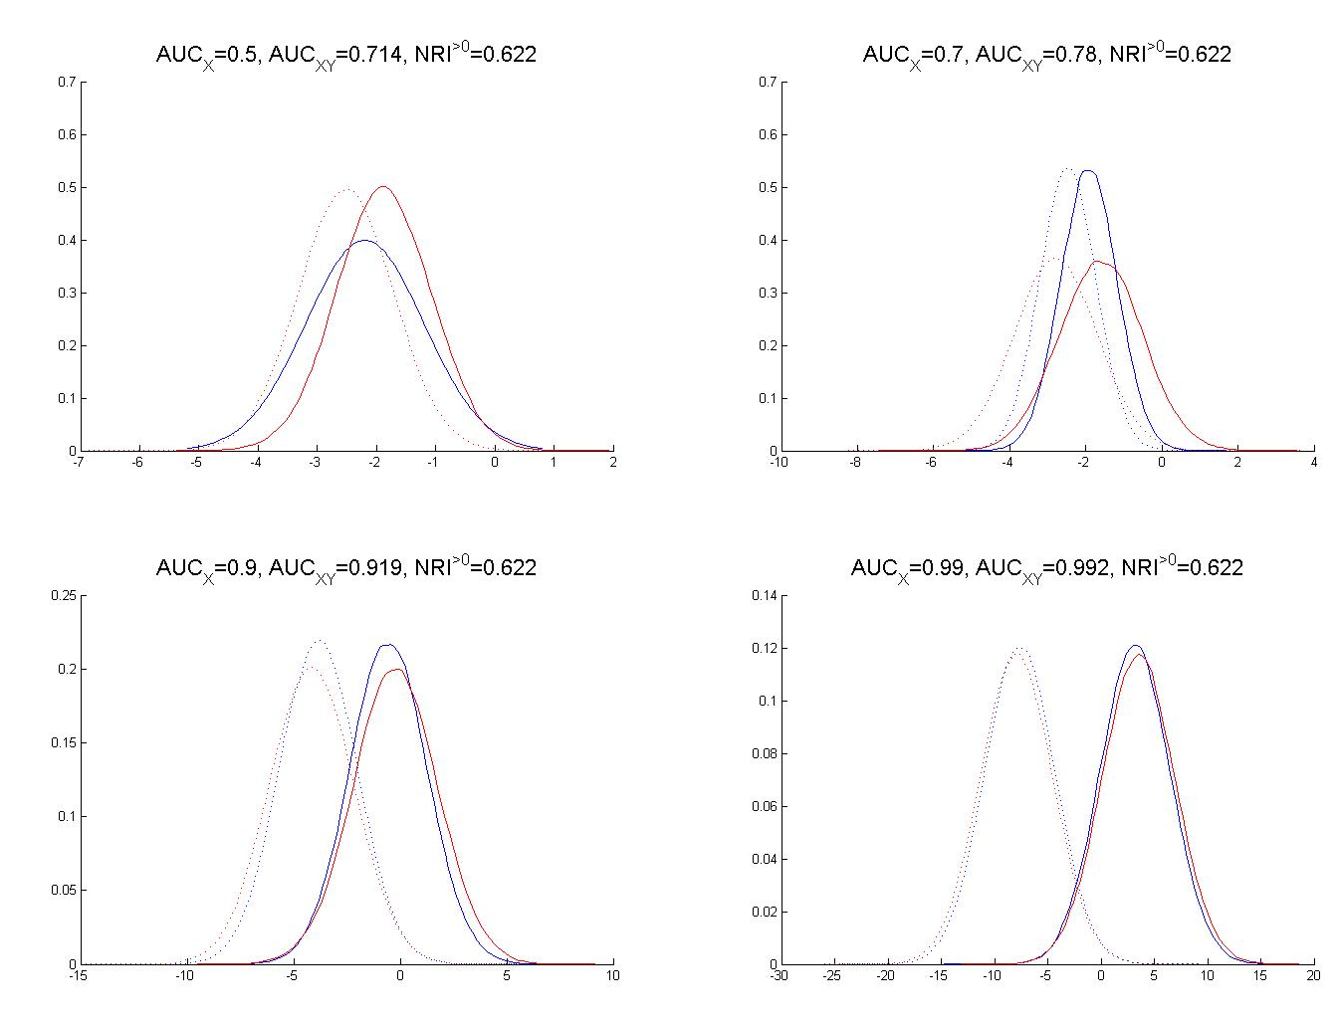

Slide 34
For 3 or more categories, NRI weights reclassifications indiscriminately
For three categories, “up” can mean
  low risk to medium risk
  medium risk to high risk
  low risk to high risk
NRI treats all of these the same
For three categories, “down” can mean
  high risk to medium risk
  medium risk to low risk
  high risk to low risk
NRI treats all of these the same

Slide 35
When risk categories correspond to treatment decisions, the nature of reclassification matters, not just the direction
Suppose:
High risk | Lifestyle changes + Rx
Medium risk | Lifestyle changes
Low risk | No intervention
A new marker that moves a nonevent from “high risk” to “medium risk” improves risk prediction for that person, and that benefit is arguably greater than moving a nonevent from “medium risk” to “low risk.”
NRI counts these movements equally.

Slide 36
2-category NRI: new names for existing measures
It is easy to see that for two risk categories (“low risk” and “high risk”)
  NRI_{event} is the change in the True Positive rate (sensitivity)
  NRI_{nonevent} is the change in the False Positive Rate (specificity)
For 2-categories there is also a weighted NRI, wNRI, that takes into account the costs/benefits of correct/incorrect classifications
  wNRI is the change as the change in Net Benefit

Slide 37

NRI makes poorly calibrated models look good
Over-fit models for a useless new marker tend to give positive values for the NRI, even on an independent “test” dataset

Slide 38
MESA example: Polonsky et al, JAMA 2010
Adding CACS to Framingham risk factors to predict CHD events
Risk categories 0-3%, 3-10%, >10%
model with CACS reclassifies 26% of the sample
estimated 3-category NRI_{event} = 0.23
estimated 3-category NRI_{nonevent}= 0.02
These are summaries of the reclassification tables (next slide)
estimated IDI = 0.0256
How do we interpret these NRIs or IDIs? Do they help us understand the clinical or public health benefit of incorporating CACS into the model?

Slide 39
Nonevents
Old | Model with CACS
Model | 0-3% | 3-10% | >10% | Total
0–3% | 58% | 7% | 1%
 | 3276 | 408 | 5 | 65%
3–10% | 12% | 14% | 4%
 | 697 | 791 | 244 | 31%
>10% | 1% | 1% | 3%
 | 30 | 63 | 155 | 4%
Total | 71% | 22% | 7% | 5669
Events
Old | Model with CACS
Model | 0-3% | 3-10% | >10% | Total
0–3% | 16% | 11% | 0%
 | 34 | 22 | 1 | 27%
3–10% | 7% | 25% | 23%
 | 15 | 52 | 48 | 55%
>10% | 1% | 3% | 13%
 | 2 | 7 | 28 | 18%
Total | 24% | 39% | 37% | 209

Slide 40
Risk | Old risk model |  | New risk model (model with CACS)
Category | nonevent | event | nonevent | event
0-3% | 67.1% | 27.3% | 70.6% | 24.4%
3–10% | 30.6% | 55.0% | 22.3% | 38.8%
>10% | 4.4% | 17.7% | 7.1% | 36.8%
Total | 5669 | 209 | 5669 | 209
 | 100% | 100% | 100% | 100%

Slide 41
Summary
IDI and NRI do not help us understand the value new markers add to risk prediction
The most useful NRI statistics are re-named versions of existing measures
Category-free NRI has many of the same problems as Δ AUC
  and its own problem of being hard to interpret
Statistical problems with these measures
  cannot rely on p-values or confidence intervals computed from published formulas

Slide 42
reclassification should be in the right direction
insensitive
not clinically relevant
incorporates irrelevant information
Reclassification Measures
Categorical NRI
AUC
IDI
Category-free NRI
we don’t want to rely on pre-specified risk categories

Slide 43
Thanks
Elizabeth Brown, Thomas Lumley
Aasthaa Bansal, Zheyu Wang
Robyn McClelland
Bruce Psaty
Holly Janes
Margaret Pepe
MESA

