Slide 1
MESA Air Update
September 13, 2012
MESA Steering Committee Meetings

Slide 2
Advances in Exposure Predictions
PM_{2.5}
Final “maximum likelihood-based” estimates using all available data, 1999-2011
Published infiltration model employ data from Air Questionnaires

Slide 3
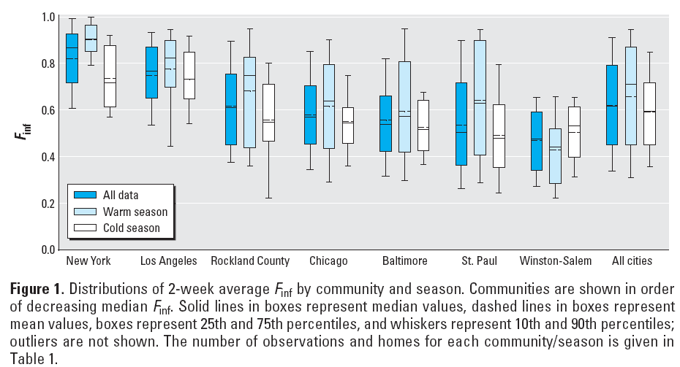

Slide 4
Advances in Exposure Predictions
PM_{2.5}
Final “maximum likelihood-based” estimates using all available data, 1999-2011
Published infiltration model employ data from Air Questionnaires
Oxides of nitrogen (NO_{X})
Final “maximum likelihood-based” estimates using all available data, 1999-2011

Slide 5
NO_{x} Predictions (ppb) weighted by residential location during the year 2000
City | N | Min | 1st Qu. | Median | 3rd Qu. | Max | Cross-validated R²
Chicago | 1214 | 17.2 | 41.5 | 44.4 | 48.7 | 83.8 | 0.81
St. Paul | 821 | 11.1 | 23.1 | 25.1 | 28.7 | 81.6 | 0.92
LA | 892 | 22.8 | 60.5 | 70.7 | 85.3 | 128.5 | 0.94
LA – Coastal | 74 | 31.0 | 60.0 | 68.9 | 74.0 | 99.3
LA-Riverside | 66 | 37.4 | 51.6 | 56.8 | 62.8 | 74.7
New York | 1134 | 19.0 | 74.4 | 82.9 | 91.5 | 155.3 | 0.79
Rockland | 97 | 23.4 | 27.0 | 31.8 | 35.9 | 99.2
Baltimore | 852 | 13.1 | 36.2 | 41.3 | 49.4 | 84.0 | 0.93
Winston-Salem | 999 | 10.7 | 18.7 | 23.3 | 28.9 | 65.8 | 0.84

Slide 6
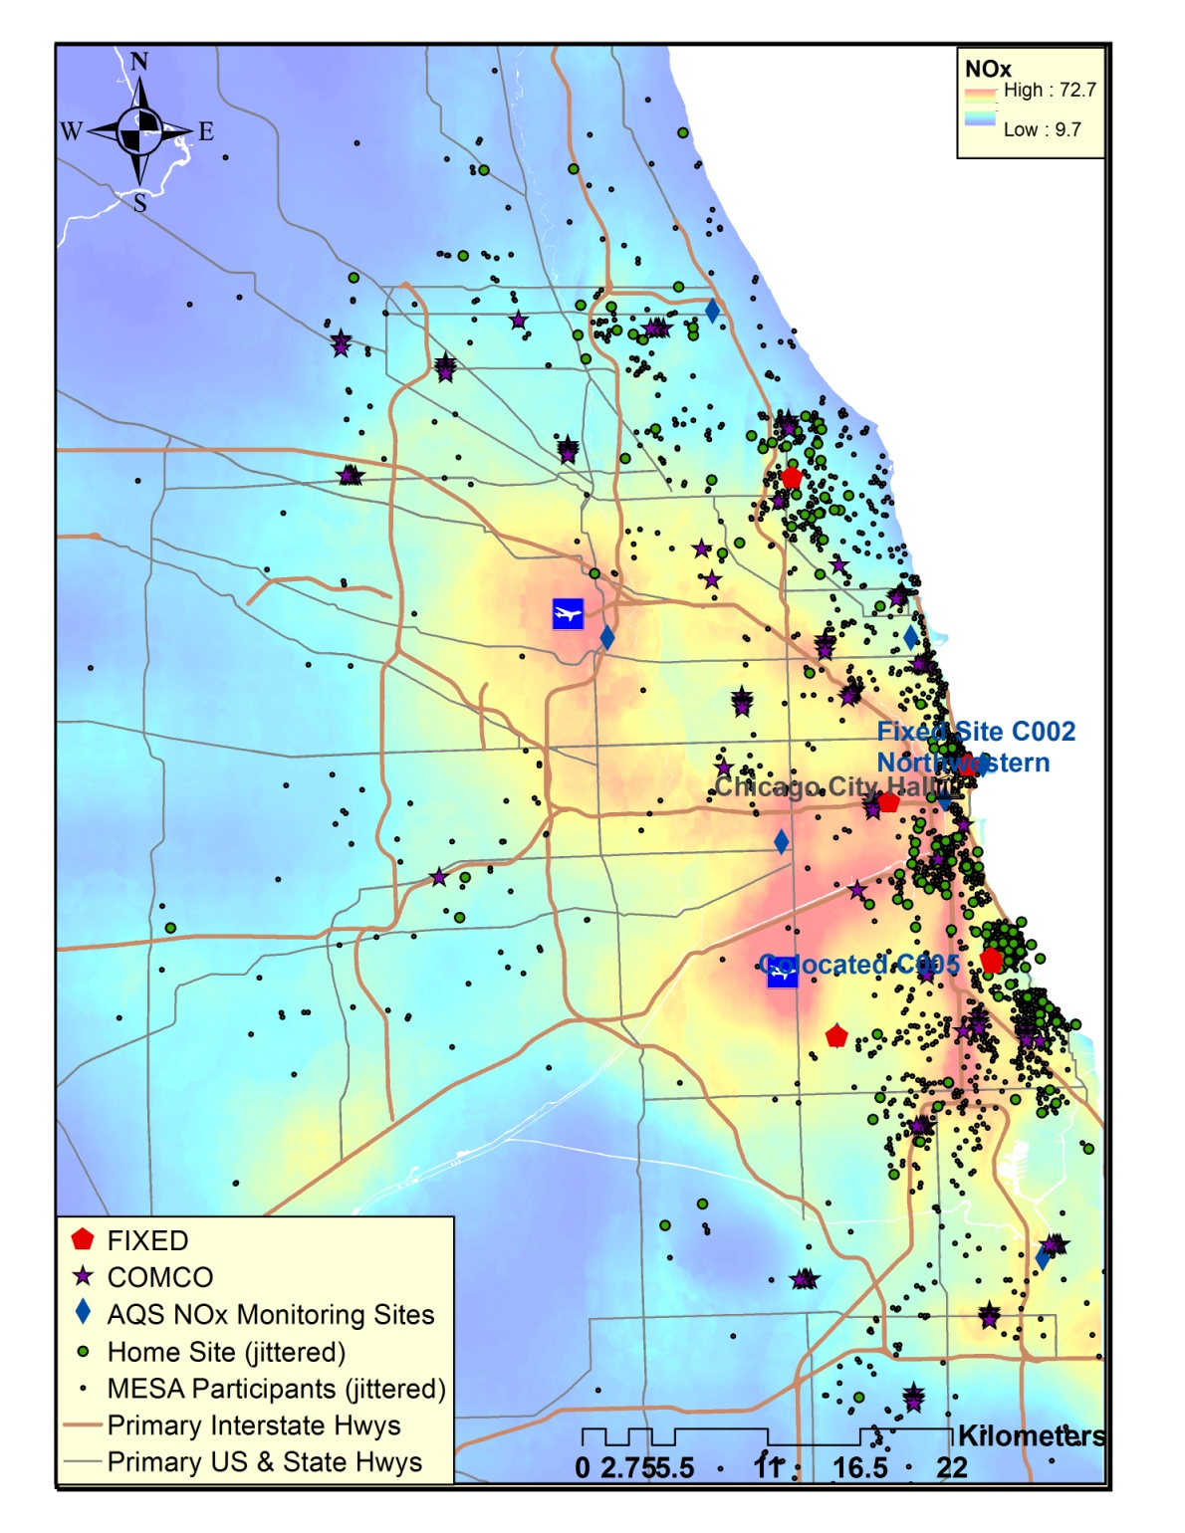

Slide 7
Advances in Exposure Predictions
PM_{2.5}
Final “maximum likelihood-based” estimates using all available data, 1999-2011
Published infiltration model employ data from Air Questionnaires
Oxides of nitrogen (NO_{X})
Final “maximum likelihood-based” estimates using all available data, 1999-2011
Light absorption coefficient (LAC, “black carbon”)
Final “maximum likelihood-based” LAC predictions to represent a long-term exposure (averaged over 2006-2008)

Slide 8
LAC Predictions (10⁻⁵ m⁻¹) weighted by residential location during the year 2000
City | N | Min | 1st Qu. | Median | 3rd Qu. | Max | Cross-validated R²
Chicago | 1194 | 0.38 | 0.62 | 0.68 | 0.72 | 1.20 | 0.76
St. Paul | 991 | 0.22 | 0.41 | 0.45 | 0.50 | 1.22 | 0.82
LA | 1114 | 0.79 | 1.15 | 1.26 | 1.36 | 1.87 | 0.90
LA–Coastal | 73 | 0.58 | 0.84 | 0.94 | 1.04 | 1.26
LA-Riverside | 70 | 0.99 | 1.21 | 1.26 | 1.37 | 1.47
New York | 1115 | 0.38 | 1.13 | 1.27 | 1.41 | 2.50 | 0.66
Rockland | 98 | 0.45 | 0.52 | 0.55 | 0.60 | 1.27
Baltimore | 988 | 0.27 | 0.60 | 0.65 | 0.75 | 1.25 | 0.81
Winston-Salem | 1007 | 0.35 | 0.44 | 0.49 | 0.54 | 0.78 | 0.84

Slide 9
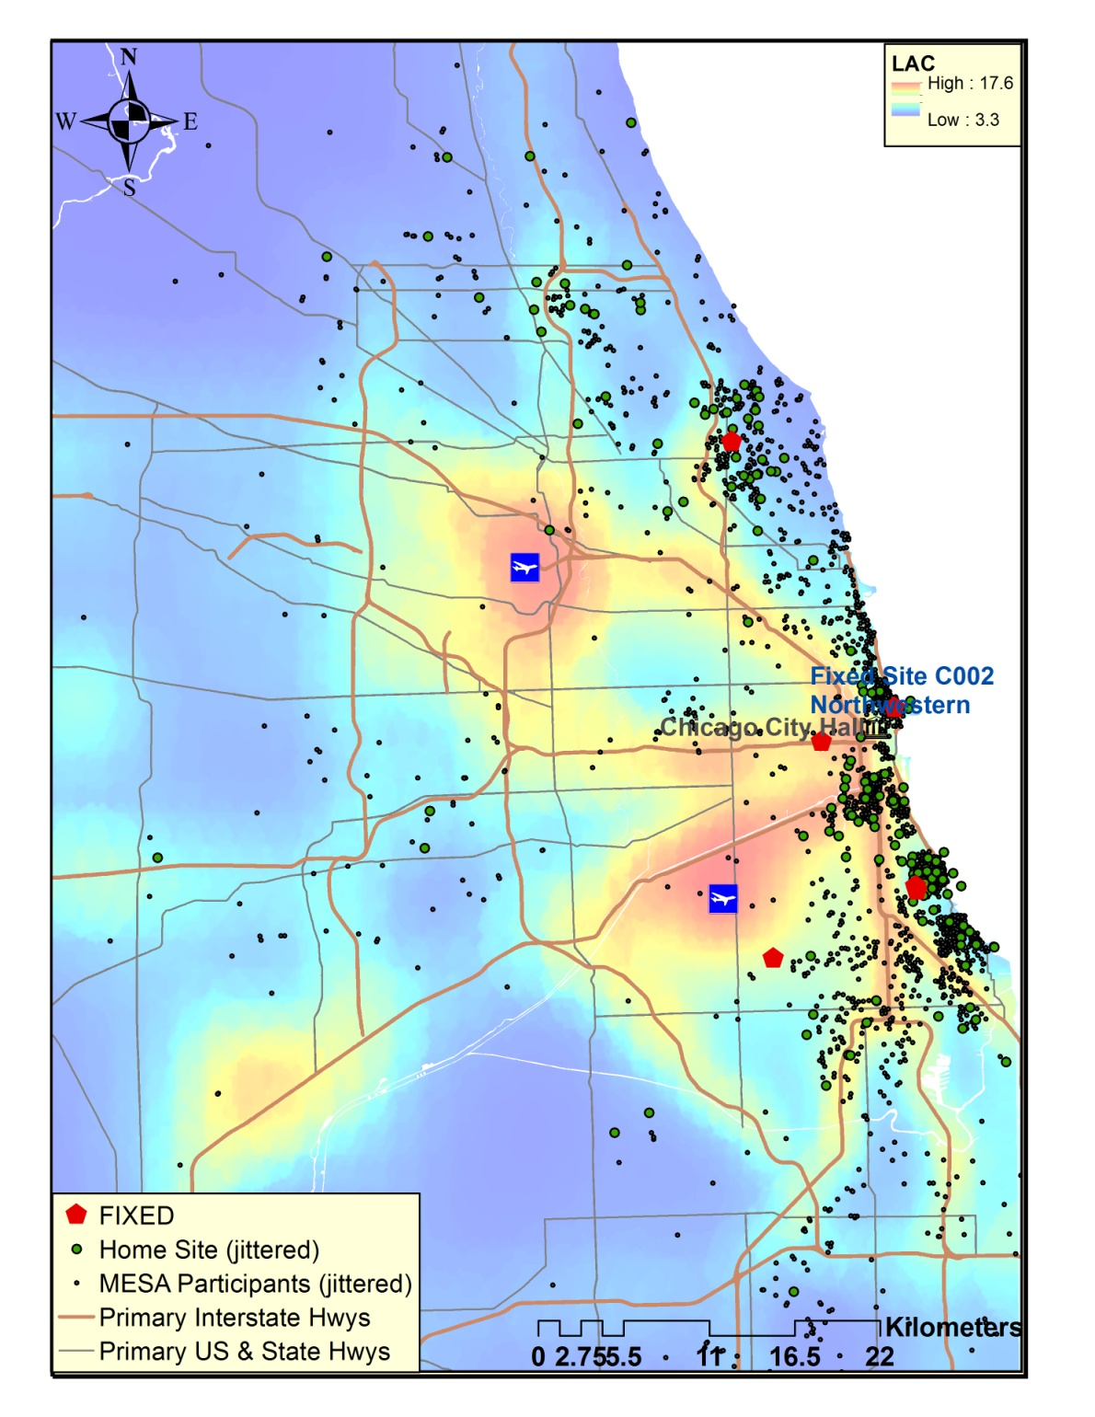

Slide 10
Available Air Pollution Metrics
 | Used in published MESA manuscripts | Time covered
Predictions not specific to MESA Air
Nearest monitor
PM_{2.5} | X | 1999-2011
Roadway proximity
Distance to A1, A2, A3 | X | 1999-2011
Binary near-roadway metric | X | 1999-2011
University of of Michigan
PM_{2.5} (outdoor) | X | 1982-2002
PM₁₀ (outdoor) | X | 1982-2002
MESA Air predictions
PM_{2.5}
Initial pragmatic (outdoor) | X | 2000-2006
Final pragmatic (outdoor) | X | 1999-2009
Likelihood-based (outdoor) |  | 1999-2011
Individual-level (incorporating infiltration & time location) |  | 1999-2011
NO_{X} (outdoor)
Initial likelihood-based |  | 1999-2009
Final likelihood-based |  | 1999-2011
Other pollutants (outdoor)
Likelihood-based EC/OC |  | 2007-2008
Likelihood-based elements |  | 2007-2008
Likelihood-based LAC |  | 2006-2008
PM_{10-2.5} (MESA Coarse) |  | 2009

Slide 11
Exam 5 MESA Air Completion
Site | Completed Air Q | Completed CT | Completed US
MESA Classic
Wake Forest | 751 | 557 | 573
Columbia | 787 | 613 | 633
Johns Hopkins | 585 | 424 | 443
Minnesota | 705 | 563 | 526
Northwestern | 853 | 631 | 668
UCLA | 767 | 507 | 586
MESA Air New Recruits
Rockland, NY | 84 | 67 | 76
Riverside, CA | 58 | 55 | 57
Coastal LA, CA | 62 | 60 | 62
Total | 4562 | 3295 | 3624

Slide 12
Subclinical Progression Analysis (primary focus of current efforts)
Indices: subject i, area k, follow-up duration t
Outcome:
X-sectional: exposure at baseline
cross-sectional covariates at baseline
error in the intercept model (mean 0)
Longitudinal: follow-up duration since baseline (in years)
exposure during follow-up (time-constant)
longitudinal covariates during follow-up (time-constant)
error in the longitudinal model (mean 0)
Transient: time-varying covariates to adjust for transient effects
Effect per unit change in exposure:
Cumulative at baseline
For a one year increment

Slide 13
Highlights of Recently Published / In Press Manuscripts
A prospective study of particulate air pollution exposures, subclinical atherosclerosis, and clinical cardiovascular disease (AJE)
An alternative method of quantifying coronary artery calcium (Liang et al., BMC Medical Imaging)
Systemic vascular responses to short and long term residential outdoor air pollution concentrations (Krishnan et al., JACC)

Slide 14
UW Center for Clean Air Research
Indoor, outdoor, personal and in-vehicle monitoring to understand the contribution of time-in-transit to individual exposure
GPS data-logging of travel patterns
Proximity monitors in home and in cars
Personal time-location diary
48 participants in each Winston-Salem and UCLA for 2 weeks during each of 2 seasons in 2013

