Slide 1
Future Environmental Health Initiatives in MESA

Slide 2
More Environmental Stuff?
MESA Air represented unusual investment in a cohort study
High profile, and attention now on the cohort
Other ancillary studies ongoing
Credit to supportive and collaborative nature of MESA investigators

Slide 3
Understanding the E in G x E
Major focus on phenotyping in MESA
Major focus on genotyping in MESA
Is that enough?
Among Environmental aspects, most focus historically on those with more individual-level control
Diet
Smoking
Exercise habits
Interest in agents for which exposure is not a choice or “lifestyle”

Slide 4
Notes:
The National Institute of Environmental Health Science (NIEHS) just released their new strategic plan.

Slide 5
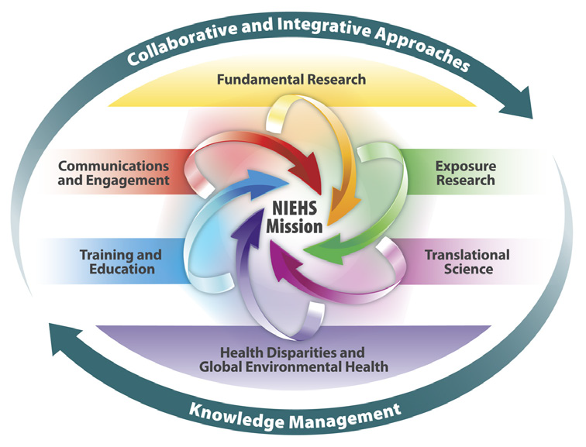

Slide 6
Theme: Exposure Research
“This theme focuses on the study of environmental exposures themselves — internal and external — not just chemical environmental pollutants, but also exposures arising from a variety of sources, such as the microbiome, infectious agents, nutritional sources, and stress.”

Slide 7
Unique Data Sources in MESA: Measuring Exposure
MESA Classic
Biological samples (blood, urine)
Dietary data
MESA Neighborhood
Residential history
Stress
MESA Air
Ambient air pollution exposure estimates
Home characteristics / air pollution infiltration
Time-location information
Second-hand smoke
UW Center for Clean Air Research
Detailed information on location and transit

Slide 8
Potential Agents
Air pollutants
PM_{2.5}, PM_{10-2.5}, NO_{X}, NO₂, black carbon, O₃
Metals
Air, biological samples
Pesticides
Diet, biological samples
Persistent organic compounds
Bisphenol A
Perfluroalkyl chemicals

Slide 9
Unique Data Sources in MESA: Assessing Relevant Health Outcomes
Quantitative Phenotypes in Several Domains
Often serial measurements
Atherosclerosis
Well-characterized incident outcomes
Genetics
Epigenetics
Telomere length
Cognition
Emphysema/Lung function

Slide 11
Theme: Translational Science
“Research that moves a basic science observation into a public health or medical application”…..“applied, outcome-oriented research”
Gene-Environment interactions
Air pollution policy implications
“Bench-to-beside”: clinical recommendations

Slide 13
Health Disparities
“It has long been recognized that individuals and communities that are socioeconomically disadvantaged also tend to suffer inequalities in both health and environmental burdens. It is also known that characteristics such as age, gender and occupation can be factors in vulnerability…..NIEHS endeavors to support environmental justice research…by studying chemical and nonchemical stressors at the community level.”

Slide 14
Unique Aspects of MESA: Informing our Understanding of Health Disparities
MESA Classic
Multi-ethnic nature
Older population
MESA Neighborhood
Individual- and neighborhood SES
Built environment
MESA Occupation
Work-related exposures

Slide 15
NIEHS Strategic Goal #1
“Identify and understand fundamental shared mechanisms or common biological pathways, e.g., inflammation, epigenetic changes, oxidative stress, mutagenesis, etc.”
We can use the rich health data in MESA alongside our understanding of biological from basic research to map pathways

Slide 16
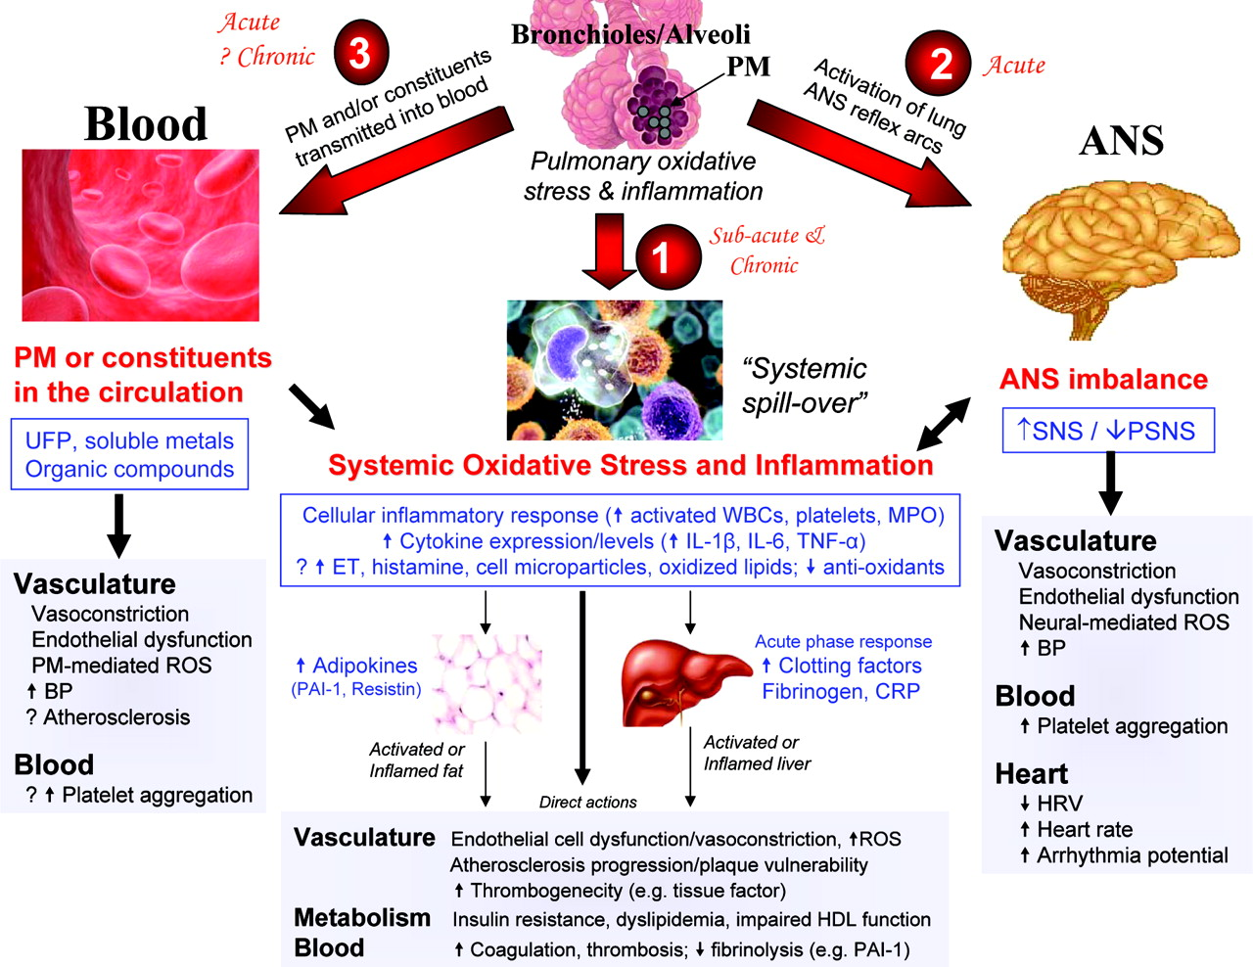
Brook R D et al. Circulation 2010;121:2331-2378

Slide 17
Air Pollution Exposures
(Particulate Matter and Traffic-Related Agents)
Systemic Oxidative Stress and Inflammation
ANS Imbalance
Metabolism
Endothelial Function
Hypertension
Vascular Compliance
Thrombosis
Atherosclerosis
Altered Cardiac Structure and Function
Ischemic Events
Peripheral Vascular Disease
Cardiomyopathy

Slide 18
Air Pollution Exposures
(Particulate Matter and Traffic-Related Agents)
Systemic Oxidative Stress and Inflammation
CRP, IL-6, fibrinogen
ANS Imbalance
Heart rate variability, retinal vascular caliber
Metabolism
Pericardial fat, diabetes, hepatic fat, lipid profile,
metabolic syndrome
HOMA-IR
Endothelial Function
ICAM-1, VCAM-1, E-selectin, flow-mediated brachial artery dilation, retinal vascular caliber
Hypertension
Blood pressure, hypertensive treatment
Vascular Compliance
Carotid and aortic distensibility, brachial imaging, radial pulse wave analysis – small & large vessel
Thrombosis
Fibrinogen, Factor VIII, PAI-1, Plasmin-antiplasmin, D-Dimer, Von Willebrand factor, soluble tissue factor, tissue factor pathway inhibitor, thrombotic stroke
Atherosclerosis
Coronary artery calcium (CAC), calcified coronary artery plaque, plaques with lipid core, extracoronary calcifications, intima-medial thickness (IMT), aortic and coronary wall thickness, ankle-brachial index, coronary artery remodeling, CABG, PCI
Altered Cardiac Structure and Function
Ventricular mass and function, concentric remodeling, LV hypertrophy & papillary muscle mass, stroke volume, ejection fraction, cardiac output, ECG (QT,R waves, axis)
Ischemic Events
MI, ischemic stroke, ECG (Q wave), gadolinium enhancement
Peripheral Vascular Disease
Ankle-brachial index, peripheral revascularization
Cardiomyopathy
Congestive heart failure

Slide 19
Air Pollution Exposures
(Particulate Matter and Traffic-Related Agents)
Manuscript in preparation or published
Systemic Oxidative Stress and Inflammation
CRP, IL-6, fibrinogen
ANS Imbalance
Heart rate variability, retinal vascular caliber
Metabolism
Pericardial fat, diabetes, hepatic fat, lipid profile,
metabolic syndrome
HOMA-IR
Endothelial Function
ICAM-1, VCAM-1, E-selectin, flow-mediated brachial artery dilation, retinal vascular caliber
Hypertension
Blood pressure, hypertensive treatment
Vascular Compliance
Carotid and aortic distensibility, brachial imaging, radial pulse wave analysis – small & large vessel
Thrombosis
Fibrinogen, Factor VIII, PAI-1, Plasmin-antiplasmin, D-Dimer, Von Willebrand factor, soluble tissue factor, tissue factor pathway inhibitor, thrombotic stroke
Atherosclerosis
Coronary artery calcium (CAC), calcified coronary artery plaque, plaques with lipid core, extracoronary calcifications, intima-medial thickness (IMT), aortic and coronary wall thickness, ankle-brachial index, coronary artery remodeling, CABG, PCI
Altered Cardiac Structure and Function
Ventricular mass and function, concentric remodeling, LV hypertrophy & papillary muscle mass, stroke volume, ejection fraction, cardiac output, ECG (QT,R waves, axis)
Ischemic Events
MI, ischemic stroke, ECG (Q wave), gadolinium enhancement
Peripheral Vascular Disease
Ankle-brachial index, peripheral revascularization
Cardiomyopathy
Congestive heart failure

Slide 20
INSERT YOUR FAVORITE ENVIRONMENTAL EXPOSURE HERE
Systemic Oxidative Stress and Inflammation
CRP, IL-6, fibrinogen
ANS Imbalance
Heart rate variability, retinal vascular caliber
Metabolism
Pericardial fat, diabetes, hepatic fat, lipid profile,
metabolic syndrome
HOMA-IR
Endothelial Function
ICAM-1, VCAM-1, E-selectin, flow-mediated brachial artery dilation, retinal vascular caliber,
erectile dysfunction
Hypertension
Blood pressure, hypertensive treatment
Vascular Compliance
Carotid and aortic distensibility, brachial imaging, radial pulse wave analysis – small & large vessel
Thrombosis
Fibrinogen, Factor VIII, PAI-1, Plasmin-antiplasmin, D-Dimer, Von Willebrand factor, soluble tissue factor, tissue factor pathway inhibitor, thrombotic stroke
Atherosclerosis
Coronary artery calcium (CAC), calcified coronary artery plaque, plaques with lipid core, extracoronary calcifications, intima-medial thickness (IMT), aortic and coronary wall thickness, ankle-brachial index, coronary artery remodeling, CABG, PCI
Altered Cardiac Structure and Function
Ventricular mass and function, concentric remodeling, LV hypertrophy & papillary muscle mass, stroke volume, ejection fraction, cardiac output, ECG (QT,R waves, axis)
Ischemic Events
MI, ischemic stroke, ECG (Q wave), gadolinium enhancement, RMD
Peripheral Vascular Disease
Ankle-brachial index, peripheral revascularization
Cardiomyopathy
Congestive heart failure

Slide 21
Examining Novel Outcomes in EH Research
MESA first to publish analysis of Environmental Exposures and
Retinal microvasculature
MRI cardiac structure
Aortic atherosclerosis

Slide 22
Manuscripts that can be written with existing data

Slide 23
Projects to be Encouraged
Analysis of biological markers of exposure
In relation to plausible MESA phenotypes (current or future)
Metals in whole blood (stored from exam 5)
Tobacco exposure biomarkers
Persistent organic pollutants (POPs)
“Endocrine Disrupting” Agents
Phthalates
Bisphenol A
others
Projects that Expand Tools to Understand GxE in relatively small sample size

Slide 24
Ideas for next steps in MESA (Exam or otherwise)
Health endpoints suspected to have environmental contributors? (other than athero/ CV function)
Brain Impacts
Cognition
cranial MRI (functional?)
Olfactory assessment
Metabolic Impacts
Renal function
Additional biological samples to allow exposure assessment?
Adipose tissue
Nails
Support investigator efforts to include environmental exposures

