Slide 1
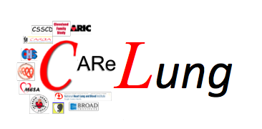

- Lung
Cardiovascular Candidate Genes, HDL and the Lung
Kristin M Burkart, MD MSc
Department of Medicine
Division of Pulmonary & Critical Care Medicine
Columbia University Medical Center

Slide 2
Background
Chronic Lower Respiratory Disease recently overtook stroke as the third-leading cause of death
Endothelial dysfunction is implicated in the pathogenesis of emphysema and COPD
Patients with COPD have an increased risk of cardiovascular disease (CVD)
Lung function, COPD and CVD are heritable traits
GWAS have identified loci associated with lung function in people of European Ancestry
Petrache, et al. Nature Med, 2005, Curkendall, et al. Annals of Epi, 2006, -Hancock Nature Genetics, 2010

Slide 3
Hypothesis
There are shared mechanisms for the development of CLRD and Cardiovascular Diseases
Candidate genes for cardiovascular disease will be associated with an obstructive pattern on spirometry

Slide 4
Candidate-gene Association
Resource (CARe) Consortium
7 NHLBI cohorts with spirometry
  Atherosclerosis Risk in Communities (ARIC)
  Coronary Artery Risk Development in Young Adults (CARDIA)
  Cleveland Family Study (CFS)
  Cardiovascular Health Study (CHS)
  Framingham Heart Study (FHS)
  Jackson Heart Study (JHS)
  Multi-Ethnic Study of Atherosclerosis (MESA)
IBC Chip: 50K SNPs in ~2100 candidate genes for cardiovascular disease

Slide 5
Statistical Analysis
Excluded restrictive ventilatory defects
Analyses stratified by race/ethnicity
Linear regression adjusted for
  age, sex, height, 10 principal components, smoking status, pack-years
Additive genetic model
Meta-analyzed across cohorts
  Genomic control
  SNPs filtered for MAF < 10/n or HWE p < 5 x 10⁻⁵
Bonferroni correction (p< 1.3 x10⁻⁶)
Notes:
Kristin M Burkart, MD, MSc Assistant Professor of Clinical Medicine September 2006
November 2006
5

Slide 6
Characteristics: European-Americans
 | ARIC | CARDIA | CFS | CHS | FHS | MESA
 |  |  |  |  |  |  | Total
N | 8,932 | 1,233 | 180 | 3,571 | 5,427 | 1,068 | 20,411
Age | 54 | 36 | 51 | 73 | 65 | 65 | 55
Male Sex (%) | 47 | 47 | 47 | 44 | 46 | 51 | 46
BMI | 27 | 26 | 32 | 26 | 27 | 27 | 27
Ever smoker (%) | 59 | 40 | 50 | 54 | 49 | 60 | 54
Pack-years | 26 | 10 | 14 | 30 | 16 | 19 | 23
ppFEV₁ | 94 | 99 | 96 | 89 | 97 | 92 | 94
FEV₁/FVC | 0.74 | 0.79 | 0.77 | 0.69 | 0.76 | 0.73 | 0.74
Airflow Obstruction* (%) | 13 | 2 | 9 | 25 | 8 | 15 | 13
*Defined as FEV₁/FVC < 0.70 & FEV₁ pp < 80%
Notes:
6

Slide 7
Characteristics: African-Americans
 | ARIC | CARDIA | CFS | CHS | JHS | MESA
 |  |  |  |  |  |  | Total
N | 2808 | 1057 | 210 | 532 | 1619 | 820 | 7046
Age | 53 | 34 | 48 | 73 | 50 | 65 | 52
Male Sex (%) | 37 | 40 | 41 | 36 | 38 | 47 | 39
BMI | 30 | 29 | 34 | 28 | 32 | 30 | 30
Ever Smokers (%) | 52 | 39 | 60 | 51 | 32 | 60 | 46
Packyears | 17 | 6 | 11 | 21 | 14 | 15 | 14
ppFEV₁ | 97 | 100 | 92 | 91 | 95 | 94 | 96
FEV₁/FVC | 0.76 | 0.81 | 0.78 | 0.70 | 0.80 | 0.75 | 0.77
Airflow obstruction* (%) | 8 | 2 | 14 | 24 | 7 | 12 | 9
*Defined as FEV₁/FVC < 0.70 & FEV₁ pp < 80%
Notes:
7

Slide 8
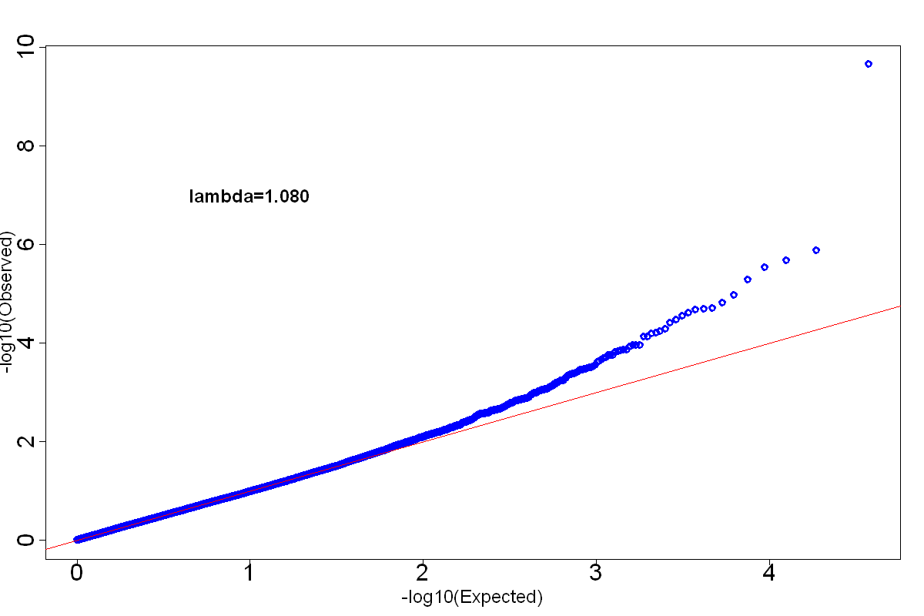
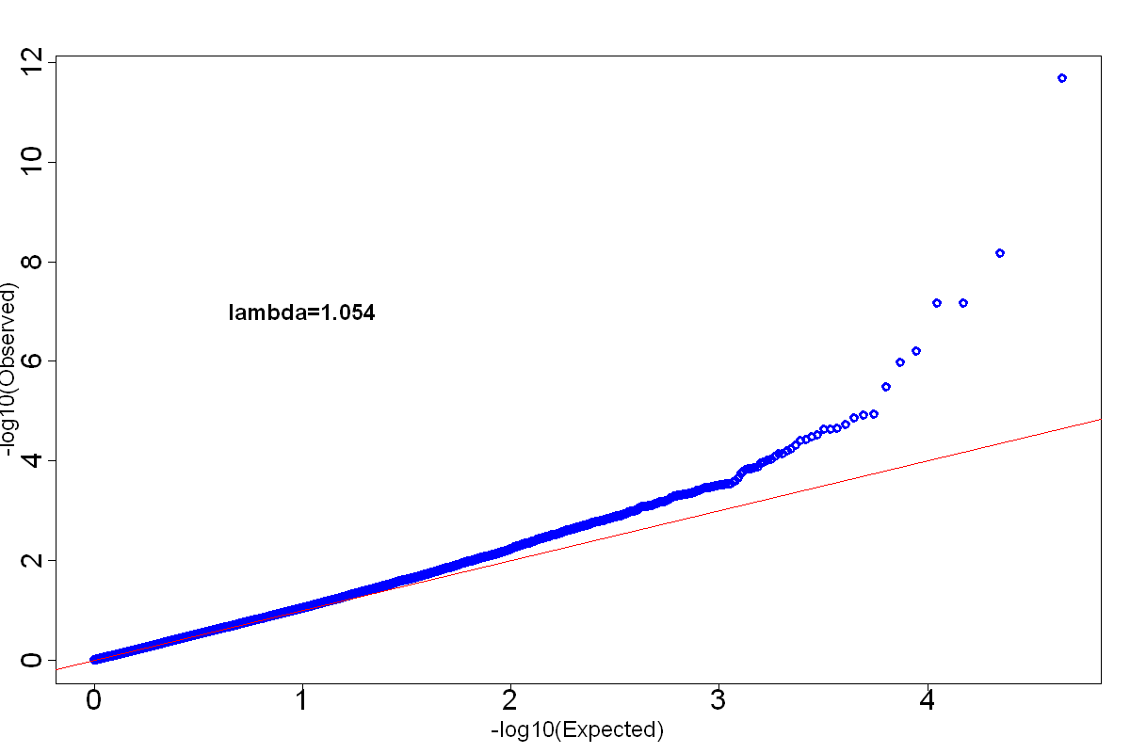
FEV₁/FVC Quantile-Quantile Plots
European-American
African-American
λ_{gc=1.080}
λ_{gc=1.028}
Combined
λ_{gc=1.054}

Slide 9
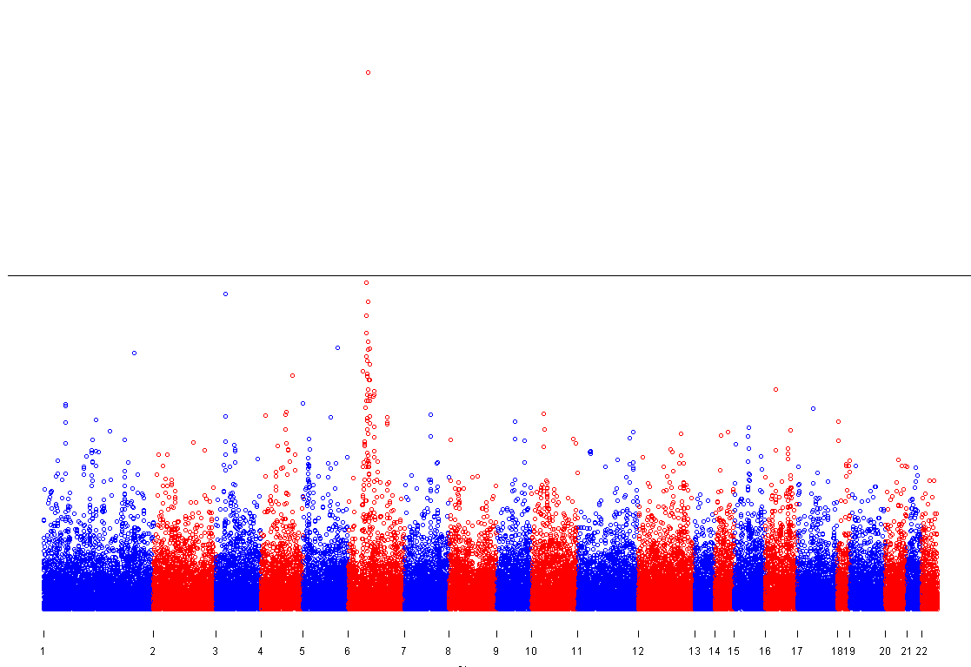
Manhattan Plots and in European-Americans
6
-log(P-value)
Chromosome

Slide 10
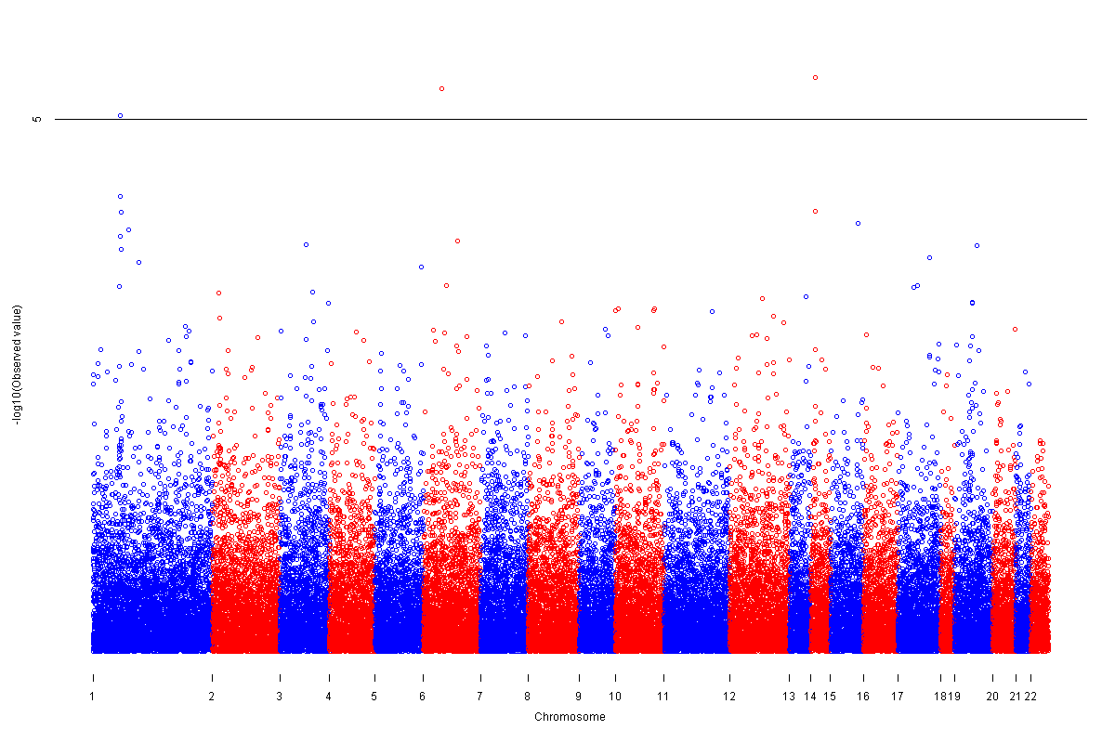
Manhattan Plots and in African-Americans
5
-log(P-value)
Chromosome

Slide 11
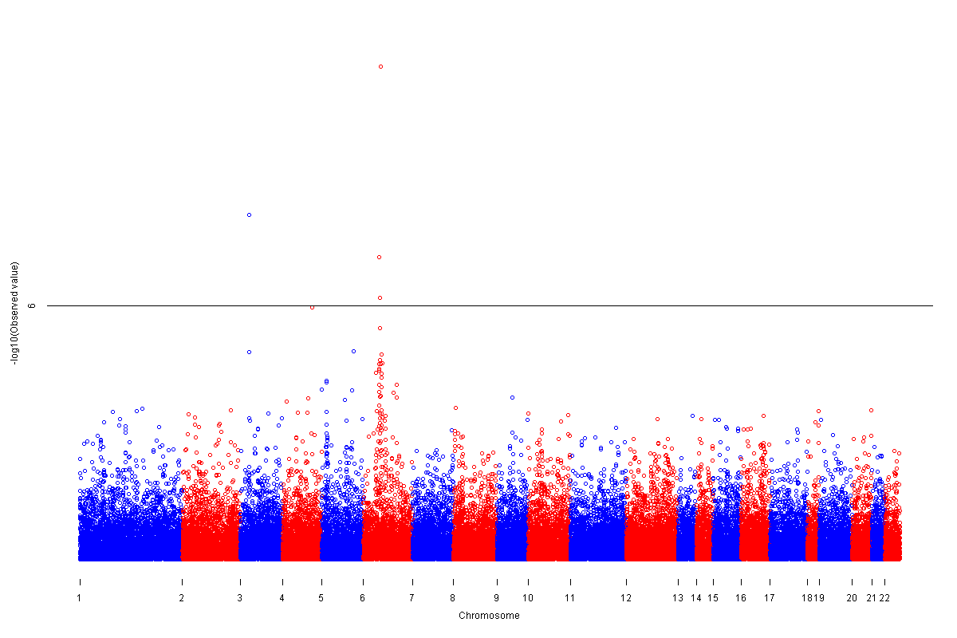
Manhattan Plots and in Combined Races
-log(P-value)
6
Chromosome

Slide 12
SNPs associated with FEV₁/FVC
European-Americans
SNP | Chr | Gene | MAF | β -Estimate | P value
rs2070600 | 6 | AGER/RNF | 0.05 | + 0.162 | 2.19 x 10⁻¹⁰
rs805301 | 6 | BAT3/APOM | 0.37 | - 0.054 | 1.32 x 10⁻⁶
rs1286664 | 3 | RARB | 0.17 | + 0.067 | 2.07 x 10⁻⁶
rs6941112 | 6 | STK19/C4B | 0.33 | + 0.053 | 2.90 x 10⁻⁶
rs3117582 | 6 | BAT3 | 0.11 | -0.081 | 5.23 x 10⁻⁶
African-Americans
SNP | Chr | Gene | MAF | β -Estimate | P value
rs1951269 | 14 | NG/NFKBIA | 0.22 | + 0.097 | 4.08 x 10⁻⁶
rs707974 | 6 | C6orf47/APOM | 0.02 | + 0.291 | 5.17 x 10⁻⁶
rs565436 | 1 | PCSK9 | 0.40 | -0.083 | 9.32 x 10⁻⁶
rs533375 | 1 | PCSK9 | 0.25 | - 0.083 | 5.29 x 10⁻⁵
rs7156874 | 14 | PSMA6 | 0.02 | +0.271 | 7.33 x 10⁻⁵

Slide 13
SNPs associated with FEV₁/FVC
Combined European-Americans and African-Americans
SNP | Chr | Gene | MAF | β -Estimate | P value
rs2070600 | 6 | AGER/RNF | 0.04 | + 0.168 | 8.37 x 10⁻¹²
rs1286664 | 3 | RARB | 0.18 | + 0.067 | 1.60 x 10⁻⁸
rs805301 | 6 | BAT3/APOM | 0.43 | - 0.050 | 1.26 x 10⁻⁷
rs707974 | 6 | C6orf47/APOM | 0.10 | + 0.088 | 1.38 x 10⁻⁷
rs6941112 | 6 | STK19/C4B | 0.30 | + 0.053 | 1.22 x 10⁻⁶

Slide 14
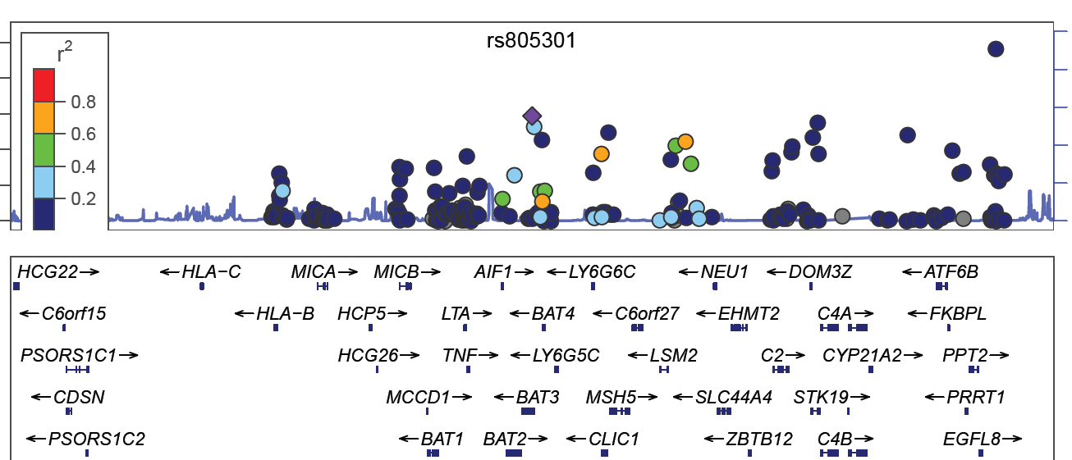
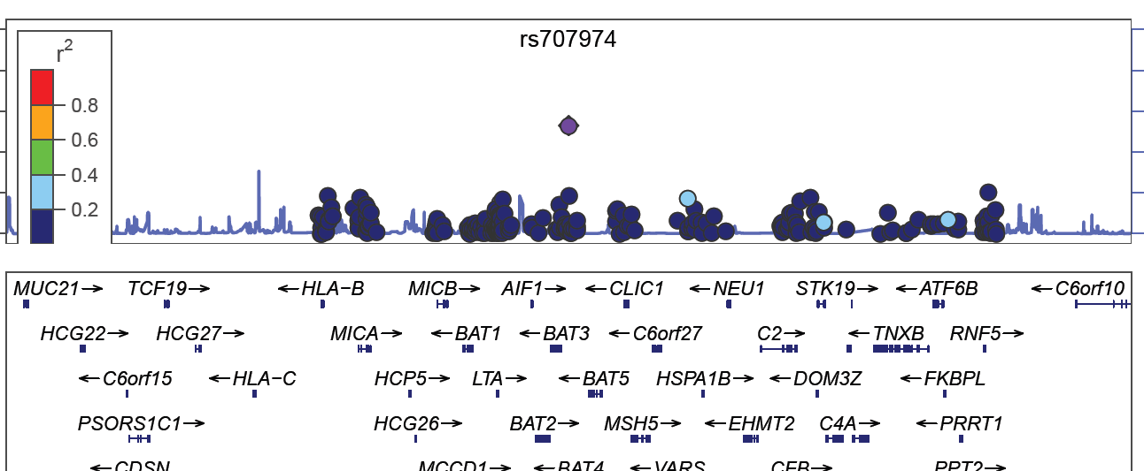
APOM SNPs and FEV₁/FVC
European-Americans
SNP | MAF | β | P value
rs805301 | 0.37 | - 0.054 | 1.32 x 10⁻⁶
rs707974 | 0.10 | + 0.73 | 2.84 x 10⁻⁵
Position on chromosome 6
African-Americans
SNP | MAF | β | P value
rs707974 | 0.02 | +0.291 | 5.17 x 10⁻⁶
rs805301 | 0.41 | -0.039 | 0.036
Position on chromosome 6
Notes:
R2 for 805301 and 707974 in CEU = r2 = 0.059

Slide 15
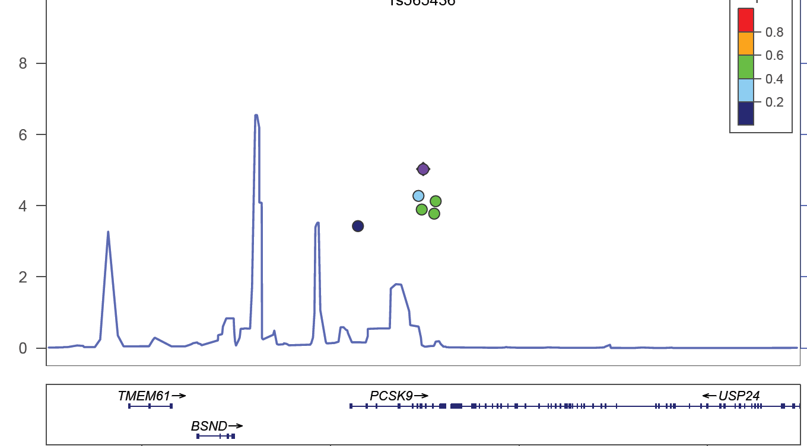
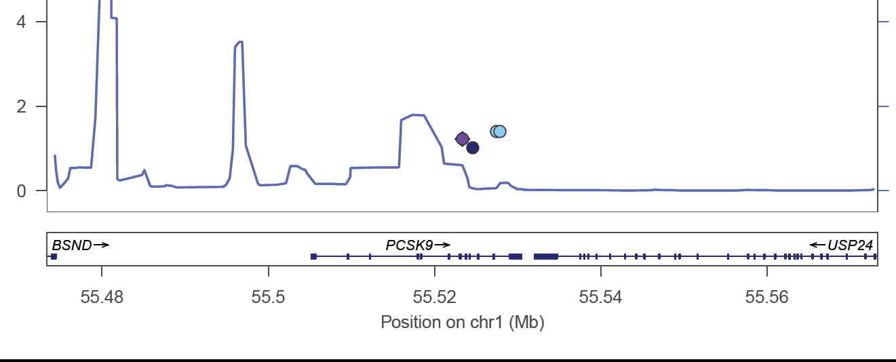
PCSK9 SNPs and FEV₁/FVC
African-Americans
SNP | MAF | β | P value
rs565436 | 0.40 | -0.083 | 9.32 x 10⁻⁶
rs533375 | 0.25 | - 0.083 | 5.29 x 10⁻⁵
rs643257
rs631220
Position on chromosome 1
Asian-Americans
SNP | MAF | β | P value
rs565436 | 0.10 | -0.177 | 0.095
rs533375 | 0.006 | -0.759 | 0.06
rs643257 | 0.007 | -0.775 | 0.039
rs631220 | 0.007 | -0.775 | 0.039
Position on chromosome 1

Slide 16
Apolipoprotein M
APOM gene encodes for Apolipoprotein M, a lipoprotein-associated plasma protein
Predominantly a component of HDL
In genetically modified mice
  ApoM transgenic → increase in Cholesterol
  ApoM knock-out → decrease in Cholesterol
  ApoM might affect quality rather than quantity of HDL in murine models
Christoffersen et al. J of Biol Chem 2008
Christoffersen et al. Circ Res 2010

Slide 17
HDL Inhibits Endothelial Cell Sphingosine Kinase
Sphingomyelin
SM-ase
Ceramide
APOM
Sphingosine
HDL
X
Sph Kinase
S1-P
Adapted from Xia, J Biol Chem, 1999

Slide 18
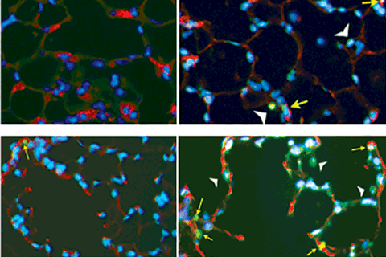
Ceramide
Triggers endothelial apoptosis
Causes emphysema in mice
Control Ceramide
Petrache, Nature Med, 2005

Slide 19
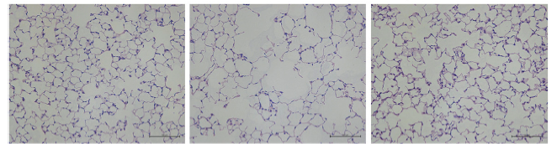
Sphingosine 1-Phosphate (S1P)
Augmentation of S1P signaling prevents airspace enlargement
Control
VEGFR-inh
Sph + VEGFR-inh
- Diab et al. AJRCCM 2010

Slide 20
Hypothesis
APOM would be associated with emphysema
There would be an association between HDL and emphysema.

Slide 21
Characteristics: MESA SHARe
- Lung
 | White | Black | Chinese | Hispanic
 |  |  |  |  | Total
No. ApoM genotype No. genotype + CT%emphysema No. genotpe + HDL No. genotype + HDL subfractions No. overlap with CARe | 2,684 2,552 2,579 2,433 1,068 | 2,547 2,457 2,551 1,598 820 | 777 707 705 705 485 | 2,140 2,071 2,127 1,425 650 | 8,148 7,787 7,962 6,161 3,023
Age | 63 | 61 | 62 | 61 | 62
Male Sex (%) | 48 | 44 | 49 | 46 | 46
BMI | 28 | 30 | 24 | 30 | 29
Ever smoker (%) | 56 | 53 | 25 | 46 | 49
Pack-years | 22 | 17 | 18 | 11 | 17
ppFEV₁ (%) | 88 | 90 | 96 | 93 | 91
FEV₁/FVC | 0.72 | 0.75 | 0.75 | 0.76 | 0.74
Airflow Obstruction* (%) | 22 | 15 | 16 | 15 | 17
*Defined as FEV₁/FVC < 0.70 & FEV₁ pp < 80%
Notes:
21

Slide 22
APOM candidate gene analysis
- Lung
 |  | European-American |  |  | African-American
Phenotype | SNP ID | β | P-value |  | β | P-value
FEV₁/FVC | rs805301 rs707974 | - 0.054 + 0.073 | 1.32 x 10⁻⁶ 2.84 x 10⁻⁵ |  | 0.039 +0.291 | 0.036 5.17 x 10⁻⁶
Percent emphysema | rs805301 rs707974 | +0.029 -0.247 | 0.47 1.26 x 10⁻⁴ |  | + 0.058 -0.335 | 0.17 0.016
HDL | rs805301 rs707974 | -0.013 +0.026 | 0.07 0.03 |  | 0.002 0.008 | 0.75 0.76

Slide 23
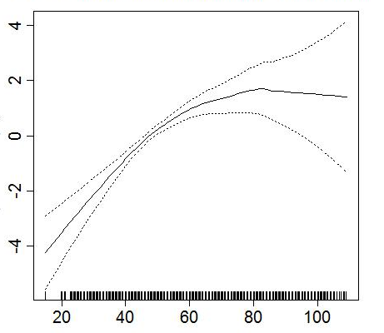
HDL-c and CT Percent Emphysema
- Lung
CT Percent Emphysema
(p < 0.0001)
HDL, mg/dl
Burkart, ATS, 2010
Adjusted for age, gender, height, weight, race, CT type, smoking status, pack years, cotinine, asthma, education, total cholesterol, exercise, alcohol use, ICS, lipid lowering agents
Notes:
Every 10mg increase in HDL we see a 0.53% increase in percent emphysema. Relationship is non-linear (p = 0.0003)
No effect modification by age > 65 or race.
Modified by gender p = 0.024, male 0.68m female 0.47 %
Loess smoothing function in a genearalized addtive model.

Slide 24
Conclusions
SNPs in APOM are associated with an obstructive pattern of spirometry and emphysema on CT scan among European- and African-Americans
HDL is positively associated with emphysema on CT scan
These findings suggest a novel effect of HDL pathway in the pathogenesis of CLRD

Slide 25
Acknowledgements
- Lung
MESA Lung Study and MESA Lung SHARe
Columbia Firas Ahmed, MD MPH Rui Jiang, MD DrPH
Joe Schwartz, PhD
Johns Hopkins Wendy Post, MD PhD
Northwestern Kiang Liu, PhD
Lewis Smith, MD
Wake Forest Jeff Carr, MD MS
Univ Arizona Paul Enright, MD
Eyal Shahar, MD MS
Univ Iowa Eric Hoffman, PhD
Univ Virginia Ani Manichaikul, PhD
Steve Rich, PhD
Univ Vermont Russell Tracy, PhD
Univ Washington Richard Kronmal, PhD
Karen Hinckley, MS
UCLA Matt Budoff, MD
Karol Watson, MD PhD
Other John Hankinson, PhD
NHLBI R01s HL077612, HL075476, HL093081; RC1-HL100543
NHLBI/CARe Lung
Columbia R Graham Barr
Elizabeth Oelsner
Sri Raghavan
Dan Rabinowitz
Harvard Jemma Wilk
Susan Redline
Boston Univ George O’Connor
Johns Hopkins Nadia Hansel
UNC Laura Loehr
Stephanie London
Univ Mississipi Marcy Petrini
Demondes Haynes
Wendy White
Univ Washington Susan Heckbert
NHLBI N01-HC065226

