Slide 1
MESA Elasticity
PIs: David Jacobs and Daniel Duprez (Univ MN)
Lyn Brumback UW CoC and Craig Johnson
Small artery elasticity predicts incident hypertension (Peralta et al AJE 2010) and CVD events (Duprez et al AJE resubmitted)
Grant proposal received 2nd percentile
Subcontracts to be sent any day now
Plan to repeat tonometry with the HDI, Inc device used at Exam 1 fell through due to fears in the company about looking more deeply at their measures and related measures

Slide 2
MESA Elasticity
Millar tonometer system devised/assembled by consulting bioengineer Andres Belalcazar
Equivalent waveform assessment to HDI, SAE calculation in process
Advantage of the Millar device – systolic and diastolic part can be more easily analyzed
Under 15 minute exam time
MN started early August, 56 ppts seen to date
Columbia training August 25,26, first 3 ppts Sept 13
WFU training Sept 13,14, first ppts Sept 14
JHU, UCLA, Northwestern training is scheduled
Post certification, repeat at least 1/week until IRB approval
Plan to see all MESA ppts, recalling as needed

Slide 3
Main Finding to Date: SAE predicts incident CVD, PVD, HF
CVD in 5.8 yr median followup: 454/6235
Stiffest vs most elastic quartile: HR 2.28 (95% CI: 1.55,3.36)
Per SD: HR 0.71 (95% CI: 0.61,0.83)
Similar for each CVD subset
NRI: improvement by adding SAE in
P(correct dir. of reclassification) – P(incorrect dir. of reclassification)
Base risk NRI (SE) p
Q1 0.27 (0.137) 0.04
Q2 0.05 (0.058) 0.36
Q3 0.09 (0.036) 0.013
Q4 0.04 (0.016) 0.014
Mean 0.11 (0.015) <0.0001
Unstratified -0.01 (0.016) 0.72

Slide 4
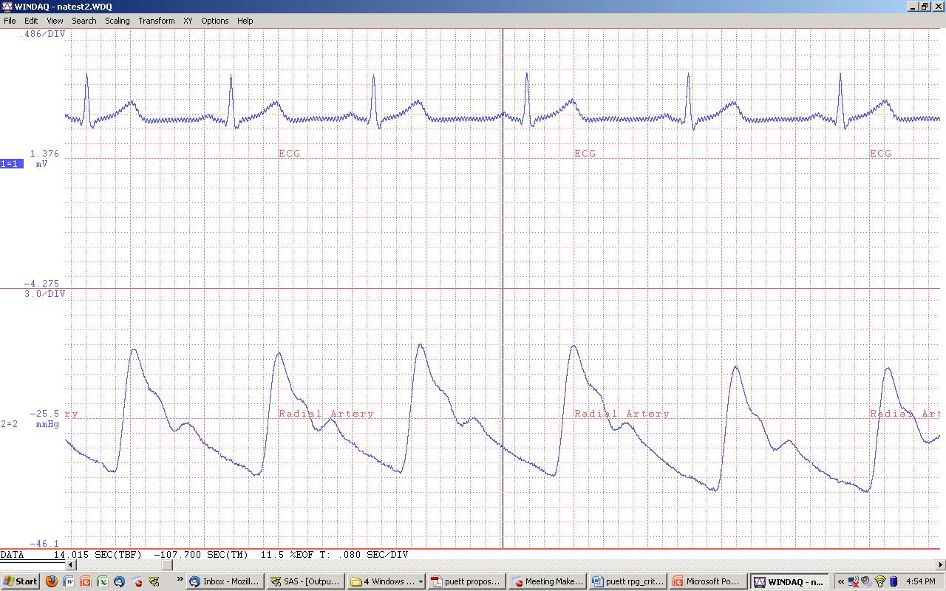
Waveform and Several Aspects
Diastolic portion
Electromechanical delay – like Pulse Wave Velocity (Belalcazar)
Systolic wave reflection– like Augmentation Index

Slide 5
Understanding the Main Finding
Diastole decomposed
LAE comes mostly from the change in pressure during diastole
SAE comes mostly from the oscillations during diastole
SAE/Oscillations predict incident CVD in all its forms, capacity of the arterial system to withstand actions in vasculature and LV when LV is “at rest”

