Slide 1

SNPs and Extent of Atherosclerosis (SEA) Study
Wake Forest: Herrington, Liu, Howard, Langefeld
LSU: Strong, Malcom, Vander Heide
UT Houston: Hixson
Cedars Sinai: Rotter, Chen, Guo
U of Washington: Johnson, Kronmal
Perlegen: Cox, Beliharz
NHLBI: Paltoo, Papanicolaou, Applebaum-Bowden

Slide 2
Genetic Variants
inflammation
atherosclerosis
thrombosis
LV structure/fxn
stress responses
Acute Coronary Syndromes

Slide 3
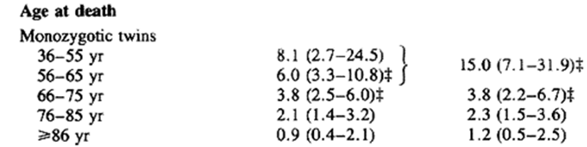
Premature CHD is More Heavily Influenced by Genetic Factors than CHD at a Later Stage of Life
Genetic Susceptibility to Death From Coronary Heart Disease in a Study of Twins
Marenberg, Risch, Berkman, Floderus, Ulf de Faire , NEJM ‘94

Slide 4
Pathobiological Determinants of Atherosclerosis in Youth (PDAY)
NIH-funded multi-center collaboration formed in 1983
Males and females aged 15-34 who died of violent causes
Standardized autopsies and quantitative assessment of extent of atherosclerosis
Broad array of specimen collections

Slide 5
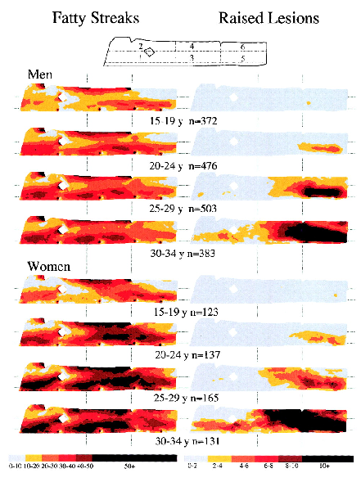
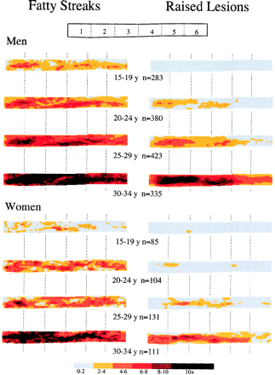
PDAY: Extent of Intimal Involvement by Location and Severity
Abdominal Aorta
Right Coronary

Slide 6
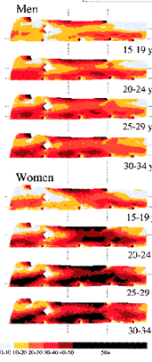
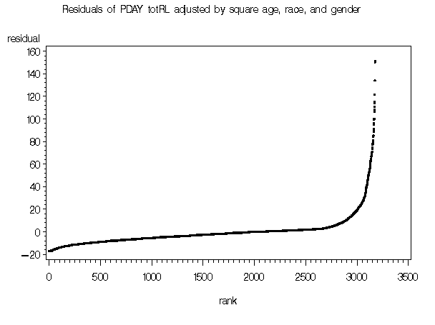
Distribution of the Primary Phenotype in the SEA Study
Controls
N=666
Cases
N=333

Slide 7
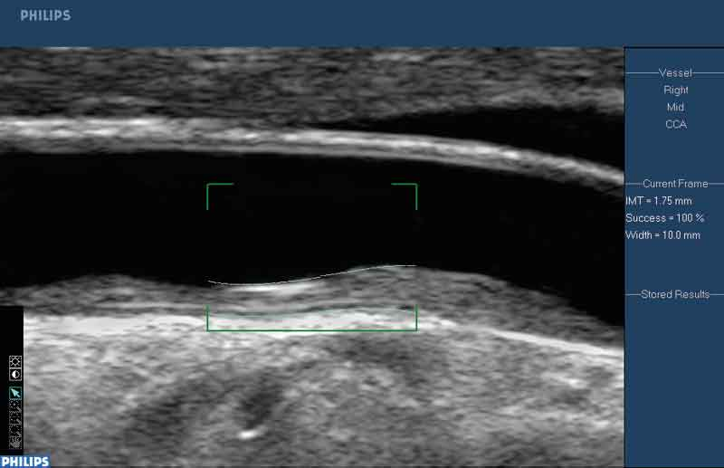
Carotid Intimal-Medial Thickness in MESA

Slide 8
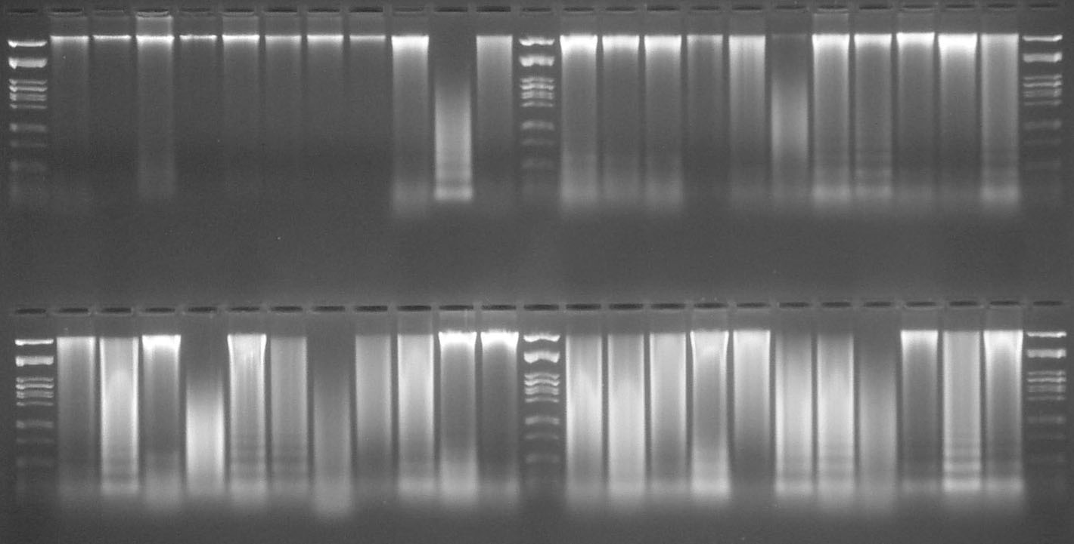
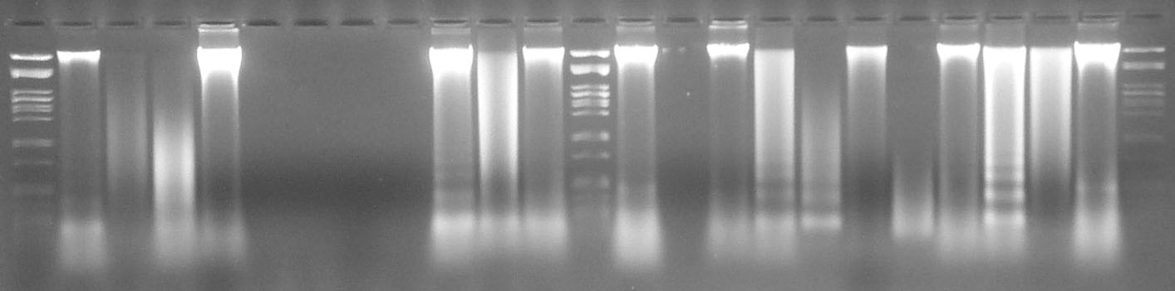
Variable Quality DNA from the Original PDAY Specimens
Category
M 1 1 1 1 1 1 1 1 1 4 2 M 1 1 1 1 2 3 1 1 1 1 2 M
11 Kb
5 Kb
1 Kb
Category
M 2 3 1 4 2 3 4 3 3 1 1 M 3 3 3 2 2 3 3 3 1 3 2 M
11 Kb
5 Kb
1 Kb
Category
M 1 3 4 1 5 5 5 5 1 2 3 M 1 5 1 3 4 1 4 1 2 2 1 M
11 Kb
5 Kb
1 Kb
M : λ / Pst1 Marker

Slide 9
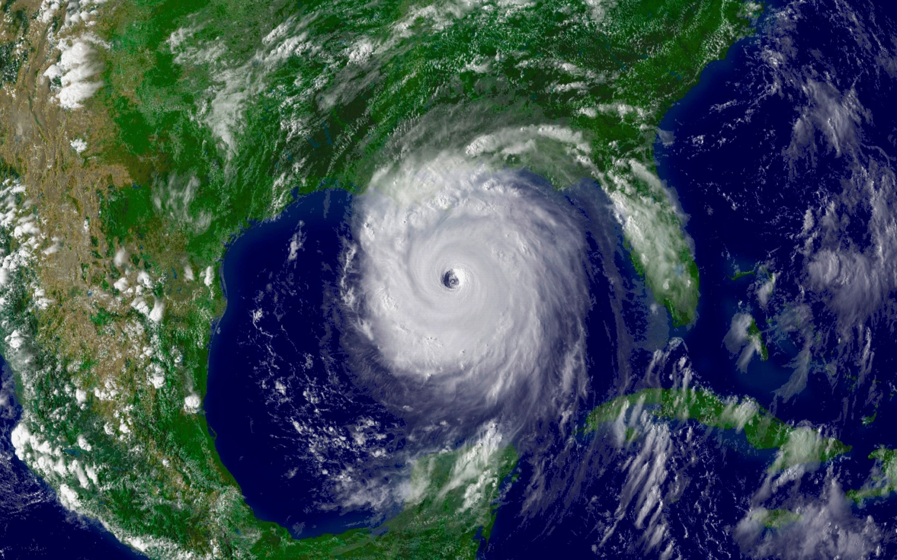
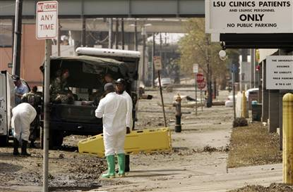
Hurricane Katrina Devastates New Orleans

Slide 10
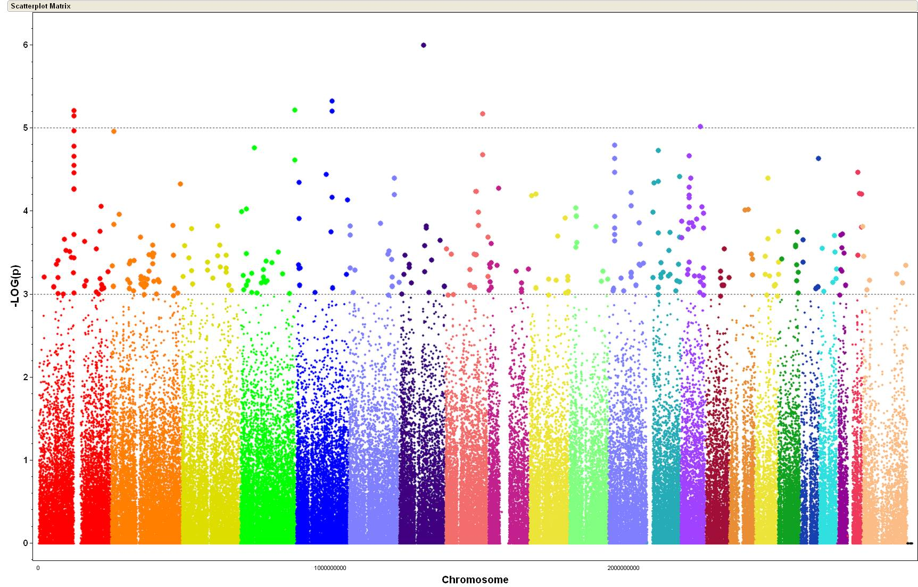
Combined races, PC-adjusted p-values
8.2 kb from ENPP6
LOC728460
FLRT2 fibronectin leucine rich transmembrane protein 2
124.8 kb from SEMA3E
POSTN periostin, osteoblast specific factor
463.5 kb from SPAG17
162.9 kb from ZHX2
1
2
3
4
5
6
7
8
9
10
11
12
13
14
15
16
17
18
19
20
X
21
22
Chromosome
Notes:
10

Slide 11
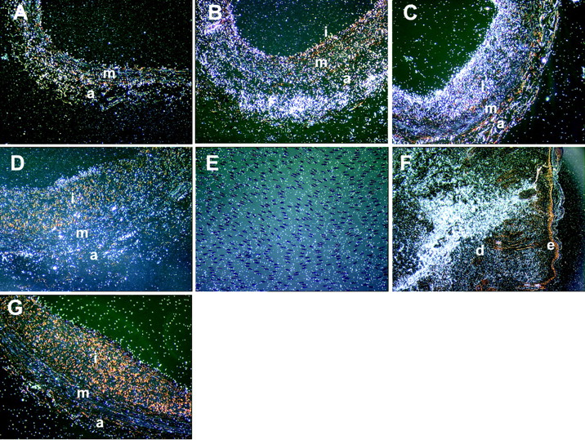
Periostin is Expressed by Adventitial and Neointimal Cells in Response to Injury
Lindner, V. et al. Arterioscler Thromb Vasc Biol 2005;25:77-83
Notes:
11

Slide 12
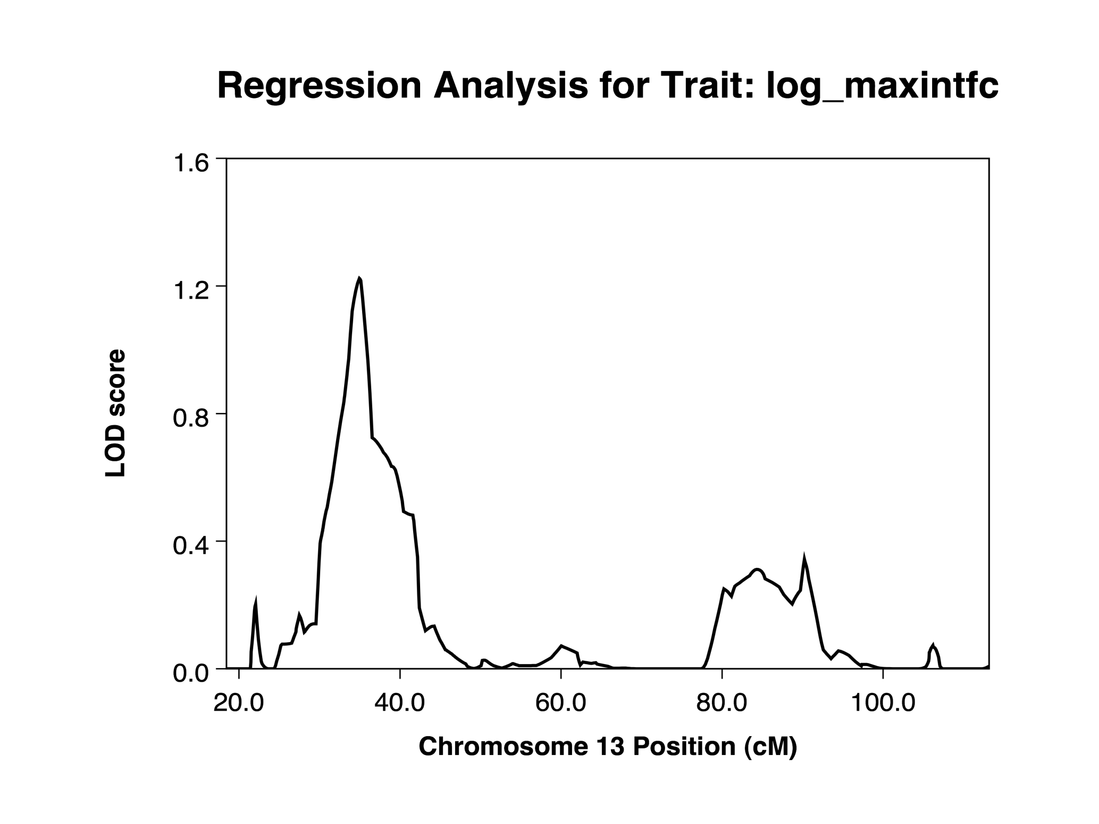
Linkage of Internal Carotid Intimal-Medial Thickness in MESA Family – HA Sample, Regression
POSTN

Slide 13
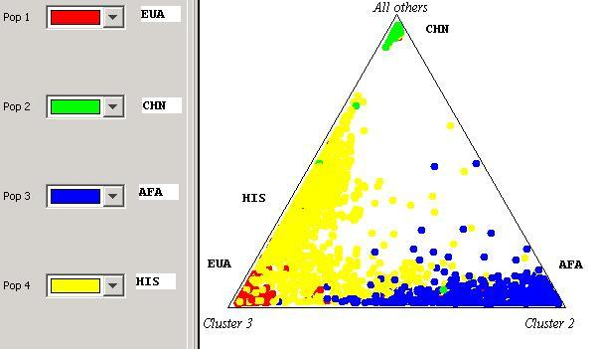
Structure Ternary Plot of Uncorrelated Phase III SNPs for 4 Populations in MESA

Slide 14
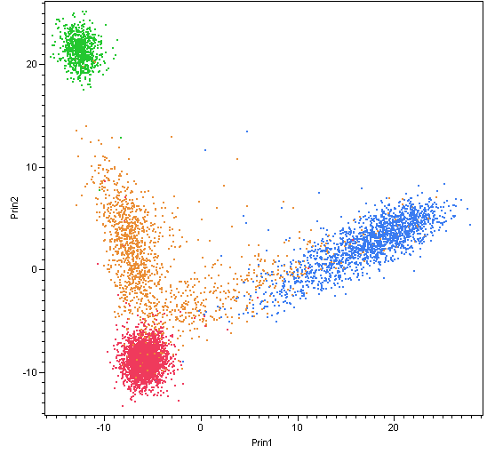
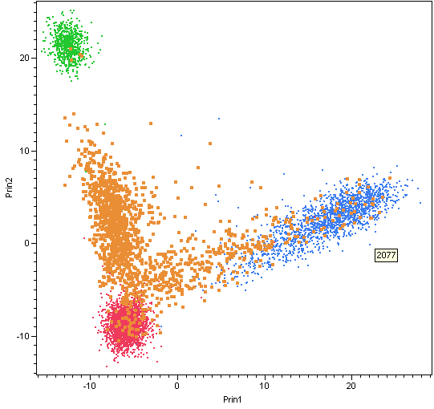
Plot of PC 1 and PC2 Color Coded by Self Reported Ethnicity in MESA
MESA Self Reported Ethnicity
African-Am: ■
Chinese: ■
European: ■
Hispanic: ■
MESA Self Reported Ethnicity
African-Am: ■
Chinese: ■
European: ■
Hispanic: ■

Slide 15
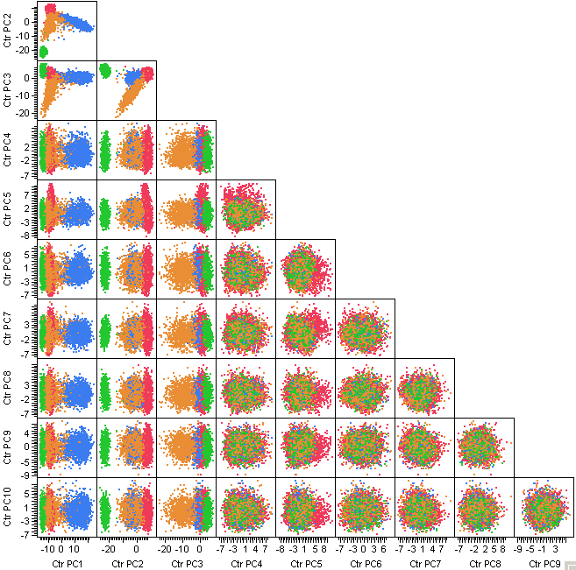
Principle Component Analysis of Phase III SNP Data in MESA
MESA Self Reported Ethnicity
African-Am: ■
Chinese: ■
European: ■
Hispanic: ■

Slide 16
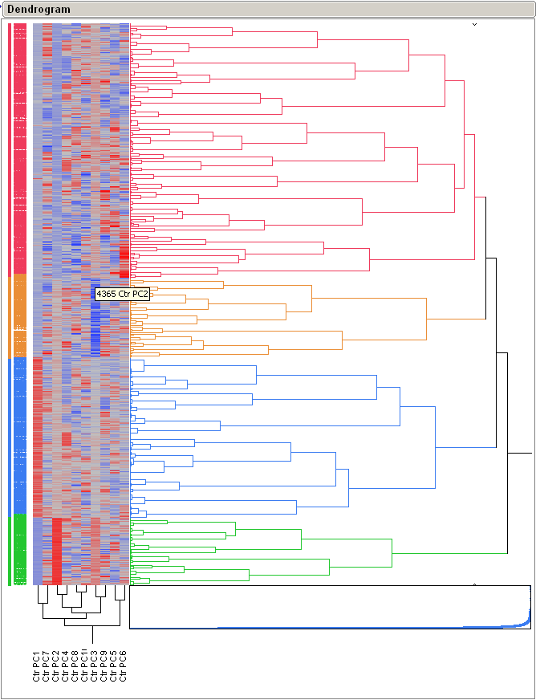
Hierarchical Clustering of Phase III SNP
PC1-PC10 in MESA
MESA Hierarchical Clusters
HCluster1 (AA): ■
HCluster2 (CHN): ■
HCluster3 (EUA): ■
HCluster4 (HIS): ■

Slide 17
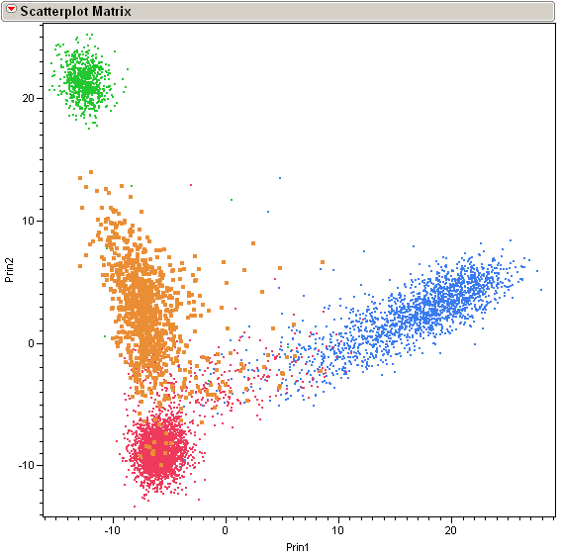
Re-classification of MESA Subjects to Genetic Ancestral Clusters Based on PC1-10
MESA Hierarchical Clusters
HCluster1 (AA): ■
HCluster2 (CHN): ■
HCluster3 (EUA): ■
HCluster4 (HIS): ■
MESA Self Reported Ethnicity
African-Am: ■
Chinese: ■
European: ■
Hispanic: ■

Slide 18
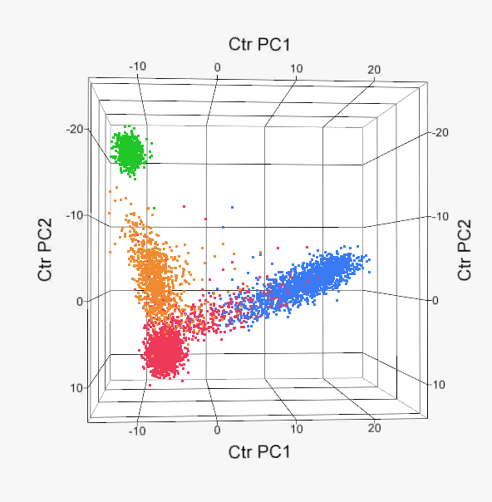
3-D Plot of MESA PC1-PC3 Color Coded by Cluster Assignment

Slide 19
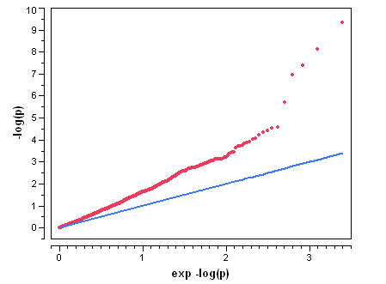
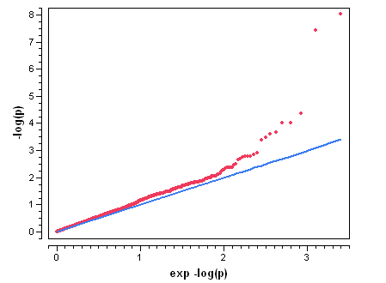
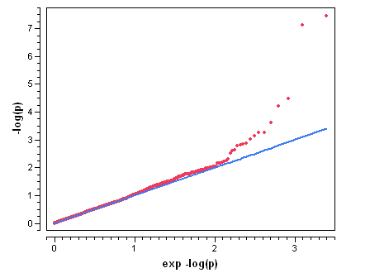
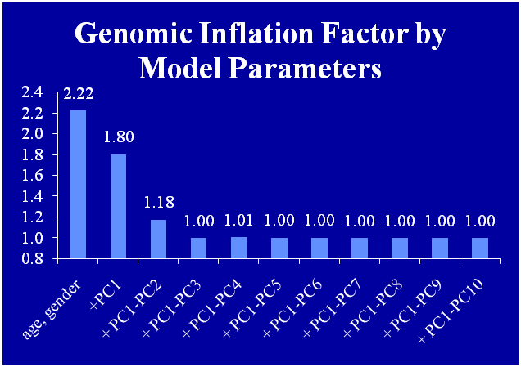
Logistic Model of Phase III SNPs vs CAC (Y/N)
Adj age, sex, PC1
GC Lambda = 1.80
Adj age, sex, PC1, PC2
GC Lambda = 1.18
Adj for age, gender, PC1
GC lambda = 1.80
Adj for age, gender, PC1-PC2
GC lambda = 1.17
Adj age, sex, PC1, PC2, PC3
GC Lambda = 1.002
Adj for site, age, gender, PC1-PC3
GC lambda = 1.002

Slide 20
Meta-Analysis of SNP Associations with Premature Athero in PDAY and CAC in MESA

Slide 21
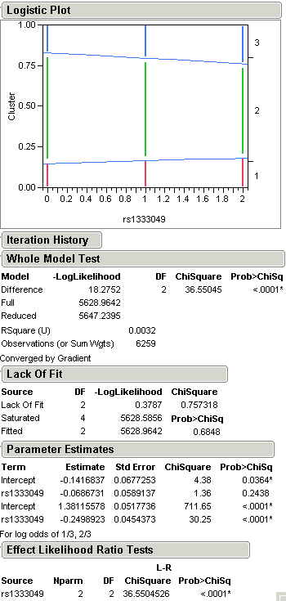
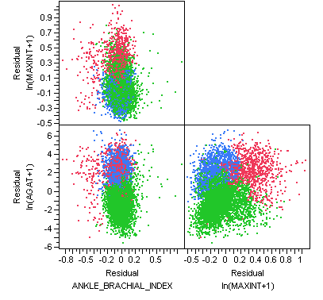
Association of MESA Athero Sub-Phenotypes with rs1333049 (9p21)

Slide 22
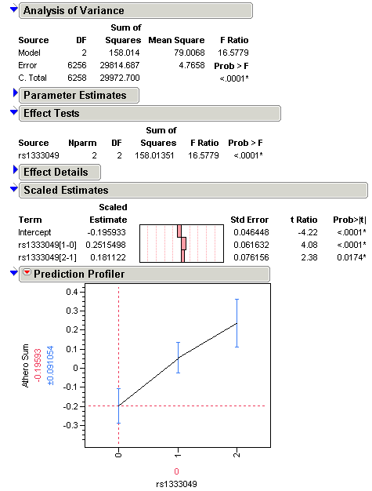
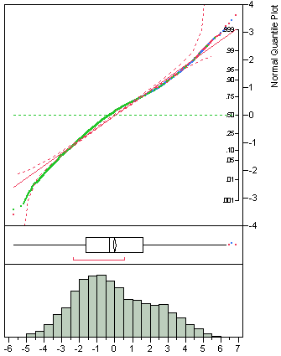
Association of MESA Athero Score with rs1333049 (9p21)
Athero-Score

Slide 23
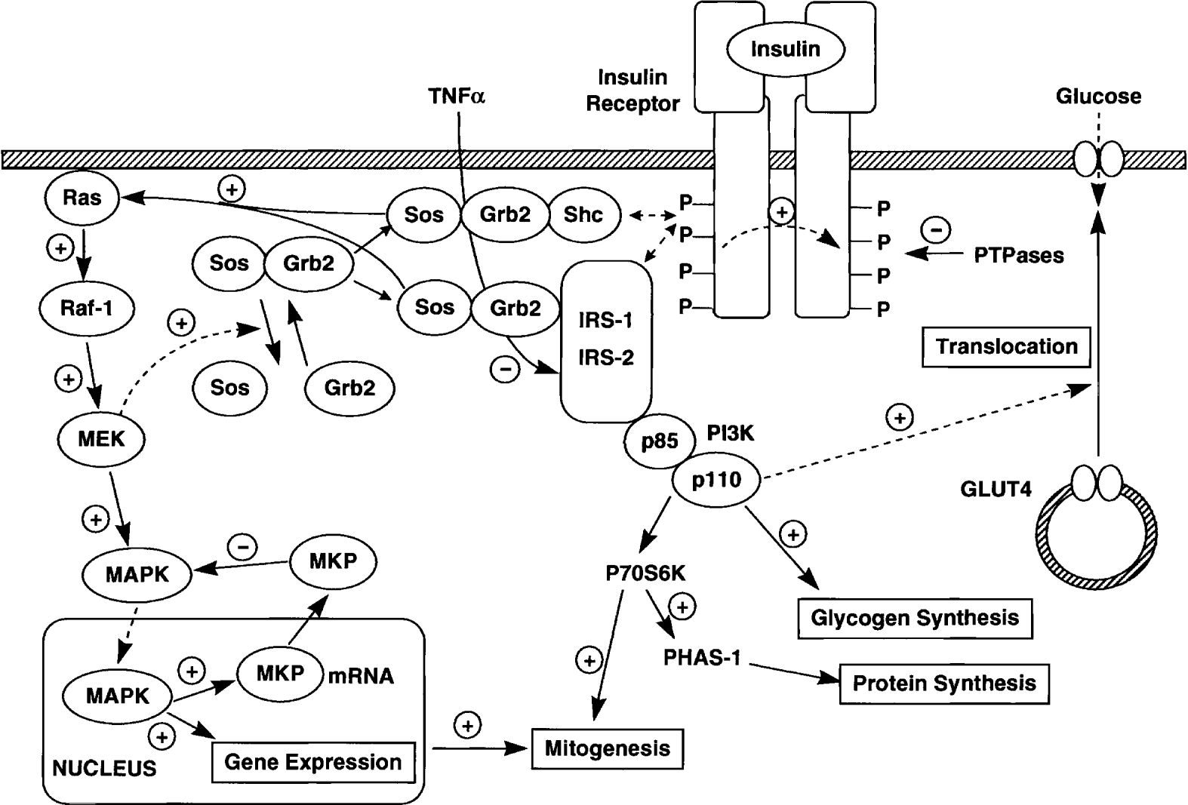
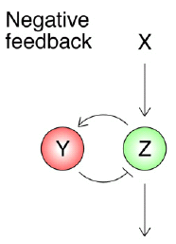
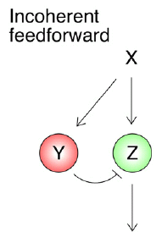
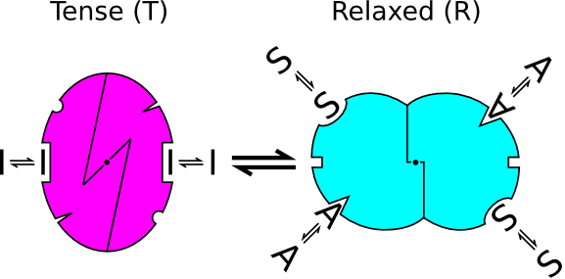
Challenges in the Detection of Gene*Gene and Gene*Environment Interactions (cont.)
Trying to use simple epidemiologic tools to detect complex molecular and cellular phenomenon
Examples of simple cell signaling motifs
MWC model
cellular-scale signal transduction networks

Slide 24
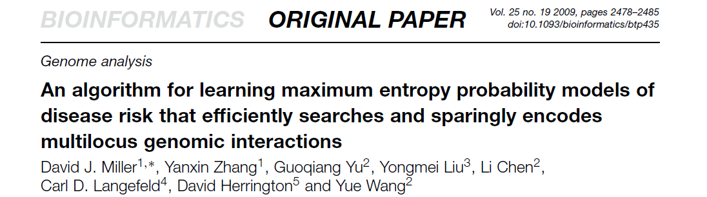
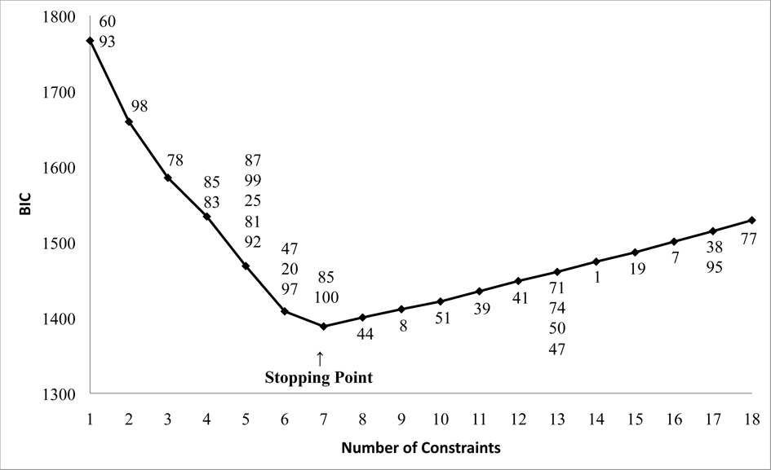
Fig. 1. BIC versus number of constraints for 100 SNPs. The SNPs in each added constraint are labeled above the curve. The first interaction involved SNPs 60 and 93 and the last, at the stopping point, involved SNPs 85 and 100. The method detected 7 out of 8 true interactions, including the 5-way.

Slide 25
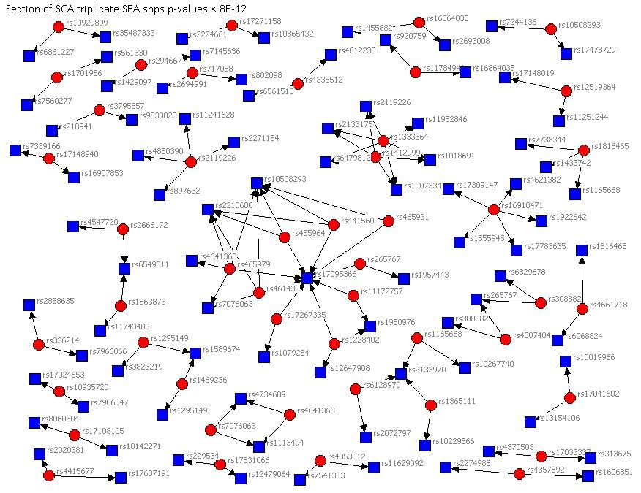

Slide 26
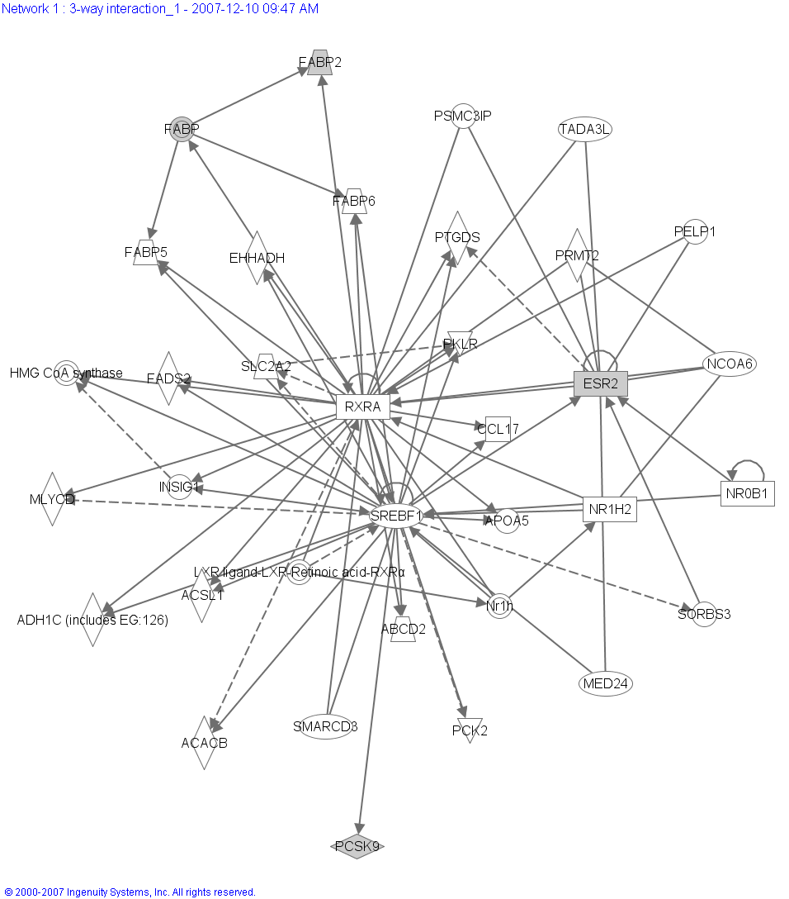
Gene*Gene Interaction Predicting Coronary Calcium in MESA
3-Way Interaction
 | Index1 | Index2 | Index3 | p-value
SNP | rs10888897 | rs1397613 | rs1256061 | 2.01E-10
Gene | PCSK9 | FABP2 | ESR2
PCSK9
proprotein convertase subtilisin/kexin type 9
Chr 1p32
plays a role in cholesterol homeostasis and may have a role in the differentiation of cortical neurons
associated with a third form of autosomal dominant familial hypercholesterolemia
FABP2
intestinal fatty acid binding protein 2
Chr 4q26
associated with increased fat oxidation and insulin resistance
ESR2
estrogen receptor 2 (beta)
Chr 14q23
Notes:
26
26

Slide 27
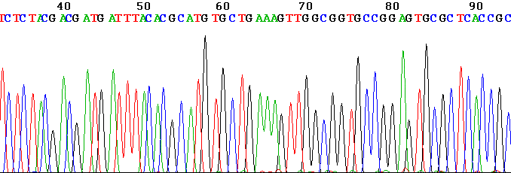
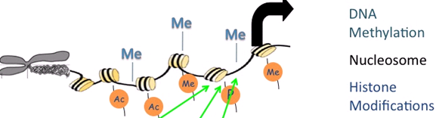
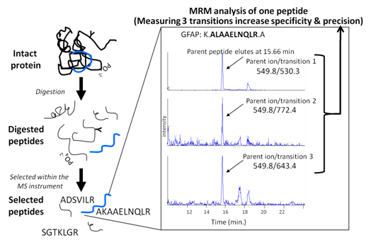
Opportunities:
Greater Molecular Specificity

Slide 29
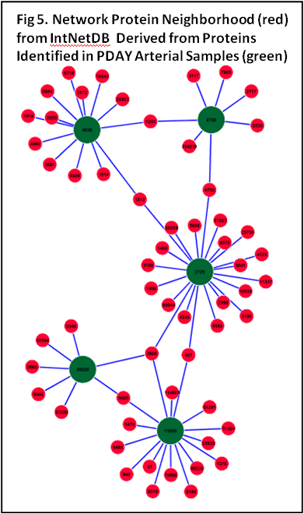
Specification of Network Structures
Protein co-expression networks elucidated separately in the cases and in the controls, followed by the construction of Undirected Dependency Graphs (UDGs)
(de la Fuente et al. 2004).

Slide 30

Opportunities for Future Progress:
Greater Analytic Sophistication
Example: Challenges in Detection of Gene*Gene and Gene*Environment Interactions
Exhaustive search of GWAS data for high order interactions is computationally infeasible
No consensus on the definition of experiment-wide significance level
Admixture, non-random missingness, genotyping errors
Model bias (eg. generalized linear models designed to detect multiplicative interactions),

Slide 31
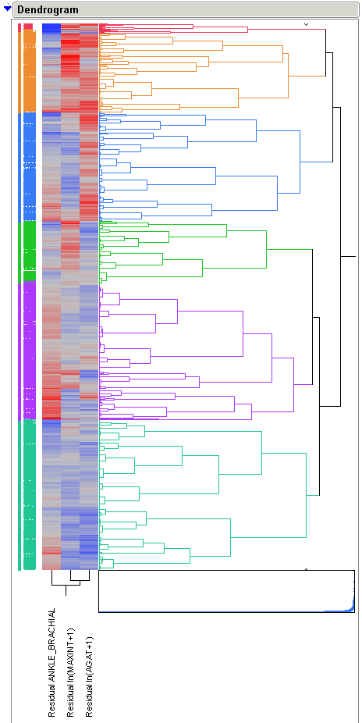
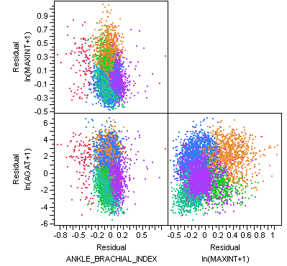
Potential Higher-Order Athero Phenotypic Classification

Slide 32
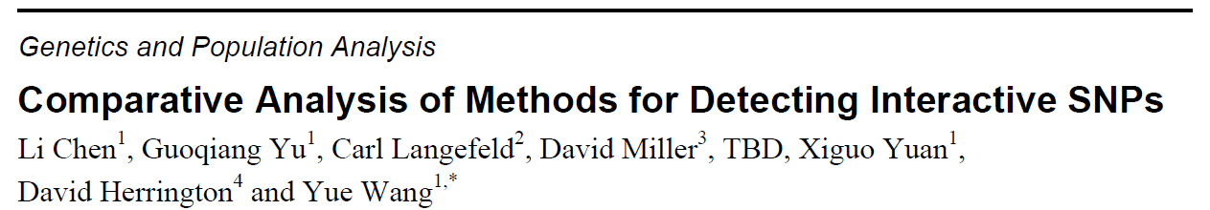
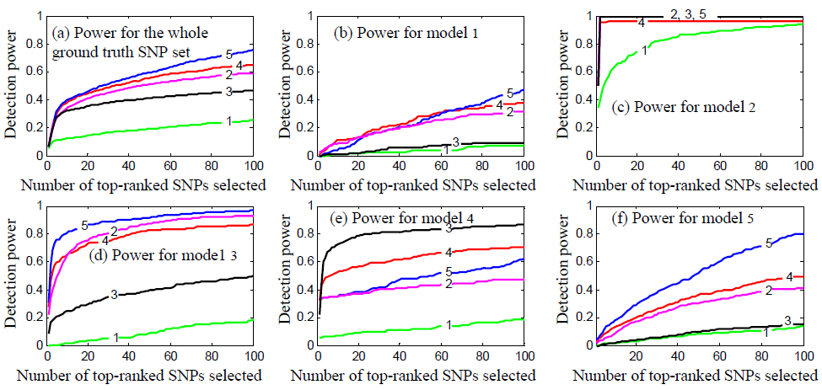
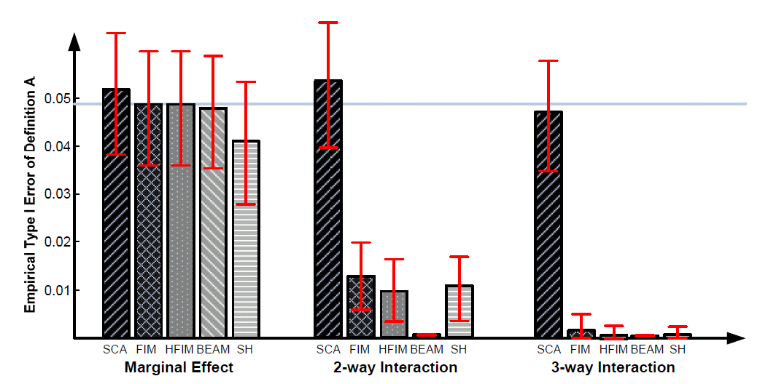
Power of most contemporary techniques varies considerably by type of interaction and technique.
Most contemporary methods grossly over estimate type I error for interactions.

Slide 33
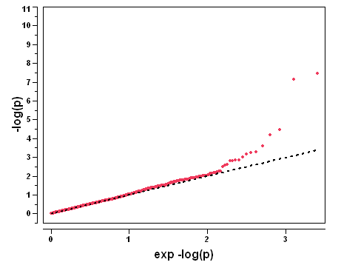
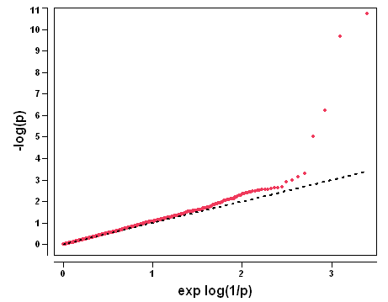
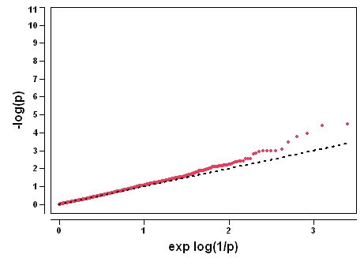
Phase III SNPs with Coronary Calcium in MESA
CAC (Y/N)
Adj age, sex, PC1, PC2, PC3
GC Lambda = 1.002
Ln(AGAT+1)
Adj age, sex, PC1, PC2, PC3
GC Lambda = 1.024
Ln(AGAT+1), AGAT>0
Adj age, sex, PC1, PC2, PC3
GC Lambda = 1.000
*

Slide 34
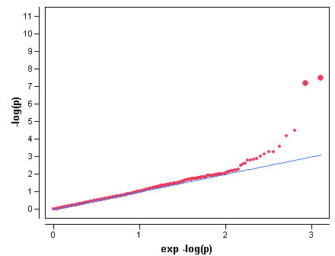
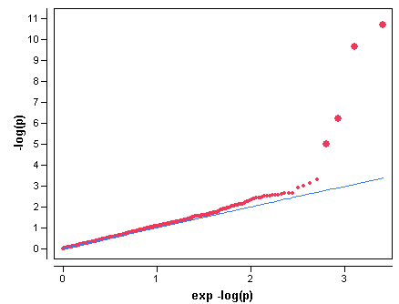

Phase III SNPs with Coronary Calcium in MESA
CAC (Y/N)
Adj age, sex, PC1, PC2, PC3
GC Lambda = 1.002
Ln(AGAT+1)
Adj age, sex, PC1, PC2, PC3
GC Lambda = 1.024
Ln(AGAT+1), AGAT>0
Adj age, sex, PC1, PC2, PC3
GC Lambda = 1.000
Bold dots are 9p21 loci

Slide 35


Correlation Between Pooled and Individual Genotyping Results in SEA

Slide 36
Association of SNPs with Premature Atherosclerosis in the PDAY Cohort

Slide 37
Phase III SNPs Associated with CAC (Y/N) in MESA
MARKER | CHR | POSITION | NEARGENEU | NEARGENED | GENE NAME | DESCRIPTION | RISK | FUNCTION | CpGISLAND | VARIATION
rs4977574 | 9 | 22088574 | 358.265 kb from DMRTA1 | 79.262 kb from CDKN2B |  |  | 0 | N/A | 0
rs1333049 | 9 | 22115503 | 331.336 kb from DMRTA1 | 106.191 kb from CDKN2B |  |  | 0 | N/A | 0
rs12412348 | 10 | 60550415 | 385.932 kb from PHYHIPL | 73.124 kb from LOC728640 |  |  | 0 | N/A | 0 | CopyNumber
rs275240 | 6 | 4933270 | 62.01 kb from RPP40 | None within 500 kb |  |  | 0 | N/A | 15791 | CopyNumber
rs1246979 | 6 | 4936710 | 58.57 kb from RPP40 | None within 500 kb |  |  | 0 | N/A | 12351 | CopyNumber
rs1870712 | 3 | 133157408 |  |  | CPNE4 | copine IV | 3 | Intronic Enhancer | 0
rs547316 | 3 | 80813052 | None within 500 kb. | None within 500 kb |  |  | 0 | N/A | 0 | CopyNumber
rs17647684 | 5 | 29983522 | None within 500 kb. | None within 500 kb |  |  | 0 | N/A | 1019128
rs7865618 | 9 | 22021005 | 425.834 kb from DMRTA1 | 11.693 kb from CDKN2B |  |  | 0 | N/A | 0 | CopyNumber
rs7335989 | 13 | 72832486 | 450.008 kb from C13orf37 | 391.156 kb from DACH1 |  |  | 0 | N/A | 300115
rs1017621 | 5 | 29987934 | None within 500 kb. | None within 500 kb |  |  | 0 | N/A | 0
rs16964148 | 17 | 23374125 | None within 500 kb. | None within 500 kb |  |  | 0 | N/A | 0
rs16924197 | 8 | 59964002 |  |  | TOX | thymocyte selection-associated high mobility group box | 3 | Intronic Enhancer | 0
rs523096 | 9 | 22009129 | 437.71 kb from DMRTA1 | 14.639 kb from CDKN2A |  |  | 0 | N/A | 0 | CopyNumber
rs2456731 | 10 | 67823561 |  |  | CTNNA3 | catenin (cadherin-associated protein), alpha 3 | 3 | Intronic Enhancer | 1339494 | CopyNumber
rs1749147 | 6 | 4947736 |  |  | RPP40 | ribonuclease P/MRP 40kDa subunit | 0 | Intronic With No Known Function | 0 | CopyNumber
https://wakegen.phs.wfubmc.edu/public/snpdoc/

Slide 38
Phase III SNPs Associated with CAC (Y/N) in MESA
MARKER | CHR | POSITION | NEARGENEU | NEARGENED | GENE NAME | DESCRIPTION | RISK | FUNCTION | CpGISLAND | VARIATION
rs4977574 | 9 | 22088574 | 358.265 kb from DMRTA1 | 79.262 kb from CDKN2B |  |  | 0 | N/A | 0
rs1333049 | 9 | 22115503 | 331.336 kb from DMRTA1 | 106.191 kb from CDKN2B |  |  | 0 | N/A | 0
rs12412348 | 10 | 60550415 | 385.932 kb from PHYHIPL | 73.124 kb from LOC728640 |  |  | 0 | N/A | 0 | CopyNumber
rs275240 | 6 | 4933270 | 62.01 kb from RPP40 | None within 500 kb |  |  | 0 | N/A | 15791 | CopyNumber
rs1246979 | 6 | 4936710 | 58.57 kb from RPP40 | None within 500 kb |  |  | 0 | N/A | 12351 | CopyNumber
rs1870712 | 3 | 133157408 |  |  | CPNE4 | copine IV | 3 | Intronic Enhancer | 0
rs547316 | 3 | 80813052 | None within 500 kb. | None within 500 kb |  |  | 0 | N/A | 0 | CopyNumber
rs17647684 | 5 | 29983522 | None within 500 kb. | None within 500 kb |  |  | 0 | N/A | 1019128
rs7865618 | 9 | 22021005 | 425.834 kb from DMRTA1 | 11.693 kb from CDKN2B |  |  | 0 | N/A | 0 | CopyNumber
rs7335989 | 13 | 72832486 | 450.008 kb from C13orf37 | 391.156 kb from DACH1 |  |  | 0 | N/A | 300115
rs1017621 | 5 | 29987934 | None within 500 kb. | None within 500 kb |  |  | 0 | N/A | 0
rs16964148 | 17 | 23374125 | None within 500 kb. | None within 500 kb |  |  | 0 | N/A | 0
rs16924197 | 8 | 59964002 |  |  | TOX | thymocyte selection-associated high mobility group box | 3 | Intronic Enhancer | 0
rs523096 | 9 | 22009129 | 437.71 kb from DMRTA1 | 14.639 kb from CDKN2A |  |  | 0 | N/A | 0 | CopyNumber
rs2456731 | 10 | 67823561 |  |  | CTNNA3 | catenin (cadherin-associated protein), alpha 3 | 3 | Intronic Enhancer | 1339494 | CopyNumber
rs1749147 | 6 | 4947736 |  |  | RPP40 | ribonuclease P/MRP 40kDa subunit | 0 | Intronic With No Known Function | 0 | CopyNumber
https://wakegen.phs.wfubmc.edu/public/snpdoc/

Slide 39


Slide 40

Phase III SNPs Below the Bonferroni Significance Threshold
CAC (Y/N)
Adj for site, age, gender, PC1-PC3
GC Lambda = 1.002
9p21
????

Slide 41
Phase III SNPs Associated with CAC (Y/N) in MESA
MARKER | CHR | POSITION | NEARGENEU | NEARGENED | GENE NAME | DESCRIPTION | RISK | FUNCTION | CpGISLAND | VARIATION
rs4977574 | 9 | 22088574 | 358.265 kb from DMRTA1 | 79.262 kb from CDKN2B |  |  | 0 | N/A | 0
rs1333049 | 9 | 22115503 | 331.336 kb from DMRTA1 | 106.191 kb from CDKN2B |  |  | 0 | N/A | 0
rs12412348 | 10 | 60550415 | 385.932 kb from PHYHIPL | 73.124 kb from LOC728640 |  |  | 0 | N/A | 0 | CopyNumber
rs275240 | 6 | 4933270 | 62.01 kb from RPP40 | None within 500 kb |  |  | 0 | N/A | 15791 | CopyNumber
rs1246979 | 6 | 4936710 | 58.57 kb from RPP40 | None within 500 kb |  |  | 0 | N/A | 12351 | CopyNumber
rs1870712 | 3 | 133157408 |  |  | CPNE4 | copine IV | 3 | Intronic Enhancer | 0
rs547316 | 3 | 80813052 | None within 500 kb. | None within 500 kb |  |  | 0 | N/A | 0 | CopyNumber
rs17647684 | 5 | 29983522 | None within 500 kb. | None within 500 kb |  |  | 0 | N/A | 1019128
rs7865618 | 9 | 22021005 | 425.834 kb from DMRTA1 | 11.693 kb from CDKN2B |  |  | 0 | N/A | 0 | CopyNumber
rs7335989 | 13 | 72832486 | 450.008 kb from C13orf37 | 391.156 kb from DACH1 |  |  | 0 | N/A | 300115
rs1017621 | 5 | 29987934 | None within 500 kb. | None within 500 kb |  |  | 0 | N/A | 0
rs16964148 | 17 | 23374125 | None within 500 kb. | None within 500 kb |  |  | 0 | N/A | 0
rs16924197 | 8 | 59964002 |  |  | TOX | thymocyte selection-associated high mobility group box | 3 | Intronic Enhancer | 0
rs523096 | 9 | 22009129 | 437.71 kb from DMRTA1 | 14.639 kb from CDKN2A |  |  | 0 | N/A | 0 | CopyNumber
rs2456731 | 10 | 67823561 |  |  | CTNNA3 | catenin (cadherin-associated protein), alpha 3 | 3 | Intronic Enhancer | 1339494 | CopyNumber
rs1749147 | 6 | 4947736 |  |  | RPP40 | ribonuclease P/MRP 40kDa subunit | 0 | Intronic With No Known Function | 0 | CopyNumber
https://wakegen.phs.wfubmc.edu/public/snpdoc/

Slide 42


Slide 43


Slide 44


Phase III SNPs Associated with CAC (Y/N) in MESA HC3 (EUA) and HC1 (AA) Subjects
CAC (Y/N)
Adj age, sex, PC1-PC3
GC Lambda = 1.002
CAC (Y/N) HC3 (EUA)
Adj age, sex, HC3PC1-HCPC5
GC Lambda = 1.035
CAC (Y/N) HC1 (AA)
Adj age, sex, HC1PC1-HC1PC5
GC Lambda = 1.058

Slide 45


Slide 46


Slide 47

Phase III SNPs Associated with CAC (Y/N) in MESA HC3 (EUA) and HC1 (AA) Subjects
CAC (Y/N)
Adj age, sex, PC1-PC3
GC Lambda = 1.002
CAC (Y/N) HC3 (EUA)
Adj age, sex, HC3PC1-HCPC5
GC Lambda = 1.035
CAC (Y/N) HC1 (AA)
Adj age, sex, HC1PC1-HC1PC5
GC Lambda = 1.058
???

Slide 48
Phase III SNPs Associated with CAC (Y/N) in MESA HC1 (AA)
MARKER | CHR | POSITION | NEARGENEU | NEARGENED | GENENAME | DESCRIPTION | RISK | FUNCTION | CpGISLAND | VARIATION
rs17090062 | 18 | 51914022 |  |  | LOC727961 | hCG1776047 | 0 | Intronic With No Known Function | 0 | CopyNumber
rs17043605 | 12 | 76351132 | 68.095 kb from PHLDA1 | 445.714 kb from KRR1 |  |  | 0 | N/A | 0
rs569772 | 18 | 62458651 | None within 500 kb. | None within 500 kb |  |  | 0 | N/A | 0
rs16964148 | 17 | 23374125 | None within 500 kb. | None within 500 kb |  |  | 0 | N/A | 0
rs512743 | 18 | 62455609 | None within 500 kb. | None within 500 kb |  |  | 0 | N/A | 0
rs17647684 | 5 | 29983522 | None within 500 kb. | None within 500 kb |  |  | 0 | N/A | 1019128
rs12912393 | 15 | 69540196 |  |  | THSD4 | thrombospondin, type I, domain containing 4 | 3 | Intronic Enhancer | 0
rs6746075 | 2 | 75568444 | 150.999 kb from FAM176A | 141.799 kb from TACR1 |  |  | 0 | N/A | 0 | CopyNumber
rs1017621 | 5 | 29987934 | None within 500 kb. | None within 500 kb |  |  | 0 | N/A | 0
https://wakegen.phs.wfubmc.edu/public/snpdoc/

Slide 49



Phase III SNPs and Various Athero Phenotypes
(bold dots are 9p21)
Ln(AGAT+1)
GC Lambda = 1.024
Ln(MaxInt)
GC Lambda = 1.010
ABI
GC Lambda = 1.000
Athero Score
GC Lambda = 1.000

Slide 50



Phase III SNPs and Max Int. IMT Overall and for HC1 (AA) and HC3 (EUA)
MaxInt Overall
GC Lambda = 1.010
MaxInt HC3 (EUA)
GC Lambda = 1.0711
MaxInt HC1 (AA)
GC Lambda = 1.0376

Slide 51
Phase III SNPs and Max Int. IMT Overall and for HC1 (AA) and HC3 (EUA)
MaxInt Overall
GC Lambda = 1.010
MaxInt HC3 (EUA)
GC Lambda = 1.0711
MaxInt HC1 (AA)
GC Lambda = 1.0376
MARKER | CHR | POSITION | NEARGENEU | NEARGENED | GENENAME | DESCRIPTION | RISK | FUNCTION | CpGISLAND | VARIATION
rs11624849 | 14 | 21124193 | 28.142 kb from ANG | 14.343 kb from OR6S1 |  |  | 0 | N/A | 0 | CopyNumber
rs11624979 | 14 | 21124558 | 27.777 kb from ANG | 14.708 kb from OR6S1 |  |  | 0 | N/A | 0 | CopyNumber
rs4888416 | 16 | 74006678 |  |  | CFDP1 | craniofacial development protein 1 | 0 | Intronic With No Known Function | 17673 | CopyNumber
rs7188604 | 16 | 74008672 |  |  | CFDP1 | craniofacial development protein 1 | 0 | Intronic With No Known Function | 15679 | CopyNumber

Slide 52

Overall IMT Hits

Slide 53

EUA IMT Hits

Slide 54

Phase III SNPs and Aortic Diameter in MESA (N=3401)

Slide 55

Aortic Diameter

Slide 56

Exome Sequencing for the Early MI Phenotype
Objective: To detect low-frequency and rare variants associated with early-onset MI, 266 cases with early MI and 303 controls free of MI are being sequenced across the exome in the NHLBI Exome Sequencing Program Early MI Project.
Cohort Participants:
Framingham Heart Study HARPS
ARIC Triumph
JHU Penn

Slide 57




Figure 1: Rare variants identified by resequencing GWAS-identified genes in individuals with HTG and controls.
From Excess of rare variants in genes identified by genome-wide association study of hypertriglyceridemia
Christopher T Johansen, Jian Wang, Matthew B Lanktree, Henian Cao, Adam D McIntyre, Matthew R Ban, Rebecca A Martins, Brooke A Kennedy, Reina G Hassell, Maartje E Visser,
Stephen M Schwartz, Benjamin F Voight, Roberto Elosua, Veikko Salomaa, Christopher J O'Donnell, Geesje M Dallinga-Thie, Sonia S Anand, Salim Yusuf, Murray W Huff,
Sekar Kathiresan & Robert A Hegele Journal name: Nature Genetics Volume: 42, Pages: 684–687 Year published: (2010) DOI: doi:10.1038/ng.628
“A significant accumulation of rare variants was identified in individuals with HTG including 154 total variants in 438 HTG diploid genomes, compared to 53 total variants in 327 control diploid genomes (P = 6.2 × 10⁻⁸).”

Slide 58





Opportunities for Progress: Greater Social and Environmental Specificity
Example: NIEHS Exposure Biology Program

Slide 59



…Subsequently, the whole body of current genetics theory, even when it deals with sequence and expression data, relies on gene action concepts that do not provide any information about the functional dependency between the two alleles composing each genotype.

Slide 60

Corollary to Moore’s Law: Exponential Gains in Sequencing and Genotyping Capacity

Slide 61
The Increasing Dominance of
Teams in Production of Knowledge
Stefan Wuchty, Benjamin F. Jones, Brian Uzzi
1036 18 MAY 2007 VOL 316 SCIENCE
“None of us are as good as all of us” – anonymous

Slide 62
National Health Expenditures
Actual and Projected: 1965-2019
public

Slide 63
National Health Expenditures
Actual and Projected: 1965-2019
Reducing pubic expenditures
is our obligation,
Reducing private expenditures
is our opportunity
private
public

Slide 64

Individual Variability in Clinical Medicine
“Variability is the law of life, and as no two faces are the same, so no two bodies are alike, and no two individuals react alike, …” Sir William Osler,1904

Slide 66
Perisotin
a 90 kDa secreted homophilic cell adhesion protein (matricellular protein)
Expression during fetal development
  connective tissues including the periodontal ligament, tendons, skin and bone, cardiac structures
Expression during adult life
  wound repair
  neoplastic tissues,
  cardiovascular disease

Slide 67
Known Effects of Matricellular Proteins Cell Physiology
Cell adhesion
Cell de-adhesion
ECM synthesis
Collagen fibrillogenesis
Proliferation
Apoptosis
Differentiation
De-differentiation
Migration
Growth factor production
Morphology
Biomineralization

Slide 68


Fig. 1. A: Northern blot analysis of total RNA isolated from vascular smooth muscle cells (VSMCs) probed with radioactively labeled periostin-like factor (PLF) cDNA
Litvin, J. et al. Am J Physiol Cell Physiol 292: C1672-C1680 2007;
doi:10.1152/ajpcell.00153.2006
Copyright ©2007 American Physiological Society

Slide 69

Common variants at ten loci influence QT interval duration in the QTGEN Study
Newton-Cheh Nature Genetics 2009
p = 0.000000000000001
NOS1AP
Nature Genetics 41, 399 - 406 (2009)

Slide 70
Exome Sequencing for the Early MI Phenotype
Objective: To detect low-frequency and rare variants associated with early-onset MI, 266 cases with early MI and 303 controls free of MI are being sequenced across the exome in the NHLBI Exome Sequencing Program Early MI Project.
Cohort Participants:
Framingham Heart Study HARPS
ARIC Triumph
JHU Penn

Slide 71

Periostin and periostin-like factor in the human heart: possible therapeutic targets
Fig. 4. Sectioned human left ventricle was immunoreacted with anti-PLF antibody. (A) nonfailing muscle (200×), (B) ischemic muscle (200×), (C) idiopathic muscle (600×). *Located in the lumen of blood vessel.
Litvin et alCardiovascular Pathology2006

Slide 72

Linkage of AGATP in MESA Family – AA Sample, Variance Component Analysis
POSTN

Slide 73
Prevalence of the 312 POSTN SNP Minor Allele (G) in Cases and Controls by Ethnicity
Overall p~ 1x10⁻⁵
P=0.004

Slide 74

Odds of Premature Atherosclerosis by POSTN 312 A/G in the SEA Study

Slide 75


SEA, Imputed SEA, Framingham and Welcome Trust POSTN SNPs

Slide 76
Opportunities:
Greater Molecular Specificity

Slide 77
Figure 1: Rare variants identified by resequencing GWAS-identified genes in individuals with HTG and controls.
From Excess of rare variants in genes identified by genome-wide association study of hypertriglyceridemia
Christopher T Johansen, Jian Wang, Matthew B Lanktree, Henian Cao, Adam D McIntyre, Matthew R Ban, Rebecca A Martins, Brooke A Kennedy, Reina G Hassell, Maartje E Visser,
Stephen M Schwartz, Benjamin F Voight, Roberto Elosua, Veikko Salomaa, Christopher J O'Donnell, Geesje M Dallinga-Thie, Sonia S Anand, Salim Yusuf, Murray W Huff,
Sekar Kathiresan & Robert A Hegele Journal name: Nature Genetics Volume: 42, Pages: 684–687 Year published: (2010) DOI: doi:10.1038/ng.628
“A significant accumulation of rare variants was identified in individuals with HTG including 154 total variants in 438 HTG diploid genomes, compared to 53 total variants in 327 control diploid genomes (P = 6.2 × 10⁻⁸).”

Slide 78
Opportunities for Progress: Greater Social and Environmental Specificity
Example: NIEHS Exposure Biology Program

Slide 79
Opportunities for Progress in Personalized Medicine:
phenotypic specificity
molecular specificity
social/environmental specificity
analytic sophistication

Slide 80


Slide 81
Two Keys for Success in the Future
Embrace collaboration

Slide 82
Two Keys for Success in the Future
Embrace collaboration
scientia potentia est (Knowledge is power) Sir Francis Bacon
…. or recognize that we live in an information age

Slide 83



POSTN SNPs & in silico replication
SEA – PDAY
Framingham (All athero)
Framingham (Hard athero)
Wellcome Trust (CAD)
P = 0.01
P = 0.05
CEU LD (r²)
YRI LD (r²)
Notes:
83

Slide 84
Promises of Genomics for Cardiovascular Medicine
Improve prediction of risk – allow more efficient targeting of interventions
Improve selection and dosing of pharmacologic interventions
Produce novel insights into the pathogenesis and prevention of disease that may lead to new and more effective interventions

Slide 85

Pharmacogenomics: barcode?

Slide 86
Models of Translational Team Science: Multi-disciplinary
Important medical
research question
Discipline A
Discipline B
Lexicon A
Lexicon B
Translation

Slide 88
Models of Translational Team Science: Inter/Trans-Disciplinary
Important medical
research question
Discipline A
Discipline B
Discipline C
New Lexicon
Translation

Slide 89
Opportunities for Future Progress: Greater Genetic Specificity
MESA Self Reported Ethnicity
African-Am: ■
Chinese: ■
European: ■
Hispanic: ■
MESA Self Reported Ethnicity
African-Am: ■
Chinese: ■
European: ■
Hispanic: ■

Slide 90
Re-classification of MESA subjects to genetic ancestral clusters based on PC1-10
MESA Hierarchical Clusters
HCluster1 (AA): ■
HCluster2 (CHN): ■
HCluster3 (EUA): ■
HCluster4 (HIS): ■
MESA Self Reported Ethnicity
African-Am: ■
Chinese: ■
European: ■
Hispanic: ■

Slide 91
Hierarchical Clustering of Phase III SNP
PC1-PC10 in MESA
MESA Hierarchical Clusters
HCluster1 (AA): ■
HCluster2 (CHN): ■
HCluster3 (EUA): ■
HCluster4 (HIS): ■

Slide 92


Slide 93

Variants in ZFHX3 associated with atrial fibrillation in individuals of European ancestry Benjamin et al. Nature Genetics 2009
A sequence variant in ZFHX3 associates with atrial fibrillation and ischemic stroke Gudbjartsson Nature Genetics 2009
ZFHX3
▪
▪
▪
▪
▪
▪
▪
Benjamin et. al. 2009

Slide 94

Evaluating Drug Treatment Effects
Mutations in MiRP1 that increase risk for drug induced torsades de pointes
Effects of the G-protein
subunit C825T Variant on
Response to Thiazide Diuretic
p = 0.01
Drug safety
-5
genetic
variation
Diastolic BP (mmHg)
-10
Drug efficacy
CC CT TT
Turner et.al. HTN 2001
Sesti et.al. PNAS 2000

Slide 95
Evaluating Drug Treatment Effects
p = 0.01
Drug safety
genetic
variation
Drug efficacy

Slide 96
Long-term Clopidogrel Following PCI for UA/NSTEMI (AHA/ACC I/B)
MI/CV Deaths (%)
PCI-Cure
N = 2,358
12 month f-up
1° outcome:MI/CV Death
RRR = .72
ARR = 3.8%
NNT = 26
Cost/event saved $31K(US)
Mehta et al. Lancet 2001

Slide 97



Slide 98

Principle Component Analysis of Phase III SNP Data in MESA
MESA Self Reported Ethnicity
African-Am: ■
Chinese: ■
European: ■
Hispanic: ■

Slide 99
Staged Strategy for Identification of SNPs
Associated with Atherosclerosis
Pooled genotyping
Individual level genotyping
>2,000,000 SNPs
120,000 SNPs*
~ 1500 SNPs*
cases
N=300
cases
N=350
MESA
N = 6500
PDAY pools
PDAY subjects
controls
N=500
controls
N=750
*Framingham in-silico replication/meta analysis
** replication of other cohort SNPs

Slide 100






Evolving Public Health Challenges
Acute to Complex Chronic Conditions
Aging Population
Health Disparities
Emerging Diseases
Biodefense
Adapted from E Zerhouni 2004

Slide 101
What is the ROI for US Health Expenditures??

Slide 102
Association of MESA Athero Sub-Phenotypes with rs1333049 (9p21)

Slide 103
Staged Strategy for Identification of SNPs
Associated with Atherosclerosis
Pooled genotyping
Individual level genotyping
~2,000,000 SNPs
120,000 SNPs*
~ 1500 SNPs*
cases
N=300
cases
N=350
MESA
N = 6500
PDAY pools
PDAY subjects
controls
N=500
controls
N=750
*Framingham in-silico replication/meta analysis
** replication of other cohort SNPs

Slide 104
Combined races, PC-adjusted p-values
8.2 kb from ENPP6
LOC728460
FLRT2 fibronectin leucine rich transmembrane protein 2
124.8 kb from SEMA3E
POSTN periostin, osteoblast specific factor
463.5 kb from SPAG17
162.9 kb from ZHX2
1
2
3
4
5
6
7
8
9
10
11
12
13
14
15
16
17
18
19
20
X
21
22
Chromosome
Notes:
104

Slide 105
Staged Strategy for Identification of SNPs
Associated with Atherosclerosis
Pooled genotyping
Individual level genotyping
~2,000,000 SNPs
120,000 SNPs*
~ 1500 SNPs*
cases
N=300
cases
N=350
MESA
N = 6500
PDAY pools
PDAY subjects
controls
N=500
controls
N=750
*Framingham in-silico replication/meta analysis
** replication of other cohort SNPs

Slide 106
Phase III SNPs Associated with CAC (Y/N) in MESA
MARKER | CHR | POSITION | NEARGENEU | NEARGENED | GENE NAME | DESCRIPTION | RISK | FUNCTION | CpGISLAND | VARIATION
rs4977574 | 9 | 22088574 | 358.265 kb from DMRTA1 | 79.262 kb from CDKN2B |  |  | 0 | N/A | 0
rs1333049 | 9 | 22115503 | 331.336 kb from DMRTA1 | 106.191 kb from CDKN2B |  |  | 0 | N/A | 0
rs12412348 | 10 | 60550415 | 385.932 kb from PHYHIPL | 73.124 kb from LOC728640 |  |  | 0 | N/A | 0 | CopyNumber
rs275240 | 6 | 4933270 | 62.01 kb from RPP40 | None within 500 kb |  |  | 0 | N/A | 15791 | CopyNumber
rs1246979 | 6 | 4936710 | 58.57 kb from RPP40 | None within 500 kb |  |  | 0 | N/A | 12351 | CopyNumber
rs1870712 | 3 | 133157408 |  |  | CPNE4 | copine IV | 3 | Intronic Enhancer | 0
rs547316 | 3 | 80813052 | None within 500 kb. | None within 500 kb |  |  | 0 | N/A | 0 | CopyNumber
rs17647684 | 5 | 29983522 | None within 500 kb. | None within 500 kb |  |  | 0 | N/A | 1019128
rs7865618 | 9 | 22021005 | 425.834 kb from DMRTA1 | 11.693 kb from CDKN2B |  |  | 0 | N/A | 0 | CopyNumber
rs7335989 | 13 | 72832486 | 450.008 kb from C13orf37 | 391.156 kb from DACH1 |  |  | 0 | N/A | 300115
rs1017621 | 5 | 29987934 | None within 500 kb. | None within 500 kb |  |  | 0 | N/A | 0
rs16964148 | 17 | 23374125 | None within 500 kb. | None within 500 kb |  |  | 0 | N/A | 0
rs16924197 | 8 | 59964002 |  |  | TOX | thymocyte selection-associated high mobility group box | 3 | Intronic Enhancer | 0
rs523096 | 9 | 22009129 | 437.71 kb from DMRTA1 | 14.639 kb from CDKN2A |  |  | 0 | N/A | 0 | CopyNumber
rs2456731 | 10 | 67823561 |  |  | CTNNA3 | catenin (cadherin-associated protein), alpha 3 | 3 | Intronic Enhancer | 1339494 | CopyNumber
rs1749147 | 6 | 4947736 |  |  | RPP40 | ribonuclease P/MRP 40kDa subunit | 0 | Intronic With No Known Function | 0 | CopyNumber
https://wakegen.phs.wfubmc.edu/public/snpdoc/

Slide 107

Ternary plot of uncorrelated Phase III SNPs on HapMap Data
(release 23, NCBI build 36)

Slide 108

Ternary plot of Structure probabilities and 3-D plot of MESA PC1-PC3

Slide 109
Distribution of Hispanics by Genetic Ancestry in MESA
MESA Self Reported Ethnicity
African-Am: ■
Chinese: ■
European: ■
Hispanic: ■
MESA Self Reported Ethnicity
African-Am: ■
Chinese: ■
European: ■
Hispanic: ■

Slide 110
Principle Component Analysis of Phase III SNP Data in MESA
MESA Self Reported Ethnicity
African-Am: ■
Chinese: ■
European: ■
Hispanic: ■

Slide 111
Hierarchical Clustering of Phase III SNP
PC1-PC10 in MESA
MESA Hierarchical Clusters
HCluster1 (AA): ■
HCluster2 (CHN): ■
HCluster3 (EUA): ■
HCluster4 (HIS): ■

Slide 112
Re-classification of MESA subjects to genetic ancestral clusters based on PC1-10
MESA Hierarchical Clusters
HCluster1 (AA): ■
HCluster2 (CHN): ■
HCluster3 (EUA): ■
HCluster4 (HIS): ■
MESA Self Reported Ethnicity
African-Am: ■
Chinese: ■
European: ■
Hispanic: ■

Slide 113
2:1 Frequency Matching For Controls Based on Race, Sex …
 | Cases (N=361) | Controls (N=674)
Black | 177 (49%) | 325 (48%)
White | 184 (51%) | 349 (52%)
Female | 76 (21%) | 140 (21%)
Male | 285 (79%) | 534 (79%)

Slide 114
… and Age
 | Cases (N=361) | Controls (N=674)
15-19 yrs | 28 (8%) | 56 (8%)
20-24 yrs | 55 (15%) | 104 (15%)
25-29 yrs | 134 (37%) | 276 (41%)
30-35 yrs | 144 (40%) | 238 (35%)

Slide 115
300% increase from 1960 to 2008

Slide 116
National Health Expenditures
Actual and Projected: 1965-2019
Challenge: How to change the trajectory of
this pattern of escalating health expenditures?
→ comparable health outcomes at lower cost
→ improve the ROI on our health care dollars
→ achieve greater health care efficiency
Centers for Medicare & Medicaid Services, Jan 2010

Slide 117
Relative and Absolute Risk Reductions in HPS and AF/TX CAPS
RR = 0.78
ARR = 1.08%
NNT = 92
RR = 0.62
ARR = 0.41%
NNT = 243

Slide 118
Relative and Absolute Risk Reductions in HPS and AF/TX CAPS

Slide 119


Winston Churchill, the Canonical Coronary Disease Resistance Phenotype
Winston Churchill 1945
Jim Fixx 1984

Slide 120
National Health Expenditures
Actual and Projected: 1965-2019
US Statin Utilization, 2005:
29.7 million users
$19.7 billion total outpatient
Source: Center for Financing, Access, and Cost Trends, AHRQ, Household Component of the Medical Expenditure Panel Survey, 2000 and 2005

Slide 121
Results From a Typical Randomized Clinical Trial
Mutations in MiRP1 that increase risk for drug induced torsades de pointes
Effects of the G-protein
subunit C825T Variant on
Response to Thiazide Diuretic
p = 0.01
“Variation is absolute, and in physiology averages give nothing real.”
Claude Bernard
Cahier Rouge, 1860
Drug safety
-5
genetic
variation
Diastolic BP (mmHg)
-10
Drug efficacy
CC CT TT
Turner et.al. HTN 2001
Sesti et.al. PNAS 2000

Slide 122
Genome-Wide Association Publications by Year: 2000-2009

Slide 123


Genome-wide Associations Reported through March 2010.
Feero WG et al. N Engl J Med 2010;363:166-176.
Notes:
123
Figure 3. Genomewide Associations Reported through March 2010. Circles indicate the chromosomal location of nearly 800 single-nucleotide polymorphisms (SNPs) significantly associated (P<5×10−8) with a disease or trait and reported in the literature (545 studies published through March 2010 yielded the associations depicted). Each disease type or trait is coded by color. Adapted from the National Human Genome Research Institute. 4

Slide 124


Lessons Learned From Initial GWA Studies
Signals in Previously Unsuspected Genes
Macular Degeneration CFH
Coronary Disease CDKN2A/2B
Childhood Asthma ORMDL3
Type II Diabetes CDKAL1
QT Duration NOS1AP
Signals in Gene “Deserts”
Prostate Cancer 8p24
Crohn’s Disease 5p13.1, 1q31.2, 10p21
Signals in Common
Diabetes, CHD, Melanoma, Frailty CDKN2A/2B
Prostate, Breast, Colorectal Cancer 8q24 Region
Crohn’s Disease, Psoriasis IL23R
Crohn’s Disease, Diabetes PTPN2
Rheumatoid Arthritis PTPN22
Adapted from Manolio 2009

Slide 125


Slide 126

Distribution of ORs from the Genome-wide
Association Studies

Slide 127



Consumer Genomics Hype
Saliva or buccal swab
~ 1M SNPs
$400-$2500
“making you aware of risks so
that you and your doctor can
make better decisions to detect
health conditions early, reduce
their effects, or prevent them
entirely”

Slide 128
Staged Strategy for Identification of SNPs
Associated with Atherosclerosis in SEA
Pooled genotyping
Individual level genotyping
~2,500,000 SNPs
120,000 SNPs*
~ 3000 SNPs*
cases
N=300
cases
N=350
MESA
N = 6500
PDAY pools
PDAY subjects
controls
N=500
controls
N=750
*Framingham in-silico replication/meta analysis
** replication of other cohort SNPs

Slide 129
Staged Strategy for Identification of SNPs
Associated with Atherosclerosis
Pooled genotyping
Individual level genotyping
~2,000,000 SNPs
120,000 SNPs*
~ 3000 SNPs*
cases
N=300
cases
N=350
MESA
N = 6500
PDAY pools
PDAY subjects
controls
N=500
controls
N=750
*Framingham in-silico replication/meta analysis
** replication of other cohort SNPs

