Slide 1
Health Care Use, Treatment, and Outcomes of Atrial Fibrillation Analyses Using CMS data
Susan R. Heckbert, MD, PhD
University of Washington

Slide 2
Analyses using CMS data
Methods
Strengths & limitations
Application in MESA
Applications outside MESA
Medicare 5% sample, 100% sample
CHS and Framingham Heart Study

Slide 3
Grant support
R01: Patterns of health care use, treatment, & outcomes in atrial fibrillation: PATH-AF
PIs: Lesley Curtis, Susan Heckbert, Emelia Benjamin
Data sources
5% Medicare sample
100% Medicare sample
MarketScan
CHS, Framingham

Slide 4
Other support
Subcontracts with Coordinating Centers
Lesley Curtis, Brad Hammill at Duke U
Cohorts
MESA
CHS
Framingham
Jackson Heart Study
ARIC to be added

Slide 5
Atrial fibrillation
Most common chronic arrhythmia
Affected 3 million Americans in 2010
Responsible for considerable morbidity and health care cost
Relatively little information from large population-based studies on health care use, treatment, or outcomes

Slide 6
MESA events ascertainment
Self-report of all hospitalizations at each MESA contact (every 9-12 months)
Obtain discharge summaries, discharge diagnoses, ICD-9 codes for all hospitalizations
For CV codes (including AF codes), obtain admission H&P, ECGs, echocardiography report
AF not an adjudicated outcome

Slide 7
Validity of inpatient ICD-9 codes
CHS¹ PPV = 209/212 = 99%
ARIC² PPV = 111/125 = 89%
MESA PPV = 43/45 = 96%
Sensitivity
CHS: among 314 ppts reviewed for CV events, 29 of 41 (71%) with AF were identified by ICD-9 codes
ARIC: among ppts reviewed for stroke events, 135 of 161 (84%) with AF were identified by ICD-9 codes
¹ Psaty BM. Circulation 1997;96:2455 ² Alonso A. Am Heart H 2009;158:111
Notes:
CHS used 427.3, 427.31, & 427.32
ARIC used 427.31 only
MESA used 427.31 or 427.32

Slide 8
What about AF diagnosed and managed as an outpatient?
40 – 70% of initial AF episodes are managed in the outpatient setting
age- and comorbidity-dependent

Slide 9
Validity of self-reported outpatient AF
MESA
At each MESA contact (every 9-12 months):
“Since our last telephone interview with you, has a doctor told you that you had atrial fibrillation?”
If “Yes”, name & address of doctor seen
PPV = 13/26 = 50%

Slide 10
Medicare claims data
Inpatient claims
Outpatient facility claims
Physician services claims (Carrier)
Fee-for-service (FFS) Medicare
Medicare managed care plans
Notes:
Other files include: Home health care, Skilled nursing services; Hospice, Durable medical equipment, Prescription medications

Slide 11
Medicare fee-for-service (FFS)
Only FFS enrollees will have claims
How to define enrollment in FFS?
Enrolled in Medicare Parts A & B
Not enrolled in a Medicare managed care plan
People can enroll & disenroll in FFS
Often examine only the first period of FFS enrollment

Slide 12
CMS data: Decisions
For selecting date of inpatient claims:
Use admission date or discharge date?
Require 1 or more than 1 AF codes?
Primary code vs. any code for AF?
Include atrial fibrillation & atrial flutter?
How to determine prevalent AF?
Previous ICD-9 codes; for how long?

Slide 13
Defining incident AF in MESA
MESA events/hospitalization ascertainment
Inpatient discharge codes
[Self-report of outpatient AF]
MESA Exam ECGs – only at Exams 1 & 5
CMS diagnoses of AF
Inpatient
Outpatient

Slide 14
CMS data: Definition of incident AF
ICD-9 code 427.31 (AF) or 427.32 (a flutter), any position
AF defined by:
1 inpatient AF claim OR
2 outpatient or carrier AF claims not on the same day & within 365 days of one another (location = office, home, SNF, nursing facility, or custodial care facility)
Exclude participants with AF before baseline
Date of incident AF is earliest of:
Admission date of hospitalization with AF code
Service date of the 2nd outpatient/carrier AF claim

Slide 15
Limitations – general
Imperfect sensitivity & specificity of ICD-9 codes
Can’t distinguish pre-existing conditions from complications
Need a “look-back” period
Financial incentives affect coding
Changes in coding over time
People who enroll in FFS Medicare may be less healthy than those in Medicare managed care plans

Slide 16
Limitations in MESA
MESA participants were ages 45-84 in 2000-02; no CMS data until age 65
CMS data only available since 2000

Slide 17
Applications in MESA
Risk of incident AF in relation to:
Race/ethnicity
Analytes – neurohormones, minerals
ECG and imaging measures
Genetic variation

Slide 18
Applications outside MESA
Medicare FFS beneficiaries
AF incidence & associated mortality, 1993-2007
Catheter ablation for AF, 2007-2009
Initial evaluation of patients with new-onset AF
Notes:
Ongoing: Validation of incident AF in Framingham Heart Study

Slide 19
AF incidence & associated mortality, 1993-2007
Jon Piccini, Duke Clinical Research Institute
5% sample of US Medicare FFS beneficiaries
433,000 patients with incident AF
Median age 80 years (IQR 74,86)
45% women
92% white
Piccini JP.Circ Cardiovasc Qual Outcomes 2012;5:85-93

Slide 20
AF incidence, 1993-2008
Notes:
In this nationally representative 5% sample of Medicare beneficiaries, the age- and sex-adjusted incidence of AF declined slightly from 27.1 per 1000 person-years in 1993 to 24.3 per 1000 person-years in 2008 (P < .001). However, in general - the overall incidence rates remained relatively stable during the study period.
Effective October 2007, CMS discontinued the coding of AF as a “major complication or comorbidity”, a designation that could lead to greater reimbursement
Outpatient dxs rose from 26 to 34% over the study period.

Slide 21
Outcomes of Medicare beneficiaries undergoing catheter ablation for AF
Jon Piccini
100% sample of US Medicare FFS beneficiaries who underwent ablation, 7/2007 – 12/2009
Piccini JP.Circulation (in press)

Slide 22
Identification of AF ablation, comorbidity
Intracardiac catheter ablation with primary diagnosis of AF identified from carrier claims
Additional exclusions to improve specificity and avoid non-AF procedures:
Atrioventricular node ablation
Anomalous atrioventricular excitation
Paroxysmal supraventricular tachycardia
Comorbidity assessed by searching claims in the 6 months prior to ablation

Slide 23
Outcomes
30-day outcomes
Death
Stroke or TIA
Myocardial infarction
Pericardial effusion or tamponade
Vascular complication requiring surgery
1-year outcomes
Death
Stroke
Heart failure
Hospitalization
Repeat ablation

Slide 24
Patient Characteristics
N | 15,423
Age, years, mean (SD) | 72.0 (5.3)
Age groups
65-69 | 39.1%
70-74 | 32.1%
75-79 | 16.3%
≥80 | 12.4%
Female | 40.6%
Race/ethnicity
Black | 1.8%
White | 96.1%
Other | 2.1%
Notes:
More than 70% of the patients were under age 75.

Slide 25
Patient Characteristics
N | 15,423
Hypertension | 78%
Ischemic heart disease | 51%
Valvular heart disease | 39%
Heart failure | 26%
COPD | 25%
Diabetes mellitus | 24%
Peripheral vascular disease | 16%
Cerebrovascular disease | 14%
Cancer | 11%
Renal disease | 8%
Stroke/TIA | 6%
Dementia | 0.6%
CHADS₂ score ≥ 2 | 51%

Slide 26
Unadjusted 30-day outcomes
Outcome | Rate per 100 Beneficiaries
 | Overall | Age Group
 |  | 65-69 | 70-74 | 75-79 | ≥ 80
Death | 0.8 | 0.5 | 0.6 | 1.1 | 1.8
Myocardial infarction | 0.3 | — | — | 0.5 | 1.2
Pericardial effusion | 1.7 | 1.7 | 1.8 | 1.9 | 1.5
Stroke or TIA | 0.8 | 0.6 | 0.8 | 1.0 | 0.9
Vascular complication requiring surgery | 0.5 | 0.4 | 0.6 | — | 0.6
Notes:
Stroke or TIA calculated in the subset of patients with no stroke or TIA in any claim in the prior 6 months.

Slide 27
Unadjusted 1-year outcomes
Outcome | Rate per 100 Beneficiaries
Death | 3.8
Heart failure | 2.5
Stroke/TIA | 2.1
Hospitalization | 43.0
Repeat ablation | 10.9

Slide 28
Post-ablation mortality, by age

Slide 29
Post-ablation stroke, by age

Slide 30
Post-ablation hospitalization, by age
Notes:
Hospitalization within one year was common in all age groups; a diagnosis of AF or A flutter was present in fewer than 40% of these hospitalizations

Slide 31
Repeat ablation, by age

Slide 32
Conclusions
Death and major complications following AF ablation were fairly infrequent, but new hospitalization was common
Complications and death were strongly associated with increasing age
Younger patients were more likely to receive repeat ablation
Randomized trials are needed to better inform risk-benefit of AF ablation for elderly patients who have failed drug therapy

Slide 33
Ongoing analyses
Costs of care pre-AF vs. post-AF (CHS, FHS)
Disability-free survival following AF (CHS)
Functional impairment following AF (CHS)
Hip, arm, & pelvis fractures following AF (CHS)
Comparison of adjudicated AF vs. Medicare claims ascertained AF (FHS)

Slide 34
References
Piccini JP, Hammill BG, Sinner M, Jensen PN, Hernandez AF, Heckbert SR, Benjamin EJ, Curtis LH. Incidence and prevalence of atrial fibrillation and associated mortality among Medicare beneficiaries, 1993-2007. Circ Cardiovasc Qual Outcomes 2012;5:85-93. PMC3332107.
Piccini JP, Sinner MF, Greiner MA, Hernandez AF, Daniel J, Walkey A, Heckbert SR, Benjamin EJ, Curtis, LH. Outcomes of Medicare beneficiaries undergoing catheter ablation for atrial fibrillation. Circulation (in press).
Sinner MF, Greiner MS, Xiaojuan M, Hernandez AF, Jensen PN, Piccini PJ, Setoguchi S, Walkey AJ, Heckbert SR, Benjamin EJ, Curtis LH. Completion of guideline-recommended initial evaluation of atrial fibrillation among Medicare beneficiaries and commercially insured patients. Clin Cardiol (in press).
DiMartino LD, Hammill BG, Curtis LH, et al. External validity of the Cardiovascular Health Study: a comparison with the Medicare population. Med Care 2009;47:916-23.

Slide 36
AF incidence by age, 1993-2007
Notes:
Incidence increased substantially with age.

Slide 37
AF incidence by sex, 1993-2007
Notes:
Incidence was consistently higher among men

Slide 38
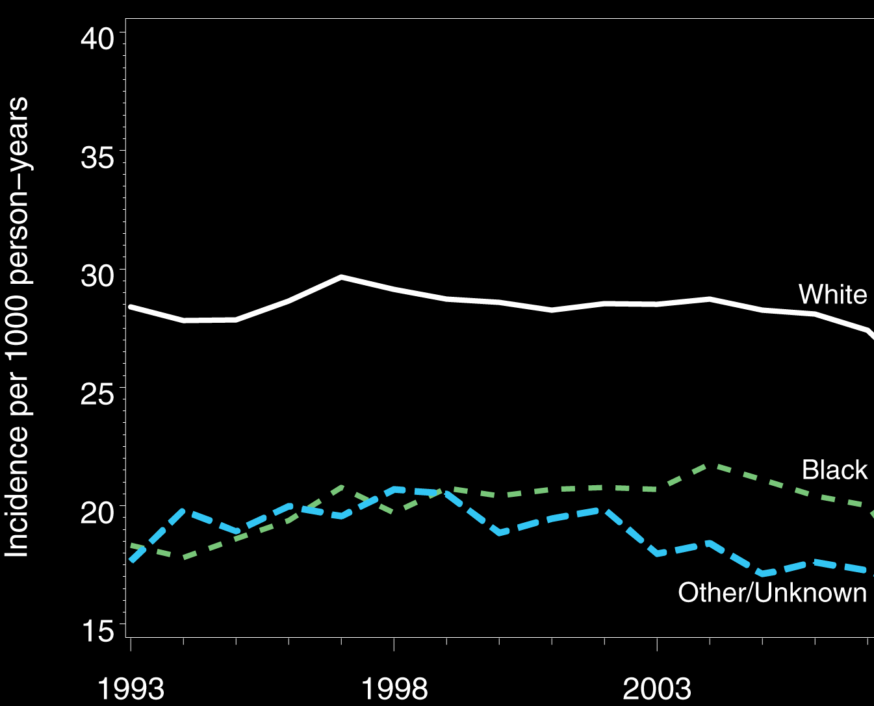
AF incidence by race, 1993-2007
Notes:
Incidence was consistently higher among white beneficiaries

Slide 39
AF Prevalence, 2993-2007
Notes:
Increased recognition; increased coding over time.

Slide 40
Mortality after incident AF (2007)
Notes:
Shown here is the 1-year mortality rate after incident diagnosis of AF in 2007, the last year for which complete 1-year follow-up data were available.
The 1-year mortality rate was 26.9%, or 3.4 times greater than the expected mortality.

Slide 41
Limitations & Strengths
Estimates from Medicare claims data are not directly comparable to medical record review
Comorbid conditions are not uniformly coded
Coding practices change over time
Estimates are derived from the largest payor for US elderly
Large sample size
For mortality, unbiased outcome, highly accurate

Slide 42
Conclusions
In the elderly, incident AF is common and has remained relatively stable for more than a decade.
Incident AF is associated with significant comorbidity and mortality
Death occurs in one-quarter of beneficiaries within 1 year after AF diagnosis

Slide 43
Limitations
Lack of comparison group
No specific code for AF ablation
Could not distinguish types of AF
Limited to FFS Medicare beneficiaries

