Slide 1
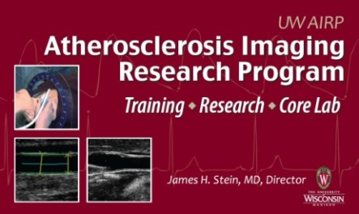
A Comparison of Coronary Artery Calcium Presence, Carotid Plaque Presence, and Carotid Intima-Media Thickness for Cardiovascular Disease Prediction in the Multi-Ethnic Study of Atherosclerosis (MESA)
Adam D. Gepner; Rebekah Young; Joseph C. Delaney; Matthew C. Tattersall; Michael J. Blaha; Wendy S. Post; Rebecca F. Gottesman; Richard Kronmal; Matthew J. Budoff; Gregory L. Burke; Aaron R. Folsom; Kiang Liu; Joel Kaufman; James H. Stein
Notes:
I would like to thank the moderators, Dr. Khera

Slide 2
A Comparison of Coronary Artery Calcium Presence, Carotid Plaque Presence, and Carotid Intima-Media Thickness for Cardiovascular Disease Prediction in the Multi-Ethnic Study of Atherosclerosis (MESA)
Adam D. Gepner; Rebekah Young; Joseph C. Delaney; Matthew C. Tattersall; Michael J. Blaha; Wendy S. Post; Rebecca F. Gottesman; Richard Kronmal; Matthew J. Budoff; Gregory L. Burke; Aaron R. Folsom; Kiang Liu; Joel Kaufman; James H. Stein
Notes:
I would like to thank the moderators, Dr. Khera

Slide 3
Background
Cardiovascular disease (CVD) is the leading cause of death in the US
First symptoms often are sudden cardiac death, MI, or stroke
Great interest in using imaging to detect pre-clinical vascular disease
Early diagnosis and treatment of subclinical disease could reduce the health burden of CVD

Slide 4
Arterial Imaging for Detecting Pre-Clinical Arterial Disease
Carotid ultrasound
Carotid intima-media thickness (IMT)
Carotid artery plaque (CAP) presence
Computed tomography (CT)
Coronary artery calcium (CAC) presence
CAC score

Slide 5
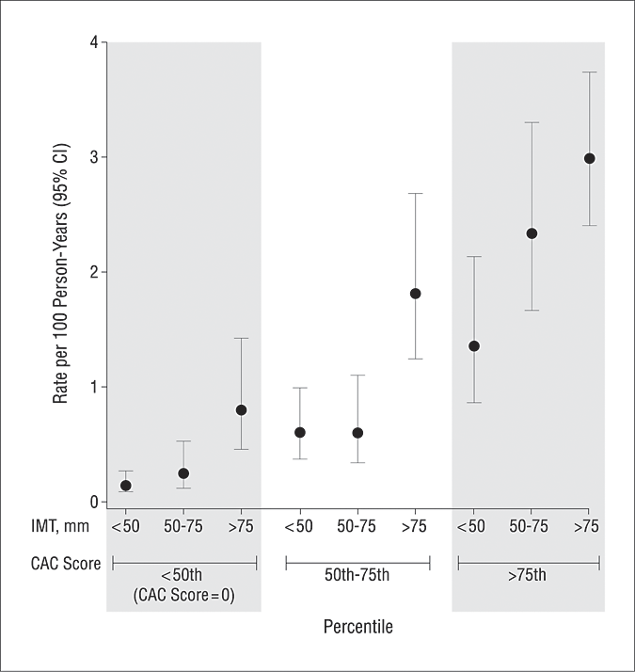
MESA: CVD Prediction with CIMT and CAC
N = 6698 adults
45 - 84 years old
Free of clinical CVD
5.3 years median f/up
N = 222 CVD events
159 CHD events
59 strokes
7 other CVD death
Folsom AR, et al. Arch Intern Med 2008;168:1333
Notes:
Table 1. Baseline Demographic Characteristics and Risk Factors According to Whether the Participant Had a Subsequent Coronary Event.

Slide 6
MESA: CVD Prediction with CIMT and CAC
Highest quartile CIMT predicted CVD events: adjusted HR 2.3 (1.4 – 3.8) to 3.8 (2.2 – 6.4)
Adjusted HR higher with CAC (6.0, 3.9 – 9.1)
Risk factors AUC = 0.772
RFs + CIMT AUC = 0.782
RFs + CAC AUC = 0.808
CIMT predicted stroke (HR_{SD} = 1.3, p=0.01), but CAC did not (HR_{SD} = 1.1, p=0.71)
Folsom AR, et al. Arch Intern Med 2008;168:1333

Slide 7
Use of Carotid Ultrasound for Clinical Risk Prediction
Carotid artery plaque (CAP) in MESA
Multiple plaque definitions
HRs 1.2-1.6 for major CVD events
ASE and AHA/ACC recommendation
Common carotid IMT ≥75th percentile, or
CAP
Focal thickening ≥1.5 mm, or
≥50% focal protrusion compared adjacent wall
Polak JP, et al. JAHA 2013
Stein JH, et al. J Am Soc Echocardiogr 2008;21:93
Greenland P, et al. J Am Coll Cardiol 2010:56:2182

Slide 8
Rationale
For CVD risk prediction, carotid IMT has been compared with CAP presence and both CAC presence and score
No study has directly compared carotid IMT, CAP, and CAC presence and score
Previous studies that compared CAP did not use standardized, consensus recommendations

Slide 9
Objective
To compare predictive utilities of carotid IMT, CAP presence, and CAC presence, for incident CVD events in a large, multi-ethnic cohort with extended follow-up
Notes:
Lead in with sentence about rationale

Slide 10
Study Participants and Design
MESA: Population-based sample
6814 men and women
45 to 84 years from 6 US communities
Free of known CVD at baseline (2000-2002)
Current analysis included those with
Exam 1 CAC evaluation (N=6799)
Exam 1 CCA IMT measurements (N=3098)
Exam 1 CAP assessment (N=3310)

Slide 11
Carotid Ultrasonography
B-mode ultrasound the right and left distal CCA, bulb, and internal carotid (ICA)
Carotid IMT measured using a semi-automated border detection program
Percentiles based on age, sex and race
CAP presence - ASE Guidelines
Carotid IMT >1.5 mm
Focal wall thickening >50%
Increased CVD risk = CAP presence or CCA IMT ≥75th percentile (CAP/CIMT75)

Slide 12
Coronary Artery Calcium
Assessed by CT
Categorized as present or absent
CAC Agatston score reported as a continuous variable

Slide 13
Cardiovascular Disease Events
Central adjudication; median 8.5 years
Coronary heart disease (CHD): myocardial infarction (MI), CHD death, resuscitated cardiac arrest, angina
CVD: CHD, stroke, or CVD death
Stroke: Focal neurologic deficit with relevant lesion on brain imaging
TIA: Resolved neurologic deficit without imaging suggestive of stroke

Slide 14
Statistical Analyses
Cox proportional hazards models
Effects of multiple covariates on outcomes
Account for potential confounders
Multiple imputation
Partially account for selection bias
Augmented with complete MESA data set
Area under the receiver-operating characteristic curves (AUC)
Net reclassification improvement (NRI)

Slide 15
Baseline Characteristics
 | All Subjects | Participants with Carotid Ultrasounds
N | 6779 | 3310
Age (years), mean (SD) | 62.2 (10.2) | 60.3 (9.4)
Male gender, % | 47.2 | 47.1
Race/ethnicity, %
White | 38.6 | 39.5
Chinese | 11.8 | 13.2
Black | 27.7 | 25.4
Hispanic | 21.9 | 22.0
Body-mass index (kg/m²), mean (SD) | 28.3 (5.5) | 28.2
Former smoker, % | 36.6 | 36.4
Current smoker, % | 13.1 | 11.4
LDL-C (mg/dL), mean (SD) | 117.2 (31.5) | 117.3 (31.0)
HDL-C(mg/dL), mean (SD) | 51.0 (14.8) | 51.0 (14.7)
Lipid-lowering medication, % | 16.2 | 16.3
Systolic blood pressure (mmHg) mean (SD) | 126.6 (21.5) | 124.1 (20.0)
Antihypertensive medication, % | 37.3 | 34.2
Untreated diabetes mellitus,% | 2.7 | 1.8
Treated diabetes mellitus, % | 9.9 | 8.1 (268)
Notes:
You should highlight some lines in yellow that you want to tell them about - basically age, sex, race, on average overweight, lipids and BP, but 16% on LLT and 37% on anitHTN

Slide 16
Carotid Ultrasound and CAC
 | All Participants | Participants with Carotid US
CAC present, % (n) | 49.9 (3382) | 44.7 (1479)
CAC score (if present), mean (SD) | 290.8 (545.9) | 222.6 (417.0)
CAP present, % (n) | -- | 46.7 (1544)
CAP/CIMT75, % (n) | -- | 61.7 (1784)
Left CCA mean IMT (mm), mean (SD) | -- | 0.754 (0.210)
Left CCA max IMT(mm), mean (SD) | -- | 0.930 (0.246)
Right CCA mean IMT (mm), mean (SD) | -- | 0.751 (0.187)
Right CCA max IMT (mm) , mean (SD) | -- | 0.921 (0.220)

Slide 17
Incident CVD Events Over 8.5 Years
 | All Participants | Participants with Carotid Ultrasound
N | 6779 | 3310
CVD event, % (n) | 7.9 (538) | 5.0 (166)
CVD death | 5.5 (370) | 2.8 (91)
CHD event, % (n) | 5.7 (388) | 4.1 (136)
MI | 2.5 (171) | 1.6 (54)
CHD death | 3.5 (235) | 1.7 (55)
Cardiac arrest | 0.4 (24) | 0.1 (2)
Definite Angina | 2.6 (175) | 2.8 (92)
Probable angina w/ PCI | 1.1 (77) | 1.2 (38)
Stroke, % (n) | 2.2 (148) | 1.1 (36)
Stroke + TIA, % (n) | 2.9 (196) | 1.7 (57)
Notes:
These are events the follow-up period, not baseline, right? Need to emphasize certain key events, the high numbers we have over median 8.5 years, and note that as expected those with CUS had somewhat lower event rates since they had to survive to the US visit - which we'll address later

Slide 18
Adjusted Cox Regression Models for Predicting CVD Events*
 | With Multiple Imputation** |  | Without Multiple Imputation**
 | HR (95% CI) | P | HR (95% CI) | P
CAC presence | 3.12 (2.44 – 3.99) | <0.001 | 3.09 (2.03 – 4.69) | <0.001
CAP presence | 1.61 (1.17 – 2.21) | 0.003 | 1.54 (1.09 – 2.17) | 0.015
CCA IMT ≥75th percentile | 1.20 (0.94 – 1.52) | 0.141 | 1.58 (1.11– 2.23) | 0.011
CAP/CIMT75 | 2.06 (1.46 – 2.91) | <0.001 | 1.70 (1.11 – 2.59) | 0.014
* Adjusted for age, gender, race/ethnicity, education, income, HR, BMI, smoking, total chol, HDL-C, lipid meds, DM status, SBP and anti-HTN meds ** Multiple imputation N=6779; W/out imputation N= 3310 (CAP and CAC); 2892 for IMT
Notes:
CAC presence was a stronger predictor of CHD events (HR 4.48, 95% CI 3.24 to 6.17, p<0.001) than CVD events

Slide 19
Adjusted Cox Regression Models for Predicting CHD Events*
 | With Multiple Imputation** |  | Without Multiple Imputation**
 | HR (95% CI) | P | HR (95% CI) | P
CAC presence | 4.48 (3.24 – 6.17) | <0.001 | 3.75 (2.28 – 6.17) | <0.001
CAP presence | 1.76 (1.23 – 2.52) | 0.002 | 1.61 (1.10 – 2.36) | 0.015
CCA IMT ≥75th percentile | 1.29 (0.98 – 1.68) | 0.065 | 1.61 (1.10 – 2.37) | 0.015
CAP/CIMT75 | 2.33 (1.56 – 3.47) | <0.001 | 1.97 (1.21 – 3.22) | 0.007
* Adjusted for age, gender, race/ethnicity, education, income, HR, BMI, smoking, total chol, HDL-C, lipid meds, DM status, SBP and anti-HTN meds ** Multiple imputation N=6779; W/out imputation N= 3310 (CAP and CAC); 2892 for IMT
Notes:
CAC presence was a stronger predictor of CHD events (HR 4.48, 95% CI 3.24 to 6.17, p<0.001) than CVD events

Slide 20
Adjusted Cox Regression Models for Predicting Stroke/TIA*
 | With Multiple Imputation** |  | Without Multiple Imputation**
 | HR (95% CI) | P | HR (95% CI) | P
CAC presence | 1.54 (1.09 – 2.18) | 0.015 | 1.82 (0.97 – 3.42) | 0.061
CAP presence | 1.40 (1.35 – 1.45) | <0.001 | 1.34 (0.75 – 2.39) | 0.317
CCA IMT ≥75th percentile | 1.01 (0.70 – 1.47) | 0.944 | 1.31 (0.70 – 2.44) | 0.399
CAP/CIMT75 | 1.86 (1.10 – 3.13) | 0.020 | 1.60 (0.79 – 3.23) | 0.189
* Adjusted for age, gender, race/ethnicity, education, income, HR, BMI, smoking, total chol, HDL-C, lipid meds, DM status, SBP and anti-HTN meds ** Multiple imputation N=6779; W/out imputation N= 3310 (CAP and CAC); 2892 for IMT
Notes:
CAC presence, CAP presence, and CAP/CIMT75 independently predicted stroke/TIA, with similar hazard ratios

Slide 21
Subgroup/Additional Results
Similar HR estimates obtained in:
Younger participants (men <50, women <60 years old)
Between races/ethnicities
Excluding those with diabetes (n=850)
CAC & CAP score
CAC score (1.48, 95% CI 1.20 – 1.86, p<0.001)
CAP score (1.49, 95% CI 1.39 – 1.58, p<0.001)
Notes:
CAC score (1.48, 95% CI 1.20 – 1.86, p<0.001) and for CAP score (1.49, 95% CI 1.39 – 1.58, p<0.001) predicting CVD were lower than for CAC and CAP presence.

Slide 22
AUC/NRI Results: CVD Events
N = 6779 | C-statistic | P | NRI (95% CI)
CVD
Traditional risk factors | 0.756 | - | -
CAC presence | 0.776 | <0.001 | 0.110 (0.060 – 0.159)
CAP presence | 0.760 | 0.033 | 0.012 (-0.022 – 0.045)
CCA IMT ≥ 75th percentile | 0.757 | 0.111 | -0.007 (-0.031 – 0.018)
CAP/CIMT75 | 0.759 | 0.034 | 0.008 (-0.020 – 0.035)

Slide 23
AUC/NRI Results: CHD Events
N = 6779 | C-statistic | P | NRI (95% CI)
CHD
Traditional risk factors | 0.752 | - | -
CAC presence | 0.784 | <0.001 | 0.103 (0.052 – 0.155)
CAP presence | 0.757 | 0.043 | 0.006 (-0.026 – 0.037)
CCA IMT ≥ 75th percentile | 0.754 | 0.153 | -0.005 (-0.031 – 0.022)
CAP/CIMT75 | 0.756 | 0.055 | 0.012 (-0.016 – 0.039)

Slide 24
AUC/NRI Results: Stroke/TIA Events
N = 6779 | C-statistic | P | NRI (95% CI)
Stroke/TIA
Traditional risk factors | 0.782 | - | -
CAC presence | 0.785 | 0.438 | 0.028 (-0.012 – 0.068)
CAP presence | 0.787 | 0.045 | 0.015 (-0.017 – 0.048)
CCA IMT ≥ 75th percentile | 0.783 | 0.160 | 0.000 (-0.003 – 0.034)
CAP/CIMT75 | 0.785 | 0.450 | 0.006 (-0.022 – 0.034)

Slide 25
Limitations
Observational study
Missing baseline ultrasounds
Selection bias
Multiple Imputation

Slide 26
Conclusions
CAC and CAP reliably improved CVD and CHD risk prediction, however
CAC was a better predictor than CAP or the other carotid ultrasound measures
For stroke/TIA, CAC and CAP had similar HRs; CAP was the only parameter that sig. increased AUC (though small)
Similar results for younger participants and ethnic minorities
Notes:
Consistent res
It is likely that the proximity of the carotid arteries to the brain and the coronary arteries to the heart explains much of the divergence of prediction between CAC scoring and carotid ultrasound measures. Physiologically, however, treatment with lipid-lowering and/or antihypertensive therapy may mitigate the increased risk imparted by increased carotid IMT or CAP presence, since progression of both are inhibited and potentially reversed by use of these therapies²⁸⁻³⁰ CAC presence, however, is cumulative and tends to increase even with medical treatment and risk factor optimization

Slide 27
Acknowledgements
Co-investigators
UW AIRP MESA Team
Jim Stein
Matt Tattersall
Claudia Korcarz
Kristen Hansen
Jessica Horn
Jean Einerson

