Slide 1
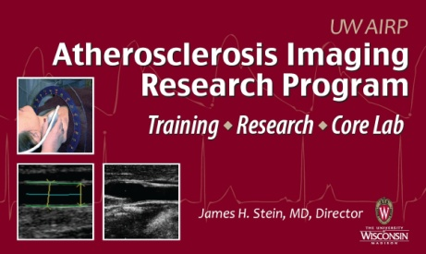

Changes in Carotid Artery Stiffness over a Decade of Aging: The Multi-Ethnic Study of Atherosclerosis (MESA)
Adam D. Gepner; Claudia E. Korcarz; Laura A. Colangelo;
Elizabeth K. Hom; Matthew C. Tattersall; Brad C. Astor;
Joel D. Kaufman; Kiang Liu; James H. Stein

Slide 2
Changes in Carotid Artery Stiffness over a Decade of Aging: The Multi-Ethnic Study of Atherosclerosis (MESA)
Adam D. Gepner; Claudia E. Korcarz; Laura A. Colangelo;
Elizabeth K. Hom; Matthew C. Tattersall; Brad C. Astor;
Joel D. Kaufman; Kiang Liu; James H. Stein

Slide 3
Disclosures: None

Slide 4
Arterial Function and Stiffness
Arteries serve as conduits that deliver and regulate blood flow to end organs
Large arteries
  Primarily conduits
  Provide “cushioning” effect
    More blood ejected than runs off into peripheral vasculature
    Converts intermittent ejection of cardiac SV into continuous organ flow

Slide 5
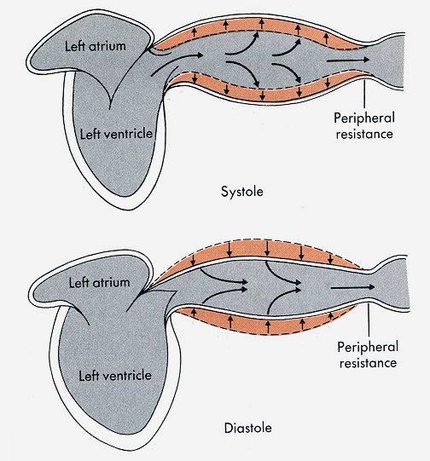
Ventricular-Vascular Coupling
Berne RM, Levy MN. Cardiovascular Physiology, 5th ed. CV Mosby Co., 1986

Slide 6
Arterial Stiffness
Increases with aging
  Reduction in elastin:collagen ratio
  SMC hypertrophy, inflammation
Associated with CVD risk factors
  Mainly cross-sectional analyses
  Less on longitudinal associations
Contributes to MI, LVH, heart failure, stroke, and cognitive dysfunction
O’Rourke M, et al. JACC 2007;50:1; Zieman SJ, et al. ATVB 2005;25:932
Notes:
Propagation of the pulse wave inversely related to arterial distensibility (ΔD/ΔP)

Slide 7
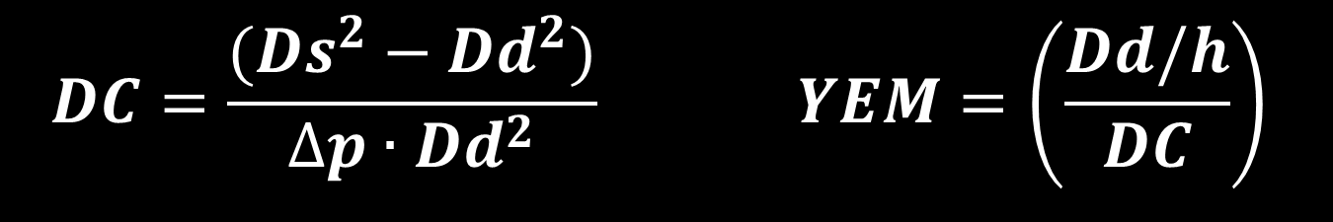
Stiffness Measurements
Distensibility Coefficient
Young’s Elastic Modulus
$$DC=\frac{(Ds^{2}−Dd^{2})}{∆p∙{Dd}^{2}} YEM=\left(\frac{Dd/h}{DC}\right)$$
ΔD/ΔP = relative Δ in diameter for a given
Δ in pressure
Lower DC = more stiff artery
Reciprocal of DC, corrected for thickness and diameter
Higher YEM = more stiff artery
Oliver J and Webb DJ. ATVB 2003;23:554
Reneman RS, et al. Eur Heart J. 2005;26:960
Laurent S, et al. Eur Heart J. 2006;27:2588

Slide 8
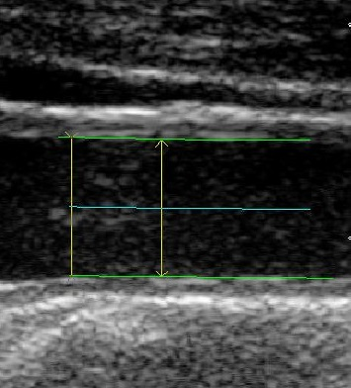
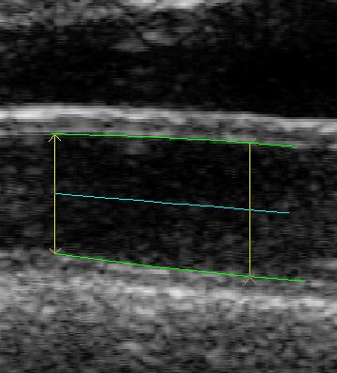
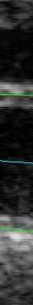
Stiffness Measurements
B-mode ultrasound; standardized BP measurements
Systole
Diastole
Ds
Dd

Slide 9
Methods
Multi-Ethnic Study of Atherosclerosis (MESA)
  Large, prospective cohort study (N=6814)
  No known CVD at baseline
  Ongoing since 2000
Subset of MESA participants (N=2650)
  Valid carotid ultrasounds with stiffness measurements at exam 1 and exam 5
  Mean (SD) of 9.4 (0.5) years follow up

Slide 10
Statistical Methods
Mean DC and YEM at each exam and their changes: repeated measures mixed model
  Baseline age was classified into decades (ages 45-54, 55-64, 65-74, and 75-84 years)
  Adjusted for CVD risk factors
    BMI, diabetes mellitus status, SBP, antihypertensive medication, lipids, lipid-lowering medications, physical activity, smoking
  Interactions: exam*age group, exam*ethnicity

Slide 11
Statistical Methods
Differences between exams: ANCOVA
  Unadjusted
  Adjusted for age, sex, ethnicity, study site baseline CVD risk factors
  Antihypertensive medication use at exam 1 and exam 5
  With and without adjustment for baseline stiffness measures

Slide 12
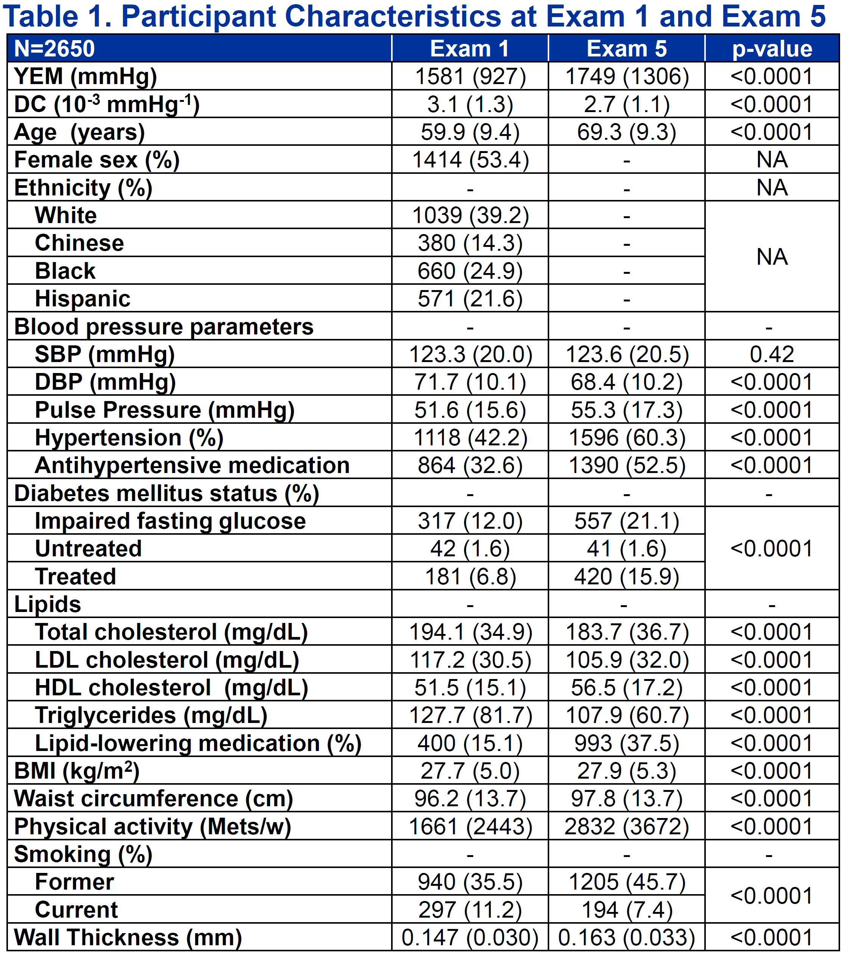
Table 1

Slide 13
Results: DC
↓ 3.1 (1.2) to 2.7 (1.2) 10⁻³ /mmHg (p<0.001)
∆DC was similar across age groups (p>0.05)
Older age was not an independent predictor of ↓ DC until after adjustment for baseline DC (p<0.0001), indicating a floor effect
Chinese ethnicity (p=0.006) and higher SBP (p=0.007) independently predicted a ↓ DC

Slide 15
Results: YEM
↑ 1581 (927) to 1749 (1306) mmHg (p<0.0001)
∆YEM > among older participants (p<0.0001)
↑ age independently predicted ↑ YEM (p<0.0001)
Baseline antihypertensive medication use predicted greater ↑ YEM (p=0.001)
Lipid levels, diabetes mellitus, BMI, & smoking: not independent predictors of ∆YEM

Slide 16
*p<0.0001 when compared to all other age groups

Slide 17
Effects of Hypertension and Antihypertensive Medications
Use of antihypertensive meds increased from baseline to exam 5 (p<0.0001)
Stopping antihypertensive medication:
  Strong, independent predictor of worsening YEM (β=360.2 mmHg/year, p=0.008)
Starting on antihypertensive medication:
  Independent predictor of improved DC
  (β=1.1 x10⁻⁴/mmHg/year; p=0.024)

Slide 18
Ethnicity Differences in DC and YEM
YEM and DC were significantly worse in non-Whites at both visits (all p<0.0001)
Ethnic groups stiffened at similar rates (p>0.23 for both)

Slide 19
Limitations
Participants are a subset of the entire MESA cohort
  Possible survivorship bias
Blood pressure measurements taken from the brachial artery
  Surrogate for central pressure
Calculations of DC and YEM assume no longitudinal motion of the arterial wall

Slide 20
Conclusions
Arterial stiffening accelerates w/advanced age, but at a similar rate among ethnicities
YEM increases most rapidly in adults >75 years old, independent of CVD risk factors
  Longitudinal use of antihypertensive therapy slows progression of carotid arterial stiffness
  Stopping antihypertensive medication predicts worsening YEM
These findings support for treating blood pressure in the elderly

Slide 21
Serum 25-hydroxyvitamin D,
Parathyroid Hormone, and Carotid Artery Distensibility: The Multi-Ethnic Study of Atherosclerosis (MESA)
Adam D. Gepner; Laura A. Colangelo; Marc Blondon;
Claudia E. Korcarz; Ian H. de Boer; Bryan Kestenbaum;
David S. Siscovick; Joel D. Kaufman;
Kiang Liu; James H. Stein
Notes:
I would like to thank the moderators, Dr. Khera

Slide 22
Serum 25-hydroxyvitamin D,
Parathyroid Hormone, and Carotid Artery Distensibility: The Multi-Ethnic Study of Atherosclerosis (MESA)
Adam D. Gepner; Laura A. Colangelo; Marc Blondon;
Claudia E. Korcarz; Ian H. de Boer; Bryan Kestenbaum;
David S. Siscovick; Joel D. Kaufman;
Kiang Liu; James H. Stein
Notes:
I would like to thank the moderators, Dr. Khera

Slide 23
What About Arterial Stiffness,
Vitamin D, and PTH?
Low vitamin D and high PTH are associated with increased CVD risk
Linked to hypertension, insulin resistance, metabolic syndrome, CHD, and CHF
Increased arterial stiffness may be a mechanism through which 25(OH)D and PTH affect CVD risk

Slide 24
Methods
2,707 participants at exam 1 and 2,580 participants at exam 5
DC and YEM calculated as previously described
25(OH)D concentrations measured by mass spectrometry; adjusted for seasonal variation
Serum PTH measured by two-site immunoassay

Slide 25
Statistical Analyses
Cross-sectional analyses: linear regression models
Differences between baseline and exam 5 measures: ANCOVA
  Adjusted for risk factors
  With and without adjustment for baseline stiffness measures
Tests of trend used median values

Slide 26
Models
Model 1: age, sex, race, study field center, education, and income
Model 2: Model 1 + physical activity, waist circumference, smoking status, and BMI
Model 3: Model 2 + diabetes mellitus status, antihypertensive medication use, log[CRP], total cholesterol, HDL-C, lipid lowering therapy, and creatinine
Model 4: Model 3 + SBP

Slide 27
Cross-Sectional Results
25(OH)D not associated with either stiffness measure
PTH associated w/increased arterial stiffness
  Lower DC (β=-2.5x10⁻⁶ mmHg⁻¹, p=0.04)
  Higher YEM (β=1.98 mmHg, p=0.06)
Strongest w/ PTH ≥65 pcg/ml
  Lower DC (β=-2.4x10⁻⁴ mmHg⁻¹, p=0.003)
  Higher YEM (β=166 mmHg, p=0.01)
  Associations no longer statistically significant when SBP included in the model (DC: β=-1.4x10⁻⁴ mmHg⁻¹ p=0.08; YEM: β=118 mmHg p=0.07)

Slide 28
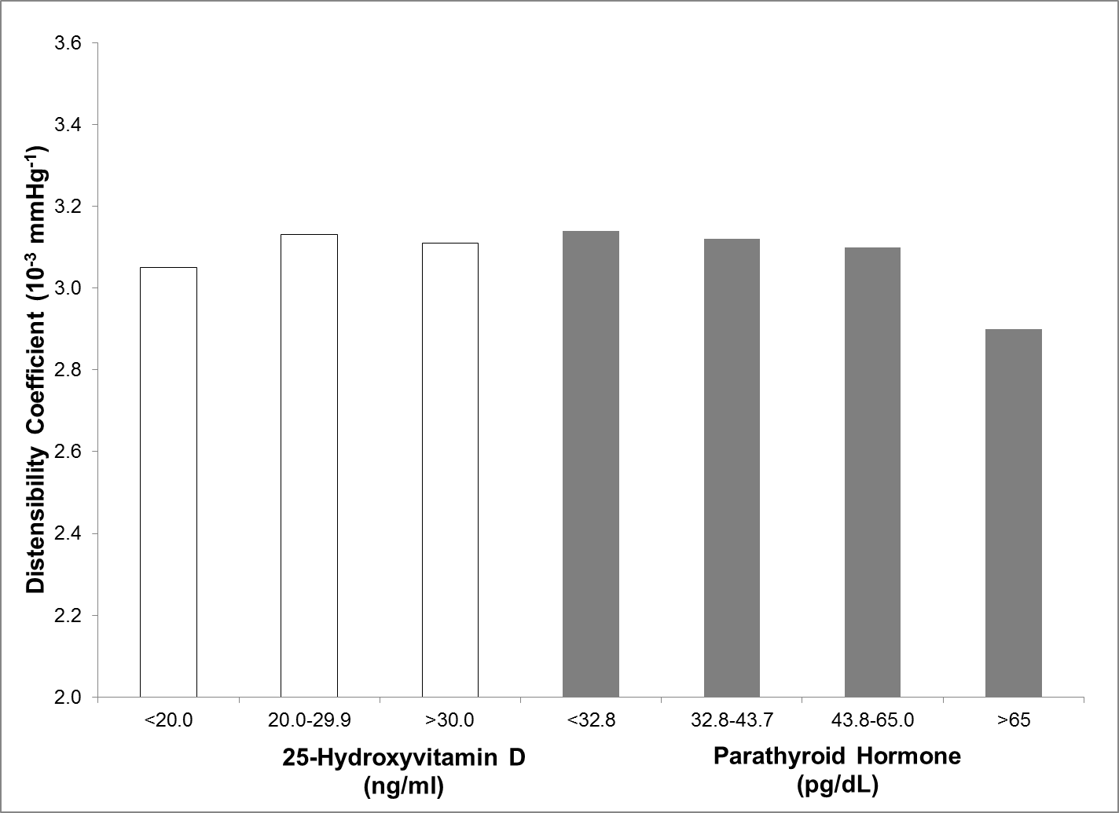
Baseline DC by 25(OH)D and PTH
p-trend = 0.46* p-trend = 0.005*
25-Hydroxyvitamin D
(ng/ml)
Parathyroid Hormone
(pg/dL)
*Median p-trends fully adjusted as in Model 3

Slide 29
Baseline YEM by 25(OH)D and PTH
p-trend = 0.32* p-trend = 0.02*
25-Hydroxyvitamin D
(ng/ml)
Parathyroid Hormone
(pg/dL)
*Median p-trends fully adjusted as in Model 3

Slide 30
Cross-Sectional Results: 25 (OH)D
 | Baseline DC (mmHg-1 x10-4) (95% CI)
25(OH)D (ng/ml) | n | Beta Parameter
 |  | Model 1 | Model 2 | Model 3 | Model 4
≥30.0 | 918 | ref. | ref. | ref. | ref.
20.0-29.9 | 973 | -0.5 (-1.5, 0.6) | 0.1 (-1.0, 1.1) | 0.2 (-0.8, 1.3) | 0.3 (-0.7, 1.3)
<20 | 816 | -1.6‡ (-2.8, -0.4) | -0.7 (-1.9, 0.5) | -0.6 (-1.8, 0.6) | -0.3 (-1.5, 0.8)
 | Baseline YEM (mmHg) (95% CI)
25(OH)D (ng/ml) | n | Beta Parameter
 |  | Model 1 | Model 2 | Model 3 | Model 4
≥30.0 | 918 | ref. | ref. | ref. | ref.
20.0-29.9 | 973 | 50.2 (-34.1, 134.6) | 24.0 (-60.7, 108.7) | 13.1 (-72.0, 98.2) | 12.3 (-71.8, 96.3)
<20 | 816 | 107.2+ (11.0, 203.3) | 59.5 (-38.5, 157.5) | 53.5 (-45.1, 152.2) | 42.2 (-55.1, 139.6)
‡ p<0.01; ⁺ p<0.05;
Model 1: adjusted for age, sex, race, study field center, education, and income
Model 2: Model 1 plus physical activity, waist circumference, smoking status, and BMI
Model 3: Model 2 plus diabetes mellitus status, antihypertensive medication use, log[CRP], total cholesterol, HDL-C, lipid-lowering therapy, and creatinine
Model 4: Model 3 plus SBP

Slide 31
Cross-Sectional Results: PTH
 | Baseline DC (mmHg-1 x10-4) (95% CI)
PTH (pg/mL) | N | Beta Parameter
 |  | Model 1 | Model 2 | Model 3 | Model 4
<32.8 | 806 | ref. | ref. | ref. | ref.
32.8-43.7 | 808 | -0.6 (-1.7, 0.5) | -0.2 (-1.3, 1.0) | -0.2 (-1.3, 0.9) | -0.2 (-1.3, 0.9)
43.8-65.0 | 808 | -1.2⁺ (-2.3, -0.0) | -0.4 (-1.6, 0.7) | -0.5 (-1.6, 0.7) | 0.0 (-1.1, 1.1)
>65 | 285 | -3.4‡ (-5.0, -1.8) | -2.2‡ (-3.8, -0.5) | -2.4‡ (-4.0, -0.8) | -1.4 (-3.0, 0.1)
 | Baseline YEM (mmHg) (95% CI)
 | n | Beta Parameter
 |  | Model 1 | Model 2 | Model 3 | Model 4
<32.8 | 806 | ref. | ref. | ref. | ref.
32.8-43.7 | 808 | 39.2 (-50.9, 129.4) | 20.1 (-70.0, 110.1) | 17.9 (-72.3, 108.1) | 18.3 (-70.8, 107.3)
43.8-65.0 | 808 | 63.4 (-28.7, 155.5) | 28.4 (-64.2, 120.9) | 28.6 (-64.2, 121.5) | 5.6 (-86.2, 97.5)
>65 | 285 | 217.0‡ (88.1, 345.9) | 159.0⁺ (28.8, 289.2) | 166.2⁺ (35.6, 296.7) | 117.6 (-11.8, 247.0)
‡ p<0.01; ⁺ p<0.05;
Models as in previous table

Slide 32
Longitudinal Associations with Arterial Stiffness measurements
DC decreased from 3.1 (1.3) x 10⁻³ mmHg⁻¹ to 2.7 (1.2) x 10⁻³ mmHg⁻¹
YEM increased from 1591 (938) mmHg to 1754 (1340) mmHg
No associations or even trends were observed between baseline 25(OH)D or PTH and carotid stiffness (all p>0.3)
No differences between ethnic groups

Slide 33
Conclusions
No cross-sectional or longitudinal associations between arterial stiffness and vitamin D status
Carotid arterial stiffness associated with PTH >65 mg/dL
  Associations attenuated by SBP
Interrelationships of PTH, blood pressure, and carotid stiffness are not entirely clear

Slide 34
Summary
Age, SBP, and antihypertensive medication use are strongly associated with progression of arterial stiffness
Rate of progression is greatest in older participants
High PTH levels are associated with greater baseline stiffness
Neither vitamin D nor PTH were associated with progression of stiffness

Slide 35
Acknowledgements
UW AIRP MESA Team
  Jim Stein
  Matt Tattersall
  Claudia Korcarz
  Kristen Hansen
  Jessica Horn
  Jean Einerson

Slide 36
Questions?

Slide 37
ΔDC ANCOVA Models
 | Significant predictors | β | p-value
Model 1 R² = 0.359 | Age | -2.2x10⁻⁵ | <0.0001
 | Chinese Race | -1.9x10⁻⁴ | 0.006
 | Study site University of Minnesota UCLA | 3.1x10⁻⁴ 1.6x10⁻⁴ | <0.0001 0.025
 | Education level (compared to less than high school education) Graduated high school | 1.7x10⁻⁴ | 0.006
 | Baseline systolic blood pressure (per mmHg) | -2.8x10⁻⁶ | 0.007
 | Treated diabetes at baseline | -1.6x10⁻⁴ | 0.029
Model 2 R² = 0.361 | Age | -2.2x10⁻⁵ | <0.001
 | Chinese race | -1.9x10⁻⁴ | 0.006
 | Study site University of Minnesota | 3.1x10⁻⁴ | <0.0001
 | Education level (compared to less than high school education) Graduated high school | 1.7x10⁻⁵ | 0.007
 | Baseline systolic blood pressure (per mmHg) | -3.6x10⁻⁶ | 0.001
 | Starting antihypertensive medication | 1.1x10⁻⁴ | 0.024
 | Treated diabetes mellitus at baseline | -1.8x10⁻⁴ | 0.018
*Models shown are adjusted for baseline DC

Slide 38
ΔYEM ANCOVA Models
 | Significant predictors | β | p-value
Model 1 R²=0.148 | Age | 16.5 | <0.0001
 | Education level (compared to less than high school education) Some high school Graduated high school | -235.8 -243.1 | 0.007 0.003
 | Use of antihypertensive medication at baseline | 175.8 | 0.001
Model 2 R²=0.150 | Age | 16.8 | <0.001
 | Education level (compared to less than high school education) Some high school Graduated high school | -236.4 -243.0 | 0.007 0.003
 | Former smoker at baseline | -101.6 | 0.050
 | Baseline systolic blood pressure (per mmHg) | 2.8 | 0.043
 | Stopping antihypertensive medication | 360.2 | 0.008
Model 1: Age, sex, race, study site, socioeconomic factors (education level, income) and traditional cardiovascular risk factors (diabetes status, smoking status, total cholesterol, high density lipoprotein cholesterol, body-mass index, and physical activity level) and treatment of traditional cardiovascular risk factors at baseline (use of antihypertensive medications, use of lipid lowering medications, and treatment of diabetes)
Model 2: Model 1 + exchanging use of antihypertensive medication at baseline with never treated with antihypertensive medication (untreated at exam 1 and exam 5), continued use of antihypertensive medication (treated at exam 1 and treated at exam 5), starting antihypertensive medication (untreated at Exam 1, treated at exam 5) or stopping antihypertensive medications (treated at exam 1, untreated at exam 5)

Slide 39
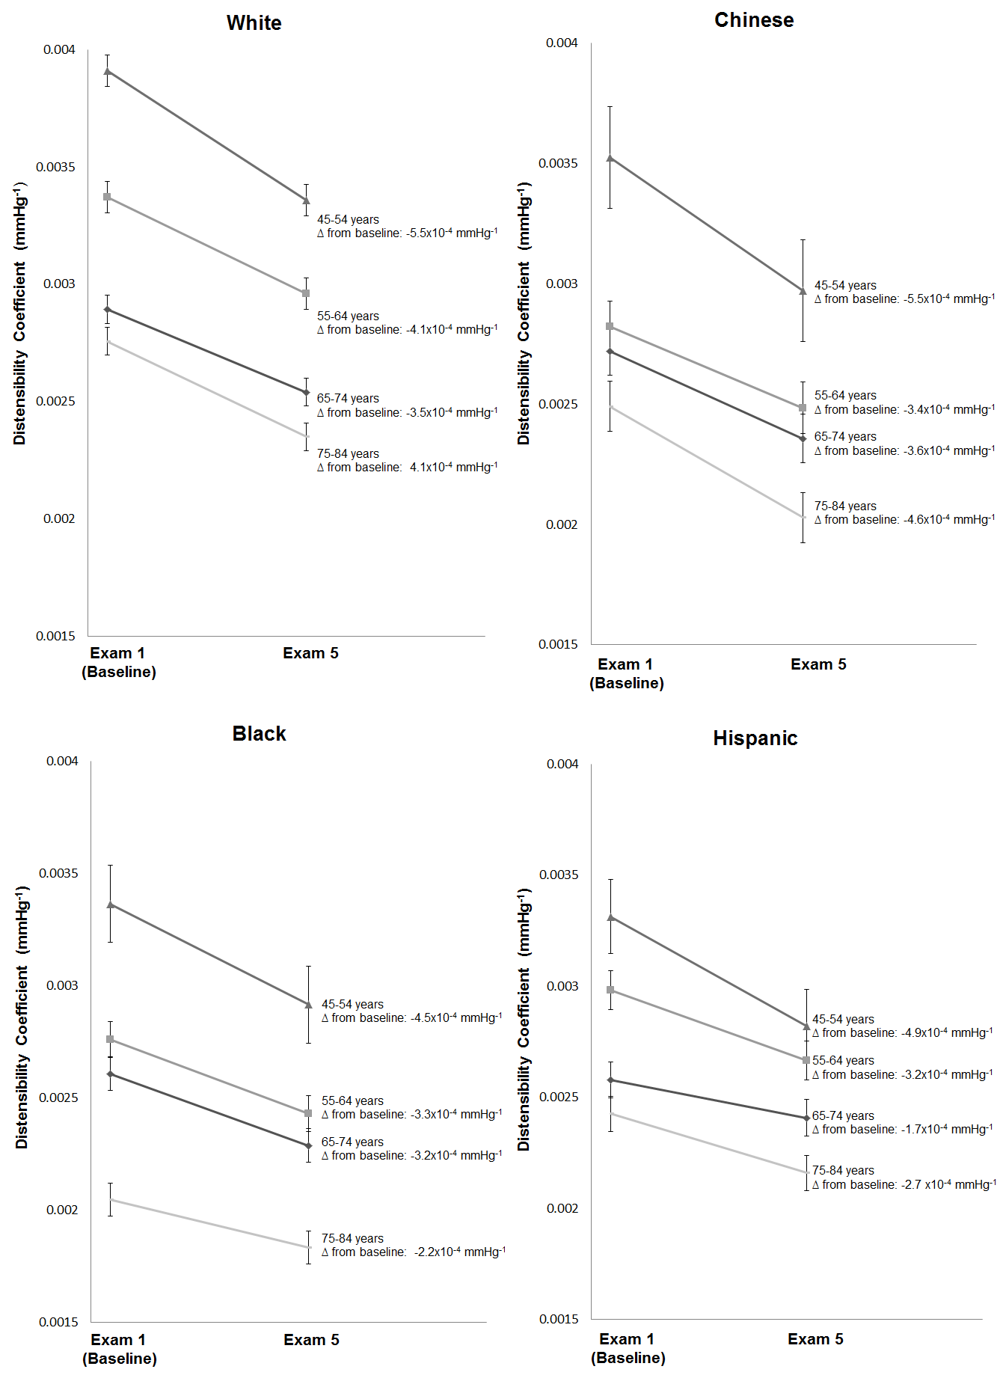

Slide 40
