Slide 1
Outcomes Research in MESA (…..mostly CMS)
MESA Steering Committee Meeting
September 13, 2012

Slide 2
Definition of Health Outcome
An outcome or result of a medical condition that directly affects the length or quality of a person's life (Free Dictionary)
…..often referring to CMS data
Diagnoses
Procedures
Costs

Slide 3
Outline
Reminder about what the CMS data includes
Attempt to estimate completeness
Availability of data by race
Examples of applications from CHS

Slide 4
What We Have
CMS files from 1991 – 2009
Enrollment (eligibility for denominator)
Claims files (various sources for numerator)
Inpatient services
Outpatient services
Physician services (aka Carrier)
Home health care
Skilled nursing facilities
Hospice
Durable medical equipment
Prescription medications

Slide 5
Enrollment includes:
Part A and B – designates retirees
Part A only
Part B only
Managed Care (beneficiaries MUST choose MC or FFS)
FFS: Use those enrolled in Parts A & B excluding those in Managed Care
employed persons
(have other insurance)

Slide 6
Participants by Age Group 2000-09

Slide 7
Excluded Participants 2000-09

Slide 8
% MESA Ppts in FFS

Slide 9
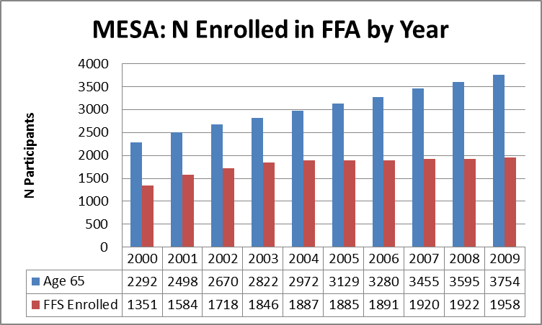
Total N for Analysis

Slide 10
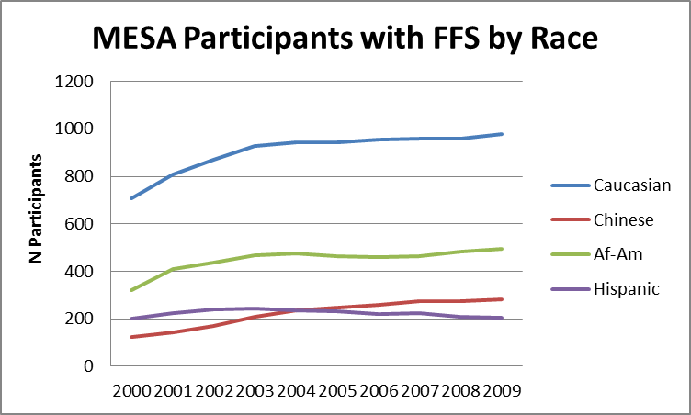
Available for Analysis

Slide 11
Comparison of FFS Enrollment by Gender 2009

Slide 12
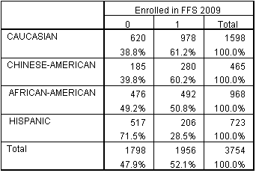
Comparison of FFS Enrollment by Race 09

Slide 13
Outcomes
Main claims file | Diagnosis file (DX) | Procedure file (PX) | Revenue center file (REV)
Inpatient (IP) | X | X | X
Outpatient (OP) | X |  | X
Skilled nursing (SNF) | X |  | X
Home health (HH) | X |  | X
Hospice (HSP) | X |  | X
Carrier (CARR) | X |  | X

Slide 14
Value of the Data
Inpatient: History of claims prior to MESA enrollment
Outpatient/MD Visits: Can increase ascertainment of non-hospitalized diagnoses
Total Healthcare Utilization (major types)
COST DATA !

Slide 15
Claims per Year

Slide 16
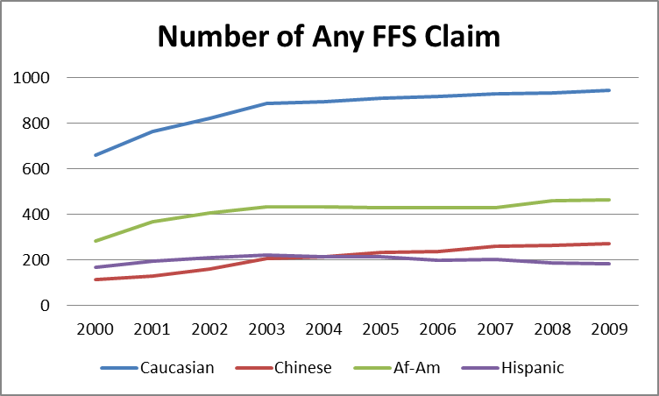
Claims by Race

Slide 17
Use of CMS Data CHS as an Example
Health Outcomes Working Group
Lesley Curtis (Duke) and Annette Fitzpatrick (UW) leading it
40 Members and growing
Monthly conference calls
Have PhD level 0.5 fte for analysis

Slide 18
CHS Health Outcomes WG Membership
About 75% Junior Faculty
Members of Other Working Groups
Multidisciplinary
Medicine, Nursing, Geriatrics, Cardiology, Neurology, Pharmacy, Palliative Care, Epidemiolgy, Biostatistics
Universities Involved
UW, Duke, Pittsburgh, UC-Davis, Wake Forest
Harvard, Stanford, Northwestern, Yale, Columbia, Mayo, University of Vermont, Albert Einstein, U Florida, U Akron, Mt Sinai,

Slide 19
6 Projects
PI | Sponsor | Title
Erin Wallace | Heckbert | Disability and Functional Impairment after AF
Joal Fontes | Heckbert | Health Care Costs for Medicare Ppts with AF
Samay Jain | Longstreth | Clinical Decision-Making in Parkinson's Disease
D. Stojanovic | Mukamal | Validation of Administrative Coding for Diabetes
Uptal Patel | Curtis | Healthcare Utilization for Chronic Kidney Disease
Nori Allen | Curtis | Trajectories in Successful Aging and Costs

