Slide 1



Sleep and Blood Pressure
Dennis A. Dean, II, Ph.D.
Harvard Medical School
Brigham and Women’s Hospital
Program in Sleep and Cardiovascular Medicine
Program in Sleep Epidemiology
April 26, 2013
Multi-Ethnic Study of Atherosclerosis, Steering Committee Meeting, Seattle Washington

Slide 2
Outline
Overview
  Sleep and blood pressure research objective
  Research and training context
Specific Aim -1: To perform statistical analysis to test the association between hypertension and traditional indices of sleep disruption and sleep disordered breathing.
  Analysis approach
  Results
  Interpretation

Slide 3
Overview

Slide 4
Supplement specific aims have been selected to provide training in traditional and novel method for studying the relationship between sleep and hypertension
Hypotheses:
1. Traditional indices of sleep disruption and sleep disordered breathing are associated with hypertension status. (MESA-Sleep parent grant confirmatory aim)
2. Breath-by-breath disruptions of cortical activity (Respiratory cycle-related EEG change, RCREC) is associated with hypertension status.
Arterial elasticity estimates derived from the Pleth waveform (Pleth Derived Arterial Elasticity Estimate –PDAE): a) decreases in association with AHI, ArI, and RCREC; b) correlates with daytime elasticity measurements made using radial tonometry; and c) is associated with hypertension status even after considering other sleep and daytime elasticity measurements and potential confounders.
Specific Aims:
1. To perform statistical analysis to test the association between hypertension and traditional indices of sleep disruption and sleep disordered breathing
2. To compute RCREC from the PSG data and to perform statistical analysis to test the association between RCREC and hypertension.
3. To derive and implement the PDAE and to perform statistical analysis to test the association between PDAE, Arl, AHI, small artery elasticity from tonometry and hypertension.

Slide 5
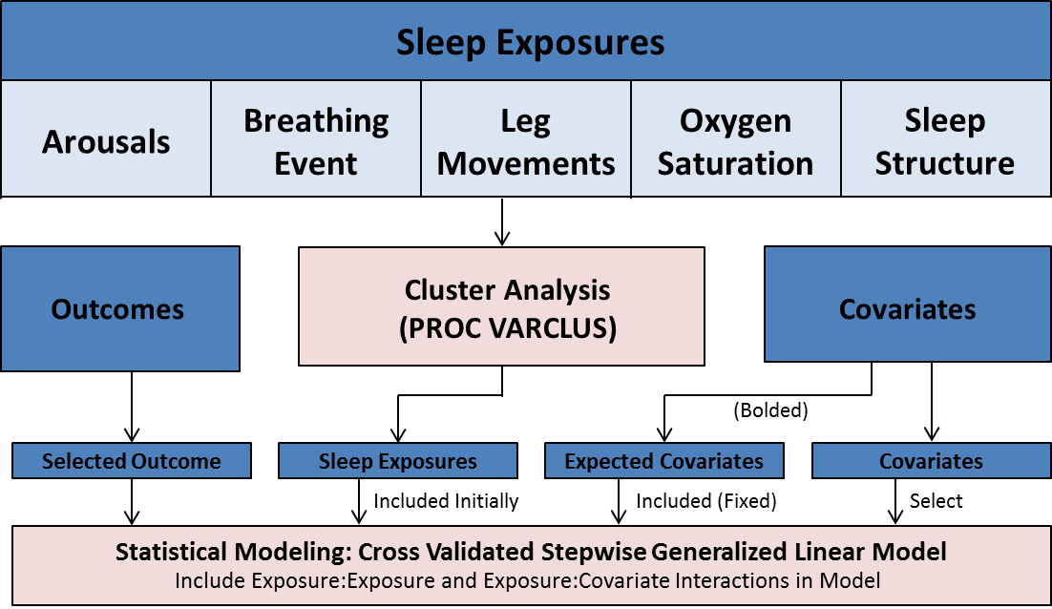
Out proposed approach evolved from analysis proposed in the supplement
Goal:
Develop an objective and robust approach for selecting models that associate sleep and blood pressure
Strategy:
Preselect commonly modeled sleep exposures across 5 exposure domains from 2500 sleep indices
Analytical Approach:
Reduce the number sleep exposures by cluster analysis (variable reduction)
Select exposures by stepwise selection and models by cross validation

Slide 6
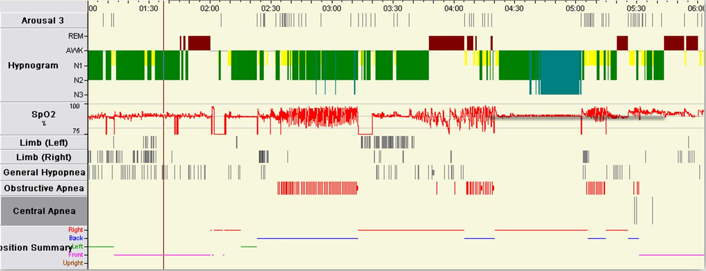
Sleep exposures across five exposure domains were selected for modeling consideration
Sleep Analysis Software Screen Shot
Sleep Structure
Stage 1 %
Stage 2 %
Slow wave %
REM %
Sleep Efficiency
Sleep Duration
Oxygen
Saturations
SaO2 < 90
Average SaO₂
Minimum O₂
Arousals
Arousal Index
Leg Movements
Leg Movements
w/wo arousals
Breathing Event
Apnea Hypopnea Index
w/wo arousals
3% and 4%
Desaturation
Variables are also summarized by REM and Non-REM state

Slide 7
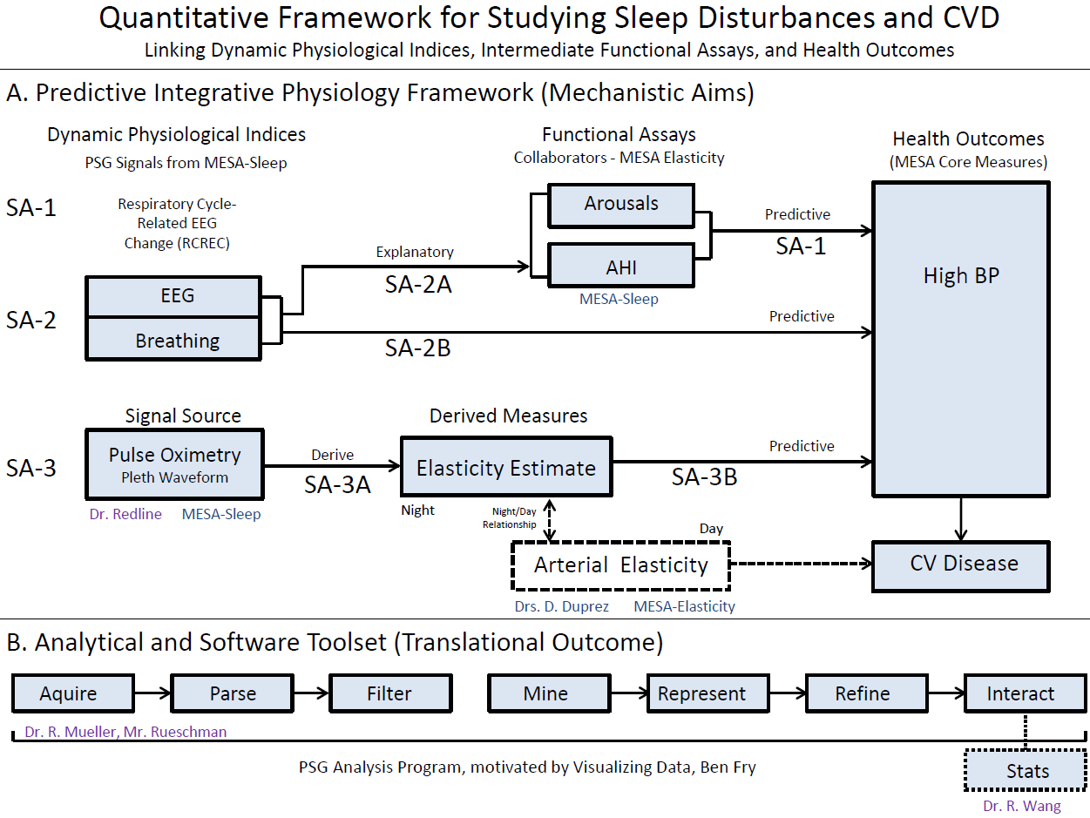
Postdoctoral research is funded as a supplement to an R01 ( Redline PI )
Statistics
Engineering
Methods
Novel
Methods

Slide 8
Sleep and Blood Pressure

Slide 9
Data from MESA Exam 5 Core Data and MESA Sleep Ancillary Study
MESA-Core:
Average seated systolic and diastolic blood pressures are the outcome measures.
All models adjusted for age, gender, race and BMI
MESA-Sleep:
Cross sectional data were analyzed from 2,240 MESA-Sleep participants
  Included unattended 15-channel polysomnography
  (Somte, Compumedics).
28 sleep indices from 5 exposure domains
Experimental Note:
Exam 5 core data collection and the in home sleep studies were collected on different days scheduled within a year from each other.

Slide 10
MESA Sleep Characteristics
N = 2240
Age 68.7 years
Hypertension 57.5%
Hypertension Meds 53.8%
Total # of Meds 4.7
Male 46.4%
BMI 28.7 kg.m^2
Chinese American 11.8%
African American 27.5%
Hispanic 23.5%

Slide 11
Sleep exposures across five exposure domains were selected for modeling consideration
Median Sleep Exposure Values
Sleep Structure
Stage 1 % 16 %
Stage 2 % 63 %
Slow wave % 4 %
REM % 11 %
Sleep Efficiency 79 %
Sleep Duration 5.8 hr.
Arousals
Arousal Index 30
Arousal Index (REM) 20
Arousal Index (NREM) 30
Breathing Event
AHI (3%) 16
AHI (4%) 6
Oxygen Saturations
Average SaO₂ 95 %
Minimum O₂ 86 %
Leg Movements
Leg Movements 28
Leg Movements (REM) 28
Leg Movements (NREM) <1

Slide 12
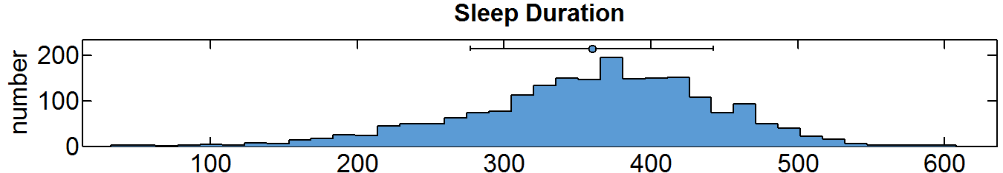
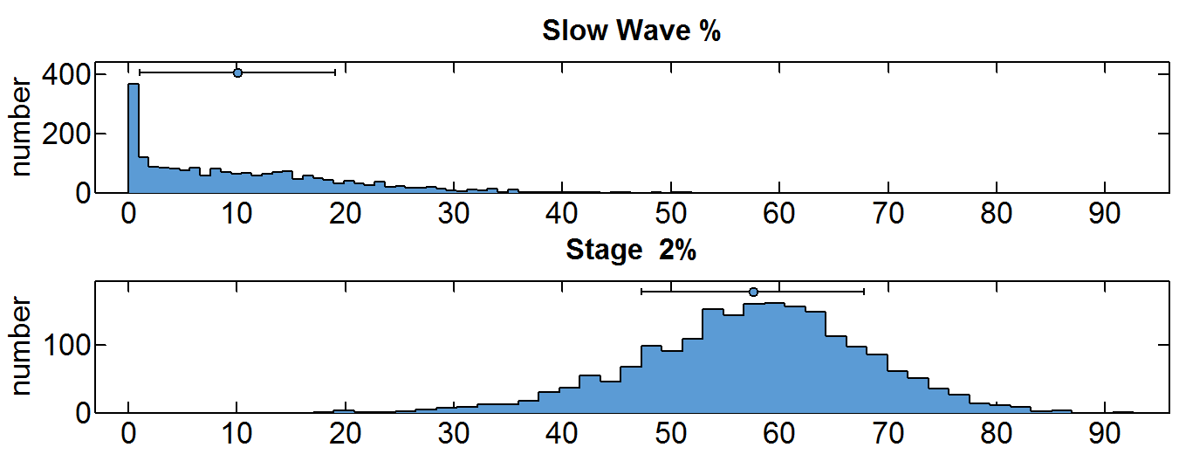
There is substantial variability in sleep characteristics
Minutes
Sleep Structure
% Sleep

Slide 13
Research provided data analysis and model building training opportunities, which were directed by my mentoring team
Issues considered during the course of the research
Conceptualizing the outcome variable
Objective sleep exposures selection
Selecting covariates
Identifying robust and repeatable models

Slide 14
Outcome Conceptualization: Several hypertension outcome formulations were considered
Dichotomous:
Hypertension vs. No Hypertension
Polychotomous:
Normal Blood Pressure No HTN Medications
Normal Blood Pressure with Medications
Elevated no HTN medications
Elevated with HTN medications
Elevated with 3 or more HTN Medications
Continuous:
Systolic, Diastolic and Pulse Pressure

Slide 15
Outcome Conceptualization: Systolic and diastolic blood pressure selected as outcome
Rationale for selecting systolic and diastolic pressures as outcomes:
More power in continuous variable
Concerned about limited numbers across dichotomous and polychotomous groups
Median Systolic BP = 120.0 mmHg
Median Diastolic BP = 68.0 mmHg

Slide 16
Outcome Conceptualization: Accounting for hypertension medication
Literature
Tobin, M. D., et al. (2005). Adjusting for treatment effects in studies of quantitative traits: antihypertensive therapy and systolic blood pressure. Statistics in Medicine. 24: 2911-2934.
Addition of a sensible constant
Censored normal regression model
Non-parametric approach based on averaging ordered residuals
McClelland, R.L., et al. (2008). "Estimation of risk factor associations when the response is influenced by medication use: An imputation approach." Statistics in Medicine 27(24): 5039-5053.
Parametrically estimate the underlying untreated variable of interest as a function of the observed treated value
Approaches
Added 10 mmHG to systolic pressure and 5 mmHG to diastolic pressure
Will revisit adjustment for hypertension medications (See future work)

Slide 17
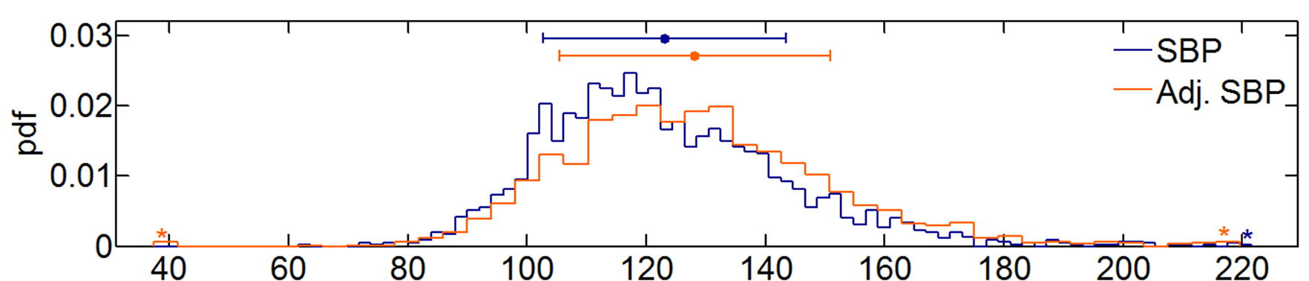
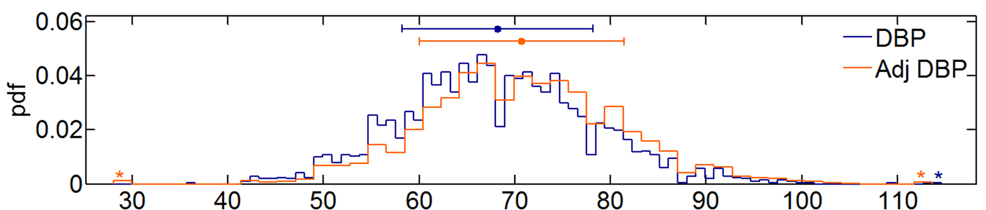
Outcome Conceptualization: Visualizing adjusted blood pressures
Adjusted Systolic BP
Adjusted Diastolic BP
Median Systolic BP = 120.0 mmHg
Median Diastolic BP = 68.0 mmHg
Median Adj. Systolic BP = 126.5 mmHg
Median Adj. Diastolic BP = 70.5 mmHg

Slide 18
Outcome Conceptualization: There can be significant correlations between and with sleep exposure groups
Exposure Correlations
O₂
Sleep
Structure
Breathing
Event
Arousal
Index
Leg Movements
O₂
Sleep Structure
Breathing Event
Arousal
Index
Leg Move.

Slide 19
Exposure Conceptualization: Reducing high-dimensional sleep dataset with physiologically correlated cluster analysis
Literature
Anderberg, M. R. (1973). Cluster Analysis for Applications.
Advantages
Objective selection of variable clusters which we represent as a single variable
Method Outline
Cluster selected for splitting (largest eigenvalue associated with the second principal component)
Chosen cluster is spit into two clusters by finding the first two principal components, performing an orthoblique rotation of the eigenvectors and assigning each variable to the rotated component with which it has the higher square correlation.
Variables are iteratively reassigned to clusters to maximize variance accounted for by the cluster components.
The signal with the minimum 1-R^2 ratio is selected to represent each cluster
Technical Notes: Method is available in R and STATA

Slide 20
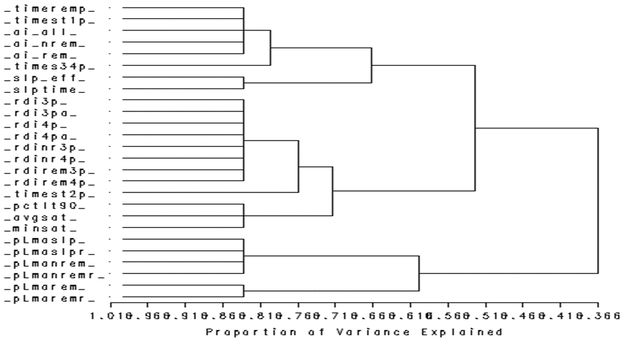
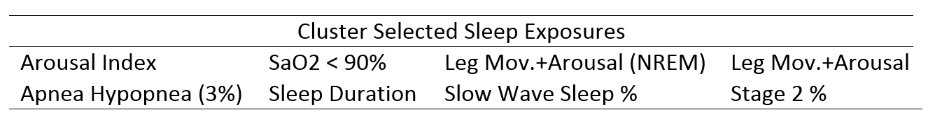
Sleep exposures selected by variable cluster analysis for modeling

Slide 21
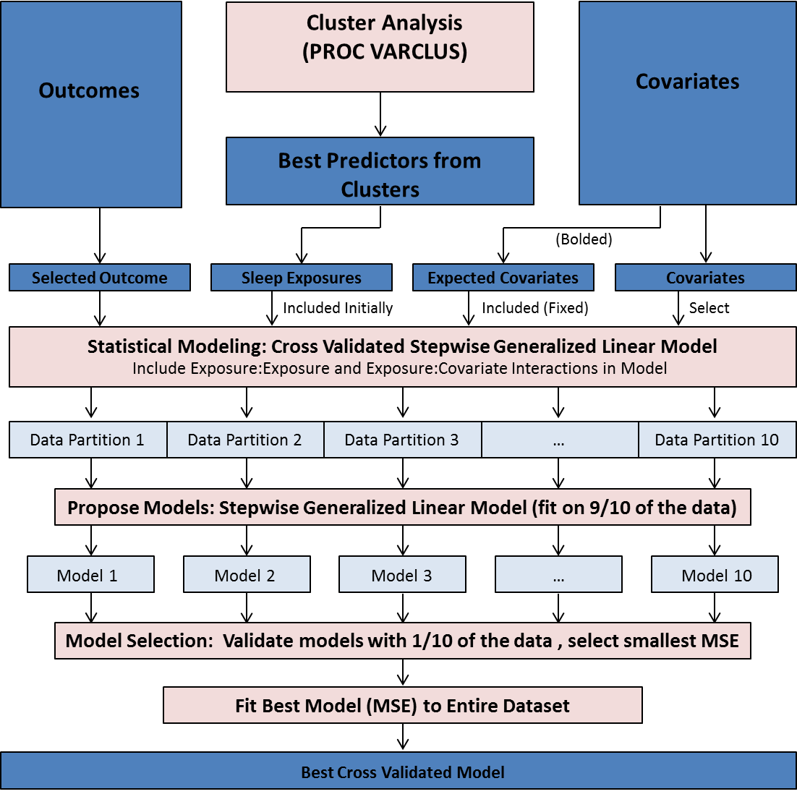
Identifying robust and repeatable models

Slide 22
Model Results Presented Today
Stepwise sleep exposure selection
All models adjusted for age, race, gender and BMI

Slide 23
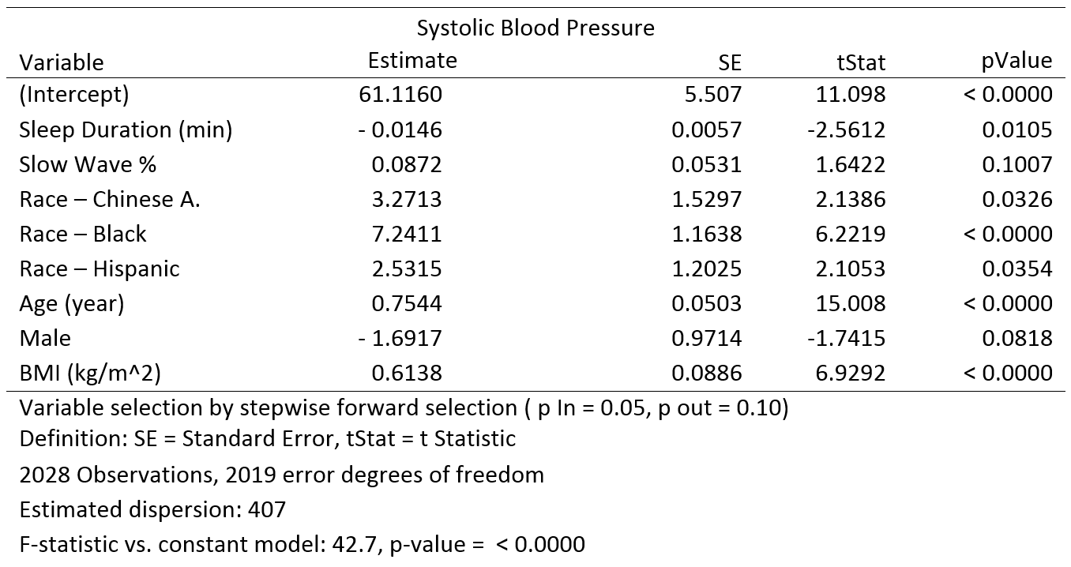
Total sleep time is associated with systolic blood pressure

Slide 24
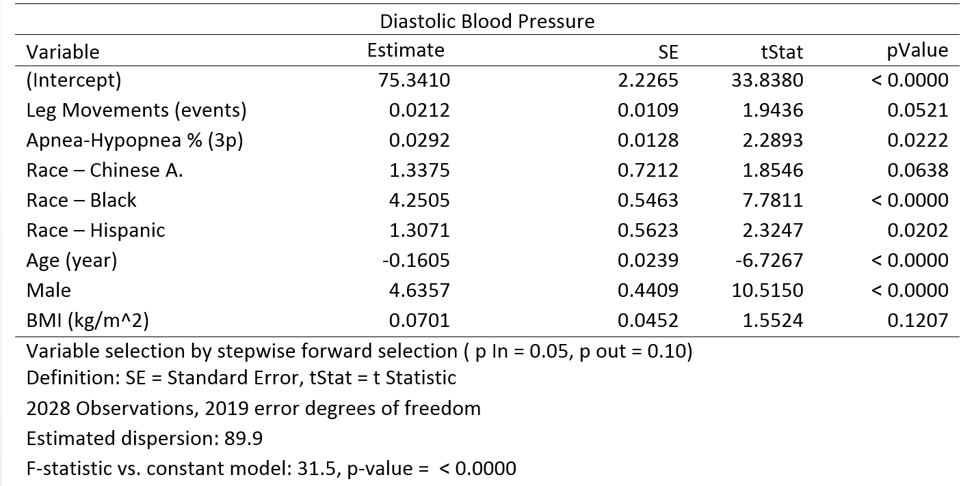
Respiratory distress index is associated with diastolic blood pressure

Slide 25
Our results have methodological and pathway implications
Methodological
The application of cluster analysis and cross validation to the model building process produced physiologically interpretable models
Pathway Implications
Systematic consideration of a wide variety of sleep indices identified shorter sleep duration and apnea-hypopnea index to be associated with elevated SBP or DBP
These results support the importance of sleep duration and physiological disturbances caused by AHI and LM as important pathways that influence BP and that can be targeted for evaluation in future studies.

Slide 26
Our results are novel and require further exploration
Future Work
Revisit categorical hypertension definitions
Apply model selection procedure to cohort subset without medications
Explore application of alternative blood pressure adjustment methods
Add covariates to the stepwise selection procedure

Slide 27

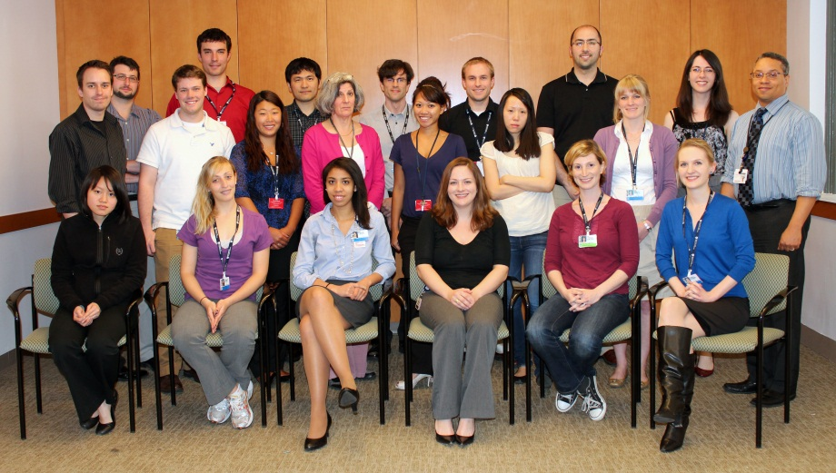

Postdoctoral Affiliation:
Faculty
Collaborators:
Daniel Gottlieb, MD, MPH
Sanjay Patel, MD, MS
Rui Wang, PhD
Program in Sleep and Cardiovascular Medicine
Program in Sleep Epidemiology
Brigham and Women’s Hospital, Harvard Medical School
Rui Wang
Harvard School of Public Health
Daniel Duprez
University of Minnesota
Postdoctoral Mentor:
Trainees
David Jacobs
University of Minnesota
Anne-Marie Chang, PhD
Brian Cade, PhD
Susan Redline, M.D., M.P.H.
Harvard Medical School, BWH
Naresh M. Punjabi
Northwestern University
Staff
Steven J. Shea
Columbia University
Melissa Giglio
Daniel Mobley
Remo Mueller, PhD
Michael Rueschman, MPH
Jia Weng, PhD
Karol Watson
University of California at
Los Angeles
Phyllis Zee
Northwestern University
MESA Collaborators and Staff
Lydia Brumback
Norma Desmond
Karen Hansen
Craig Johnson
Robin McClelland
Bruce Psaty
Erika Right
Otto Sanchez
David Vu
Funding:
NIH 1R01HL083075-01, R01HL098433, R01 HL098433-02S1(SR-DAD), 1U34HL105277-01, 1R01HL110068-01A1 and 1R01HL113338-01; and a research agreement with the Emma B. Bradley Hospital/Brown University (DAD).

Slide 28
Plethysmography
Many Thanks to David Jacobs and Daniel Duprez!

Slide 29
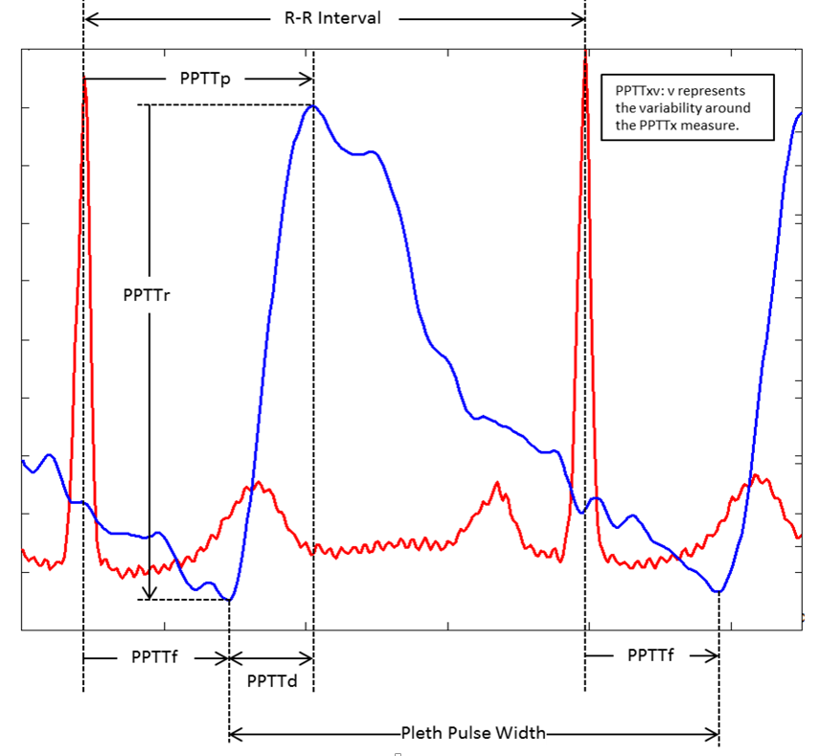
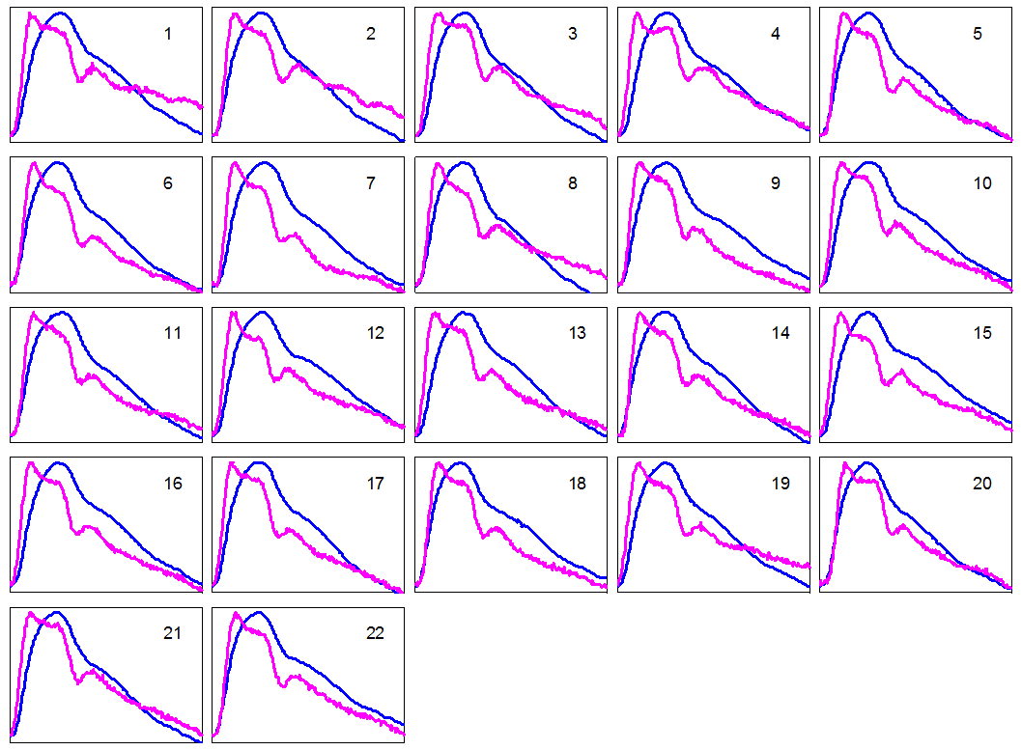
Plethysmography may provide non-invasive indices of cardiovascular health during the night that are related to tonometry
Plethysmography Pulse
Automatic Comparison of Plethysmography and Tonometry Pulses
Challenge: Automated pulse identification during the night from signals which may be noise
Opportunity: Estimate of autonomic tone / arterial elasticity during the night

Slide 30
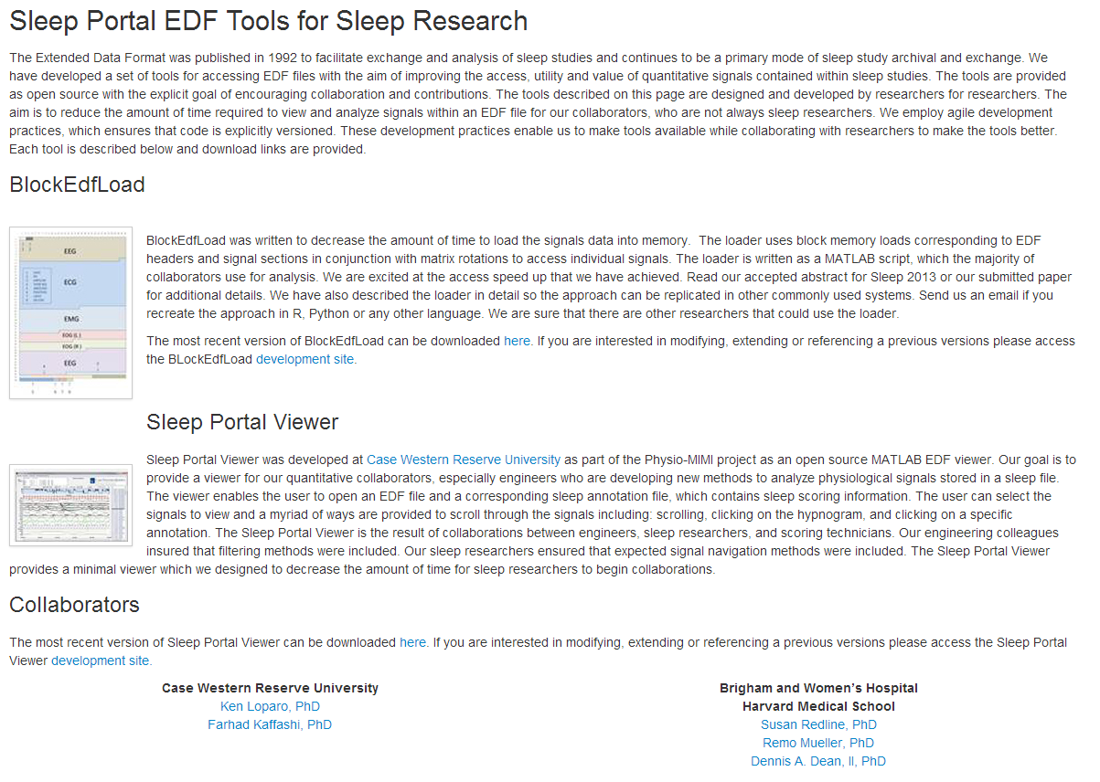
New tools are required to extract dynamic signals from sleep data
http://sleep.partners.org/edf/

