Slide 1

Central pressure profiles, wave reflections and cardiovascular risk in MESA
Julio A. Chirinos, MD.
Assistant Professor of Medicine.
University of Pennsylvania.
Director of Non-Invasive Imaging.
Philadelphia VA Medical Center.

Slide 2
Central pressure profiles, wave reflections and cardiovascular risk in MESA
Julio A. Chirinos, MD
David R. Jacobs Jr., PhD
Lyndia Brumback, PhD
Daniel A. Duprez, MD, PhD
David A. Bluemke, MD
Raymond R. Townsend, MD
Sebastian Vermeersch, PhD
Jan Kips,PhD
Patrick Segers, PhD
Senior MESA Sponsor: Richard Kronmal, PhD

Slide 3
Objectives
General principles regarding central pressure profiles.
Initial results from MESA ancillary study on central pressures.

Slide 4
Why study central pressures?
  Brachial pressures are not equal to central pressures.
  Hypertensive target organs are exposed to central pressure profiles.
  The aortic pressure profile is determined by the interactions between the left ventricle (LV) and the load imposed by the arterial tree.

Slide 5
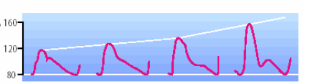
Arterial Pulse Wave propagation
PP and SBP and the pressure waveform progressively change towards the periphery
Nichols WW, O’Rourke MF. McDonald’s Blood Flow in Arteries. 5th ed. 2005.
Safar ME et al. Am J Geriatr Cardiol 11(5):295-298, 304, 2002

Slide 6
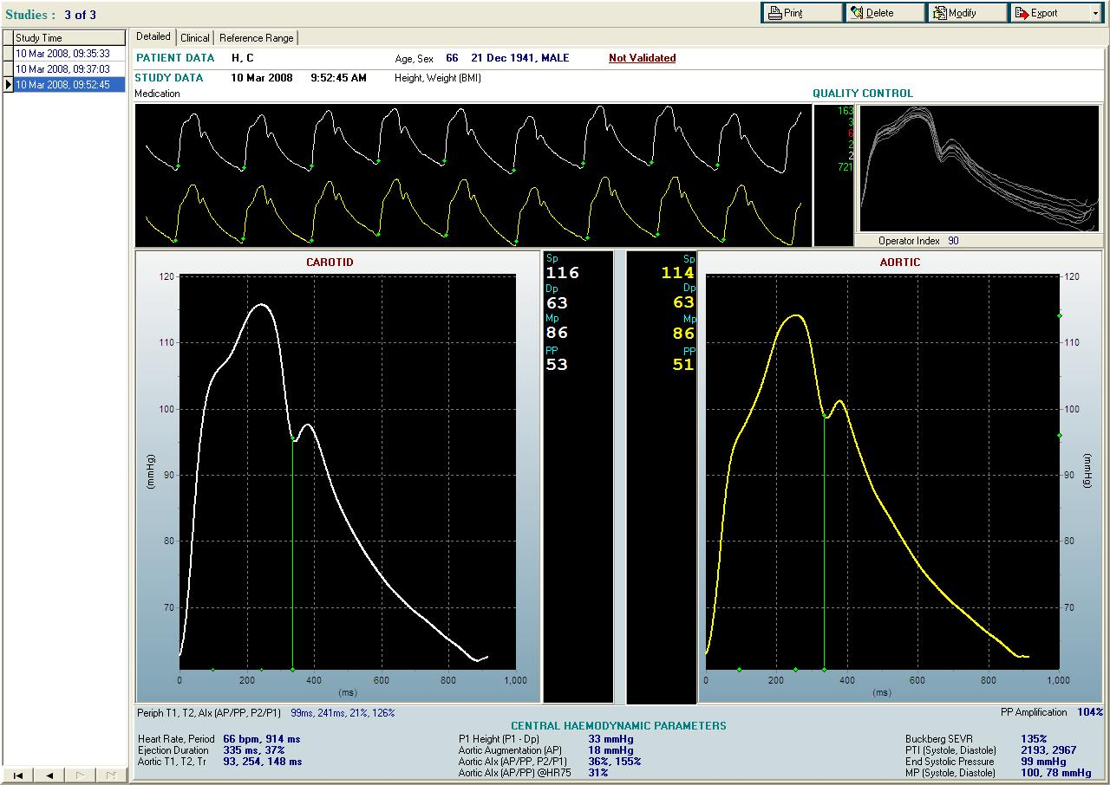

Slide 7
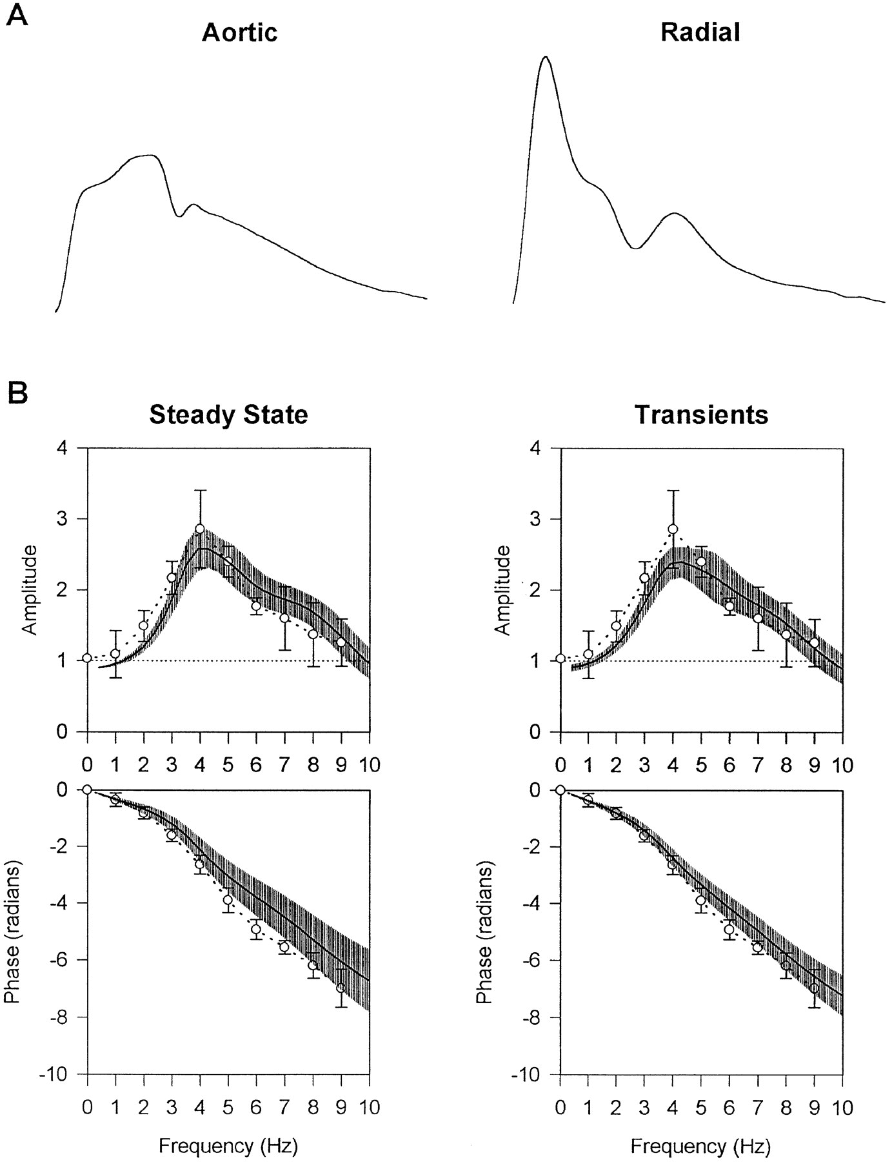
Nichols WW, O’Rourke MF. McDonald’s Blood Flow in Arteries. 5th ed. 2005.

Slide 8
Period duration (T)
Amplitude (modulus)
Phase (position in time relative to the parent wave)
Chirinos JA, Segers P. Hypertension 2010; 56(4):555-62.

Slide 9
\
φ
φ
φ
Fundamental Period
Time
Chirinos JA, Segers P. Hypertension 2010; 56(4):555-62.

Slide 10
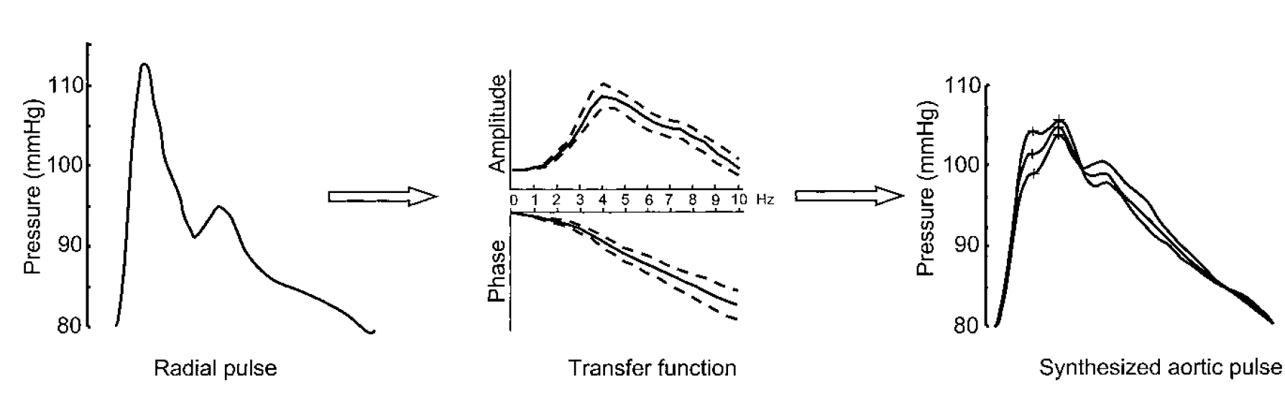
Millasseau et al. Hypertension. 2003;41:1016-1020.)

Slide 11
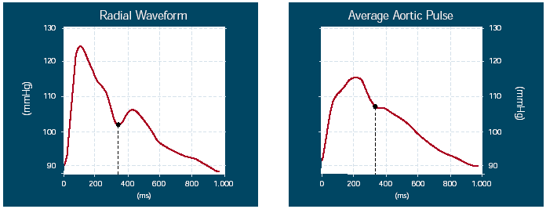
Pressure: Radial Tonometry
Radial Pressure Waveform
Generalized Transfer
Function
Central (Aortic) Waveform
Nichols WW, O’Rourke MF. McDonald’s Blood Flow in Arteries. 5th ed. 2005.
Safar ME et al. Am J Geriatr Cardiol 11(5):295-298, 304, 2002

Slide 12
TFs are reasonably accurate to predict central systolic (peak) blood pressure and pulse pressure.
Nichols WW, O’Rourke MF. McDonald’s Blood Flow in Arteries. 5th ed. 2005.
Safar ME et al. Am J Geriatr Cardiol 11(5):295-298, 304, 2002

Slide 13
There more to central pressure profiles than peak pressure

Slide 14
Systolic load = Systolic Blood Pressure
Complex
Time-varying

Slide 15
Systolic load = Systolic Blood Pressure
Patients with identical bSBP (or even aSBP) may different afterload patterns.

Slide 16
SYSTOLE
DIASTOLE
Nichols WW, O’Rourke MF. McDonald’s Blood Flow in Arteries. 5th ed. 2005.
Safar ME et al. Am J Geriatr Cardiol 11(5):295-298, 304, 2002

Slide 17
Augmentation Index
P2
P1
Notes:
. The first and second systolic peaks (P1 and P2) of the derived aortic pressure waveform are analyzed. Augmented pressure is calculated as the difference between the second and first systolic peaks (P2-P1). The Augmentation Index is defined as the augmented pressure expressed as a percentage of the pulse pressure.

Slide 18
Vlachopoulos et al. European Heart Journal 2010; 31(15):1865-71.

Slide 19
High frequencies of the TF are more variable
Between individuals
Nichols WW, O’Rourke MF. McDonald’s Blood Flow in Arteries. 5th ed. 2005.

Slide 20
How else can we measure wave reflections?

Slide 21
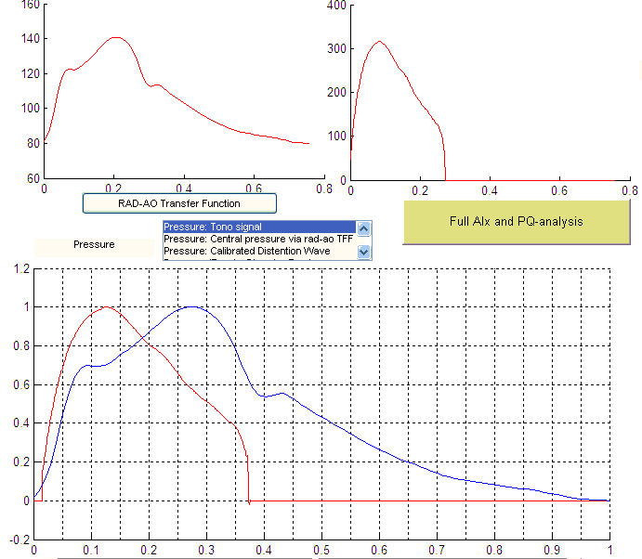
Pressure-Flow analyses

Slide 22
In the absence of reflected waves (from the periphery) pulsatile pressure and flow wave forms should be identical.
Pressure
Flow
Chirinos JA, Segers P. Hypertension 2010; 56(4):555-62.
Notes:
The effects of intermittent flow injection into a single elastic
tube of infinite length illustrate pressure-flow relations in the
absence of reflected waves. Under such conditions, pulsatile
energy imparted from one end of the tube promotes forward
flow and increases pressure within the tube. Measured flow
and pressure signals demonstrate exactly the same shape
(Figure 3).
Impedance to pulsatile flow
imparted by a given vessel segment is defined, in analogy, as
the ratio of pulsatile change in pressure/pulsatile change in
flow in that particular vessel. In the absence of reflected
waves in the vessel, this property is called characteristic
impedance (Zc).

Slide 23
The incident wave (ventricular contraction)
  Increases pressure
  Increases flow
Reflected waves:
  Increase pressure
  Decrease flow
  P
  P
`
  F
  F
Chirinos JA, Segers P. Hypertension 2010; 56(4):555-62.

Slide 24
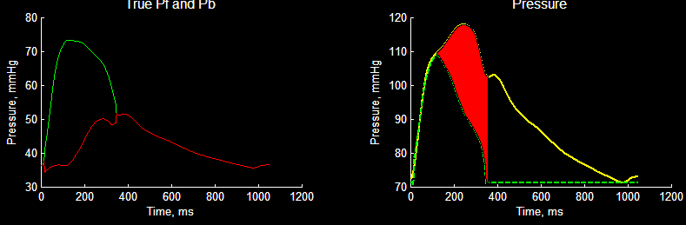
Wave separation analysis
Incident wave (Pf)
Reflected Wave (Pb)
Reflection magnitude = Pb / Pf
Westerhof BE et al. Hypertension. 2006;48:595-601.

Slide 25
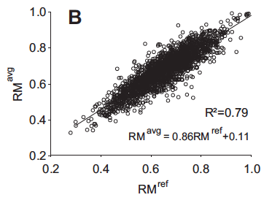
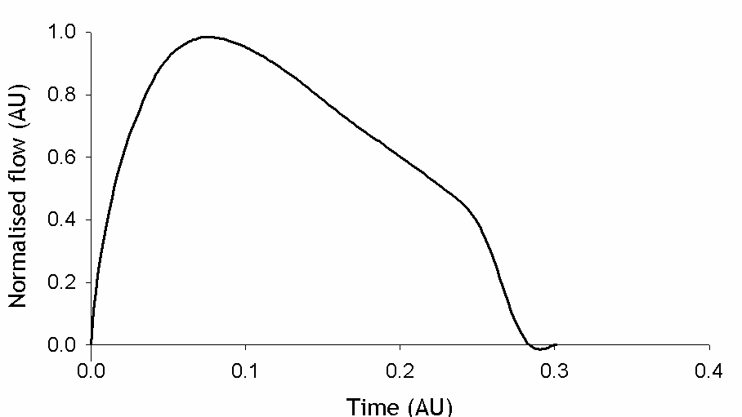
Kips et al. Hypertension. 2009;53:142-149

Slide 26
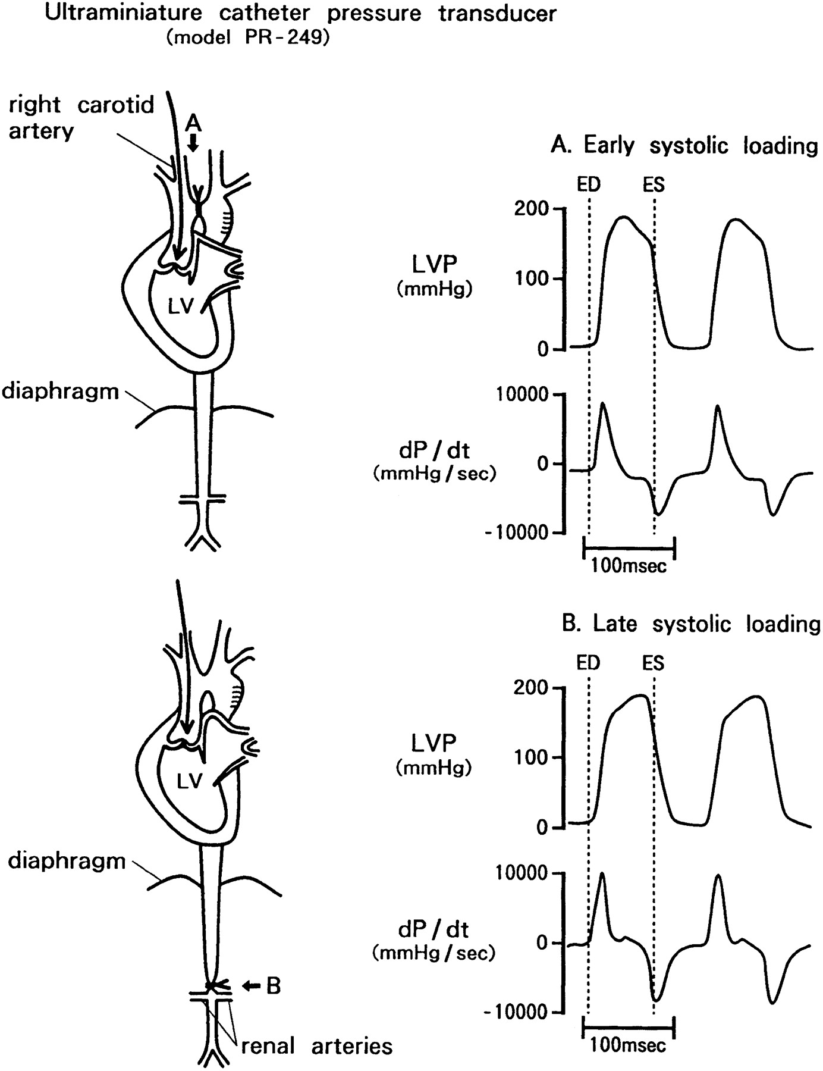
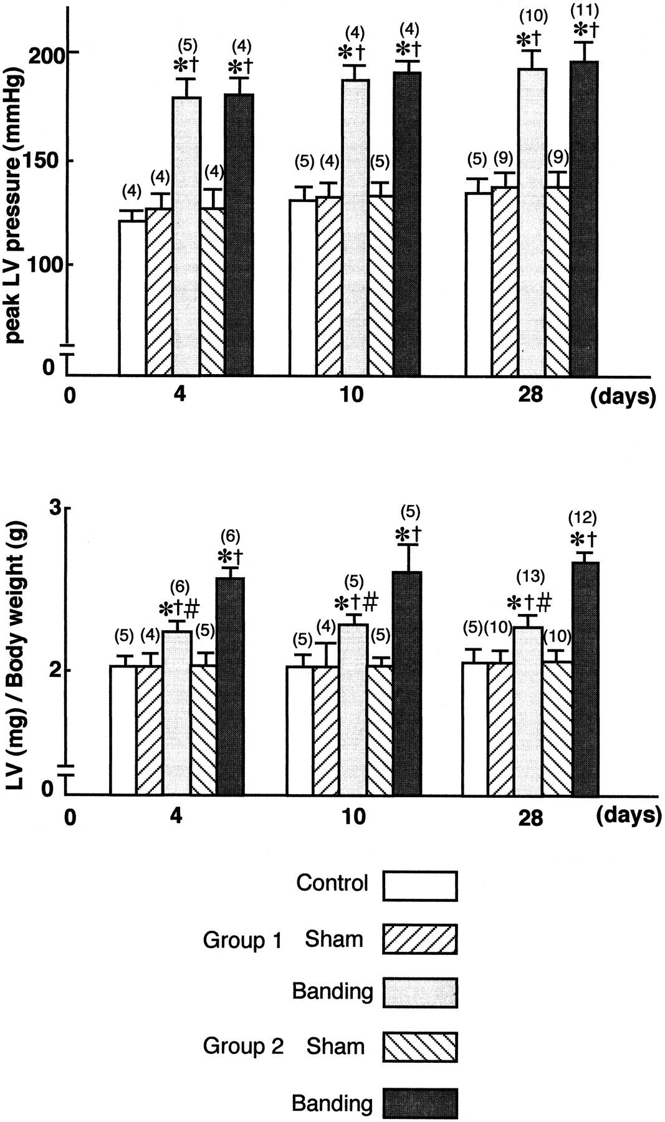
Effect of Early versus Late Pressure Overload in Rats
A
B
Kobayashi S. Circulation. 1996;94:3362-3368.

Slide 27
Objectives
Assess the relationship between central pressure profiles (cPP, AIx, RM)
  Incident hard CVE
  Heart Failure

Slide 28
Methods
Radial arterial waveform 30-second recordings were obtained at baseline using the HDI/PulseWave-CR2000 tonometry device, digitized at 200Hz and exported.
Offline-processing using custom-designed software written in Matlab (The Mathworks; Natick,MA).

Slide 29
Methods
A generalized transfer function was applied to the radial pressure waveform to obtain a central pressure waveform.

Slide 30
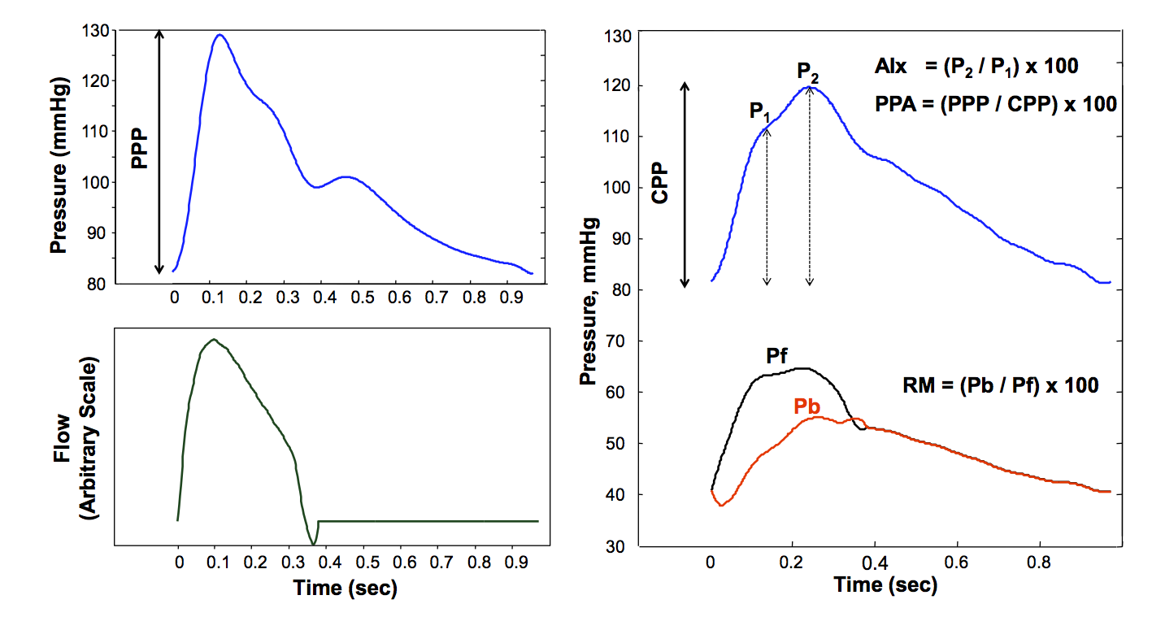

Slide 31
Endpoints
Hard CVE
All CVE
Heart Failure (“hard” criteria)

Slide 32
Statistical Methods
Kaplan Meier method
Cox regression
Model fit
  Akaike’s information criterion
  Bayesian information criterion
  Harrel’s c index
  Calibration Hosmer Lemeshow test

Slide 33
Methods
NRI
  Depends on the increased probability that a new model will categorize case subjects as higher-risk and decreased probability that it will categorize control subjects as lower-risk, compared to a base model.
Category free NRI
rIDI, which expresses the relative improvement in discrimination slopes between the base model and new model.
Notes:
We computed 2 versions of the NRI: a category-based NRI based on usual categories for 10-year coronary heart disease risk (adapted at 5 years as <2.5%, 2.5-<5%, 5-<10% and ≥10%). Since no established categories exist that guide clinical decisions for CHF risk, we computed category-free reclassification measures, which are independent on arbitrarily defined risk thresholds²⁶. These include the category-free NRI and the relative integrated discrimination improvement (rIDI), which expresses the relative improvement in discrimination slopes (mean difference in predicted probabilities between case and control participants) between the base model and new model.^{23, 25-27}
which expresses the relative improvement in discrimination slopes (mean difference in predicted probabilities between case and control participants) between the base model and new model.

Slide 34
Results
Of 6,336 participants who underwent radial tonometry, 6153 (97.1%) had technically-adequate data.
Central waveforms from 164 subjects had no discernible inflections, impeding adequate identification of the first and second systolic peaks.
37 participants had no follow-up information
5,958 participants in the analysis.
Notes:
We computed 2 versions of the NRI: a category-based NRI based on usual categories for 10-year coronary heart disease risk (adapted at 5 years as <2.5%, 2.5-<5%, 5-<10% and ≥10%). Since no established categories exist that guide clinical decisions for CHF risk, we computed category-free reclassification measures, which are independent on arbitrarily defined risk thresholds²⁶. These include the category-free NRI and the relative integrated discrimination improvement (rIDI), which expresses the relative improvement in discrimination slopes (mean difference in predicted probabilities between case and control participants) between the base model and new model.^{23, 25-27}
which expresses the relative improvement in discrimination slopes (mean difference in predicted probabilities between case and control participants) between the base model and new model.

Slide 35
Results
During a median follow-up of 6.46 (interquartile range: 6.19-6.67) years
  356 subjects experienced a first CVE
  241 subjects experienced a first hard CVE
  104 experienced a first episode of CHF.
Notes:
We computed 2 versions of the NRI: a category-based NRI based on usual categories for 10-year coronary heart disease risk (adapted at 5 years as <2.5%, 2.5-<5%, 5-<10% and ≥10%). Since no established categories exist that guide clinical decisions for CHF risk, we computed category-free reclassification measures, which are independent on arbitrarily defined risk thresholds²⁶. These include the category-free NRI and the relative integrated discrimination improvement (rIDI), which expresses the relative improvement in discrimination slopes (mean difference in predicted probabilities between case and control participants) between the base model and new model.^{23, 25-27}
which expresses the relative improvement in discrimination slopes (mean difference in predicted probabilities between case and control participants) between the base model and new model.

Slide 36
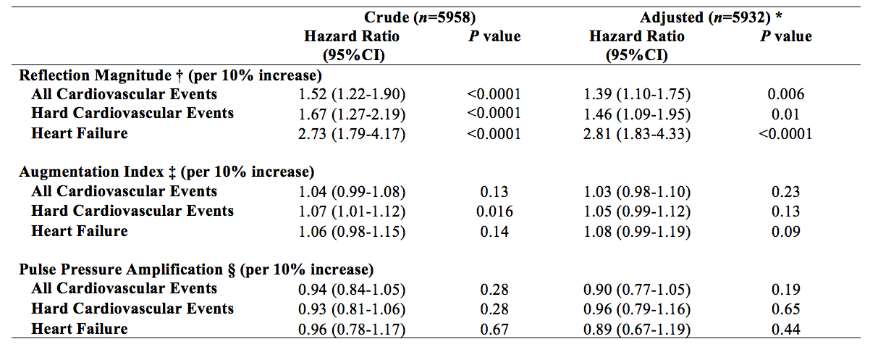
Results of Cox models examining the relationship between hemodynamic variables at baseline and the risk of
CVE and HF during follow-up.
* Adjusted for age, ethnicity, gender, body height, body weight, diabetes mellitus, systolic blood pressure, diastolic blood pressure, antihypertensive medication use, total cholesterol, HDL-cholesterol, current smoking, heart rate and estimated glomerular filtration rate. Complete covariate data was available from 5932 subjects.

Slide 37
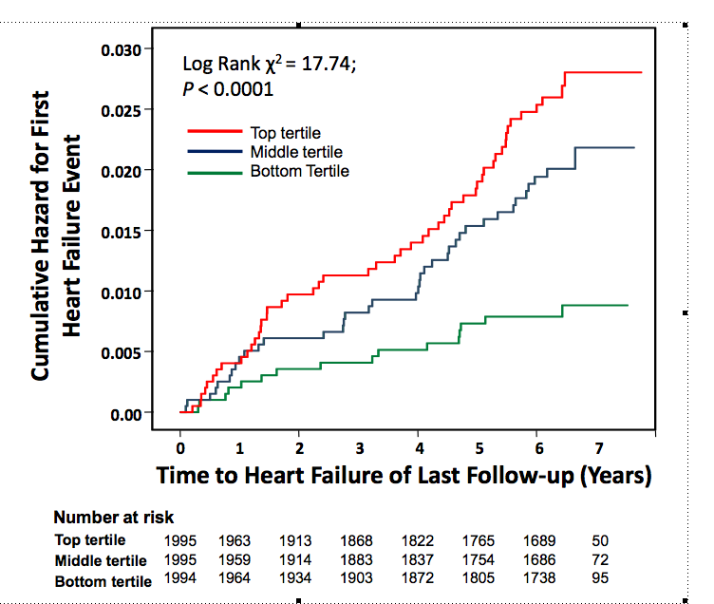

Slide 38
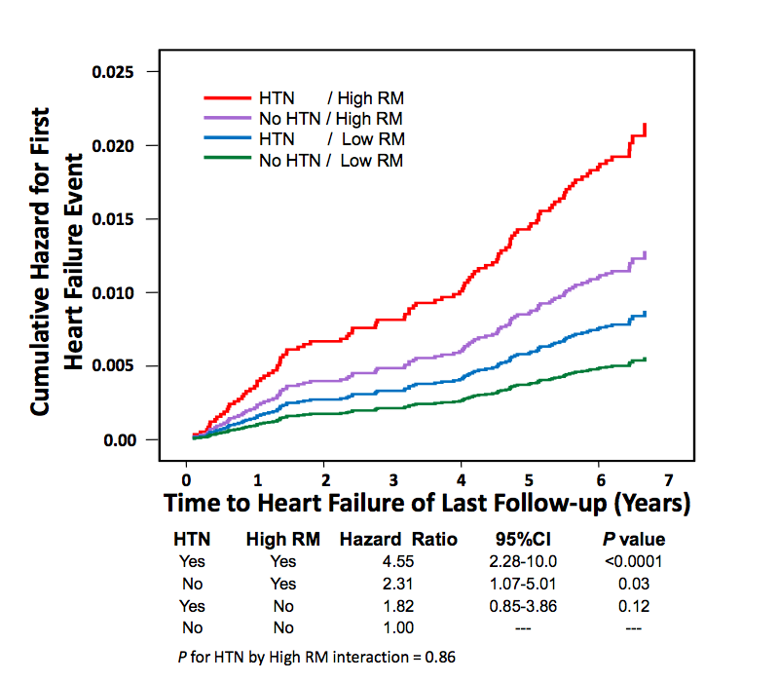

Slide 39
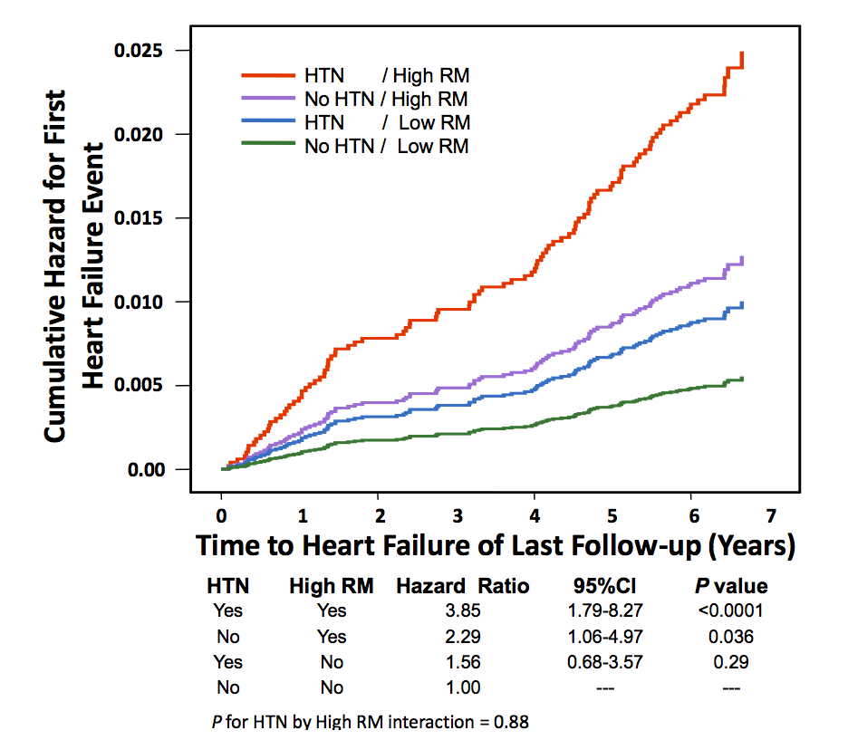

Slide 40
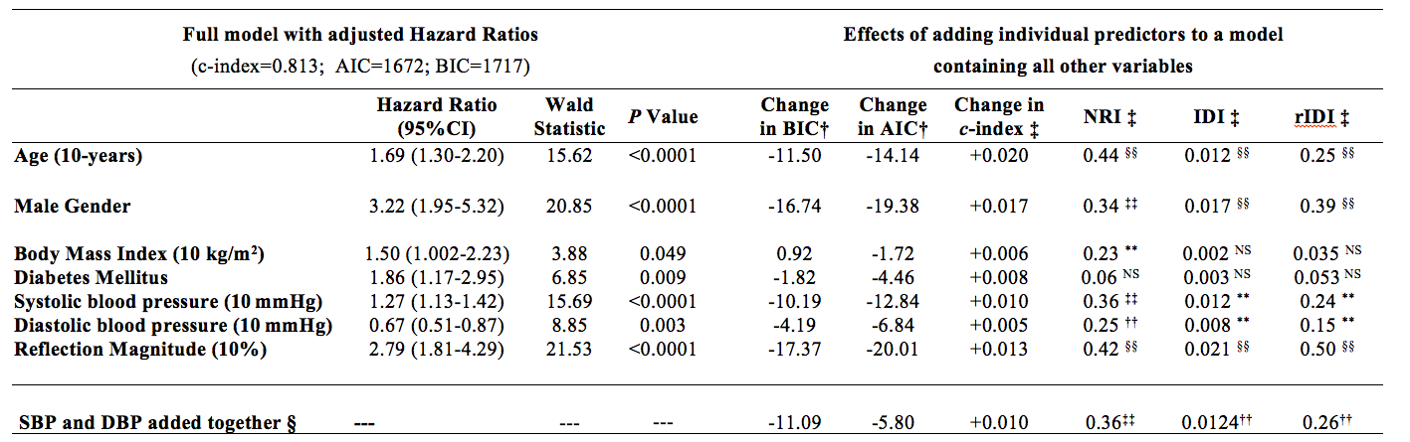
Predictors of incident heart failure in multivariate analysis (n=5932)
* All models are adjusted for ethnicity, antihypertensive medication use, total cholesterol, HDL-cholesterol, current smoking, heart rate and estimated glomerular filtration rate. Only significant predictors of CHF are shown.

Slide 41
Conclusions
In this large multiethnic sample, the magnitude of arterial wave reflections assessed non-invasively was a strong predictor of incident HF (stronger than other modifiable risk factors for HF).
Our study identifies an important novel independent risk factor for new-onset HF among adults in the general population who are free of clinically apparent CVD.
Notes:
The NRIs within specific risk categories were also calculated. These were 0.05 (95%CI=-0.13 to 0.24; P=0.57) for <2.5%, 0.31 (95%CI=0.04-0.57; P=0.02) for 2.5 to <5%, 0.38 (95%CI=0.12-0.63; P=0.004) for 5 to <10% and 0.23 (95%CI=0.17-0.29; P<0.00001) for ≥10% 5-year risk.

Slide 42
Conclusions
Based on these data and consistent with animal studies, the reflected wave (and loading sequence) appears to be important for HF risk.
Potential therapeutic target for HF prevention (vasoactive drugs such as organic nitrates profoundly decrease wave reflections despite small effects on brachial pressures).

Slide 43
Future approaches?
Assess the relationship between RM and types of HF (systolic vs. HFpEF)
Gender differences in the relationship between RM and incident HF.
Correlates of RM and of progression of RM over time.
Relationship with LV remodeling.

Slide 44
Arterial determinants of the Central Pressure Profile
300
Zc
Reflection timing
TAC
240
RM
Reflection
timing
180
Pressure (mmHg)
Flow (mm³/sec )
120
SVR
Zc
60
Reflection
Magnitude
TAC
0
SVR
Chirinos JA, Segers P. Hypertension 2010; 56(4):555-62.

Slide 45
Acknowledgements
Richard Kronmal
MESA Elasticity Team
David R. Jacobs Jr, Lyndia Brumback, Daniel Duprez
Collaborators
David A. Bluemke, Ray Townsend, MD
Ghent University Team
Sebastian Vermeersch, Jan Kips, Patrick Segers.
Entire MESA Team!

