Slide 1
MESA AIR – CT REPORT
Matthew Budoff
Budoff@ucla.edu

Slide 2
CT
No new Scanners are being implemented – UCLA will go to Siemens 64
Excellent scanning and data being sent
Protocol violations dropping per month

Slide 3
CAC Scans
We did a push to read scans last week and submitted over 100 reads to the CC on Friday. We have read all scans prior to 2/15/11.
Scans Done: 1258
Scans Read: 1154
We have asked the CC to chang the reporting of overdue scans from >30 to >14 days.

Slide 4
MESA CT Changes
New Field of View (32 cm) – less incidental findings and lower radiation (40% reduction)
New Triggering (70-75% of the RR) – less motion artifacts
New Equipment – Toshiba 320 (Hopkins)
Progression evaluation underway (C. Johnson)
Single Scan protocol

Slide 5
Scientific Changes for Exam 5
We are obtaining thin slices (0.625-1.25 mm slices) in addition to normal 2.5-3 mm slices
Should allow more visualization of CAC and more accurate quantification
E. Brown is evaluating a new scoring algorithm to capture calcification better

Slide 6
Progress to Date
Number of Scans Done 2010 *Number of Scans Done 2011
3-WFU 71 250
4-Columbia 42 231
5-JHU 49 224
6-FairviewMN 86 236
7-NWU 75 333
8-UCLA 50 206
Grand Total 373 1480*
*Scans Thru 2/15/11

Slide 7
Radiation Doses
1258 patients underwent calcium scoring. (LIMITS 3 mSev, DLP 214)
Median Dose mSev (DLP): 0.95 (68)
Mean Dose mSev (DLP): 0.96 (69)
Maximum Dose mSev (DLP): 3.18 (227)
Minimum Dose mSev (DLP): 0.4 (29)
1306 patients underwent lung Scanning: (LIMITS 6.5 mSev, DLP 470)
Median Dose mSev (DLP): 3.93 (281)
Mean Dose – mSev (DLP): 4.23 (302)
Maximum Dose mSev (DLP): 8.38 (599)
1128 underwent both lung and CAC Scanning (LIMITS 9.5 mSev, DLP 684)
Median Dose mSev (DLP): 4.91 (351)
Mean Dose mSev (DLP) 5.19 (371)
Maximum Dose mSev (DLP): 9.29 (664)

Slide 8
Protocol Violations
MAJOR Violations –
5 patients received CAC scans that shouldn’t
6 Patients with radiation dose too high
1 CAC scan too high
5 Lung Scans too high

Slide 9
Protocol Violations
53 total protocol violations reported to PIs and CC (mostly wrong body weight used or scan length):
These violations affected rad dose, but DLPs are still within IRB limits.
There were other minor deviations, e.g., Field of View, rotation time, recon kernel but these were not reported to PIs

Slide 10
CT Alerts – 2/15/11
 | WFU | Columbia | JHU | Fairview MN | NWU | UCLA | Grand Total
Protocol Violation | 7 | 10 | 7 | 7 | 19 | 3 | 53

Slide 11
Major Violations Since OSMB 10/10
1 - local clinical chest protocol used, instead of MESA Lung study CT protocol. (1 at UMN). This violation resulted in excess radiation in the lung scan only, but overall radiation was less than the amount to which the participant consented. Minnesota reported this violation to their IRB, but did not contact the participant (with their IRB's blessing).

Slide 12
Minor SINCE OSMB 10/2010
9 Cardiac:
5 - incorrect xray tube current setting (1 at WFU; 3 at COL; 1 at NWU)
3 - incorrect FOV used (3 at NWU)
1 - incorrect protocol used for weight; weight <220 but large patient protocol used (1 at NWU)
8 Lung:
7 - incorrect protocol used for body size
1 - BMI < 20, used medium patient protocol (1 at JHU)
4 - BMI > 30, used medium patient protocol (4 at NWU)
1 - BMI <=30, used large patient protocol (1 at UMN)
1 - BMI >=20, used small patient protocol (1 at WFU)
1 - scanned stopped and restarted (1 at WF)

Slide 13
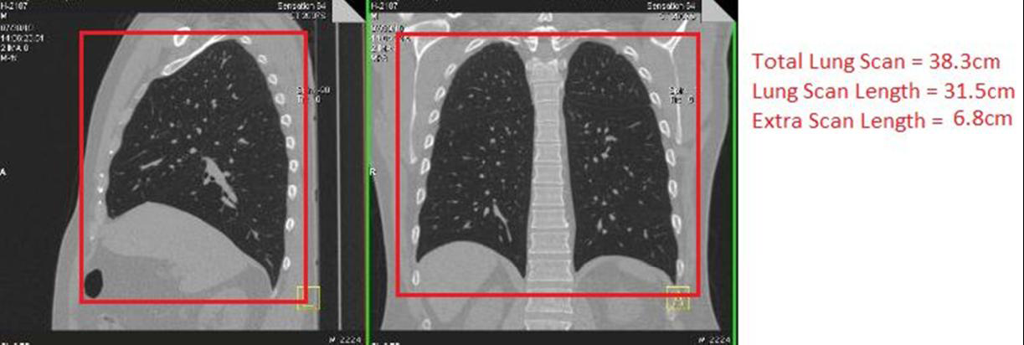

Slide 14
Scientific Opportunities
Heart and Lung Scans
Thin Slices obtained (0.625 mm slices)
Will lead to higher CAC scores (less negatives)
Better Scanners, less noise
More Atherosclerosis seen on lung scans
(aortic arch)

Slide 15
Aortic Valve Calcium

Slide 16
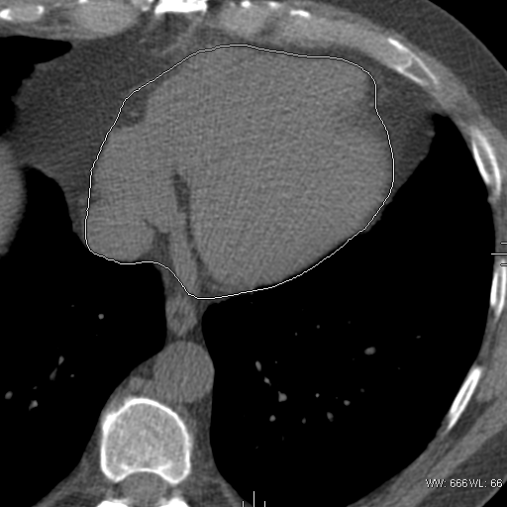
Measuring Pericardial Fat

Slide 17
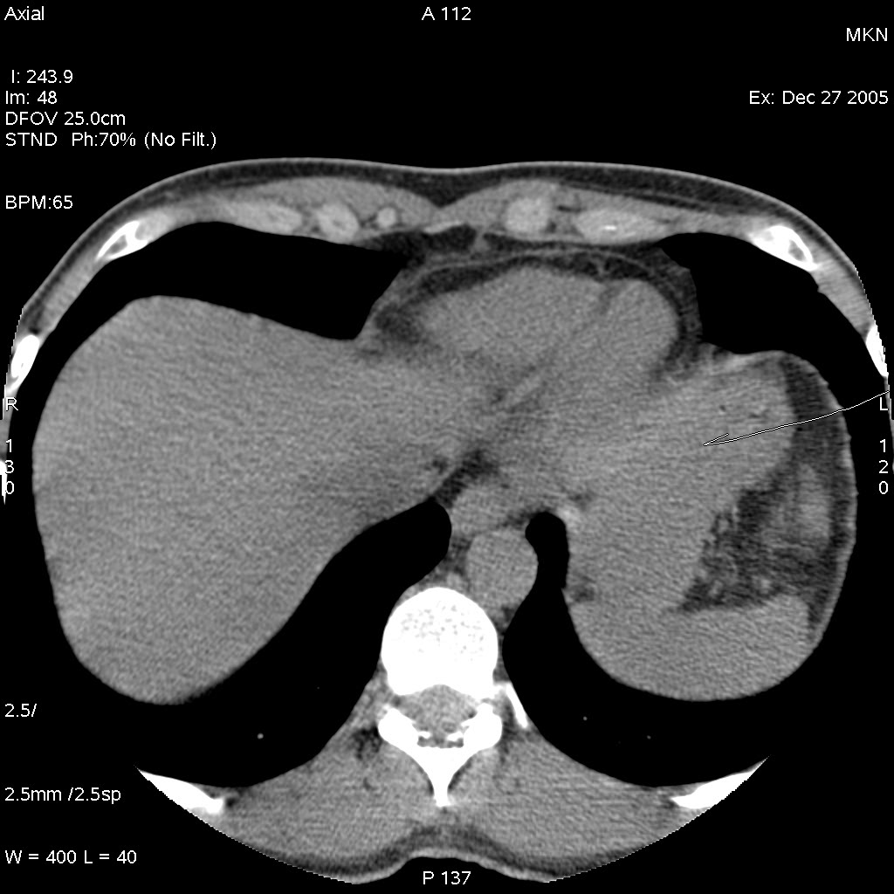
Liver and spleen HU measurement

Slide 18
Additional Variables that have been obtained from calcium scan
Aortic valve, mitral valve, thoracic calcification - done
Left Ventricular size - done
Thoracic Aortic diameters - NEW
RV size, Pulmonary artery diameters –K Nasir
Atrial sizes – done, J Carr
Bone density (thoracic) – 2000, M Budoff
Pericardial fat – done, J Carr
Non-Alcoholic Fatty Liver Disease - NEW

Slide 19
MESA EXAM 6?

Slide 20
MACS CTA
DLP: 174±74 mGycm;
Dose: 2.4±1.0 mSv
400 patients scanned so far:
I with minor contrast allergy
No other adverse events
No radiation protocol violations
100% interpretability

Slide 21
Table 1: Measurements from CTA for each Participant
Coronary artery stenosis | Type of Analysis
Sum Stenosis Score (SSS)* | Continuous
Presence of significant stenosis (≥50%) | Categorical
Plaque composition
Any Plaque (present/absent) | Categorical
Non-calcified (present/absent) | Categorical
Mixed (present/absent) | Categorical
Calcified (present/absent) | Categorical
Total Plaque Score (TPS)** Any Calcified Mixed Non Calcified | Continuous Continuous Continuous Continuous
Percent Plaque Score (%PS)*** Calcified Mixed Non Calcified | Continuous Continuous Continuous
Cardiac Chambers
Left ventricular mass | Continuous
Left ventricular volume | Continuous
Left Atrial volume | Continuous
Aortic Diameter | Continuous
Left Atrial Diameter | Continuous

Slide 22
MESA CTA
Doing a multi-center, multi-vendor NIH study (W. Post – MACS CTA) - we have achieved doses of: 2.4±1 mSv
Endpoints Derived:
Plaque composition (non-calcified, mixed, calcified)
Plaque Score/quantity
Stenosis Severity Score
LV Mass/Hypertrophy
LV Volume
Left Atrial Volume
Pericardial fat
Coronary calcium
Aortic valve calcification
Mitral Annular calcification
Thoracic calcification
Infarction/Scar

