Slide 1


Induced Pluripotent Stem Cells in MESA
Tissue Assays w/o a Biopsy
Ulrich Broeckel, MD
Section of Genomic Pediatrics
Department of Pediatrics,
Medicine and Physiology
Medical College of Wisconsin

Slide 2
CONGRATULATIONS!
We can analyze more DNA and analyze more samples for less money than ever before.
And it will only get better…

Slide 3
But Wait….
Where are we today with GWAS?
GWAS: We identified many, many loci
Sequencing will add even more data
And sometimes we have more questions than we had before…

Slide 4
Questions :
What does this gene do?
What can we do with this gene?
Oh –wait, there is no gene???

Slide 5
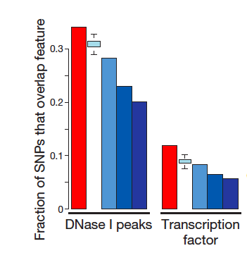
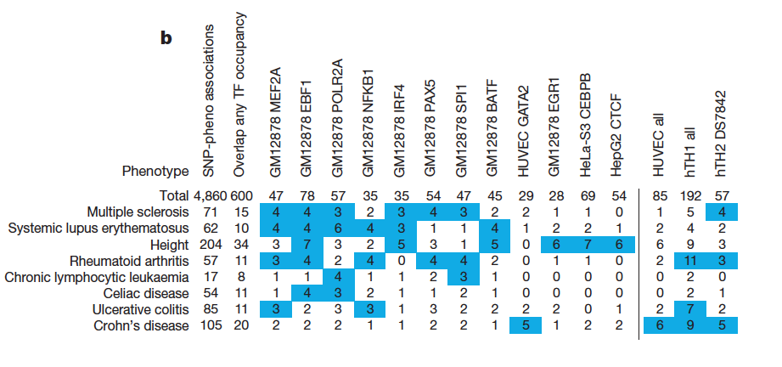
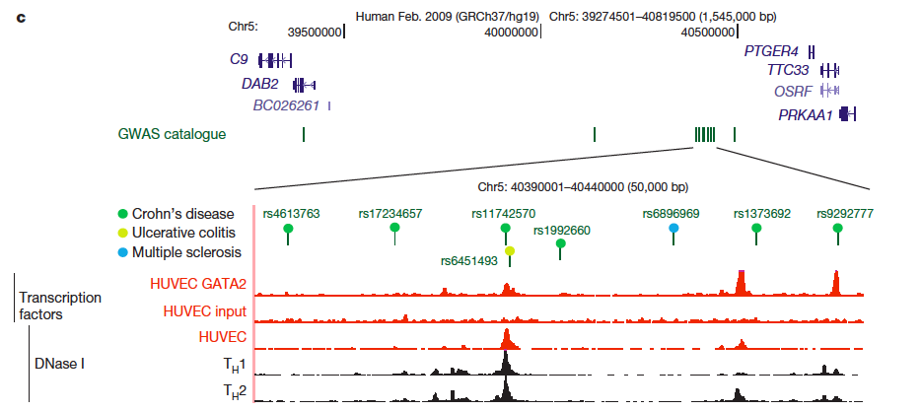
A Next Generation View of the Genome
Encode Project, Nature 2012

Slide 6
ENCODE: Tools to expand on function
Next generation DNA analysis, scale-up
Next Gen Sequencing
Large scale genome annotation
Relevant tissue – phenotypes are tissue specific
+ Large number of different cell types studied
+ Data available
± Lots of fetal tissue
- Mechanisms are likely tissue specific, disease specific
- Not from patients with disease SNPs/mutations

Slide 7
Tools
Animal models
Rat, mouse, zebrafish
Cell culture
How can we get human cells?
Many tissue types are not easily available
Limited amount of material
- Neural cells Neurodegenerative disease
- Cardiac cells Heart Failure

Slide 8
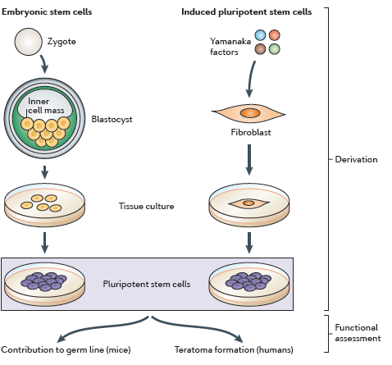
Stem Cells
Zhou et al. Nat Rev Genet 2011

Slide 9
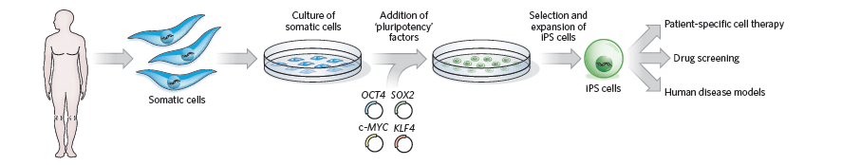
The Power of iPS cells
Cell unique as patient
Should recapitulate each patients disease - genetic
Yamanaka, Blau. Nature 2010

Slide 10
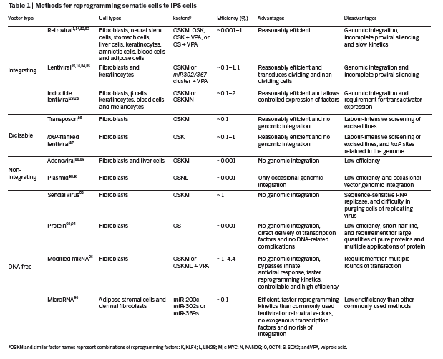
Methods

Slide 11
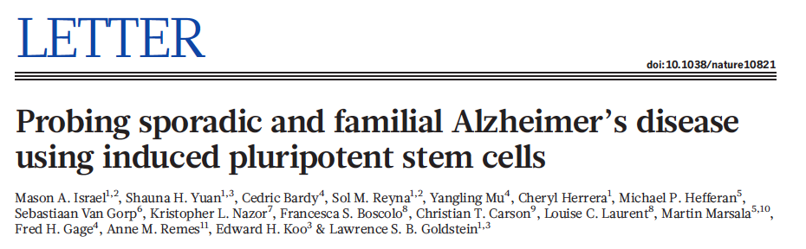
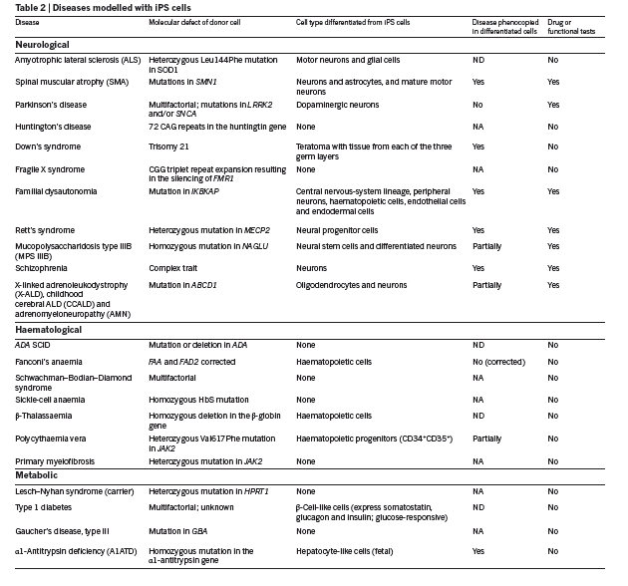
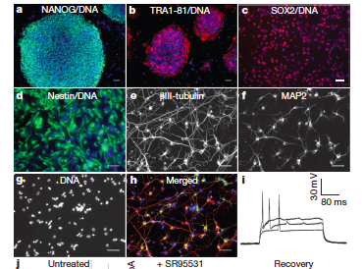
Disease Models

Slide 12
Left Ventricular Hypertrophy
Increase of left ventricular mass
Compensatory mechanism due to increase in
mechanical load
(increased wall stress, hypertension)
Independent cardiovascular risk factor
Considerable inter-individual variability at
equal blood pressure

Slide 13
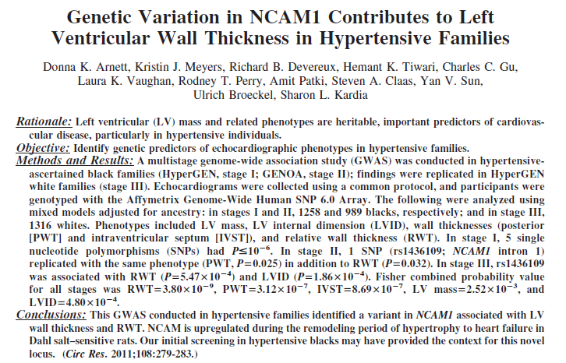
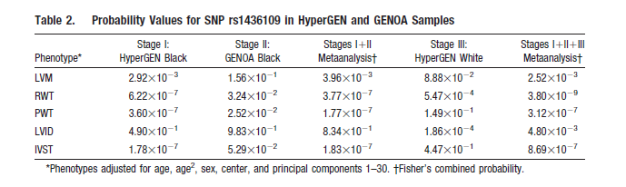
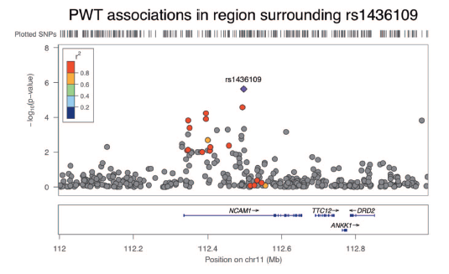
GWAS- HyperGEN

Slide 14
Next Steps….
Develop a disease model
Human cells
Recapitulate disease
Test for treatment

Slide 15
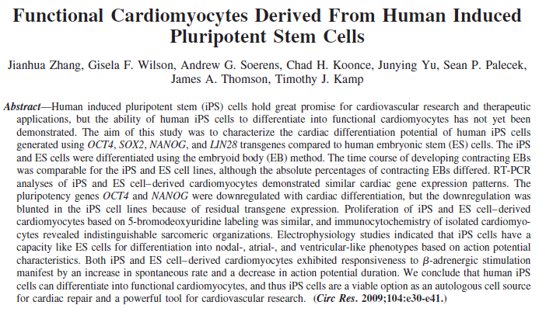
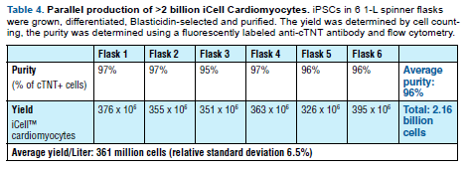
Cardiomyocytes
Differentiation and selection of cardiomyocytes:
Blasticidin resistance gene and Red-Fluorescent Protein (RFP) gene from cardiomyocyte- specific alpha-Myosin Heavy Chain (α-MHC) promoter
Culture medium and conditions to drive cardiomyocyte phenotype
PiggyBac (PB) transposon/transposase system
Cardiac Troponin T
MYL2 (myosin regulatory light chain 2) – ventricular cardiomyoctes
Testing nuclease-mediated gene delivery
Phenotyping for quality control
cardiomyocyte markers and ion channels including: IRX4, HCN1-4, RyR2, GJA1, GJA5, potassium
channels, sodium channels and calcium channels. Ventricular specific electrophysiology will be verified by
patch clamping, action potential duration and sensitivity to the hERG-type potassium channel blocker E-4031

Slide 16
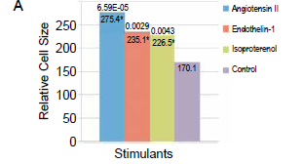
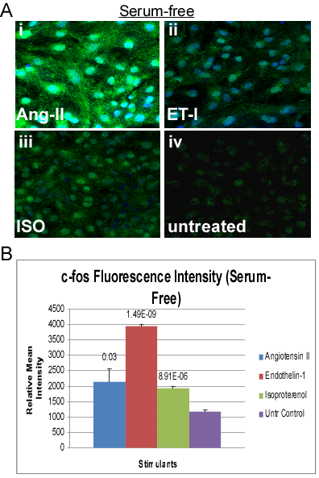
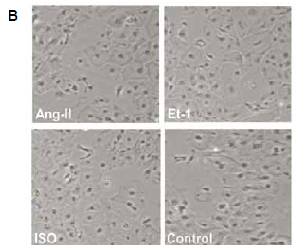
Human Cardiomyocyte Model of Hypertrophy

Slide 17
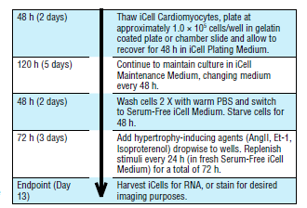
Expression Analysis
Analysis:
Combined analysis using identified genes from association and expression study (Array, RNA seq)
Study design:
Family-based Association
Genetic Information Content
Selection of individuals based on
- GWAS results and
- phenotype to maximize power

Slide 18
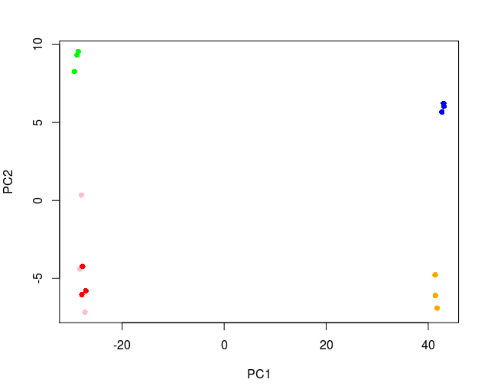
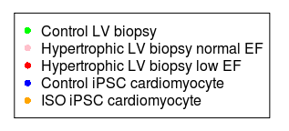
PC Analysis of Gene Expression
Human LV Biopsy vs iPSC Cardiomyocytes
PC1 captures
in vitro - in vivo differences
PC2 captures common aspects of hypertrophy

Slide 19
How can we Screen?
Drug screening
+ Known drugs – quick approach to treatment
+ Compounds - new mechanisms
- Mechanisms of action often unclear
siRNA
+ Targeted approach for each gene
Over-expression required
- Potentially long way to drug

Slide 20
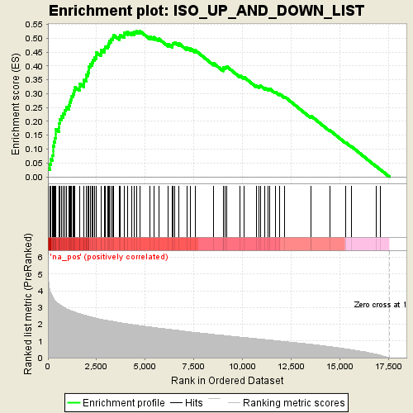
Gene Set Enrichment Analysis
Combining Expression and Genetics
Genes expressed in cardiomyocyte model of LVH show strong enrichment in genes ranked by association from human GWAS study.
We identify a number of significant genes which are associated with disease and are differentially expressed
Highly likely to play a role in disease
Screening

Slide 21
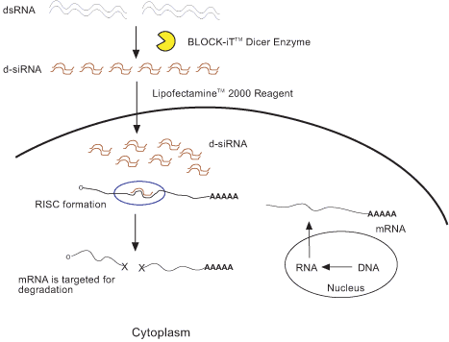
How Does siRNA work?

Slide 22
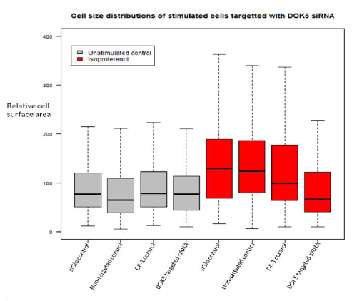
siRNA Prevents Development of Hypertrophy

Slide 23
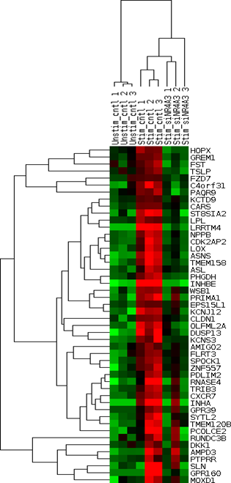
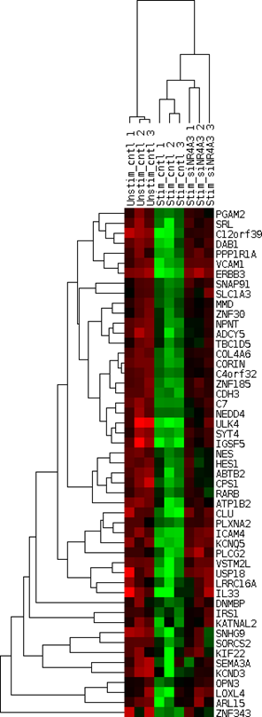
siRNA and Expression Analysis
BNP
Corin – processor of BNP

Slide 24
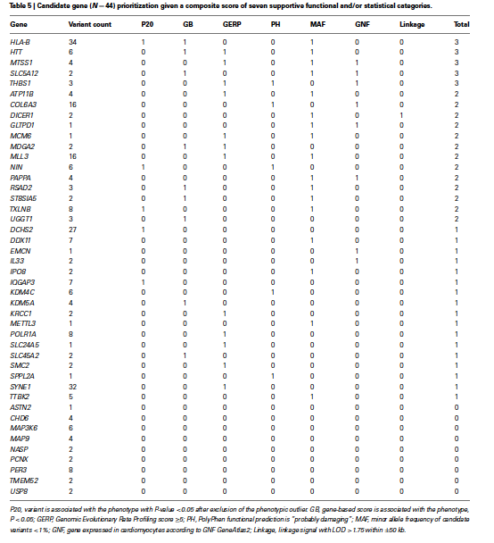
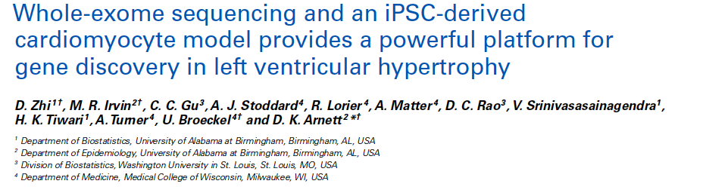
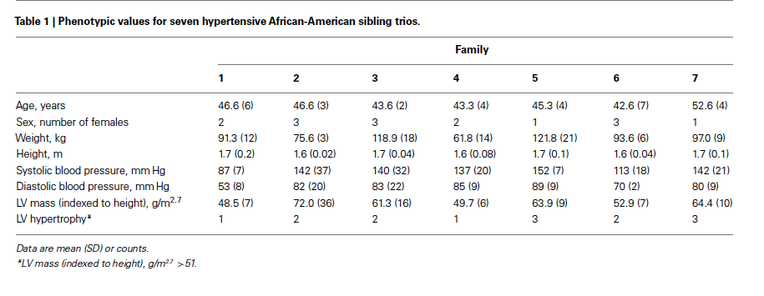
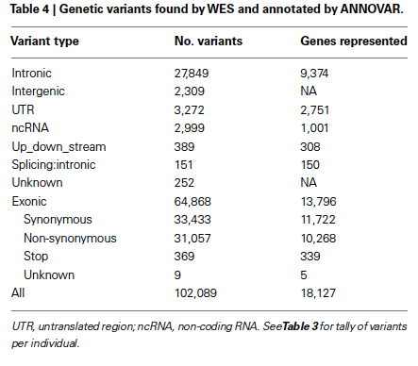

Slide 25
Taking the Next Steps…
Data and cell line is from one individual - so far
The greatest potential lies in generating individual specific iPS cells
Allows for the functional interrogation of the whole “polymorphisome”

Slide 26
Taking the Next Steps…
Develop the technology and infrastructure or generate large number of patient specific iPS cells
Improve the differentiation protocols at the same time
Reduction of cost:
Efficiency
Reduction of hands on time
Automation
Reduce time requirements

Slide 27
Let’s Not Forget…
Cell – Organ – Organism
  Cell culture has well established limitation
Cell ‘state’
  iPSCs and derived cells might represent more of an ‘early’ developmental disease
Molecular disease model
  Not every disease phenotype can easily and correctly be reduced to a cell based system.
  However: intermediate phenotypes

Slide 28
What can we do?
Plan for cardiomyocyte/LVH project
Unique advantages of MESA
Explore ideas
iPSC can serve as a general resource
Neural, endothelial, liver cells
Prioritize samples? It is still VERY expensive

Slide 29
Acknowledgement
HyperGEN: Donna K Arnett
Charles Gu
DC Rao
Beth Lewis
Steve Hunt
Cellular Dynamics International:
Emile Nuwaysir
Blake Anson
Chris Kendrick-Parker
Jamie Thomson
MESA:
Bruce Psaty
Russ Tracy
Wendy Post
Rachel Kraemer
Andrea Matter
Amy Turner
Alex Stoddard
Praful Aggarwal
Beth Virlee
Catherine Stabelfeldt
Erin Storvick
Diane Linzmeier
Susan Pachowitz
Paula Engelking
Janice Peete
Sandy Grieger

