Slide 1

MESA Project Office Report
MESA Steering Committee meeting
March 8, 2011
Diane Bild, MD, MPH
Prevention and Population Sciences Program
Division of Cardiovascular Sciences
NHLBI

Slide 2
Project Office Report Items
Exam 5
  Retention, results reports, protocol violations
Reminder about IRB and OSMB
Publications
Planning for the future
NIH and NHLBI (and federal government) news

Slide 3

Exam 5
Exam started in April
  Clinic site visits conducted in June and July
    No major problems identified
    Three clinics needed to increase capacity
    Clinic exams are well-received by
    participants
At the end of September, retention was 77% of
goal
*As of September 8, 2010

Slide 4

Exam 5
Phone calls with each site in January 2011
  Four sites with retention <80%
  Problems with staffing being resolved
  Two sites had resolved space limitations; third site on track for March
  Major weather issues at several sites
All sites thought that extending Exam 5 by 2
months would be greatly beneficial
  NHLBI Office of Acquisitions determined budgetary feasibility of extension

Slide 5
Exam 5 Percent of Target Examined
Downloaded from MESA web site (Enrollment Reports) March 4, 2011

Slide 6
Exam 5 retention
Goal for Exam 5 is 5,200, which represents
87-88% of enrolled cohort
  Enrolled cohort as of Feb 2011 – 5,915
  Enrolled cohort as of April 2010 – 6,002
Retention is falling short in minorities (Table 1.1.3)
Follow up phone calls somewhat behind.

Slide 7
Exam 5 Results Reporting to Ppts – CT scans
MESA Steering Committee report, section 2.2.2.2

Slide 8

Exam 5 Results Reporting to Ppts – as of September 2010
MESA Steering Committee report, section 2.2.2.2

Slide 9
Exam 5 Results Reporting to Ppts – as of March 2011
MESA March 2011
Steering Committee report, section 2.2.2.2

Slide 10
Exam 5 protocol violations
As of October 12, we reported a total of 6 serious protocol violations to the MESA OSMB that resulted in excess radiation.
Since then, we have had none (CT).
None reported for MRI (gadolinium given to someone with low GFR)

Slide 11
OSMB notifications
When an IRB is notified, please notify the PO so we can notify the OSMB
  Protocol violation that violates informed consent
  Adverse events
    Serious adverse events or unanticipated problem
    Other AEs

Slide 12
MESA Publications
??
Number
of
Manuscripts
(n=356)
* Published or in press as of March 4, 2011.

Slide 13
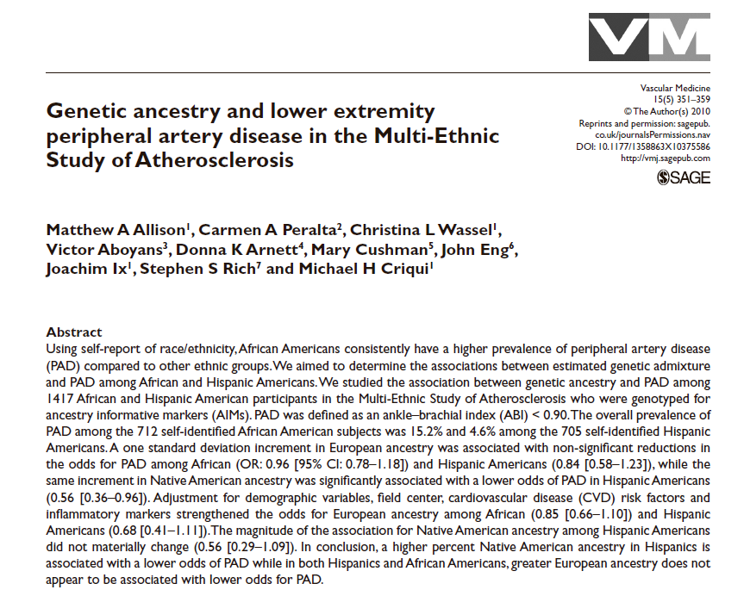
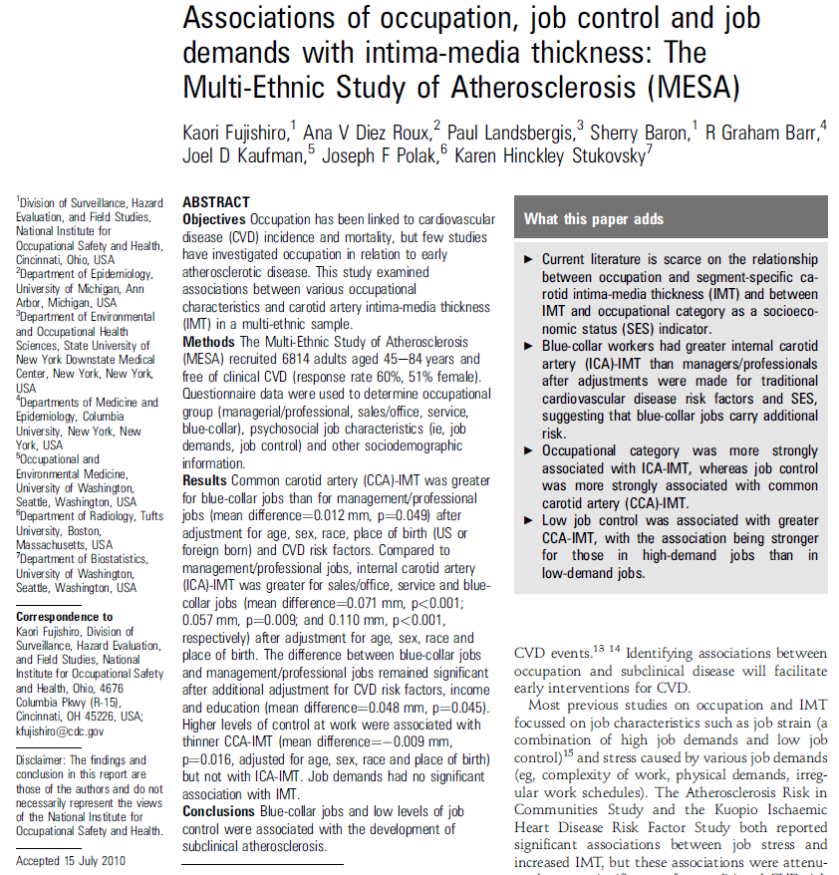
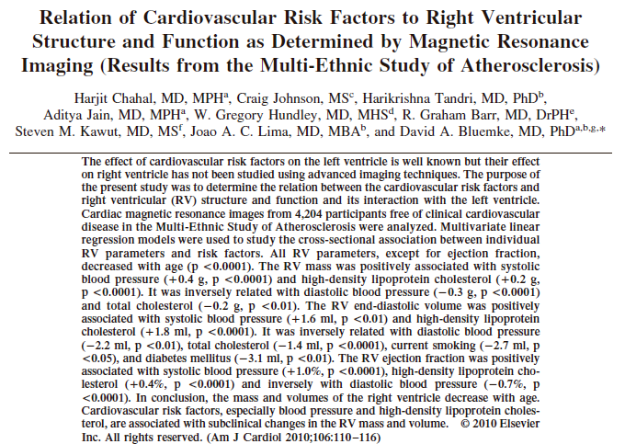
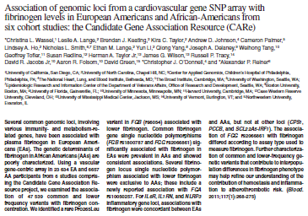
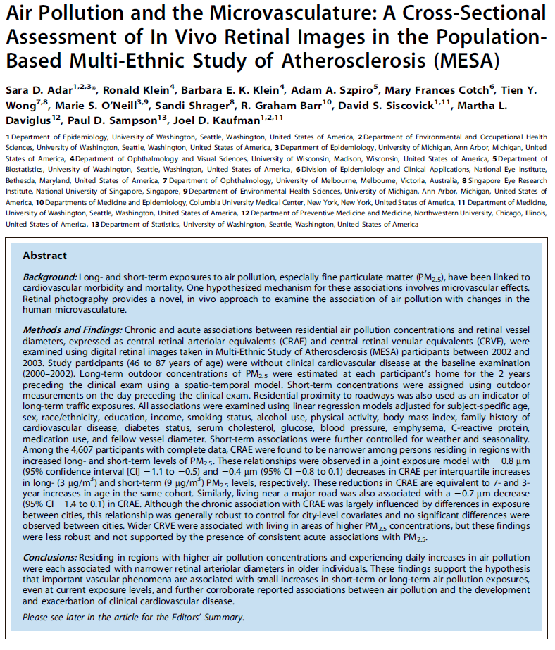
Publications

Slide 14
1 SD increment in Native American ancestry was associated with a lower odds of PVD (0.56, CI 0.36-0.96) in Hispanics.

Slide 15
RV mass and volume is related to age, SBP, HDL, TC, smoking, and DM

Slide 16
Blue-collar workers had greater IC IMT than managers/professionals after adjusting for risk factors.

Slide 17
A rare Pro265Leu variant was associated with lower fibrinogen level; several SNPs associated with lower fibrinogen were exclusive to African Americans.

Slide 18
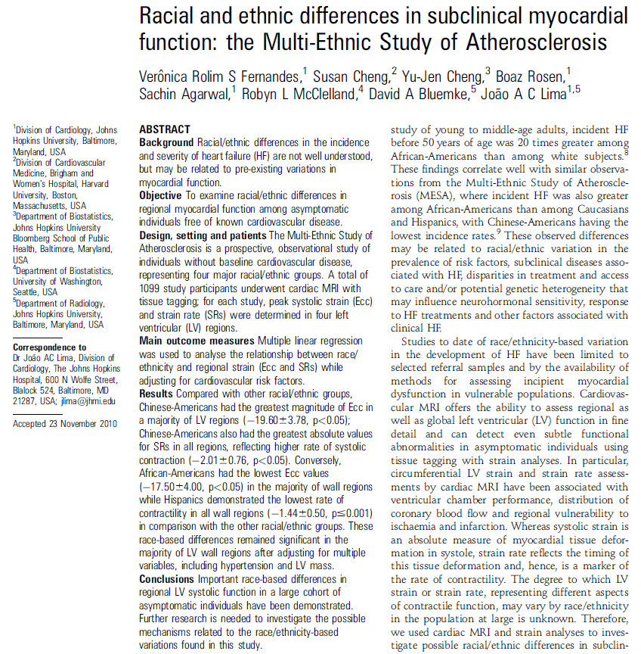
Peak systolic strain was greatest in Chinese and lowest in African Americans after RF adjustment
Systolic circumferential strain (Ecc) - values are negative and increased negativity (greater value) =enhanced function

Slide 19
Residing in more polluted areas was associated with narrower retinal arterioles

Slide 20
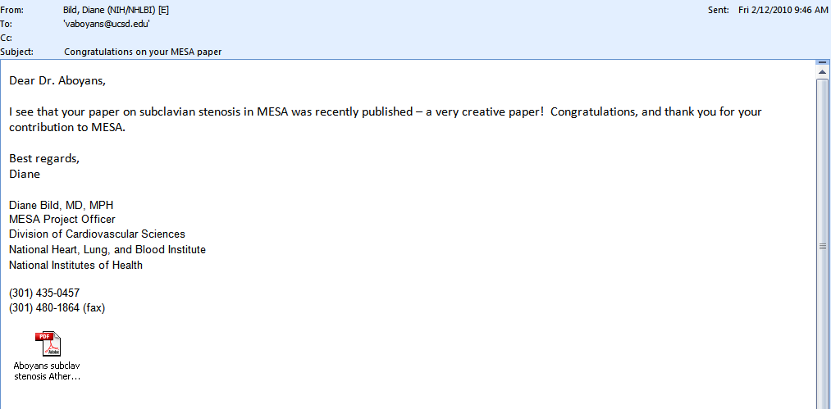
Dropping “Thank You’s” from the Project Office (with regret)

Slide 21

Important Discussion about future analyses
Exam 5 data – linked to 4 previous exams
About eight years of follow-up data
What have we found?
What are the most exciting and important topics to write with Exam 5 data?

Slide 22
NIH and NHLBI news
Appointment of new NHLBI Director still pending
Susan Shurin is Acting Director of NHLBI
The NHLBI OA is working with each contractor to restructure the contracts and bring them into compliance with the law

Slide 23
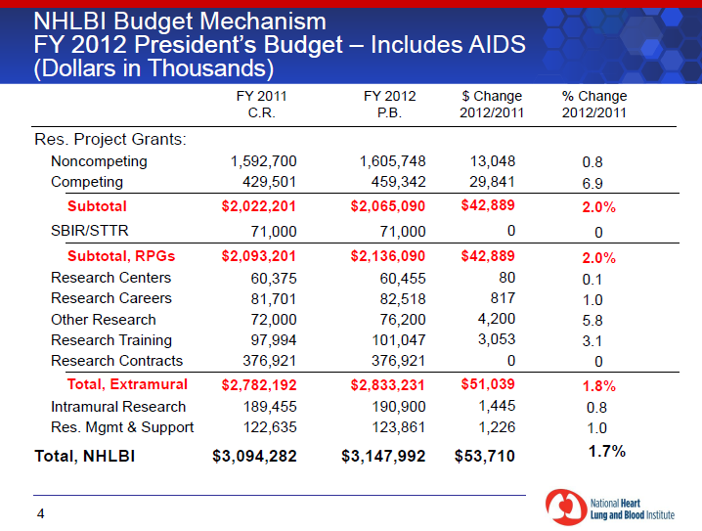
NIH and NHLBI news

Slide 24
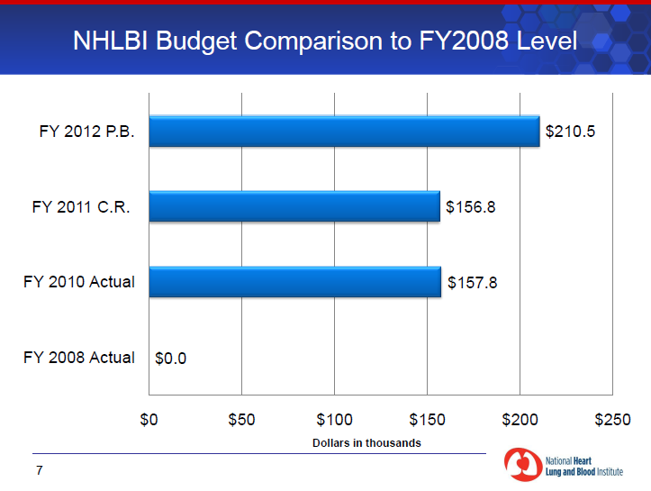
NIH and NHLBI news

Slide 25
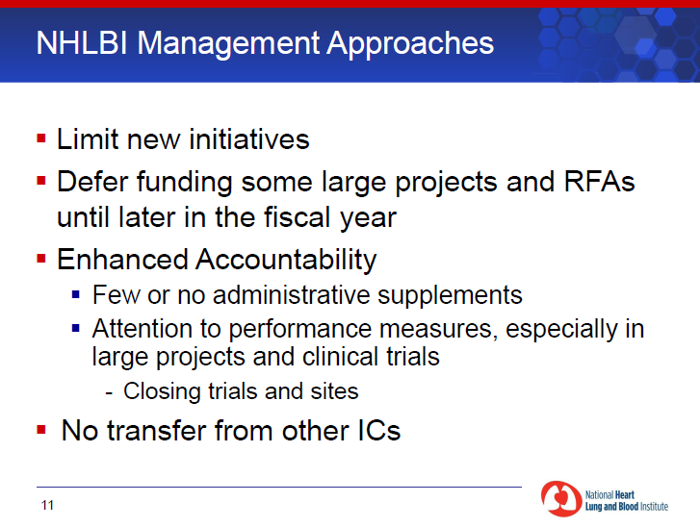
NIH and NHLBI news

Slide 26
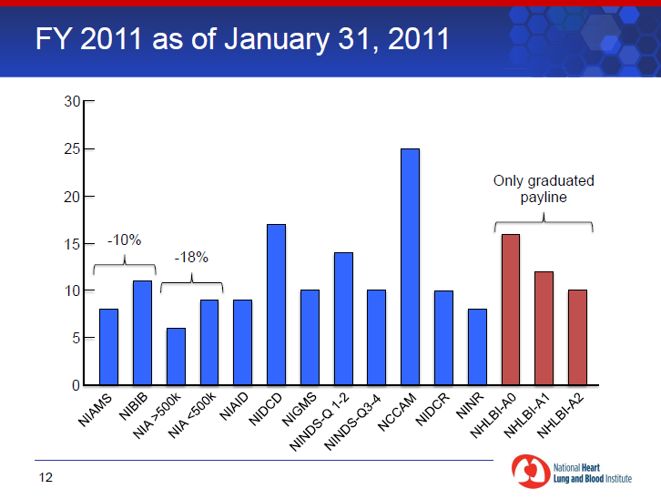
NIH and NHLBI news

Slide 27
NIH and NHLBI news
Recent NHLBI retreat addressed communicating science to the public
Mary Whoolley, President of Research!America addressed the group

Slide 28
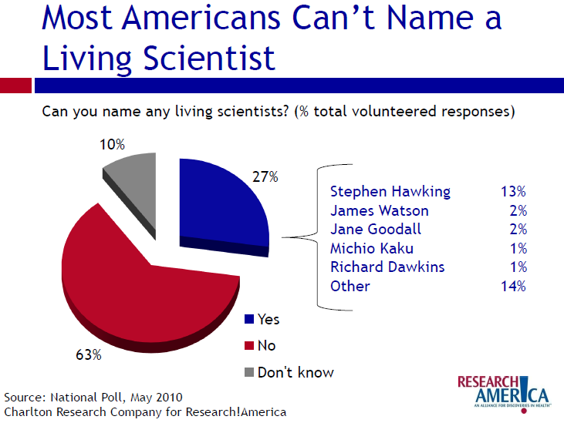

Slide 29
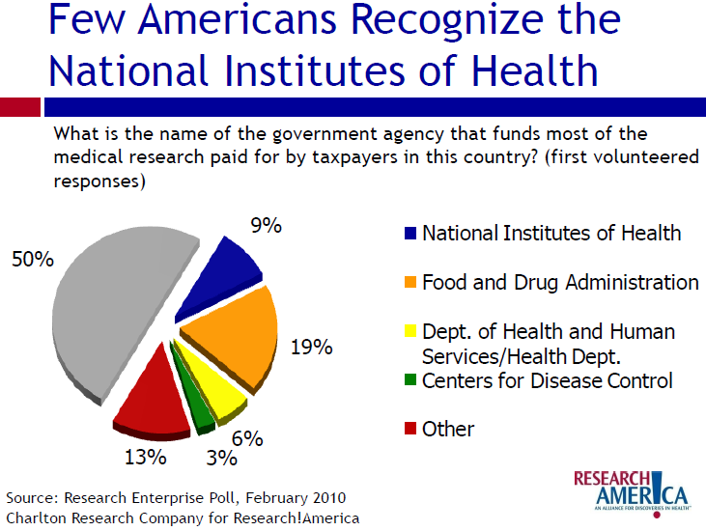

Slide 30
Questions?
Comments?

Slide 31
Exam 5 Ancillary studies
Ancillary studies
  We are still operating under a moratorium for Exam 5
  Still actively receiving proposals to use samples and read scans
  There have been 12 approved by Ancillary Studies Committee

Slide 32
Exam 5 Ancillary Studies
13 proposals with no participant burden
  Tsai – fatty acid composition – funded locally
  Ventetuolo – estrogen metabolism – pending AHA submission
  Jiang – receptor for advanced glycation end products – resubmitting to NIH in July
  Herrington – gene expression of iPS cells – NHLBI Council in February 2011
  Shrestha – genetic epi carotid athero in HIV – NIH resubmission planned

Slide 33
Exam 5 Ancillary Studies
13 proposals with no participant burden, cont.
  Ding – epigenetics type 2 DM – being reviewed (for NIEHS)
  Salifu – soluble F11 receptor – score not in funding range
  Sarnak – urinary proteomics in CKD – July resubmission planned
  Donohue – epigenomics of airways – NIH submitted in February 2011

Slide 34
Exam 5 Ancillary Studies
13 proposals with no participant burden, cont.
  Jensen – HDL subclasses using apo C-III – submitted February 2011
  Seeman – The Great Recession – submitted February 2011
  Majka – rheumatoid arthritis dx – to be submitted May 2011
  Hall – exome sequencing for arterial elasticity in AAs – to be submitted March 2011

