Slide 1
MESA Project Office Report
Diane Bild, MD, MPH
Prevention and Population Sciences Program
Division of Cardiovascular Sciences NHLBI
MESA Steering Committee meeting September 2012

Slide 2
Project Office Report Items
Publications
NIH and NHLBI news
Next steps for MESA
OSMB meeting

Slide 3
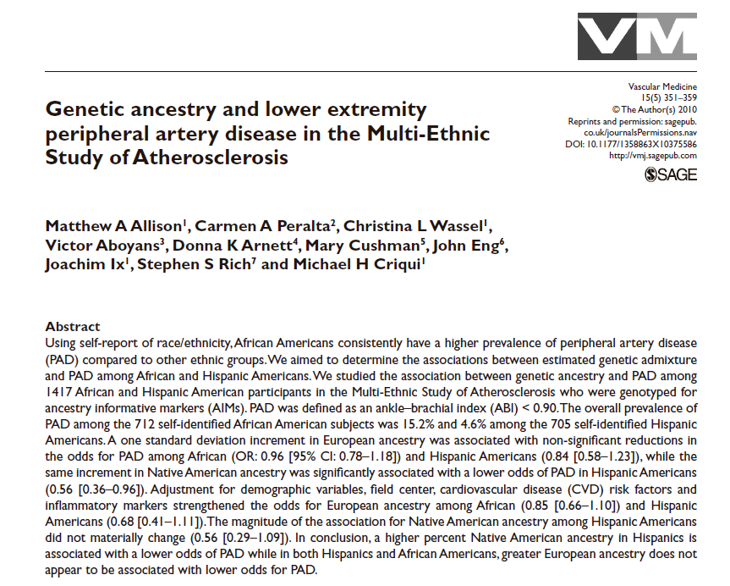
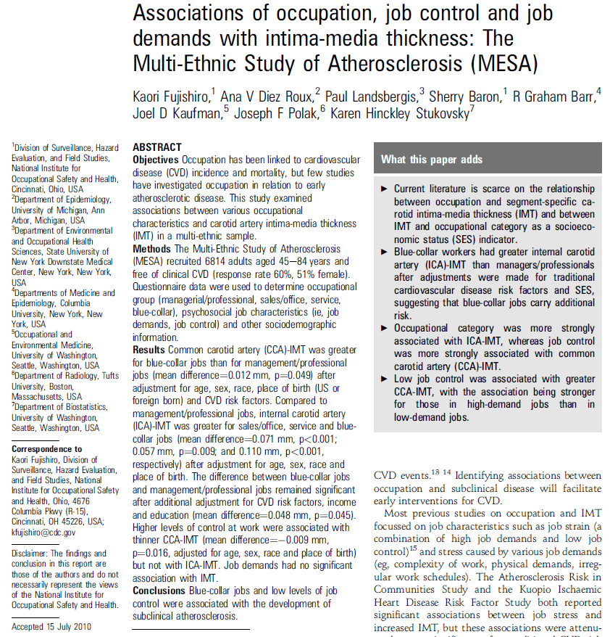
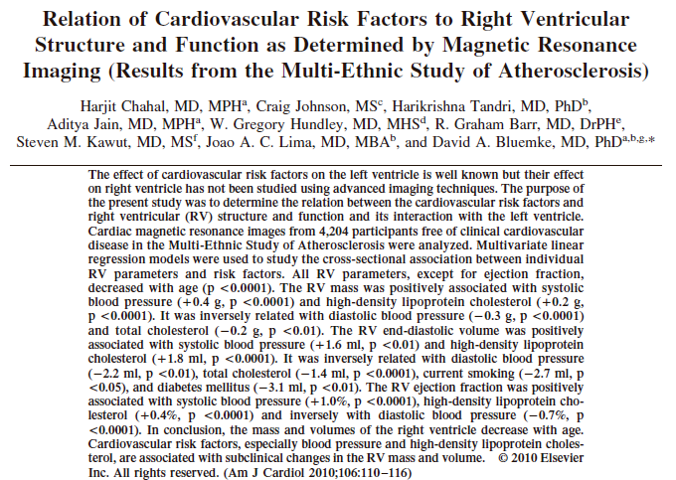
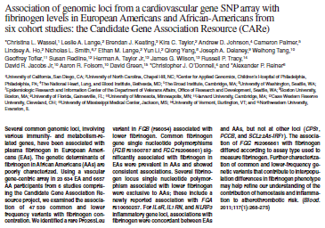
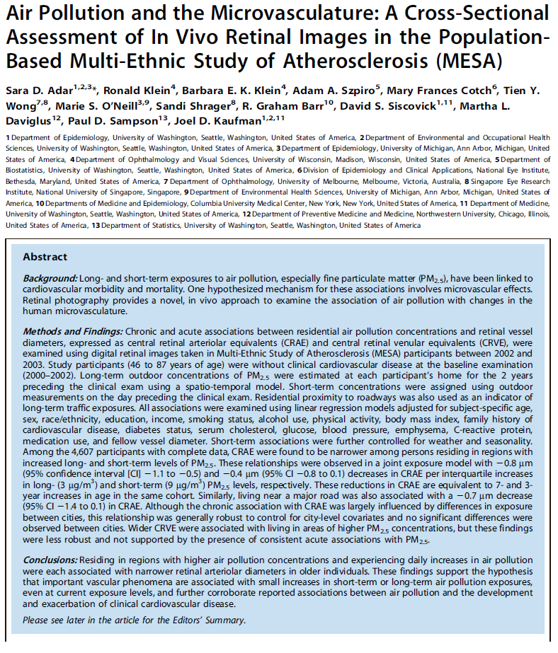
Publications

Slide 4
MESA Publications
Number
of
Manuscripts
(n=486)
Published or in press as of August 28, 2012.

Slide 5
Other metrics
Papers in high-impact journals (IF > 10) since the last meeting:
Nature (36.3) – 1 (genetics BP consortium)
JAMA (30.0) – 2 (subclinical, diabetes & mortality)
Circulation (14.4) – 1
JACC (14.3) – 2
New Engl J Med (53.5) – 1 (in press)
29 out of 34 abstracts submitted to AHA Scientific Sessions were accepted.
Notes:
The impact factor for a journal is calculated based on a three-year period, and can be considered to be the average number of times published papers are cited up to two years after publication.

Slide 6
NIH and NHLBI news
Gary Gibbons became NHLBI Director on August 13, 2012.
Sequestration would result in $2.4B cut to NIH, and 700 fewer grants in FY13. For NHLBI, this would be a $240M cut from a budget of $3.08B.
DCVS is planning a robust set of workshops for FY13 – stay tuned.
Epidemiology “digital forum” still active - http://www.nhlbi.nih.gov/resources/epidemiology-forum/
Report from Sen. Tom Harkin, Chairman, Sen. Appropriations Subcommittee on Labor, Health and Human Services, July 25, 2012

Slide 7
OSMB recommendations
Would like a scientific presentation on statistical methods
Add a pulmonary expert to the OSMB
Provide metrics on number of publications and collaborations and how collaborations are encouraged; compare to other studies
How is consent obtained from cognitively impaired individuals?
Describe age distribution by ethnicity – strategies will be needed for retention

Slide 8
OSMB recommendations
Retention by center is uneven – a strategy should be put in place for centers that are not retaining as well
Look at reasons why exams were not completed in Exam 5
Non-coronary pathology/unexpected findings from CT and MRI

Slide 9
Recommendations about renewal
What are the main findings of MESA?
What are the implications for prevention?
Issues in the elderly, frailty, particularly with multiethnicity
What are the gaps among the cohort studies?
Ask the investigators what questions could be answered
Consider informative subgroups
Consider an offspring study
MRI plaque; MRI inflammation
Peripheral vascular disease; MRI assessment
Cognition, brain issues
Ask the investigators what they think should be studied

Slide 10
MESA continuation mechanisms
Contracts are for “government needs” or projects that require strong central coordination and control
E.g., used to fill looming gaps in data in key age or ethnic groups
Contracts tend to be competitive.
Grants tend to be more nimble in proposing new science, high risk projects, or cutting edge ideas
E.g., used to augment contracts with investigators’ ideas

Slide 11
Options
Support event surveillance and data analysis only
PRO
Maximizes ability to utilize all prior data
Larger number of events provides power to investigate subgroups
Less expensive than supporting an exam
Success with similar models
Creates some opportunity to support productive investigative team
CON
Not innovative

Slide 12
Options
Support core Exam 6 with basic measurements
PRO
Allows basic investigation of trends in risk factors
Creates the opportunity for ancillary studies requiring new data collection
CON
Retention in the oldest age groups likely to be poor; might need to do home visits, which limits exam procedures in this group
Costs higher than surveillance only

Slide 13
Options
Support “complete” Exam 6
PRO
Possible innovative measurements can be made
Allows basic investigation of trends in risk factors
Creates the opportunity for ancillary studies
CON
It is not clear what innovative exam components to include
Retention in the oldest age groups likely to be poor; might need to do home visits, which limits exam procedures
Costs very high

Slide 14
Options
Provide no active support
PRO
Saves funds for other projects
CON
Missed opportunity to maximize use of data and samples by linking to more events
Unlikely that grants can coordinate efficiently to collect new exam data
Loss of investigative group

Slide 15
MESA continuation - steps for contract renewals and RFAs
Project Office develops concept
Idea Forum discussion within NHLBI
NHLBI Board of External Experts review
NHLB Advisory Council review of concept
NHLBI Director approval
Contracts:
~6 months to release of RFPs
~13 months to awards
Grants:
~7 months to publication in the NIH Guide
~13 months to awards

