Slide 1
MESA Project Office Report
Diane Bild, MD, MPH
Prevention and Population Sciences Program
Division of Cardiovascular Sciences NHLBI
MESA Steering Committee meeting September 2011

Slide 2
Items
Publications
Report from OSMB meeting, September 22

Slide 3
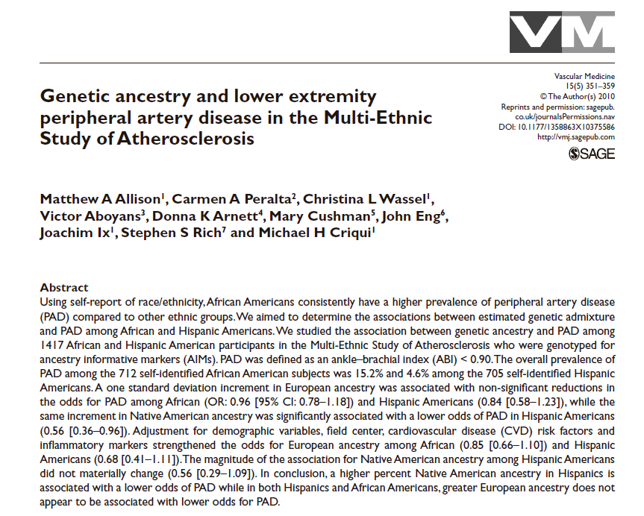
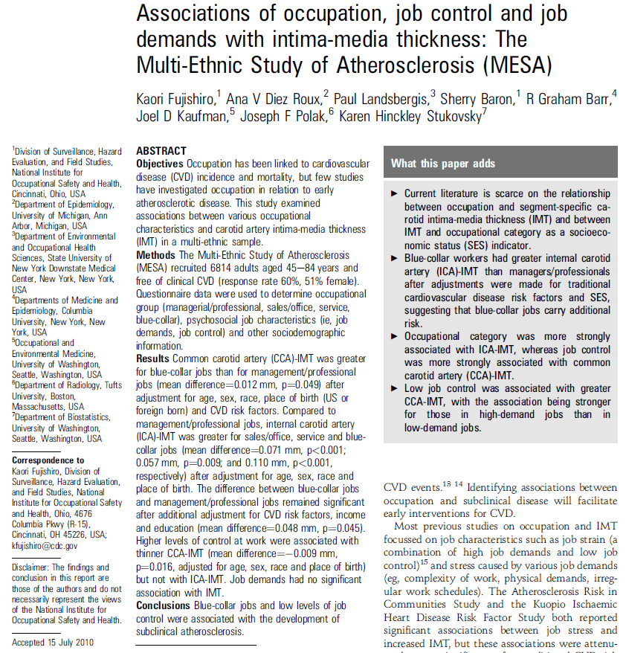
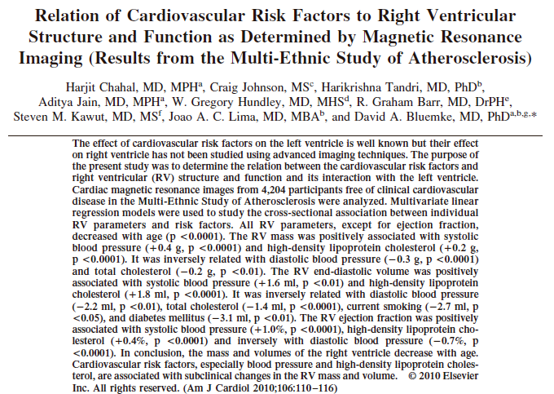
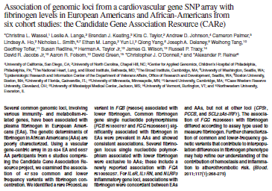
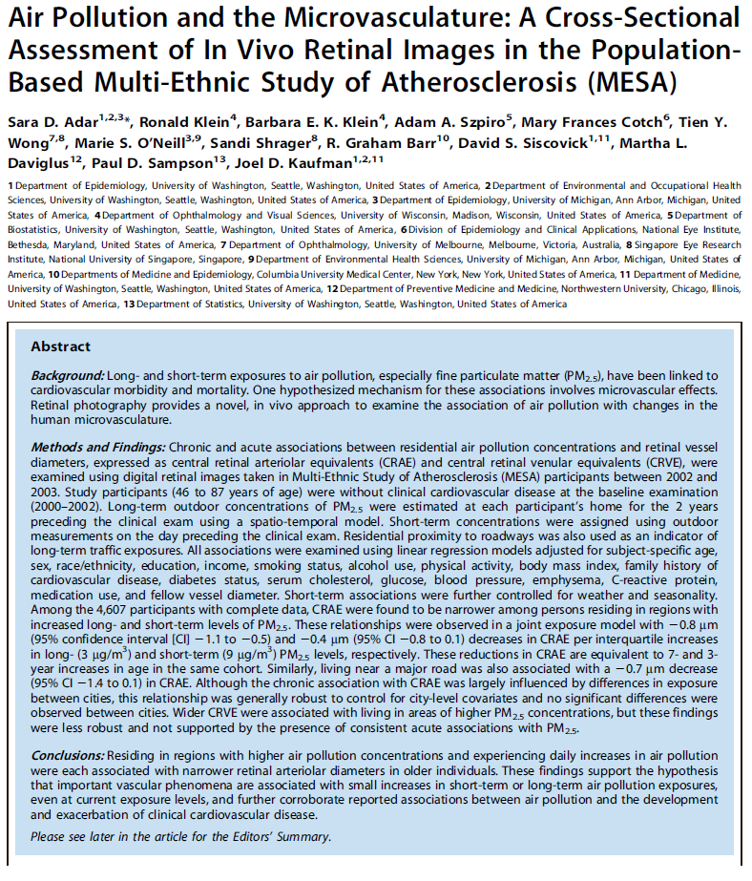
Publications

Slide 4
MESA Publications
*
Number
of
Manuscripts
(n=403)
Represents 235 unique first authors
* Published or in press as of September 8, 2011.

Slide 5
MESA Objectives and Publications
July 2011
Notes:
Papers fit into one main topic as 1. Secondary topic coded as 0.01 (but not exhaustively). Cross-sectional risk factor analyses coded in column G (screening methods). For ethnic differences, I looked for mention of ethnicity in the title. I tended into include all papers on LV function in the second group.

Slide 6
OSMB remarks
Enthusiastically endorsed study continuation
Want to hear about only true SAEs/UPs
Encourage more analyses of ethnic differences
Endorsed home visits
Suggested selective extension of home visits, especially for groups with low retention

Slide 7
OSMB remarks
Would like to hear more science!
Liked the Executive Summary
Expressed interest in the ethnic composition of the MESA investigators
Would like a mid-year report and a meeting next September

Slide 8
Questions?
And thanks to all of you who have made MESA such a terrific study!

Slide 10
Changes proposed to Common Rule
News Release
FOR IMMEDIATE RELEASE July 22, 2011
Contact: HHS Press Office (202) 690-6343
HHS announces proposal to improve rules protecting human research subjects
Changes under consideration would ensure the highest standards of protections for human subjects involved in research, while enhancing effectiveness of oversight
http://www.hhs.gov/news/press/2011pres/07/20110722a.html

Slide 11
OSMB notification
Current directive to investigators:
When an IRB is notified, please notify the PO so we can notify the OSMB
Protocol violation that violates informed consent
Adverse events and unanticipated problems

Slide 12
Adverse Events and Unanticipated Problems
Any event or problem that is
Unexpected;
AND
Possibly, probably, or definitely related to study participation;
AND one of the following:
Is fatal, life-threatening, or serious (SAE + UP)
Report within 7 calendar days
Suggests greater risk of harm to study participant(s) than was previously known or recognized(UP)
Report within 30 calendar days
http://www.nhlbi.nih.gov/funding/policies/adverse.htm#formsandattachments

Slide 13
OSMB notification
Proposal:
Report only SAEs and UPs urgently; report others routinely. (They are still reported to IRBs.)

