Slide 1

Multi-Scale Biology of Atherosclerosis in the Cellular Adhesion Pathway
MESA Adhesion Ancillary Study
Design and Preliminary Results
Suzette J. Bielinski, PHD
Cecilia Berardi, MD
MESA Steering Committee Meeting
Silver Springs, Maryland
October 2-4, 2013

Slide 2
Outline
Introduce the MESA Adhesion Team
Background
Specific Aims
Progress to Date
Preliminary Data
Future Plans

Slide 3




MESA Adhesion Research Team
Site | Name | Role
Mayo Clinic, Rochester | Suzette J. Bielinski, PhD | Principal Investigator
 | Mariza de Andrade, PhD | Statistician
 | Paul A. Decker, MS | Statistician
 | Phil Kirsch, MPH | Statistical Programmer
 | Hughes Sicotte, PhD | Bioinformatician
 | Cecilia Berardi, MD | Post-doctoral Fellow
University of Minnesota | Michael Tsai, MD | MESA Core Lab
 | Naomi Hanson, MS | MESA Core Lab
 | James S. Pankow, PhD | Co-Investigator
 | Weihong Tang, PhD | Co-Investigator
University of Virginia | Michele Sale, PhD | MESA Genotype Lab
University of Pittsburgh | Christina Wassel, PhD | Co-Investigator

Slide 4
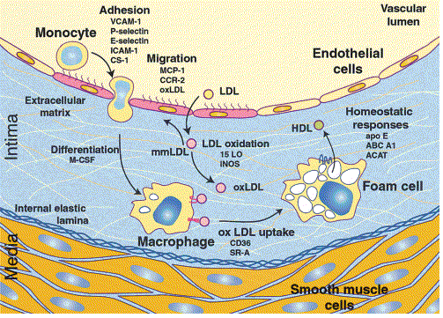
Background – Cellular Adhesion and Atherosclerosis
Reprinted from Cell, Vol 104, CK Glass et al, Atherosclerosis: The Road Ahead, pp 503-516, 2001, with permission from Elsevier.
Notes:
What you are looking at is a cross section of an artery
This is the cavity where blood flows
This cell layer is the inner lining of the vessel
These are the various outer layers of the vessel
These cells here colored pink have sustained some injury and as a result have become more permeable to LDL (bad cholesterol).
This increase in permeability causes LDL to accumulate and it is more likely to be modified through oxidation (mLDL is really bad cholesterol)
This mLDL has a variety of functions including acting as chemoattractant for monocytes (type of immune cell)- and with the help of the adhesion molecules, notably ICAM-1, monocytes enter the intima of the vessel wall.
mLDL has also been shown to stimulates expression of ICAM1 and other inflammation genes
All of this results in bypassing the normal feedback mechanisms and results in uncontrolled ingestion of mLDL by macrophages resulting in foam cells
Although not pictured, further progression of the lesion includes the migration of smooth muscle cells into the area eventually forming a fibrous plaque that is the hallmark of advanced disease.

Slide 5
Background- Immunoglobulin Superfamily
Intercellular Adhesion Protein 1 (ICAM1)
Atherosclerosis Risk In Communities (ARIC) Study Population cohort of n = 15,792, (Hwang et al., 1997)
  *OR = 5.5 for incident CHD
  *OR = 2.6 for carotid IMT
Physicians Health Study, (Ridker et al., 1998)
  *RR = 1.8 for incident MI
Women’s Health Study, (Ridker et al., 2000)
  *RR = 2.6 for cardiovascular events
*Highest quartile compared to lowest
Notes:
ICAM-1 has been associated with CVD has been reported in three large cohort studies.
Increased risk of incident CHD, carotid intimal medial thickness, and cardiovascular events defined as death from CHD, nonfatal MI or stroke, or the need for a coronary revascularization procedure have been reported for the highest quartile of ICAM-1 levels compared to the lowest.
<Skip>
The relationship between ICAM-1 level an atherosclerosis has been shown in several human studies.
In the ARIC study which is a population study of more than 15,000, the odds of CHD were 5.5 times greater, and the odds of carotid artery atherosclerosis 2.6 times, in the highest quartile of ICAM-1 compared to the lowest.
In the Physicians Health Study, a RR of 1.8 was reported for participants whose baseline ICAM-1 levels were in the highest quartile compared to the lowest.
Finally, a RR of 2.6 was reported for cardiovascular events defined as death from CHD, nonfatal MI or stroke, or the need for a coronary revascularization procedure, again in the highest quartile compared to the lowest

Slide 6
Background – Cellular Adhesion
Immunoglobulin superfamily
Selectins
Integrins
Cadherins
Linking the processes of homostasis, thrombosis, and inflammation include chemokines, kinases, cytokines, growth factors, matrix metalloproteinases, etc

Slide 7
Cellular Adhesion Pathway
Ingenuity Neighborhood Explorer and MetaCore™
Pathway Protein Selection
  Extracellular or cleaved proteins
  Biologic Plausibility
  Circulates in serum or plasma
  Availability of high quality commercial assay
Proposed to measure 15 adhesion pathway proteins

Slide 8
Specific Aims
Aim 1: To test the hypothesis that the adhesion pathway is associated with subclinical atherosclerosis
Aim 2: To test the hypothesis that variants in adhesion genes account for a significant portion of the variation in adhesion protein level and that these variants are associated with subclinical atherosclerosis
Aim 3: To replicate the strongest associations from Aims 1 & 2

Slide 9
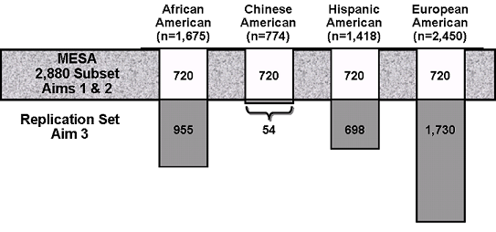
MESA Adhesion Study Population

Slide 10
MESA Adhesion Proteins
Mean and Standard Deviation of Circulating Adhesion Protein Level by Ethnicity in MESA measured at Exam 2
 | European | Chinese | African | Hispanic | p value
n | 619 | 600 | 579 | 603
VCAM-1, ng/mL | 784 (225) | 742 (227) | 668 (223) | 757 (238) | < 0.001
P-selectin, ng/mL | 58.1 (20.3) | 42.6 (14.7) | 45.7 (17.6) | 60.6 (19.8) | < 0.001
L-selectin, ng/mL | 956 (215) | 834 (175) | 867 (192) | 904 (196) | < 0.001
E-Cadherin, ng/mL | 215 (58.4) | 227 (63.8) | 209 (59.4) | 247 (75.1) | < 0.001
MMP-1, ng/mL | 5.5 (4.0) | 5.5 (3.6) | 6.0 (4.9) | 5.4 (4.3) | 0.2769
MMP-2, ng/mL | 196 (30.3) | 190 (28.9) | 201 (35.2) | 198 (31.0) | < 0.001
TIMP-2, ng/mL | 83.0 (13.1) | 76.9 (11.0) | 82.8 (13.6) | 81.9 (11.7) | < 0.001
6Ckine, pg/mL | 844 (280) | 779 (281) | 811 (289) | 813 (280) | < 0.001
RANTES, pg/mL | 4195 (3969) | 4385 (3317) | 4334 (4611) | 4284 (4287) | < 0.001
SDF1a, pg/mL | 1904 (434) | 1998 (436) | 1947 (481) | 1942 (447) | 0.002
HGF, pg/mL | 1005 (254) | 876 (200) | 982 (265) | 1099 (260) | < 0.001
TGFb1, pg/mL | 3708 (2162) | 4385 (2225) | 3908 (2513) | 3855 (2250) | < 0.001
SLPI, pg/mL | 45525 (10058) | 44977 (10250) | 47677 (12241) | 47439 (10626) | < 0.001
Notes:
We measured several cellular adhesion molecules including:
VCAM-1 of the Immunoglobulin superfamily
P and L – Selectin and
E-cadherin
In addition we measured several other proteins important in the adhesion pathway including
MMP1 and 2 and its inhibitor TIMP-2
Three chemokines – 6CKine, RANTES, and SDF1a
We also measured two growth factors – HGF and TGFB1
And we measured SLPI that has been shown to inhibit several of the adhesion pathway components.
As you can see in the table, significant mean differences by race were observed in all proteins accept MMP1. However, is is unknown whether these differences are biologically significant and we have the power to detect very small differences.
These proteins are all measured in either serum or plasma. - need to comment about member bound issues and challenges associated with interpreting circulating levels.

Slide 11
MESA Adhesion Proteins
Not measured
  Monocyte Chemotactic Protein 3 (MCP3)
  Epidermal Growth Factor (EGF)
Added on the 2880 at exam 2
  ICAM-1
  IL2sr
Replication Proteins
  HGF
  P-selectin
Notes:
Two of the proteins originally proposed in the grant were not measured due to assay issues – MCP3 and EGF
Based on our preliminary analyses, we are substituting ICAM-1 and IL2sr. We are in the process of measuring these two proteins on the 2880 subset at exam 2. Both of these proteins were measured on a subset at exam 1. However, for ICAM-1 we have chosen an alternative assay that is not affected by rs5491
Also based on our preliminary analyses, we are seeking permission to replicate HGF and P-selectin in the larger MESA cohort.

Slide 12
Subclinical Measures and Events
 |  |  | Race/Ethnicity
Measure | Exam | % of MESA | European |  | Chinese |  | African |  | Hispanic
MESA 2880 Sample | 1 | - | 720 |  | 720 |  | 720 |  | 720
Coronary Artery Calcium Score (CAC) | 1 | 100 | 620 |  | 600 |  | 579 |  | 604
 | 2 | 50 | 295 |  | 282 |  | 276 |  | 293
 | 3 | 50 |  | 270 |  | 278 |  | 249 |  | 255
 | 4 | 25 | 220 |  | 113 |  | 165 |  | 165
 | 5 | 75 | 360 |  | 317 |  | 326 |  | 333
Carotid Ultrasound (IMT) | 1 | 100 | 608 |  | 598 |  | 560 |  | 587
 | 2 | 50 | 283 |  | 288 |  | 268 |  | 274
 | 3 | 50 |  | 260 |  | 277 |  | 233 |  | 257
 | 4 | 25 | 184 |  | 111 |  | 145 |  | 143
 | 5 | 75 | 375 |  | 367 |  | 334 |  | 324
ABI | 1 | 100 | 616 |  | 596 |  | 575 |  | 597
 | 2 | -
 | 3 | 100 | 548 |  | 550 |  | 512 |  | 523
 | 4 | -
 | 5 | 100 | 445 |  | 433 |  | 403 |  | 415
Post -exam 2 CVD events | FU10 |  | 50 |  | 21 |  | 36 |  | 47
Counts includes all those with serum proteins measured
Notes:
We show this slide to illustrate the complexity of investigating associations of exam 2 measurements and subclinical disease. The counts is this table include only those with serum measurements in the MESA Adhesion Study.
Using CAC as an example, at exam 1 all participants were measured for CAC, however, only 50% were measured at exam 2 and the other 50% exam 3. Similarly, 25% were measured at exam 4 and the other 75% at exam 5. This design issue needs to be taken into account in the analyses.
Refer that you will be showing preliminary data
As for CVD events, we are able assess relationship between events and protein levels, albeit with limited power at this point in time.

Slide 13
Preliminary Data – VCAM1
Expressed on endothelial cells
Cleaved by ADAM17
Limited evidence on VCAM-1 role as a marker of clinical and subclinical atherosclerosis
Notes:
As an example of phenotype preliminary data, we chose to present VCAM-1.
This protein belongs to the Ig superfamily and is expressed on endothelial cells, mediating their interaction with leukocytes during inflammation.
The soluble form derives from enzymatic cleavage via ADAM 17
To date, Few studies have investigated the role of this protein as a marker of clinical and subclinical atherosclerosis.

Slide 14
Preliminary Data – VCAM1
Association of VCAM-1 levels and CV risk factors
Characteristic | Non-Hispanic whites |  | Chinese Americans |  | African Americans |  | Hispanic Americans
 | β | p-value | β | p-value | β | p-value | β | p-value
Age, years | 0.03 | <0.001 | 0.04 | <0.001 | 0.03 | <0.001 | 0.03 | <0.001
Total Cholesterol, mg/dl | -0.006 | <0.001 | -0.007 | <0.001 | -0.0004 | 0.72 | -0.005 | <0.001
LDL Cholesterol, mg/dl | -0.005 | <0.001 | -0.007 | <0.001 | -0.0003 | 0.80 | -0.005 | <0.001
Hypertension | -0.34 | <0.001 | -0.48 | <0.001 | -0.31 | <0.001 | -0.22 | 0.009
Alcohol, current use | 0.31 | <0.001 | 0.15 | 0.095 | 0.26 | <0.001 | 0.22 | 0.008
β per SD of VCAM-1 level for the population=231.8
Notes:
This table illustrates the association of soluble VCAM-1 with cardiovascular risk factors.
VCAM-1 levels are directly associated with age across ethnicities.
In all racial groups but African Americans, circulating VCAM-1 is associated with total and LDL cholesterol.
An inverse association is again found across races-ethnicities with hypertension.
Finally, soluble VCAM-1 is directly associated with current alcohol use in all four ethnic groups.
This underlines the complexity of interpreting results when considering the soluble portion of cell-bound protein

Slide 15
Preliminary Data – VCAM1
Outcomes | Non-Hispanic whites |  | Chinese Americans |  | African Americans |  | Hispanic Americans
CAC Exam 2 | β (S.E.) | p | β (S.E.) | p | β (S.E.) | p | β (S.E.) | p
Model 1 | 21.9 (56.4) | 0.7 | 55.0 (35.3) | 0.1 | 29.9 (50.4) | 0.6 | -34.7 (50.1) | 0.5
Model 2 | 43.3 (57.6) | 0.5 | 27.5 (34.3) | 0.4 | 28.2 (53.0) | 0.6 | -56.1 (49.8) | 0.3
CAC Exam 3
Model 1 | -43.5 (50.2) | 0.4 | -16.6 (41.8) | 0.7 | 157.3 (63.2) | 0.013 | 21.2 (35.0) | 0.5
Model 2 | -46.5 (54.3) | 0.4 | -10.8 (41.9) | 0.8 | 195.3 (63.4) | 0.002 | 7.15 (35.8) | 0.8
Time to CHD | HR (CI) | p | HR (CI) | p | HR (CI) | p | HR (CI) | p
Model 1 | 0.84 (0.5, 1.3) | 0.4 | 0.97 (0.6, 1.7) | 0.9 | 1.52 (1.1, 2.1) | 0.008 | 1.13 (0.8, 1.6) | 0.5
Model 2 | 0.87 (0.5, 1.4) | 0.6 | 1.08 (0.6, 1.9) | 0.8 | 1.70 (1.2, 2.4) | 0.003 | 1.12 (0.8, 1.6) | 0.5
Model 1 = age and sex Model 2 = age, sex, BMI, smoking status, LDL, HDL, triglycerides, hypertension, diabetes β per SD of VCAM-1 level for the population=231.8
Notes:
This table presents the association of soluble VCAM-1 levels with subclinical and clinical cardiovascular outcome.
Circulating VCAM-1 is associated to CAC and CHD in African American only, suggesting heterogeneity in the role of this protein in atherosclerosis across ethnicities.
Moreover, VCAM-1 levels predict coronary calcium deposition at exam 3, but is not associated with CAC cross-sectionally at exam 2. Expand -

Slide 16
Genetic Data
MESA Genotype Sources
  Candidate Gene
  IBC Chip
  Exome Chip
Collaboration of MESA Adhesion, Air, and Genotype groups
  CardiometaboChip
GWAS – available through SHARE or dbGAP

Slide 17
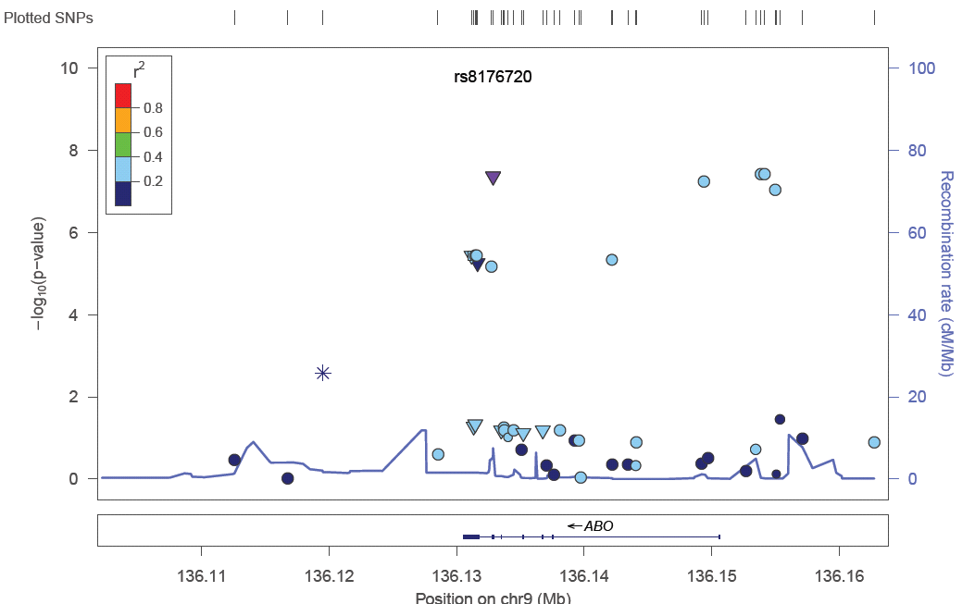
Preliminary Data –E-Cadherin

Slide 18
Predicting ABO Phenotypes
Prediction of the ABO haplotypes is based on the data in Yip (2002)
  Sequence variation of the human ABO locus. Ann Hum Genet 66: 1-27
The blood group determination is then based on the dominance rules
  A and B co-dominant, dominant over O
Many of those SNPs are ambiguous (A/T or C/G), which makes correct phase assignment both crucial and tricky.
We have genotype or imputed data for all those SNPs or indel.

Slide 19
Future Plans
Collaboration with Dr. Kanaya - expansion of this work to include the MASALA Population
Renewal of MESA Adhesion
Collaborations with PAGE and other consortia

Slide 20
Questions
Contact email
Bielinski.suzette@mayo.edu

