Slide 1
Physical Activity and the Incidence of Type 2 Diabetes: The Multi-Ethnic Study of Atherosclerosis (MESA)
Alain G Bertoni (1,2) Matthew S. Kalapurakal, (2) Haiying Chen (1), Evrim Bengi Turkbey (3) Nancy Swords Jenny (4), Mercedes Carnethon (5) , Sherita Hill Golden (6),
David Jacobs Jr (7), Gregory L. Burke(1)
(1) Public Health Sciences, (2) Internal Medicine,
Wake Forest University School of Medicine
(3) National Institutes of Health,
(4) University of Vermont College of Medicine
(5) Northwestern University (6) Johns Hopkins University
(7) University of Minnesota

Slide 2
Acknowledgement
This research was supported by contracts N01-HC-95159 through N01-HC-95165 and N01-HC-95169 from the National Heart, Lung, and Blood Institute. The authors thank the other investigators, the staff, and the participants of the MESA study for their valuable contributions. A full list of participating MESA investigators and institutions can be found at http://www.mesa-nhlbi.org

Slide 3
Background
Weight loss, increased moderate/vigorous intensity PA (MVPA) reduces short-term incidence of T2DM in high risk participants
MPVA is consistently inversely associated with T2DM risk
Sedentary activity (e.g. television) is positively associated with T2DM risk
Prior studies often conducted only in men or women, or did not include non-whites

Slide 4
Objective
To investigate the differential associations of different PA and sedentary measures on incident T2DM in a large, contemporary multi-ethnic population
Determine the extent to which these associations are similar across race and/or gender groups.

Slide 5
Multi-Ethnic Study of Atherosclerosis
6814 participants aged 45-84 years without clinical CVD were identified from 6 field centers in 2000-2002
Forsyth County (NC), Baltimore, New York, Los Angeles, Chicago, and St. Paul (MN), USA
53% Female; 38% white 12% Chinese 28% black, 22% Hispanic
Standard questionnaires and examination protocols used to determine anthropometric measures, medical history and medications, blood pressure

Slide 6
Laboratory Assays
Participants reported to clinic after overnight (8+ hours) fast, phlebotomy performed and blood sent to central laboratories for analysis.
Serum glucose measured by rate reflectance spectrophotometry using the glucose oxidase method on the Vitros analyzer (Johnson & Johnson Clinical Diagnostics)
Serum Insulin determined by a radioimmunoassay method using the Linco Human Insulin Specific RIA Kit (Linco Research).

Slide 7
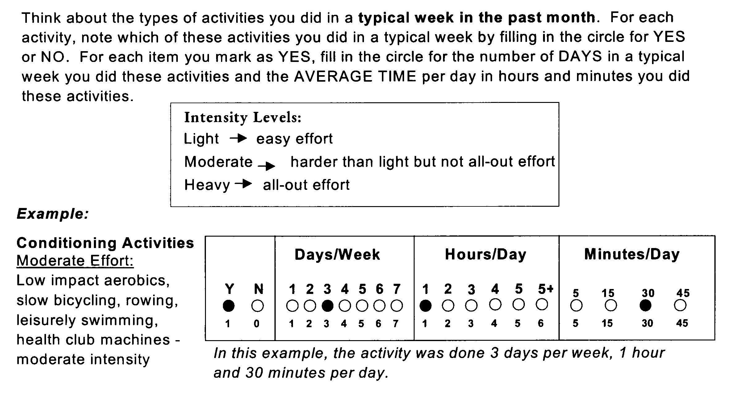
Physical Activity Survey
27 questions about activities
1 question about usual walking pace

Slide 8
Physical Activity Survey
Time for each activity multiplied by activity specific Metabolic Equivalent (MET) value , then summed by light/moderate/ vigorous intensity categories.
Derived variables:
Moderate plus Vigorous PA MET-hours/wk
Intentional exercise MET-hrs/wk
sum of walking for exercise, sports/dancing, and conditioning
Sedentary activities
sum of television, non-work computer, reading, sewing, and do-nothing time

Slide 9
Incident Diabetes
2003 ADA definition: use of hypoglycemic meds or insulin or glucose > 7.0mmol/l (126mg/dl)
Incidence at exam 2 (2003-04), 3 (2004-05) and 4 (2005-07) defined among those who did not have diabetes at baseline
Assume Type 2 Diabetes

Slide 10
Statistical Analysis
Final study sample 5,557 individuals
excluded 857 (12.5%) baseline DM
24 (0.4%) missing baseline DM status
349 (5.1%) no follow-up, 14 (0.2%) no PA Data
PA distribution skewed, categorized into quartiles except vigorous (none vs. any)
Person-time analysis to calculate incidence rates
Cox proportional hazards modeling to estimate risk associated with PA categories

Slide 11
Baseline Characteristics I
 | White | Chinese | African American | Hispanic
Characteristic | N=2344 | N=644 | N=1434 | N=1155
Age | 62 (10) | 61(10) | 62 (10) | 61(10)
Female | 52% | 52% | 56% | 53%
Current Smoking | 11% | 5% | 18% | 14%
Education >Bachelors | 51% | 41% | 36% | 11%
BMI (kg/m2) | 27.5 (4.9) | 23.9 (3.3) | 29.8 (5.8) | 29.1 (4.8)
Hypertension | 37% | 34% | 55% | 37%

Slide 12
Baseline Characteristics II
 | White | Chinese | African American | Hispanic
Characteristic | N=2344 | N=644 | N=1434 | N=1155
Glucose (mg/dl) | 88 (10) | 92 (10) | 90 (11) | 91 (11)
Impaired Fasting Glucose | 12% | 20% | 18% | 19%
DM Family History* | 29% | 26% | 42% | 41%

Slide 13
Physical Activity at Baseline
Moderate + Vigorous
Sedentary Activity

Slide 14
Physical Activity at Baseline
 | White | Chinese | African American | Hispanic
Physical Activity | N=2344 | N=644 | N=1434 | N=1155
Any Vigorous PA | 41% | 26% | 30% | 27%
Walking Pace
Walking <2mph | 19% | 21% | 35% | 28%
Average Pace | 51% | 62% | 42% | 55%
Walking >4mph | 30% | 17% | 23% | 17%
Notes:
Any vigorous PA Men: 46%, women 23%

Slide 15
Incident DM: 418 persons (16.8/1000 PY)
Notes:
Rate not markedly different by gender: Women 16.3/1000, Men 17.4/1000 , p=0.6

Slide 16
Diabetes Incidence by PA
p<0.001 by Log Rank Test
p<0.001 by Log Rank Test

Slide 17
Diabetes Incidence by PA
p<0.05 by Log Rank Test except Exercise: p<0.001

Slide 18
Adjusted Hazards for DM incidence
Activity type |  | Hazards Ratio
 |  | Model 1 | Model 3*
Walking Pace | none or casual | 1.0 | 1.0
 | average | 0.71 (0.57-0.89) | 0.89 (0.71-1.11)
 | brisk or striding | 0.61 (0.46-0.82) | 0.93 (0.69-1.25)
Exercise PA | Quartile 1 | 1.0 | 1.0
 | Quartile 2 | 1.07 (0.84-1.37) | 1.17 (0.14-1.50)
 | Quartile 3 | 0.74 (0.56-0.98) | 0.88 (0.67-1.17)
 | Quartile 4 | 0.69 (0.51-0.92) | 0.91 (0.68-1.22)
Sedentary Activity | Quartile 1 | 1.00 | 1.00
 | Quartile 2 | 1.12 (0.84, 1.49) | 1.03 (0.78-1.37)
 | Quartile 3 | 1.22 (0.91-1.64) | 1.13 (0.84-1.52)
 | Quartile 4 | 1.49 (1.12-1.97) | 1.24 (0.93-1.64)
Vigorous PA | None | 1.0 | 1.0
 | Any | 0.62 (0.49-0.79) | 0.75 (0.59-0.96)
Model 1=age, gender, race, education, site, smoking, anti-HTN med, SBP
Model 2=Model 1+ bmi
Model 3= Model 2+ homa-IR (insulin mU/L *(glucose mg/dl*0.055))/22.5) * potentially adjusting for variables in causal pathway

Slide 19
Exercise and Gender Interaction
Exercise PA (vs. Quartile 1) |  | Model 1 | Model 3
Women | Quartile 4 | 0.40 (0.24, 0.65) | 0.58 (0.40, 0.95)
Men | Quartile 4 | 0.98 (0.66, 1.45) | 1.23 (0.83, 1.84)
Model 1=age, gender, race, education, site, smoking, anti-HTN med, SBP
Model 3= Model 1+ BMI + homa-IR (insulin mU/L *(glucose mg/dl*0.055))/22.5) * potentially adjusting for variables in causal pathway

Slide 20
Sedentary Activity and Race/Ethnicity
Sedentary Activity, Hazard Ratios (vs. Quartile 1) |  | Model 1 | Model 3
White | Quartile 4 | 4.23 (2.19-8.15) | 2.35 (1.20-4.60)
Chinese | Quartile 4 | 0.90 (0.38, 2.13) | 0.55 (0.23, 1.32)
Black | Quartile 4 | 0.99 (0.62-1.58) | 0.98 (0.61, 1.55)
Hispanic | Quartile 4 | 1.35 (0.78, 2.36) | 1.17 (0.67, 2.03)

Slide 21
Several PA constructs modeled simultaneously
Activity type |  | Hazards Ratio
 |  | Model 1 | Model 3
Walking Pace | none or casual | 1.0 | 1.0
 | average | 0.75 (0.60-0.93) | 0.90 (0.72-1.14)
 | brisk or striding | 0.69 (0.51-0.92) | 0.98 (0.72-1.33)
Exercise PA | Quartile 1 | 1.0 | 1.0
 | Quartile 2 | 1.16 (0.90-1.49) | 1.21 (0.94-1.55)
 | Quartile 3 | 0.84 (0.63-1.11) | 0.92 (0.69-1.22)
 | Quartile 4 | 0.80 (0.60-1.08) | 0.96 (0.71-1.30)
Sedentary Activity | Quartile 1 | 1.0 | 1.0
 | Quartile 2 | 1.15 (0.86-1.53) | 1.04 (0.78-1.38)
 | Quartile 3 | 1.24 (0.92-1.66) | 1.14 (0.84-1.53)
 | Quartile 4 | 1.46 (1.10-1.94) | 1.25 (0.94-1.66)
Vigorous PA | None | 1.0 | 1.0
 | Any | 0.68 (0.51-0.92) | 0.77 (0.59-0.99)
Model 1=age, gender, race, education, site, smoking, anti-HTN med, SBP
Model 3= Model 1+bmi + homa (potential mediators)

Slide 22
Stratification by Vigorous PA
No vigorous PA (N=3719): exercise level, walking pace associated with risk of T2DM; sedentary activities not significant
Quartile 4 exercise HR 0.66 (95%CI 0.45-0.96)
Fast pace walking HR 0.63 (95% CI 0.44-0.90)
Some vigorous PA (N=1872): exercise, walking pace not associated with DM, sedentary activity associated with T2DM
Quartile 4 sedentary HR 2.23 (95%CI 1.23, 4.03)

Slide 23
Conclusions
Several PA measures associated with incident T2DM in multi-ethnic sample of U.S. adults
Potentially mediated by obesity and insulin resistance
Any vigorous PA remained protective against incident T2DM, independent of other PA constructs, potential confounders, and baseline BMI, and insulin resistance

Slide 24
Implications
Promotion of vigorous PA in public health recommendations and clinical interventions aimed at preventing T2DM for those able to perform it
non-white groups had higher T2DM incidence, reported less participation in vigorous PA
Encourage moderate intensity exercise among those not partaking in vigorous PA
If walking, best at a brisk pace
Decreased time in sedentary activities for all

Slide 25
Questions?

