Slide 1
MESA Operations
Subcommittee Report

Slide 2
Operations Subcommittee Meeting
Retention
Follow-up calls
F/U 13 progress
Currently at 82%; working to hit 85% in F/U 13
F/U 14 underway
MESA Air Report
Participant Communications
Ancillary Studies Ongoing
Notes:
Updated for Oct. 2013

Slide 3
Follow-up Call Retention
Retention = Completed / (Enrolled – Dead)
Notes:
Updated for October, 2013; New line added to show slope (visually, not mathematically!)

Slide 4
Follow-up Retention by Ethnicity
Retention = Completed / (Enrolled – Dead) except FU 13 (windowed)
Notes:
Updated for October– Includes FU13 or all participants with closed windows (including study dropouts)

Slide 5
Followup Retention by Site
Retention = Completed / (Enrolled – Dead) except FU 13 (windowed)
Notes:
Updated for October, 2013

Slide 6
Follow-up 13 Productivity Closed Windows
Expected* Contacts Made
3: Wake Forest 769 639 83%
4: Columbia 776 667 86%
5: Johns Hopkins 691 657 95%
6: Minnesota 774 713 92%
7: Northwestern 841 739 88%
8: UCLA 903 807 89%
TOTAL 4754 4222 89%
* Study dropouts not included in these numbers
Notes:
Updated for Oct, 2013

Slide 7
Follow-up 13 Productivity
Site | Window Closed Interview Done | All Interviews Done | Additional interviews done and not included in retention slide | % of FU13 Completed
WFU | 639 | 652 | 13 | 74%
Col | 667 | 748 | 81 | 82%
JHU | 657 | 719 | 62 | 89%
Minn | 713 | 728 | 15 | 81%
NWU | 739 | 763 | 24 | 78%
UCLA | 807 | 905 | 98 | 86%
TOTAL | 4222 | 4515 | 293 | 82%
Notes:
Updated for Oct. 2013

Slide 8
Follow-up 13 – Air/Family Participants
 | Target Cumulative | Completed Cumulative | Percent of Goal
MESA Air – Recruited from MESA Family
Wake Forest | 44 | 44 | 100%
Columbia | 139 | 96 | 69%
Northwestern | 146 | 146 | 100%
UCLA | 16 | 16 | 100%
Minnesota | 80 | 58 | 73%
Johns Hopkins | 47 | 43 | 91%
MESA Air New Recruits
UCLA | 152 | 148 | 97%
Columbia | 95 | 83 | 87%
Notes:
Updated for Oct. 2013

Slide 9
Follow-up Retention
F/U 13
Heterogeneity across sites improved
MESA Air follow-up is on track for most sites → Those not finished by Oct 15 should be coded as not done.
F/U 14 has commenced
Considerable heterogeneity across sites in startup and completion rates
Includes medications inventory and residential history review
F/U 15 due to start January 2014
Notes:
Updated for Oct, 2013

Slide 10
Common Retention Obstacles
Declining cognitive function
Hearing loss
Aging, health issues, and life events require all available time and energy
Cultural and Immigration issues
Search options less effective with dropping of land lines
Insufficient number of contact people

Slide 11
Approaches for 85%+ FU Retention
Revised Web Reports (for PIs and Coordinators) and Software Updates
Abbreviated FU call “Have you been hospitalized”
Letter/email asking the same (handwritten notes have been most effective)
Notes:
Updated for Oct. 2013

Slide 12
Follow-up 14
Call to discuss streamlining of electronic form
Issues with collection of medication data
Notes:
Updated for Oct. 2013

Slide 13
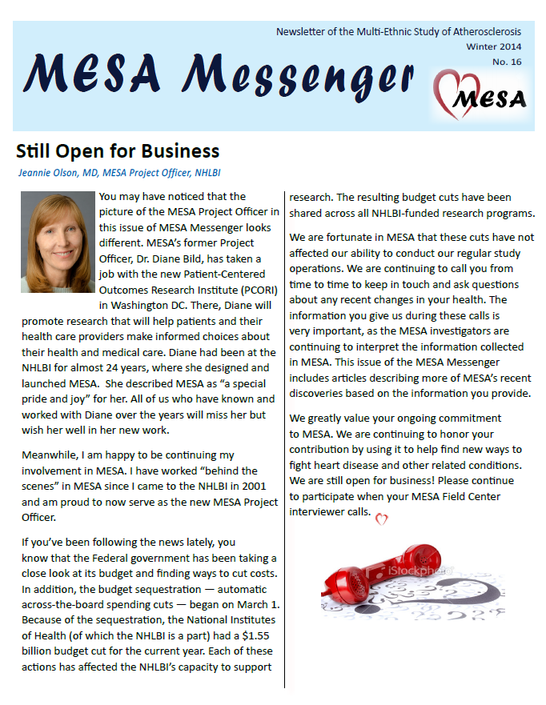
Newsletter
Last issue mailed in July
Current issue in near final draft – will mail in November
Reformatted for greater participant appeal:
Full color
More graphics and pictures
More white space
Articles contained on a single page if possible, no skipping pages to continue
Notes:
Updated for Oct., 2013

Slide 14
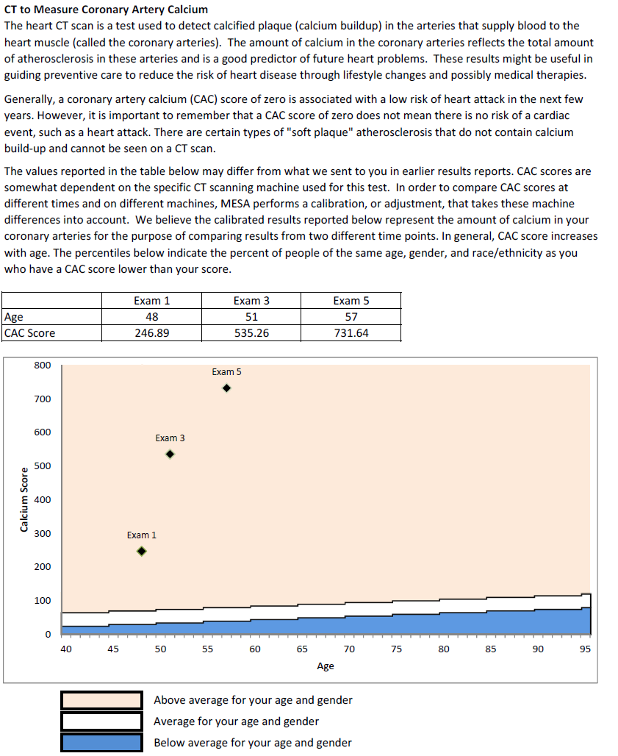
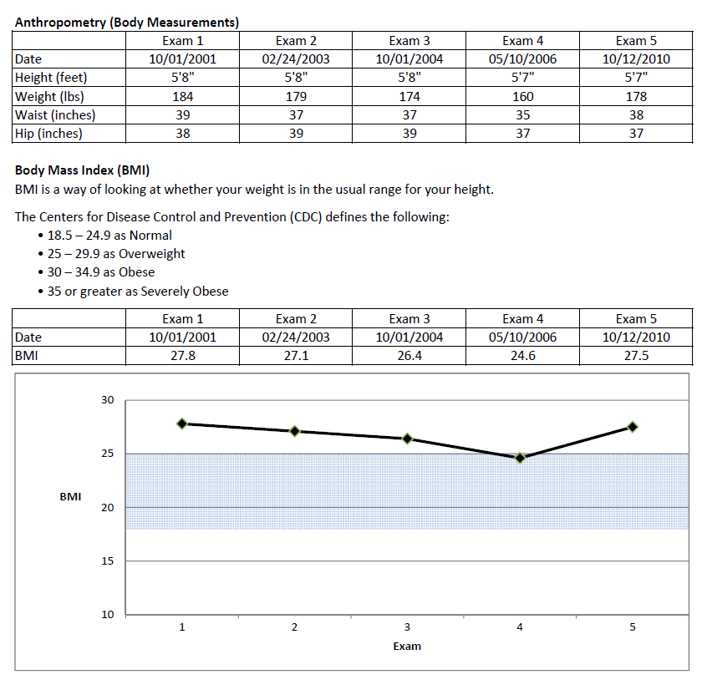
Participant Summary Report
Summarizes data from all five exams
November 1, 2013
Notes:
New for Oct. 2013

Slide 15
Ancillary Study Status
Study | Site(s) | Current Activities | Enrollment / participation
MESA Kidney | JHU | 6-7 hour clinic visit to collect blood at 6-7 time points. DEXA scan and arterial elasticity included. Blood samples are analyzed to measure the rate of iohexol clearing to determine a precise measure of kidney function. | ~375 participants (actual enrollment likely closer to 325)
MESA Air | Col. & UCLA | Mailed Health & Life Questionnaire. Data collection underway at Col. And will begin soon at UCLA. Participants receive gift card to Target or Starbucks upon completion. | MESA Air New Recruits only - ~250 expected
MESA Air / CCAR | WFU & UCLA (WFU complete, LA to commence Jan. 2014) | Home/Personal/Vehicle Air Quality Monitoring in each of two seasons via GPS tracking unit, proximity monitor, and self-reported time-location diary. | 50 participants at each site

Slide 16
Ancillary Study Status (cont.)
Study | Site(s) | Current Activities | Enrollment / participation
MESA COPD | Col., JHU, NWU, UCLA | Follow-up to original COPD ancillary study. Recruitment to begin shortly. Procedures include clinical measures, blood draw, MR with gadolinium, spirometry, ECG, lung CT, questionnaires. | Total n=265, including 160 MESA Classic participants
MESA Lung Fibrosis | Col. only | Case/control study. Recruitment just completed. Selected participants had two exercise tests in the clinic to measure lung function. Lung fields from previous CT scans were | 83 participants enrolled

Slide 17
Thank You!!!

