Slide 1
Operations Subcommittee Report
Follow-up calls
  F/U 7 Final numbers
  F/U 8 Status
  F/U 9 Status
Exam 5
  Timelines
  Components / Participant Burden
“Gap” Incentives
Newsletter / website
Participant Relations Committee

Slide 2
Follow-up 7 Retention by Site, Ethnicity
Overall 93%
Notes:
ND – Updated 2/22/2008

Slide 3
Follow-up 8 Retention by Site, Ethnicity
Overall 92%
Notes:
ND – Updated 2/22/2008

Slide 4
Follow-up 9
Pilot test of direct data entry completed
Follow-up 9 interviews are underway
Air Questionnaire built in
Data being received at CC
Weekly reports of data received sent to FCs

Slide 5
Follow-up Calls in MESA II
Notes:
ND - Moved white line

Slide 6
Exam 5 Timeline
August 15, 2008 – August 14, 2009 | Protocol development
November 1, 2008 – November 30, 2009 | Software development
December 31, 2009 | Forms, consents, & results reports finalized
January 1, 2010 – January 31, 2010 | Translation of forms, consents, & results reports
February 1, 2010 | IRB submissions at sites
February, 2010 (2nd or 3rd week) | Central Training
March, 2010 (1st week) | Pilot Study
April 15, 2010 – September 15, 2011 | Exam 5
September 30, 2011 – October 31, 2011 | Closeout at FCs and final data check
Notes:
No change

Slide 7
Exam 5 Components and Timing
Maximum Total Hours 8.0

Slide 8
“Gap Incentive”
Each FC to finalise gift/reminder during the Classic “Gap”

Slide 9
Newsletter
English version done and at printer
Spanish and Chinese versions in final formatting
Spanish and Chinese to printer this week
All versions in homes this month

Slide 10
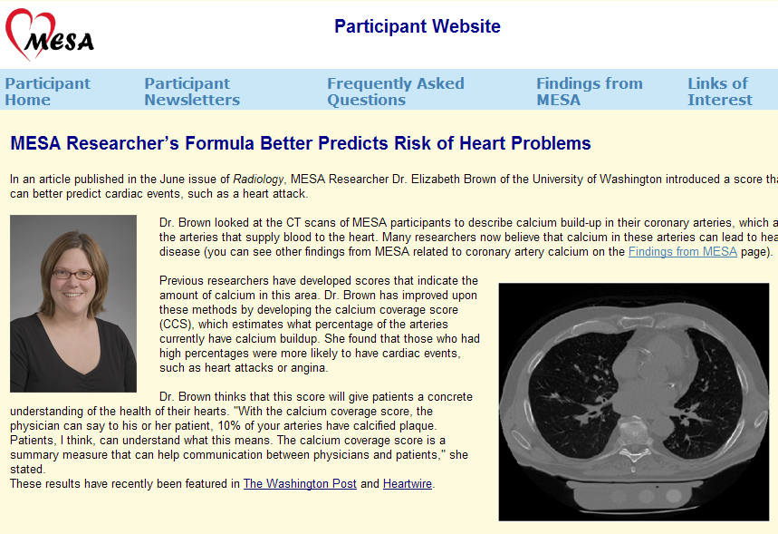
Participant Website

Slide 11
Participant Relations Committee
No meeting tonight
Purpose – Advocate for participants
  Reports; burden; other pt issues
Proposal composition
  Chair: Study coordinator
  Members: 1-2 investigators, PO, study coordinator
    ? Participants vs. Site-specific participant groups

Slide 13
Agenda
1. Exam 4 Final Numbers
2. Follow-up calls
• F/U 7 Final numbers
• F/U 8 Status
• F/U 9 Status
3. Exam 5
• Timelines
• Components/Burden
4. Participant Relations Committee
• Membership
• Charges / Tasks
&#61692; Participant Results
&#61692; Participant Web site
&#61692; Newsletter
&#61692; Translations
&#61692; Other
5. Ancillary Studies – Impact on Exam 5
6. Newsletter
7. Other issues

