Slide 1
MESA Operations
Subcommittee Meeting

Slide 2
Operations Subcommittee Report
Retention
Follow-up calls
F/U 13 progress
Approaching to hit 85% in F/U 13
Starting F/U 14
MESA Air Report
Participant Communications
Notes:
Updated for April 2013

Slide 3
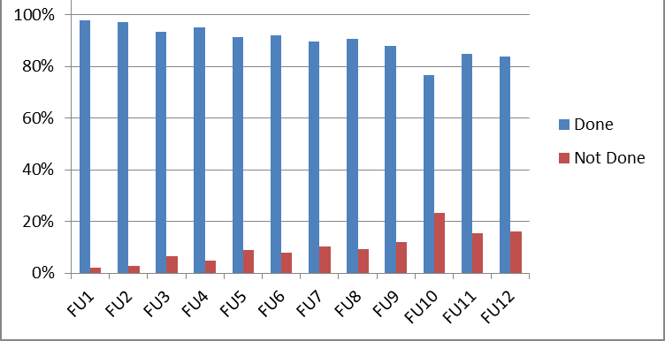
Follow-up Call Retention
Retention = Completed / (Enrolled – Dead)
Notes:
New for April, 2013

Slide 4
Follow-up Retention by Ethnicity
Retention = Completed / (Enrolled – Dead) except FU 13 (windowed)
Notes:
Updated for April – Includes FU13 for all participants with closed windows (including study dropouts)

Slide 5
Followup Retention by Site
Retention = Completed / (Enrolled – Dead) except FU 13 (windowed)
Notes:
Updated for April, 2013 – FU 13 added

Slide 6
Follow-up 13 Expected* Closed Windows
Expected Contacts Made
3: Wake Forest 465 272 58%
4: Columbia 448 317 71%
5: Johns Hopkins 411 408 99%
6: Minnesota 460 391 85%
7: Northwestern 505 494 98%
8: UCLA 533 472 89%
* Study dropouts not included in these numbers
Notes:
Updated for April, 2013

Slide 7
Follow-up 13 Productivity
Site | Window Closed Interview Done | All Interviews Done | Additional interviews not reported in retention slide | % of FU13 Completed
WFU | 306 | 323 | 17 | 35%
Col | 319 | 481 | 162 | 50%
JHU | 364 | 443 | 79 | 47%
Minn | 378 | 496 | 118 | 52%
NWU | 489 | 536 | 47 | 51%
UCLA | 432 | 640 | 208 | 54%

Slide 8
Follow-up 13 – Air/Farmily Participants
 | Target Cumulative | Completed Cumulative | Percent of Goal
MESA Air – Recruited from MESA Family
Wake Forest | 26 | 8 | 31%
Columbia | 87 | 6 | 7%
Northwestern | 88 | 75 | 85%
UCLA | 10 | 0 | 0%
Minnesota | 48 | 27 | 56%
Johns Hopkins | 28 | 24 | 86%
MESA Air New Recruits
UCLA | 91 | 0 | 0%
Columbia | 58 | 18 | 31%

Slide 9
Follow-up Retention
F/U 12 finished
F/U 13
Heterogeneity across sites improving
MESA Air follow-up is on track for some sites and extremely behind for others → Need to finish by July 1
F/U 14 starting soon
IRB approval received at three sites
Will include medications inventory and residential history review
Notes:
Updated for April, 2013

Slide 10
Common Retention Obstacles
Declining cognitive function
Hearing loss
Aging, health issues, and life events require all available time and energy
Cultural and Immigration issues
Search options less effective with dropping of land lines
Insufficient number of contact people

Slide 11
Approaches for 85%+ FU Retention
Revised Web Reports (for PIs and Coordinators) and Software Updates
Abbreviated FU call “Have you been hospitalized”
Letter/email asking the same
Systematic reexamination of “Dropped” ppts

Slide 12
If money were no object……
Incentives and strategies:
Informative breakfast or event
Consider using social media to help find people
Payment or gift card for completed interview
Give certificates or reward milestones (e.g. specific # of FU)
Send them to lunch/dinner at a nice restaurant
Enter them into a drawing for a scooter or car
Give them cell phones (with GPS)
Create MESA app or game for cell phone

Slide 13
Newsletter
Will be mailed in May
Translation underway
Reformatted for greater participant appeal:
Full color
More graphics and pictures
More white space
Articles contained on a single page if possible, no skipping pages to continue
Notes:
Updated for April, 2013

Slide 14
Thank You!!!

