Slide 1
A synopsis of MESA Epigenetic Studies
Yongmei Liu, MD PhD FAHA
Department of Epidemiology and Prevention
Division of Public Health Sciences
Wake Forest School of Medicine

Slide 2
What is Epigenetics?
A heritable state of gene expression (phenotype) that cannot be ascribed to differences in DNA sequence (genotype) – Conrad Waddington, 1942
Epigenetic changes influence the phenotype without altering the genotype.

Slide 3
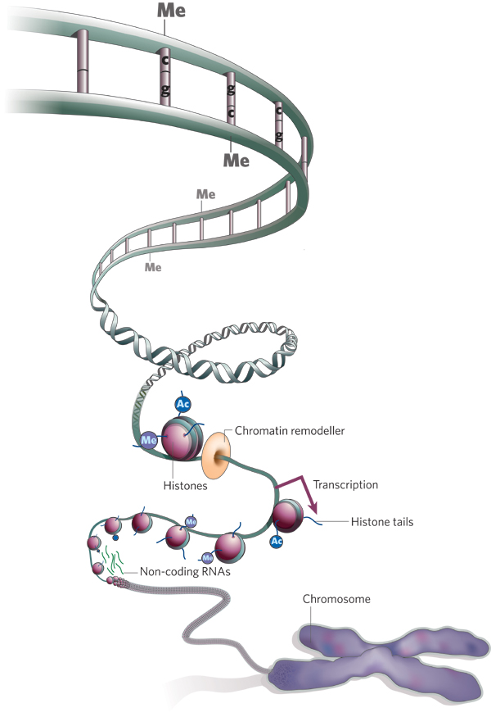
DNA methylation
Epigenetic Mechanisms
Gene expression; Chromosome stability
Methylation
Acetylation
Phosphorylation
Sumoylation
Ubiquitination
Chromatin remodeling
-- remodeler
Histone
Modification
--Transcription
Chromosome
Nature, 2008

Slide 4
A “Complete” Human Epigenome
--- Cell Type-specific
DNA methylation (shotgun bisulfite, RRBS, MeDIP/MRE)
Histone modifications by ChIP-seq (e.g. H3K4me1H3K4me3, H3K27Ac)
Chromatin accessibility by DNAseI hypersensitivity
RNA by ssRNA-seq
miRNA by miRNA-seq
BE Bernstein et al, Nat Biotech 2010; Zhou, Nature Methods, 2011

Slide 5
Function of DNA Methylation in Eukaryotes
X-chromosome Inactivation
Imprinting
Chromosome Stability and organization
Gene expression
Exon usage/splicing

Slide 6
Study Design
MESA epigenomics study funded by NIH Roadmap Epigenomic Program and NHLBI
2,500 MESA participants at Exam 5
Age: 55-94 years
51% Female, 49% Male
47% Caucasians, 21% AAs, 32% Hispanics
WFU, JHU, Columbia, UMN
Monocytes/CD4+ T cells: anti-CD14/CD4 coated magnetic beads; PBMC stored

Slide 7
MESA Epigenomic Studies
Exam 5 (N_{(max)=}~2500)
RNA expression (Illumina 48K microarray & RNA-seq): N=1, 269
DNA methylation (Illumina 450K): N=1,269
miRNA (miRNA-seq): N=842
Histone modifications by ChIP-seq (e.g. H3K4me1H3K4me3, H3K27Ac)
Chromatin accessibility (ATAC-seq)

Slide 8
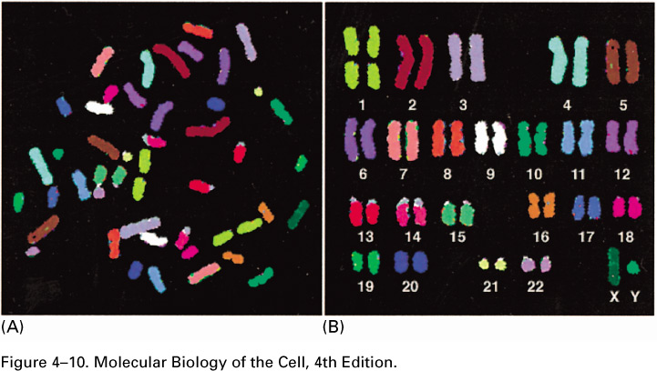
Epigenomic Changes Have Been Implicated in a Wide Variety of Human Diseases
Development
Cell Differentiation
Aging
Reprogramming to iPS
Cancer
Cardiopulmonary disease
Autoimmune disease
Obesity
Diabetes
Neurodevelopmental disorders
Schizophrenia
Addiction
Depression
Autism
GENOME
EPIGENOME
GENE Exp.
DISEASE
Environmental exposures
Nutrition/Diet
Chemical toxins
Metals
Mediators of stress
Infection
HIV latency
NIH: N. Volkow

Slide 9
Publications
Reynolds LM, Taylor JR, Ding J, Lohman K, Johnson C, Siscovick D, Burke G, Post W, Shea S, Jacobs DR, Jr., Stunnenberg H, Kritchevsky SB, Hoeschele I, McCall CE, Herrington DM, Tracy RP, Liu Y. Age-related variations in the methylome associated with gene expression in human monocytes and T cells. Nature Communications. 2014;5:5366. (PMCID: PMC4280798).
Ding J, Reynolds LM, Zeller T, Muller C, Mstat KL, Nicklas BJ, Kritchevsky SB, Huang Z, Fuente A, Soranzo N, Settlage RE, Chuang CC, Howard T, Xu N, Goodarzi MO, Ida Chen YD, Rotter JI, Siscovick DS, Parks JS, Murphy S, Jacobs DR, Jr., Post W, Tracy RP, Wild PS, Blankenberg S, Hoeschele I, Herrington D, McCall CE and Liu Y. Alterations of a cellular cholesterol metabolism network is a molecular feature of obesity-related type 2 diabetes and cardiovascular disease. Diabetes. In press, 2015.
Reynolds LM, Wan M, Ding J, Taylor JR, Lohman K, Su D, Bennett, BD, Porter DK, Gimple R, Pittman GS, Wang X, Howard TD, Siscovick D, Psaty BM, Shea S, Burke G, Jacobs DR, Rich SS, Hixson JE, Stein JH, Stunnenberg H, Barr RG, Kaufman J, Post W, Hoeschele I, Herrington D, Bell DA, Liu Y. DNA Methylation of the Aryl Hydrocarbon Receptor Repressor Links Cigarette Smoking to Subclinical Atherosclerosis. Circ Cardiovas Genet. 2015.
Reynolds LM, Ding J, Taylor JR, Lohman K, Soranzo N, de la Fuente A, Liu TF, Johnson C, Barr RG, Register TC, Donohue KM, Talor MV, Cihakova D, Gu C, Divers J, Siscovick D, Burke G, Post W, Shea S, Jacobs DR, Jr., Hoeschele I, McCall CE, Kritchevsky SB, Herrington D, Tracy RP, Liu Y. Transcriptomic profiles of aging in purified human immune cells. BMC genomics. 2015;16:333 (PMCID: PMC4417516).
Yi,H, Breheny,P, Imam,N, Liu,Y, Hoeschele,I: Penalized Multi-Marker Versus Single-Marker Regression Methods for Genome-Wide Association Studies of Quantitative Traits. Genetics 2014.
Liu Y, Ding J, Reynolds LM, Lohman K, Register TC, de la Fuente A, Howard TD, Hawkins GA, Cui W, Morris J, Smith SG, Barr RG, Kaufman JD, Burke GL, Post W, Shea S, McCall CE, Siscovick D, Jacobs DR, Jr., Tracy RP, Herrington DM, Hoeschele I. Methylomics of gene expression in human monocytes. Hum Mol Genet. 22(24): 5065-5074, 2013. (PMCID: PMC3836482).
Ma Y, Follis JL, Smith CE, Tanaka T, Manichaikul AW, Chu AY, Samieri C, Zhou X, Guan W, Wang L, Biggs ML, Chen YI, Hernandez DG, Borecki I, Chasman DI, Rich SS, Ferrucci L, Irvin MR, Aslibekyan S, Zhi D, Tiwari HK, Claas SA, Sha J, Kabagambe EK, Lai CQ, Parnell LD, Lee YC, Amouyel P, Lambert JC, Psaty BM, King IB, Mozaffarian D, McKnight B, Bandinelli S, Tsai MY, Ridker PM, Ding J, Mstat KL, Liu Y, Sotoodehnia N, Barberger-Gateau P, Steffen LM, Siscovick DS, Absher D, Arnett DK, Ordovas JM, Lemaitre RN: Interaction of methylation-related genetic variants with circulating fatty acids on plasma lipids: a meta-analysis of 7 studies and methylation analysis of 3 studies in the Cohorts for Heart and Aging Research in Genomic Epidemiology consortium. Am J Clin Nutr 2016: PMID:26791180. [Epub ahead of print].
Needham,BL, Smith,JA, Zhao,W, Wang,X, Mukherjee,B, Kardia,SL, Shively,CA, Seeman,TE, Liu,Y*, Diez Roux,AV*: Life Course Socioeconomic Status and DNA Methylation in Genes Related to Stress Reactivity and Inflammation: The Multi-Ethnic Study of Atherosclerosis. Epigenetics. In press, 2015. *These authors jointly contributed to the work.
CHARGE consortium. The transcriptional landscape of human age. Nat. Commun.2015.

Slide 10
Manuscripts Under Review
Liu Y, Reynolds LM, Ding J, Hou L, Lohman K, Young T, Cui W, Wan M, Stunnenberg HG, Parks JS, Siscovick D, Hou L, Psaty BM, Rich SS, Rotter JI, Kaufman JD, Burke GL, Jacobs DR, Post W, Hoeschele I, Bell DA, Herrington D, Tracy RP, McCall CE, Stein JH. Transcriptomics and Methylomics of Atherosclerosis in Human Blood Monocytes; manuscript under review at Nature Communication.
Liu C*, Marioni RE*, Hedman A*, Pfeiffer L*, Tsai P *, Reynolds L*, Just AC*, Duan Q*, Boer CG*, Tanaka T,….Conneely KN†, Baccarelli AA†, Deary IJ†, Bell JT†, North KE†, Liu Y†, Waldenberger M†, London S†, Ingelsson E†, Levy D†. A DNA Methylation Biomarker of Alcohol Consumption; manuscript submitted to Nature Communication (Feb 2016). *co-first authors; †co-senior authors
Joehanes R*, Just A*, Pilling LC*, Reynolds LM*, Mandaviya PR*, Guan W*, Xu T*, Elks CE*, Aslibekyan S*, Moreno-Macias H*, Smith JA*, Brody JA*, Dhingra R*,…,Conneely K#, Sotoodehnia N#, Kardia SLR#, Melzer D#, Baccarelli AA#, van Meurs J#, Romieu I#, Arnett D#, Ong KK#, Liu Y#, Waldenberger M#, Deary I#, Fornage M#, Levy D#, London SJ#. Epigenetic Signatures of Cigarette Smoking; manuscript submitted to Circulation (January 2016). *co-first authors; #co-senior authors
Chi GC, Liu Y, MacDonald JW, Reynolds LM, Barr RG, Donohue KM, Hensley MD, Hou L, McCall CE, Siscovick DS, Kaufman JD. Long-term outdoor air pollution and DNA methylation in circulating monocytes: Results from the Multi-ethnic Study of Atherosclerosis (MESA); manuscript under review at Am J Physiol Heart Circ Physiol.

Slide 11
Cross-sectional study findings
CVD risk Factors
(e.g. Obesity, Smoking, Lipids, et.al)
Environmental factors
Genetic Sequence
Variants
Epigenetic modifications
Transcriptome
Age, Gender, Race
Monocytes At MESA Exam 5
T2DM or Atherosclerosis

Slide 12
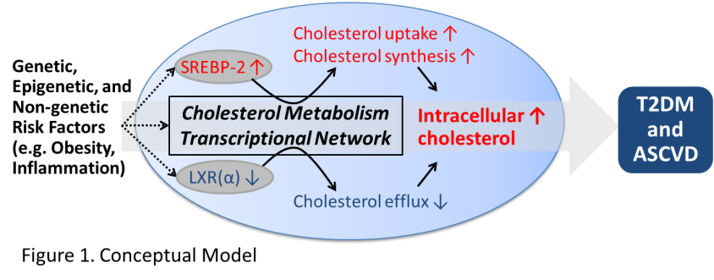
RATIONALE
Goal: to elucidate the temporal relationship between obesity/inflammation, molecular features (e.g.CMTN), and T2DM

Slide 13
Grant Title:
Obesity-related Epigenetic Changes and type-2 Diabetes
(R01 DK101921: 7/2015-5/2020)

Slide 14
AIMS
Replicate cross-sectional associations of T2DM with molecular features in an independent set of 1, 526 MESA participants.
Determine whether molecular features predict incident T2DM in a 6-year follow-up (N=~2,200).
New Aim: Determine effects of BMI and inflammatory mediators (plasma IL-6 ) at Exam 5 on changes in molecular features from Exam 5 to Exam 6 (N=~1,100-1,500).

Slide 15
METHODS
Aim 1&2:
Quantify molecular features (DNA methylation and mRNA expression) in the remaining monocyte samples at MESA Exam 5
Measure plasma IL-6 at MESA Exam 5
Assess fasting glucose/HbA1C and insulin measures at Exam 6
Aim 3:
Conduct a follow-up assessment of molecular changes (DNA methylation and mRNA expression) in monocytes at Exam 6.

