Slide 1
Vitamin K, Race/Ethnicity and Coronary Calcium in MESA
Kyla Shea, PhD
Department of Internal Medicine/Gerontology Section
Sticht Center on Aging; Wake Forest School of Medicine

Slide 2
Outline
Vitamin K overview
Determinants of vitamin K status in MESA
Vitamin K and CAC in MESA

Slide 3
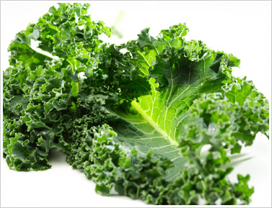
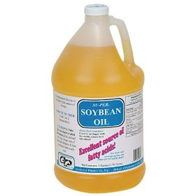
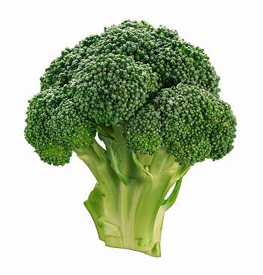
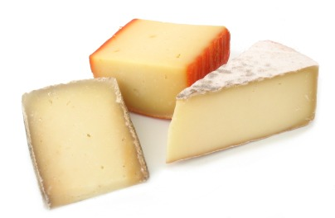
Dietary forms
Phylloquinone (Vitamin K1)
Menaquinones (Vitamin K2)
MK4
MK7-10
Notes:
There are more than one form of vitamin K.
Phylloquionone (K1) is the most common form in western diet, found in green leafy and cruciferous vegetables and vegetable oils.
Menaquinones are a class of vitamin K compounds known as vitamin K2 collectively; differ from phylloquinone in length and saturation of the side chain.
MK4 is most structurally similar to K1, found in chicken meat and also some cheeses.

Slide 4
Dietary Sources of Vitamin K
Recommended Intakes: 90 µg/day (women); 120 µg/day (men)
1 cup (200 g) collard greens (cooked) 830 µg PK
1 cup (160 g) broccoli (cooked) | 220 µg PK
1 cup (72 g) green leaf lettuce | 71 µg PK
1 tbsp (14 g) soybean oil | 25 µg PK
1 tbsp (14 g) canola oil | 17 µg PK
3 oz. (84 g) chicken (white) | 20 µg MK4
1 oz. (28 g) cheese | 20-25 µg MK
40 g natto | 380 µg MK7 + 20 µg PK
PK= phylloquinone
MK= menaquinone
Notes:
Current recommendations: (based on maintaining coagulation)
United States (IOM, 2003):Men: AI = 120 mcg/day; Women: AI = 90 mcg/day (based on median intakes from food, as estimated from NHANES III (1988–1994))

Slide 5
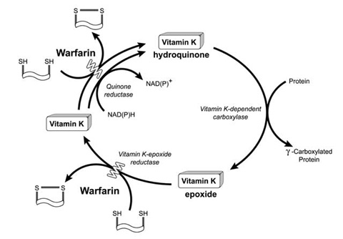
The Vitamin K Cycle
Notes:
Although new roles for vitamin K are emerging, right now its only known function is to carboxylate VKD proteins. This is a diagram of that process… vit K (can be K1 or K2) enters the cycle …. Its reduced to HQ, the HQ functions as the enzymatic cofactor for the carboxylation. The epoxide is then reduced back to the vitamin K form. This carboxylation confers function to the protein … uncarboxylated forms are less functional. The reductase enzyme is inhibited by warfarin. So when people take warfarin, the cycle is interrupted and VKD proteins are not fully carboxylated.

Slide 6
Vitamin K-dependent proteins
Tissue | Proteins
Blood | Factor II (prothrombin), VII, IX, X, proteins C, S, Z
Vascular tissue | Growth Arrest Specific protein-6 (GAS-6), matrix gla protein (MGP), Gla-rich protein (GRP), periostin
Cartilage | MGP, GAS-6, periostin, GRP, osteocalcin
Bone | Osteocalcin, MGP, GRP, periostin, protein S
Pancreas | protein S, GAS-6
Notes:
Although the most well-known VKD proteins are part of the coagulation cascade, there are several other VKD proteins present throughout the body, including in vascular tissue.

Slide 7
Vitamin K-dependent proteins
Tissue | Proteins
Blood | Factor II (prothrombin), VII, IX, X, proteins C, S, Z
Vascular tissue | Growth arrest specific protein-6 (GAS-6), matrix gla protein (MGP), Gla-rich protein (GRP), periostin
Cartilage | MGP, GAS-6, periostin, GRP, osteocalcin
Bone | Osteocalcin, MGP, GRP, periostin, protein S
Pancreas | protein S, GAS-6

Slide 8
Biomarkers of Vitamin K Status
Plasma/serum phylloquinone
Under-carboxylated vitamin K dependent proteins:
Osteocalcin (ucOC)
Matrix Gla Protein (ucMGP)
Urinary metabolites
Notes:
There is no single robust biomarker of vitamin K status…
We measured circulating K1-a more global measure- in MESA.
There are assays that measure the undercarboxylated fractions of VKD proteins which are considered functional measures of vitamin K status. For example, OC is the most common VKD in bone and ucOC is considered a measure of VK status of bone. Assays that measure the ucMGP (which is found in vascular tissue) are now available, although still not validated.
Due to bias associated with self-reported dietary intake, many population-based nutrition studies use biomarkers…not subject to reporting bias (although biomarkers are not perfect).
Serum K1 is better measure of exposure and has been validated against FFQs

Slide 9
Race/ethnic differences
in serum phylloquinone
Notes:
Primarily focus on race/ethnicity since race/ethnic differences in K status would be important for clinical trial design & interpretation.

Slide 10
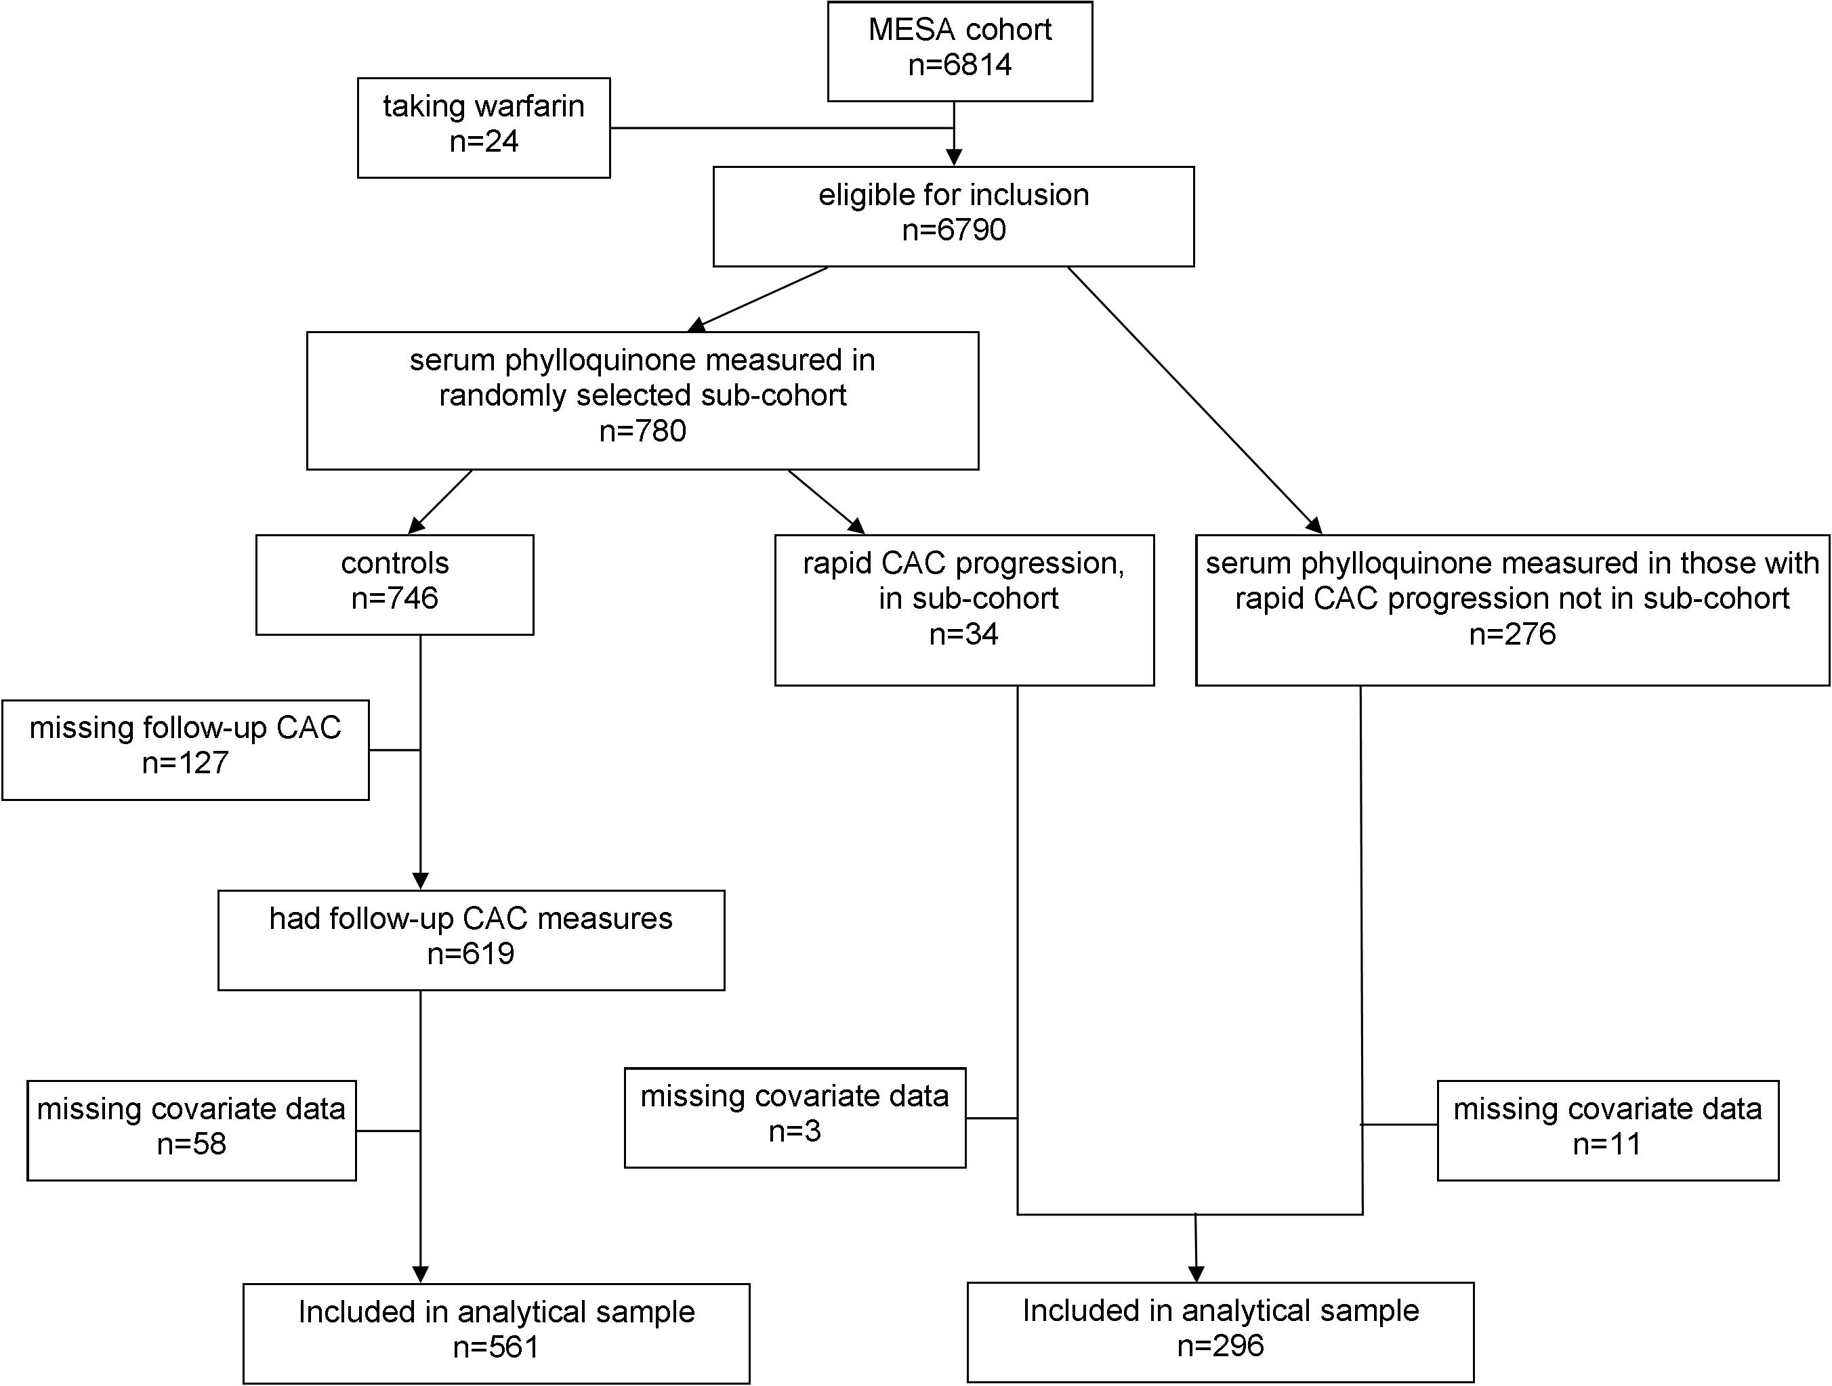
Case-cohort Design
Notes:
For this part of my talk I’m going to discuss analyses that utilized only the participants selected in the random sub-cohort.
The details of the rest of this diagram I’ll discuss in a few minutes.

Slide 11
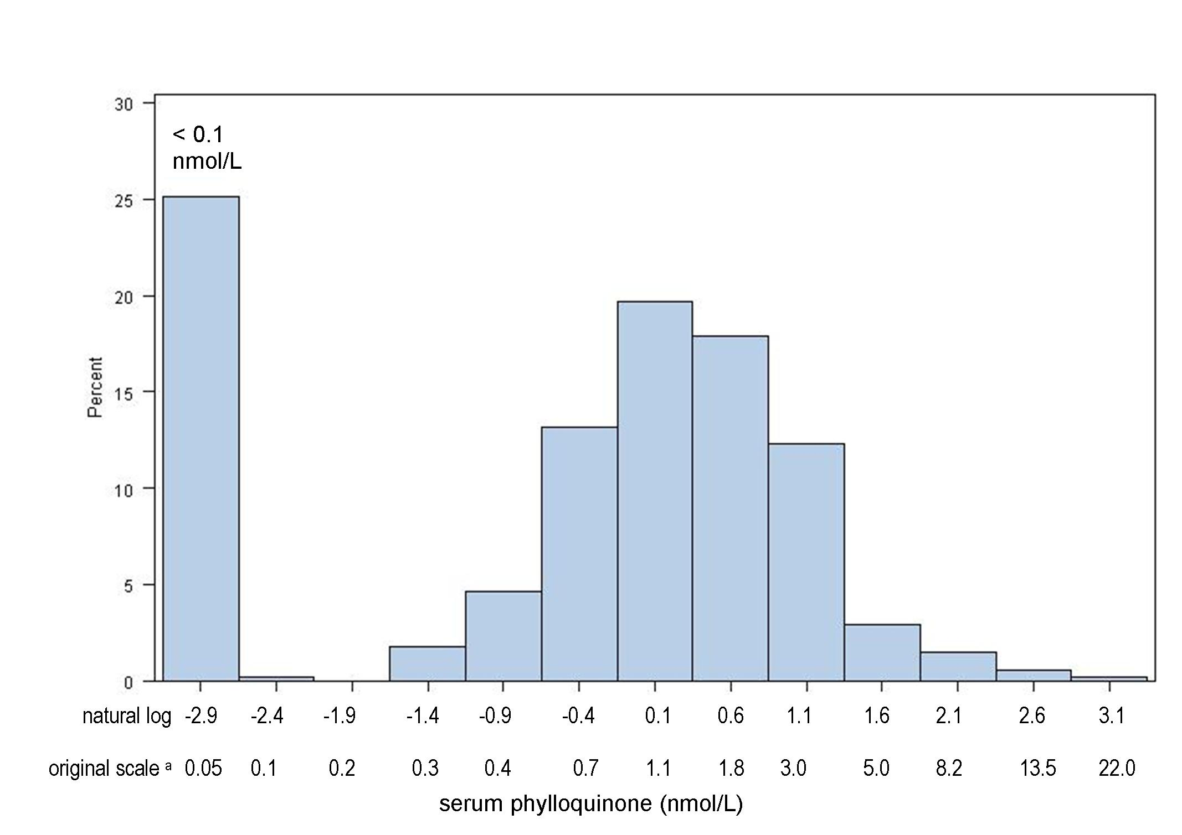
Serum phylloquinone (PK) in MESA
1.0 nmol/L
1.4 nmol/L
Notes:
Overall distribution in MESA…

Slide 12
Race/Ethnic Differences
White (n=262)
Hispanic (n=169)
African American (n=180)
Chinese American (n=93)
Shea MK et al, J Nutr, in revision
Notes:
Total n was 704 – excluded people with missing pertinent covariate data.

Slide 13
OR(95%CI) for low serum PK according to Race/Ethnicity
n | White 262 | African American 180 | Hispanic 169 | Chinese American 93 | p-value
Serum PK < 0.1nmol/L n (%) | 62 (24) | 53 (29) | 59 (33) | 7 (4)
Unadjusted | 1.00 | 1.35 (0.88-2.07) | 1.73 (1.13-2.65) | 0.26 (0.12-0.60) | <0.001
Model 2 | 1.00 | 1.17 (0.75-1.82) | 1.95 (1.25-3.04) | 0.26 (0.11-0.59) | <0.001
Model 3 | 1.00 | 1.30 (0.79-2.15) | 1.19 (0.66-2.15) | 0.23 (0.09-0.60) | 0.005
Model 2: adjusted for triglycerides and PK intake
Model 3: additionally adjusted for education (SES), age, gender, BMI, smoking status, total cholesterol, site, season, lipid lowering medication use
Notes:
Very consistently, Chinese had higher serum K1 than other groups; lower odds for low serum K1.
Hispanics had higher OR for low K than whites, but it was not statistically significant in fully adjusted model, primarily due to SES/education.
Among those with detectable serum K1, when analyzed continuously geo mean serum K1 by race/ethnicity were:
Whites: 1.2 nmol/L (fully adjusted)
Chinese: 2.2
Black: 1.5
Hispanic: 1.1
No significant differences in energy adjusted K1 intakes in blacks, whites, Chinese; hispanics did self-report lower intakes than the other 3 groups.

Slide 14
Predictors of serum PK <0.1 nmol/L in MESA
 | OR(95%CI) | p-value | % variability
Race (compared to white)
Chinese | 0.23 (0.09-0.53) | <0.001 | 3.2
Hispanic
African American
(ln) Triglycerides, mmol/L | 0.51 (0.34-0.74) | <0.001 | 1.6
(ln) PK intake, µg/day | 0.74 (0.59-0.94) | 0.01 | 0.8
Total cholesterol, mg/dl | 0.99 (0.98-1.00) | 0.02 | 0.7
Lipid lowering medication use | 0.46 (0.26-0.79) | 0.005 | 0.7
Season (compared to Jan.-Mar.) |  |  | 1.2
April-June | 0.58 (0.37-0.93) | 0.02
July-Sept. | 0.49 (0.29-0.83) | 0.008
Oct.-Dec. | 0.58 (0.35-0.98) | 0.04
Site (compared to St. Paul, MN) |  |  | 2.7
Los Angeles, CA | 0.53 (0.29-0.97) | 0.04
Forsyth County, NC | 0.44 (0.24-0.81) | 0.01
New York, NY | 0.79 (0.44-1.43) | 0.43
Chicago, IL | 0.36 (0.19-0.69) | 0.002
Baltimore County, MD | 0.35 (0.18-0.67) | 0.001
Total % variability explained |  |  | 10.8
Based on stepwise logistic regression, the following exposures were entered: triglycerides, race (Chinese, Hispanic, African American), total cholesterol, BMI, age, gender, education (category), lipid lowering medication use, current smoker, season, study site; entry p<0.15
Notes:
When analyzed as a continuous measure among persons with detectable concentrations, the model explained ~20@ variability. In that analysis, predictors of serum K1 were similar, except black race was also identified (compared to white, 2.7%), as was BMI (only ~1%). Site was not a significant predictor in that model.
WRT to site – driven by Minnesota, which hispanic ethnicity … MN was 43% hispanic and the remainder white. When we excluded MN from the model, hispanic became significant predictor.

Slide 15
Vitamin K and CAC Progression

Slide 16
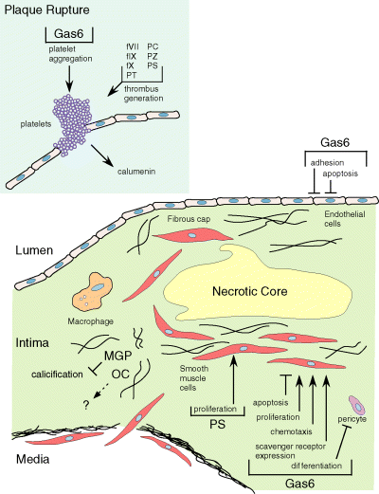
Vitamin K Dependent Proteins in CVD
Berkner & Runge, J Thromb & Haemos 2004: 2118-32
Notes:
There are several VKD proteins in vascular tissue….
MGP (matrix gla protein, which functions as a calcification inhibitor) is probably the most studied VKD with respect to CVD.
However, I think its important to realize there are several VKD proteins in vascular tissue, and implicated in atherosclerosis.
Emphasize we’re not proposing VKD proteins are implicated in initiation of calcifications, they’re more implicated in proliferation, differentiation, etc.

Slide 17
Cross-sectional studies find dietary MK, but not PK, intake is associated with vascular calcification.
Participants | Form | Outcome measure | Results | Reference
4473 men and women, >55 yrs (38% male) | PK | Abdominal aortic calcification | No association [1.03(0.72,1.48)] | Geleijnse JM et al, J Nutr 2004: 3100-05
 | MK |  | Lower odds in highest tertile MK intake [0.48(0.32-0.71)]
564 post-menopausal women | PK | CAC | No association [1.17(0.96,1.42), Q4 compared to Q1] | Beulens JW et al, Atherosclerosis 2009: 489-93
 | MK |  | Lower prevalence in Q4 compared to Q1 [0.80(0.65,0.98)]
807 men and women (83% male), 39-45 yrs | PK | CAC | No association [1.03(0.62, 1.72), comparing Q4 to Q1] | Villines TC et al, Coron. Artery Dis. 2005: 199-03

Slide 18
PK supplementation reduced CAC progression.
Mean (SEM) 3-year change in CAC in older men and women (60-80 yrs old); Vitamin D and calcium replete
3 yr change in AS
Shea et al. Am J Clin Nutr., 2009

Slide 19
CAC Progression in MESA
Kronmal RA et al., Circulation, May 2007; p. 2722- 30.

Slide 20
Case-cohort Design

Slide 21
Participant Characteristics
Mean(SD), unless otherwise indicated | Cases (n=296) | Controls (n=561)
Baseline CAC (Agatson Score, AS) * | 764 (968) | 0 (62)
Yearly CAC increase (AS) * | 181 (140) | 0 (12)
Serum PK, nmol/L* | 0.9 (1.7) | 1.1 (1.6)
PK intake, mcg/d* | 87 (95) | 97 (100)
Age, yr | 69 (9) | 61 (10)
BMI, kg/m² | 28.7 (5.2) | 28.4 (5.5)
Triglycerides, mg/dl* | 123 (86) | 110 (81)
Systolic blood pressure, mmHg | 135 (78) | 126 (21)
Male, n(%) | 214 (69) | 281 (45)
Caucasian, n(%) | 149 (48) | 219 (35)
Hypertension, n(%) | 199 (67) | 237 (42)
Diabetes, n(%) | 84 (28) | 63 (11)
Lipid lowering medication, n(%) | 86 (29) | 94 (17)
Current smoker, n(%) | 34 (11) | 71 (13)
* presented as median (IQR); significantly different p<0.05
Notes:
Range of
CAC progression: cases = 74->800; controls = 0-160
Baseline CAC: cases = 34-6000; controls = 0-4000

Slide 22
Low serum PK is associated with rapid CAC progression
HR(95%CI) for rapid CAC progression according to serum PK
n | <1.0 nmol/L 436 | ≥ 1.0 nmol/L 452 | < 0.1 nmol/L 223 | ≥ 0.1 nmol/L 665
unadjusted | 1.20 (0.85-1.67) | 1.00 | 1.26 (0.86-1.84) | 1.00
Model 1 | 1.47 (1.03-2.10) | 1.00 | 1.55 (1.05-2.29) | 1.00
Model 2 | 1.71 (1.05-2.77) | 1.00 | 1.73 (1.04-2.90) | 1.00
Model 3 | 1.73 (1.04-2.89) | 1.00 | 1.74 (1.05-2.91) | 1.00
Covariates:
Model 1: triglycerides and lipid lowering medication use
Model 2: model 1 + age, race, gender, bmi, systolic blood pressure, hypertension
medication use, diabetes status, kidney function (GFR <60), total cholesterol, study site
Model 3: model 2 + energy adjusted PK intake, physical activity, season, education

Slide 23
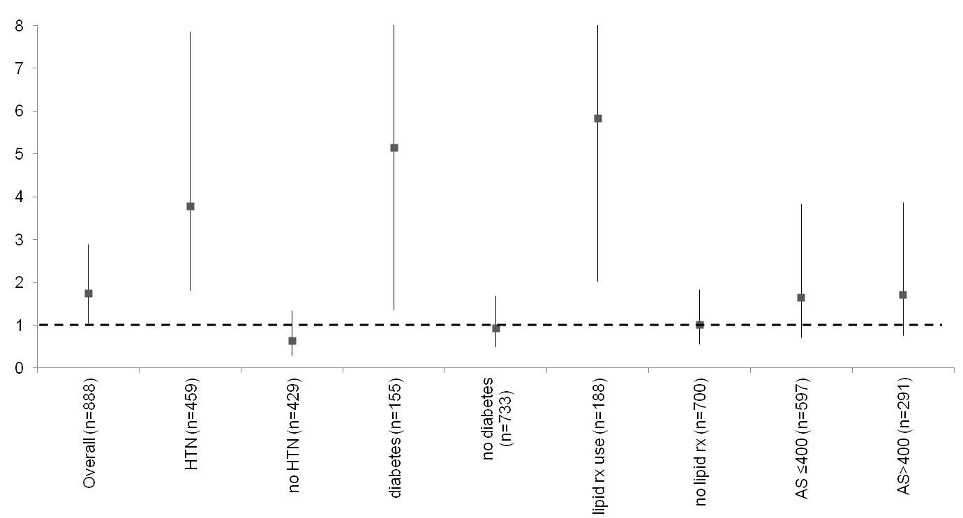
Exploratory Analyses
HR(95%CI) for rapid CAC progression for those with < 1 nmol/L serum PK
Adjusted for triglycerides, lipid lowering medication use, age, race, gender, BMI, SBP, hypertension medication use, diabetes status, kidney function (GFR <60), total cholesterol, study site, energy adjusted PK intake, physical activity, season, education (unless stratified on that variable)
Notes:
We did check for potential effect modification by demographics and prevalent comorbidities. We did not detect any significant interactions between serum K1 and gender, age (above/below the median), race wrt CAC progression. Interestingly, we found higher K appeared to be more protective in hypertensives and diabetics (both interactions p-values were 0.03). Full disclosure, this wasn’t based on an a priori hypothesis so at this point these findings are considered hypothesis generating.

Slide 24
In the random sub-cohort
Annual CAC increase (Agatson units, AU) : | ≤ 10 n=409 | 11-99 n=146 | ≥ 100 n=37
Age, y | 59 (9) | 66 (9) | 71 (8)
Female, n(%) | 248(61) | 54 (37) | 12 (32)
Caucasian, n(%) | 137 (34) | 70 (48) | 20 (55)
Triglycerides, mg/dl* | 109 (77) | 110 (87) | 115 (110)
Cholesterol, mg/dl | 195 (33) | 188 (32) | 188 (36)
Systolic blood pressure, mmHg | 122 (20) | 133 (21) | 138 (24)
Hypertension, n(%) | 142 (35) | 92 (63) | 26 (70)
Diabetes, n(%) | 31 (8) | 29 (20) | 11 (30)
Serum PK <1 nmol/L, n(%) | 195 (48) | 66 (45) | 21 (57)
PK intake, mcg/day ** | 103 (3) | 93 (6) | 77 (9)
Baseline CAC (AS)* | 0 (0) | 103 (197) | 926 (849)
Yearly CAC increase (AS)* | 0 (1) | 31 (42) | 160 (165)
* presented as median (IQR)
** energy-adjusted, geometric mean (SEM)
significantly different, p-trend<0.001

Slide 25
Serum PK and CAC progression in the random sub-cohort
OR (95%CI) for annual CAC progression ≥ 100 AU (n=37), compared to CAC progression ≤ 10 AU (n=409), according to serum PK
 | <1.0 nmol/L serum PK n=216 | ≥ 1.0 nmol/L serum PK n=230
unadjusted | 1.44 (0.73-2.84) | 1.00
Model 1 | 1.68 (0.82-3.44) | 1.00
Model 2 | 1.73 (0.71-4.19) | 1.00
Covariates:
Model 1: triglycerides and lipid lowering medication use
Model 2: model 1 + age, race, gender, BMI, SBP, hypertension
medication use, diabetes status, kidney function (GFR <60), total cholesterol, study site

Slide 26
Serum PK and CAC progression in the random sub-cohort
OR (95%CI) for annual CAC progression ≥ 100 AU (n=37), compared to CAC progression 11 – 99 AU (n=146), according to serum PK
 | <1.0 nmol/L serum PK n=87 | ≥ 1.0 nmol/L serum PK n=96
unadjusted | 1.59 (0.77-3.29) | 1.00
Model 1 | 1.87 (0.85-4.13) | 1.00
Model 2 | 1.82 (0.85-3.89) | 1.00
Covariates:
Model 1: triglycerides and lipid lowering medication use
Model 2: model 1 + age, race, gender, BMI, SBP, hypertension
medication use, diabetes status, kidney function (GFR <60), total cholesterol, study site

Slide 27
Serum PK and CAC progression in the random sub-cohort
OR (95%CI) for annual CAC progression 11-99 AU (n=146), compared to CAC progression ≤ 10 AU (n=409), according to serum PK
 | <1.0 nmol/L serum PK n=261 | ≥ 1.0 nmol/L serum PK n=294
unadjusted | 0.91 (0.62-1.32) | 1.00
Model 1 | 1.08 (0.73-1.61) | 1.00
Model 2 | 0.95 (0.58-1.55) | 1.00
Covariates:
Model 1: triglycerides and lipid lowering medication use
Model 2: model 1 + age, race, gender, BMI, SBP, hypertension
medication use, diabetes status, kidney function (GFR <60), total cholesterol, study site

Slide 28
Caveats
Case cohort design – strengths & limitations.
This is a first step – clinical relevance needs to be established.
Relied on a single biomarker at one time point.

Slide 29
Next steps
Expand beyond this case-cohort design
Association between serum PK and clinical CVD events
Extend findings using exam 5 measures

Slide 30
Collaborators:
Funding:
Steve Kritchevsky, PhD
Sarah Booth, PhD
Greg Burke, MD, MS
Jennifer Nettleton, PhD
Mike Miller, PhD
Haying Chen, PhD
American Heart Association: 09CRP2070013, 0515605T
National Institutes of Health: N01HC95159-95169, P30AG021332
U.S. Department of Agriculture, Agricultural Research Service under Cooperative Agreement No. 58-1950-7-707

Slide 31
Questions? Feedback?

