Slide 1
Sleep Architecture: A Novel Marker in Cardiovascular Risk: Findings from MESA Sleep
MESA Steering Committee Meeting, Arlington, VA
September 2014
Young Kwon, MD
University of Minnesota

Slide 2
Sleep and Cardiovascular Health
Sleep and cardiovascular health is increasingly being recognized
Sleep disordered breathing (SDB)
Hypertension, HF, stroke, CHD
Short (or long) sleep duration
CVD /Metabolic syndrome/Diabetes
Sleep disturbance (arousal / deep sleep)
Hypertension

Slide 3
Sleep and AF
Atrial Fibrillation (AF) burden increasing
Sleep and AF
SDB associated with
higher odds of “nocturnal AF” (Mehra/ Redline. Sleep Heart Health Study)
Increased recurrence of AF following DC Cardioversion or ablation (Clinical studies)
Long sleep duration associated with
Incident AF (Physician Health Study)

Slide 4
Questions and Hypothesis
Sleep and AF (beyond nocturnal AF) prevalent association?
In addition to SDB, objectively measured sleep quality /quantity and AF?
Hypothesis
Both measures of SDB and Sleep quality/ quantity would be associated with AF.
MESA provides unique opportunity

Slide 5
Methods
Cross-sectional
MESA Sleep study (E5) participants with valid polysomnography (PSG) data (n=2057-9=2048)
AF determined from
hospital discharge diagnosis ICD-9 codes from MESA events follow-up
inpatient and outpatient Medicare claims data.
12-lead ECG during study examination
Polysomnography-derived AF events

Slide 6
Key Sleep Variables (Exposure)
SDB and Hypoxemia [↑sympathetic tone]
Apnea hypopnea index (AHI)
Oxygen (O2) desaturation index (ODI)
% Time spent with O2 saturation < 90%
Sleep quality
Sleep architecture (Deep sleep = Slow wave sleep: SWS) [↑ parasympathetic tone]
Sleep fragmentation (Arousal Index) [↑sympathetic tone]
Sleep quantity
Sleep duration (Average based on Actigraphy)

Slide 7
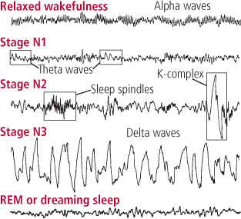
Sleep Architecture
Rapid Eye Movement (REM) Sleep vs. Non-REM
Reference. Improving Sleep: A Guide to a Good Night’s Rest, Harvard Health Publications
Notes:
Sleep architecture refers to the basic structural organization of normal sleep. There are two types of sleep, non-rapid eye-movement (NREM) sleep and rapid eye-movement (REM) sleep. NREM sleep is divided into stages 1, 2, 3, and 4, representing a continuum of relative depth. Each has unique characteristics including variations in brain wave patterns, eye movements, and muscle tone. Sleep cycles and stages were uncovered with the use of electroencephalographic (EEG) recordings that trace the electrical patterns of brain activity
Sleep architecture represents the structure of sleep and is generally composed of a somewhat cyclical pattern of the various NREM and REM sleep stages. It is typically summarized by a chart called a hypnogram.
During this stage, known as deep sleep or slow-wave sleep, the brain becomes less responsive to external stimuli, making it difficult to wake the sleeper.
During the night, a normal sleeper moves between different sleep stages in a fairly predictable pattern, alternating between quiet sleep (non-REM) and dreaming sleep (REM).
Large, slow brain waves called delta waves become a major feature on the EEG.
Normally, young people spend about 20% of their sleep time in half-hour stretches of deep sleep lasting up to half an hour, but deep sleep is nearly absent in most people over age 65.
Breathing becomes more regular. Blood pressure falls, and pulse rate slows to about 20% to 30% below the waking rate.
Blood flow is directed less toward your brain, which cools measurably.
At the beginning of this stage, the pituitary gland releases a pulse of growth hormone that stimulates tissue growth and muscle repair.
Blood levels of substances that activate your immune system increase, raising the possibility that slow-wave sleep helps the body defend itself against infection.

Slide 8
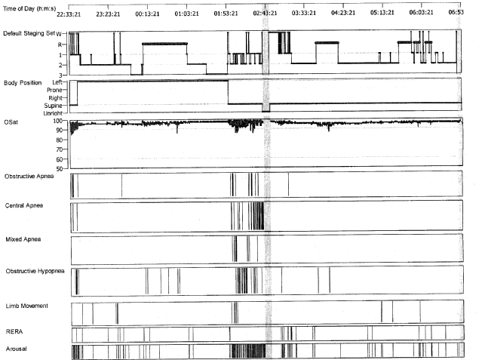
Example: Sleep Architecture of 39 yo Man

Slide 9
Questions and Hypothesis
Sleep and AF (beyond nocturnal AF) prevalent association?
In addition to SDB, objectively measured sleep quality /quantity and AF?
Hypothesis
Both measures of SDB and Sleep quality/ quantity would be associated with AF.
MESA provides unique opportunity

Slide 10
Participants Characteristics based on severity of sleep disordered breathing (SDB) apnea hypopnea index (AHI)
 | Overall | <5 (Normal) | 5-14 (Mild) | 15-29 (Moderate) | >=30 (Severe)
 | n=2048 | n=707 | n=650 | n=384 | n=307
Age | 68.4 ± 9.2 | 67.2 ± 9.1 | 69.3 ± 9.2 | 69.2 ± 9.0 | 68.8 ± 9.1
Male | 950 (46.4%) | 231 (32.7%) | 288 (44.3%) | 220 (57.3%) | 211 (68.7%)
Race / ethnicity
White | 742 (36.2%) | 273 (38.6%) | 244 (37.5%) | 132 (34.4%) | 93 (30.3%)
Chinese-American | 249 (12.2%) | 86 (12.2%) | 67 (10.3%) | 53 (13.8%) | 43 (14.0%)
African-American | 568 (27.7%) | 207 (29.3%) | 178 (27.4%) | 99 (25.8%) | 84 (27.4%)
Hispanic | 489 (23.9%) | 141 (19.9%) | 161 (24.8%) | 100 (26.0%) | 87 (28.3%)
Notes:
The mean age of the analytical sample was 68.4 ±9.2, 46.4 % were men,

Slide 11
Participants Characteristics
 | Overall | <5 (Normal) | 5-14 (Mild) | 15-29 (Moderate) | >=30 (Severe)
 | n=2048 | n=707 | n=650 | n=384 | n=307
Body mass index (kg/m^2) | 28.7 ± 5.6 | 26.7 ± 5.0 | 28.8 ± 5.1 | 29.7 ± 5.6 | 31.5 ± 6.1
Seated systolic blood pressure (mmHg) | 122.8 ± 20.2 | 121. 0± 21.5 | 123.6 ± 19.7 | 122.6 ± 18.9 | 125.8 ± 19.7
Seated diastolic blood pressure (mmHg) | 68.3 ± 9.9 | 67.2 ± 9.9 | 68.2 ± 9.8 | 68.9 ± 9.9 | 70.1 ± 10.0
Total cholesterol (mg/dl) | 184.0 ± 36.9 | 188.8 ± 36.7 | 185.0 ± 35.8 | 179.4 ± 37.6 | 176.6 ± 36.8
HDL (mg/dl) | 55.6 ± 16.3 | 59.9 ± 17.8 | 55.5 ± 15.6 | 51.7 ± 14.4 | 50.6 ± 13.6
Fasting glucose (mg/dl) | 102.0 ± 28.4 | 98.3 ± 23.9 | 101.1 ± 27.2 | 104.1 ± 28.4 | 109.8 ± 37.2
Hypertension by JNC VII (2004) criteria | 1161 (56.7%) | 362 (51.2%) | 378 (58.2%) | 228 (59.4%) | 193 (62.9%)
Hypertension medication | 1093 (53.4%) | 336 (47.5%) | 358 (55.1%) | 212 (55.2%) | 187 (60.9%)
Lipid-lowering medication | 763 (37.3%) | 230 (32.5%) | 246 (37.8%) | 159 (41.4%) | 128 (41.7%)
Diabetes | 407 (19.9%) | 101 (14.3%) | 126 (19.4%) | 93 (24.2%) | 87 (28.3%)
Prevalent coronary heart disease | 32 (1.6%) | 7 (1.0%) | 10 (1.5%) | 9 (2.3%) | 6 (2.0%)
Prevalent stroke | 20 (1.0%) | 9 (1.3%) | 6 (0.9%) | 2 (0.5%) | 3 (1.0%)
Prevalent heart failure | 27 (1.3%) | 3 (0.4%) | 6 (0.9%) | 10 (2.6%) | 8 (2.6%)
Notes:
and the mean BMI was 28.7 ±10 kg/m². These characteristics were similar to the entire MESA exam 5 cohort (n = 4651). Participants belonging to the more severe SDB group tended to have worse CVD risk profiles. Despite a high prevalence of hypertension and diabetes, overt CVD was low. With increasing AHI severity, participants were more likely to be male, and to have higher BMI, blood pressure, and fasting glucose level, and lower HDL. Similar trends were observed for prevalence of hypertension and diabetes.

Slide 12
Sleep Characteristics by AF
 | Overall (n=2048) |  |  | No AF (n = 1948) |  | AF (n = 100) |  | P value
 | N | Mean | SD | Mean | SD | Mean | SD
AHI (events/hr) | 2048 | 14.8 | 16.7 | 14.6 | 16.5 | 20.0 | 20.6 | 0.01
ODI (events/hr) | 2018 | 14.2 | 16.2 | 13.9 | 15.9 | 19.7 | 20.3 | 0.004
% time SpO2< 90% | 2048 | 3.8 | 9.0 | 3.7 | 8.8 | 6.4 | 12.8 | 0.003
Minimum SpO2 (%) | 2048 | 82.9 | 8.1 | 83.0 | 8.0 | 80.8 | 9.8 | 0.04
SWS time (min) | 2026 | 36.9 | 34.2 | 37.6 | 34.4 | 23.9 | 26.5 | <.0001
% SWS time | 2026 | 10.0 | 9.0 | 10.2 | 9.0 | 7.3 | 8.0 | 0.0004
REM time (min) | 2026 | 66.4 | 29.9 | 66.7 | 30.0 | 60.5 | 28.7 | 0.05
% REM time | 2026 | 18.0 | 6.7 | 18.0 | 17.7 | 17.6 | 6.4 | 0.6
Arousal index (events/hr) | 2026 | 22.3 | 12.0 | 22.3 | 12.0 | 22.1 | 12.3 | 0.7
Sleep efficiency (%) | 2026 | 79.6 | 12.7 | 79.9 | 12.6 | 73.4 | 13.3 | <.0001
Sleep duration (hr) | 1938 | 6.5 | 1.4 | 6.5 | 1.3 | 6.4 | 1.6 | 0.8
ODI: Oxygen desaturation index

Slide 13
Multivariate Analysis (per 1 SD increment) AHI / Hypoxemia and AF
 |  | Model 1 |  |  | Model 2 |  |  | Model 3 |  |  | Model 4
 | N | OR | 95% CI | p-value | OR | 95% CI | p-value | OR | 95% CI | p-value | OR | 95% CI | p-value
AHI (events/hr) | 2048 | 1.30 | [1.08,1.56] | 0.01 | 1.22 | [1.00,1.49] | 0.04 | 1.23 | [1.01,1.50] | 0.04 | 1.22 | [0.99,1.49] | 0.06
ODI (events/hr) | 2018 | 1.33 | [1.11,1.60] | 0.002 | 1.25 | [1.03,1.52] | 0.02 | 1.26 | [1.03,1.54] | 0.02 | 1.24 | [1.01,1.52] | 0.04
% time SpO2< 90% | 2048 | 1.16 | [1.00,1.34] | 0.05 | 1.11 | [0.95,1.29] | 0.20 | 1.1 | [0.94,1.29] | 0.23 | 1.06 | [0.90,1.25] | 0.50
Minimum SpO2 | 2048 | 0.77 | [0.63,0.93] | 0.01 | 0.81 | [0.66,1.00] | 0.05 | 0.81 | [0.66,1.00] | 0.04 | 0.84 | [0.68,1.04] | 0.12
Model 1 adjusted for age, age squared, field center, race/ethnicity, sex;
Model 2 adjusted for Model 1 covariates plus BMI and height;
Model 3 adjusted for Model 2 covariates plus smoking status, diabetes, systolic blood pressure, hypertension medication;
Model 4 adjusted for Model 3 covariates plus prevalent coronary heart disease, prevalent stroke, prevalent heart failure.
ODI: Oxygen desaturation index
Notes:
In adjusted models, each SD increase (16.7/hr) in AHI was associated with a modest increase in the odds of prevalent AF in all models, although statistical significance was attenuated to borderline in a model accounting for prevalent CVD
Higher ODI, a measure of intermittent hypoxemia, also was associated with significantly higher odds of prevalent AF in both unadjusted and all adjusted models. Minimum SpO2 during sleep was associated with higher odds of AF but statistical significance was lost after accounting for prevalent CVD. No significant association was observed for % time SpO2 < 90%, a measure of cumulative time at low hemoglobin oxygen saturation.

Slide 14
Multivariate Analysis (per 1 SD increment) Sleep Quality/Quantity and AF
 |  | Model 1 |  |  | Model 2 |  |  | Model 3 |  |  | Model 4
 | N | OR | 95% CI | p-value | OR | 95% CI | p-value | OR | 95% CI | p-value | OR | 95% CI | p-value
SWS time | 2026 | 0.65 | [0.49,0.86] | 0.003 | 0.67 | [0.51,0.90] | 0.01 | 0.69 | [0.52,0.92] | 0.01 | 0.66 | [0.50,0.89] | 0.01
% SWS time | 2026 | 0.74 | [0.58,0.96] | 0.02 | 0.77 | [0.60,0.99] | 0.04 | 0.79 | [0.61,1.02] | 0.07 | 0.77 | [0.59,1.00] | 0.05
REM time | 2026 | 0.99 | [0.79,1.24] | 0.92 | 1.01 | [0.81,1.27] | 0.91 | 1.02 | [0.81,1.29] | 0.86 | 1.01 | [0.80,1.28] | 0.93
% REM time | 2026 | 1.12 | [0.90,1.39] | 0.31 | 1.13 | [0.91,1.41] | 0.25 | 1.14 | [0.91,1.41] | 0.25 | 1.13 | [0.91,1.41] | 0.27
Arousal index (events/hr) | 2026 | 0.87 | [0.69,1.09] | 0.21 | 0.84 | [0.67,1.05] | 0.12 | 0.83 | [0.67,1.05] | 0.12 | 0.84 | [0.66,1.05] | 0.12
Sleep efficiency (%) | 2026 | 0.8 | [0.66,0.97] | 0.02 | 0.81 | [0.67,0.98] | 0.03 | 0.82 | [0.68,1.00] | 0.05 | 0.81 | [0.66,0.99] | 0.04
Sleep duration (hr) | 1938 | 0.91 | [0.74,1.11] | 0.35 | 0.92 | [0.75,1.13] | 0.43 | 0.91 | [0.75,1.12] | 0.39 | 0.92 | [0.75,1.14] | 0.44
Notes:
Greater SWS time was significantly associated with lower odds of AF in all models (OR: 0.66 [0.50,0.89] per 1 SD increase in model 4).
Higher sleep efficiency was significantly associated with lower likelihood of AF. Surprisingly, a higher arousal index was associated with lower likelihood of AF, though this was statistically not significant. No association between average daily sleep duration and AF was found.

Slide 15
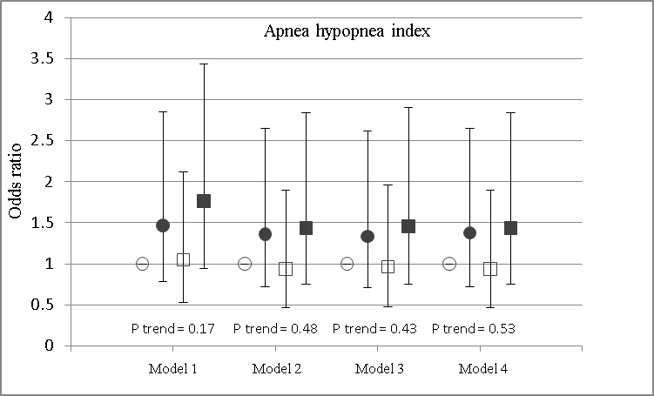
Apnea Hypopnea Index: Quartile Analysis

Slide 16
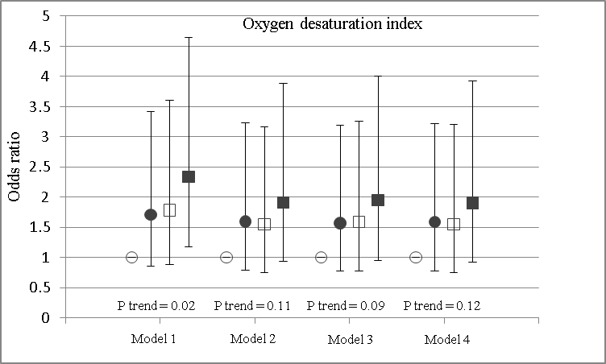
Oxygen Desaturation Index: Quartile Analysis

Slide 17
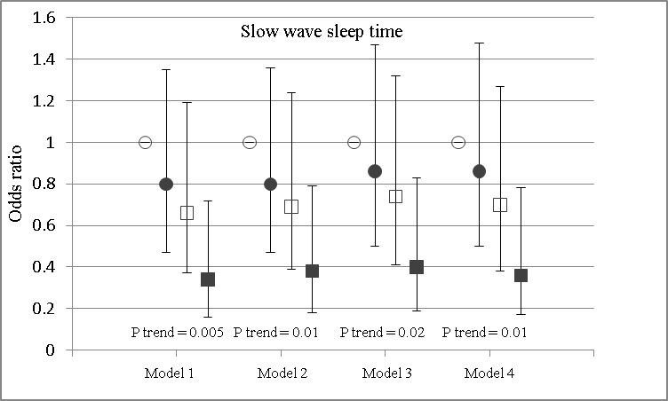
Slow Wave Sleep: Quartile Analysis
Notes:
In category-based analyses of SWS time, there was a significant linear trend of lower likelihood of AF with higher quartile of SWS time (Figure 1). % SWS time showed a similar albeit slightly weaker association with AF

Slide 18
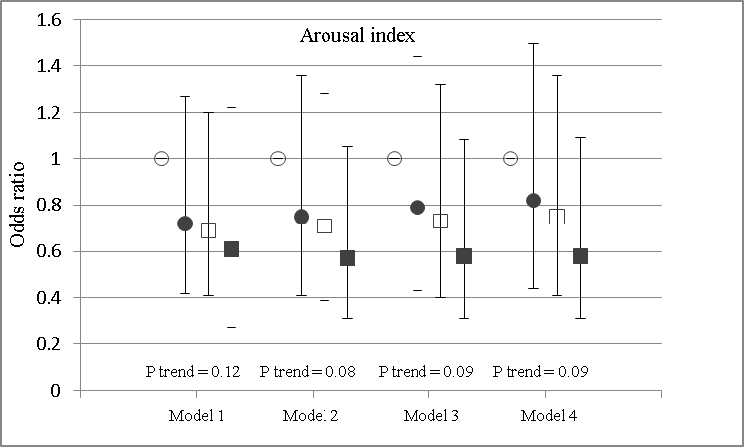
Arousal Index: Quartile Analysis

Slide 19
Participants Characteristics by SWS time Quartiles
 |  | SWS (min)
 | Overall | <=7 | >7-29 | >29-57 | >57
 | n=2026 | (n=513) | (n=502) | (n=509) | (n=502)
Age | 68.4 ± 9.2 | 69.9 ± 9.3 | 69.1 ± 9.2 | 67.9 ± 8.8 | 66.9 ± 8.9
Male | 950 (46.4%) | 346 (67.4%) | 269 (53.6%) | 210 (41.3%) | 112(22.3%)
Race / ethnicity
1:White | 742 (36.2%) | 137 (26.7%) | 179 (35.7%) | 200 (39.3%) | 224 (44.6%)
2: Chinese-American | 249 (12.2%) | 50 (9.7%) | 54 (10.8%) | 72 (14.1%) | 70 (13.9%)
3: African-American | 568 (27.7%) | 185 (36.1%) | 143 (28.5%) | 135 (26.5%) | 96 (19.1%)
4: Hispanic | 489 (23.9%) | 141 (27.5%) | 126 (25.1%) | 102 (20.0%) | 112 (22.3%)
Attained education
High school or less | 640 (31.3%) | 169 (32.9%) | 156 (31.1%) | 136 (26.9%) | 169 (33.7%)
At least some college or technical school | 992 (48.5%) | 245 (47.8%) | 240 (47.9%) | 253 (50.0%) | 243 (48.4%)
Graduate or professional school | 412 (20.2%) | 99 (19.3%) | 105 (21.0%) | 117 (23.1%) | 90 (17.9%)

Slide 20
Participants Characteristics by SWS time Quartiles
 |  | SWS (min)
 | Overall | <=7 | >7-29 | >29-57 | >57
 | n=2026 | (n=513) | (n=502) | (n=509) | (n=502)
Cigarette smoking status, exam 5
Never | 962 (47.0%) | 208 (40.5%) | 220 (43.8%) | 248 (48.7%) | 277 (55.2%)
Former | 941 (45.9%) | 264 (51.5%) | 240 (47.8%) | 224 (44.0%) | 202 (40.2%)
Current | 145 (7.1%) | 41 (8.0%) | 42 (8.4%) | 37 (7.3%) | 23 (4.6%)
Alcohol (current use) | 881 (43.2%) | 233 (45.7%) | 220 (44.3%) | 210 (41.3%) | 214 (42.8%)
Height (cm) | 165.4 ± 10.1 | 168.5 ± 10.2 | 166.3 ± 10.3 | 164.7 ± 9.9 | 162.1 ± 8.6
Body mass index (kg/m^2) | 28.7 ± 5.6 | 28.9 ± 5.3 | 28.9 ± 5.6 | 28.6 ± 5.7 | 28.1 ± 5.5
Seated systolic blood pressure (mmHg) | 122.8 ± 20.2 | 122.8 ± 19.2 | 124.6 ± 21.7 | 121.9 ± 20.1 | 122.0 ± 9.8
Seated diastolic blood pressure (mmHg) | 68.3 ± 9.9 | 69.2 ± 9.9 | 68.9 ± 9.7 | 68.1 ± 10.5 | 66.8 ± 9.1

Slide 21
Participants Characteristics by SWS time Quartiles
 |  | SWS (min)
 | Overall | <=7 | >7-29 | >29-57 | >57
 | n=2026 | (n=513) | (n=502) | (n=509) | (n=502)
Total cholesterol(mg/dl) | 184.0 ± 36.9 | 177.1 ± 35.8 | 180.6 ± 36.2 | 187.0 ± 37.8 | 191.5 ± 6.0
HDL (mg/dl) | 55.6 ± 16.3 | 53.3 ± 14.8 | 54.6 ± 16.5 | 56.2 ± 17.0 | 58.4 ± 16.9
Fasting glucose (mg/dl) | 102.0 ± 28.4 | 103.6 ± 28.4 | 102.8 ± 27.6 | 102.3 ± 31.6 | 99.0 ± 25.3
Hypertension by JNC VI (1997) criteria, exam 5 | 1161 (56.7%) | 319 (62.2%) | 300 (59.8%) | 273 (53.6%) | 252 (50.2%)
Any hypertension medication | 1093 (53.4%) | 306 (59.6%) | 277 (55.2%) | 258 (50.7%) | 235 (46.8%)
Any lipid-lowering medication | 763 (37.3%) | 201 (39.2%) | 196 (39.0%) | 176 (34.6%) | 179 (35.7%)
Diabetes | 407 (19.9%) | 125 (24.4%) | 107 (21.3%) | 93 (18.3%) | 74 (14.7%)
Prevalent coronary heart disease | 32 (1.6%) | 8 (1.6%) | 8 (1.6%) | 11 (2.2%) | 4 (0.8%)
Prevalent stroke | 20 (1.0%) | 10 (1.9%) | 3 (0.6%) | 1 (0.2%) | 5 (1.0%)
Prevalent heart failure | 27 (1.3%) | 9 (1.8%) | 6 (1.2%) | 7 (1.4%) | 4 (0.8%)

Slide 22
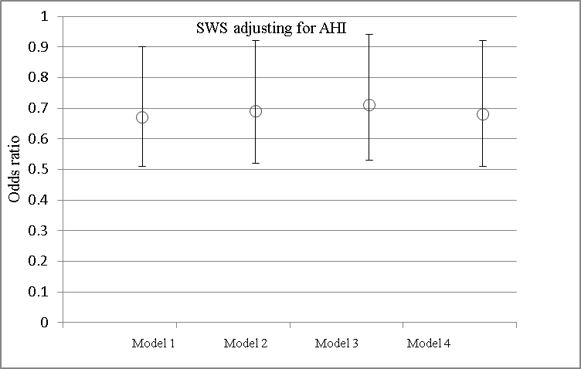
SWS adjusting for AHI (OR per 1 SD increment)

Slide 23
SWS adjusting for Sleep Duration (OR per 1 SD increment)

Slide 24
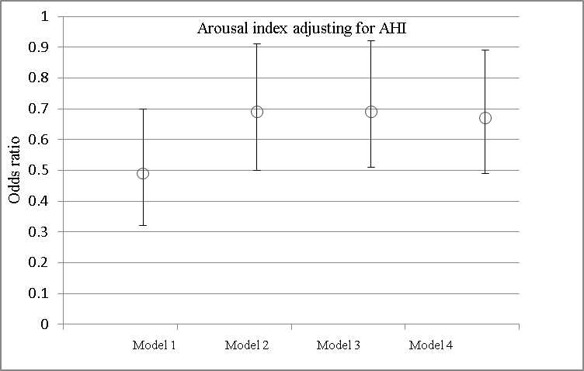
Arousal Index adjusting for AHI (OR per 1 SD increment)

Slide 25
Summary of Findings
Higher AHI and ODI
Adjusting for arousal index increases strength
Lower slow wave sleep time (deep sleep)
Even after adjusting for AHI or sleep duration
Lower arousal index (Inverse association)
Significant association after adjusting for AHI
Stronger AHI/ODI and AF association after adjusting for arousal index
Sleep duration no association with AF

Slide 26
Major Strength of the Study
Multi-Ethnic Population
Objective measurement of all the sleep indices
AF: Diagnosis from various sources

Slide 27
Sleep Architecture and CAC
 |  | CAC > 400
 |  | Model 1 |  | Model 2 |  | Model 3
 | 1 SD | PR (95% CI) | p-value | PR (95% CI) | p-value | PR (95% CI) | p-value
Sleep Architecture
Percent Time in Stage N3 | 9.0 | 0.86 [0.70,1.06] | 0.15 | 0.86 [0.70,1.06] | 0.15 | 0.77 [0.64,0.92] | 0.005
Sleep Fragmentation
Arousal Index | 12.0 | 1.09 [0.97,1.21] | 0.15 | 1.09 [0.97,1.21] | 0.15 | 1.14 [1.02,1.27] | 0.02
Arousal Index—REM | 11.8 | 1.14 [1.01,1.30] | 0.04 | 1.15 [1.01,1.30] | 0.04 | 1.15 [1.02,1.29] | 0.02
Arousal Index—NREM | 12.8 | 1.08 [0.96,1.22] | 0.18 | 1.08 [0.96,1.21] | 0.18 | 1.14 [1.02,1.28] | 0.03
Adopted from Lutsey/ Redline “Sleep and CAC Prevalence”
Notes:
Prevalence Ratios (95% CI's) † of measures of sleep disordered breathing, sleep architecture, sleep fragmentation and sleep duration and high coronary artery calcification burden (CAC > 400): The Multi-Ethnic Study of Atherosclerosis 2010-2013
All continuous variables have PR expressed per SD increment
Model 1: adjusted for age, race/ethnicity, sex, center, education (< HS, HS or some college, college degree or higher), income (<$20K, 20K to <$50K, ≥$50K) and smoking status (current, former, never).
Model 2: Adjusted for Model 1 + BMI
Model 3: Adjusted for Model 2 + traditional CVD risk factors (prevalent diabetes, systolic BP, hypertension medication use, HDL-C, LDL-C, use of lipid-lowering medications)
Model 4: Adjusted for Model 3+sleep duration category

Slide 28
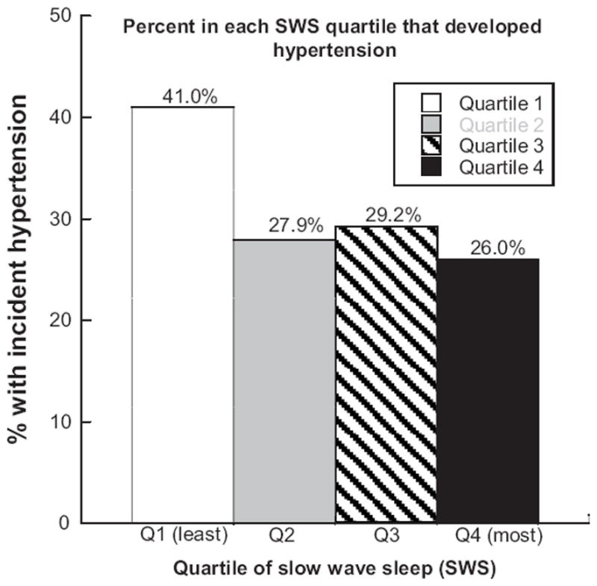
Prior studies on SWS - Cardiovascular
Incident hypertension
MrOS Fung et al.

Slide 29
Future Studies
Analysis based on prospective design
More formal quantitative analysis employing EEG power spectral analysis of slow wave activity
Autonomic Measurements
Mediating mechanism
Extend to other cardiovascular problems beyond AF ?
Can SWS help predict incident AF / recurrence of AF in general population & people with SDB?

Slide 30
Contributors
Younghoon Kwon, David R. Jacobs Jr., Alvaro Alonso, Daniel Duprez : Univ of MN
Sina A. Gharib, Mary L.Biggs, Susan R. Heckbert: Univ of WA
Joao Lima: Johns Hopkins Univ
Gen-Min Lin: Northwestern Univ
Elsayed Z. Soliman: Wake Forest Univ
Reena Mehra: Cleveland Clinic
Susan Redline: Harvard Medical School
All MESA participants and investigators

Slide 31
Sleep variables Distribution
 | Overall (n=2048) |  |  |  |  |  | No AF (n = 1948) |  | AF (n = 100) |  | P value
 | N | Mean | SD | Range | Median | IQR | Mean | SD | Mean | SD
AHI (events/hr) | 2048 | 14.8 | 16.7 | 0-102.9 | 9.1 | 3.3-19.7 | 14.6 | 16.5 | 20.0 | 20.6 | 0.01
CAI (events/hr) | 2026 | 0.4 | 1.7 | 0-49.1 | 0.0 | 0-0.2 | 0.4 | 1.8 | 0.5 | 1.3 | 0.02
ODI (events/hr) | 2018 | 14.2 | 16.2 | 0-99.4 | 8.2 | 3.1-19.1 | 13.9 | 15.9 | 19.7 | 20.3 | 0.004
% time SpO2< 90% | 2048 | 3.8 | 9.0 | 0-99.9 | 0.6 | 0-3.2 | 3.7 | 8.8 | 6.4 | 12.8 | 0.003
Minimum SpO2 (%) | 2048 | 82.9 | 8.1 | 40.0-96.0 | 85.0 | 80.0-89.0 | 83.0 | 8.0 | 80.8 | 9.8 | 0.04
SWS time (min) | 2026 | 36.9 | 34.2 | 0-212.0 | 29.0 | 7.0-57.0 | 37.6 | 34.4 | 23.9 | 26.5 | <.0001
% SWS time | 2026 | 10.0 | 9.0 | 0-51.3 | 8.1 | 2.0-15.5 | 10.2 | 9.0 | 7.3 | 8.0 | 0.0004
REM time (min) | 2026 | 66.4 | 29.9 | 0-261.0 | 66.0 | 45.0-86.0 | 66.7 | 30.0 | 60.5 | 28.7 | 0.05
% REM time | 2026 | 18.0 | 6.7 | 0-58.6 | 18.3 | 13.8-22.4 | 18.0 | 17.7 | 17.6 | 6.4 | 0.6
Arousal index (events/hr) | 2026 | 22.3 | 12.0 | 1.7-97.7 | 19.8 | 13.8-27.9 | 22.3 | 12.0 | 22.1 | 12.3 | 0.7
Sleep efficiency (%) | 2026 | 79.6 | 12.7 | 10.6-99.0 | 82.2 | 73.5-89.2 | 79.9 | 12.6 | 73.4 | 13.3 | <.0001
Sleep duration (hr) | 1938 | 6.5 | 1.4 | 1.2-10.6 | 6.6 | 5.7-7.4 | 389.1 | 80.7 | 385.9 | 95.2 | 0.8

Slide 32
Correlation(r) between Sleep Measures
 | AHI | ODI | SWS time | REM time | Arousal index | Sleep efficiency | Sleep duration
AHI (events/hr) | NA | 0.98 | -0.18 | -0.24 | 0.58 | -0.22 | -0.13
ODI (events/hr) | 0.98 | NA | -0.17 | -0.23 | 0.55 | -0.20 | -0.15
SWS time | -0.18 | -0.17 | NA | 0.05* | -0.23 | 0.26 | 0.14
REM time | -0.24 | -0.23 | 0.05* | NA | -0.38 | 0.27 | 0.09
Arousal index (events/hr) | 0.58 | 0.55 | -0.23 | -0.38 | NA | -0.36 | -0.05*
Sleep efficiency (%) | -0.22 | -0.20 | 0.26 | 0.27 | -0.36 | NA | 0.19
Sleep duration (hr) | -0.13 | -0.15 | 0.14 | 0.09 | -0.05* | 0.19 | NA

Slide 33
AF frequency by AHI quartiles

Slide 34
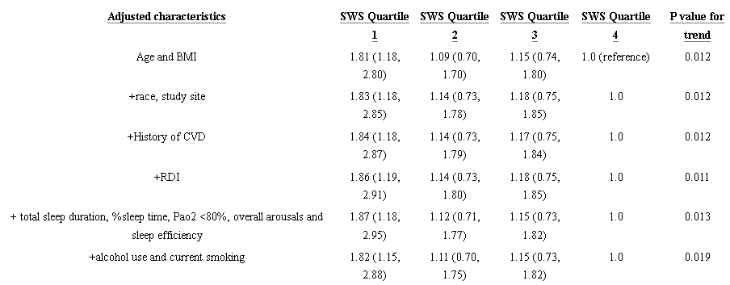
Prior studies on SWS - Cardiovascular
Incident hypertension
MrOS Fung et al.

