Slide 1
Air Pollution and CVD:
Results from MESA Air
MESA SC Meeting
Feb 6, 2014

Slide 2

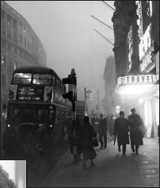
Daytime in London, 1952
Particle levels – 3,000 μg/m³
Source: National Archives
Notes:
2
In this photograph, visibility is so low that the bus driver cannot see the road, even though it is mid-morning. A police officer is on foot leading the bus with a flashlight.

Slide 3
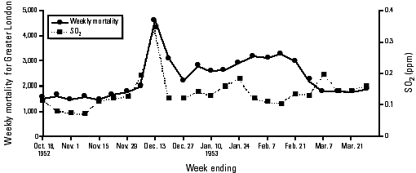
Historical Pollution Episodes Established Temporal relationship between PM/Sulfates and Mortality
Combination of industrialization and weather conditions
  Meuse Valley, Belgium 1-5 December 1930
    60 people died in last 2 days (10x expected)
  London Smog 5-9 December 1952
    TSM reached 1500 µg/m³
    12,000 Excess Deaths Attributed to Event

Slide 4
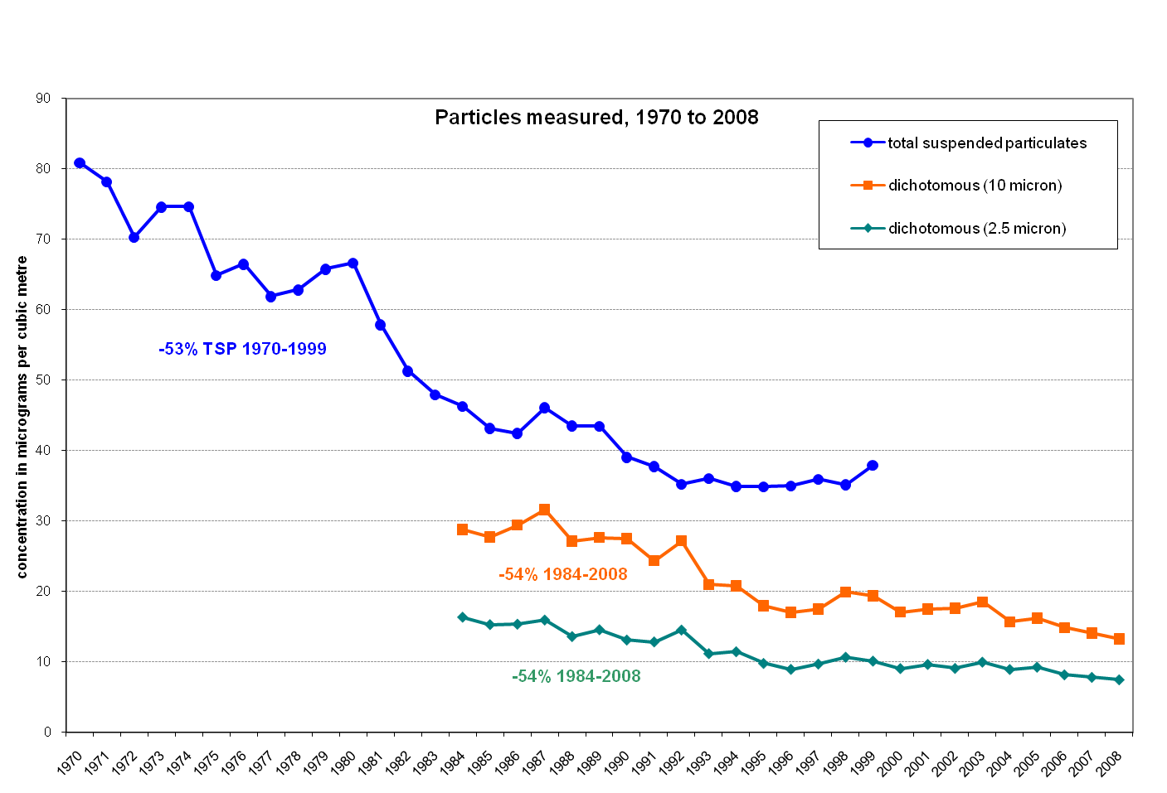
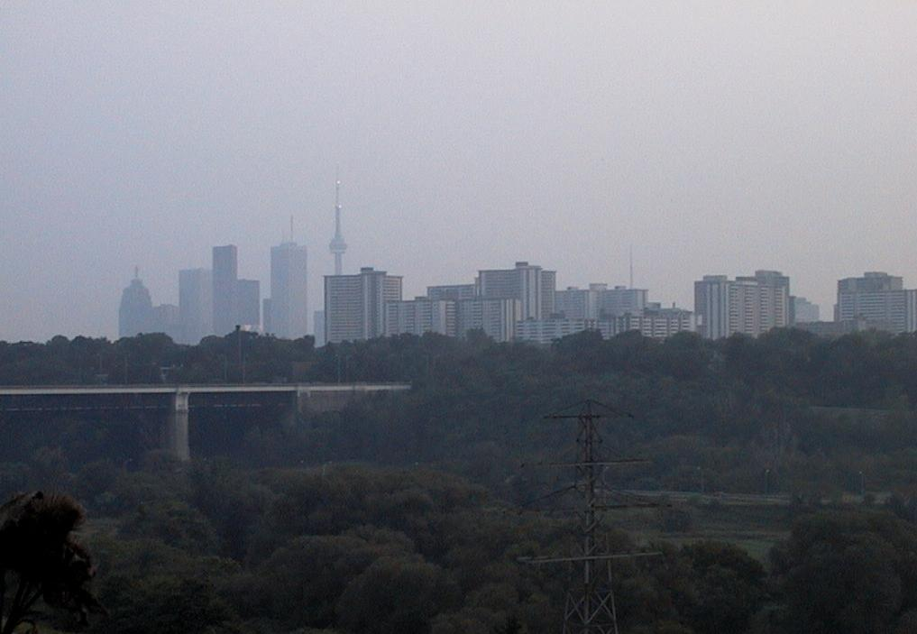
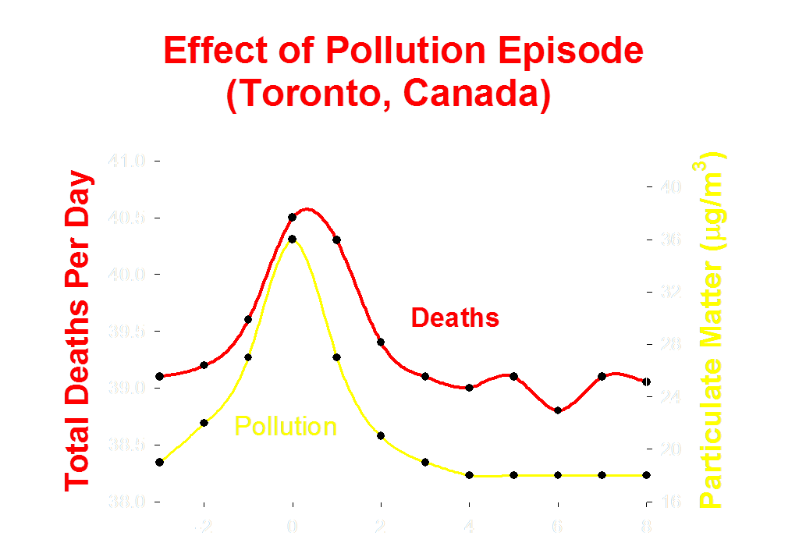

Slide 5
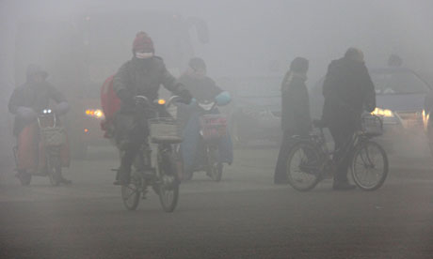
Severe smog and air pollution in Beijing, where hospitals reported increases of up to 30% in the number of patients reporting breathing problems.
Photograph: HAP/Quirky China News / Rex Feat

Slide 6
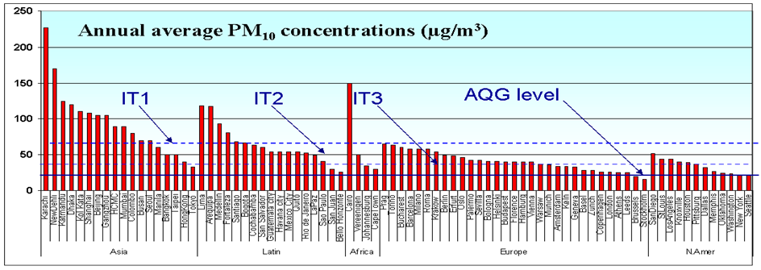
Air Pollution: A Problem Worldwide
M Krzyzanowski 2006
Notes:
6
Today there are more measurements available in more locations. These more recent data for selected major cities were compiled by M Krzyzanowski at WHO, are broadly consistent with the WB model estimates. The highest levels are in Asia, Africa, and Latin America, but few major cities in any region meet the new WHO AQGs for PM: 20 for PM10 and 10 for PM2.5.
But we still lack basic measurements for smaller cities and rural areas, and this presents a major challenge for global HIA. Recent advances in measurement, such as the satellite data discussed by Daniel Jacob yesterday, and in spatial modeling of air pollution, such as the GAINS and RAINS models developed by the IIASA institute in Vienna may be able to provide wider global coverage where traditional measurement methods are not currently feasible, but more detailed studies of air pollution exposure from multiple sources in developing countries is clearly needed, if for no other reason than to inform the development, application and interpretation of the results of such methods. Fortunately, such studies are beginning in cities in Asia, Africa and Latin America, including the HEI-ADB funded study of exposure of the poor in Ho Chi Minh City, and studies by Kirk Smith of UC Berkeley of the rapidly developing Yangtze River Valley.

Slide 7
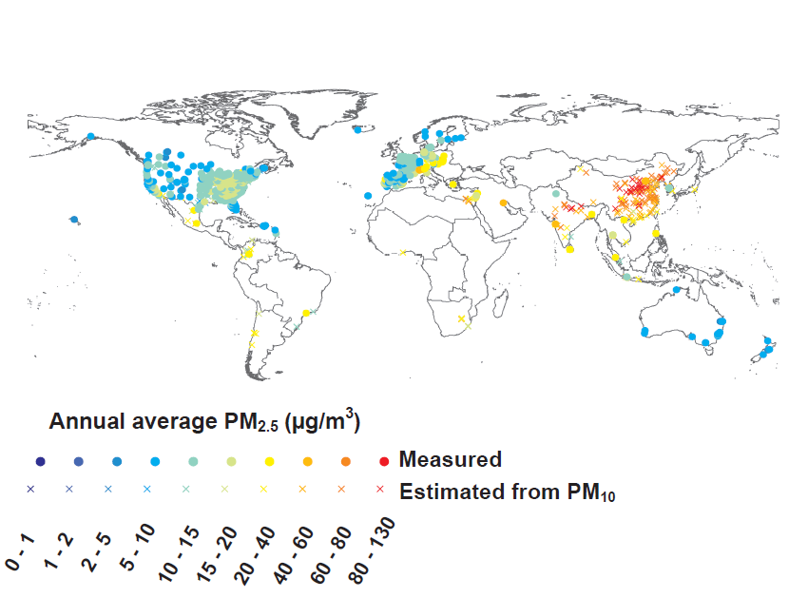
PM ground-level measurements (2005)
Measurements: North America, Europe, Australasia
Estimates (from PM₁₀): Asia, Latin America

Slide 8
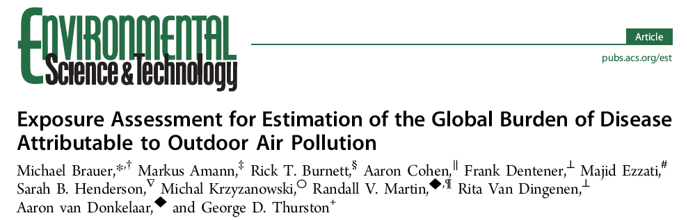
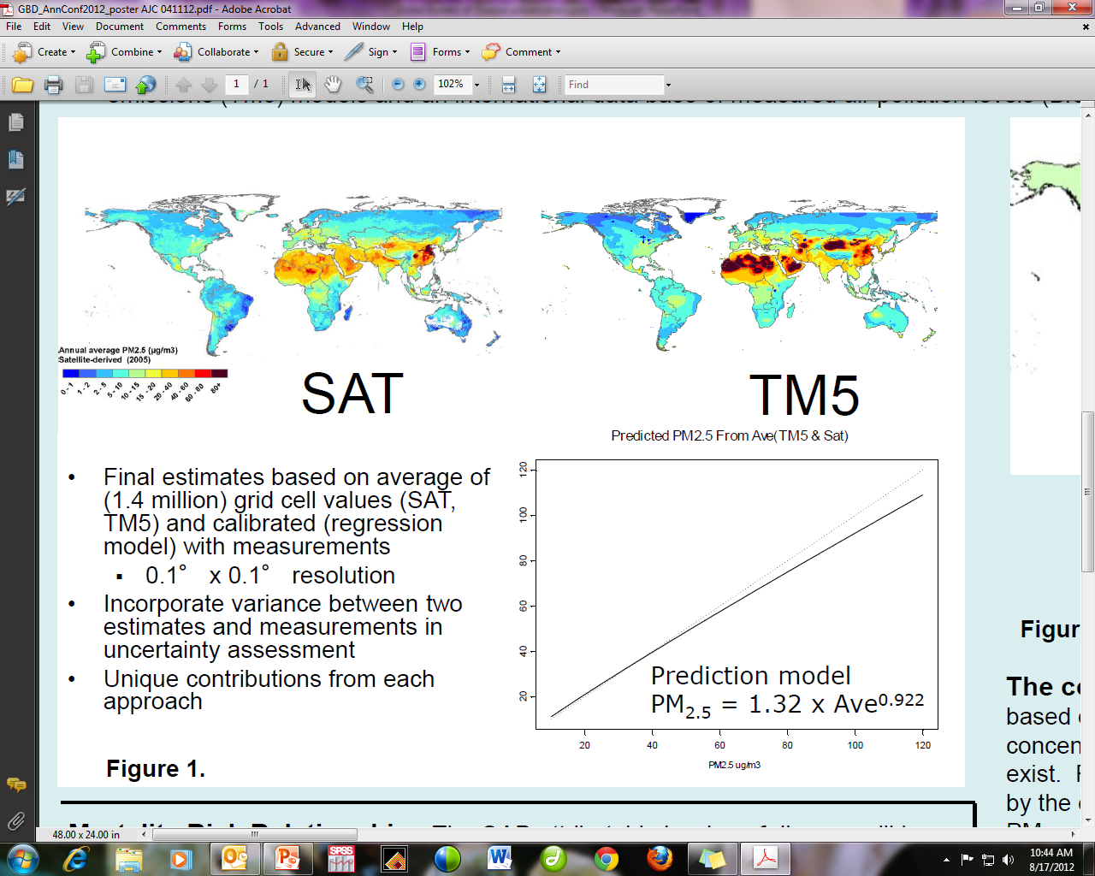
Global estimates of PM_{2.5} at 10km x 10km scale
Combined estimates from satellites (AOD), chemical transport models and ground-level measurements
Estimates include contribution of all sources of PM_{2.5}

Slide 9
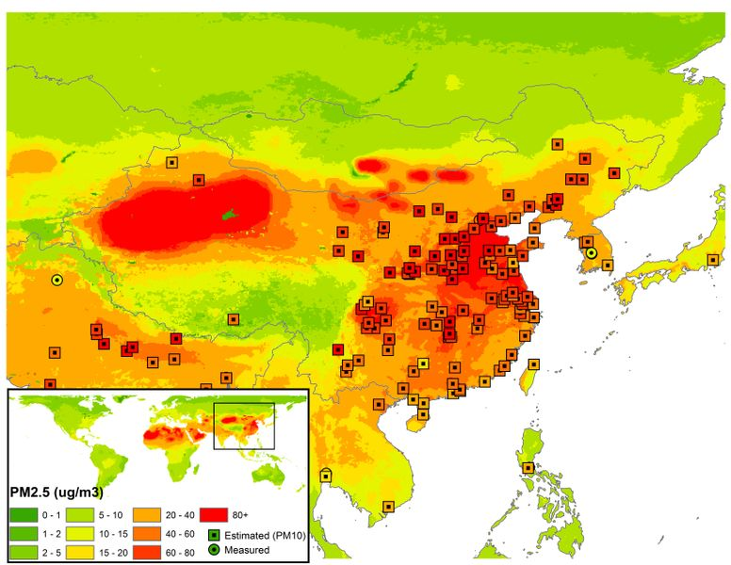
Estimated 2010 levels of PM_{2.5} in China

Slide 10
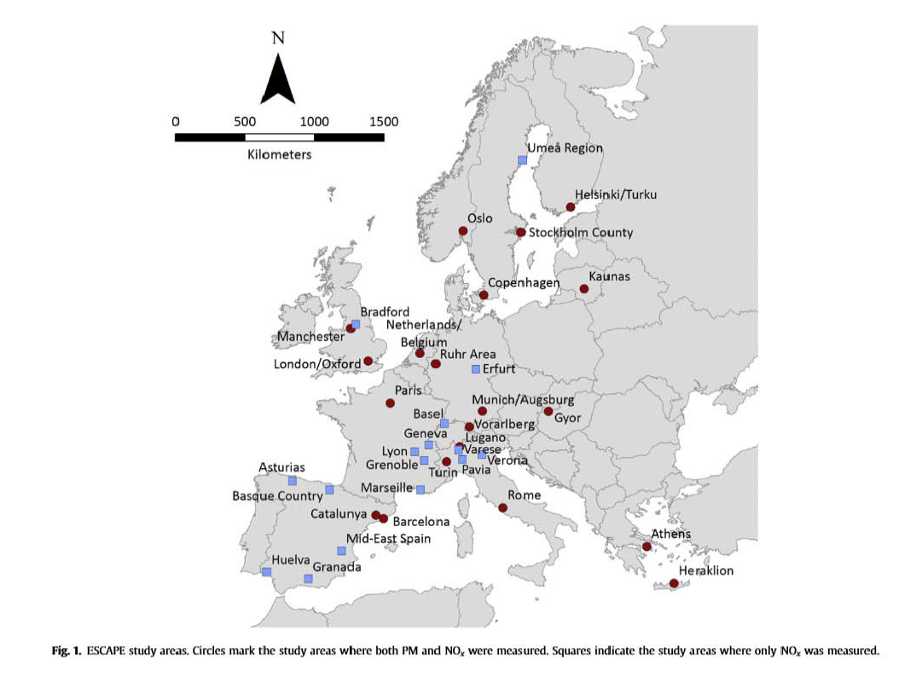
ESCAPE Project

Slide 14
MESA Air Update
Timeline
Exposure models
New findings
Recent publications

Slide 15
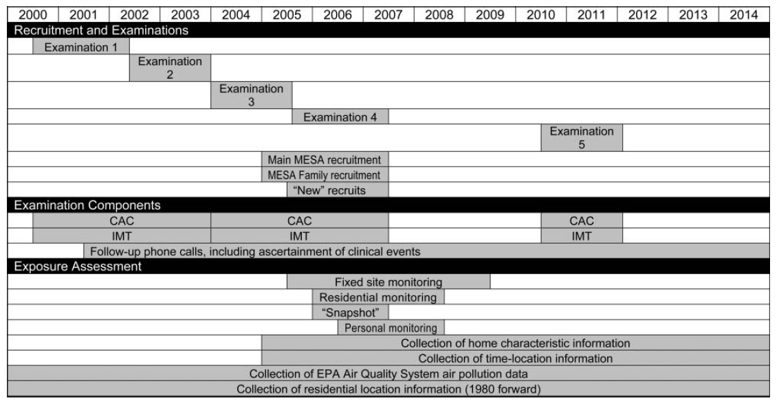
Timeline

Slide 16
Outdoor
Pollutant
Measurements
Indoor
Pollutant
Measurements
Geographic
Data
Reported
Housing
Characteristics
Deterministic Models
Observed
Housing
Characteristics
Spatio-temporal
Hierarchical
Modeling
Infiltration
Modeling
Predicted
Outdoor Concentrations
at Homes
Predicted
Indoor Concentrations
at Homes
Reported
Time/Location
Information
Weighted
Average
Measurements
Questionnaires
Predictions
Personal Exposure
Predictions for
Each Subject

Slide 17
Outdoor
Pollutant
Measurements
Indoor
Pollutant
Measurements
Geographic
Data
Reported
Housing
Characteristics
Deterministic Models
Observed
Housing
Characteristics
Spatio-temporal
Hierarchical
Modeling
Infiltration
Modeling
PM_{2.5}
NO_{X}
NO₂
BC
Predicted
Outdoor Concentrations
at Homes
Predicted
Indoor Concentrations
at Homes
Reported
Time/Location
Information
Weighted
Average
Personal Exposure
Predictions for
Each Subject
PM_{2.5} Only

Slide 18
Unified Spatio-Temporal Model Manuscript Under Review (P 036)
Developed a unified model to employ consistent inputs and predict PM_{2.5}, BC, NO_{X}, NO₂
Combined EPA and MESA monitoring data, geographic covariates, temporal trends
Prediction accuracy was high, with R²_{CV} > 0.80 at regulatory and fixed sites for most pollutants and regions

Slide 20
Keller et al., submitted

Slide 21


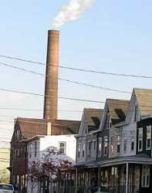
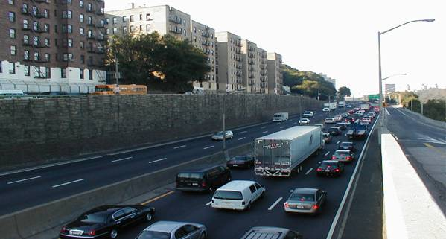
Residential segregation, socioeconomic status and air pollution
Anjum Hajat, PhD, UW
Miranda Jones, PhD, JHU
Notes:
This is work I have done in conjunction with many others

Slide 22
Lead and coauthors
Anjum Hajat (lead author SES)
Ana Diez Roux
Sara Adar
Amy Auchincloss
Gina Lovasi
Marie O’Neill
Lianne Sheppard
Joel Kaufman
Miranda Jones (lead author residential segregation)
Ana Diez Roux
Anjum Hajat
Eliseo Guallar
Kiarri Kershaw
Marie O’Neill
Wendy Post
Joel Kaufman
Ana Navas-Acien
Notes:
In fact, what I will present today are the results of two separate manuscripts. NSES recently published in EHP. And the res seg work was lead by Miranda Jones who is a post-doc at JHU.

Slide 23
Background
Race/ethnicity and socioeconomic status (SES) are strongly associated with health
Residential segregation and neighborhood SES are also associated with health
Neighborhood level factors impact health via
  Stress pathway
  Behavioral pathway
Notes:
Little doubt that race and SES are associated with health outcomes.
Moving from the individual to the NH level, we can think about res seg and nses as being parallel characteristics to ndividual level race/ses. These nh social characteristics are also assoc with health.

Slide 24
Neighborhood physical environments
Environmental exposures
Food & recreational resources
Built environment
Aesthetic quality/natural spaces
Services
Quality of housing
Residential segregation
Inequalities in resource distribution
Behavioral mediators
Stress
HEALTH
Neighborhood social environments
Safety/violence
Social connections/cohesion
Local institutions
Norms
Diez Roux 2010
Personal characteristics
Notes:
This conceptual model is helpful in illustrating how neighborhood characteristics can impact health. Res seg and unequal distribution of resources influence the quality of the neighborhood environment, both the social and physical nh envir. NH environ then effect individual level processes like behaviors and stress, which in turn cause health or disease. In much of the NH lit, both behaviors and stress are considered the pathways by which NH impact health. Those of you working in the built environment sphere have probably thought a lot about behavioral mechanisms. Things like, access to healthy foods and phys activity resources encourage better eating and more exercise thus improving health. Additionally the stress pathway is something our colleagues in psychology and neurobiology have been studying for some time. For example, a stressful NH environment, one filled with violence and crime may cause an individual to experience chronic stress (AKA toxic stress), which is thought to have negative health consequences.
There are many reinforcing mechanisms here. For example res segr can result in spatial inequalities in resources and these inequalities can then reinforce res segr. Similarly nh phys envir can impact the nh social environ. For example, nh with better recreational resources may have better social cohesion/connections and these social connections may result in better advocacy for further improved recreational or natural spaces. As for the pathways, these may not be mutually exclusive pathways in that many individuals respond to stress with changes in behavior, increased eating, but other behaviors like exercise can help to alleviate stress.
And at the bottom of the model, we see personal characteristics that are likely to modify the NH environment, through material or psychosocial resources or biological attributes.

Slide 25
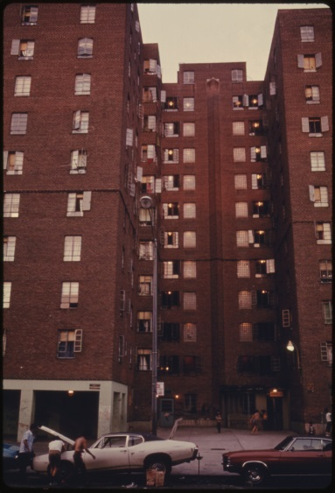
Introduction
Environmental justice research has established association between race, class and environmental hazards
  Higher pollutant concentrations among low SES and race/ethnic minority communities
Few studies have examined air pollution concentrations and
  racial residential segregation
  the simultaneous association of individual & neighborhood SES (NSES)
Notes:
Today I will discuss the association between AP and NH factors, specifically residential segr and NSES.

Slide 26
Race/ethnicity
Residential
location
Air pollution
exposure
Socioeconomic
status
Notes:
This diagram is meant to help focus on the factors we will be discussing today. In the US today, indiv race and SES determine, to a large degree, where one lives and where you live determines your exposure to AP. Differential residential location by race is racial res segr, while differential residential location by SES is class based res segr. NSES is also reflected in residen location. Since individuals of similar SES tend to cluster spatially.

Slide 27
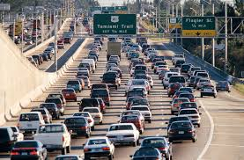
Objectives
To assess associations of ambient air pollution exposure with:
  Individual and neighborhood SES
  Race/ethnicity and racial residential segregation

Slide 28

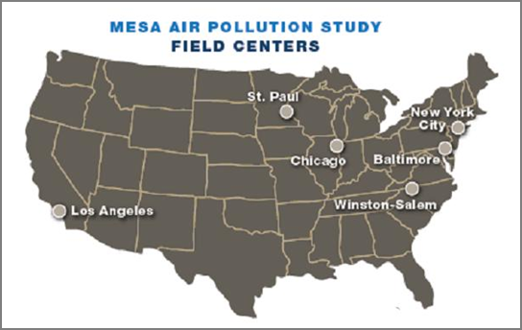
Methods
MESA Air Pollution Study
MESA Neighborhood Study
Notes:
MESA is a unique platform for studying social, physical and built environment in the context of well measured CVD outcomes. We are able to closely examine certain aspects of the social, physical and built env because of several ancillary studies to MESA.
Among other things, Mesa Air focuses on ap exposure assessment by undertaking ap monitoring specific to the MESA cohort and developing statistical methods to improve AP exposure predictions.
MESA NH focused on bringing in a rich set of nh data into the MESA study, everything from food stores and recreational facilities to NH safety and social cohesion, violence and disorder

Slide 29
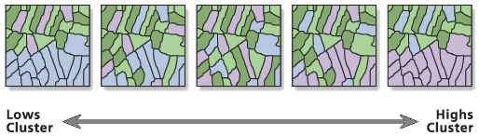
Air pollution, SES and residential segregation
Air pollution: Long-term ambient concentrations of PM_{2.5} and NO_{x} for year 2000
Individual and neighborhood SES: income, wealth, education, occupation and composite measure
Residential segregation: Getis and Ord’s G* statistic
Notes:
Fine particulate matter and oxides of nitrogen.
SES is a multifaceted concept, so to measure SES we wanted to capture all the major domains of SES.
Both NSES and res seg measured at CT level.
A spatial measure, which evaluates a given CT and its neighbors to assess if that area deviates from the mean racial/ethnic composition of the county overall.
We operationalized the G stat as being either neutral (no clustering), over-representation (clustering of cts with a specific race/ethnicity over-represented compared to the county) or under representation (clustering of cts with a specific race/ethnicity being under-represented compared to the county).

Slide 30
Statistical methods
 | NSES analysis | Residential Segregation
Outcomes | PM_{2.5} and log-transformed NO_{X} | log-transformed PM_{2.5} and NO_{X}
Measures | difference from mean PM_{2.5} and % difference from geometric mean of NO_{X} | Ratios of geometric means (GM)
Statistical model | Intrinsic conditional autoregressive model | Linear mixed model
Covariates | age, sex, race, population density, high density land use, site | age, sex, education, income, median income, population size, site
Notes:
The covariates we used were similar given the main independent variable of interest.

Slide 31
Higher NSES associated with lower pollutant concentrations
Mean PM_{2.5} =17.2 µg/m³
Geometric mean NO_{x} = 43.7 ppb
Individual SES model adjusted for age, race/ethnicity, sex, population density, high-density land use and site
NSES models further adjusted for individual SES (income, wealth and education)
Notes:
All SES variables were transformed into z-scores, so we would interpret results as 1 sd unit increase in SES being associated with pollutants. Higher values indicate higher SES.
I am showing the association between family income and pollutants, to give a sense of magnitude. As you can see the effect sizes are small. We see a similar result for the other ISES vars, wealth, education and occupation.
For NSES we see a stronger effect. For example a 1 sd unit increase in HH income (about $20K) is associated with a 0.24 ug/m3 decrease in PM2.5 and an 7.7% decrease in NOx concentration. Similarly for education, having 17% more persons with at least a HS degree in the CT is associated with 0.47 ug/m3 lower PM and 9.6% lower NOx concentrations. All these models are adjusted for the variables listed at the bottom of the slide. The NSES variables not shown here have similar magnitudes to the income, education indicators presented here.

Slide 32
Hispanic ethnicity and segregation of Hispanics associated with higher pollutant concentrations
Referent group: White participants and Neutral census tracts
Race/ethnicity model adjusted for age, sex, individual SES, census tract median income, population size and site
Residential segregation models further adjusted for race/ethnicity
Notes:
After adjustment for site, participant and neighborhood characteristics, Hispanic race/ethnicity was associated with 1% higher PM2.5 concentrations, and 2% higher NOX concentrations, compared to White participants and black race/ethnicity was also associated with 1% higher NOx concentrations compared to whites.
Compared to participants living in neutral census tracts, participants living in a clusters of census tracts where Whites were significantly under-represented were exposed to 5% higher PM2.5 concentrations and 12% higher NOX concentrations in the fully adjusted model.
• Participants living in a cluster of census tracts where Hispanics were over-represented were exposed to higher PM2.5 and NOX concentrations (4% and 13% respectively) compared to participants in neutral census tracts.
• Participants living in a cluster of census tracts where Asians were under-represented were exposed to higher PM2.5 and NOX concentrations compared to participants in neutral census tracts.
• There were no ss differences comparing participants living in clusters of census tracts with Blacks over or under-represented.
Geometric mean for PM = 16.9 ug/m3 and NOx = 43.9 ppb.

Slide 33
Conclusions
We observed higher PM_{2.5} and NO_{X} concentrations associated with:
  Hispanic ethnicity and residential segregation of Hispanics
  Lower neighborhood SES
Stronger associations with neighborhood characteristics than individual level characteristics
Notes:
Stronger NH associations is what one would expect. In terms of AP concentrations, place matters more than individual level characteristics.
I thought it would be helpful to put results into context. For the SES analysis we observed effect sizes as high as 0.47 and for res seg as high as 0.67 ug/m3 which represents between 4 – 5.5% of annual National Ambient Air Quality Standards (NAAQS) for PM2.5.
annual National Ambient Air Quality Standards (NAAQS) for PM2.5 (12 μg/m3)
For NOx, we observed effect sizes between 4.2 ppb and 5.7 ppb (mean is about 50 ppb), which is about 10% of the mean level.

Slide 34
Implications
In health analysis, important to consider potential for confounding by NSES and/or residential segregation
Relevant to joint effects research
Environmental justice
Notes:
Evidence to support association of both NSES and res seg with health outcomes (e.g. mental health, CVD, birth outcomes)
If there is no reason to be concerned about confounding by NSES or res segr, then it may be worth while to consider any possible mediating or moderating role these NH characteristics may have.
Some consider it chemical non chemical stressors, I think of it as intersection of social and physical environment.
Given considerable attention to EJ at the federal and local levels, this research may have implications for future policy.

Slide 35
Air Pollution and CAC Progression in MESA
Employ the spatio-temporal exposure estimates from the unified exposure model
Similar to results shown before, but constitute some of the primary findings of MESA Air

Slide 36
Progression of CAC with Outdoor and Individual Ambient-Derived PM_{2.5} Exposure
Outdoor
PM_{2.5} Model 1
PM_{2.5} Model 2
PM_{2.5} Model 3
PM_{2.5} Model 4a
PM_{2.5} Model 4b
Individual Ambient-Derived
PM_{2.5} Exposure Model 1
PM_{2.5} Exposure Model 2
PM_{2.5} Exposure 3
PM_{2.5} Exposure 4a
PM_{2.5} Exposure 4b
Model 1: Age, sex, race/ethnicity
Model 2: + individual risk factors
Model 3: + neighborhood & individual SES
Model 4a: 3 + blood pressure, diabetes
Model 4b: 3 + CRP, fibrinogen, creatinine, alcohol, family history
Score units per 5 µg/m³ per year

Slide 37
Progression of CAC with NO_{X}
NO_{X} Model 1
NO_{X} Model 2
NO_{X} Model 3
NO_{X} Model 4a
NO_{X} Model 4b
Model 1: Age, sex, race/ethnicity, site
Model 2: + adiposity, smoking, cholesterol, PA
Model 3: + neighborhood and individual SES
Model 4a: 3 + hypertension, blood pressure, diabetes
Model 4b: 3 + alcohol, family history, CRP, fibrinogen, creatinine
Score units per 40 ppb per year

Slide 38
Sensitivity Analyses
PM_{2.5} Main Result
PM_{2.5} on Agatston Score
PM_{2.5} Adj. for Scanner
PM_{2.5} Not Site-Adjusted
NO_{X} Main Result
NO_{X} on Agatston Score
NO_{X} Adj. for Scanner
NO_{X} Not Site-Adjusted
Model 3: age, sex, race/ethnicity, site, adiposity, smoking and second-hand smoke, cholesterol, intentional exercise, neighborhood and individual SES
5 µg/m³
40 ppb
Score units per per year

Slide 39
Publications Progress
Over a dozen MESA-Air related studies published in the last 6 months
  Exposure modeling papers
  Health analyses
  SES/social factors
  Papers that utilize non-air pollution products of MESA Air

Slide 41
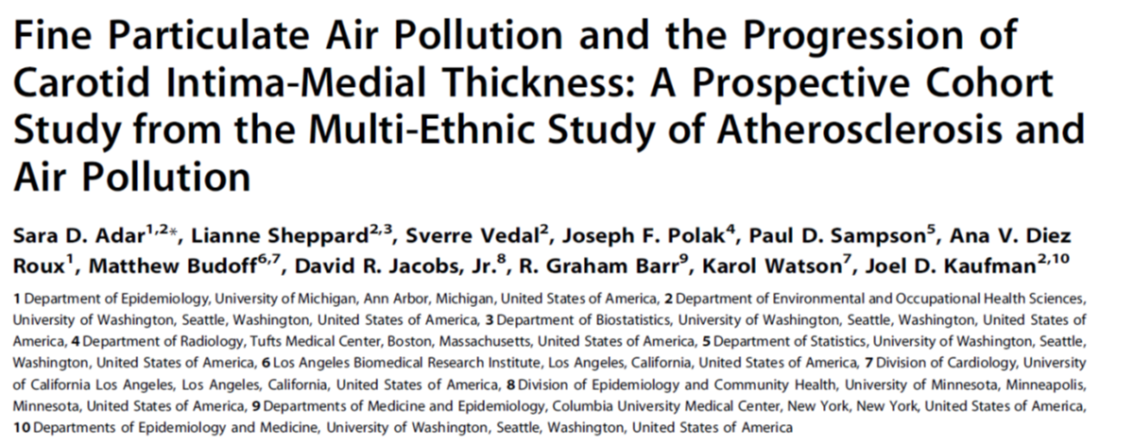

Slide 43


Slide 44
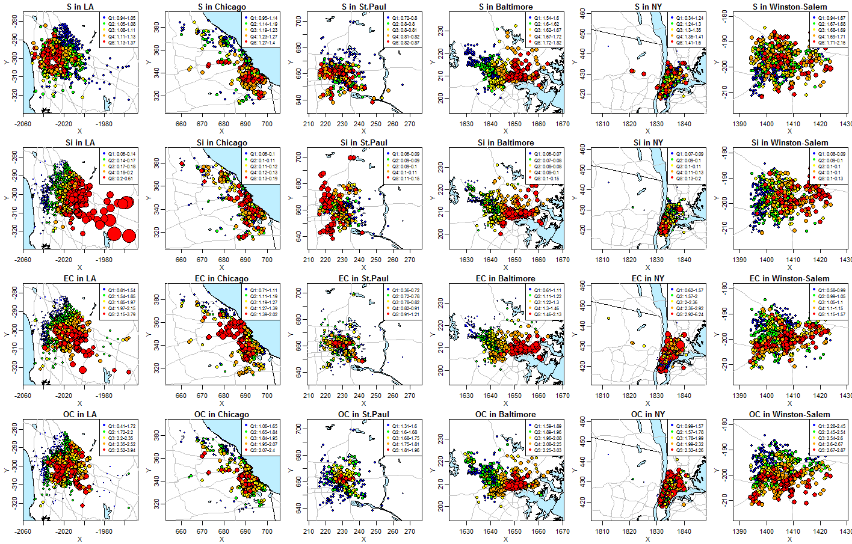
spatio-temporal model predictions in six MESA cities:
S, Si, EC and OC

Slide 45
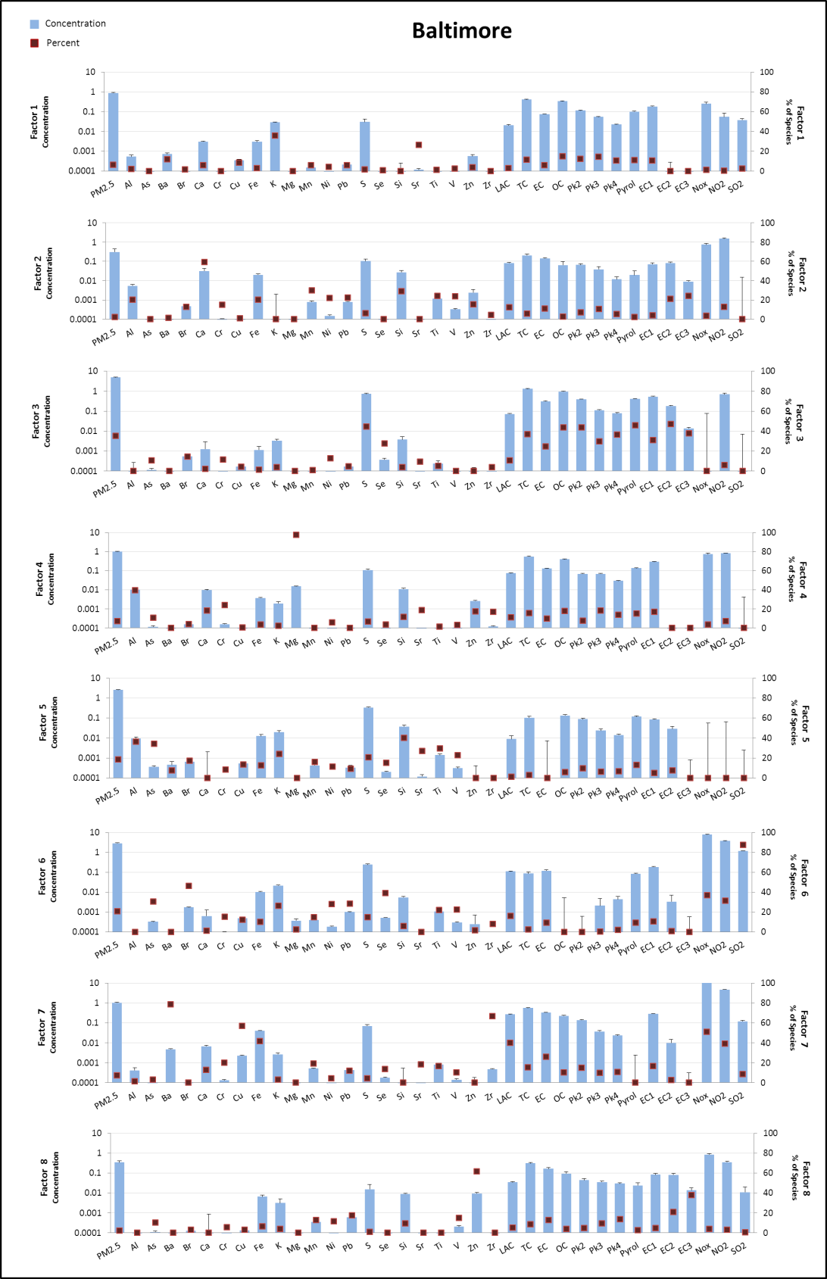
source apportionment
(PMF) profiles example

Slide 46
Summary points
No single PM2.5 component (of those selected) clearly dominated PM cardiovascular effects
  best evidence for OC and sulfur
  less evidence for EC and silicon
Generally consistent pattern of findings with exposure predictions based on different monitoring data (in MESA using s-t and spatial models).
General consistency of findings across cohort.

Slide 47
Other recent publications highlight contributions of MESA Air other than air pollution metrics
~1400 US and ~500 CTs from Exam 4
All US and CT from Exam 5
MESA Air Questionnaire
  Residential information
  Workplace addresses
MESA Air New Recruits

Slide 49



MESA Air
EPA Grant RD831697
Project Period 8/1/04 – 7/31/14
Although the research described in this presentation has been funded wholly or in part by the United States Environmental Protection Agency through RD831697 to the University of Washington, it has not been subjected to the Agency's required peer and policy review and therefore does not necessarily reflect the views of the Agency and no official endorsement should be inferred.

