Slide 1

The Association of Ideal Cardiovascular Health with Incident Type 2 Diabetes Mellitus: The Multi-Ethnic Study of Atherosclerosis
Joshua J. Joseph, MD
Christopher D. Saudek M.D. Fellow in Diabetes Research
Division of Endocrinology, Diabetes and Metabolism
Johns Hopkins University School of Medicine
Presented by: Joshua J. Joseph, MD

Slide 2
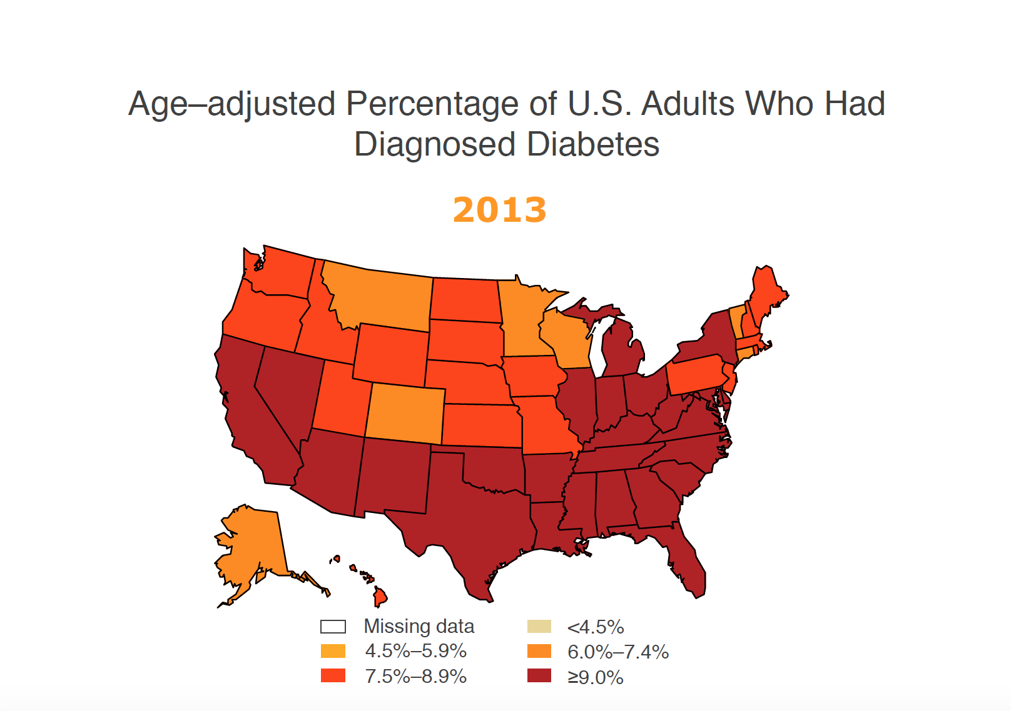
Number and Percentage of U.S. Population with Diagnosed Diabetes 1958-2009
CDC’s Division of Diabetes Translation. National Diabetes Surveillance System available at http://www.cdc.gov/diabetes/statistics
Notes:
Although diabetes incidence has plateaued in NHW during the 1980 – 2012 period, it continues to rise in AA,¹ indicating the need to identify novel preventive intervention targets Menke et al and Geiss et al, JAMA 2014, 2015
It is anticipated that, by 2035, some 592 million people, or one adult in 10, will have diabetes.
Methodology
Number and percent of the U.S. population with diagnosed diabetes were obtained from the National Health Interview Survey (NHIS, available at http://www.cdc.gov/nchs/nhis.htm) of the National Center for Health Statistics (NCHS), Centers for Disease Control and Prevention (CDC) for years. Conducted continuously since 1957, the NHIS is a health survey of the civilian, noninstitutionalized population of the United States. The survey provides information on the health of the United States population, including information on the prevalence and incidence of disease, the extent of disability, and the utilization of health care services. The multistage probability design of the survey has been described elsewhere (1,2). Estimates for years 1958-1979 were obtained from published data (3) and estimates from 1980 forward were derived directly from the NHIS survey data.
References
1. Massey JT, Moore TF, Parsons VL, Tadros W. Design and estimation for the National Health Interview Survey, 1985-1994. Hyattsville, MD: National Center for Health Statistics. Vital and Health Statistics 1989;2(110).
2. Botman SL, Moore TF, Moriarity CL, Parsons VL. Design and estimation for the National Health Interview Survey, 1995–2004. National Center for Health Statistics. Vital and Health Statistics 2000;2(130).
3. Harris MI: Prevalence of noninsulin-dependent diabetes and impaired glucose tolerance. Chapter VI in Diabetes in America, Harris MI, Hamman RF, eds. NIH publ. no. 85-1468, 1985.

Slide 3
Estimated lifetime risk of developing diabetes for individuals born in the United States in 2000
Narayan et al, JAMA, 2003

Slide 4
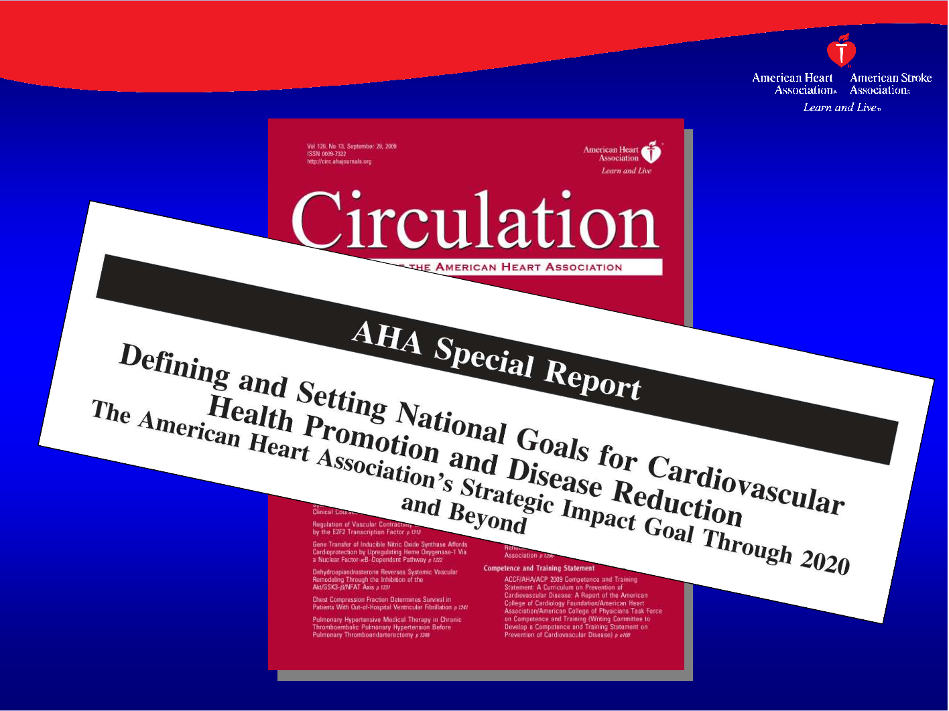
Background
In 2010, The American Heart Association’s (AHA) Strategic Planning Task Force and Statistical Committee implemented 2020 Impact Goals for cardiovascular health promotion with the goal of improving the cardiovascular health and reducing deaths from cardiovascular disease and stroke by 20% by the year 2020.
As part of the AHA initiative, it defined the concept of ideal cardiovascular health, identifying seven health factors and behaviors, “Life’s Simple 7,” that have been associated with longevity and healthy aging without cardiovascular disease including smoking, BMI, blood pressure, glucose, diet, physical activity and cholesterol.
Lloyd-Jones, D.M. et al. Defining and Setting National Goals for Cardiovascular Health Promotion and Disease Reduction: The American Heart Association’s Strategic Impact Goal Through 2020 and Beyond. Circulation 121, 586–613 (2010).

Slide 5
Goal/Metric | Poor health | Intermediate health | Ideal health
Current smoking | Yes | Former ≤ 12 months | Never or quit ≥12 months
Total cholesterol | ≥240 mg/dl | 200-239 mg/dl or treated to goal | <200 mg/dl
Blood pressure | SBP≥140 or DBP ≥90 | SBP 120-139 or DBP 80-89 or treated to goal | <120/<80 mm Hg
Fasting plasma glucose | ≥126 mg/dl | 100-125 mg/dl or treated to goal | <100 mg/dl
Body mass index | ≥30 kg/m² | 25-29.9 kg/m² | <25 kg/m²
Physical activity | None | 1-149 min/week moderate intensity or 1-74 min/week vigorous intensity | ≥150 min/week moderate intensity or ≥75 min/week vigorous intensity
Healthy diet score* | 0-1 components | 2-3 components | 4-5 components
Notes:
Factors vs Behaviors
We ran our models with and without fasting plasma glucose as we believe glucose predicts glucose based outcomes.

Slide 6
Components of Healthy Diet Score
Fruits and vegetables ≥4.5 cups/day
fish ≥ two 3.5 oz servings per week
fiber-rich whole grains ≥three 1 oz-equivalent servings/day
sodium <1500 mg/day
sugar-sweetened beverages ≤450 kcal (36 oz)/wk

Slide 7



Smoking
Total Cholesterol
Blood Pressure
Type 2 Diabetes
Fasting Plasma Glucose
Body-mass Index
Physical Activity
Nutrition/Diet
Notes:
Cardiovascular Disease and Diabetes share similar risk factors.
Given the shared risk factors and burden of both CVD and diabetes in the US, it is important to determine if the 2020 impact goals for ICH will impact incident diabetes.

Slide 8
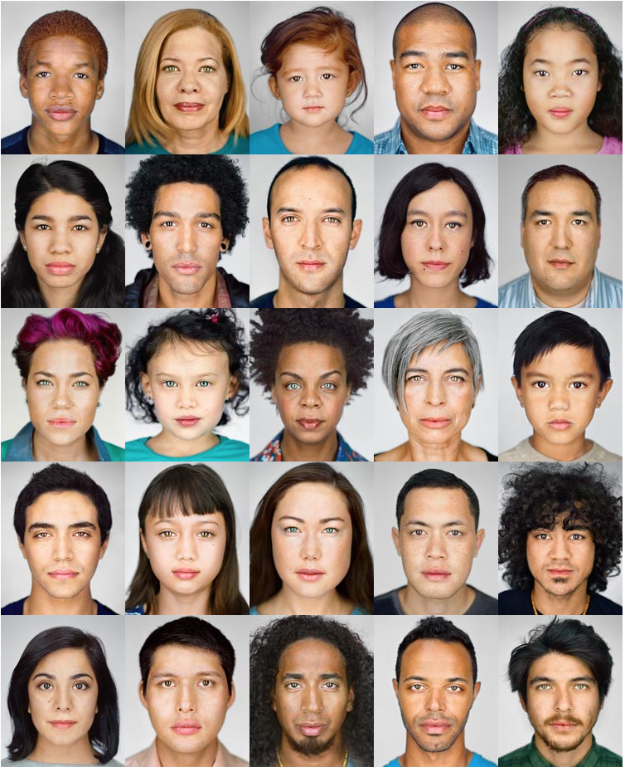
NGM, 2013
Notes:
Given the changing face of America, it is important to understand how ideal cardiovascular health may impact different racial/ethnic groups.

Slide 9
The Association of Ideal Cardiovascular Health with Incident Type 2 Diabetes Mellitus: The Multi-Ethnic Study of Atherosclerosis
Joshua J. Joseph, Justin B. Echouffo Tcheugui, Mercedes R. Carnethon, Alain G. Bertoni, Christina M. Shay, Haitham M. Ahmed, Roger S. Blumenthal, Mary Cushman and Sherita H. Golden

Slide 10
The Multi-Ethnic Study of Atherosclerosis (MESA)
Multi-center, longitudinal cohort study of occurrence and correlates of subclinical CVD and factors influencing its progression
6 centers: Northwestern University, Wake Forest University, University of Minnesota, Columbia University, Johns Hopkins University, University of California-Los Angeles
6,000 men and women aged 45-85 years
  40% non-Hispanic White
  10% Chinese American
  30% African American
  20% Hispanic American
  No history of clinical CVD

Slide 11

MESA: Timeline
Visit 1
00-02
Visit 2
02-04
Visit 3
04-05
Visit 4
05-06
Visit 5
10-12
Exam
Bloodwork
Diabetes
Exam
Bloodwork
Diabetes
Notes:
Exam refers to imaging, blood work, completed series of questionnaires

Slide 12
Research Aims and Hypotheses:
Aim 1: Assess total and ethnicity-specific incidence of T2DM based on baseline ideal levels of CV Health.
Aim 2: Assess total and ethnicity-specific incidence of T2DM based on baseline CV Health Total Score
Aim 3: Assess total and ethnicity-specific incidence by individual CV Health component, comparing the risk of incident T2DM among individuals whom achieved intermediate health or ideal health to those with poor health.

Slide 13
Methods
Sample: All subjects recruited to the MESA Cohort, except for individuals with T2DM at baseline (fasting plasma glucose > 126 mg/dL, history of treated or untreated diabetes mellitus or anti-diabetic medications). Additional participants were excluded based on incomplete data on CV Health components and covariates.

Slide 14
Methods
Independent Variables: (baseline exam)
We categorized participants based on whether their health components fell in the ideal, intermediate, and poor cardiovascular health range, as defined in the 2020 Impact Goals
Ethnicity and other confounding variables including age, sex, study site, alcohol use, education, socio-economic status and estimated glomerular filtration rate.
Dependent Variable: Incident T2DM over approximately 10 years

Slide 15
Methods
We used the components of the CV Health to develop two overall scoring systems.
Using baseline attainment of ideal health in the individual components, we summed them into categories 0–1, 2–3, and 4+ levels of ideal CV health to achieve consistency with the three-tiered classification scheme for the individual health metrics.
Hazard ratios (HRs; 95% CI) were calculated for participants who achieved 2–3 or 4+ levels of ideal health, using those who achieved 0–1 ideal levels as the referent group; adjusted for baseline study site, age, sex, and race/ethnicity, education, occupation status, alcohol use and eGFR
Notes:
baseline study site, age, sex, and race/ethnicity, education, occupation status, alcohol use and estimated glomerular filtration rate

Slide 16
Methods
Based on the three tiered classification of CV health per component, we used a second scoring system in which, each CV health component was given a point score of 0, 1, or 2 to represent poor, intermediate, or ideal health, respectively. A Total CV Health score ranging from 0 to 12 was calculated as the sum of the CV Health component scores.
This score was classified as inadequate (0-4), average (5–8), or optimal (10–12) cardiovascular health and HRs for incident T2DM were derived using inadequate overall CV Health score as the referent group; adjusted for baseline study site, age, sex, and race/ethnicity, education, occupation status, alcohol use and eGFR

Slide 17
Results

Slide 18
Characteristics of participants, by race/ethnicity, in the Multi-Ethnic Study of Atherosclerosis 2000-2012
 | All | Non-Hispanic White | Chinese American | African American | Hispanic American
 | n= 5341 | n=2275 | n=675 | n=1290 | n=1101
Age | 61.9 (10.3) | 62.4 (10.3) | 61.8 (10.4) | 62.0 (10.2) | 60.7 (10.5)
Female † | 53.5% | 52.5% | 52.4% | 56.79% | 52.39%
Current Smoking | 14.0% | 13.1% | 5.3% | 19.8% | 14.1%
CV Health Diet Score (0-5) | 1.49 (0.94) | 1.56 (0.92) | 1.70 (0.78) | 1.42 (0.99) | 1.30 (0.95)
Current Alcohol use | 58.3% | 73.4% | 31.9% | 52.7% | 50.0%
Education >Bachelors | 38.0% | 51.3% | 39.9% | 36.5% | 11.2%
Employed Full Time | 39.4% | 40.4% | 37.3% | 39.3% | 38.5%
Exercise PA (met-min/week) | 1602 (2410) | 1726 (2349) | 1152 (1547) | 1826 (2995) | 1361 (2134)
BMI (kg/m2) | 27.9 (5.3) | 27.5 (4.9) | 23.8 (3.3) | 29.7 (5.8) | 29.0 (4.7)
SBP (mmHg) | 125.5 (21.1) | 122.9 (20.1) | 123.7 (21.7) | 130.7 (21.2) | 125.8 (21.6)
DBP (mmHg) | 71.8 (10.2) | 70.2 (9.9) | 72.0 (10.4) | 74.6 (10.2) | 71.9 (10.1)
EGFR CKD-EPI Equation | 77.7 (15.5) | 74.2 (14.2) | 80.0 (15.4) | 80.4 (16.9) | 80.4 (15.2)
Total cholesterol (mg/dL) | 194.9 (35.1) | 196.0 (34.6) | 193.5 (32.0) | 190.1 (36.0) | 199.0 (36.3)
Mean (SD) or percentages are listed.
‡ Rate per 1000 person-years with confidence interval
All comparisons p<0.001 except † not significant, p-values calculated using chi-square analysis (categorical variables) and ANOVA (continuous variables)
Notes:
The statement recommends clinicians consider testing for diabetes in all Asian American adults who present with a BMI ≥23 kg/m2.

Slide 19
Table 1. Characteristics of participants, by race/ethnicity, in the Multi-Ethnic Study of Atherosclerosis (2000-2012)
 | All | non-Hispanic white | Chinese American | African American | Hispanic American
 | n= 5341 | n=2275 | n=675 | n=1290 | n=1101
Incident Diabetes‡ | 11.1 (10.3, 12.1) | 8.3 (7.2, 9.5) | 11.6 (9.3, 14.5) | 12.9 (11.0, 15.0) | 15.3 (13.1, 17.8)
Baseline Ideal CV Health Factors
0-1 Poor | 14.2% | 12.9% | 5.8% | 18.4% | 16.9%
2-3 Intermediate | 62.8% | 61.1% | 55.7% | 66.2% | 66.8%
4+ Ideal | 23.0% | 26.0% | 38.5% | 15.4% | 16.4%
Total CV Health Score
0-4 Inadequate | 9% | 7.2% | 2.5% | 13.0% | 12.0%
5-8 Average | 65.1% | 62.8% | 53.5% | 70.7% | 70.5%
10-12 Optimal | 25.9% | 30.0% | 44.0% | 16.4% | 17.5%
‡ Rate per 1000 person-years with confidence interval
All comparisons p<0.001 except † not significant, p-values calculated using chi-square analysis (categorical variables)
and log-rank test (Incident Diabetes)
Notes:
Christina Shay, Circulation NHANES 2012

Slide 20
Likelihood Ratio Test for Interaction among Age, Gender, Race/Ethnicity at Baseline
P for interaction | Age | Gender | Race/Ethnicity
Attainment of Ideal CV Health Components (0-6) | p=0.326 | p=0.800 | p=0.001
Attainment of Ideal CV Health Components (3 Tiered Classification) | p=0.561 | p=0.796 | p<0.001
CV Health Total Score (0-12) | p=0.112 | p=0.489 | p=0.005
CV Health Total Score (3 Tiered Classification) | p=0.300 | p=0.906 | p=0.002
CV Health Lifestyle Components (0-1 vs. 2+) | p=0.798 | p=0.874 | p=0.007
CV Health Biologic Components (0-1 vs. 2+) | p=0.326 | p=0.624 | p=0.959
Notes:
Cross Product Interaction Term and Likelihood Ratio Test

Slide 21
Results
Baseline Ideal CV Health

Slide 22
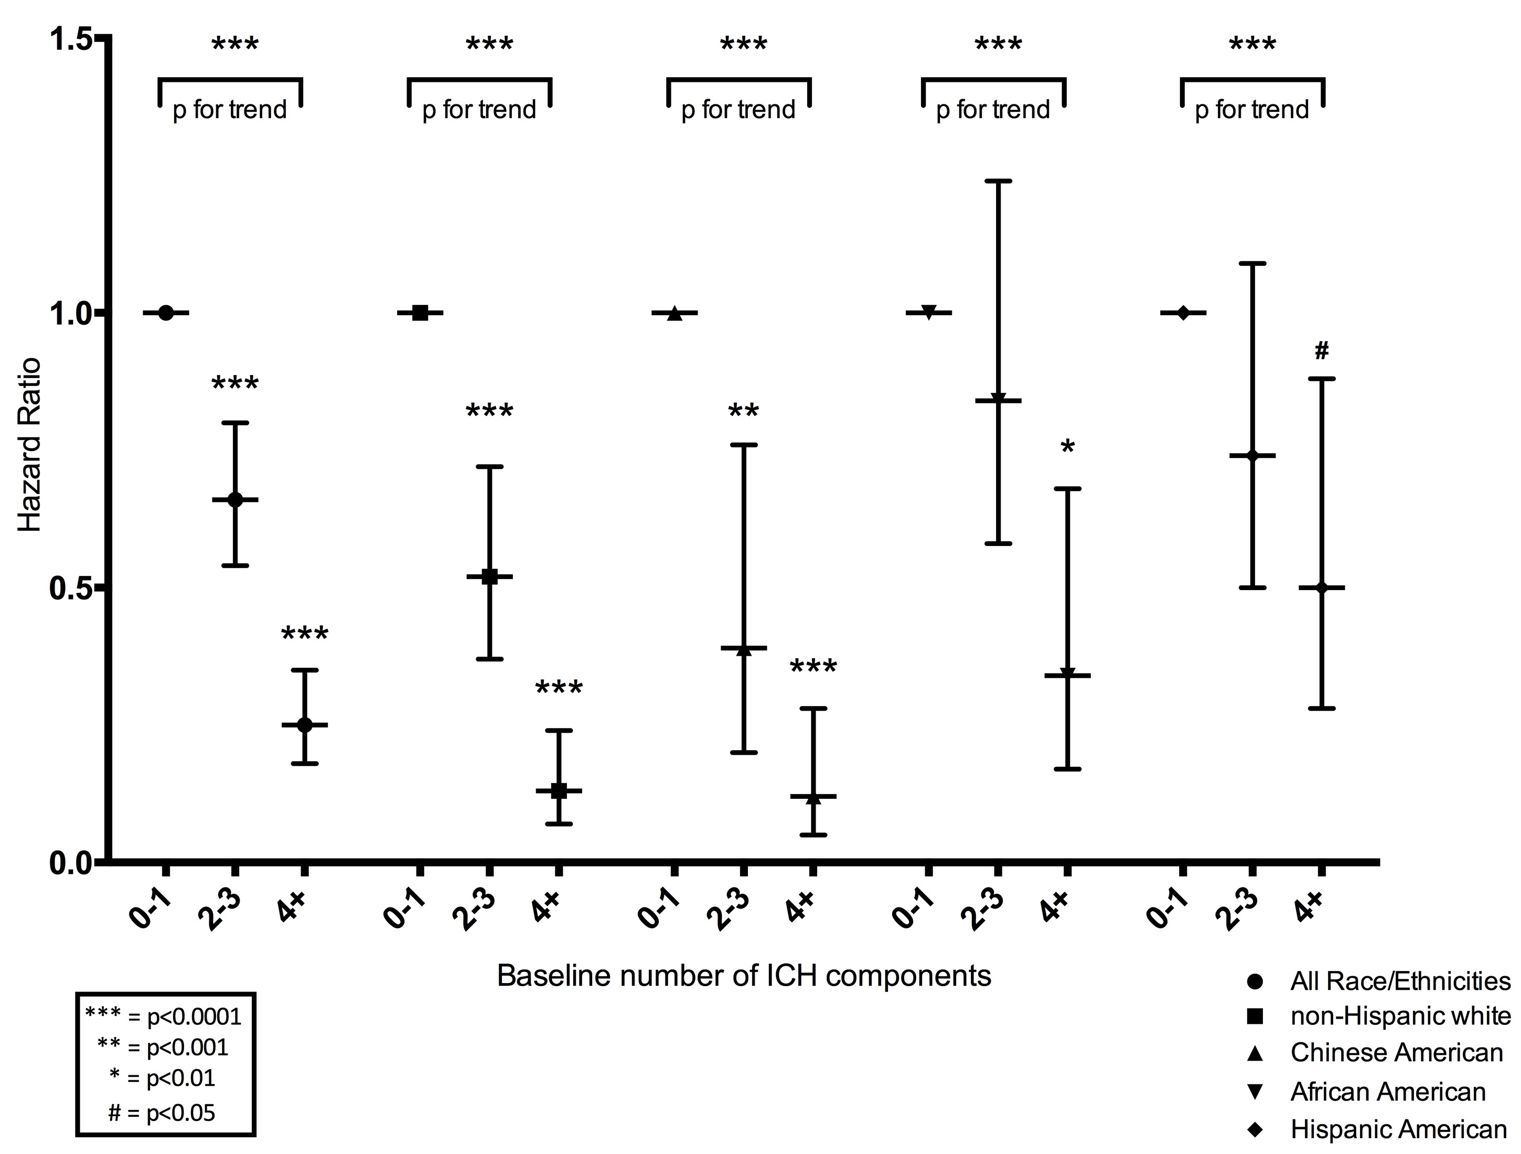
Diabetes Incidence Hazard Ratios for Baseline Ideal Cardiovascular Health
Notes:
baseline study site, age, sex, and race/ethnicity, education, occupation status, alcohol use and estimated glomerular filtration rate

Slide 23
Notes:
Incidence rate ratios were assessed using the Mantel-Cox method.

Slide 24
Results
Baseline Total CV Health

Slide 25
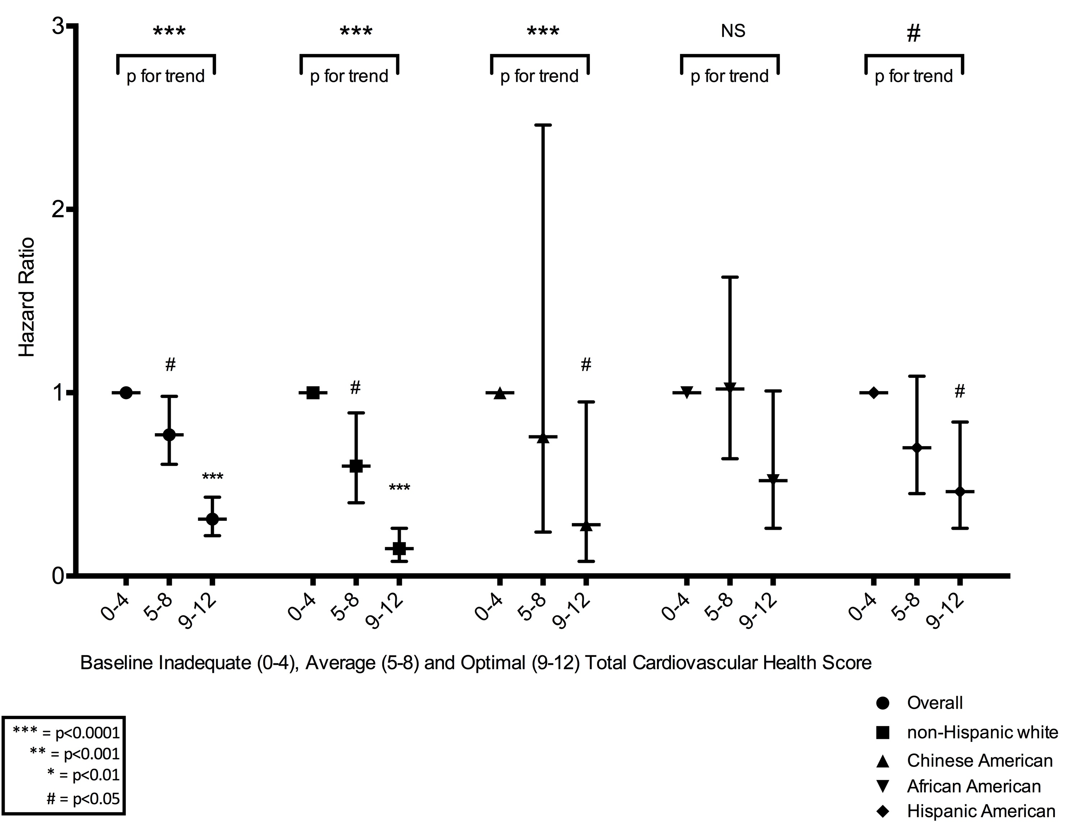
Diabetes Incidence Hazard Ratios for Baseline Inadequate, Average and Optimal Total Cardiovascular Health Score
Notes:
baseline study site, age, sex, and race/ethnicity, education, occupation status, alcohol use and estimated glomerular filtration rate

Slide 26
Results
Hazard Ratios by Individual
CV Health Components

Slide 27
 | Overall | Overall Adjusted* | Non-Hispanic white* | Chinese American* | African American* | Hispanic American*
BP
Poor | 1 (Ref) | 1 (Ref) | 1 (Ref) | 1 (Ref) | 1 (Ref) | 1 (Ref)
Intermediate | 0.96 (0.79, 1.16) | 0.92 (0.76. 1.12) | 0.71 (0.50, 0.99) | 1.12 (0.64, 1.97) | 0.86 (0.61, 1.22) | 1.26 (0.84, 1.89)
Ideal | 0.46 (0.37, 0.58) | 0.43 (0.34, 0.55) | 0.27 (0.18, 0.41) | 0.36 (0.18, 0.70) | 0.47 (0.29, 0.78) | 0.75 (0.48, 1.20)
BMI
Poor | 1 (Ref) | 1 (Ref) | 1 (Ref) | 1 (Ref) | 1 (Ref) | 1 (Ref)
Intermediate | 0.52 (0.44, 0.62) | 0.52 (0.44, 0.63) | 0.51 (0.37, 0.68) | 0.43 (0.22, 0.85) | 0.55 (0.39, 0.77) | 0.42 (0.30, 0.58)
Ideal | 0.22 (0.17, 0.29) | 0.23 (0.18, 0.30) | 0.27 (0.13, 0.31) | 0.15 (0.07, 0.30) | 0.22 (0.12, 0.42) | 0.20 (0.11, 0.38)
Total Cholesterol
Poor | 1 (Ref) | 1 (Ref) | 1 (Ref) | 1 (Ref) | 1 (Ref) | 1 (Ref)
Intermediate | 1.05 (0.79, 1.39) | 1.04 (0.78. 1.38) | 0.78 (0.50, 1.22) | 1.13 (0.47, 2.68) | 1.26 (0.67, 2.39) | 1.20 (0.69, 2.08)
Ideal | 0.90 (0.68, 1.20) | 0.84 (0.63, 1.12) | 0.64 (0.40, 1.01) | 0.70 (0.29, 1.67) | 0.87 (0.46, 1.65) | 1.31 (0.76, 2.25)
Smoking
Poor | 1 (Ref) | 1 (Ref) | 1 (Ref) | 1 (Ref) | 1 (Ref) | 1 (Ref)
Intermediate | 1.30 (0.63, 2.68) | 1.40 (0.67, 2.89) | 0.96 (0.29, 3.16) | N/A | 2.32 (0.55, 9.84) | 2.11 (0.63, 7.10)
Ideal | 0.96 (0.76, 1.22) | 1.06 (0.83, 1.35) | 0.95 (0.63, 1.42) | 0.60 (0.25, 1.44) | 1.28 (0.82, 2.00) | 1.00 (0.62, 1.62)
Diet AHA
Poor | 1 (Ref) | 1 (Ref) | 1 (Ref) | 1 (Ref) | 1 (Ref) | 1 (Ref)
Intermediate | 0.98 (0.83, 1.16) | 1.08 (0.91. 1.29) | 1.02 (0.75, 1.38) | 1.23 (0.76, 1.98) | 1.06 (0.76, 1.47) | 1.17 (0.84, 1.63)
Ideal | 1.23 (0.67, 2.24) | 1.39 (0.76, 2.55) | 1.17 (0.37, 3.74) | 1.24 (0.16, 9.35) | 2.54 (1.02, 6.33) | 0.80 (0.19, 3.34)
PA
Poor | 1 (Ref) | 1 (Ref) | 1 (Ref) | 1 (Ref) | 1 (Ref) | 1 (Ref)
Intermediate | 0.95 (0.73, 1.25) | 1.05 (0.81. 1.38) | 1.16 (0.74, 1.82) | 1.32 (0.65, 2.72) | 1.12 (0.64, 1.95) | 0.71 (0.40, 1.24)
Ideal | 0.82 (0.68, 1.00) | 0.91 (0.74, 1.11) | 0.68 (0.47, 0.98) | 1.26 (0.72, 2.22) | 1.21 (0.81, 1.82) | 0.86 (0.60, 1.23)
Notes:
Factors vs. Behaviors, baseline study site, age, sex, and race/ethnicity, education, occupation status, alcohol use and estimated glomerular filtration rate

Slide 28
Conclusions

Slide 29
Strengths
Multiethnic Cohort
Contemporary Cohort
Length of Follow-up
Fasting glucose, cholesterol measured
Limitations
Observational Study
Self Report Physical Activity, Dietary Intake
Results not generalizable to individuals with clinical cardiovascular disease
HbA1c, glucose load testing unavailable

Slide 30
Conclusions
There were significant benefits for attainment of greater Ideal CV Health components and a higher CV health score in reduction in diabetes risk indicating that promotion of “Life’s Simple 7 goals” and improving cardiovascular health will also reduce the risk of incident diabetes.
Ethnic minority groups were less likely to attain higher levels of Ideal CV health, so targeted public health messages around “LS7 goals” in Racial/Ethnic Minority communities is needed.
Race/Ethnic differences were significant suggesting that more research into other avenues for risk reduction in ethnic minorities is paramount given the higher burden of diabetes in these groups.
Notes:
BMI, Blood Pressure, Physical Activity -> Strong Family Heart Study, Amanda Fretts and David Siscovick
3/5 cases of diabetes were due to not having 4+ ICH.

Slide 31
Conclusions
Risk factors for T2DM that vary by race/ethnicity
may play an important role in the development of diabetes in non-white populations including:
Diet
Social determinants of health
Chronic stress/allostatic load
Neighborhood resources
Sleep insufficiency
Inflammation
Joseph, Golden. Type 2 Diabetes and Cardiovascular Disease: What next? - 2014

Slide 32
Future and Ongoing Work
Notes:
MESA STRESS – Ana Diex Roux

Slide 33
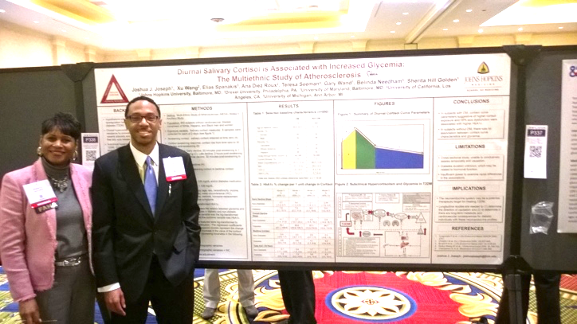

Acknowledgements
MESA & MESA Stress
Investigators, Staff, and the participants of the MESA study
Co-Authors
Sherita H. Golden, M.D., MPH
Justin B. Echouffo-Tcheugui, M.D., Ph.D.
Johns Hopkins University Division of Endocrinology, Diabetes and Metabolism
Christopher Saudek, MD and Family
Michael Sack, M.D., Ph.D.
Kenneth C. Edelin, M.D.
NIH-Medical Research Scholars Program
My Family
Funding Agencies
NHLBI
NIDDK
  T32 DK062707

