Slide 1
Exam 6 Quality Control and Safety
Craig Johnson
July 26, 2016

Slide 2
Outline
Definitions of Quality, Quality Assurance (QA), and Quality Control (QC)
Importance of Quality in MESA
Examples of Quality issues in MESA
Specific QC Monitoring Plan for Exam 6
Roles and responsibilities in MESA Exam 6

Slide 3
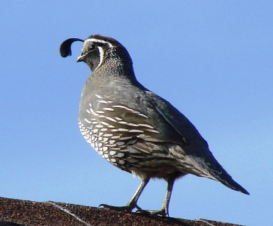
Definitions
Quailty – a high level of value or excellence (Merriam-Webster)
Quality Assurance (QA)
Rules/procedures/activities that make sure you are doing things the correct way
Process oriented
Prevention of errors/mistakes/…
Preparatory Steps
Quality Control (QC)
Testing the outcome
Product oriented
Detecting errors/mistakes/…
Corrective actions (best done while the activity is ongoing)

Slide 4
Definitions
Quality – a high level of value or excellence (Merriam-Webster)
Quality Assurance (QA)
Rules/procedures/activities that make sure you are doing things the correct way
Process oriented
Prevention of errors/mistakes/…
Preparatory Steps
Quality Control (QC)
Testing the outcome
Product oriented
Detecting errors/mistakes/…
Corrective actions (best done while the activity is ongoing)

Slide 5
Definitions continued
QC is used to verify the quality of the output.
Testing for quality is not assuring quality, it is controlling it.
QA is the process managing for quality.
Both QA and QC are necessary for ensuring quality in Exam 6.
Everyone needs to take an active role in order to ensure quality.

Slide 6
QA or QC?
Activity | QA or QC?
Central Training
Manual of Operations
Repeated Anthropometry measures
Operations Committee
Interview recordings
IRB Review
Equipment calibration
QC Committee

Slide 7
QA or QC?
Activity | QA or QC?
Central Training | QA
Manual of Operations | QA
Repeated Anthropometry measures | QC
Operations Committee | QA
Interview recordings | QC
IRB Review | QA
Equipment calibration | Both
QC Committee | Both

Slide 8
QA / QC Example from MESA
Ankle Brachial Index (ABI)
measurement of ankle BP / brachial BP.
Supine
Carefully designed and identical protocol and MOP at Exams 1 , 3, 5.

Slide 9
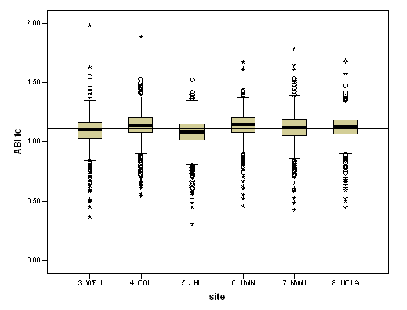
Exam 1 ABI by Field Center

Slide 10
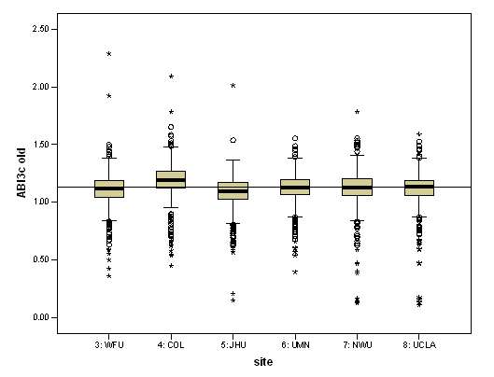
Exam 3 ABI by Field Center

Slide 11
What changed between Exams 1 and 3?
Efficient exam table introduced
Lower extremities were not as well supported by the shelf
Data were able to be corrected by taking into account estimated effect of gravity on ankle BP measures.

Slide 12
QC Plan for Exam 6
Laboratory/Bioassay repeat measures
Specimens collected at prior exams for calibration
Replicate assays for excess variability in the measures
Clinic Exam components
Anthropometry repeat measures
Review of sampled Interview recordings
SC/Lead technician observation
Data checking (versus prior exam’s values)
Exam metrics (time to complete exam components, reporting, retention)
High Tech components
Echocardiogram replication

Slide 13
Roles and responsibilities
Technicians
Become proficient in your procedures (includes certification)
Communicate questions and concerns right away
Take critique constructively
Participate in QC
Study Coordinators and Leads
Train, certify, coach your team members
Forward questions and concerns to CC and Operations Committee
Calibration and maintenance (document)
Review and coach
Take and offer critique constructively

