Slide 1
Fatty Liver and development of type 2 diabetes: the Multi-Ethnic Study of Atherosclerosis (MESA)
Jingzhong Ding, PhD
Department of Internal Medicine/Geriatrics
Wake Forest University School of Medicine

Slide 2
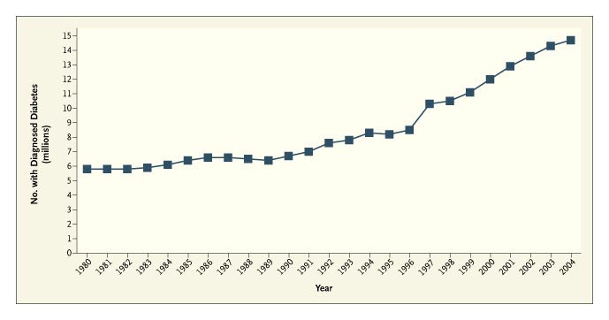
The type-2 diabetes epidemic coincides with the obesity epidemic, data from NHANES (Gregg, 2005) and the National Health Interview Survey (Steinbrook, 2006)

Slide 3
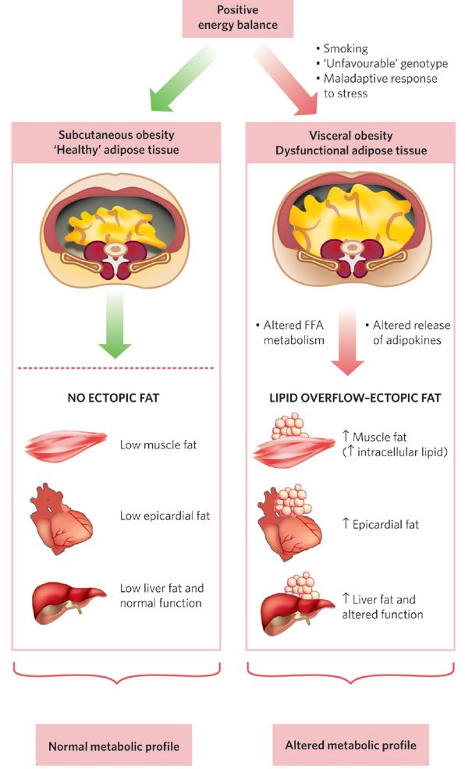
Visceral/subcutaneous obesity and metabolic profile

Slide 4
Previous studies
Fat content in the liver, but not visceral fat, is associated with obesity-related metabolic abnormalities, including insulin resistance (Fabbrini, 2009)
A Japanese study (Shibata, 2007) and a Korean study (Kim, 2007) suggest that fatty liver disease, qualitatively assessed by ultrasonography, predicts the development of type 2 diabetes.
Ethnic differences?
Independent of other regional fat depots?

Slide 5
Objective
To examine the independent association of the extent of liver fat with the development of type 2 diabetes in Caucasians, Chinese Americans, African Americans, and Hispanics

Slide 6
Study design
MESA is a community-based prospective study to investigate progression of subclinical cardiovascular disease.
6,814
Age 45-84 years
Caucasians, Chinese Americans, African Americans, and Hispanics
Baltimore, MD; Chicago, IL; Forsyth County, NC; Los Angeles, CA; New York, NY; and St. Paul, MN
5,578 participants, after excluding those with prevalent type 2 diabetes
448 incident type 2 diabetes from 2000 to 2007 (three follow-up examinations at intervals of 18-24 months)

Slide 7
Study methods
Type 2 diabetes: fasting glucose ≥ 6.99 mmol/L (126 mg/dL) or use of hypoglycemic medication
Cardiac CT scans at baseline:
Liver fat (liver attenuation, high value indicates low fat content): average density of three regions in the right lobe of liver
Pericardial fat: fat around the proximal coronary arteries
ICC of intra- and inter-reader reliability: 0.89 and 0.74 for liver attenuation; 0.99 and 0.89 for pericardial fat

Slide 8
Baseline characteristics by liver fat quartiles

Slide 9
Odds ratios of diabetes per standard deviation increment in liver fat in pooled logistic regression analysis
Model 1: Unadjusted;
Model 2: Age, gender, ethnicity, pack-years of smoking, alcohol drinking, physical activity, education, systolic blood pressure, anti-hypertensive medication, triglycerides, HDL cholesterol, cholesterol-lowering medication, and C-reactive protein
Model 3: Model 2 + pericardial fat, body mass index, and waist circumference
Model 4: Model 3 + fasting glucose and insulin

Slide 10
Odds ratios of diabetes per standard deviation increment in fat measures by ethnicity
* The models including age, gender, ethnicity, pack-years of smoking, alcohol drinking, physical activity, education, systolic blood pressure, anti-hypertensive medication, triglycerides, HDL cholesterol, cholesterol-lowering medication, C-reactive protein, Liver fat, pericardial fat, body mass index and waist circumference

Slide 11
Odds ratios of diabetes by sextiles of liver fat
Adjusting for Age, gender, ethnicity, pack-years of smoking, alcohol drinking, physical activity, education, systolic blood pressure, anti-hypertensive medication, triglycerides, HDL cholesterol, cholesterol-lowering medication, C-reactive protein, pericardial fat, body mass index, and waist circumference

Slide 12
Discussion
High Liver fat predicts increased risk of developing type 2 diabetes, independent of other fat measures.
The relationship between liver fat and type 2 diabetes is consistent across various ethnic groups.

Slide 13
Implication
Better identify individuals at high risk of type-2 diabetes
A potential therapeutical target for preventing type-2 diabetes

Slide 14
Acknowledgement
Supported by a NHLBI grant R01-HL-085323, Wake Forest University Claude D. Pepper Older Americans Independence Center (NIH P30-AG21332) and NHLBI contracts N01-HC-95159 through N01-HC-95165 and N01-HC-95169
Wake Forest University
Carr, J. Jeffrey
Kritchevsky, Stephen
Du, Lisa
Hightower, Caresse
Pillsbury, Suzanne
Ellison, Bob
Ge, Yaorong
Hsu, Fang-Chi
Espeland, Mark
Burke, Gregory
Liu, Yongmei
Lohman, Kurt
National Institute on Aging
Harris, Tamara
Univ of Cal – San Diego
Allison, Matthew
Criqui, Michael
Johns Hopkins Univ.
Szklo, Moyses
Bluemke, David
Univ of Cal – LA
Detrano, Robert
Budoff, Matthew

