Slide 1
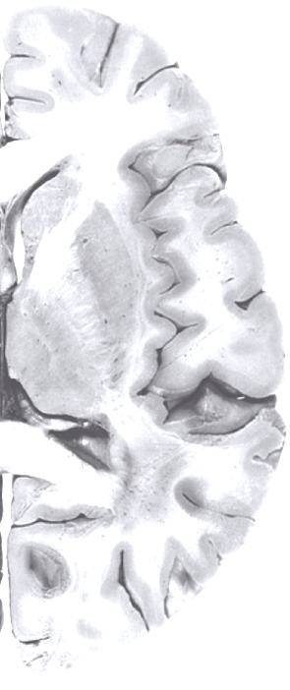
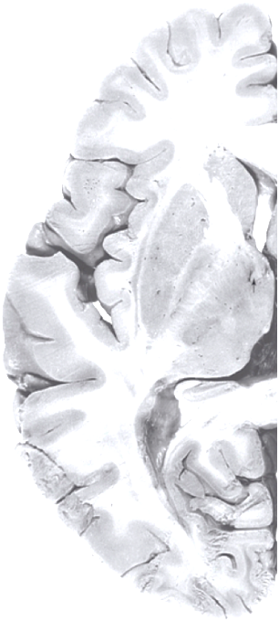
Cardiometabolic Predictors of Alzheimer’s disease: MESA Memory
Timothy Hughes, PhD, MPH
MESA Steering Committee Meeting
3/22/16
Proposal A301 approved 09/30/2015

Slide 2
Overview
Funding pending P30 NIA Alzheimer’s disease Center (July)
MESA Memory is a single site study at Wake Forest
Adds detailed neuropsychological testing and brain imaging
Biomarker Intensive Subset
Brings tractable cognitive outcomes to MESA
Notes:
**Consider dropping for this 15 min talk

Slide 3
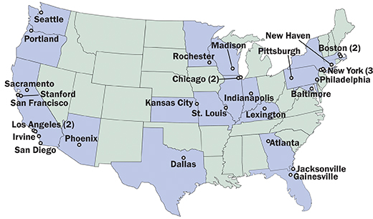
Funding - July 2016
P30 Mechanism for Alzheimer's Disease Core Center (ADCC)
Wake Forest ADCC’s Approach
7 Cores of Wake Forest ADCC
  Administrative
  Clinical
  MESA Memory
  Data
  Neuropathology
  Outreach
  Research Education
Notes:
Approach - Address the growing burden of dementia through prevention strategies
Clinical Core brings a portfolio of pharmaceutical and non-pharmacological interventions including diet and exercise

Slide 4
MESA Memory
Aims
Find antecedent biomarkers of metabolic and vascular dysregulation in middle and older age that predict:
  global and domain-specific cognitive impairment (executive function, episodic memory),
  structural and functional abnormalities on MRI,
  abnormal AD biomarkers (amyloid PET imaging, CSF amyloid and tau).
Determine if cardiometabolic biomarkers prospectively predict cognitive trajectory (decline and resilience) and incident MCI and AD over 3 years of follow-up.
Conduct multidimensional systems-based analysis of genetic, epigenetic, and phenotypic data.
Examine differential risk factor profiles by race and gender.

Slide 5
MESA Memory Design
Procedure | Baseline (MESA Exam 6) | Interim Telephone Assessment | 3-Year Follow-up
Enrollment & Consenting | X |  | X
History, Clinical Evaluation | X |  | X
Medication Review | X | X | X
Physical Exam, Blood Collection | X |  | X
Cognitive Assessment (in-person) CASI, DSC, DS UDS-3 PACC | X |  | X
Telephone Cognitive Assessment (TICSm, EBMT, OTMT, DS) |  | X
Brain MRI (volume, blood flow) | X |  | X
Amyloid PET Imaging* | X
CSF collection* | X
CASI: Cognitive Abilities Screening Instrument; DSC: Digit Symbol Coding; DS: Digit Span; UDS-3: Uniform Data Set, v. 3; PACC: Preclinical Alzheimer Cognitive Composite; TICSm: Telephone Interview for Cognitive Status-modified; EBMT: East Boston Memory Test; OTMT: Oral Trail Making Test
* Optional biomarker intensive components (40%)
Recruit 80% of the WF Exam 6 participants (n=540)
Optional Biomarker Intensive Subset (estimated n=216, 40%)
New data yield comprehensive cognitive and brain phenotyping, adjudicated cognition burden of AD biomarkers

Slide 6
Cognitive Neuropsychological Exams
Continues CASI, digit symbol and digit span test from Exam 5
Abbreviated Uniform Data Set (UDS) v. 3 for all ADCC/ADRCs
  Physician interview
  Detailed cognitive battery
Preclinical Alzheimer Cognitive Composite (PACC)
Proxy informant
Weekly adjudication by consensus conference

Slide 7
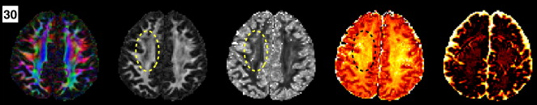
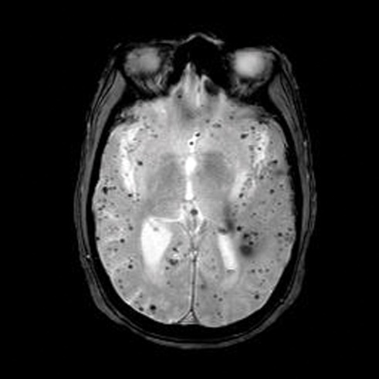
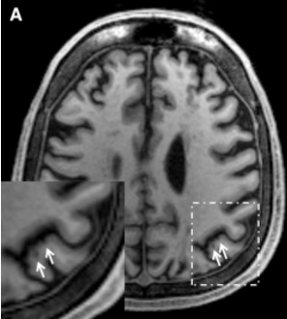
Brain MRI
Zhang et al. Neuroimage. 2012
2 MRI (baseline and 3 years later)
Basic MRI sequences overlap completely with Dr. Heckbert’s AFIB study
7-8 more minutes of scanning time with novel sequences:
  Neurite orientation dispersion and density imaging (NODDI)
  Susceptibility weighted images
    Microbleeds
    Microinfarcts
Notes:
MRI is a non-invasive technique with no known side effects other than possible physical or
psychological discomfort. No contrast agent is used. The MR apparatus attracts certain metals. Participants are scanned with a metal detector before entering the magnet area and all metal objects are removed. Participants with MRI non-compatible metal implants are excluded. Some participants experience claustrophobia or physical discomfort during the scan. There is a communication system set up so participants can talk with investigators and if participants report feeling uncomfortable, they are removed immediately from the scanner. Clinically significant results are communicated to participants.

Slide 8
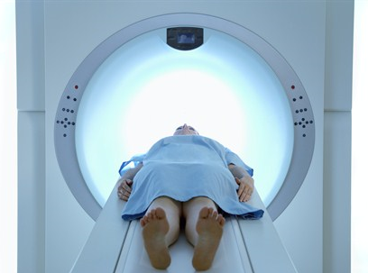
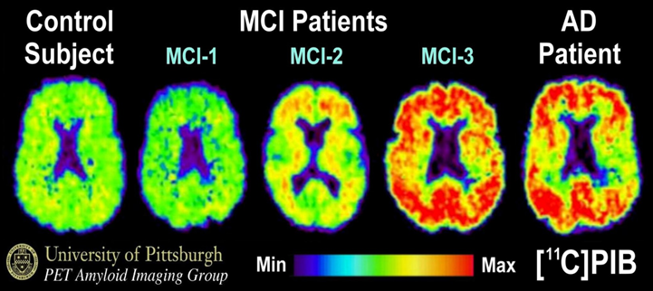
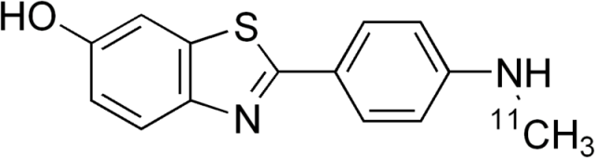
Optional Amyloid Imaging
Positron Emission Tomography (PET)
Aβ-
Aβ+
PET infusion of C¹¹ Pittsburgh Compound B (PiB-PET)
PiB retention averaged over AD susceptible regions
C¹¹ Pittsburgh Compound B
Notes:
The procedure for co-registration of the MRI and PiB PET images has been described.18 Regionsof-
interest (ROIs) were hand-drawn on a template that was a high-resolution MR image of a single
elderly MCI subject.19 The ROIs included five primary cortical areas [i.e., anterior cingulate (ACG),
frontal cortex (FRC), lateral temporal cortex (LTC), parietal cortex (PAR), precuneus cortex (PRC)
which comprised the Global-5 composite region], as well as medial temporal cortex (MTC), anterior
ventral striatum (AVS), occipital cortex (OCC), occipital pole (OCP), sensorimotor cortex (SMC),
thalamus (THL), subcortical white matter (SWM), pons (PON), and cerebellum (CER)]. PiB
retention was measured using the standardized uptake value ratio (SUVR) over the 50-70 min scan
(or SUV: scaled to injected dose and body mass) that is then normalized by the SUV of the CER
reference region

Slide 9
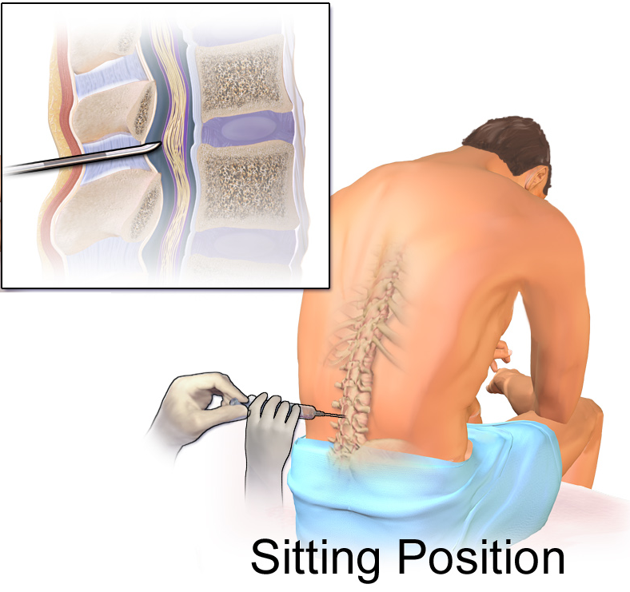
Optional Lumbar Puncture
NIA and Alzheimer’s Association recommended procedure for assessment of AD biomarkers, discovery of new biomarkers and therapeutic targets
Well-validated LP research protocol uses 22g Sprotte needle to drip, low risk of complications, headache
Of 200 LPs in past two years at Wake Forest, incidence of headache was <2%
Notes:
Collection – ~22 mL (1.69 tablespoons), replaced within 2 hours
Details of Lumbar puncture (LP): The LP is performed well below the termination point of the spinal cord.
Because the nerve roots readily move aside from the spinal needle, the possibility of permanent nerve root damage is extremely rare. The incidence of post-LP headache is a function of the diameter and type of needle rather than the amount of CSF drawn. We use a 22g or 24g atraumatic needle (Sprotte) as opposed to a cutting needle. Using the ADNI CSF collection procedures, there is a very low incidence of post-LP headache in older adults (<2%).68 We have performed over 200 LPs in the past 2
years with a similarly low post-LP headache rate; no participants have had to have any intervention for an LP headache. If necessary, a “blood patch” can be readily performed by an anesthesiologist to participants experiencing serious post-puncture headaches.69 Although very rare, it is possible that there may be an allergic reaction to the local anesthetic (lidocaine 1%) used for the LP. This reaction would cause swelling and a rash on the skin where the anesthetic was injected. Participants are queried about allergies to lidocaine and related local anesthetics before the LP. There is also a risk of introducing infection where the needle enters the skin, but standard sterile procedures are undertaken to minimize this risk. There is also a small risk of bleeding but in an effort to minimize these risks, labs including a PT, INR, PTT, and platelets are checked prior to the LP. LP is not done on participants on anticoagulants, such as warfarin or thrombin inhibitors.

Slide 10
Participant Burden
Exam 6 components
Additional Visits
CASI, DSC and DS = 10 min
UDS v3 cog testing = 25 min
PACC cog testing = 25 min
UDS physical exam = 45 min
MRI visit = 60 min
Optional PET = 90 min
Optional LP = 90 min
Telephone assessment of cognition 1.5 years later
Cog testing and MRI repeated 3 years later

Slide 11
Overlap with AFIB
Cognitive tests (CASI, DSC and DS) integrated
2 MRI posed by MESA memory; 1 by AFIB
Plans to consolidate MRI if possible

Slide 12
Summary
MESA Memory is designed as a prospective cohort sub-study
Provides detailed cognitive adjudication for WF MESA participants
Gold standard cognitive data will be informative for CASI thresholds
Can be considered a pilot for a larger MESA wide proposal in the future
Notes:
MESA Memory is designed as a prospective cohort sub-study, leveraging the 15+ years of cardiometabolic risk factor data from MESA.

