Slide 1
MESA Atrial Fibrillation Study
Atrial fibrillation burden, vascular disease of the brain and cardiac MRI in MESA
All 6 field centers
N=1500 participants
PI: Susan Heckbert

Slide 2
Rationale
Atrial fibrillation (AF) is common
Prevalence of 5-7% in 70s; 7-11% in 80s
Complications: cognitive decline, dementia, stroke, HF
Research has relied on a binary definition of AF
Misses subclinical AF
Little known about sequelae of subclinical AF
Ancillary study of subclinical arrhythmias
Novel device permits weeks of continuous ECG monitoring
Identify subclinical AF
AF burden: proportion of monitored time in AF

Slide 3
Primary aims
1) Association of AF and AF burden on extended (28-day) cardiac monitoring with brain structure & function on MRI
Exam 5 Exam 6 avg 18 mos after Ex 6 follow-up
Cardiac MRI
NT-proBNP
ECG monitor, 2x14 days
Cognitive function Qs
Physical function Q
Blood draw
Brain MRI
Physical function Q
CV events ascertainment

Slide 4
Primary aims
1) Association of AF and AF burden on extended (28-day) cardiac monitoring with brain structure & function on MRI
2) Association of cardiac structure and function with AF and AF burden
Exam 5 Exam 6 avg 18 mos after Ex 6 follow-up
Cardiac MRI
NT-proBNP
ECG monitor, 2x14 days
Cognitive function Qs
Physical function Q
Blood draw
Brain MRI
Physical function Q
CV events ascertainment

Slide 5
Secondary aims
1) Cross-sectional association of AF and AF burden with cognitive function and physical function at Exam 6
Exam 5 Exam 6 avg 18 mos after Ex 6 follow-up
Cardiac MRI
NT-proBNP
ECG monitor, 2x14 days
Cognitive function Qs
Physical function Q
Blood draw
Brain MRI
Physical function Q
CV events ascertainment

Slide 6
Secondary aims
1) Cross-sectional association of AF and AF burden with cognitive function and physical function at Exam 6
2) Association of biomarkers with AF burden
Exam 5 Exam 6 avg 18 mos after Ex 6 follow-up
Cardiac MRI
NT-proBNP
ECG monitor, 2x14 days
Cognitive function Qs
Physical function Q
Blood draw
Brain MRI
Physical function Q
CV events ascertainment

Slide 7
Secondary aims
1) Cross-sectional association of AF and AF burden with cognitive function and physical function at Exam 6
2) Association of biomarkers with AF burden
3) Association of AF burden at Exam 6 with subsequent CV events
Exam 5 Exam 6 avg 18 mos after Ex 6 follow-up
Cardiac MRI
NT-proBNP
ECG monitor, 2x14 days
Cognitive function Qs
Physical function Q
Blood draw
Brain MRI
Physical function Q
CV events ascertainment

Slide 8
Study Sample
Cohort design (total N=1500; ~250 per FC)
300 with clinically recognized AF during MESA follow-up
450 at high AF risk based on Exam 5 NT-proBNP and AF risk score
750 random sample of MESA participants

Slide 9
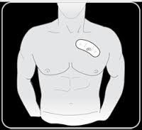
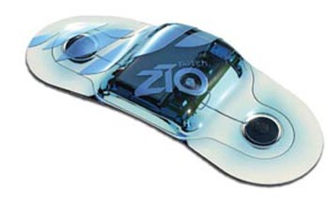
Two 14-day cardiac monitoring episodes
First patch: applied by clinic staff
Second patch: applied by participant
Ppt mails patch to manufacturer for reading

Slide 10
Brain MRI
Penn MRI Reading Center
PI: Nick Bryan
Ilya Nasrallah, Lisa Desiderio

Slide 11
Cerebrovascular Disease Model
CardioVasc Risk Factor
CerebroVasc Disease
↓Cerebral Blood Flow
↓Vascular Reactivity
Stroke, SVID, WMI
↓
Functional Connectivity
Function/Cognition
↓

Slide 12
Brain MRI Scan Protocol
3D T1 (4 min)
3D T2 (4 min)
3D FLAIR (4 min)
DTI (9 min)
ASL CBF (5.5 min)
Resting state BOLD fMRI (4 min)
Breath hold fMRI (3.5m)
SWI (4 min)
Total Time: 41 min

Slide 13
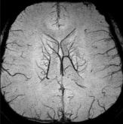
Input: MRI image data
Output:
MRI Variable
T1
Brain Tissue Normal
Brain Tissue Abnormal
Cerebrospinal Fluid
Infarcts
T2
FLAIR
Fractional Anisotropy
Trace
DTI
SWI
Microbleeds
ASL
Cerebral Blood Flow
BH
fMRI
Vascular Reactivity
rs
fMRI
Functional Connectivity

Slide 14
Update
Add follow-up Qs on anticoagulant/aspirin use; ablation, cardioversion, pacemaker/AICD
Measure NT-proBNP at Exam 5 in all ppts
In progress:
Participant selection
IRB applications
Data collection forms
FC staff training
Purchase of ECG monitors
Planning for brain MRI
Paper proposals, analyses, manuscripts

Slide 16
Extra slides

Slide 17
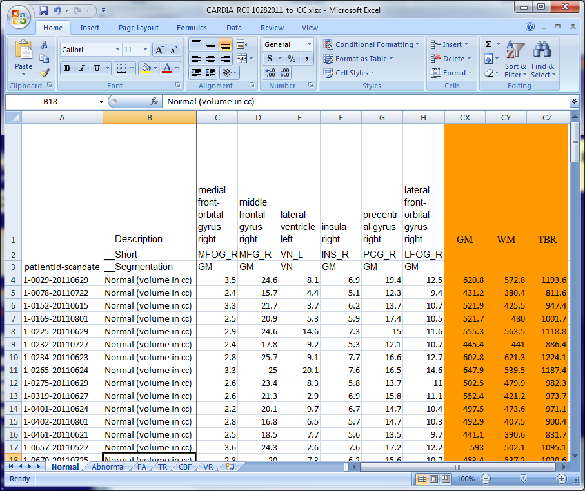
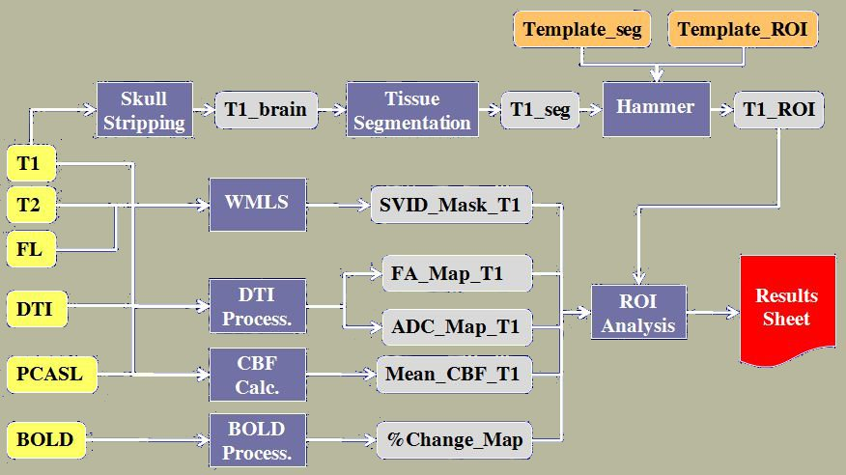
MRI Processing Pipeline: Overview
Raw Images
Processing Modules
Results
Sheet
Database
T1
T2
FLAIR
DTI
PCASL
BOLD-BH
Notes:
Processing pipeline is out of date

Slide 18
MARS ROI Hierarchy:
Jacob Atlas ROIs

Slide 19
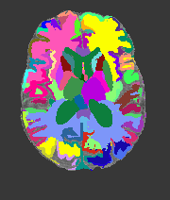
Eve Atlas: White Matter
Commonly used with DTI data, mainly for WM regions
Defines typical locations of WM tracts
Available as separate ROI set

