Slide 1



COMBI-BIO
Development of COMBInatorial
BIOmarkers for subclinical atherosclerosis
PI: Paul Elliott, MD, PhD
Professor Epidemiology & Public Health Imperial College, London
FUNDED BY EUROPEAN UNION

Slide 2
http://www.combi-bio.eu/

Slide 3


Atherosclerosis & CVD
OBJECTIVES:
  To better understand causal pathways and regulatory networks in atherosclerosis
  To develop early markers of atherosclerosis
  To develop improved prediction models for CVD
Need for novel biomarkers of atherosclerosis and CVD

Slide 5
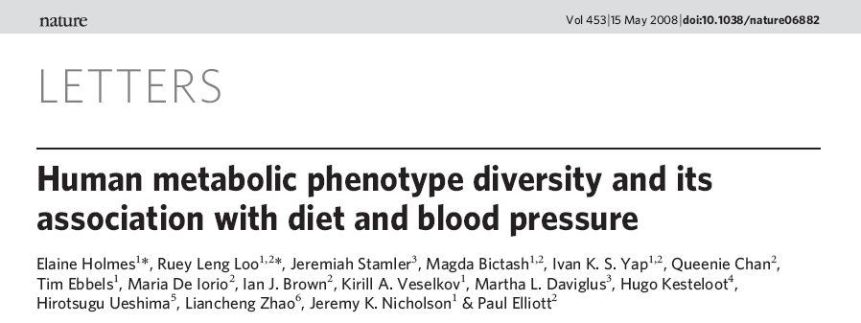
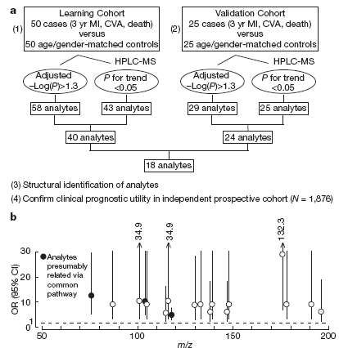
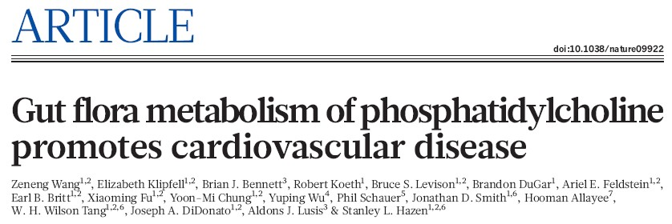
Metabolome-Wide Association Study (MWAS)
INTERMAP Study
N = 4,680 from China, Japan, UK, USA
2 timed 24-hr urine collections per participant
4 24-hr dietary recalls per participant
Measures of BP, height, weight
Questionnaire data
Nature 2011;472:57-63
Identifies TMAO as possible new pathway in CHD

Slide 7


Specific Aims
To use systems biology approaches, based on metabolic phenotyping and computational medicine, to discover, test and validate novel biomarkers for subclinical atherosclerosis;
To use cross-platform (NMR, MS) and multi-omics (genome-wide, metabolome-wide) analyses to investigate underlying biochemical connectivities and pathways, and hence to advance understanding of aetiopathogenesis of atherosclerosis development and progression;
To develop prognostic combinatorial biomarkers and risk scores to improve early prediction and patient stratification/management for subclinical atherosclerosis.

Slide 8




COMBI-BIO consortium partners
ICL
Management and coordination
Epidemiology
LOLIPOP cohort
NWU
Development and modelling of risk scores
MESA
cohort
IOU
Statistics
Development and modelling
of risk scores
Greenland
Herrington
Tracy
Liu
C. Johnson
W. Qureshi
OTHERS
MBX
“Top down” systems biology
Metabolic profiling
Computational medicine
HMGU
•Multi-omics analyses
Pathway
modelling
EMC
Epidemiology
Risk factor modelling
Rotterdam cohort

Slide 9












Outline of the research activities, WPs and partners
ICL
(WP1)
Management and Coordination
ICL, MBX, UoI, EMC, HMGU, NWU
(WP2)
Sharing of resources: Data integration and
ICL, MBX
(WP3)
Biomarker discovery and identification
ICL, MBX
(WP4)
Biomarker
validation
ICL, MBX, EMC, HMGU, NWU
(WP5)
ICL, MBX, UoI, EMC, NWU
(WP6)
Predictive combinatorial biomarkers
Cross-platform and multi- omics analyses
harmonization
Improve subclinical atherosclerosis prediction, prevention and treatment
ICL: Imperial College London, MBX: Metabometrix Ltd, UoI: University of Ioannina, EMC:Erasmus Universiteit Rotterdam, HMGU: Helmholtz Zentrum, Munich, NWU: Northwestern University

Slide 10
COMBI-BIO Study design
Subclinical atherosclerosis
Biomarker discovery
(WP3)
N=4,000
Biomarker validation
(WP4)
N=4,000
Project coordination and management (WP1)
Data integration and harmonization (WP2)
Cross-platform & multi-omics (WP5)
Combinatorial biomarkers (WP6)

Slide 13
Timeline, milestones and deliverables |  |  |  | Year 1 |  |  |  |  |  | Year 2
 |  | Q1 | Q2 |  | Q3 | Q4 |  | Q5 | Q6 | Q6 | Q8
WP1 | Management & coordination
 | Meetings of the consortium | ◊ |  |  |  |  | ◊ |  |  |  | ◊
 | Launch of COMBI-BIO website |  |  | ◊
 | Project periodic and final reports |  |  |  |  |  | ◊ |  |  |  | ◊
WP2 | Data integration and harmonization
 | Selection of participant data for inclusion | ◊
 | Receipt of samples in laboratory |  | ◊
 | Receipt of epidemiologic data |  | ◊
 | Harmonize outcome data (CAC/IMT) |  |  |  |  | ◊
 | Harmonize data for risk score |  |  |  |  |  |  |  | ◊
 | Report on data harmonization |  |  |  |  |  |  |  |  |  | ◊
WP3 | Biomarker discovery and identification
 | Optimize analytic platforms and QC |  | ◊
 | Report on sample shipment, QC and SOPs |  |  |  |  |  | ◊
 | Database of NMR and UPLC-MS spectra |  |  |  |  |  | ◊
 | Discovery biomarker set identified |  |  |  |  |  | ◊
WP4 | Biomarker validation
 | Assay development for new biomarkers |  |  |  |  |  |  |  | ◊
 | Assays complete for validation biomarkers |  |  |  |  |  |  |  |  | ◊
 | Report on validation methods/procedures |  |  |  |  |  |  |  |  |  | ◊
WP5 | Cross-platform and multi-omics analyses
 | Report on methods: multi-omics analyses |  |  |  |  |  |  |  |  |  | ◊
 | Biochemical connectivities and pathways |  |  |  |  |  |  |  |  |  | ◊
WP6 | Predictive combinatorial biomarkers
 | Report on data/methods for risk score |  |  |  |  |  |  |  |  |  | ◊
 | Validated risk score |  |  |  |  |  |  |  |  |  | ◊

Slide 14




WP3: Biomarker Discovery &
Identification
WP4: Biomarker Validation

Slide 15
WP3, WP4, WP5, WP6 objectives
Year 1 Year 2
WP3 | Biomarker discovery and identification
 | Optimize analytic platforms and QC |  | ◊
 | Report on sample shipment, QC and SOPs |  |  |  |  |  | ◊
 | Database of NMR and UPLC-MS spectra |  |  |  |  |  | ◊
 | Discovery biomarker set identified |  |  |  |  |  | ◊
WP4 | Biomarker validation
 | Assay development for new biomarkers |  |  |  |  |  |  |  | ◊
 | Assays complete for validation biomarkers |  |  |  |  |  |  |  |  | ◊
 | Report on validation methods/procedures |  |  |  |  |  |  |  |  |  | ◊
WP5 | Cross-platform and multi-omics analyses
 | Report on methods: multi-omics analyses |  |  |  |  |  |  |  |  |  | ◊
 | Biochemical connectivities and pathways |  |  |  |  |  |  |  |  |  | ◊
WP6 | Predictive combinatorial biomarkers
 | Report on data/methods for risk score |  |  |  |  |  |  |  |  |  | ◊
 | Validated risk score |  |  |  |  |  |  |  |  |  | ◊

Slide 16
Training Opportunities
Data analysis subgroup
  Monthly meetings at IC
  Remote participation from non-London partners
Introduction to Metabolic Profiling short course
  Runs October and June, 4 days
Partners welcome to send staff on this course
In-house training for London-based staff
  Via data analysis subgroup
  Via close working with Metabometrix staff & consultants

Slide 17
Training Opportunities
  From: Meiser, Andrea [mailto:andrea.meiser@imperial.ac.uk]
  Sent: Tuesday, January 28, 2014 1:38 PM
  Subject: Sabbaticals on COMBI-BIO project
  Dear All,
  For our COMBI-BIO project we are welcoming applications for 2-3 months sabbaticals to work with us on this exciting project.
  We can offer a high level salary, but we wouldn’t be able to cover other expenses.
  We were delighted if you could identify someone within / or associated to your institution.
  Please don’t hesitate to contact me for further information.
  Kind regards,
  Dr Andrea Meiser
  Programme Manager
  Faculty of Medicine

Slide 18
Closing Comments
Special thanks to David Herrington and Russell Tracy for their considerable efforts in this work.
Thanks to MESA Steering Committee for their efforts to allow this study to occur.
Thanks to the COMBI-BIO collegiality.
Future opportunities for EU funding for research focused on “healthy aging.”
Others invited to join in.

