Slide 1
Exome Chip Investigation of Fasting Glucose, Insulin, and Type 2 Diabetes from the CHARGE Diabetes/Glycemia Working Group
Mark Goodarzi, MD, PhD for the CHARGE T2D WG

Slide 2
CHARGE Glycemia-T2D Working Group
Ping An
Abi Baldridge
Ingrid Borecki
Dan Chasman
Ida Chen
Yuning Chen
Audrey Chu
Aldofo Correa
Marco Dauriz
George Dedoussis
Josée Dupuis
Tim Frayling
Melissa Garcia
Mark Goodarzi
Xiuqing Guo
Kazuo Hara
Bertha Hidalgo
Marie-France Hivert
Jenny Huffman
Kamran Ikram
Johanna Jakobsdottir
Rich Jensen
Linda Kao
Leslie Lange
Ethan Lange
Mandy Li
Jiemin Liao
Ruth Loos
Kevin Lu
Karina Meidtner
James Meigs
Mike Nalls
Jim Pankow
Bruce Psaty
Laura Rasmussen-Torvik
Steve Rich
Jerome Rotter
Matthias Schulze
Robert Scott
David Siscovick
Albert Smith
Loz Southam
Rona Strawbridge
Shuai Wang
Jennifer Wessel
Sara Willems
Jim Wilson
Hanieh Yaghootkar
Jie Yao
Ele Zeggini

Slide 3
CHARGE Glycemia-T2D Working Group
Ping An
Abi Baldridge
Ingrid Borecki
Dan Chasman
Ida Chen
Yuning Chen
Audrey Chu
Aldofo Correa
Marco Dauriz
George Dedoussis
Josée Dupuis
Tim Frayling
Melissa Garcia
Mark Goodarzi
Xiuqing Guo
Kazuo Hara
Bertha Hidalgo
Marie-France Hivert
Jenny Huffman
Kamran Ikram
Johanna Jakobsdottir
Rich Jensen
Linda Kao
Leslie Lange
Ethan Lange
Mandy Li
Jiemin Liao
Ruth Loos
Kevin Lu
Karina Meidtner
James Meigs
Mike Nalls
Jim Pankow
Bruce Psaty
Laura Rasmussen-Torvik
Steve Rich
Jerome Rotter
Matthias Schulze
Robert Scott
David Siscovick
Albert Smith
Loz Southam
Rona Strawbridge
Shuai Wang
Jennifer Wessel
Sara Willems
Jim Wilson
Hanieh Yaghootkar
Jie Yao
Ele Zeggini
Part II
Part I

Slide 4
Background
GWAS have identified 56 common SNVs associated with fasting glucose (FG) and fasting insulin (FI) in non-diabetic individuals, explaining 5% of variation
GWAS have also discovered 66 loci for T2D, which explain <10% of the heritability.
Recent large sequencing projects report ~95% of exonic variants are rare
Notes:
Association analyses of proinsulin levels using the Exome Chip identified low-frequency variants (MAF<5%) associated with FG & FI regulation (Huyghe JR, et al. Nat Genet 2013;45:197-201)

Slide 5
Aims of the Study
Part I. Discover protein coding variants associated with FG & FI
Novel variants at the 56 known loci identified by GWAS of FG (38 SNV) and FI (20 SNV)
Identify novel loci for FG and FI
Part II. Discover protein coding variants in 66 T2D loci previously identified by GWAS

Slide 6
Part I Rare and Common Exome Chip Variants are Associated with Fasting Glucose and Insulin Levels CHARGE Glycemia-T2D Working Group

Slide 7
Methods
Exome Chip: Illumina (~250,000 SNVs)
Outcomes: 1. FG and 2. FI
Exclusions: T2D by diagnosis or FG>7 mmol/l
Covariates: age, age², gender, site/cohort, PCs, BMI (FI only)
Ancestry: African (max n=9,690) and European (max n=50,874) analyzed separately at study level & combined in meta-analysis
Excluding all X, Y, MT SNVs
Studies: up to 23
Notes:
Studies: up to 23 - AGES, ARIC, CARDIA, CHS, EPIC, Exeter, FamHS, Fenland, FHS, FIA3, GLACIER, GS, HABC, HELIC Manolis & Pomak, IPM, JHS, Korcula, MESA, PROCARDIS, RISC, RS, SCARF

Slide 8
23 Participating Studies
AGES
ARIC
CHS
CARDIA
EPIC Potsdam
Exeter Controls
FamHS
Fenland
FIA3
FHS
GS
GLACIER
HABC
HELIC MANOLIS
HELIC Pomak
IPM
JHS
KORCULA
MESA
PROCARDIS
RISC
RS
SCARF
African (16%)
European (84%)
Max n=60,564 FG
Max n=48,118 FI

Slide 9
Single Nucleotide Variant (SNV) Analyses
Single variant
Gene based tests
MAF>1% &
MAC>5
Additive coding
Type of variant: any
Significance1: P<1x10⁻⁶
Bonferroni=.05/#exome variants (autosomal)
#SNVs=197,481
#SNVs(MAF>=1%)=46,882
MAF<1%
Cumulative MAC>20
>1 SNV/gene
Type of variant: missense, splice, stop
Weighted Sum Test (WST)
Weights alleles by frequency
Sequence Kernel Association Test (SKAT)
Allows for bi-directional effect
Significance2: P<3x10⁻⁶
Bonferroni=.05/#gene tests
#genes=15,260
143,653 rare SNVs
Significance3:
Bonferroni=.05/#known genes
#known genes=38 FG: p=1x10⁻³
#known genes=20 FI: p=3x10⁻³
Notes:
sc_nonsynSplice=T replaced with Type of variant: missense, splice, stop

Slide 10
Results: Single Variants: Known Loci
Known GWAS variants are replicated (p<10⁻³) in European + African:
FG: 24 (63%) of 38 known loci are significant
FI: 17 (85%) of 20 known loci are significant
Novel variants in the known loci (p<10⁻⁶):
Gene | rs# | Type | MAF | Beta (SE) | p-value
Fasting Glucose (mmol/l), n=59,502
GCKR | rs1260326 | L147P | 0.36 | -0.04(0.004) | 7x10⁻²²
Fasting Insulin (log pmol/l), n=47,148
GCKR | rs1260326 | L147P | 0.37 | -0.02(0.002) | 4x10⁻¹⁴
Stronger association than GWAS variant, rs780094, to which it is linked, r²=0.93
Notes:
In NHGRI GWAS catalog, this variant associated with 2hrG and triglycerides and CRP and GGT (same direction of effect)
L147P is a putatively functional splice site creating multiple transcripts

Slide 11
Results: Single Variants: Known Loci
Two novel coding variants at known FG loci identified in European ancestry only (p<10⁻⁶) mmol/l, Maximum n=49,838
Gene | rs# | Type | MAF | Beta (SE) | p-value
MADD | rs35233100 | R766* | 0.06 | -0.04(0.01) | 9x10⁻⁷
GPSM1 | rs60980157 | S391L | 0.24 | -0.02(0.004) | 6x10⁻⁷

Slide 12
Single SNV & Fasting Glucose identifies a novel locus: GLP1R
African and European ancestries
Maximum n=59,748
No SNV filter
Significance <1x10⁻⁶
Chr | MapInfo | dbSNPID | maf | beta | se | p
6 | 39046794 | rs10305492 | 0.01 | -0.09 | 0.02 | 8 x 10⁻¹⁰
Rs10305492 Ala316Thr
no previously reported phenotype associations.
Predicted or known function?
GLP1R – glucagon-like peptide 1 receptor
Expressed in pancreas
Regulates insulin secretion
GLP-1 analogs (e.g. exenatide, liraglutide) are current treatments for diabetes
European ancestry p=3.8x10⁻⁹
African ancestry p=0.18 (MAF=.003)
Notes:
Updated this slide to match CHARGE Poster
FG in mmol/l

Slide 13
Single SNV & Fasting Glucose identifies a novel locus: ABO/ intergenic ABO-SURF
African and European ancestries
Maximum n=59,748
No SNV filter
Significance <1x10⁻⁶
Note: Pairwise r²=1.0 across the 3 SNPs
SNPs are ~3MB away from known GWAS loci: DNLZ (Scott 2012)
Chr | MapInfo | dbSNPID | maf | beta | se | p | Previously reported associations (NHGRI Catalog)
9 | 136153875 | rs651007 | 0.20 | 0.023 | 0.004 | 3.62E-07 | LDL levels (Koreans) & E-Selectin
9 | 136154168 | rs579459 | 0.20 | 0.023 | 0.004 | 4.42E-07 | CHD & red blood cell traits & liver enzyme levels
9 | 136155000 | rs635634 | 0.17 | 0.024 | 0.005 | 5.47E-07 | TC & LDL
Notes:
FG in mmol/l

Slide 14
Results: Gene-Based Tests
Gene-based tests of FG identify G6PC2, a known GWAS gene
Weighted Sum Test
Ancestry group | Beta | SE | Combined MAF | No. SNPs | P-value
EU+AF | -0.008 | 0.001 | 0.02 | 15 | 1.2E-08
EU | -0.010 | 0.002 | 0.02 | 11 | 6.0E-11
AF | -0.003 | 0.005 | 0.01 | 11 | 4.9E-01
Filtered by sc_nonsynSplice=T
2:169757930-169764491
Sequence Kernel Association Test
Ancestry group | Qmeta.skat | cmaf.skat | P-value
EU+AF | 66789504.2 | 0.45 | 1.7E-15
EU | 60294258.8 | 0.47 | 5.7E-15
AF | 264343.3 | 0.33 | 1.5E-01

Slide 16
Conclusions
We present novel low-frequency and common protein coding variants associated with FG & FI:
GLP1R, a therapeutic target for T2D.
ABO, previous studies report associations with T2D related traits but not FG as reported here.
We identified 4 rare SNVs in G6PC2, a known T2D associated loci, as putative causal SNVs contributing to FG levels. G6PC2 regulates the terminal step of releasing glucose into the blood.
We are currently working on conditional analyses and verifying results in exome sequence data.
Notes:
G6PC2 : remove phosphate from G-6-phosphate
Conditional analyses: are known associations independent from new low frequency/rare SNVs?
38 FG SNPs and 20 FI SNPs are used as covariates in analyses

Slide 17
Overview of single variant results & FG at P<=1x10⁻⁶
62 SNPs or 24 ‘regions’ are associated with FG
15 are known and may contain novel common or rare SNVs
2 are novel: GLP1R (MAF=1%) & ABO (MAF=20%)

Slide 18
Overview of single variant results & FI at P<=1x10⁻⁶
21 SNPs or 7 ‘regions’ are associated with FI
All are in known loci and may contain novel common SNVs

Slide 19
Part II Exome chip analysis of T2D identifies novel rare and low frequency coding variation in known T2D susceptibility loci CHARGE Glycemia-T2D Working Group

Slide 20
T2D GWAS
Previous GWAS identified 66 T2D loci from 34,840 cases and 114,981 controls (Morris et al 2012; PMID 22885922)
Mostly common variants (MAF > 5%)
10/66 SNPs expected to affect protein coding based on amino acid changes (or in LD r²>0.2, with such SNPs)
(Morris et al 2012)
Notes:
3 are nsSNPs, 1 is sSNP, 7 in LD with nsSNP, 1 in LD with sSNP
affect protein coding - > nonsynonymous SNPs, splice site variants, stop gain or stop loss variants

Slide 21
Primary Aim of T2D Exome Chip Analysis
Identify variants expected to affect protein coding at 66 known T2D loci that might underlie initial association or find additional secondary associations
-low frequency (MAF 1-5%) and rare (MAF < 1%)
AGES, ARIC, CARDIA,
CHS, EPIC-Potsdam,
FamHS, Framingham,
Generation Scotland,
HealthABC, InterAct*, JHS,
MESA, Mt. Sinai IPM,
Procardis, Rotterdam*,
SCARF, SCES, TEENAGE/
GOMAP*, WGHS* *to be added
Table. Sample Size by Ancestry
Ancestry | Cases | Controls
ALL | 10,603 | 58,483
AF | 3,109 | 10,990
AS | 456 | 3,247
EU | 5,122 | 39,886
HS | 1,916 | 4,360
Notes:
15 cohorts initially

Slide 22
Methods
T2D defined by cohort for consistency with prior studies
Genes selected based on previous publications
SNPs - Index SNP selected if genotyped on chip
- Proxy determined by LD if index not genotyped
Logistic regression of single variants in skatMeta
Inverse-variance weighted meta-analysis
ALL ancestries, EU only, and AF only
865 exonic variants at the 66 loci expected to affect protein coding based on amino acid changes
nonsynonymous variants
splice site variants
stop-gain or stop-loss variants
Notes:
66 loci tested because of LD at loci and high prior of association based on previous publications
could potentially expand to any genes near index loci
T2D case definitions (1 or more of the following):
Self report of physician diagnosis
Use of insulin or oral hypoglycemic agents
Fasting Glucose ≥ 126 mg/dl (7mmol/L)
Random Plasma Glucose > 200 mg/dl (11.1 mmol/L)
HbA1c ≥ 6.5%

Slide 23
Candidates for Followup
MAC ≥ 20 in ALL ancestry analysis
p_{nsSNP} < p_{index} or p_{nsSNP} ~ p_{index}
Passes Bonferroni corrected threshold for number of SNPs tested
α=8.3e-5 (0.05/603 variants with MAC ≥ 20)
Notes:
----- Meeting Notes (1/17/14 12:45) -----
move previous slide or larger number

Slide 24
Results
Confirmation of previous GWAS findings (66 SNPs)
57/65 index SNPs on exome chip are directionally consistent with prior findings (ALL)
34/57 associated with T2D (p < 0.05) (ALL)
603 variants at 66 candidate loci
12 more significant than index (ALL): NOTCH2, THADA, WFS1, GCK, ANK1, PTPRD, ARAP1, MTNR1B, HNF1A, ZFAND6, BCAR1, CILP2
4 similar significance to index, but not lower (ALL): KLF14, SLC30A8, HHEX, GIPR
bolded font indicates those passing Bonferroni threshold for number of SNPs tested
Notes:
if want to expand number of loci that may have signals that might explain the GWAS can look at 11 loci that make within locus bonferroni threshold in the ALL analysis: GCKR, KCNK16, GCK, KLF14, SLC30A8, HHEX, ARAP1, MTNR1B, HNF1A, ZFAND6, CILP2, GIPR (all significant after adjusting for number of SNPs tested at each locus – different thresholds by locus)
replication in EU study vs AF

Slide 25
ARAP1
Ancestry | MAF (%) | MAC | OR | 95%CI | p | N studies
rs1552224 (Index SNP)
ALL | 12% | 13668 | 0.93 | (0.88-0.96) | 0.010 | 24
EU | 15% | 11921 | 0.93 | (0.87-0.96) | 0.017 | 14
AF | 3.0% | 783 | 0.97 | (0.80-1.06) | 0.71 | 7
rs34976830 (nsSNP Arg>Gln)
ALL | 1.6% | 1941 | 0.80 | (0.72-0.85) | 1.9E-04 | 17
EU | 0.02% | 22 | 1.06 | (0.28-2.09) | 0.93 | 7
AF | 6.4% | 1677 | 0.76 | (0.67-0.81) | 1.7E-05 | 7
AF LD: r²~0, D’=1; EU LD: r²~0, D’=0.995
Predicted to be benign to potentially damaging by SIFT and benign by PolyPhen
Notes:
not assoc in AF, but lower MAF and in same direction – power
MAC in cases for AF ~ 373
proxy of index in AF 2K cases and 7K controls not associated with T2D
variant associated with T2D in ALL analysis, but primarily driven by studies of african ancestry where the MAF is much higher compared to the EU.
variant is in LD in both populations, however among AF there is no evidence of recombination between the index and the novel SNP
suggests new independent signal – allelic heterogeneity
94% power to detect association in AF – posterior power calculation
ArfGAP with RhoGAP domain, ankyrin repeat and PH domain 1 protein – involved in regulation of receptor protein in apoptosis
possibly regulates cell specific trafficking of a receptor protein involved in apoptosis

Slide 26
MTNR1B
Ancestry | MAF (%) | MAC | OR | 95%CI | p | N studies
rs10830963 (Index SNP)
ALL | 22% | 26713 | 1.07 | (1.02-1.09) | 2.8E-03 | 24
EU | 28% | 21662 | 1.06 | (1.01-1.08) | 0.027 | 14
AF | 7.1% | 1870 | 0.99 | (0.88-1.05) | 0.86 | 7
rs145440211 (nsSNP Val>Ile)
ALL | 0.10% | 121 | 2.77 | (1.67-3.59) | 7.7E-05 | 15
EU | 0.14% | 108 | 3.16 | (1.82-4.19) | 4.7E-05 | 11
AF | 0.02% | 4 | 7.06 | (0.56-25.77) | 0.13 | 1
LD in EU r²~0, D’=0.93
Predicted to be damaging by both SIFT and PolyPhen
Identified as ‘neutral’ mutation in with no impact on melatonin binding activity compared to wildtype
(Bonnefond 2012; PMID 22286214)
Notes:
not associated in AF – lower MAF 7% vs 20% in EU – effect estimate in different direction
MAC cases EU – 16
variants affecting ERK activation (exm9479380 – R138C) were not associated with T2D
Do not have the other LOF or deleterious SNPs from MTNR1B from Bonnefond paper
however the functional effect of this variant may not be evident in receptor binding or other assays tested in the Bonnefond paper
marginally associated with increased fasting insulin in EU analysis
observe effect in ALL analysis, but in contrast to the two previous examples the association seems primarily driven by the EU studies with higher MAF than AF
variant is in LD with the index and might potentially underlie the signal and appear on the same haplotype
however, this variant was identified as a "neutral" mutation in a sequencing study with functional melatonin binding assays - but does not provide definitive proof in favor or against the causailty of this variant
variant was one of many “neutral” variants tested in a variant-cluster based analysis (KBAC) > but not tested individually
posterior power calculation (83% power in EU)

Slide 27
SLC30A8
Ancestry | MAF (%) | MAC | OR | 95%CI | p | N studies
rs3802177 (Index SNP)
ALL | 26% | 30388 | 0.93 | (0.89-0.95) | 1.9E-04 | 24
EU | 31% | 24327 | 0.94 | (0.90-0.97) | 0.018 | 14
AF | 9% | 2467 | 0.95 | (0.86-1.00) | 0.35 | 7
rs73317647 (nsSNV, Arg > Cys)
ALL | 0.2% | 194 | 0.53 | (0.38-0.63) | 2.1E-04 | 13
EU | 0.004% | 3 | 12.68 | (0.29-86.90) | 0.19 | 3
AF | 0.6% | 162 | 0.46 | (0.32-0.55) | 4.1E-05 | 7
AF LD: r²~0, D’=1; EU LD: r²~0, D’=1
Predicted to be damaging by both SIFT and PolyPhen
Zinc transporter – one of the first T2D loci identified via GWAS (Sladek et al 2007; PMID 17293876)
Notes:
not associated in AF (lower MAF, but same direction as EU) – power issue?
MAC in cases for AF is ~36
nsSNP in LD with this variant is also associated with T2D in EU (10-6) but not in AF
index SNP not associated in other AF meta-gwas of T2D (2K cases and 7K controls)
associated with increased fasting insulin in AF and all analysis
May not have correct index in AF, or low power in AF
variant associated with T2D in ALL analysis, but primarily driven by studies of african ancestry where the MAF is much higher compared to the EU.
variant is in LD in both populations, however among AF there is no evidence of recombination between the index and the novel SNP
suggests new independent signal – allelic heterogeneity
posterior power calculation (74% power in AF)
Zinc transporter – one of the first T2D loci identified via GWAS (Sladek et al 2007), very high and localized expression β-cells of pancreas

Slide 28
Gene-Based Analyses
Ancestry | MTNR1B | ARAP1 | SLC30A8
 | p | p | p
Weighted Sum Test (WST)
ALL | 0.70 | 0.16 | 0.027
EU | 0.10 | 0.22 | 0.51
AF | 0.82 | 0.22 | 0.033
Sequence-Kernel Association Test (SKAT)
ALL | 0.042 | 0.55 | 4.0E-03
EU | 0.029 | 0.66 | 0.63
AF | 0.46 | 0.96 | 4.5E-05
SNVs MAF<1%,
cumulative MAC ≥ 20 with ≥ 2 SNVs,
Variants annotated as nonsynonymous, splice sites, stop-gain or stop-loss
Notes:
SLC30A8 results seem to agree with single SNP results
MTNR1B is more equivocal – nominally significant gene based results
No signal from ARAP1 in AF analyses because variant identified is ~6% in AF and not included in the gene based AF analysis, ARAP1 variant is <1% in EU, but there is no signal from that analysis in the first place.

Slide 29
Conclusions and Implications
Coding variation in these known loci are associated with T2D and may explain the initial signals observed; ~supported by single variant and gene-based analyses
Rare nsSNV rs145440211 in MTNR1B may
explain GWAS based on LD in EU
also be in LD with other rare functional nsSNV not on chip (based on results from Bonnefond et al) or
have other influence on T2D
Findings in SLC30A8 and ARAP1 from the AF ancestry analysis may indicate additional signals for T2D
Conditional analyses will be used to confirm independence from GWAS results in EU, possibly in AF
Notes:
will conditional analysis help with SLC30A8 and ARAP1 signals? – if only in AF and original index is NS in AF analyses
would need to find other index SNPs in these genes
SLC30A8, ARAP1 and MTNR1B identified in EU population
MTNR1B sequencing study identified and confirmed many additional nsSNV. Most of these do not exist on the chip – could follow up, but evidence in Bonnefond paper does not support the causality of this variant
variants from SLC30A8 and ARAP1 may help with fine mapping, but are too low in frequency in the EU population
evidence of allelic heterogeneity – causal variant is different in different populations or (?common causal variant on multiple haplotypes at different frequencies in diff populations) – Ng et al 2013
trans ethnic meta-analyses?

Slide 30
Future work
Addition of > 2300 T2D cases and 24K controls
Expand to larger gene region around index SNP
Exome-chip wide analysis
Notes:
Wider set of gene-based analyses
Combine with other T2DGenes exome-chip consortium
Look up resource for diabetes related traits – minimize multiple testing
Separate into prevalent v incident T2D case analysis – run into low sample size problem, potential to make up for lost power with increased homogeneity…

Slide 32
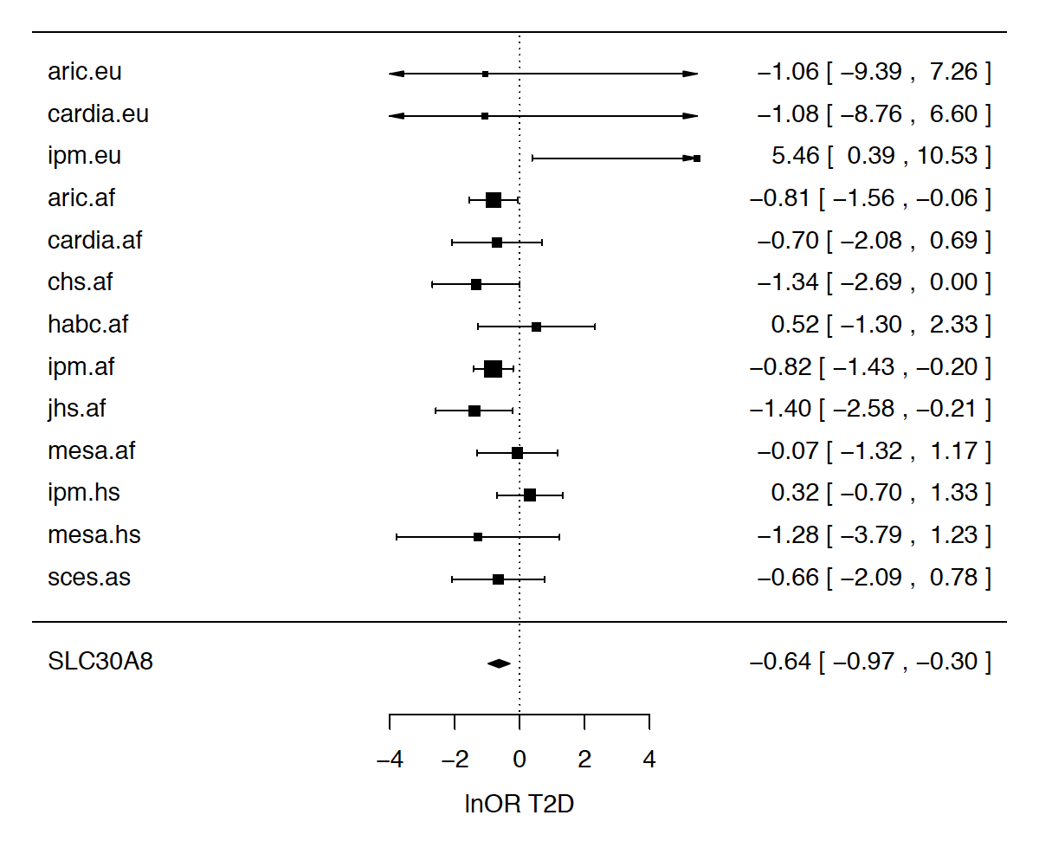
SLC30A8 Forest Plot

Slide 33
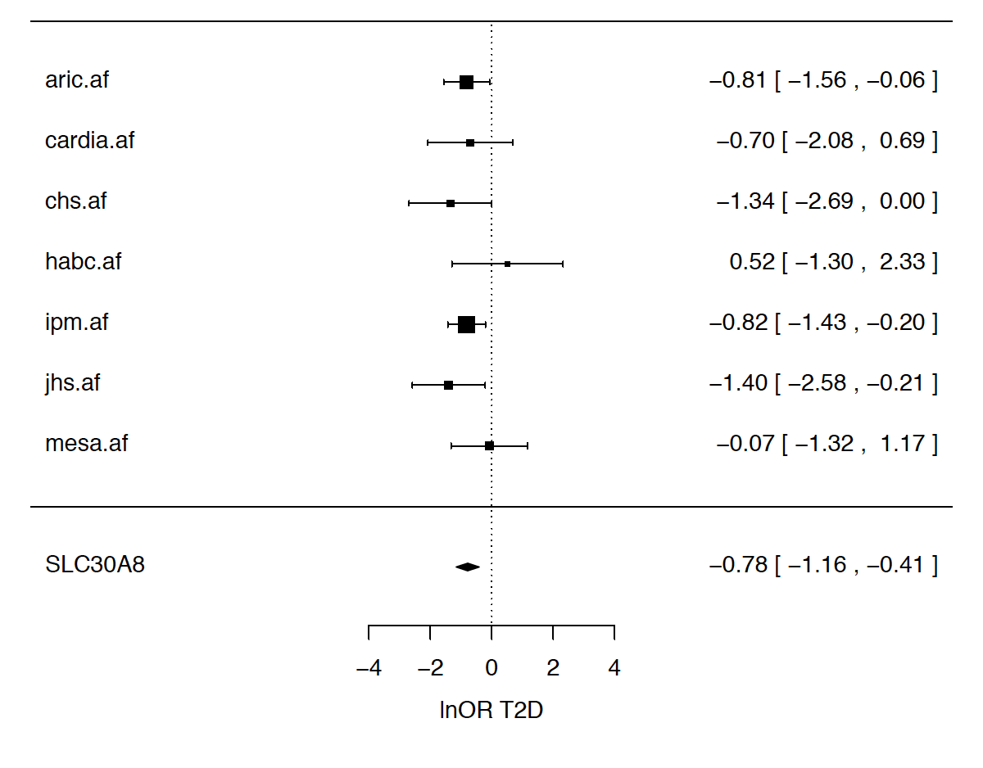
SLC30A8 Forest Plot

Slide 34
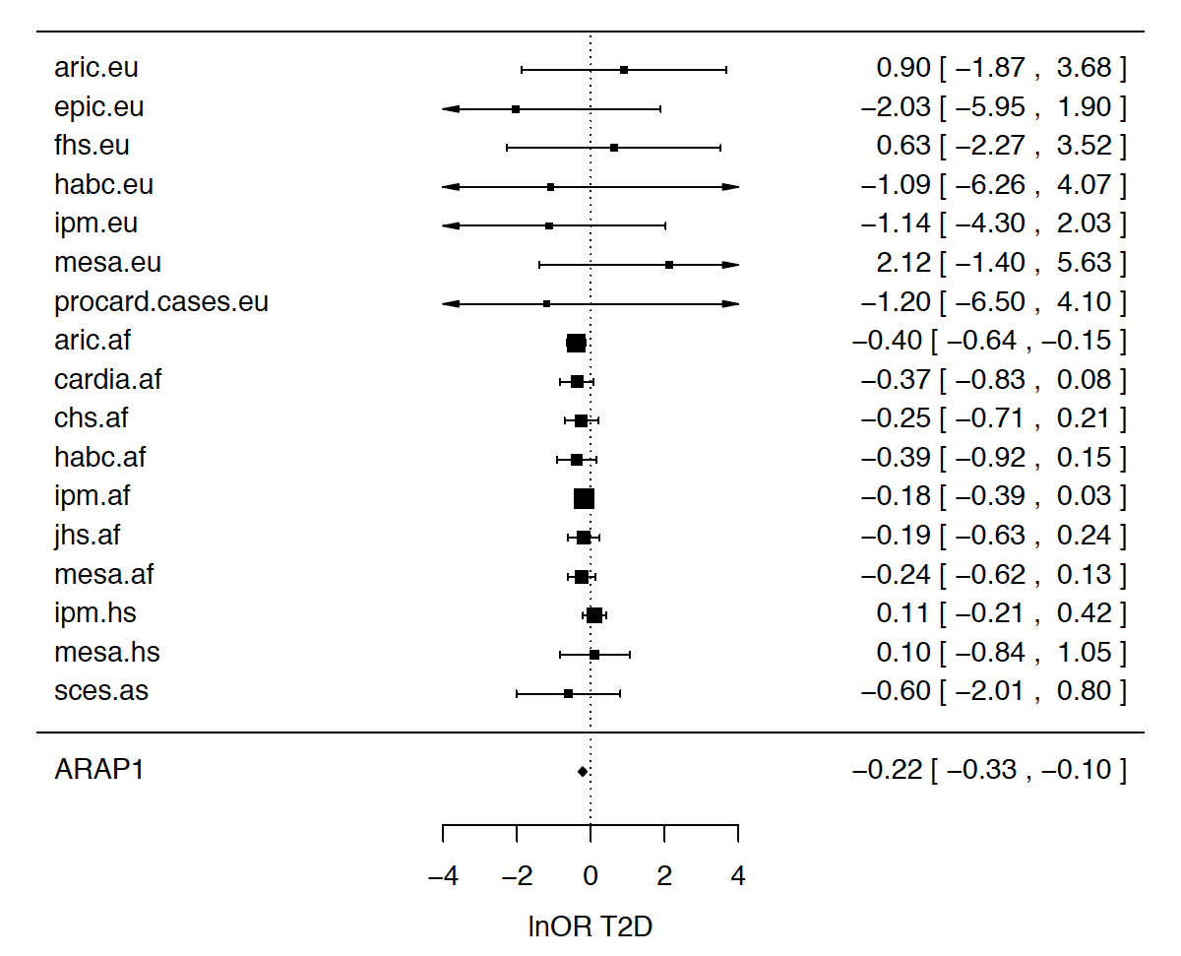
ARAP1 Forest Plot

Slide 35
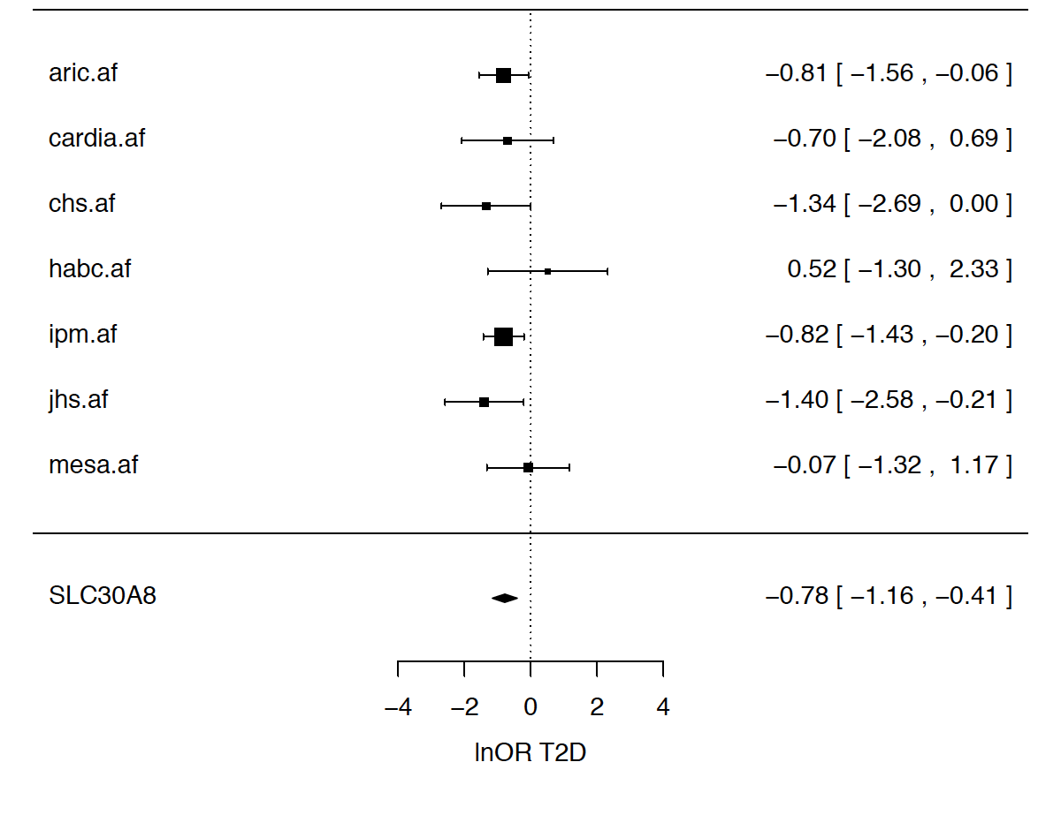
ARAP1 Forest Plot

Slide 36
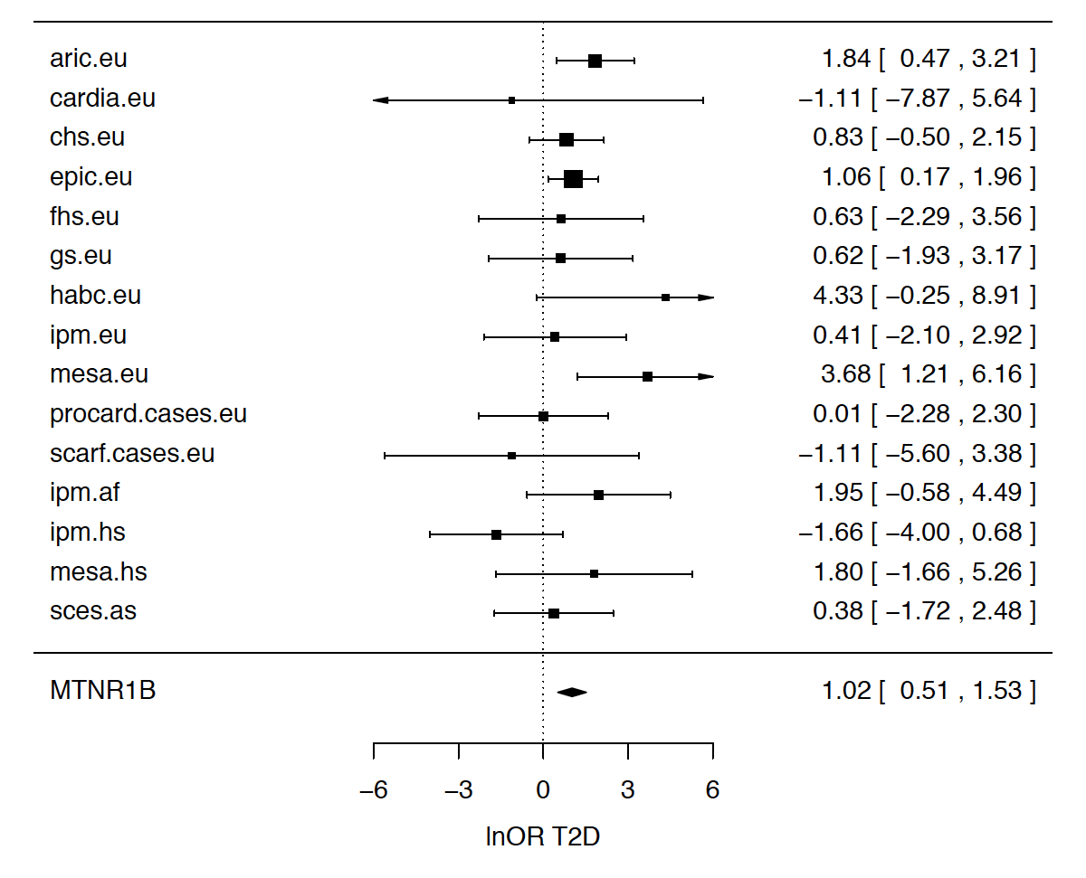
MTNR1B Forest Plot

Slide 37
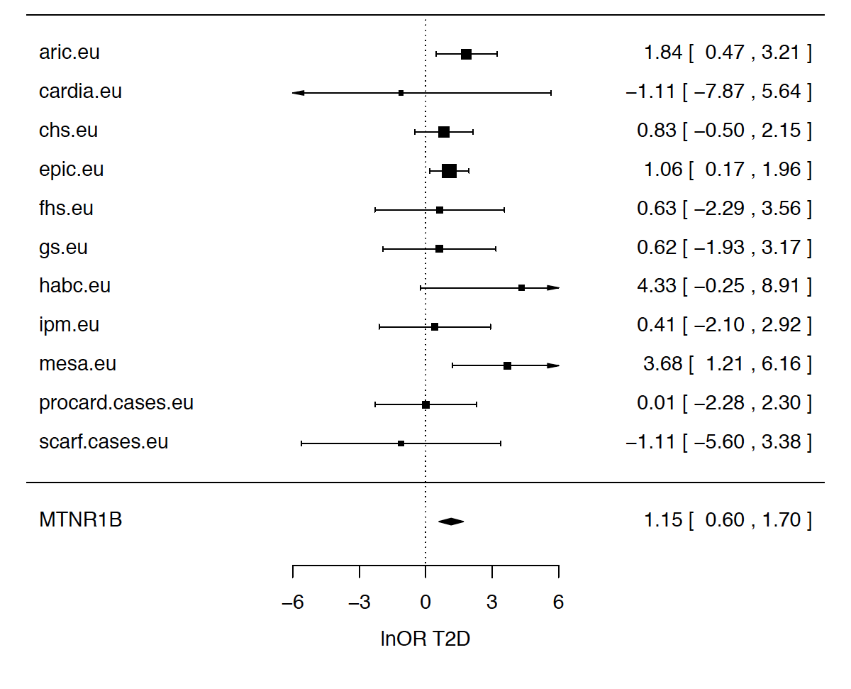
MTNR1B Forest Plot

Slide 38
FG/FI exome chip lookups
See FG/FI poster
ALL
EU Only
Gene | MAF (%) | MAC | OR | 95%CI | p | N studies
GLP1R (rs10305492) | 1.2% | 1470 | 0.79 | (0.68-0.86) | 2.7E-3 | 24
ABO (rs507666?) | 17% | 19994 | 1.06 | (1.01-1.08) | 0.015 | 24

Slide 39
Interesting issues
Within CHARGE analysis
skatMeta & seqMeta
Analysis of non-joint called cohorts
Rare variant analysis in T2D
2 Danish exome sequencing studies in 1000 T2D cases with BMI >27.5kg/m² and hypertension and 1000 controls (2013) (PMID 23160641, 24290377)
Albrechtsen et al found common variants associated
Lohmueller et al did not find any variants associated
T2DGenes exome-chip wide analysis of T2D at ASHG also identified more common variants, but none with MAF < 5%
Notes:
seqMeta - binary trait analysis not well supported – missing case and control numbers only have total numbers & remove related participants before analysis
non joint called cohorts – some cohorts not part of joint calling needed SNPs excluded manually possibly due to poor genotype calling in smaller sample sizes
NEW ICELAND STUDY..

