Slide 1

Vitamin K Dependent Protein Activity and Incident Cardiovascular Disease: Results of the Multi Ethnic Study of Atherosclerosis
John Danziger
Division of Nephrology
Beth Israel Deaconess Medical Center
March 23, 2016

Slide 2
A case…..
Mr. L.W. was a 52 year old man who as a child had complications of urinary reflux. He developed renal failure by the age of 30, and underwent a renal transplant, without ever needing dialysis. He remained very healthy, with no active medical issues except taking his immunosuppressive medications.
While on vacation in Japan in late fall, he developed a febrile illness. Upon returning to Boston, he became critically ill, and presented to our hospital in multi-organ failure due to septic shock. He was admitted to the ICU, where his febrile illness was complicated by acute renal failure, and was started on dialysis, as well as atrial fibrillation, and was initiated on warfarin.
After a long hospital course, he was eventually discharged to a long term rehabilitation center. Over the next several months, he developed progressive necrotic ulcers on his distal extremities, face, perineum, and abdomen, and eventually succumbed to complications of such.
A representative picture of his wounds is provided.

Slide 3
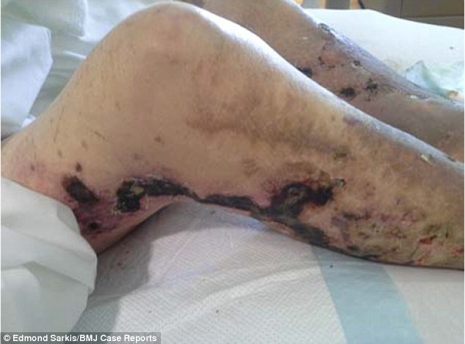

Slide 4
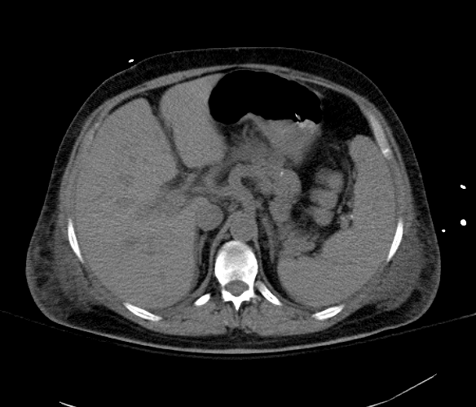
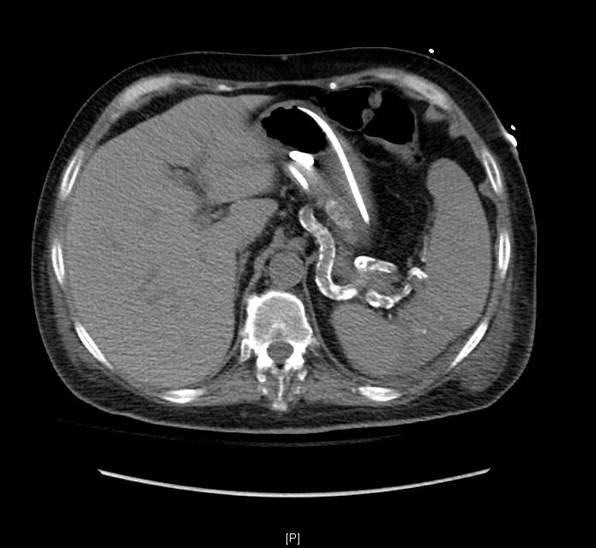
12/24/2006
9/19/2007

Slide 5
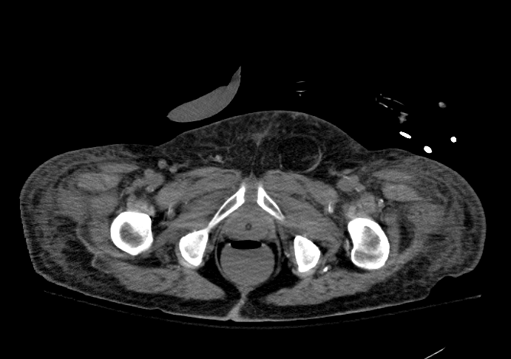
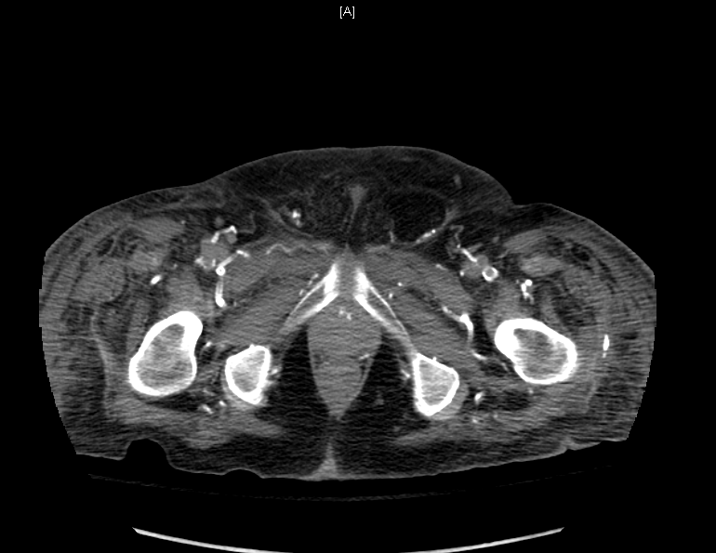
12/24/2006
9/19/2007

Slide 6
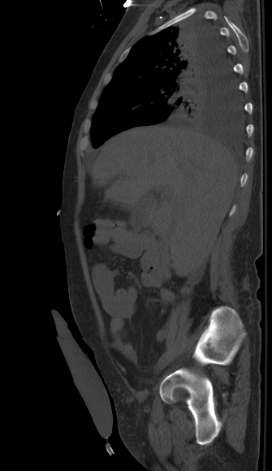
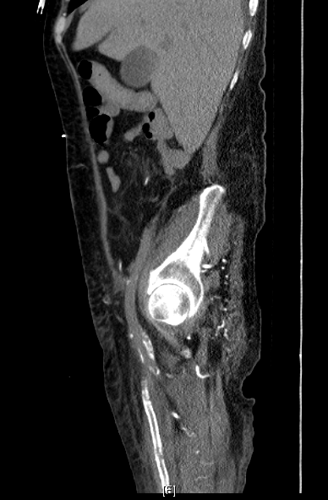
12/24/2006
9/19/2007

Slide 7
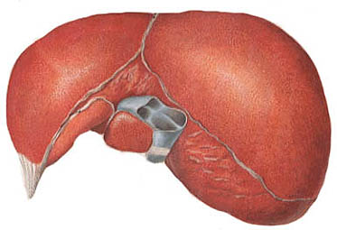
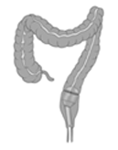
Vit K₁
Hepatic
carboxylation
Vit K₂
Carboxylated
active coagulant
factors
Peripheral
carboxylation
Platelet
active
inactive
A
A
Thrombosis
A
O
A
O
A
O
Y
Y
C-O
C-O
C-O
Inhibits
calcification
MGP
Vascular smooth
muscle cells
Gas-6
Danziger, CJASN, 2008.

Slide 8
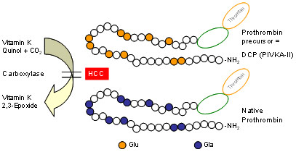
Circulating Des Carboxy Prothombin - undercarboxylated
Inhibitors?

Slide 9
Overview - VKDP activity in MESA studies
I. VKDP activity and vascular calcification
Medial vascular calcification (ankle-brachial index > 1.4) – case cohort analysis
Vascular, valvular calcification and vascular stiffness – weighted cohort analysis
II. VKDP activity and incident ischemic cardiovascular disease
Longitudinal analysis of baseline DCP and incident disease in weighted cohort
III. VKDP activity and inflammation

Slide 10
Participant selection for the MESA case control
MESA
Original Cohort
(n=6814)
Not Eligible for Inclusion
1. Warfarin Users (n=24)
2. High-Usage Random
Subcohort (n=995)
Eligible for Inclusion
(n=5795)
Random Subcohort I
Phylloquinone Measured
(n=780)
Random
Subcohort II
(n=613)
Cases (ABI >1.4))
(n=96)

Slide 11
Distribution of Des-gamma carboxy prothrombin concentrations

Slide 12
Distribution of Des-gamma carboxy prothrombin concentrations
VKDP inactivity

Slide 13
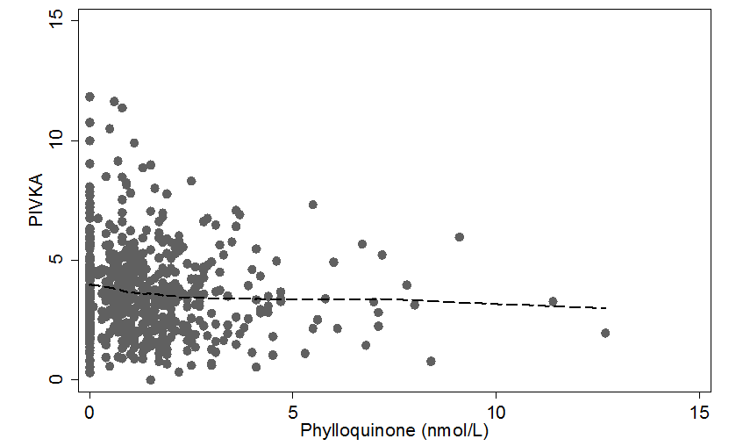
Association of VKDP activity and Vitamin K Nutrition
DCP(ng/ml)

Slide 14
Association of VKDP activity and Vitamin K Nutrition
DCP(ng/ml)
VKDP
inactivity
Vitamin
K deficiency

Slide 15
Baseline characteristics of the case-cohort sample, stratified by DCP quartiles (n=709)
 | DCP Q1 |  | DCP Q2 |  | DCP Q3 |  | DCP Q4
 | (0.33-2.40) |  | (2.41-3.47) |  | (3.48-4.63) |  | (4.64-20.1)
Variables | n=178 |  | n=177 |  | n=177 |  | n=177
Age, years | 61 (10) |  | 63 (10) |  | 62 (10) |  | 63 (10)
Women, n (%) | 92 (52) |  | 92 (52) |  | 92 (52) |  | 81 (46)
Race/ethnicity, n (%)
White | 43 (24) |  | 62 (35) |  | 78 (44) |  | 85 (48)
Chinese | 42 (24) |  | 17 (10) |  | 10 (6) |  | 8 (5)
Black | 62 (35) |  | 60 (34) |  | 38 (21) |  | 36 (20)
Hispanic | 31 (17) |  | 38 (21) |  | 51 (29) |  | 48 (27)
Body mass index | 27 (6) |  | 28 (6) |  | 29 (6) |  | 30 (5)
Cigarette smoking status, n (%)
Former | 54 (31) |  | 59 (33) |  | 68 (38) |  | 68 (38)
Pack-years cigarette smoking | 8 (18) |  | 11 (19) |  | 10 (18) |  | 16 (29)
Intentional physical activity total (MET-min/day) | 218 (310) |  | 234 (379) |  | 199 (364) |  | 194 (238)
Current alcohol use, n (%) | 96 (69) |  | 96 (67) |  | 116 (77) |  | 93 (61)
Diabetes | 27 (15) |  | 21 (12) |  | 31 (18) |  | 20 (11)
Antihypertension medication, n (%) | 58 (33) |  | 66 (37) |  | 75 (42) |  | 66 (37)
Systolic BP (mmHg) | 124 (22) |  | 128 (22) |  | 126 (23) |  | 130 (20)
Diastolic BP (mmHg) | 72 (11) |  | 72 (11) |  | 71 (12) |  | 73 (9)
LDL-C | 108 (28) |  | 116 (28) |  | 119 (33) |  | 119 (31)
HDL-C | 54 (16) |  | 53 (16) |  | 50 (14) |  | 46 (13)
Lipid-lowering medication, n(%) | 23 (13) |  | 24 (14) |  | 34 (19) |  | 42 (24)
Triglycerides, mg/dL, median (IQR) | 94 (71-136) |  | 103 (69-148) |  | 108 (79-155) |  | 134 (98-188)
Hs-CRP, median (IQR), mg/l | 1.1 (0.6-3.3) |  | 1.8 (0.9-3.7) |  | 2.8 (1.1-6.6) |  | 2.6 (1.3-5.0)
Estimated GFR | 83 (18) |  | 81 (20) |  | 81 (18) |  | 79 (19)
Urinary Albumin /Creatinine (mg/g) | 14 (37) |  | 20 (56) |  | 39 (216) |  | 40 (184)
Phylloquinone, (nmol/L) | 1.8 (2.3) |  | 1.5 (2.2) |  | 1.2 (1.2) |  | 1.2 (1.5)
Dihydrophylloquinone (nmol/L) | 0.3 (1.1) |  | 0.2 (0.5) |  | 0.2 (0.6) |  | 0.2 (0.8)

Slide 16
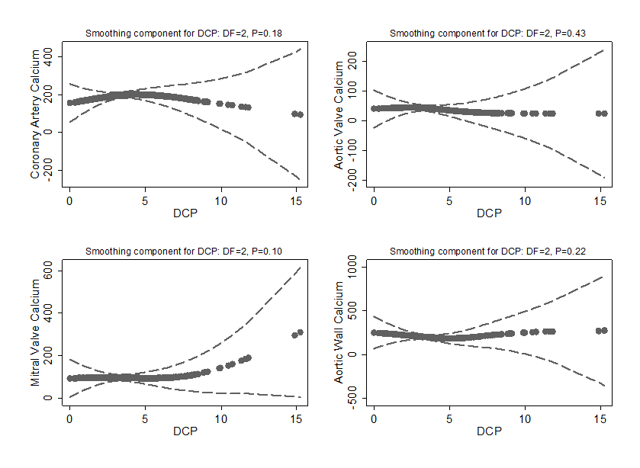
Adjusted association between DCP concentrations and vascular calcification with 95% confidence limits
Generalized additive model adjusted for age, gender, race/ethnicity, BMI, cigarette smoking, current alcohol use, physical activity diabetes, systolic blood pressure, antihypertension medication, LDL, HDL, triglycerides, hs-CRP, lipid-lowering medication, estimated glomular filtration rate, albumin/creatinine ratio, Phylloquinone and Dihydrophylloquinone. All models are weighted and use robust standard errors.

Slide 17
Adjusted differences in measures of vascular stiffness in DCP quartiles.

Slide 18
Participant selection for the MESA weighted cohort design
MESA
Original Cohort
(n=6814)
Not Eligible for Inclusion
1. Warfarin Users (n=24)
2. High-Usage Random
Subcohort (n=995)
Eligible for Inclusion
(n=5795)
Random Subcohort I
Phylloquinone Measured
(n=780)
Full Case-Cohort
(n=717)
Random
Subcohort II
(n=613)
Cases (and in Subcohort)
(n=11)
Cases (not in Subcohort) ABI>=1.4
(n=93)

Slide 19
Ischemic Cardiovascular Disease
-Definite and probable myocardial infarction, coronary percutaneous angioplasty, coronary artery bypass grafting surgery, fatal or nonfatal stroke, or coronary related death.
-During a median of 11.0 years of follow up, 75 events (16 myocardial infarctions, 29 coronary revascularization procedures, 22 fatal and nonfatal strokes, and 8 other fatal CHD events).

Slide 20
Cumulative Incidence of Ischemic Cardiovascular Disease according to Des-gamma carboxy prothrombin quartiles
In press, ATVB
Notes:
Event rate of 3 and 11 per 1000 years in lowest to highest quartile

Slide 21
Proportional Hazards Cox Regression Model Predicting the Likelihood of Ischemic Cardiovascular Disease by Des-gamma carboxy Prothrombin
 |  | DCP (quartiles)
 | Events/N | Q1 (0.33-2.40) | Q2 (2.41-3.47) | Q3 (3.48-4.63) | Q4 (4.64-<20.1) |  | DCP (continuous)
Model 1 | 76/715 | reference | 1.38 | 1.83 | 1.71 |  | 1.46
 |  |  | (0.62-3.06) | (0.81-4.12) | (0.79-3.70) |  | (1.08-1.97)
 |  |  | p=0.428 | p=0.143 | p=0.173 |  | p=0.013
Model 2 | 74/699 | reference | 1.48 | 1.96 | 2.03 |  | 1.58
 |  |  | (0.62-3.52) | (0.83-4.66) | (0.82-5.04) |  | (1.13-2.22)
 |  |  | p=0.378 | p=0.126 | p=0.125 |  | 0.008
Model 3 | 59/629 | reference | 1.46 | 1.82 | 1.87 |  | 1.53
 |  |  | (0.61-3.50) | (0.78-4.23) | (0.76-4.58) |  | (1.09-2.13)
 |  |  | p=0.39 | p=0.163 | p=0.171 |  | 0.013
Model 1: Adjusted for age, gender, and race/ethnicity.
Model 2: Adjusted for Model 1 + BMI, cigarette smoking (never, former, current), education (high school graduate), diabetes, systolic blood pressure, antihypertension medication use, low-density lipoprotein cholesterol, high-density lipoprotein cholesterol, triglycerides, high-sensitivity C-reactive protein, lipid-lowering medication, estimated glomular filtration rate, albumin and creatinine ratio, intentional physical activity, and current alcohol use.
Model 3: Adjusted for Model 2 + phylloquinone, and dihydrophylloquinone.
In press, ATVB

Slide 22
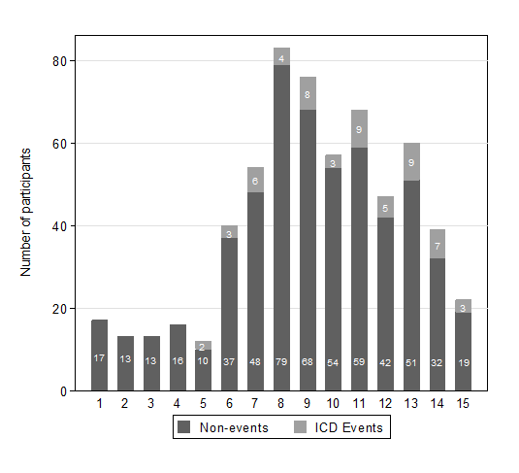
Locally weighted smoothed scatterplot and histogram of Des-gamma carboxy Prothrombin and Ischemic Cardiovascular Disease (n=617)
In press, ATVB

Slide 23
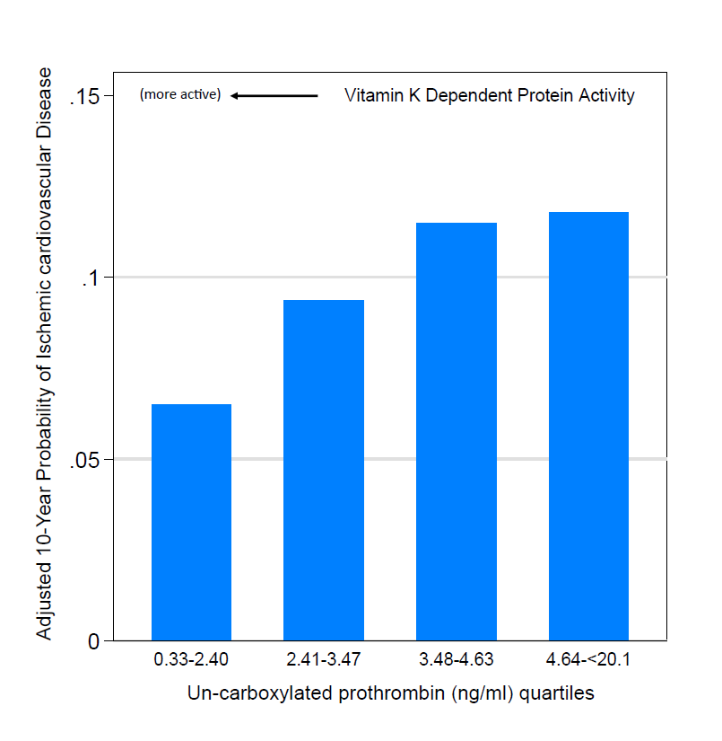
Vitamin K Dependent Protein Activity and Ischemic Cardiovascular Disease
In press, ATVB

Slide 24
Smoothed adjusted association between DCP concentrations and inflammatory markers with 95% confidence limits (n=652)
DCP was log transformed (base 2). CRP was natural log transformed. Generalized additive model adjusted for age, gender, race/ethnicity, BMI, cigarette smoking, current alcohol use, physical activity diabetes, systolic blood pressure, antihypertension medication, LDL, HDL, triglycerides, lipid-lowering medication, estimated glomular filtration rate, albumin/creatinine ratio, Phylloquinone and Dihydrophylloquinone. All models are weighted and use robust standard errors

Slide 25
Adjusted differences in inflammation and DCP

Slide 26
Interpretation of the results…
VKDP activity might be a novel diagnostic and therapeutic tool for preventing ischemic CVD.
Elevated DCP concentrations might simply reflect global hepatic dysfunction (failure to carboxylate).
Elevated DCP concentrations might simply reflect increased hepatic prothrombin production.
Elevated DCP concentrations might simply reflect poor eating habit/lifestyle, not accounted for by our current model.

Slide 27
Future Steps
To understand the relative activity amongst different VKDPs.
To understand the determinant of VKDP activity (renal dysfunction).
To confirm our findings in another cohort (perhaps with renal disease).
To perhaps redo in the larger MESA cohort.

Slide 28
Many thanks to….
Rebekah Young (U.Washington)
Ken Mukamal (BIDMC)
Nancy Jenny (U.Vermont)
Kyla Shea, Russell P. Tracy, Joachim H. Ix, Daniel A. Duprez, David R. Jacobs
Satellite Health Care – Norman Coplon Grant
Mr. LW and his parents
MESA!!

