Slide 1

EXAM 6 FIELD CENTER
EPIGENOMICS ANCILLARY TRAINING
Exam 6
Principal Investigator: Yongmei Liu, MD, PhD
Presented by Young A Choi
of the
Department of Epidemiology and Prevention
Division of Public Health Sciences
Wake Forest University School of Medicine

Slide 2
Purpose
    The purpose of the MESA Epigenomics study is to isolate DNA and RNA from specific types of blood cells referred to as monocytes and t-cells. DNA and RNA samples from this study will be used to understand variations of DNA (like DNA methylation) and gene expression patterns (from mRNA) within these cells types.
    We will investigate the association of global DNA methylation patterns in circulating monocytes and CD4+ T lymphocytes in relation to atherosclerosis and their gene expression profiles

Slide 3
Goals of MESA Epi Training
Provide a detailed explanation of the protocol and promote confidence in sample processing
  Enhanced Cell Viability
  Increase Cell Recovery Rate
  Increased Sample Purity
Provide Methods to Avoid Sample Confusion
  Within subject
  Between subject

Slide 4
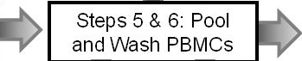
Overview of
MESA Epi Procedure
Step 1: Centrifugation of 5 CPT tubes
Step 2: Instrument Startup and Tube Labeling
Step 8: PBMC Cell Count on Countess
Step 3: Pool Plasma (~3ml/CPT tube) 15ml conical
Step 7:
LYSIS
PBMC
Subset in
Lysis
Buffer
Step 9&10: Add Running buffer & CD14 MicroBeads, incubate @ 4ºC for 15min
Step 11: Collection of Monocytes on AutoMACS
Step 3: Separation of platelets and Plasma by Centrifugation
Step 12&13: Monocyte Count and Storage MONO-CRYO in freezing media and place in Mr. Frosty
Step 15: CD14 Negative Cell Count
Step 4: Freeze Plasma Aliquots -70ºC, discard platelets
Step 13: MONO-CRYOsub in freezing media and place in Mr. Frosty
Step 16&17: Add Running buffer & CD4 MicroBeads, incubate @ 4ºC for 15min
Step 18: Collection of T Cells on AutoMACS
Step 14: MONO-Lysis in lysis buffer at -70ºC
Step 20: Negative Cell Count and discard
Step 19&21: T Cell Count and Storage in Lysis Buffer at -70ºC

Slide 5
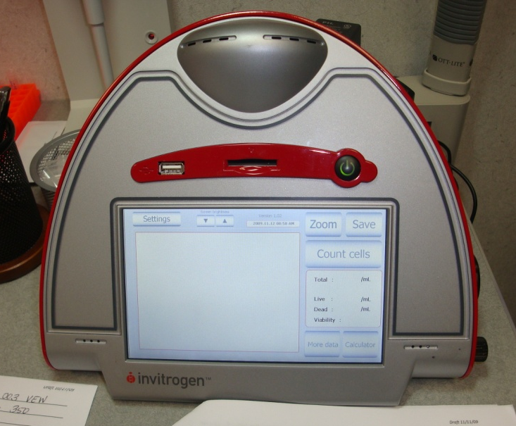
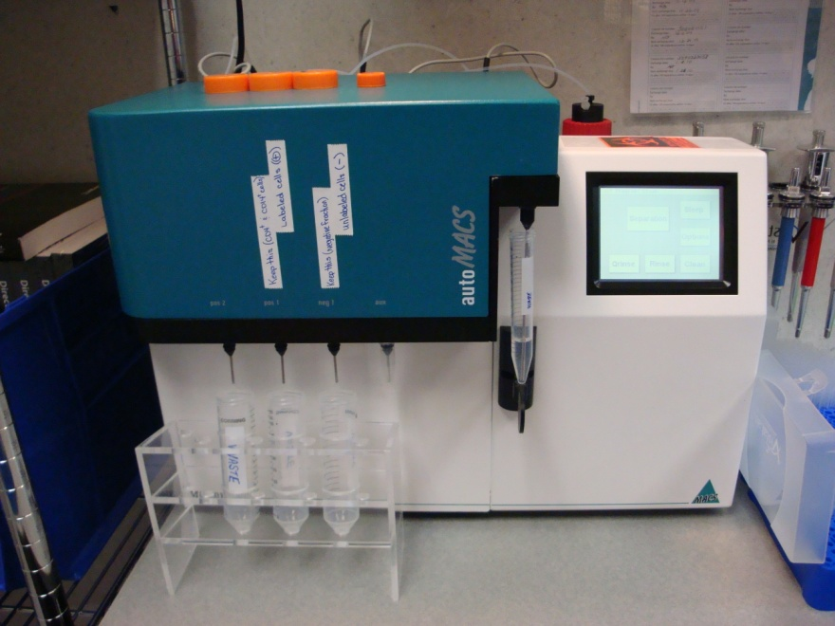
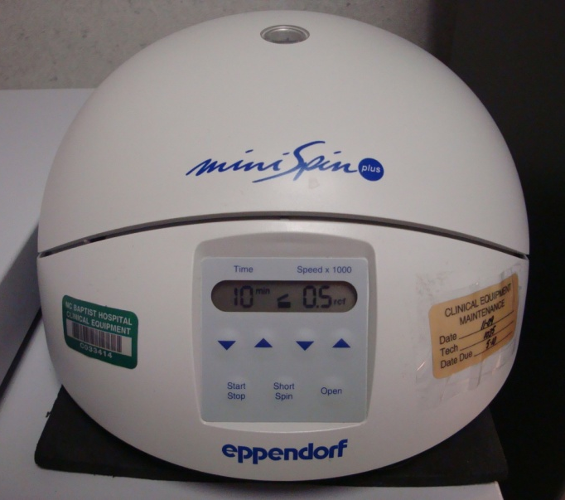
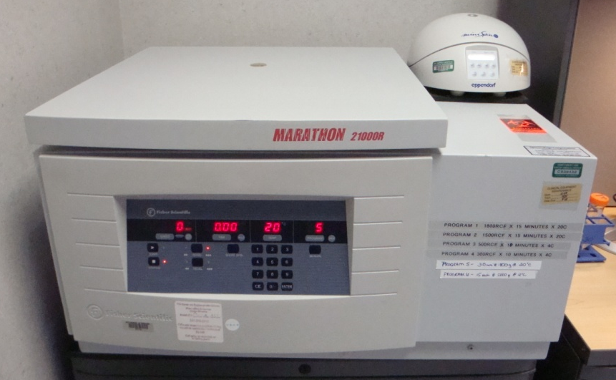
Instrumentation
Countess – Cell Counter
AutoMACS – Cell Separator
Microcentrifuge
Centrifuge

Slide 6
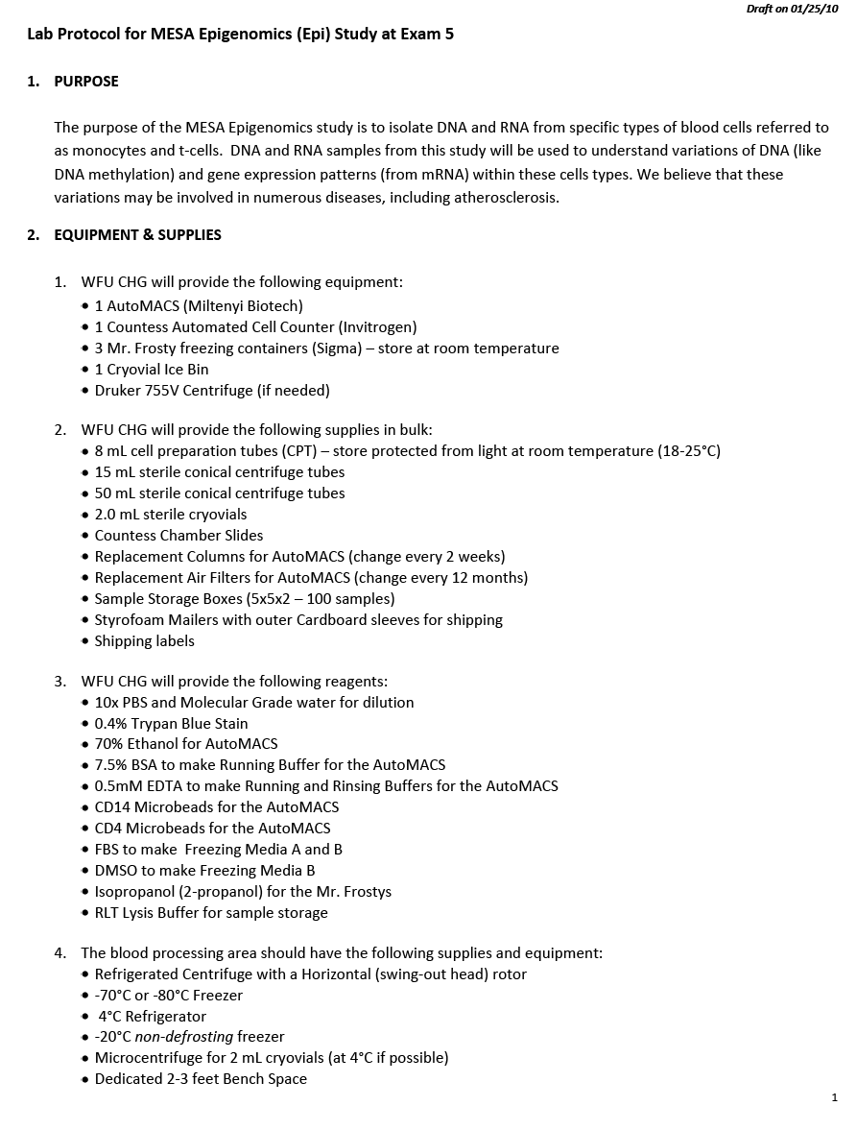
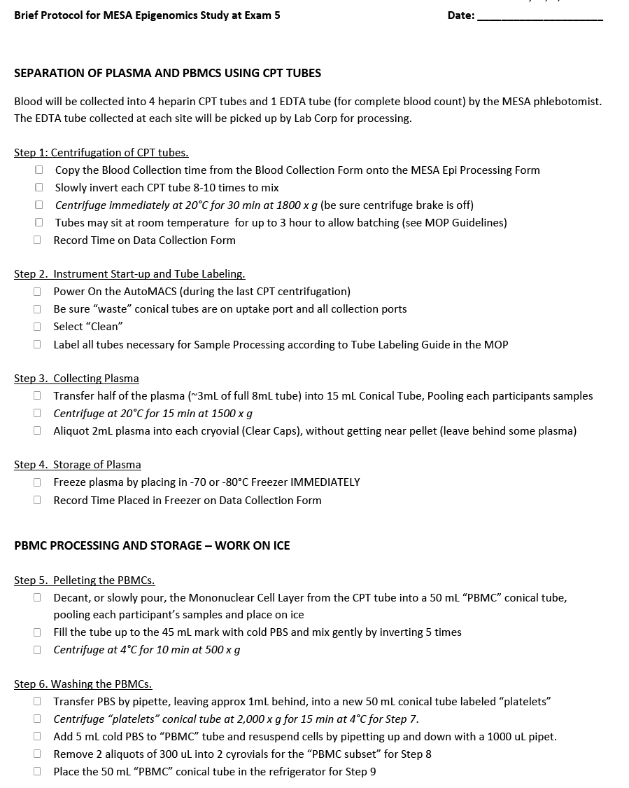
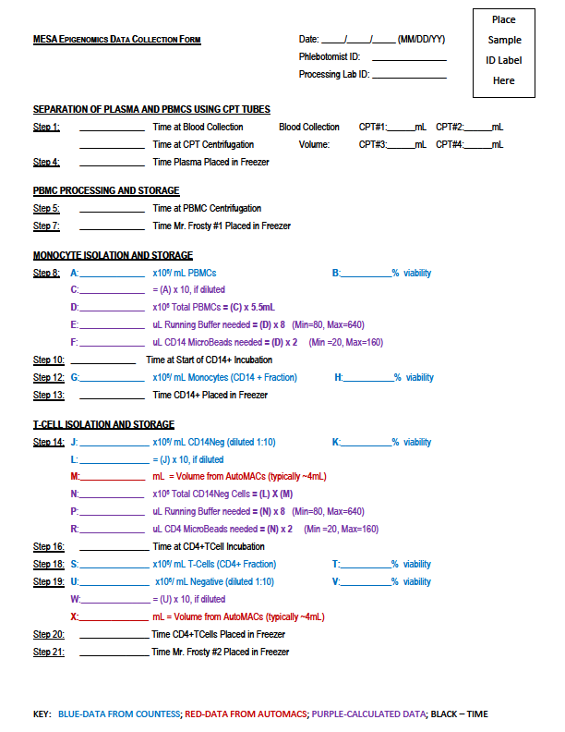
MESA Epi Documents
Detailed Protocol – Manual of Operations
Brief Protocol – for use as daily checklist
Data Collection Form – for recording times, cell counts, notes and performing calculations
Processing Form – for documenting tube storage and shipping

Slide 7
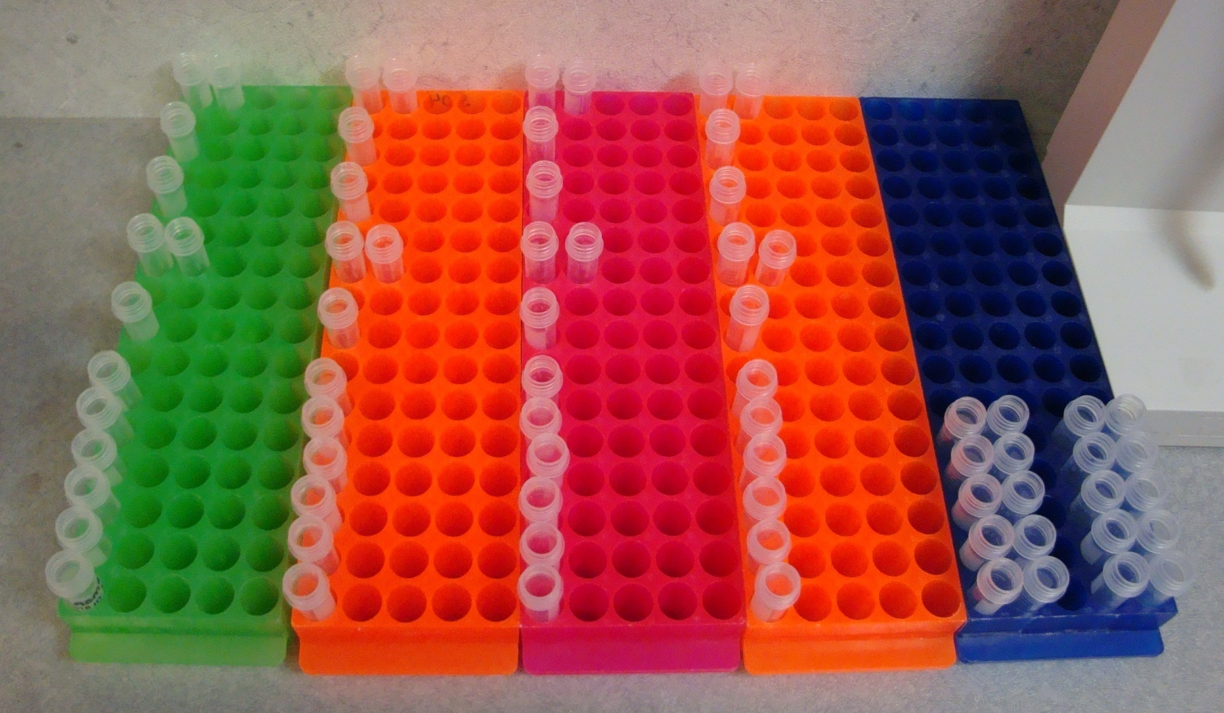
Cryovial Daily Set-Up
Tcells (CD4+)
Monocytes (CD14+)
Cryo&Lysis
PBMC Lysis
Subset
Plasma
Participant #1 Participant #3 Cell Counts
Participant #2 Participant #4

Slide 8
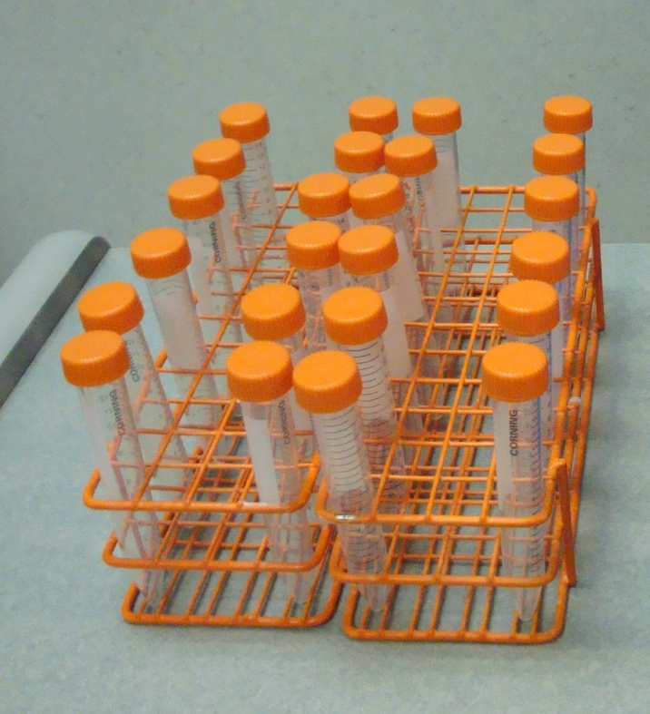

Conical Tube Daily Set-Up
CD4 Neg
CD4 Pos (T Cells)
CD14 Neg
CD14 Pos (Monocytes)
Plasma
PBMCs
Participant #1 Participant #3
Participant #2 Participant #4
Participant #1 Participant #3
Participant #2 Participant #4

Slide 9
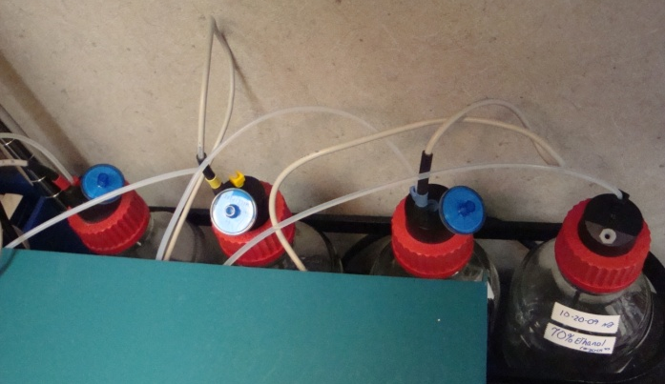
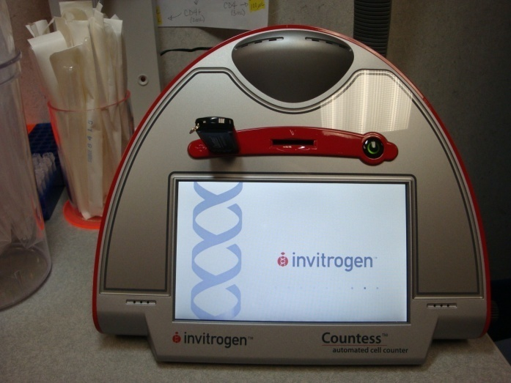
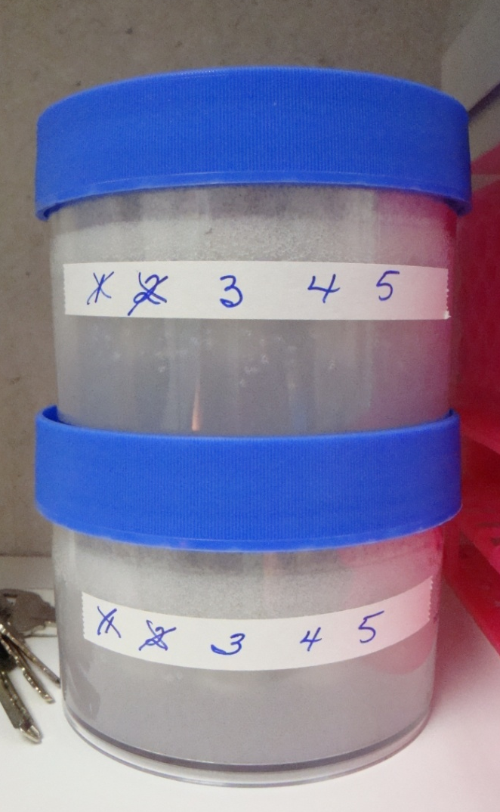
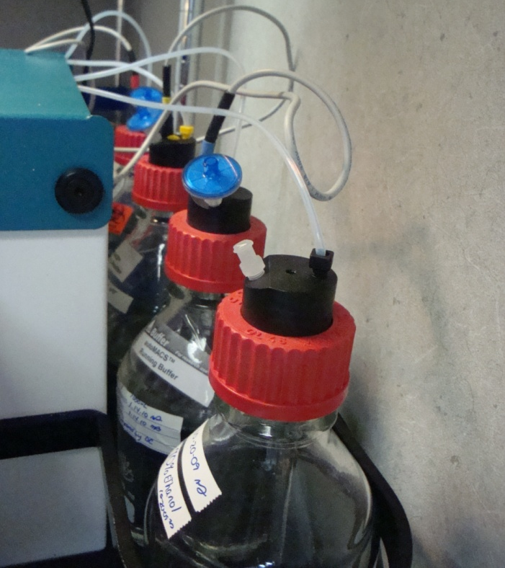
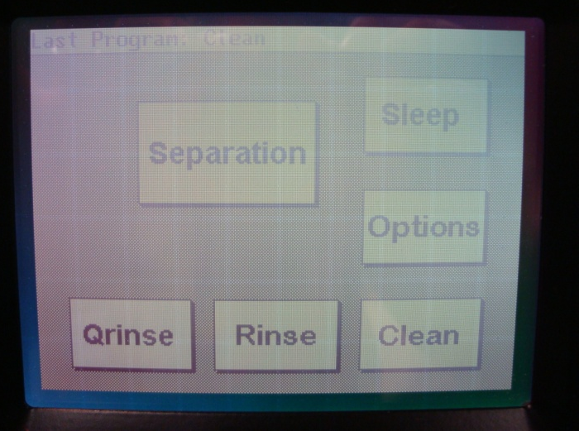
Other Daily Set-Up
Turn on Countess and
Insert Flash Drive
Check Reagent Levels
Empty/ Defrost Mr. Frosty
Start-up AutoMACs

Slide 10
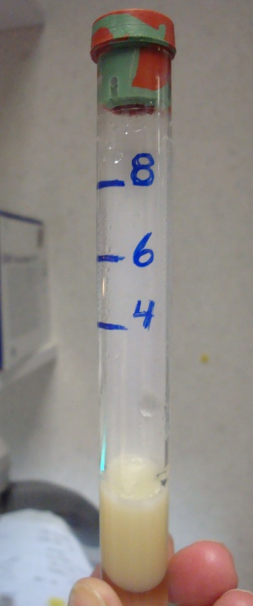
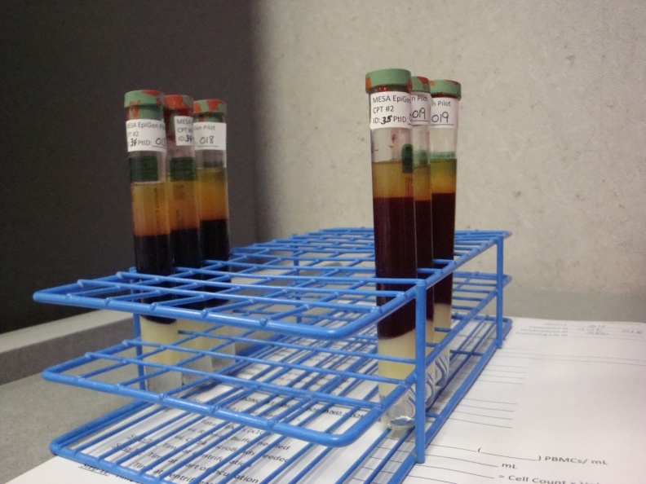
MESA Epi Protocol
SEPARATION OF PLAMSA AND PBMCs
Step 1: Centrifugation of CPT Tubes
  Tubes less than 4mL will be discarded and
  NOTES made on the Blood Collection Form
  Processing must begin within
  3 hours of first blood draw
  Tubes must be kept in a
  safe, still place free from
  drafts and out of direct
  sunlight until processing
  Copy Blood Collection and Centrifugation Time
Step 2: Instrument Start-up and Tube Labeling

Slide 11
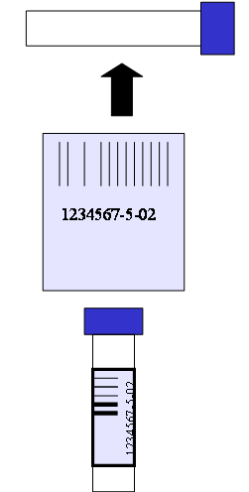
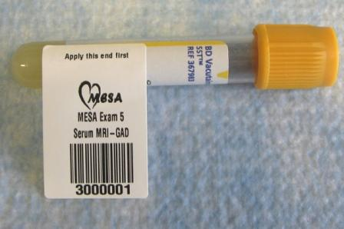
MESA Exam 6 Label Orientation on Cryovials and Tubes
ALL Labels will be provided by the MESA Coordinating Center
3.5mL Serum tube with label attached before wrapping around vial
Labels are attached to cryovials perpendicularly prior to aliquotting.
Notes:
Prior to aliquotting cryovials need to labeled with appropriate MESA Exam 5 labels. Labels are attached to cryovials perpendicularly prior to aliquotting.

Slide 12
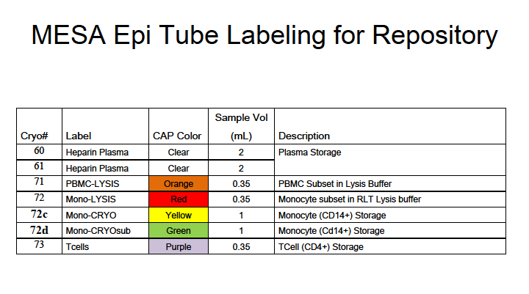
XXXXXX = Sample Number

Slide 13
Labels for Working Tubes
XXXXXX = Sample Number

Slide 14
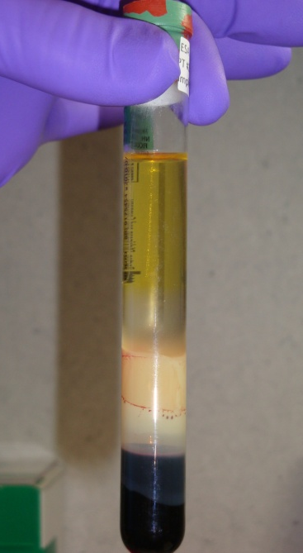
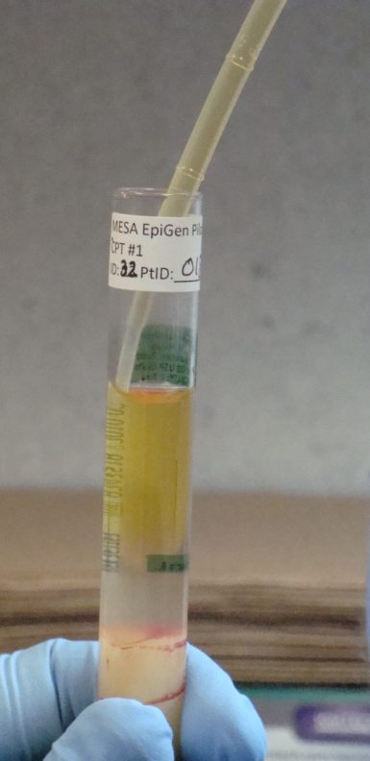
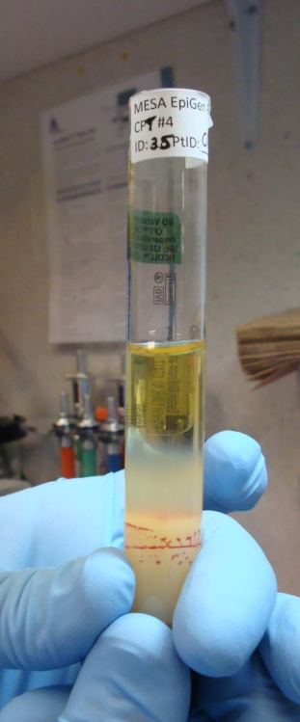
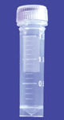
SEPARATION OF PLASMA AND PBMCS
Step 3: Collecting Plasma
  Half the plasma, or approx. 3mL from a full tube will be transferred into a 15mL conical tube
  Plasma from all 5 tubes will be pooled
  If the CPT tube is not full, transfer only half, which will be less than 3 mL
  Centrifuge at Room Temp
Step 4: Storage of Plasma
  Make 2 mL aliquots (2 CLEAR Cap tubes) and discard remaining plasma
  Freeze at -70°C or colder

Slide 15
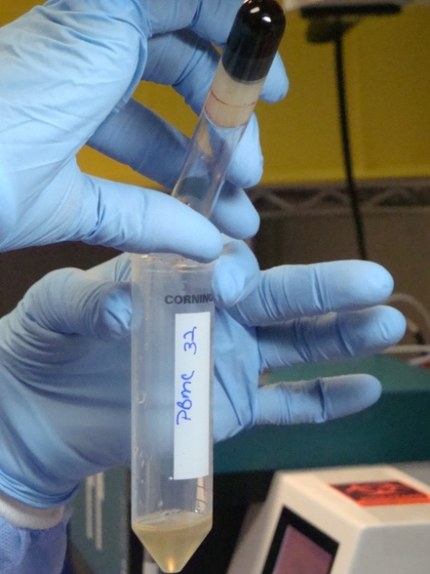
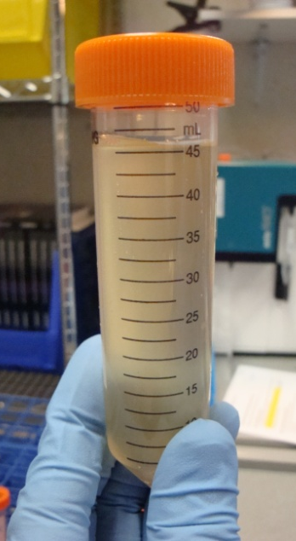
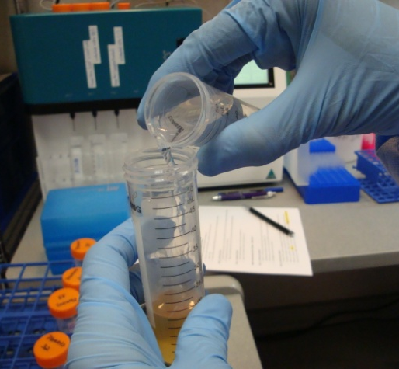
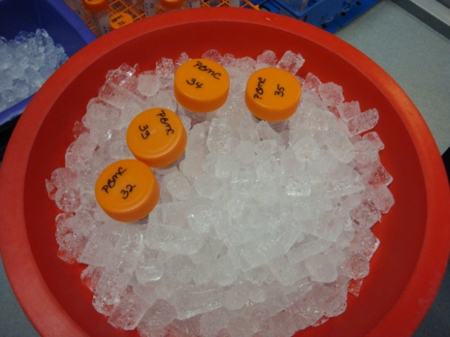
PBMC PROCESSING AND STORAGE
Step 5: Pool PBMCs
  Decant (slowly pour) the cell layer from the CPT tube into a 50mL conical tube “PBMCs”
  Pool all PBMCs from 5 CPT tubes together
  Fill tube up to 45mL mark and invert 5 times
  Centrifuge at 4°C for 10 min
Always work on Ice

Slide 16
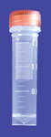
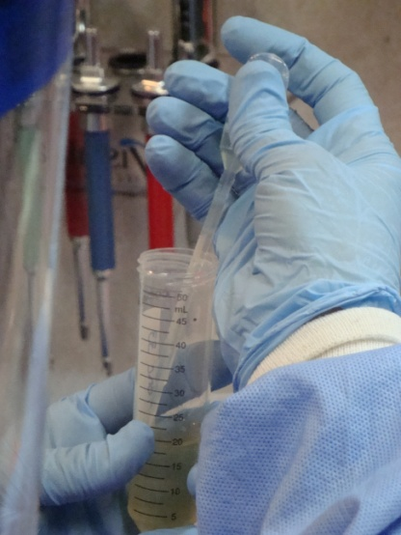
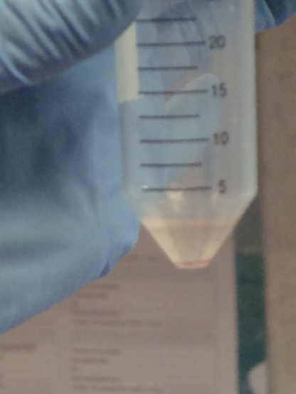
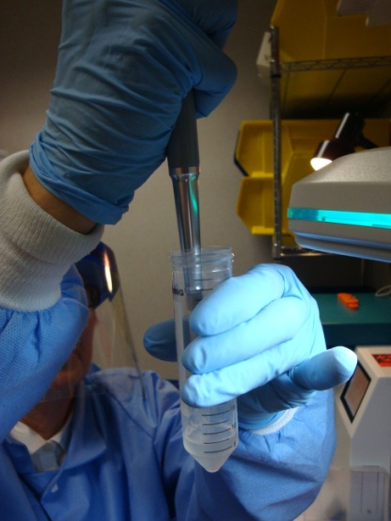
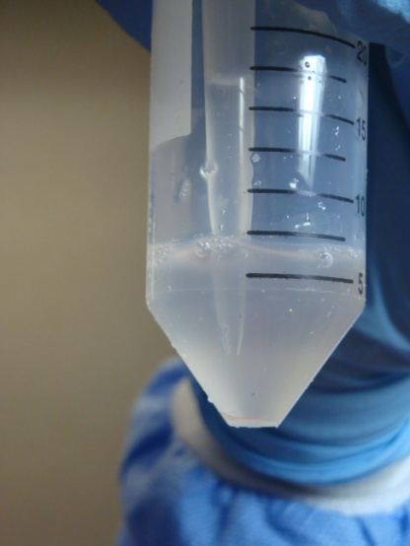
PBMC PROCESSING AND STORAGE
Step 6: Washing PBMCs
  Remove supernatant by pipet – leaving approx. 1mL behind
  Add 5mL COLD PBS and resuspend cells
  Remove 1 aliquot of 300uL for PBMC Lysis subset (Orange Cap Tube)

Slide 17
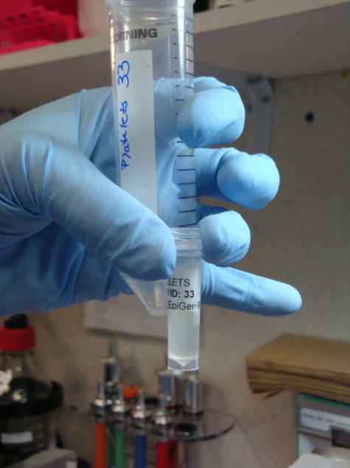
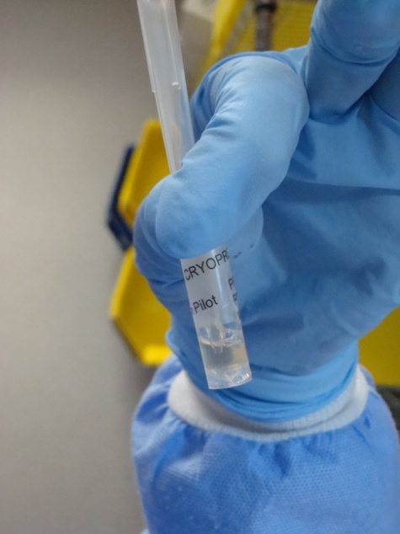
PBMC PROCESSING AND STORAGE
Step 7: Freezing Subset of PBMCs
  LYSIS (Orange Cap): Centrifuge, remove supernatant and add RLT Plus Lysis Buffer, mix well and freeze at -70°C or colder

Slide 18
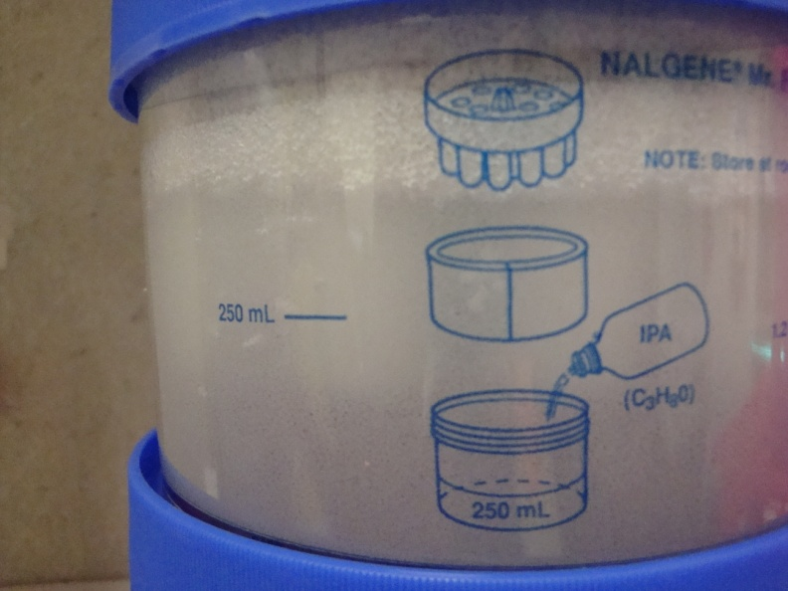

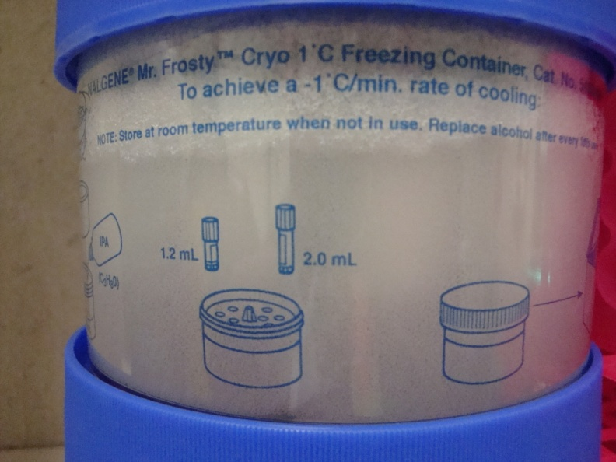
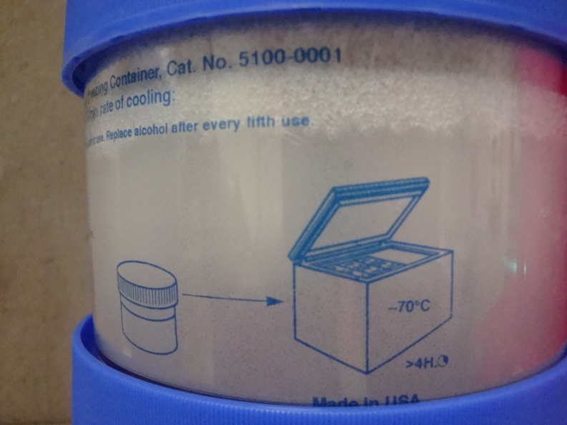
Aside: Mr. Frosty for CryoFreezing
Add 250 mL
Isopropanol
Can Be Frozen
5 Times Before New Isopropanol
Place Samples in Freezer Box Each Morning and Allow Complete Defrost
Before Use

Slide 19
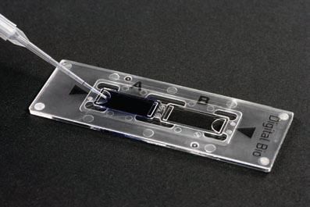
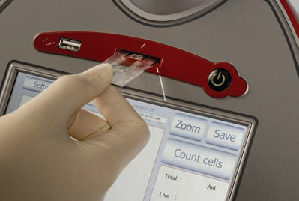
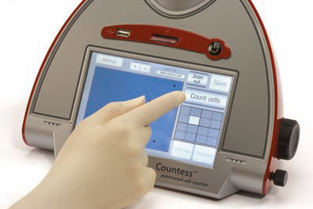
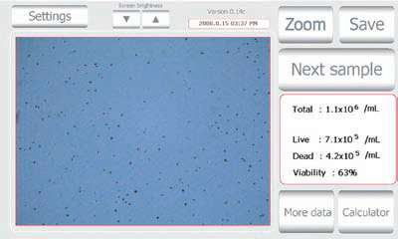
MONOCYTE ISOLATION AND STORAGE
Step 8: Determine PBMC Cell Count
  PBMC sample needs to be diluted 1:10
  10uL PBMCs + 90uL PBS + 100uL 0.4% Trypan Blue
  Add 10uL into Chamber and Insert into instrument
  Press Zoom, Optimize and Press Count Cells
  Save to Flash Drive, Record on Form and Press Close
  Complete Calculation on Data Collection Form

Slide 20
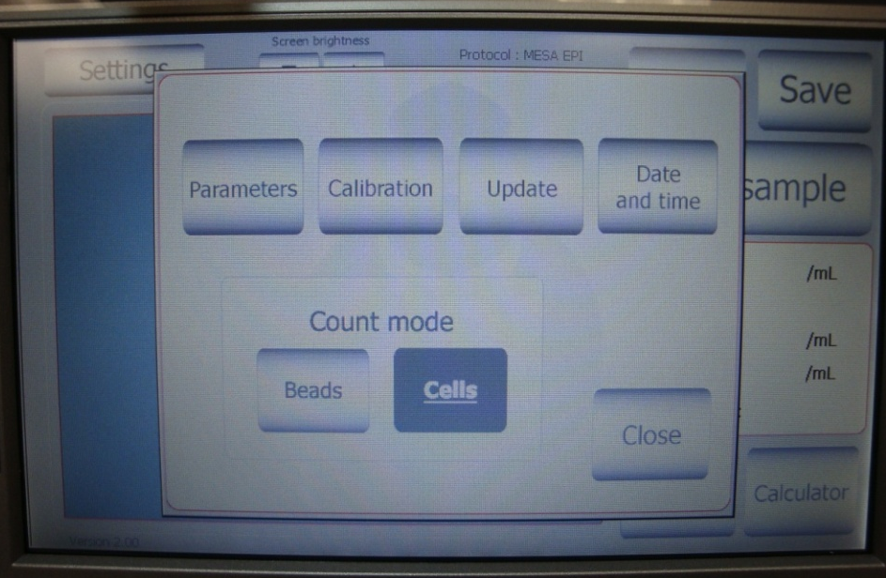
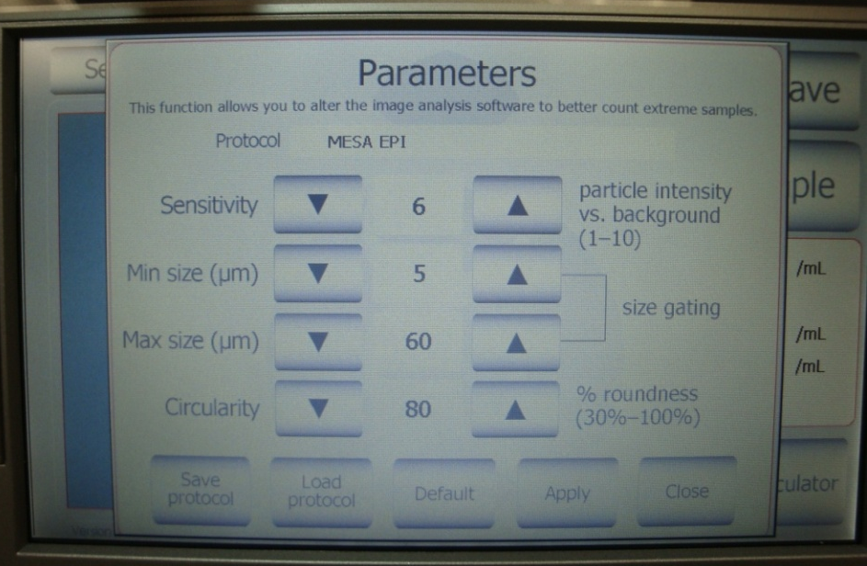
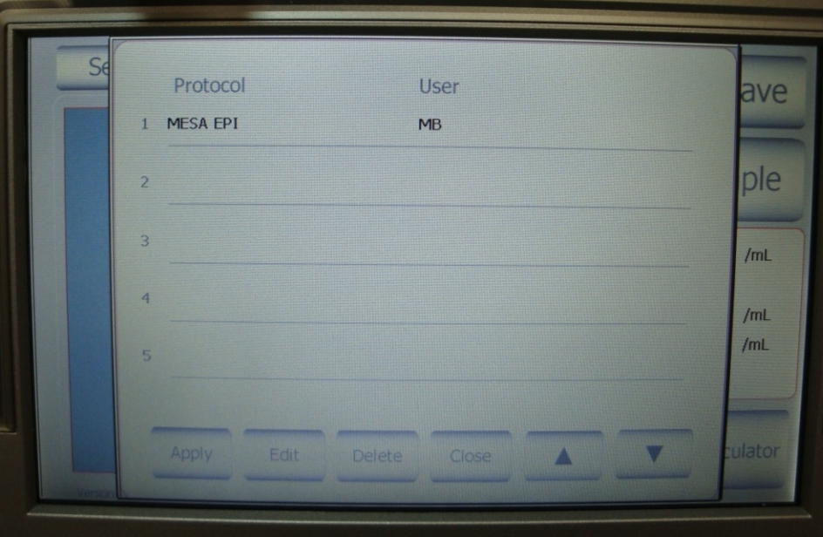
Tutorial: Using the Countess Automated Cell Counter
Countess Startup
1. Select “Settings” and verify that Count Mode = Cells
2. Select “Parameters” and choose “Load Protocol”
3. Select “MESA EPI” and press “Apply”
1.
2.
3.

Slide 21
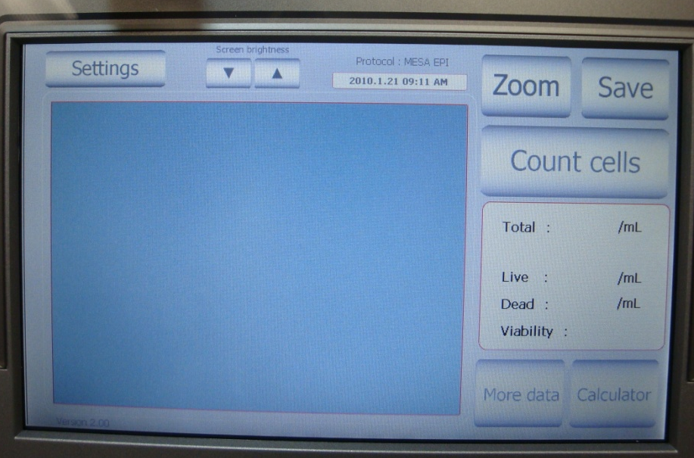
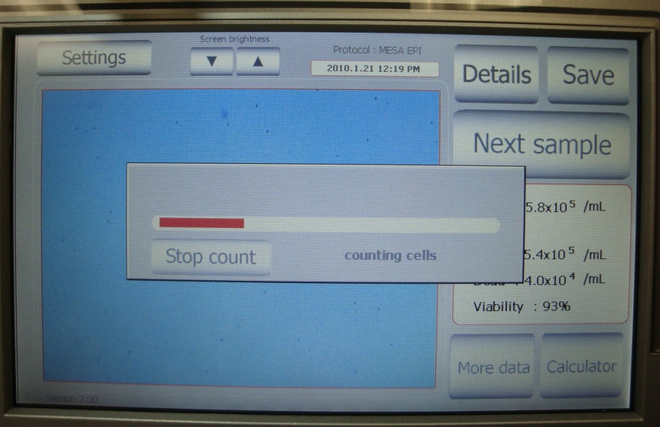
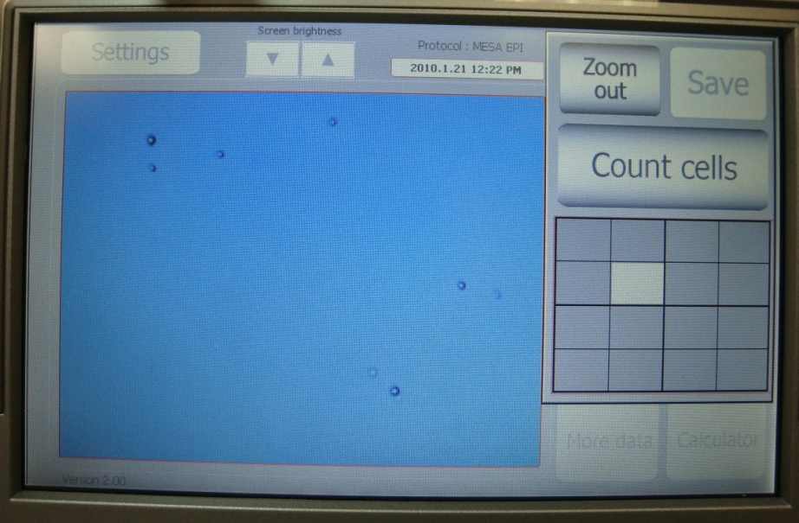
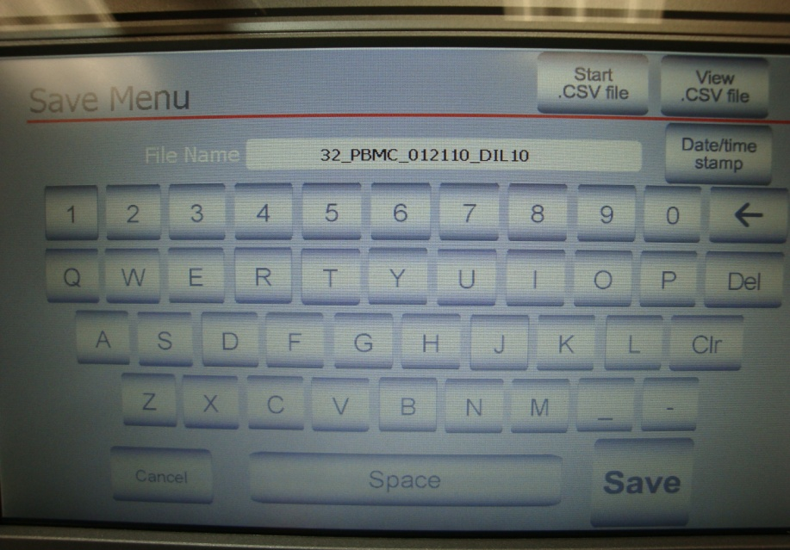
Tutorial: Using the Countess Automated Cell Counter
1. Insert Chamber Slide and Press Zoom
3. Record Count and Viability; Press Save
2. Optimize Image and Press Count Cells
4. Type File Name and Press Save

Slide 22
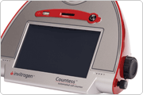



Tutorial: Using the Countess Automated Cell Counter
Optimizing Image
Slowly Adjust the focus knob to optimize the image for analysis
  → Live cells have bright centers and dark edges
  → Dead cells have a uniform blue color throughout the cell with no bright centers
Countess Demo
FOCUS
LOCK
CORRECT
INCORRECT
INCORRECT
A
B
C
Dead
Dead
Dead
Live
Live
Live

Slide 23

CALCULATIONS for AutoMACs
Follow on Data Collection Form
0.95
99
9.5
52.25
418
104.5
6.5
98
0.5
97
5
4
20
160
40

Slide 24

MONOCYTE ISOLATION AND STORAGE
Always work on Ice
Step 9: Preparing PBMCs for Monocyte Collection
  Centrifuge and Carefully remove PBS without disturbing cell pellet (leave a few uL behind)
  BE VERY CAREFUL of the cell slurry you will see; TO REDUCE SAMPLE LOSS
    keep the pipet tip touching the top of the
    solution but not IN the solution
    Pipet the supernatant away VERY slowly
  Resuspend Cells in the Calculated Volume
  of Cold Running Buffer

Slide 25

MONOCYTE ISOLATION AND STORAGE
Step 10: Adding Monocyte (CD14) MicroBeads
  Add the calculated volume of microbeads and mix by pipet
  Incubate IN DARK REFRIGERATOR for 15 min
  Add 2mL COLD Running Buffer/rxn to Dilute/Wash
  Centrifuge and Remove Supernatent being VERY CAREFUL of CELL SLURRY – leave up to 0.5mL behind
  Add 1000uL COLD Running Buffer and Mix by Pipet

Slide 26





MONOCYTE ISOLATION AND STORAGE
Step 11: Collection of Monocytes (CD14+ Cells) using AutoMACs
  Place appropriate tubes on Pos1 and Neg1 ports
  Place Sample on Uptake Port
  Select Separation, then PosSel and OK
  Once separation is complete, record the Neg elution volume and place “Waste” tubes on ports
  Select “QRinse”

Slide 27




MONOCYTE ISOLATION AND STORAGE
Step 12: Determining Monocyte Count
  10uL Monocytes + 10uL 0.4% Trypan Blue
  Use the other half of the Chamber Slide
  Count just like the PBMCs
Step 13&14: Storage of Monocytes
  Adjust total volume to be 5ml
  Aliquot 1.5ml into Yellow cap cryovial (MONO-CRYO)
  Aliquot _ul into Green cap cryovial (MONO-CRYOsub)
  Centrifuge cryovials & 15ml conical tube and remove supernatent/Buffer
  Add freezing media into Yellow & Green cap vial, place in Mr. Frosty and place in Freezer overnight
  Add 350uL Cell Lysis Buffer into conical tube, mix well and transfer to Red cap cryovial (MONO-LYSIS)
  Place immediately in -70°C Freezer

Slide 28

T-CELL ISOLATION AND STORAGE
Step 15: Count CD14 Negative Cells
  Count Same as PBMCs
Step 16: Preparing CD14 Negative
Cells for T-Cell (CD4+) Collection
  Centrifuge and CAREFULLY remove the buffer – be very aware of the cell slurry (follow previous guidelines)
  Resuspend in the calculated
  amount of Cold Running Buffer
Always work on Ice

Slide 29

T-CELL ISOLATION AND STORAGE
Step 17: Adding T-Cell (CD4) MicroBeads
  Add the calculated volume of microbeads
  and mix by pipet
  Incubate IN DARK REFRIGERATOR for 15 min
  Add 2mL COLD Running Buffer/rxn
  Centrifuge and Remove Supernatent being
  VERY CAREFUL of CELL SLURRY – leave up to 0.5mL behind
  Add 1000uL COLD Running Buffer and Mix by Pipet

Slide 30
T-CELL ISOLATION AND STORAGE
Step 18: Collection of T-Cells using the AutoMACs
  Place appropriate tubes on Pos1 and Neg1 ports
  Place Sample on Uptake Port
  Select Separation, then PosSel and OK
  Once separation is complete, record the Neg elution volume and place “Waste” tubes on ports
  Select “QRinse”

Slide 31

T-CELL ISOLATION AND STORAGE
Always work on Ice
Step 19: Determining T-Cell Count
  Same as Monocyte Count
Step 20: Determining Negative Cell Count
  Same as CD14 Neg Cell Count & discard
Step 21: Storage of T-Cells
  Centrifuge and Carefully Remove Buffer
  Add 350uL Cell Lysis Buffer, mix well and transfer to Purple Cap Cryovial
  Place immediately in -70°C Freezer

Slide 32


T-CELL ISOLATION AND STORAGE
Step 22: Shutting Down Instruments
  Make sure waste tubes are under each port
  Press SLEEP button
  Turn off when prompted

Slide 33

SAMPLE STORAGE

Slide 34

SAMPLE SHIPPING
Will Follow the Same Protocol for Packaging as MESA “classic”
Only Ship Every OTHER Monday
Ship Countess Flash Drive FIRST MONDAY of Each Month
Be Sure to Include Data Collections Forms and Brief Protocols in Each Shipment with the Corresponding Samples

Slide 35

OVERVIEW OF PACKING AND SHIPPING
Shipping Container
Rubber bands
Ziploc bags
Absorbent material
Packaging tape
Dry ice (~10 lbs)
Shipping Labels
Labeled freezer boxes with
participant samples
Completed processing and data
collection forms (to be shipped)
Completed shipping
forms (to be faxed and shipped)
Sample Shipping
Checklist

Slide 36
OVERVIEW OF PACKING AND SHIPPING
Cardboard Sleeve
Flash Drive
(in Plastic Bag)
Forms
Styrofoam Insert
Sample Box 1
Sample Box 2
Paper Towels
5lbs Dry Ice
Paper Towels
Sample Boxes
(in Plastic Bags)
Paper Towels
5lbs Dry Ice
Paper Towels
Sample Box 3
Sample Box 4
Sample Box 5
Sample Box 6

Slide 37



OVERVIEW OF PACKING AND SHIPPING
UN3373 Biological Substance (Category B) and UN1845 (dry ice) Labels
Notes:
Add extra shipping tape over all labels to ensure it will not fall off in transit.

Slide 38
MAKING REAGENTS
1X PBS
  Using a Graduated Cylinder, add 100mL 10X PBS + 900mL Molecular Grade Water
  Make 1 – 2 L at a time, Store at 4°C
Freezing Media A
  Make 2mL aliquots of 100% FBS
  Store at -20°C, working aliquots at 4°C for 2-3 days
Freezing Media B
  In a 50mL conical tube, add 7.5mL DMSO + 42.5mL 100% FBS
  Invert to mix and make 2mL aliquots
  Store at -20°C, working aliquots at 4°C for 2-3 days

Slide 39
MAKING REAGENTS for AutoMACs
Running Buffer
  Using a Graduate Cylinder, add 100ml 5% BSA + 4mL 0.5M EDTA and bring up to 1000mL with 1X PBS (F.C. BSA 0.5%, EDTA 2mM)
  Make 3 - 5 Liters at a time
  Store at 4°C for up to 2 weeks
Rinsing Solution
  Using a Graduated Cylinder, add 4mL 0.5M EDTA to 1000mL 1X PBS (F.C. EDTA 2mM)
  Make 1L at a time
  May be stored at Room Temperature

Slide 40


INSTRUMENT MAINTENANCE
Invitrogen Countess Automated Cell Counter
  No maintenance necessary
AutoMACs Automated Cell Separator
  Check Reagent and Waste bottles Regularly
    Instrument will notify when more reagents needed
  Replace AutoMACs Column every 2 weeks
    Day of Shipping or Alternate Mondays
    Replace BEFORE Instrument Start Up
  Replace AutoMACs Air Filters Annually
  Place tube of Molecular Grade Water on uptake port overnight, rather than waste tube

Slide 41
TRICKS FOR SUCCESSFUL PROCESSING
Stay Organized
  Be sure to keep your work space, tubes and samples organized.
  Always process samples in the same order in each step to reduce possibility for error
  Organize tubes by participant in the order they will be needed
  Keep each participants tubes in a separate rack and arrange racks into processing order
  Keep only the supplies needed for one day on the benchtop to reduce clutter and confusion
  Use the Brief Protocol as a check sheet to serve as a reminder throughout the protocol

Slide 42
DISCUSSION AND QUESTIONS
Supplies – Storage Capability
  Ship supplies every month? 2 months? 3 months?
Reverse Site Visits during MESA Pilot

