Slide 1
Exam 6 Anthropometry
Cecilia Castro
Columbia University
Study Coordinator

Slide 2
Anthropometry
Measurements in the MESA Study:
Standing Body Height
Body Weight
Girth Measurements:
Abdominal Girth
Hip Girth

Slide 3
Equipment
Anthropometric measures
Stadiometer with movable head piece
Balance beam scale
Flexible measuring tape, Gulick II 150/250 cm
Wall-mounted mirror
Equipment Calibration
Four 50-pound weights

Slide 4
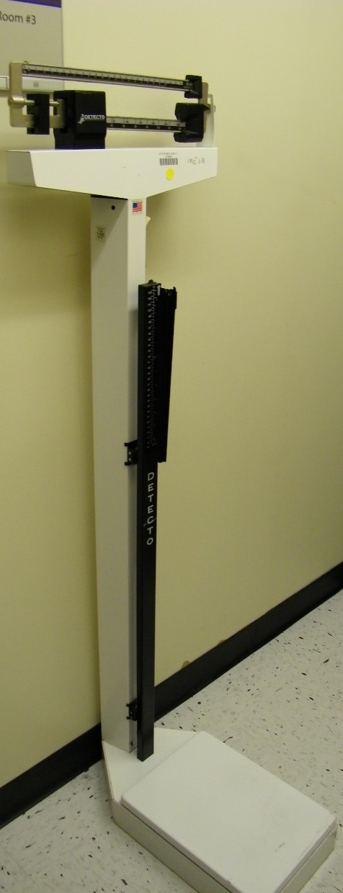
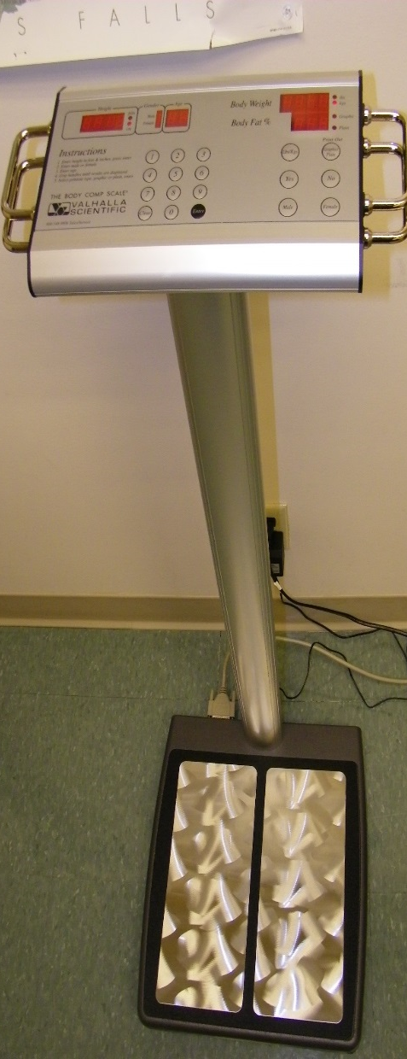
Stadiometer and Balance Beam Scale





Slide 5
Height Measurement
Eligible: All participants except those who have difficulties standing steady
Procedure:
Check the level bubble of the stadiometer
Have participant stand straight against the wall and feet together
Place the headboard over the crown of the head.
Record the result to the nearest 0.1 cm

Slide 6
Position for Height Measurement
Headboard over the crown
Eye-Ear Plane
Have participant stand
with her back to
the stadiometer
Arms at sides
Feet flat on the floor and
heels against to the wall
http://www.thl.fi/publications/ehrm/index.html

Slide 7
Height Measurement
Frankfort Plane
A plane passing through the inferior margin of the orbit (the bony socket containing the eye) and the most forward point in the supratragal notch (upper margin of the hole in the ear)

Slide 8
Weight Measurement
Eligible: All participants except those who have difficulties standing steady
Procedure:
Balance the scale with the indicator at zero
Have participant stand in the middle of the platform of the balance
Adjust the weight on the indicator until it is balanced (arrows aligned)
Record the result to the nearest 0.5 pounds

Slide 9
Weight Measurement
Always have the indicator of the scale at zero when no weight is on the scale
Participant should stand
in the middle of the
platform
http://www.thl.fi/publications/ehrm/index.html

Slide 10
Height and Weight Safety and Accurate Measuring
Some participants may have balance issues. Be sure you are prepared to steady them as they step up and down from the scale.
Participants can stand sideways on the scale if they are uncomfortable or unsafe facing forward.
As participants move out from under the stadiometer, watch to be sure they don’t bump the slider up as they step out.

Slide 11
Height and Weight Data Entry Screen

Slide 12
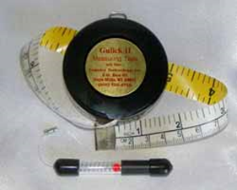
Girth Measurements
Gulick II anthropometric tape
Wall-mounted mirror

Slide 13
Waist and Hip Measurement
Check both the mirror and the part of the body facing you to ensure
that the tape is horizontal all the way around.
Measure
waist : at the level of the umbilicus
hip: at the maximum circumference of the buttocks
Round girth measurement to the nearest 0.1cm

Slide 14
Measurement Issues
For very large participants, it can be difficult to wrap the tape around the waist and hip. It is permissible to ask the participant to hold the end of the tape while you walk around him or her.
If the 150 cm tape is not adequate to measure a large participant, be sure to have the 250 cm tape handy so you can be sensitive about using the larger tape.
For consistency and standardization,
be sure the spring casing of the tape
shows just one red ball.

Slide 15
Girth Measurement Data Entry Screen

Slide 16
Recording Values
Enter values carefully – once the participant leaves, the numbers cannot be checked
The software will check values for plausibility and alert you of questionable values
To continue after an implausible value is detected, you can either confirm or correct the value

Slide 17
Quality Control
For a subset of participants (probably 5%), you will be asked to perform the measurements a second time (later in the visit).
The software will allow a second set of values to be entered for QC without overwriting the original values

Slide 18
Calibration Check
Balance scales:
monthly check using the 2 and 4 weights
2 Anthropometry tape measures :
weekly check for sign of wear

