Slide 1

MESA Sleep Apnea Genetics Update
Brian E Cade, PhD
Division of Sleep and Circadian Disorders
Brigham and Women's Hospital, Harvard Medical School
^{Boston, MA, USA}
Support: NIH/NHLBI (USA) R01 HL113338, T32 HL07901

Slide 2
Sleep Genetics Update
Sleep apnea genome-wide association study – Brian Cade
Apnea-Hypopnea Index (AHI – gasps per hour)
Average Oxygen Saturation in sleep
Sleep apnea rare variant gene-based analysis – Han Chen
Exome chip
AHI, Avg O2 Saturation, Average hypopnea length
Sleep duration – Type 2 diabetes interactions – Jackie Lane
Genetics and epigenetics
Analyses just started
Sleep apnea genetics and epigenetics – Richard Barfield
New technique (Xihong Lin et al) imputes epigenetic values
Proposal under development
Trainee Meeting 2/10/14

Slide 3
GWAS Overview
Obstructive sleep apnea is heritable
Apnea Hypopnea Index (AHI) Heritability: 0.37 (Cleveland Family Study)
60% of heritability is through BMI-independent pathways
AHI, a clinical measure, may be comprised of endophenotypes
AHI – Average O2 saturation r = 0.51
Sub-phenotypes may have distinct genetics
GWAS never performed on Average O2 saturation
Increased sample size should uncover new genetic signals
Largest OSA GWAS meta-analysis to date; additional cohorts being added
Trainee Meeting 2/10/14
Patel SR 2008 PMID: 18209735
Notes:
Obstructive sleep apnea as measured by the Apnea Hypopnea Index has been shown to be heritable through previous studies.
We know that a large portion of this heritability is through pathways independent of obesity.
In this current study, we would like to find additional genes that are associated with OSA. In my previous talk I identified other sleep disordered breathing phenotypes that are heritable, including average oxygen saturation across the sleep episode. These phenotypes may be sub-phenotypes that may describe distinct physiology with distinct genetic contributions. Average Oxygen Saturation is a promising phenotype based on heritability and a high correlation with the traditional Apnea Hypopnea Index measure. Furthermore, there has never been a genome-wide association study (or GWAS) performed on Average Oxygen Saturation.
We have assembled several cohort studies into the largest OSA genetic meta-analysis ever performed. Today I’d like to present our current results. This is a snapshot of our data as we continue to add studies to boost power.

Slide 4
GWAS Methods
Phenotypes: AHI, Average SaO2 (NREM, REM, and across night)
Rank-normal transformations
Adjusted for age, age², sex, age*sex, BMI, BMI², 10 population principal components
Genotypes: Imputed from 1000 Genomes Phase 1v3
MAF > 0.01 and 20 minor allele counts; Info > 0.88; HWE > 1 x 10-6
Analysis:
Linear regression using SNPTEST or family-based GWAF
Fixed effects meta-analysis within and across populations using METAL
Models without BMI adjustment not reported here
Trainee Meeting 2/10/14
Notes:
We performed a total of six genome-wide association studies, considering the AHI or average oxygen saturation across the night, within NREM and within REM.
We included multiple covariates including age, sex, BMI, and measures of population stratification. We used rank-normal transformations to ensure a normal distribution of phenotypes. This is very important for genetic analyses and is conservative in that it minimizes the variability contributed by individuals with extreme phenotypes.
Our study includes imputed SNPs based on a template of SNP patterns from the 1000 Genomes Project. This provides the most dense genetic screen ever attempted in a sleep genetic study. Imputed results have more power than gene chips alone to detect association signals and allow harmonization of results across studies. The quality threshold that we used is quite high relative to most imputed studies.
We used SNPTEST or GWAF to test for associations, and combined the results into a meta-analysis using METAL. Today we are only reporting BMI-adjusted results.

Slide 5
AHI Sample Size Split by Population
Cohort | Description | AA n (AHI) | AsA | EA | HA
ARIC | Atherosclerosis Risk In Communities |  |  | 1,463
CFS* | Cleveland Family Study | 679
FHS | Framingham Heart Study |  |  | 646
MESA | Multi-Ethnic Study of Atherosclerosis | 488 | 228 | 708 | 459
HCHS | Hispanic Community Health Study / Study of Latinos |  |  |  | 11,317
MrOS | Osteoporotic Fractures in Men |  |  | 2,211
Starr County* | Starr County Health Studies |  |  |  | 622
Total |  | 1,167 | 228 | 5,028 | 12,398
Max n with 1000G imputed genotypes = 18,821
Lower n for NREM/REM analyses
*: Additional samples pending
Collection: At home, except for a subset of CFS from laboratory visit
Notes:
Here are our sample sizes for seven assembled cohorts.
This is a multiple population analysis of African-Americans, Asian-Americans, European-Americans, and Hispanic Americans. We are reporting results from a maximum of over 18,000 people for the AHI. Other phenotypes and sleep stage-specific analyses will have smaller sample sizes due to differences in collection devices. All phenotypes were centrally scored using standardized criteria by the Sleep Reading Center at Brigham and Women’s Hospital
Analysis is still in progress, and we expect to boost our sample size to nearly 20,000 individuals next month.

Slide 6
Subject Characteristics Across Cohorts
Cohort | %F | Median Age (IQR) | Mean BMI (SD) | Apnea Hypopnea Index (SD) | Sleep O2 Saturation (SD) | SNPs*
ARIC EA | 51.5 | 62 (9) | 28.8 (5.1) | 14.1 (15.5) | 94.5 (2.0) | 6,876,198
FHS EA | 50.0 | 59 (14.5) | 28.5 (5.0) | 12.9 (14.7) | 94.7 (2.0) | 7,606,134
MESA EA | 53.4 | 67 (14) | 28.0 (5.2) | 18.7 (18.1) | 94.0 (1.7) | 6,416,814
MrOS EA | 0.0 | 76 (9) | 27.2 (3.7) | 17.3 (15.5) | 93.8 (1.7) | 7,297,760
HCHS HA | 60.0 | 47 (20) | 29.7 (6.0) | 6.4 (12.2) | 96.4 (1.0) | 10,724,327
MESA HA | 52.9 | 68 (14.5) | 30.1 (5.5) | 22.0 (18.8) | 94.3 (1.6) | 6,580,255
Starr HA | 72.9 | 52 (15) | 32.0 (6.9) | 19.8 (16.2) | 94.6 (2.2) | 5,776,344
CFS AA | 57.1 | 39 (30.7) | 31.7 (9.7) | 17.8 (27.0) | 94.6 (3.8) | 10,811,400
MESA AA | 54.3 | 68 (14) | 30.4 (5.7) | 19.9 (19.7) | 94.4 (2.0) | 8,384,132
MESA AsA | 50.4 | 68 (16) | 24.1 (3.2) | 19.8 (18.1) | 95.0 (1.2) | 4,834,395
*: SNPs after 1000G imputation quality control and MAF filters
Notes:
Here are our subject characteristics across cohorts. There are a range of gender percentages and ages across cohorts.
MrOS was a male-only cohort. The Cleveland Family Study was younger.
The AHI and average oxygen saturation were generally similar across cohorts, though the Hispanic Community Health Study had a lower AHI.
The SNPs column lists the number of successfully imputed SNPs for each cohort. Some of our results will be missing if an individual cohort did not have a SNP that had good enough imputation quality or high enough minor allele frequency.

Slide 7
Top Signals: AHI
Model | SNP | Chr:Gene | P | Effect (SE) | Direction | N | CAF | Info
All Sleep
All | rs1387259 | 12:48,703,522* | 4.45 x 10-7 | 0.057 (0.01) | ?++++?+-++ | 17,509 | 0.06 – 0.34 | 0.99 - 1
NREM Sleep
All | rs36086495 | 9:RFX3 | 6.52 x 10-7 | -0.204 (0.041) | ??-?---- | 5,436 | 0.03 – 0.06 | 0.96 - 1
REM Sleep
AA | rs62083355 | 18:35,738,597** | 5.58 x 10-8 | 0.2909 (0.05) | ++ | 820 | 0.19 | 0.91 – 0.94
Significance threshold: p < 5 x 10-8, Direction = Individual Cohort Effects
24 regions associated at p < 1 x 10-6 (1 MB minimal gap)
Closest genes: *H1FNT, **CELF4
Trainee Meeting 2/10/14
Notes:
Here are our top results for the AHI. We use a traditional significance cutoff of p under 5 x 10-8. There was one region for AHI within REM for African Americans that just missed significance. We have two additional African-American cohorts that we plan to add, which may improve the p-value of this result.
There are also over twenty suggestive regions that we identified at a p-value under 1 x 10-6. Some of these signals may reach significant levels with improved sample size.
I should also point out that analyses from last week indicated a significant result for Hispanic Americans at 10-9 levels. We are currently verifying these results.

Slide 8
Top Signals: Average O2 Saturation
Model | SNP | Chr:Gene | P | Effect (SE) | Direction | N | CAF | Info
All Sleep
AA | rs528937 | 3:TFRC | 1.94 x 10-8 | 0.2496 (0.04) | ++ | 1,156 | 0.20 | 0.90 – 0.97
All | rs2732462* | 12:48,696,384 | 2.41 x 10-8 | -0.0612 (0.01) | ?-+----+-- | 18,549 | 0.65 – 0.87 | 0.97 – 1.0
All | rs994831 | 4:PRDM5 | 4.65 x 10-8 | 0.1698 (0.03) | +++?+?++++ | 6,799 | 0.86 – 0.96 | 0.98 – 1.0
EA | rs72805692 | 10:HK1 | 5.55 x 10-8 | -0.1626 (0.03) | ---- | 4,957 | 0.89 – 0.91 | 0.96 – 1.0
NREM Sleep
EA | rs72805692 | 10:HK1 | 4.21 x 10-8 | -0.1661 (0.03) | ---- | 4,954 | 0.89 – 0.90 | 0.96 – 1.0
All | rs4833688 | 4:PRDM5 | 8.22 x 10-8 | -0.1743 (0.03) | -------- | 6,495 | 0.04 – 0.13 | 0.95 – 1.0
REM Sleep
All | rs72680432 | 4:PRDM5 | 1.46 x 10-7 | 0.1659 (0.03) | ++++++++ | 6,421 | 0.04 – 0.13 | 0.96 - 1
Significance threshold: p < 5 x 10-8 , Direction = Individual Cohort Effects
31 regions associated at p < 1 x 10-6 (1 MB minimal gap)
*: >250kb region includes ZNF641, with significant O2 hit and 5x10-7 AHI hit
Trainee Meeting 2/10/14
Notes:
For average oxygen saturation, we detected four significant regions, including three for average oxygen across the night, and one for NREM average oxygen. As I will show, many of these significant regions also have strong p-values for the AHI.
Many of the top NREM and REM-specific results were also found for all-night results.
We detected 31 suggestive regions. There were stronger results for average oxygen saturation versus AHI, both in terms of significant and suggestive results.

Slide 9
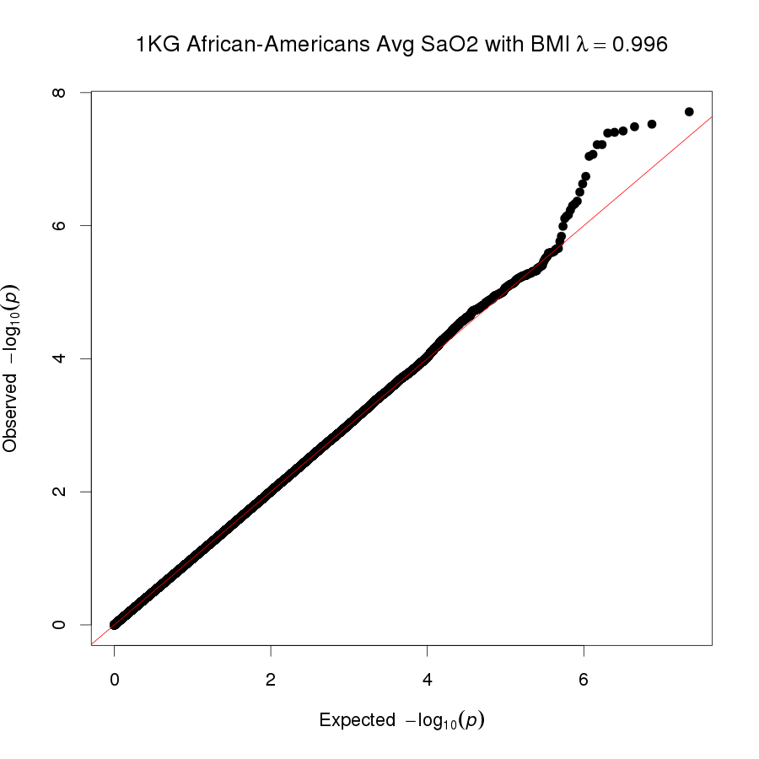
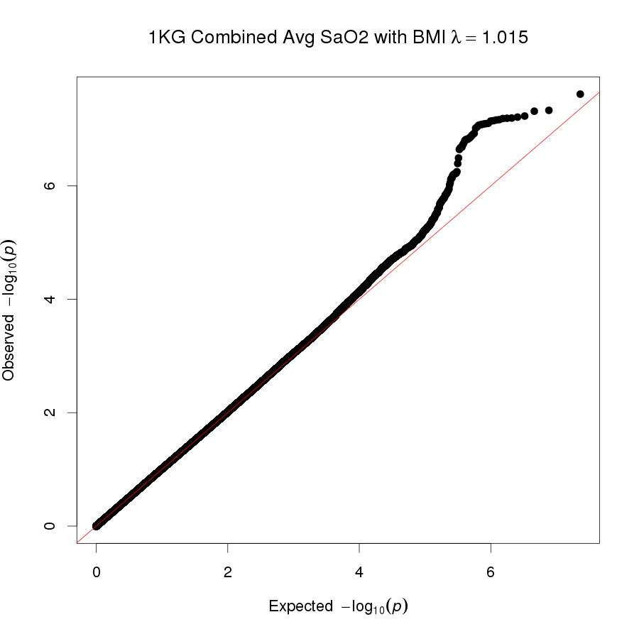
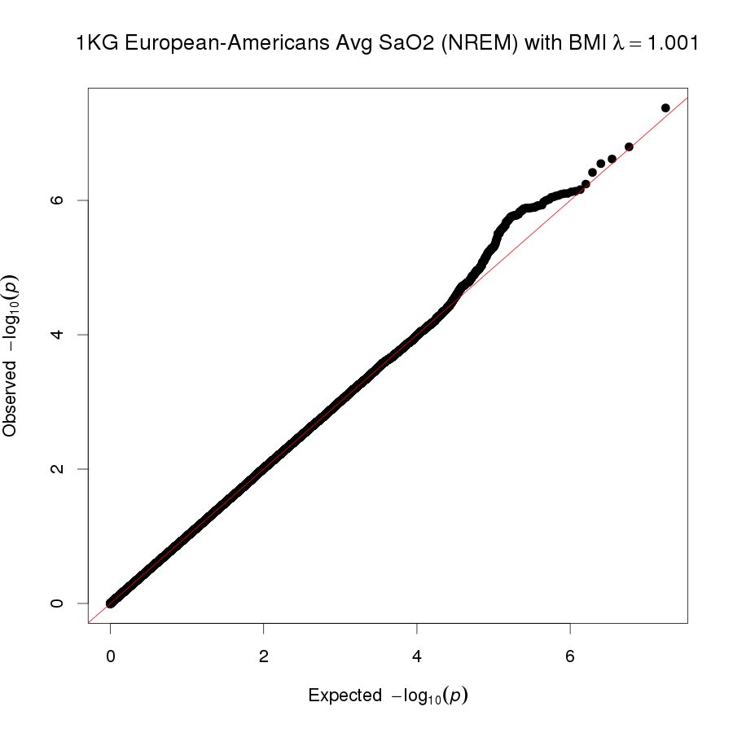
Significant Result QQ (QC) Plots
Population stratification methods: 10 principal components and genomic control
Trainee Meeting 2/10/14
Notes:
Here are our QQ plots for significant results. If you have never seen a QQ plot, essentially it is a quality control measure looking at the expected versus observed p-values.
Ideally, these values should be the same for most of the plot, with a spike up on the upper left. These plots show that are significant results are not likely to be due to artifacts such as population differences. We used two methods to control for population differences: a principal components measure, followed by genomic control which further corrects population differences.

Slide 10
Genes at Loci of Interest
HK1: Hexokinase 1 (glucose metabolism)
Implicated in red blood cell and HbA1c GWAS
PMIDs: 19862010, 23222517, 20858683, 24405752
PRDM5: PR Domain Containing 5 (transcription factor)
Craniofacial/extracellular matrix development, collagen gene transcription, hematopoiesis
PMIDs: 22589746, 23109401, 17636019
TFRC: Transferrin Receptor (cellular iron uptake)
Multiple red blood cell GWAS, up-regulated by HIF1A and GATA1 during hypoxia
PMIDs: 19862010, 23222517, 22050843
Trainee Meeting 2/10/14
Notes:
There are three genes of interest directly within our significant regions. Our fourth significant region spanned a wide region with multiple genes.
Hexokinase 1 is involved with glucose metabolism. It has been particularly important in studies of red blood cell traits and hemoglobin A1C levels, which is a measure associated with diabetes risk.
PRDM5 is a transcription factor that has been associated with craniofacial and extra-cellular matrix development. It is also related to collagen gene transcription.
Like HK1, TFRC has been associated with multiple red blood cell traits. There are established links with hypoxia.
I will highlight HK1 and TFRC, which appear to have promising epigenetic results that may support our findings

Slide 11
GWAS Summary
Combining data from 7 cohorts, across populations, with standardly scored research quality sleep studies, we identified:
Several novel GWAS significant signals for two traits associated with sleep disordered breathing: AHI and nocturnal saturation
Promising craniofacial, development, and hemoglobin pathways identified
Replication in independent cohorts required
Analyses show promise of using multi-population cohorts and analyzing phenotypes other than AHI
More genome significant regions for oxygen saturation
Preliminary multivariate analyses suggest improved power
Trainee Meeting 2/10/14
Notes:
In summary, we have reported the largest genetic study of OSA reported to date. We have measured AHI and average oxygen saturation and have identify multiple genome-wide significant regions.
We have highlighted promising craniofacial, development, and hemoglobin-related pathways.
We have reported only BMI-adjusted results. Past analyses without adjusting for BMI indicate additional regions that are likely to be genome significant.
We found more significant and suggestive results for Average Oxygen Saturation
We are including additional cohorts in the near future, which will improve power and possibly identify additional significant regions.

Slide 12
Gene-Based Meta-Analysis (SKAT)
Rationale
Gene tests can aggregate strong rare variant effects
  Severity of SNP mutations (functional weights) could improve analyses
Methodology
SKAT-O meta-analysis (Lee et al., AJHG 2013)
  Use exome chip data from MESA (226 AsA, 461 AfA, 456 HA, 701 EA)
  Assign the highest weight (1) to frameshift, stop and splice SNPs; for other SNPs, use Polyphen score or 1 – SIFT score as the weight
  Allow heterogeneous genetic effects across ethnicities
  Exclude genes with 0 or 1 SNP: 15,498 – 15,767 genes with results, depending on traits
Trainee Meeting 2/10/14
Notes:
I was highlighting interesting genes with at least 2 p-values < 1e-5, but they are not necessarily significant. A Bonferroni correction would be 0.05 / 15000 (number of genes tested) / 9 (number of traits) / 2 (with and without BMI) / 2 (Polyphen and SIFT weights) / 5 (4 ethnic groups and 1 meta-analysis) = 1.85e-8 and no gene would really be significant.

Slide 13
Gene | Chr | N SNP | Weight | Trait | BMI-adj | AsA P | AfA P | HA P | EA P | Meta P
OMA1 | 1 | 19 | Polyphen | Avg O2 Sat | No | 0.50 | 0.032 | 0.48 | 1.3e-6 | 0.0030
 |  |  | Polyphen | Avg O2 Sat | Yes | 0.61 | 0.048 | 0.59 | 3.9e-6 | 0.0061
 |  |  | Polyphen | Avg O2 Sat NREM | No | 0.38 | 0.028 | 0.63 | 8.0e-7 | 0.0029
 |  |  | Polyphen | Avg O2 Sat NREM | Yes | 0.44 | 0.033 | 0.69 | 2.6e-6 | 0.0054
MUC13 | 3 | 10 | SIFT | Avg Hyp Len | Yes | 0.43 | 0.34 | 0.18 | 6.7e-6 | 1.4e-5
 |  |  | SIFT | Avg Hyp Len NREM | Yes | 0.54 | 0.18 | 0.21 | 5.1e-6 | 9.8e-6
KIAA0895 | 7 | 9 | Polyphen | AHI NREM | No | 0.11 | 0.12 | 3.1e-6 | 0.34 | 1.1e-4
 |  |  | SIFT | AHI NREM | No | 0.11 | 0.15 | 3.2e-6 | 0.33 | 1.1e-4
OR5A2 | 11 | 6 | Polyphen | AHI NREM | Yes | 0.24 | 0.63 | 0.014 | 2.9e-5 | 5.2e-6
 |  |  | SIFT | AHI NREM | Yes | 0.21 | 0.54 | 0.013 | 3.0e-5 | 4.1e-6

Slide 14
Gene | Chr | N SNP | Weight | Trait | BMI-adj | AsA P | AfA P | HA P | EA P | Meta P
EOGT | 3 | 10 | Polyphen | Avg O2 Sat | No | 0.25 | 0.020 | 4.1e-4 | 0.36 | 1.1e-5
 |  |  | Polyphen | Avg O2 Sat | Yes | 0.19 | 0.094 | 7.7e-4 | 0.67 | 9.5e-5
 |  |  | Polyphen | Avg O2 Sat NREM | No | 0.19 | 0.020 | 0.0014 | 0.52 | 4.5e-5
 |  |  | Polyphen | Avg O2 Sat REM | No | 0.97 | 0.060 | 0.0012 | 0.091 | 9.5e-5
 |  |  | SIFT | Avg O2 Sat | No | 0.25 | 0.0021 | 2.0e-4 | 0.23 | 2.6e-7
 |  |  | SIFT | Avg O2 Sat | Yes | 0.19 | 0.0089 | 4.3e-4 | 0.52 | 5.4e-6
 |  |  | SIFT | Avg O2 Sat NREM | No | 0.19 | 0.0033 | 8.0e-4 | 0.34 | 2.2e-6
 |  |  | SIFT | Avg O2 Sat NREM | Yes | 0.14 | 0.012 | 0.0016 | 0.67 | 3.4e-5
 |  |  | SIFT | Avg O2 Sat REM | No | 0.97 | 0.0048 | 7.8e-4 | 0.057 | 3.7e-6
 |  |  | SIFT | Avg O2 Sat REM | Yes | 0.87 | 0.019 | 0.0017 | 0.17 | 5.3e-5

Slide 15
Sleep Timing – T2D Interactions
Primary Hypothesis
Common and rare genetic variants affect sleep timing and type 2 diabetes (T2D), suggesting pleiotropic effects of these variants on the complex traits of sleep timing and T2D.
Aims
Aim 1: Genetic Variation jointly associated with sleep timing & diabetes
Do genetic variants jointly associate with sleep timing and diabetes?
Do the jointly associated genetic variants drive differential gene expression in PBMCs?
Aim 2: Is sleep timing a sensitizing environment for genetic effects on diabetes?
Sleep Timing
(self report, actigraphy, polysomnography)
SNP Risk Score
(known diabetes SNPs)
Diabetes Outcomes
(cases, fasting blood glucose, HBA1C, fasting insulin)
Trainee Meeting 2/10/14

Slide 16
Next Steps
Final cohorts being added to Average O2 GWAS (n ~ 20,000).
` First manuscript, followed by AHI GWAS
New cohorts being added to gene tests: ARIC, CFS, Starr County
Gene results will likely lead to pathway analysis proposal
T2D Interactions: Just starting
Multivariate analysis methods development in progress (Xiaofeng Zhu, Case Western)
Preliminary work suggests improved GWAS results
Trainee Meeting 2/10/14

Slide 17
Phenotype Relationships
AHI – Average O2: r = -0.51, p = “0”
Phenotype | AHI r (p) | Avg O2 Saturation r (p)
FEV1 | 0.113 ("0") | -0.001 (0.956)
FEV1 %predicted | -0.147 (1.41 x 10-23) | 0.231 ("0")
FEV1/FVC | 0.042 (0.002) | 0.097 (3.21 x 10-12)
FEV1/FVC %predicted | 0.153 ("0") | 0.039 (0.026)
FVC | 0.106 (1.20 x 10-14) | 0.000 (0.991)
FVC %predicted | -0.246 (5.61 x 10-64) | 0.27 ("0")
Waking O2 Saturation | -0.201 (1.10 x 10-47) | 0.404 ("0")
Notes:
17

Slide 18
Proposal Title: Genetic and epigenetic relationships between sleep timing and type 2 diabetes in The Multi-Ethnic Study of Atherosclerosis (MESA)
Author List: Lead Author: Jacqueline M. Lane (Massachusetts General Hospital)
Coauthors: Richa Saxena (Massachusetts General Hospital), Xihong Lin (Harvard School of Public Health), Susan Redline, Brian Cade, Andrew Bjonnes, Sanjay Patel, Shamil Sunyaev (Brigham and Women's Hospital), Naresh Punjabi (Johns Hopkins), Xiaofeng Zhu (Case Western Reserve University), Yongmei Liu, Russell Tracy, Suzette Bielinski, Christina Wassel, Joel Kaufman, Ida Chen, Phyllis C. Zee, MD, PhD, Xiuguing Guo, and other nominated MESA investigators. This proposal is part of a larger meta-analysis with sub-analyses and/or methods development performed by all of our proposed coauthors. We will also invite interested investigators from all meta-analysis cohorts to participate in regular analysis teleconferences and ultimately as coauthors.

Slide 19
Rationale and Background
Variation in sleep timing, a marker of circadian phase, associates with T2D
  in laboratory studies of healthy subjects and in studies of shift-workers, circadian misalignment leads to:
    Increased insulin resistance
    Increased risk of T2D
  Mouse models bearing gene disruptions in core circadian clock components show hyperglycemia, hypoinsulinemia, suppression of diurnal glucose variation, and ablation of gluconeogenesis
  These studies demonstrate the interplay between sleep timing and T2D, and suggest a potential shared genetic basis supporting the need to determine shared heritability and genetic variation.

Slide 20
Preliminary Data in Sleep Heart Health Study
Study: NHLBI Sleep Heart Health Study (n=4,600 whites) genotyped on the IBC gene-centric array (n~50,000 SNPs)
Tested relationship between self-reported sleep timing and T2D
Examined genetics of sleep timing in diabetics and non-diabetics separately (stratified analysis)

Slide 21
Preliminary Data in Sleep Heart Health Study
FINDINGS - ODDS OF TYPE 2 DIABETES

Slide 22
Preliminary Data in Sleep Heart Health Study
FINDINGS - Genetic variants associate with sleep timing

Slide 23
This project will provide an opportunity to combine data from several sources of sleep, epigenetic and genotype data to quantify shared heritability, discover, and replicate shared genetic variants for sleep timing and diabetes in whites and extend our findings to blacks, Hispanics, and Asians

Slide 24
Aim 1: Genetic Variation jointly associated
with sleep timing & diabetes
Aim 1a
Do genetic variants jointly associate with sleep timing and diabetes ?
Sleep Timing
SNP
+
Diabetes
Aim 1b
Do the jointly associated genetic variants drive differential gene expression in PBMCs?
Sleep Timing
Gene Expression (eQTLs)
SNP
+
Diabetes
Uses MESA exam 5 ancillary sleep data, main exam 5 data, affy/metabochip genotyping, and PBMC expression chip
Notes:
When we say diabetes, we are testing case/control type 2 diabetes, as well as fasting blood glucose, HBA1C and fasting insulin in non-diabetics

Slide 25
Aim 2: Is sleep timing a sensitizing environment
for genetic effects on diabetes?
Sleep Timing
(self report, actigraphy, polysomnography)
Aim 2
SNP Risk Score
(known diabetes SNPs)
Diabetes Outcomes
(cases, fasting blood glucose, HBA1C, fasting insulin)
Uses MESA exam 5 ancillary sleep data, main exam 5 data, affy/metabochip genotyping, and PBMC expression chip
Notes:
When we say diabetes, we are testing case/control type 2 diabetes, as well as fasting blood glucose, HBA1C and fasting insulin in non-diabetics

Slide 26
Approach: Gene x Objective Sleep Timing interactions
Interaction testing using actigraphy and diabetes case/control
Sleep Timing
(actigraphy)
Aim 2
Single SNPs
(65 known T2D SNPs)
T2D
(case/control)
75 cases/665 controls
Sample Size: 665 whites (75 T2D cases)
Logistic regression with interaction term performed in Plink
Covariates: Age, gender, and body mass index
Exclusions: Shift workers, low quality actigraphy measures
(Data from MESA Exam 5)
Notes:
When we say diabetes, we are testing case/control type 2 diabetes, as well as fasting blood glucose, HBA1C and fasting insulin in non-diabetics

Slide 27
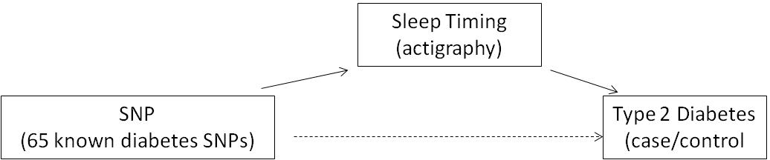
MESA results
Gene x Actigraphy Sleep Timing interactions in T2D
Sleep Timing | Day | Chr | SNP | Gene | Allele | N | Int. OR (95%CI) | Int. p-val
Wake Time | Weekly | 3 | rs11706322 | IGF2BP2 | C | 616 | 1.20 (1.05-1.36) | 0.0062
 | Weekday | 3 | rs11706322 | IGF2BP2 | C | 616 | 1.17 (1.03-1.33) | 0.015
 | Weekend | 3 | rs11706322 | IGF2BP2 | C | 616 | 1.17 (1.05-1.31) | 0.0041
MESA visit 5 white subjects. Int. = interaction. Logistic regression model adjusting for age, gender, and BMI.
Note: this result does not meet threshold for statistical significance after multiple correction testing (P= .0008) in MESA whites
Notes:
When we say diabetes, we are testing case/control type 2 diabetes, as well as fasting blood glucose, HBA1C and fasting insulin in non-diabetics

Slide 28
Next Steps
Aim 1:
  T2D+Sleep Timing GWAS in MESA (waiting for Affy data with MESA IDs)
Aim 2:
  T2D genetic risk scores x Sleep Timing interactions
    Actigraphy, PSG, and self-report
    Diabetes case, FBG, HbA1c, and insulin
  Multiethnic analysis
Meta-analysis of association and interaction results with other cohorts (N>5,000 whites; N>25,000 multi-ethnic)
Notes:
When we say diabetes, we are testing case/control type 2 diabetes, as well as fasting blood glucose, HBA1C and fasting insulin in non-diabetics

Slide 29
HK1
Top hit: rs72805692
EA Average SaO2 (NREM) p = 4.7 x 10-8
AHI (NREM) p = 5.6 x 10-5
Overlaps enhancer histone marks in 78 ENCODE/Roadmap cell lines, 8 promoter histone mark cell lines, and 8 bound proteins
rs17476364: Top HK1 HbA1c hit GWAS*
All-population Avg SaO2 (NREM) p = 3.2 x 10-7
AHI (NREM) p = 9.5 x 10-6
Overlaps enhancer histone marks in 79 ENCODE/Roadmap cell lines
*: PMID 24405752
Notes:
Our top hit for HK1 was found for European American Average Oxygen within NREM. Notably the AHI within NREM has a strong p-value as well at 10-5.
This SNP overlaps epigenetic evidence from the ENCODE and Roadmap Epigenetics studies. 78 cell lines have an enhancer that overlaps our top SNP. There are also cell lines with overlapping promoters and bound proteins. It is thus possible that this SNP or another nearby SNP may be interfering with enhancers and changing gene expression.
A nearby SNP was the top GWAS result for hemoglobin A1C levels, which raises the likelihood that it is associated with actual changes and isn’t a false positive. This SNP has an even stronger AHI p-value, at 10-6. It overlaps enhancers found in 79 cell lines. Recall from my earlier presentation that a high portion of average oxygen saturation heritability is from enhancer regions such as the one found here.

Slide 30
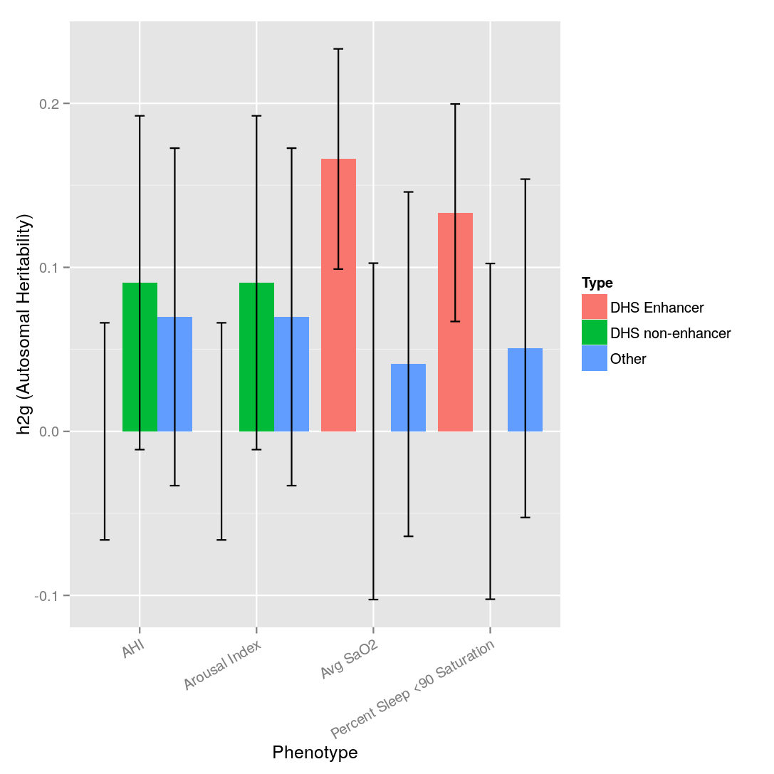
Enriched Enhancers for Average O2 Sat
Dnase I Hypersensitivity Site (DHS): open DNA where proteins bind
SNP Fractions: Enhancers 4%; DNase I non-enhancers 6%; Other: 90%
SNPs pre-thinned (r² < 0.33) to minimize overlap
Trainee Meeting 2/10/14
Notes:
30
But one interesting result that we found using GCTA was differences in heritability for regulatory regions in some phenotypes.
Here we break down heritability estimates for each phenotype into enhancers in red, regulatory regions that weren’t enhancers in green, and all other regions in blue.
Our SNPs were in enhancer regions only 4% of the time, and in non-regulatory regions 90% of the time. If the regions were contributing equally, we would expect that the non-regulatory regions would have proportionally higher results. This is the case in many GCTA findings separated by chromosomes, where the heritability of each chromosome is proportional to its length.
But here I’d like to emphasize the average oxygen saturation heritability explained by SNPs in enhancer regions. We found a four-fold increase in heritability relative to non-regulatory DNA, despite the small fraction of SNPs found in enhancer regions.
Despite 4,000 people, our sample size leads to high error bars. But even assuming equal point estimates, there is still a 20-fold heritability enrichment after accounting for the number of SNPs tested. Overall, this suggests that we should focus future efforts on studying common frequency SNPs found in enhancers for average oxygen saturation

Slide 31
Background
Obstructive sleep apnea is heritable
Apnea Hypopnea Index (AHI) Heritability: 0.37 (Cleveland Family Study)
AHI, a clinical measure, may be comprised of endophenotypes
Phenotypes with higher heritability can be prioritized for genetic analysis
Can combinations of phenotypes better describe OSA?
Oksenberg APSS Poster 366: Apnea-Hypopnea Duration / TST: ≥ correlation with multiple sleepiness measures vs AHI
Genome-wide association studies (GWAS) explain a fraction of expected heritability
“Missing heritability” problem- can we expect common OSA variants?
Height: <10% heritability explained by GWAS, raised to 45% using all- genome technique GCTA (Genome-Wide Complex Trait Analysis)
Trainee Meeting 2/10/14
Patel SR (2008), Yang J (2010) PMIDs: 18209735, 20562875
Notes:
31
The Cleveland Family Study has established a heritability for the AHI.
The Apnea Hypopnea Index is a readily available clinical summary measure. But as we proceed with genetic studies of OSA, perhaps there are more specific phenotypes that are closer to the physiology and hence the genetics of OSA. For instance a low AHI could include long hypopnea lengths and a high AHI could include short hypopnea lengths, which may have different clinical outcomes.
As we move forward, we can ask: are there other OSA traits with high heritability in families? Maybe these phenotypes should be prioritized for analysis. Also, is it possible to extend family heritability analyses into non-family studies?
GCTA is increasingly being used for non-family studies. We can use this method to estimate the heritability contributions of common mutations (as opposed to rare variants), even above those detectable in genome-wide assocation studies using the current modest sample sizes available for PSG-related phenotypes. Past work with height has estabished that common variants are responsible for 45% of height heritability, despite well-powered association studies explaining only 10% of overall heritability.

Slide 32
Aims
Quantify heritability of sleep disordered breathing related traits
Examine novel sleep disordered breathing phenotypes in Cleveland Family Study (CFS)
Transferability of heritability estimates into non-family cohorts
Determine which phenotypes should be prioritized for genetic study
Quantify phenotype heritability from regulatory DNA regions
Most GWAS signals are from regulatory DNA, not protein mutations*
DNase I Hypersensitivity Site (DHS): open DNA where proteins bind
Promoter: Near start of gene
Enhancer: Need not be close to gene, affects expression levels
Trainee Meeting 2/10/14
*Maurano MT (2012) PMID: 22955828
Notes:
32
So the aims of our study were to first quantify the heritability of sleep disordered breathing using novel traits in a family study.
We then wanted to measure if these traits are also heritable in non-family studies using GCTA.
By measuring overall heritabilty, our goal was to prioritize which phenotypes should be studied genetically.
Finally, recent studies have established that many genome-significant associations are explained by regulatory DNA and not protein mutations.
By this I mean regions of open DNA where proteins bind. This binding will affect the expression levels of the gene transcript.
A recent finding by Alkes Price and colleagues has used GCTA. They found that enhancers that affect gene expression levels explain a large portion of heritability for multiple phenotypes, despite occupying a small fraction of the overall DNA length.
We wanted to test the Price lab findings on our sleep disordered breathing phenotypes

Slide 33
Methods
Phenotype Models:
Rank-normal transformations on CFS (family) or combined 3-cohort sample (population)
Adjusted for age, age², sex, age*sex, BMI, BMI², 10 population principal components, study variable
Population Genotypes: Imputed from 1000 Genomes Phase 1v3
MAF > 0.01; Info > 0.95; HWE > 1 x 10-6; thinned r² 0.33; autosomal SNPs as discrete alleles
Functional annotations from Gusev 2014 BioRxiv doi:10.1101/004309
Family-based Heritability: MERLIN
Used thinned IBC chip markers
Population-based Heritability: GCTA
Fits all SNPs as random effects in a mixed linear model
Standard parameters, <0.025 relatedness
Trainee Meeting 2/10/14
Notes:
33
Briefly, here are our methods. For all phenotypes, we adjusted for multiple covariates including age, sex, BMI, and population structure.
We used a rank-normal transformation to account for the high skew of certain phenotypes like the AHI. This is a conservative measure to ensure a normal distribution, which is very important for genetic tests, at the loss of signal from extreme phenotype individuals.
For our population cohorts, we used genotypes that were imputed using 1000 Genomes data. These SNPs were then thinned to ensure that linkage disequillibrium between SNPs did not over-inflate the heritability estimates.
To measure the contribution of regulatory DNA, we used the functional annotation locations from the Price lab, which are available online. Each SNP was then assigned as being located in an enhancer, other regulatory DNA, or non-regulatory DNA region.
We used standard techniques for family heritability estimates
Our population based estimates used GCTA with standard parameters. We combined three studies to improve our sample size, using study as an additional covariate. This was the recommendation of the GCTA author as preferable to running a meta-analysis.

Slide 34
Subject Characteristics Across Cohorts
Cohort | AHI n | %F | Median Age (IQR) | Mean BMI (SD) | Apnea Hypopnea Index (SD) | Sleep O2 Saturation (SD) | Apnea Hypopnea Length (SD)
ARIC EA | 1,463 | 51.5 | 62 (9) | 28.8 (5.1) | 14.1 (15.5) | 94.5 (2.0) | 23.7 (6.6)
MESA EA | 708 | 53.4 | 67 (14) | 28.0 (5.2) | 18.7 (18.1) | 94.0 (1.7) | 21.6 (5.5)
MrOS EA | 2,211 | 0.0 | 76 (9) | 27.2 (3.7) | 17.3 (15.5) | 93.8 (1.7) | 26.9 (6.9)
CFS AA | 639 | 57.1 | 39 (31) | 31.7 (9.7) | 17.8 (27.0) | 94.6 (3.8) | 20.3 (5.6)
CFS EA | 665 | 52.8 | 42 (31) | 30.0 (8.6) | 15.5 (23.5) | 93.8 (3.6) | 20.6 (6.2)
Combined ARIC + MESA + MrOS n: 4,382
ARIC: Atherosclerosis Risk In Communities
MESA: Multi-Ethnic Study of Atherosclerosis
MrOS: Osteoporotic Fractures in Men
CFS: Cleveland Family Study
PMIDs: ARIC 22955828, MESA 12397006, MrOS 16084776, CFS 20538960
Notes:
34
Here are our subject characteristics across cohorts. Our three NHLBI population cohorts were ARIC, MESA, and MrOS. We studied only European Americans to minimize possible population differences. The overall sample size for population-based AHI was approximately 4,400 individuals.
Next we have our Cleveland Family characteristics. These individuals were younger than the other cohorts, and had slightly higher BMIs.

Slide 35
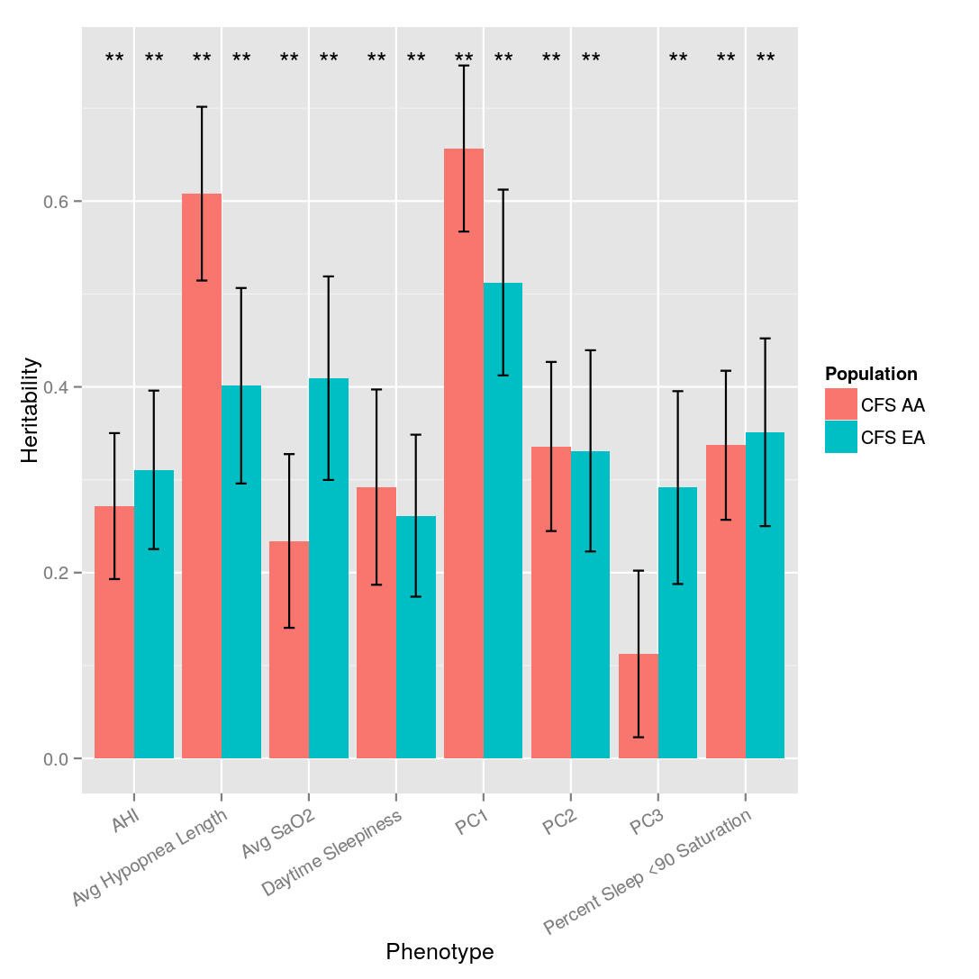
Family-based Heritability
Principal Components 1-3: Maximize Heritability (Ott J 1989 PMID:10077732)
PC loadings (5 traits plus snoring):
 | Trait | PC1 | PC2 | PC3
AA | AHI | -0.35 | -0.15 | -0.43
 | Hyp Length | 0.91 | -0.25 | -0.13
 | Day Sleepy | -0.0002 | 0.63 | -0.33
 | % Sleep <90 | -0.01 | -0.42 | 0.47
 | Snoring | 0.21 | 0.46 | 0.69
 | Avg O2 | -0.05 | 0.37 | 0.09
EA | AHI | -0.29 | 0.28 | -0.45
 | Hyp Length | 0.84 | -0.05 | -0.14
 | Day Sleepy | -0.007 | 0.54 | -0.07
 | % Sleep <90 | -0.28 | -0.46 | -0.64
 | Snoring | -0.06 | 0.46 | -0.56
 | Avg O2 | -0.37 | 0.46 | 0.23
Trainee Meeting 2/10/14
*: p < 0.05, **: p < 0.01
Notes:
35
Moving to results, here are our family-based estimates. African-American estimates are in red, followed for each phenotype by European-American estimates.
As expected, AHI was heritable in both groups. But we found higher heritability for some of the other phenotypes that we tested, notably the average hypopnea length for African-Americans. In European-Americans we noted a higher heritabilty estimate for the average oxygen saturation across the sleep episode.
We also combined the five phenotypes shown using a method developed by Ott and colleagues that maximizes heritability for principal components. The thinking here was that individual phenotypes that are commonly measured may not be as powerful in describing OSA as hidden measures that we are not capturing.
The principal component loadings are shown on the right. Principal component 1 is largely comprised of the hypopnea length, with notable contributions of AHI in both groups.

Slide 36
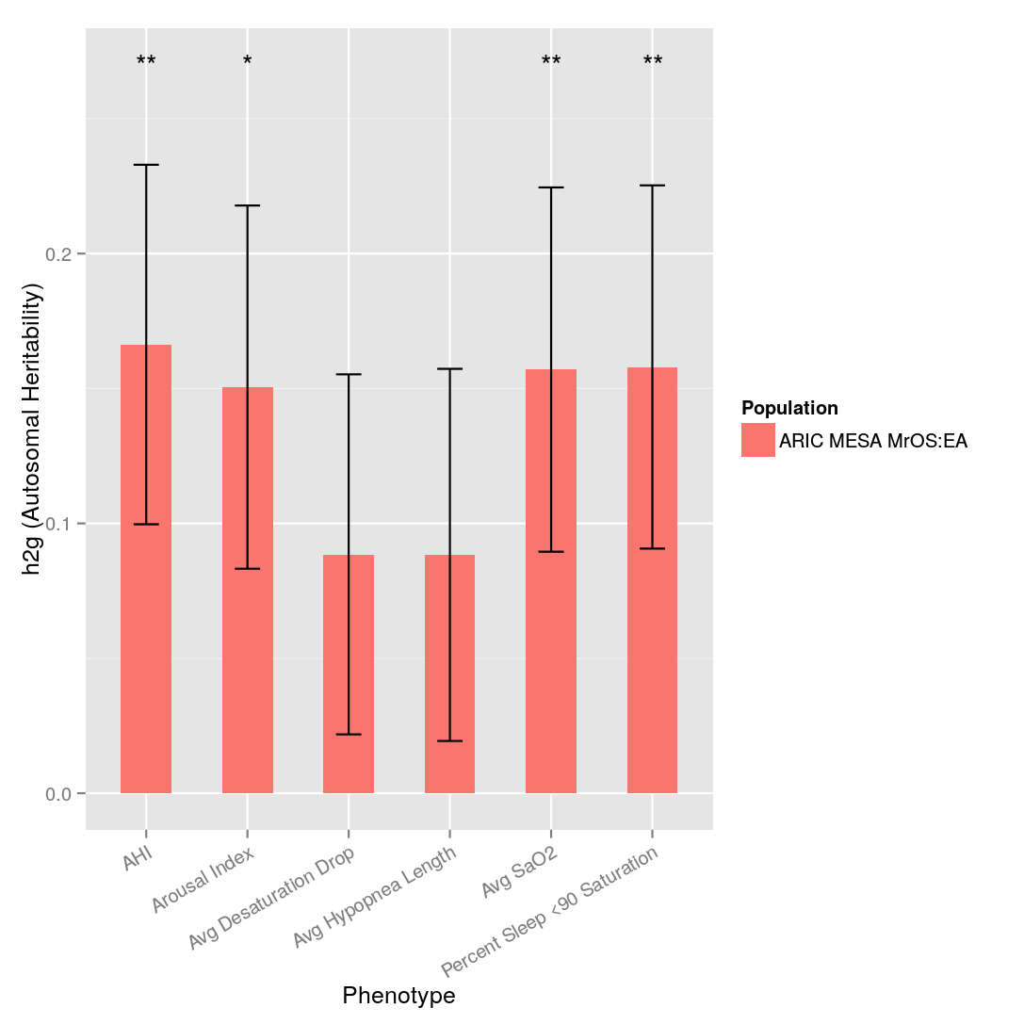
Population-based Heritability
Trainee Meeting 2/10/14
*: p < 0.05, **: p < 0.01
Notes:
36
Next we present our population-based GCTA results. Overall, the heritability estimates were lower.
The AHI had the highest estimate. Arousal index, average oxygen saturation, and the percent of sleep with under 90% saturation were also statistically significant.
We found relatively high error bars with GCTA results. We believe this is more due to an underpowered sample rather than differences across cohorts.

Slide 37
Summary
Multiple sleep disordered breathing traits are heritable
First cross-cohort heritability analysis of multiple sleep disordered breathing phenotypes
Common variants substantially contribute to OSA genetic variability
Marginal differences when adjusting for BMI or REM/NREM
Additional samples required to improve GCTA estimates
Regulatory regions appear to be enriched for heritability in some traits
Consistent with Gusev 2014, Maurano 2012 regulatory findings
Average SaO2 enhancer region heritability 0.17; non-regulatory 0.04 despite having <1/20th the SNPs
Future network analyses should include a focus on common frequency enhancers
Trainee Meeting 2/10/14
Notes:
37
So in summary, we found that multiple sleep disordered breathing traits are heritable.
We’ve extended our earlier Cleveland Family Study results to include additional phenotypes. Some phenotypes were more heritable than AHI, including hypopnea length.
We also extended our findings into population cohorts. Overall, the heritability estimates were lower, but note that these are measuring common variant heritability and don’t account for rare variants. The precision of our estimates would improve with increased sample size, which we are currently working on.
We noted minimal differences in heritability estimates when adjusting for BMI or REM and NREM status in results that we haven’t shown here.
Finally, regulatory regions appear to be enriched for heritability in some traits. This is consistent with prior findings using non-sleep phenotypes, and suggests that we should be thinking more about regulatory DNA rather than protein mutations
In particular, we should be thinking about enhancers when studying the genetic contributions to average oxygen saturation differences.
We should plan network analyses focused on common frequency enhancers

