Slide 1
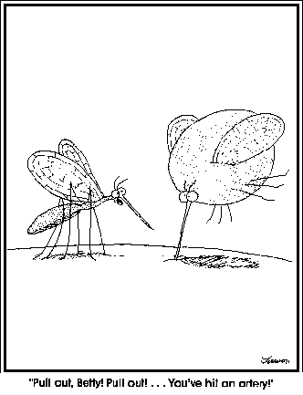
MESA has a huge reservoir of data for publications!!!

Slide 2
MESA is a great study!

Slide 3
MESA is a great study! Are there opportunities to make it greater?

Slide 4
MESA is a great study! Are there opportunities to make it greater?
Are there proactive strategies that we can take to:
Address gaps in the MESA publication portfolio?
Working groups, publicizing areas, etc.
- Should we focus on addressable translational research questions?
Should we quickly move on a few high priority analyses?
Further expand the user base of MESA data?

Slide 5
MESA is a great study! Are there opportunities to make it greater?
Are there proactive strategies that we can take to:
b. Initiate high priority new ancillary studies?
c. Ancillary Study Ideas???

Slide 6
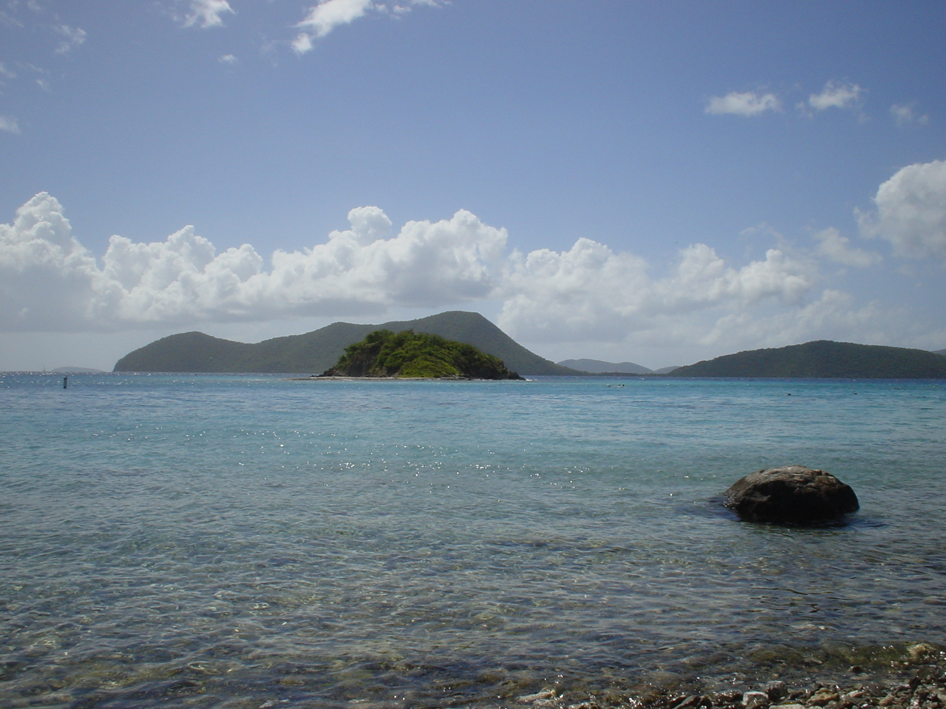
"Someone's sitting in the shade today because someone planted a tree a long time ago." Warren Buffett

