Slide 1

Reports of deposition of gadolinium in the brain associated with MRI
David A. Bluemke, MD, PhD
Director, Radiology and Imaging Sciences
National Institutes of Health
Bethesda, MD, USA

Slide 2
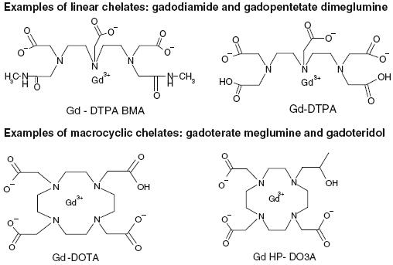
Two chemical classes of gadolinium agents for MRI
LINEAR
CYCLIC

Slide 3
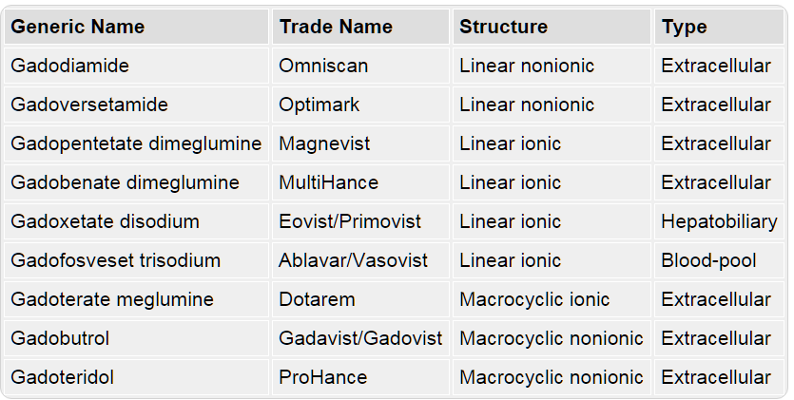
Gadolinium MRI agents FDA approved in the U.S.
http://www.medscape.org/viewarticle/780675_4

Slide 4
Literature supports residual brain gadolinium “MAY” be associated with
“macrocyclic” gad agent AND
multiple gad doses administered
Examples: (detailed references in handout)
Kanda (2015): no correlation between macrocyclic GBCA and abnormal brain signal
Radbruch (2015): linear GBCA agent was associated with abnormal signal in more than 6 doses of GBCA
Quattrochi (2015): 6 administrations of GBCA associated with increased dentate nucleus signal
Ramalho (2015): globus pallidus signal increased if linear contrast agent was used
Caveats: Incidence unknown; other associations are unknown. Majority? of patients, seems not to occur.

Slide 5
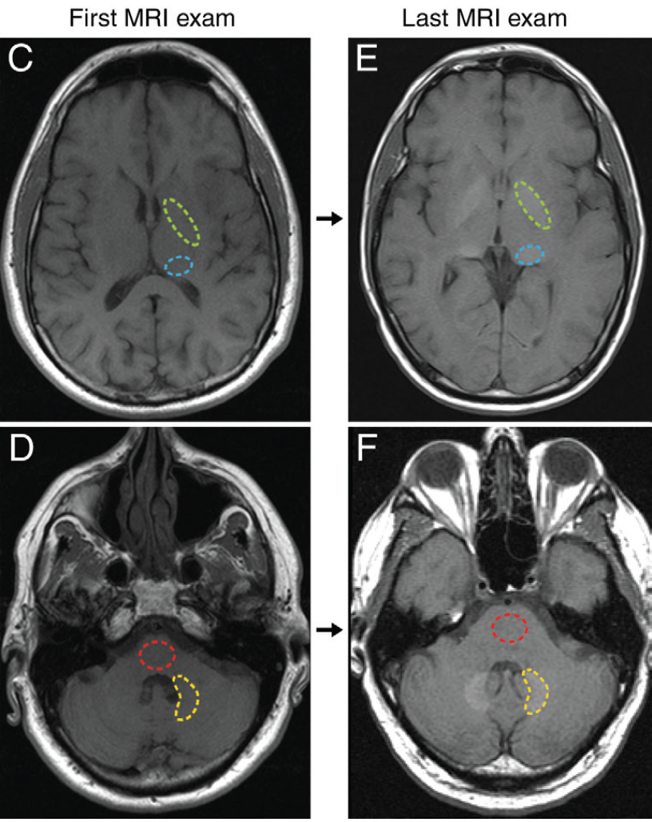
MRI scan appearance
basal ganglia
globus pallidus (green)

Slide 6
MRI scan appearance
dentate nucleus (yellow) and pons (red).

Slide 7
FDA
FDA Drug Safety Communications Statement
http://www.fda.gov/downloads/Drugs/DrugSafety/UCM455390.pdf
No adverse health effects noted

Slide 8
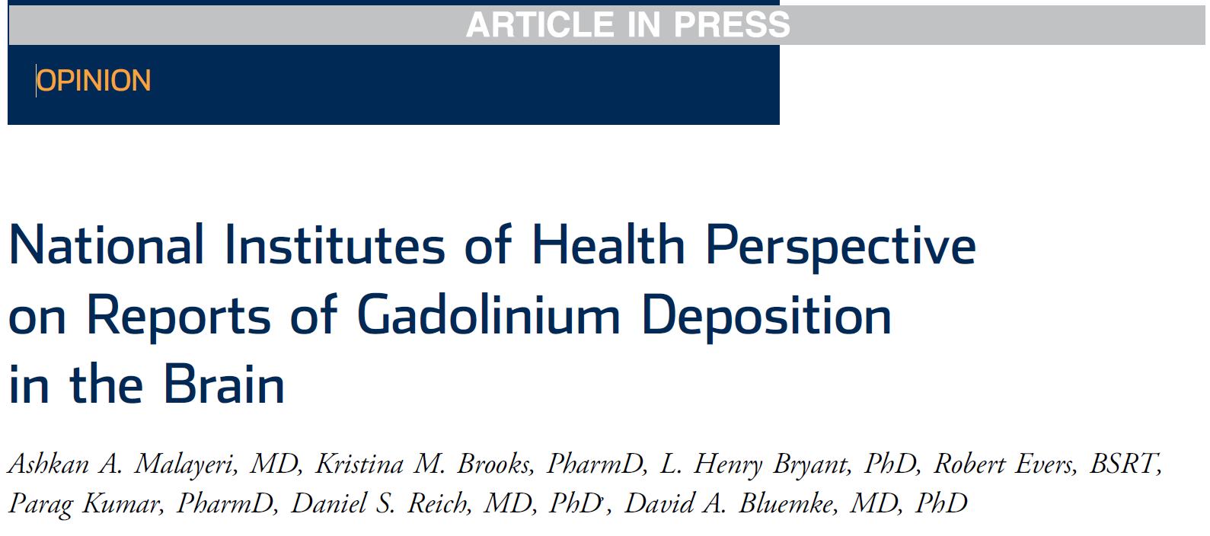
Radiology and Imaging Sciences
J Am Coll Radiol. 2016 Jan 23

Slide 9
NIH recommendations
GBCAs should only be used when clinically indicated or when specified in an institutional Review Board (IRB)-approved protocol.
When GBCAs are required, consider the use of a macrocyclic GBCA (e.g. gadobutrol, gadoteridol, or gadoterate meglumine) rather than a linear agent.
For patients with documented sensitivity (e.g. hives) to macrocyclic agents, it is appropriate to use linear agents when clinically indicated.
MRI protocols should always consider FDA label indications and dosing schemes for administration of GBCAs.
See PI letter.

