Slide 1
MESA Project Office Report
Diane Bild, MD, MPH
Prevention and Population Sciences Program
Division of Cardiovascular Sciences NHLBI
MESA Steering Committee meeting February-March 2012

Slide 2
Project Office Report Items
Exam 5
Publications
Publications metrics
NIH and NHLBI news
Next steps for MESA

Slide 3
Exam 5 - GREAT WORK!!

Slide 4
Exam 5 retention
Goal for Exam 5 was 5200, which represents 87% of enrolled cohort (not deceased).
The study saw 4655 participants for Exam 5 -- 76% retention of 6145 expected.

Slide 5
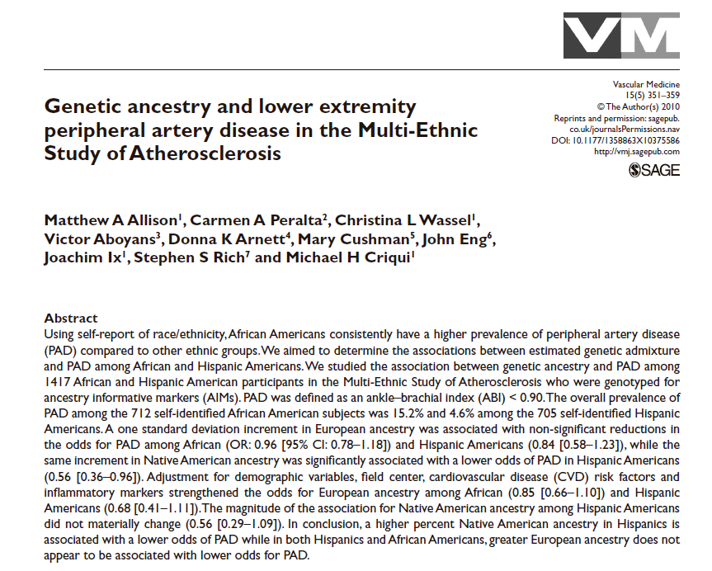
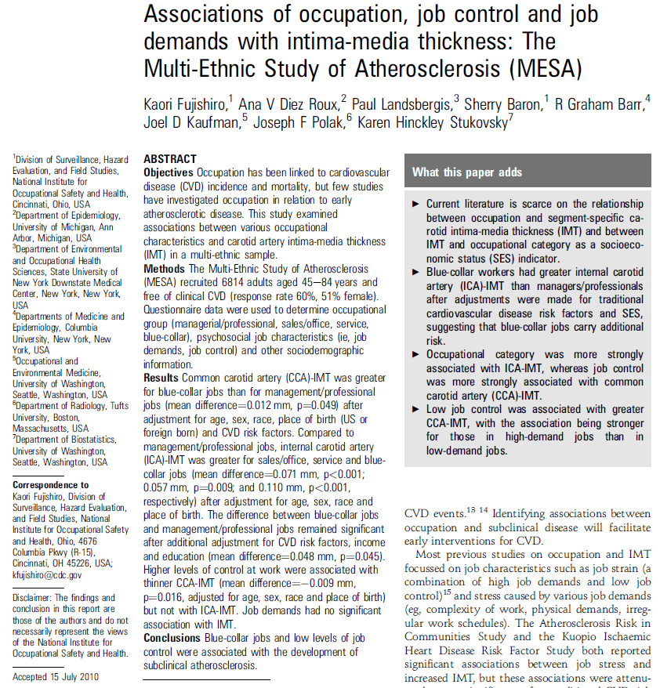
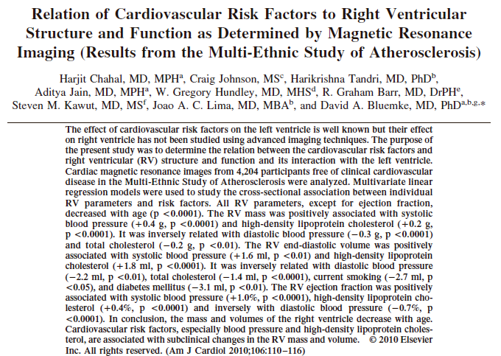
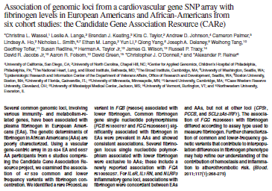
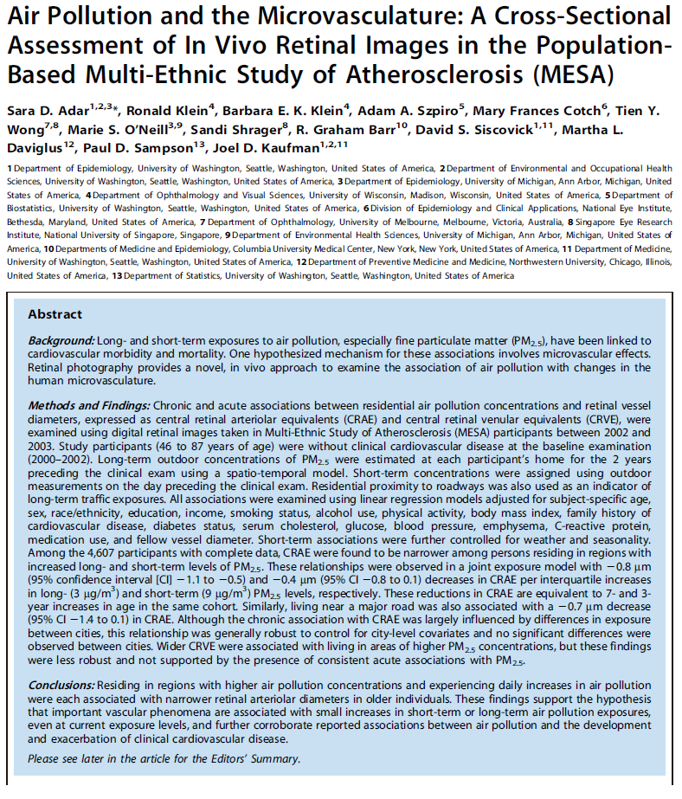
Publications

Slide 6
MESA Publications
*
Number
of
Manuscripts
(n=428)
In September this represented 235 unique first authors out of 403 papers
* Published or in press as of February 23, 2012.

Slide 7
Framingham Heart Study
Preliminary – Rich Fabsitz, September 2011

Slide 8
Cost per publication – a metric for research funding agencies
Among 1267 R01 NHLBI grants awarded 1990 to 2009 classified as “nonhuman” & “myocard,” total funding was $2.2B, yielding 15,656 publications.
Cost per publication = $143,276
“These figures compare favorably to national estimates of cost per publication for all academic-based research, which has increased from $186,567 in 1998 to $308,641 in 2008.” (from Key Science and Engineering Indicators: 2010 Digest)
Lauer MS. Circ Res 2011;108:405-9

Slide 9
MESA Analysis of Cost per Publication
As of September 2011

Slide 10
MESA – Web of Science metrics
With the search in the title “multi-ethnic study of atherosclerosis,” there were 470 citations
That day (2-1-12), there were 426 MESA papers and 7 data repository papers noted on the MESA web site.
False positives in WOS could be from public data, letters to the editor; or we could be missing some in MESA. This WOS search will miss some (e.g., those not including MESA in title).
I scanned some of the results and found 2 letters (which I did not remove).
Very useful!
From Web of Science, accessed 2-1-12

Slide 11
MESA – Web of Science metrics
Citing Articles = 3456 (smaller than # citations because of multiple citations in one article)
Citing Articles without self-citations = 3187
Average Citations per item = 10.18
h-index = 32 (This is the number of items that have that number of citations or more. For example, an h-index of 20 means that 20 items have 20 citations or more.)
From Web of Science, accessed 2-1-12
Notes:
h-index¹
This field displays the h-index count and is based on a list of publications ranked in descending order by the Times Cited count.
The h-index is indicated by an orange horizontal line. The number of items above this line, which is "h" have at least "h" citations. For example, an h-index of 20 means there are 20 items that have 20 citations or more. This metric is useful because it discounts the disproportionate weight of highly cited papers or papers that have not yet been cited.
Calculating the h-index Value - The h-index factor is based on the depth of your product subscription and your selected timespan. Items that do not appear on the Results page will not be factored into the calculation. If your subscription depth is 10 years, then the h-index value is based on this depth even though a particular author may have published articles more than 10 years ago. Moreover, the calculation only includes items in your product database - books and articles in non-covered journals are not included.
1. The h-index was developed by J.E. Hirsch and published in Proceedings of the National Academy of Sciences of the United States of America 102 (46): 16569-16572 November 15 2005.

Slide 12
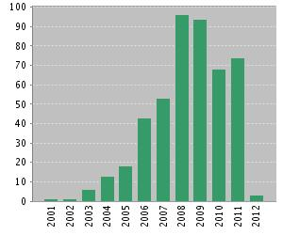
MESA – Published Items in Each Year
From Web of Science, accessed 2-1-12

Slide 13
MESA Publications
*
Number
of
Manuscripts
(n=428)
In September this represented 235 unique first authors out of 403 papers
* Published or in press as of February 23, 2012.

Slide 14
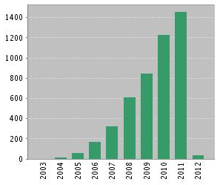
MESA – Citations in Each Year
From Web of Science, accessed 2-1-12

Slide 15
MESA – Web of Science metrics
Most highly-cited articles:
Title: Multi-ethnic study of atherosclerosis: Objectives and design Author(s): Bild DE; Bluemke DA; Burke GL; et al. Source: AMERICAN JOURNAL OF EPIDEMIOLOGY Volume: 156 Issue: 9 Pages: 871-881 Published: NOV 1 2002
550 citations
Title: Calcified coronary artery plaque measurement with cardiac CT in population-based studies: Standardized protocol of Multi-Ethnic Study of Atherosclerosis (MESA) and Coronary Artery Risk Development in Young Adults (CARDIA) study Author(s): Carr JJ; Nelson JC; Wong ND; et al. Source: RADIOLOGY Volume: 234 Issue: 1 Pages: 35-43 Published: JAN 2005
225 citations
From Web of Science, accessed 2-1-12
Notes:
h-index¹
This field displays the h-index count and is based on a list of publications ranked in descending order by the Times Cited count.
The h-index is indicated by an orange horizontal line. The number of items above this line, which is "h" have at least "h" citations. For example, an h-index of 20 means there are 20 items that have 20 citations or more. This metric is useful because it discounts the disproportionate weight of highly cited papers or papers that have not yet been cited.
Calculating the h-index Value - The h-index factor is based on the depth of your product subscription and your selected timespan. Items that do not appear on the Results page will not be factored into the calculation. If your subscription depth is 10 years, then the h-index value is based on this depth even though a particular author may have published articles more than 10 years ago. Moreover, the calculation only includes items in your product database - books and articles in non-covered journals are not included.
1. The h-index was developed by J.E. Hirsch and published in Proceedings of the National Academy of Sciences of the United States of America 102 (46): 16569-16572 November 15 2005.

Slide 16
MESA – Web of Science metrics
Most highly-cited articles:
Title: Ethnic differences in coronary calcification - The multi-ethnic study of atherosclerosis (MESA) Author(s): Bild DE; Detrano R; Peterson D; et al. Source: CIRCULATION Volume: 111 Issue: 10 Pages: 1313-1320 Published: MAR 15 2005
187 citations
Title: Coronary artery calcification compared with carotid intima-media thickness in the prediction of cardiovascular disease incidence - The Multi-Ethnic Study of Atherosclerosis (MESA) Author(s): Folsom Aaron R.; Kronmal Richard A.; Detrano Robert C.; et al. Source: ARCHIVES OF INTERNAL MEDICINE Volume: 168 Issue: 12 Pages: 1333-1339 DOI: 10.1001/archinte.168.12.1333 Published: JUN 23 2008
145 citations
From Web of Science, accessed 2-1-12
Notes:
h-index¹
This field displays the h-index count and is based on a list of publications ranked in descending order by the Times Cited count.
The h-index is indicated by an orange horizontal line. The number of items above this line, which is "h" have at least "h" citations. For example, an h-index of 20 means there are 20 items that have 20 citations or more. This metric is useful because it discounts the disproportionate weight of highly cited papers or papers that have not yet been cited.
Calculating the h-index Value - The h-index factor is based on the depth of your product subscription and your selected timespan. Items that do not appear on the Results page will not be factored into the calculation. If your subscription depth is 10 years, then the h-index value is based on this depth even though a particular author may have published articles more than 10 years ago. Moreover, the calculation only includes items in your product database - books and articles in non-covered journals are not included.
1. The h-index was developed by J.E. Hirsch and published in Proceedings of the National Academy of Sciences of the United States of America 102 (46): 16569-16572 November 15 2005.

Slide 17
MESA – Web of Science metrics
Most highly-cited articles:
Title: Retinal vascular caliber, cardiovascular risk factors, and inflammation: The Multi-Ethnic Study of Atherosclerosis (MESA) Author(s): Wong TY; Islam FMA; Klein R; et al. Source: INVESTIGATIVE OPHTHALMOLOGY & VISUAL SCIENCE Volume: 47 Issue: 6 Pages: 2341-2350 JUN 2006
115 citations
Title: Distribution of coronary artery calcium by race, gender, and age - Results from the Multi-Ethnic Study of Atherosclerosis (MESA) Author(s): McClelland RL; Chung HJ; Detrano R; et al. Source: CIRCULATION Volume: 113 Issue: 1 Pages: 30-37 CIRCULATION Published: JAN 3 2006
114 citations
From Web of Science, accessed 2-1-12
Notes:
h-index¹
This field displays the h-index count and is based on a list of publications ranked in descending order by the Times Cited count.
The h-index is indicated by an orange horizontal line. The number of items above this line, which is "h" have at least "h" citations. For example, an h-index of 20 means there are 20 items that have 20 citations or more. This metric is useful because it discounts the disproportionate weight of highly cited papers or papers that have not yet been cited.
Calculating the h-index Value - The h-index factor is based on the depth of your product subscription and your selected timespan. Items that do not appear on the Results page will not be factored into the calculation. If your subscription depth is 10 years, then the h-index value is based on this depth even though a particular author may have published articles more than 10 years ago. Moreover, the calculation only includes items in your product database - books and articles in non-covered journals are not included.
1. The h-index was developed by J.E. Hirsch and published in Proceedings of the National Academy of Sciences of the United States of America 102 (46): 16569-16572 November 15 2005.

Slide 18
MESA – Web of Science metrics
Most highly-cited articles:
Title: Dietary patterns are associated with biochemical markers of inflammation and endothelial activation in the Multi-Ethnic Study of Atherosclerosis (MESA) Author(s): Nettleton JA; Steffen LM; Mayer-Davis EJ; et al. Source: AMERICAN JOURNAL OF CLINICAL NUTRITION Volume: 83 Issue: 6 Pages: 1369-1379 Published: JUN 2006
109 citations
Title: Ankle-brachial index and subclinical cardiac and carotid disease - The Multi-Ethnic Study of Atherosclerosis Author(s): McDermott MM; Liu K; Criqu MH; et al. Source: AMERICAN JOURNAL OF EPIDEMIOLOGY Volume: 162 Issue: 1 Pages: 33-41 Published: JUL 1 2005
106 citations
From Web of Science, accessed 2-1-12
Notes:
h-index¹
This field displays the h-index count and is based on a list of publications ranked in descending order by the Times Cited count.
The h-index is indicated by an orange horizontal line. The number of items above this line, which is "h" have at least "h" citations. For example, an h-index of 20 means there are 20 items that have 20 citations or more. This metric is useful because it discounts the disproportionate weight of highly cited papers or papers that have not yet been cited.
Calculating the h-index Value - The h-index factor is based on the depth of your product subscription and your selected timespan. Items that do not appear on the Results page will not be factored into the calculation. If your subscription depth is 10 years, then the h-index value is based on this depth even though a particular author may have published articles more than 10 years ago. Moreover, the calculation only includes items in your product database - books and articles in non-covered journals are not included.
1. The h-index was developed by J.E. Hirsch and published in Proceedings of the National Academy of Sciences of the United States of America 102 (46): 16569-16572 November 15 2005.

Slide 19
MESA – Web of Science metrics
Most highly-cited articles:
Title: Risk factors for the progression of coronary artery calcification in asymptomatic subjects - Results from the Multi-Ethnic Study of Atherosclerosis (MESA) Author(s): Kronmal Richard A.; McClelland Robyn L.; Detrano Robert; et al. Source: CIRCULATION Volume: 115 Issue: 21 Pages: 2722-2730 Published: MAY 29 2007
100 citations
Title: Racial/ethnic differences in hypertension and hypertension treatment and control in the multi-ethnic study of atherosclerosis (MESA) Author(s): Kramer H; Han C; Post W; et al. Source: AMERICAN JOURNAL OF HYPERTENSION Volume: 17 Issue: 10 Pages: 963-970 Published: OCT 2004
85 citations
From Web of Science, accessed 2-1-12
Notes:
h-index¹
This field displays the h-index count and is based on a list of publications ranked in descending order by the Times Cited count.
The h-index is indicated by an orange horizontal line. The number of items above this line, which is "h" have at least "h" citations. For example, an h-index of 20 means there are 20 items that have 20 citations or more. This metric is useful because it discounts the disproportionate weight of highly cited papers or papers that have not yet been cited.
Calculating the h-index Value - The h-index factor is based on the depth of your product subscription and your selected timespan. Items that do not appear on the Results page will not be factored into the calculation. If your subscription depth is 10 years, then the h-index value is based on this depth even though a particular author may have published articles more than 10 years ago. Moreover, the calculation only includes items in your product database - books and articles in non-covered journals are not included.
1. The h-index was developed by J.E. Hirsch and published in Proceedings of the National Academy of Sciences of the United States of America 102 (46): 16569-16572 November 15 2005.

Slide 20
SPIRES – Scientific Publication Information Retrieval and Evaluation System
Searched for “multi ethnic study of atherosclerosis.”
Only 161 records identified
Output to Excel:

Slide 21
Impact Factor
SPIRES:
The impact factor for a journal is calculated based on a three-year period, and can be considered to be the average number of times published papers are cited up to two years after publication.

Slide 22
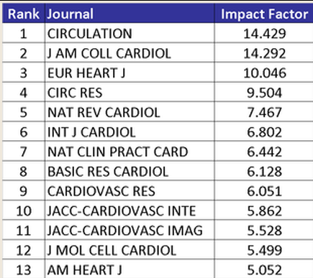
Impact Factors for Selected Journals
Medicine Cardiology
http://impactfactor.weebly.com/medicine.html
Notes:
The impact factor for a journal is calculated based on a three-year period, and can be considered to be the average number of times published papers are cited up to two years after publication.

Slide 23
SPIRES – Scientific Publication Information Retrieval and Evaluation System
Impact Factors were available for 107 of the 161 MESA papers.
IF
Notes:
The impact factor for a journal is calculated based on a three-year period, and can be considered to be the average number of times published papers are cited up to two years after publication.

Slide 24
MESA papers by Impact Factor
NEJM (53.5)
Detrano R, Guerci AD, Carr JJ, Bild DE, Burke G, Folsom AR, Liu K, Shea S, Szklo M, Bluemke DA, O’Leary DH, Tracy R, Watson K, Wong ND, Kronmal RA. Coronary Calcium as a Predictor of Coronary Events in Four Racial or Ethnic Groups. N Engl J Med. 2008;358(13):1336-1345.
Barr RG, Bluemke DA, Ahmed FS, Carr JJ, Enright PL, Hoffman EA, Jiang R, Kawut SM, Kronmal RA, Lima JA, Shahar E, Smith LJ, Watson KE. Percent emphysema, airflow obstruction, and impaired left ventricular filling. N Engl J Med. 2010;362(3):217-227.

Slide 25
MESA papers by Impact Factor
Lancet (33.6)
Danesh J, Folsom A, Psaty B, Shea S, Cushman M, Kaptoge S, Di Angelantonio E, Lowe G, Pepys MB, Thompson SG, Collins R. C-reactive protein concentration and risk of coronary heart disease, stroke, and mortality: an individual participant meta-analysis. Emerging Risk Factors Collaboration. Lancet. 2010;375(9709):132-140.
Blaha MJ, Budoff MJ, Defilippis AP, Blankstein R, Rivera JJ, Agatston A, O’Leary DH, Lima J, Blumenthal RS, Nasir K. Association between c-reactive protein, coronary artery calcium, and cardiovascular events: implications for the JUPITER population from MESA, a population-based cohort study. Lancet. 2011;378(9792):684-692.

Slide 26
MESA papers by Impact Factor
JAMA (30.0)
Golden SH, Lazo M, Carnethon M, Bertoni AG, Schreiner PJ, Diez Roux AV, Lee HB, Lyketsos C. Examining a Bidirectional Association Between Depressive Symptoms and Diabetes. JAMA. 2008;299(23):2751-2759.
Polonsky TS, McClelland RL, Jorgensen NW, Bild DE, Burke GL, Guerci AD, Greenland P. Coronary Artery Calcium Score and Risk Classification for Coronary Heart Disease Prediction. JAMA 2010;303(16):1610-1616.

Slide 27
MESA papers by Impact Factor
Ann Intern Med (16.7)
Diez Roux AV, Ranjit N, Powell L, Jackson S, Lewis TT, Shea S, Wu C. Psychosocial Factors and Coronary Calcium in Adults without Clinical Cardiovascular Disease. Ann Intern Med. 2006;144(11):822-831.
Kestenbaum B, Rudser KD, de Boer IH, Peralta CA, Fried LF, Shlipak MG, Palmas W, Stehman-Breen C, Siscovick DS. Differences in Kidney Function and Incident Hypertension: The Multi-Ethnic Study of Atherosclerosis. Ann Intern Med. 2008;148(7):501-508.
Rodriguez J, Jiang R, Johnson WC, MacKenzie BA, Smith LJ, Barr RG. The association of pipe and cigar use with cotinine levels, lung function, and airflow obstruction: a cross-sectional study. Ann Intern Med. 2010;152(4):201-210.

Slide 28
MESA papers by Impact Factor
PLoS Med (15.6)
Adar SD, Klein R, Klein BE, Szpiro AA, Cotch MF, Wong TY, O’Neill MS, Shrager S, Barr RG, Siscovick D, Daviglus ML, Sampson PD, Kaufman JD. Air Pollution and the Microvasculature: A Cross-Sectional Assessment of In Vivo Retinal Images in the Population-Based Multi-Ethnic Study of Atherosclerosis (MESA). PLoS Med. 2010;7(11):e1000372.

Slide 29
MESA papers by Impact Factor
Eur Heart J (10.0)
Erbel R, Delaney JA, Lehmann N, McClelland RL, Mohlenkamp S, Kronmal RA, Schmermund A, Moebus S, Dragano N, Stang A, Jockel KH, Budoff MJ; on behalf of the Multi-Ethnic Study of Atherosclerosis and the Investigator Group of the Heinz Nixdorf Recall Study. Signs of subclinical coronary atherosclerosis in relation to risk factor distribution in the Multi-Ethnic Study of Atherosclerosis (MESA) and the Heinz Nixdorf Recall Study (HNR). Eur Heart J. 2008;29(22):2782-2791.
Yan AT, Yan RT, Cushman M, Redheuil A, Tracy RP, Arnett DK, Rosen BD, McClelland RL, Bluemke DA, Lima JA. Relationship of interleukin-6 with regional and global left-ventricular function in asymptomatic individuals without clinical cardiovascular disease: insights from the Multi-Ethnic Study of Atherosclerosis. Eur Heart J. 2010;31(7):875-882.

Slide 30
MESA papers by Impact Factor
Circulation (14.4)
N=18
JACC (14.3)
N=23
Arch Intern Med (10.6)
N=8

Slide 31
Wordle for MESA abstracts after eliminating a bunch of obvious terms
Wordle.net
Notes:
Deleted the following:
PMID
PubMed
ePub ahead of print
as supplied by publisher
results
conclusions
conclusion
methods → created orange brown version
medline
pmcid
study
mesa
Created blue, green, purple version
Associated
Multi-ethnic
University
Participants
Indexed
Risk
Association
Years →created white orange turquoise slide
Factors
Adjustment
Total
Among
Ci
Ratio
May
Data
Interval
Confidence
Levels
level
Without
Individuals
Epub
Defined
Mean
Measures
Measure → black and white

Slide 32
MESA Objectives and Publications
Number of papers
July 2011

Slide 33
A plea for help with important metrics
What MESA papers do you think have been important and influential?
Citations by guidelines
“First” papers – something found for the first time
Elucidating pathophysiology (to tell whole story)
Providing background for clinical trials
Informing next steps in research
Informing policy
Please email your ideas to me!
bildd@nhlbi.nih.gov

Slide 34
NIH and NHLBI news
Appointment of new NHLBI Director still pending -- Susan Shurin is Acting Director of NHLBI.
FY2012 Budget had (only) a 0.5% decrease for NHLBI.
FY2013 President’s Budget $3.076B (compared to $3.085B in FY12).
http://www.hhs.gov/about/budget/fy2012/fy2012bib.pdf

Slide 35
NHLBI budget
http://www.hhs.gov/about/budget/fy2012/fy2012bib.pdf

Slide 36
Epidemiology “Blog” coming soon!
http://www.nhlbi.nih.gov/resources/epidemiology-forum/index.htm

Slide 37
MESA continuation
Collecting input
Investigator poll
Working groups
Discussion within DCVS
Engaging the extramural community
Workshop
Virtual
Other

Slide 38
MESA continuation
Options
RFPs to renew contracts for Exam 6, etc.
RFP(s) for “core” support
Grant(s) support (investigator-initiated)
Timeline
About 19 months from initial formal concept approval at NHLBI to award
Current contracts end in August 2015

Slide 40
Extras

Slide 41
MESA continuation - steps -- ~19 months

Slide 42
SPIRES – Scientific Publication Information Retrieval and Evaluation System
Impact Factors were available for 107 of the 161 papers.
IF
Notes:
The impact factor for a journal is calculated based on a three-year period, and can be considered to be the average number of times published papers are cited up to two years after publication.

Slide 43
MESA Participant Web Site

Slide 44
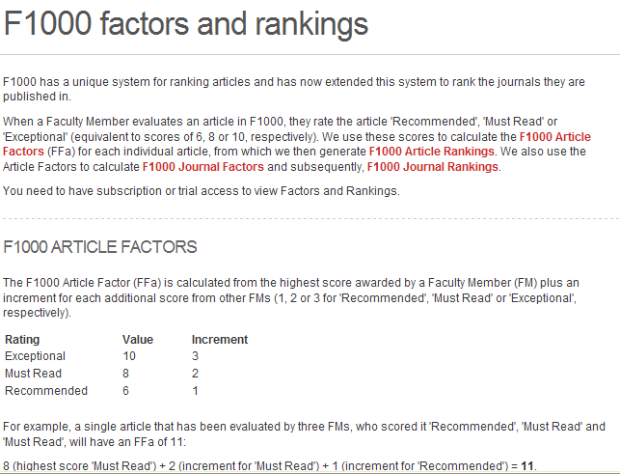
F1000 (Faculty of 1000) Post Publication Peer Review
http://f1000.com/about/whatis/factors
Notes:
h-index¹
This field displays the h-index count and is based on a list of publications ranked in descending order by the Times Cited count.
The h-index is indicated by an orange horizontal line. The number of items above this line, which is "h" have at least "h" citations. For example, an h-index of 20 means there are 20 items that have 20 citations or more. This metric is useful because it discounts the disproportionate weight of highly cited papers or papers that have not yet been cited.
Calculating the h-index Value - The h-index factor is based on the depth of your product subscription and your selected timespan. Items that do not appear on the Results page will not be factored into the calculation. If your subscription depth is 10 years, then the h-index value is based on this depth even though a particular author may have published articles more than 10 years ago. Moreover, the calculation only includes items in your product database - books and articles in non-covered journals are not included.
1. The h-index was developed by J.E. Hirsch and published in Proceedings of the National Academy of Sciences of the United States of America 102 (46): 16569-16572 November 15 2005.

Slide 45
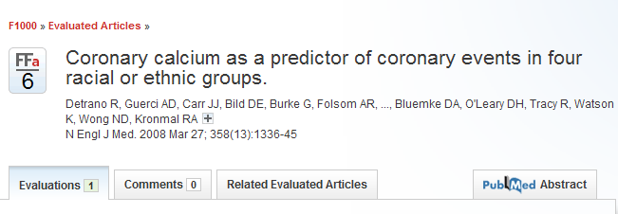
F1000 (Faculty of 1000) Post Publication Peer Review
http://f1000.com/3407958#evaluations
Notes:
h-index¹
This field displays the h-index count and is based on a list of publications ranked in descending order by the Times Cited count.
The h-index is indicated by an orange horizontal line. The number of items above this line, which is "h" have at least "h" citations. For example, an h-index of 20 means there are 20 items that have 20 citations or more. This metric is useful because it discounts the disproportionate weight of highly cited papers or papers that have not yet been cited.
Calculating the h-index Value - The h-index factor is based on the depth of your product subscription and your selected timespan. Items that do not appear on the Results page will not be factored into the calculation. If your subscription depth is 10 years, then the h-index value is based on this depth even though a particular author may have published articles more than 10 years ago. Moreover, the calculation only includes items in your product database - books and articles in non-covered journals are not included.
1. The h-index was developed by J.E. Hirsch and published in Proceedings of the National Academy of Sciences of the United States of America 102 (46): 16569-16572 November 15 2005.

Slide 46
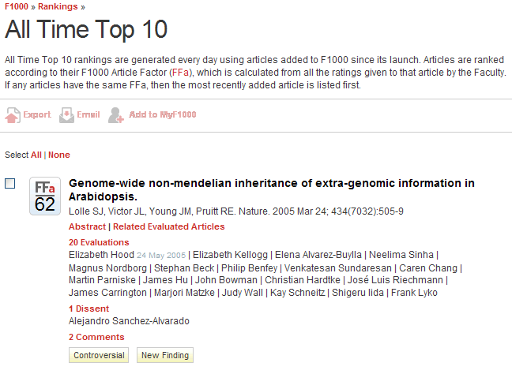
F1000 (Faculty of 1000) Post Publication Peer Review
http://f1000.com/3407958#evaluations
Notes:
h-index¹
This field displays the h-index count and is based on a list of publications ranked in descending order by the Times Cited count.
The h-index is indicated by an orange horizontal line. The number of items above this line, which is "h" have at least "h" citations. For example, an h-index of 20 means there are 20 items that have 20 citations or more. This metric is useful because it discounts the disproportionate weight of highly cited papers or papers that have not yet been cited.
Calculating the h-index Value - The h-index factor is based on the depth of your product subscription and your selected timespan. Items that do not appear on the Results page will not be factored into the calculation. If your subscription depth is 10 years, then the h-index value is based on this depth even though a particular author may have published articles more than 10 years ago. Moreover, the calculation only includes items in your product database - books and articles in non-covered journals are not included.
1. The h-index was developed by J.E. Hirsch and published in Proceedings of the National Academy of Sciences of the United States of America 102 (46): 16569-16572 November 15 2005.

Slide 47
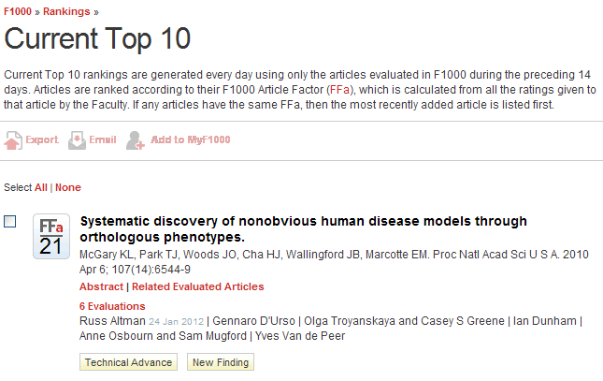
F1000 (Faculty of 1000) Post Publication Peer Review
http://f1000.com/3407958#evaluations
Notes:
h-index¹
This field displays the h-index count and is based on a list of publications ranked in descending order by the Times Cited count.
The h-index is indicated by an orange horizontal line. The number of items above this line, which is "h" have at least "h" citations. For example, an h-index of 20 means there are 20 items that have 20 citations or more. This metric is useful because it discounts the disproportionate weight of highly cited papers or papers that have not yet been cited.
Calculating the h-index Value - The h-index factor is based on the depth of your product subscription and your selected timespan. Items that do not appear on the Results page will not be factored into the calculation. If your subscription depth is 10 years, then the h-index value is based on this depth even though a particular author may have published articles more than 10 years ago. Moreover, the calculation only includes items in your product database - books and articles in non-covered journals are not included.
1. The h-index was developed by J.E. Hirsch and published in Proceedings of the National Academy of Sciences of the United States of America 102 (46): 16569-16572 November 15 2005.

Slide 48
F1000 (Faculty of 1000) Post Publication Peer Review
http://f1000.com/3407958#evaluations
Notes:
h-index¹
This field displays the h-index count and is based on a list of publications ranked in descending order by the Times Cited count.
The h-index is indicated by an orange horizontal line. The number of items above this line, which is "h" have at least "h" citations. For example, an h-index of 20 means there are 20 items that have 20 citations or more. This metric is useful because it discounts the disproportionate weight of highly cited papers or papers that have not yet been cited.
Calculating the h-index Value - The h-index factor is based on the depth of your product subscription and your selected timespan. Items that do not appear on the Results page will not be factored into the calculation. If your subscription depth is 10 years, then the h-index value is based on this depth even though a particular author may have published articles more than 10 years ago. Moreover, the calculation only includes items in your product database - books and articles in non-covered journals are not included.
1. The h-index was developed by J.E. Hirsch and published in Proceedings of the National Academy of Sciences of the United States of America 102 (46): 16569-16572 November 15 2005.

Slide 49
SPIRES – Scientific Publication Information Retrieval and Evaluation System
Here the 54 papers with no IFs were assigned a value of 0.
IF

Slide 50
Wordle 1 for MESA (see notes for term eliminations)
Notes:
Deleted the following:
PMID
PubMed
ePub ahead of print
as supplied by publisher
results
conclusions
conclusion
methods → created orange brown version

Slide 51
Wordle 2 (some eliminations)
Notes:
Deleted the following:
PMID
PubMed
ePub ahead of print
as supplied by publisher
results
conclusions
conclusion
methods → created orange brown version
medline
pmcid
study
mesa
Created blue, green, purple version

Slide 52
Wordle 3 (see notes for eliminations)
Notes:
Deleted the following:
PMID
PubMed
ePub ahead of print
as supplied by publisher
results
conclusions
conclusion
methods → created orange brown version

Slide 54
SPIRES – Scientific Publication Information Retrieval and Evaluation System
Journal Impact Factor is from Journal Citation Report (JCR), a product of Thomson ISI (Institute for Scientific Information). JCR provides quantitative tools for evaluating journals. The impact factor is one of these; it is a measure of the frequency with which the "average article" in a journal has been cited in a given period of time. The impact factor for a journal is calculated based on a three-year period, and can be considered to be the average number of times published papers are cited up to two years after publication. For example, the impact factor 2012 for a journal would be calculated as follows: A = the number of times articles published in 2010-2011 were cited in indexed journals during 2012 B = the number of articles, reviews, proceedings or notes published in 2010-2011 impact factor 2012 = A/B (note that the impact factor 2011 will be actually published in 2012, because it could not be calculated until all of the 2011 publications had been received. Impact factor 2012 will be published in 2013)
http://www.sciencegateway.org/impact/

Slide 55
MESA Objectives and Publications
July 2011

Slide 56
Impact Factors for Journals in Medicine and Cardiology, top 40
IF

Slide 57
Impact Factors for Journals in Medicine and Cardiology, top 40
IF

Slide 58
MESA continuation - steps for contract renewals and RFAs
Project Office develops concept
Idea Forum discussion within NHLBI
NHLBI Board of External Experts review
NHLB Advisory Council review of concept
NHLBI Director approval
Contracts:
~6 months to release of RFPs
~13 months to awards
Grants:
~7 months to publication in the NIH Guide
~13 months to awards

