Slide 1

MESA Adhesion Ancillary Study Results
MESA Adhesion Ancillary Study
Suzette J. Bielinski, PHD
MESA Steering Committee Meeting
Washington DC
February 6, 2014

Slide 2




MESA Adhesion Research Team
Site | Name | Role
Mayo Clinic, Rochester | Suzette J. Bielinski, PhD | Principal Investigator
 | Mariza de Andrade, PhD | Statistician
 | Paul A. Decker, MS | Statistician
 | Phil Kirsch, MPH | Statistical Programmer
 | Hughes Sicotte, PhD | Bioinformatician
 | Nicholas B. Larson, PhD | Research Associate
 | Cecilia Berardi, MD | Post-doctoral Fellow
University of Minnesota | Michael Tsai, MD | MESA Core Lab
 | Naomi Hanson, MS | MESA Core Lab
 | James S. Pankow, PhD | Co-Investigator
 | Weihong Tang, PhD | Co-Investigator
University of Virginia | Michele Sale, PhD | MESA Genotype Lab
University of Pittsburgh | Christina Wassel, PhD | Co-Investigator

Slide 3
MESA Adhesion Study Goals
To test the hypothesis that …
  the cellular adhesion pathway is associated with atherosclerosis
  variants in adhesion genes account for a significant portion of the variation in adhesion protein level and that these variants are associated atherosclerosis
Exploring Models
  Individual protein levels
  Composite protein score and multi-protein models
  Pathways

Slide 4
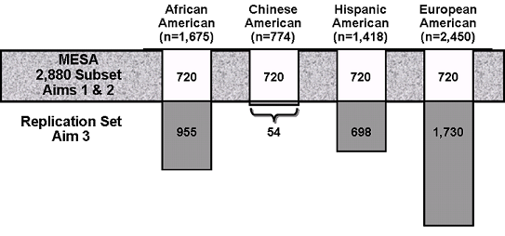
MESA Adhesion Study Population
Exam 2 Sample Availability on the 2880 Subset Serum, n = 2403
Plasma, n = 2536

Slide 5
MESA Adhesion Proteins at Exam 2 on the 2880 Random Sample
P-selectin
SDF1a
TGFb1
RANTES
VCAM-1
ICAM-1
L-selectin
E-Cadherin
*MMP-1
MMP-2
TIMP-2
6Ckine
SLPI
IL2sr
HGF
Exam 2 Sample Availability
Serum, n = 2403
Plasma, n = 2536
Notes:
*Only one not significant by race

Slide 6
Sample size with serum adhesion proteins measured ( n = 2403)
 |  | Race/Ethnicity
Measure | Exam | Non-Hispanic white |  | Chinese American |  | African American |  | Hispanic American
Target Sample - MESA 2880 | 1 | 720 |  | 720 |  | 720 |  | 720
Coronary Artery Calcium Score (CAC) | 1 | 620 |  | 600 |  | 579 |  | 604
 | 2 | 295 |  | 282 |  | 276 |  | 293
 | 3 |  | 270 |  | 278 |  | 249 |  | 255
 | 4 | 220 |  | 113 |  | 165 |  | 165
 | 5 | 360 |  | 317 |  | 326 |  | 333
Carotid Ultrasound (IMT) | 1 | 608 |  | 598 |  | 560 |  | 587
 | 2 | 283 |  | 288 |  | 268 |  | 274
 | 3 |  | 260 |  | 277 |  | 233 |  | 257
 | 4 | 184 |  | 111 |  | 145 |  | 143
 | 5 | 375 |  | 367 |  | 334 |  | 324
ABI | 1 | 616 |  | 596 |  | 575 |  | 597
 | 2
 | 3 | 548 |  | 550 |  | 512 |  | 523
 | 4
 | 5 | 445 |  | 433 |  | 403 |  | 415
Post -exam 2 CVD events | FU11 | 58 |  | 29 |  | 44 |  | 59
Notes:
We show this slide to illustrate the complexity of investigating associations of exam 2 measurements and subclinical disease. The counts is this table include only those with serum measurements in the MESA Adhesion Study.
Using CAC as an example, at exam 1 all participants were measured for CAC, however, only 50% were measured at exam 2 and the other 50% exam 3. Similarly, 25% were measured at exam 4 and the other 75% at exam 5. This design issue needs to be taken into account in the analyses.
Refer that you will be showing preliminary data
As for CVD events, we are able assess relationship between events and protein levels, albeit with limited power at this point in time.

Slide 7
Replication Protein Measures
P-Selectin
  Exam 2 – remaining cohort (n = 3437)
HGF
  Exam 1 – full cohort (n = 6814)
Additional replication measurements TBD

Slide 8
P-selectin Background
Enhances procoagulant activity and activates leukocyte integrins
Plasma p-selectin inconsistently associated with CVD
Race/ethnic specific functional SNPs (e.g. rs6136)
Predominantly white populations
MESA is ideal venue to investigate

Slide 9
Preliminary Data - Risk Factor Results
n = 2536
Plasma P-selectin varied by race and higher in men
Positively associated with WHR and triglycerides
Significant race/ethnic interaction
  P-selectin and HDL
Higher levels in diabetic hypertensives compared to normal

Slide 10
Preliminary Protein Results
P-Selectin and Atherosclerosis
Association of Plasma P-Selectin and Coronary Artery Calcium and Incident Coronary Heart Disease Per Standard Deviation of for the Population (9.3 mg/mL).
 | Non-Hispanic white |  | Chinese American |  | African American |  | Hispanic American
Subclinical Disease | Beta (S.E.) | P-value | Beta (S.E.) | P-value | Beta (S.E.) | P-value | Beta (S.E.) | P-value
CAC, Agatston Score
Model 1 | 119.9 (42.9) | 0.005 | 28.7 (36.6) | 0.43 | 85.8 (50.5) | 0.089 | 59.4 (39.2) | 0.13
Model 2 | 121.7 (44.9) | 0.007 | -1.0 (37.6) | 0.98 | 40.3 (57.2) | 0.46 | 45.2 (39.9) | 0.26
Clinical Disease | HR (CI) |  | HR (CI) |  | HR (CI) |  | HR (CI)
Time to CHD
Model 1 | 1.61 (1.23, 2.11) | <0.001 | 1.43 (0.92, 2.23) | 0.12 | 1.44 (0.97, 2.11) | 0.068 | 1.23 (0.92, 1.65) | 0.17
Model 2 | 1.56 (1.18, 2.06) | 0.002 | 1.32 (0.80, 2.17) | 0.28 | 1.39 (0.92, 2.10) | 0.12 | 1.18 (0.85, 1.66) | 0.32
Model 1 = age and sex
Model 2 = age, sex, BMI, smoking and alcohol use status, LDL and HDL cholesterol, triglycerides, hypertension and diabetes status

Slide 11
Preliminary Genetic Results
P-Selectin
African America – SELP and OPRM1
Chinese American – ATP2B4, CISH, ABO
Non-Hispanic white – SELP, ABO, DIABLO
Hispanic American – KCNH8, WDR41, HOXA10, ABO

Slide 12
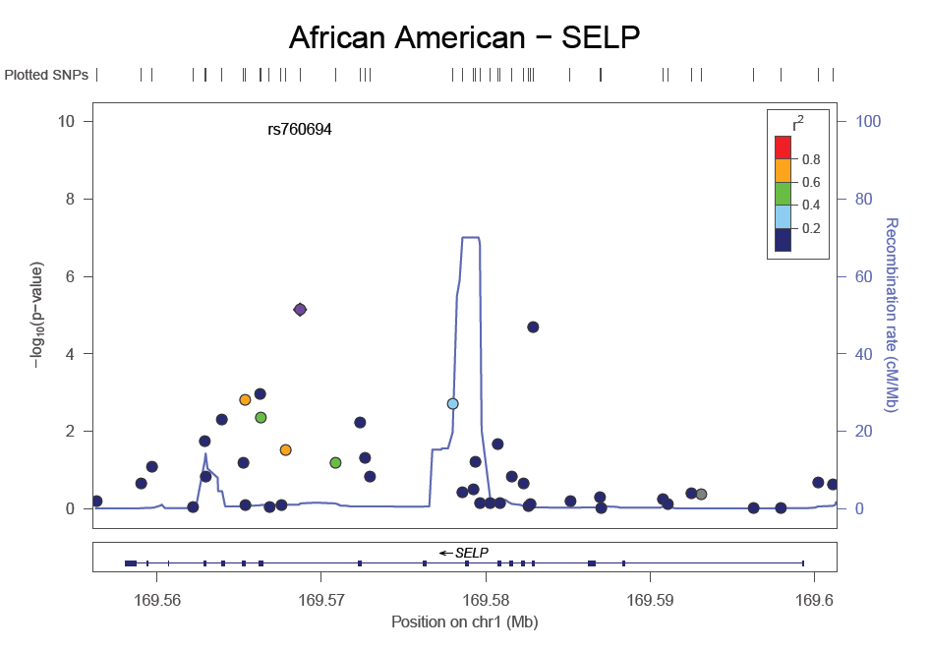
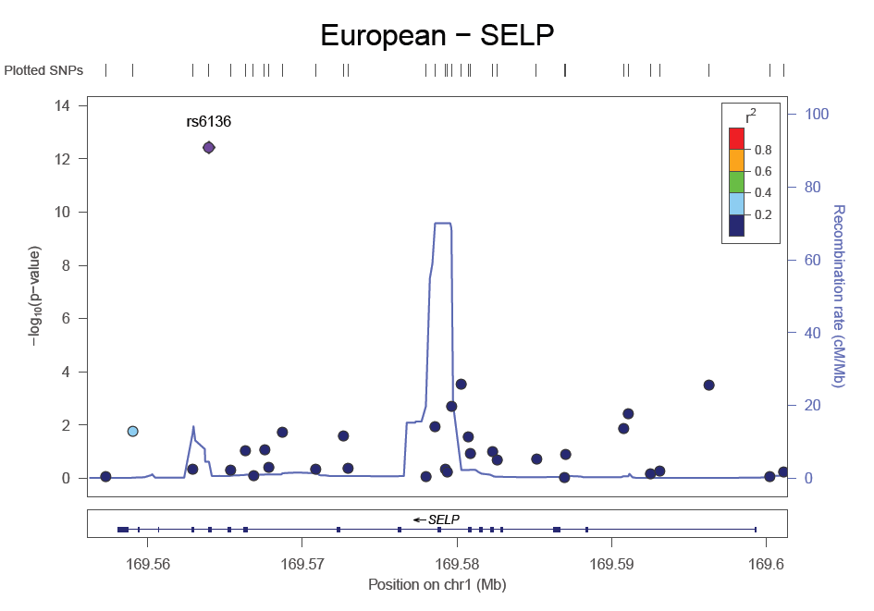
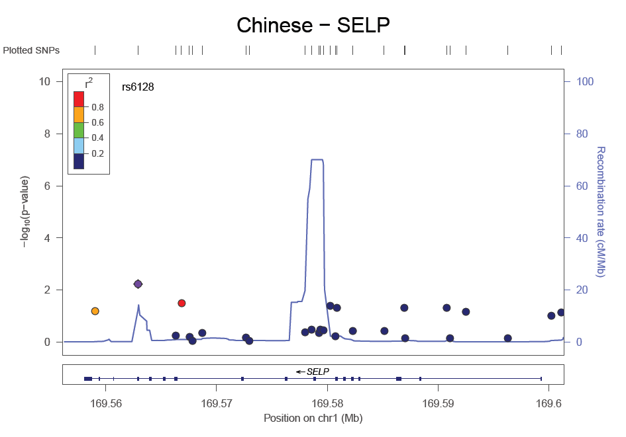
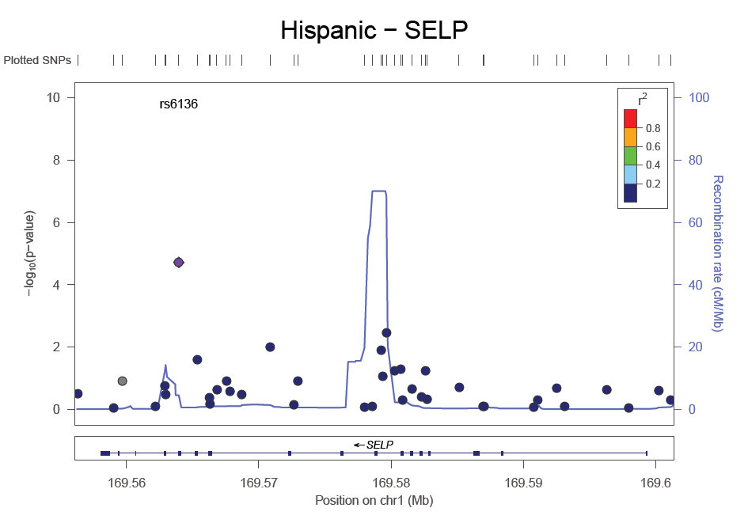

Slide 13
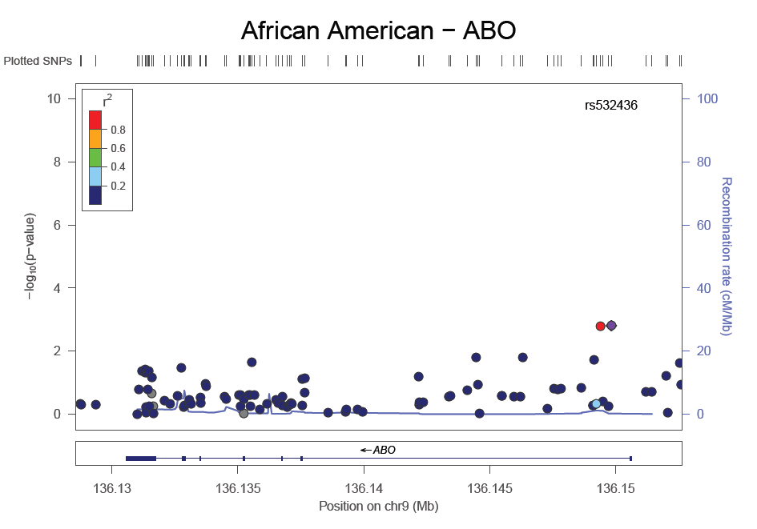
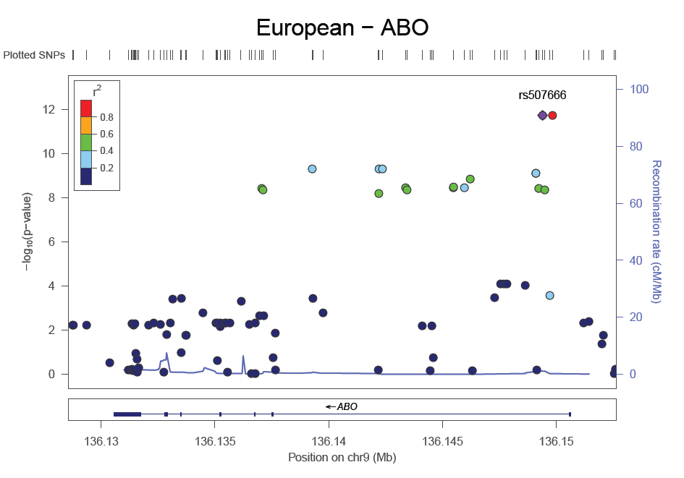
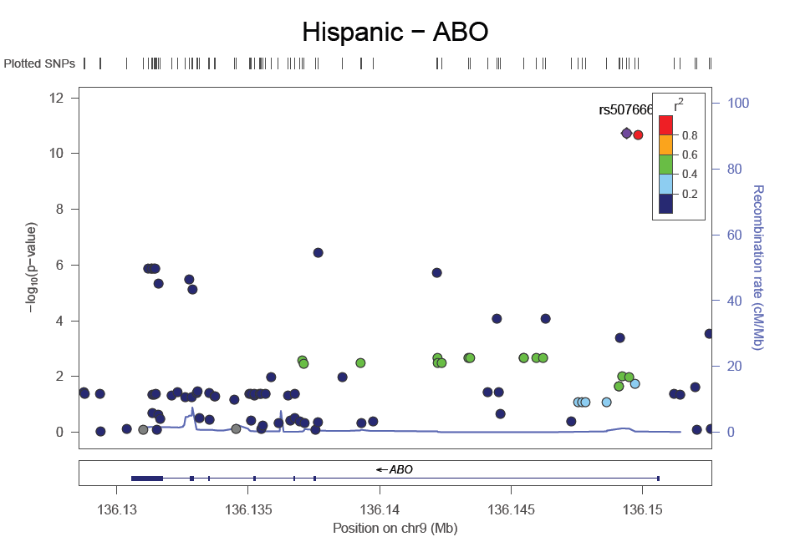
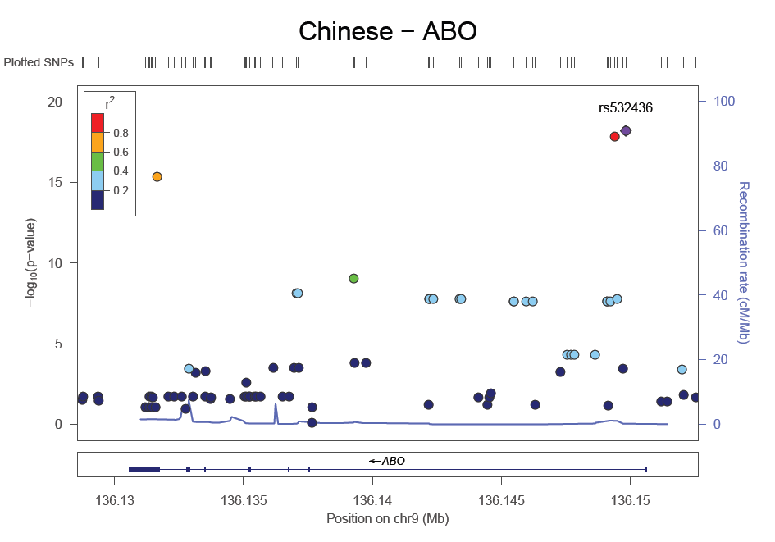

Slide 14
Investigating ABO Genotyping
Identified 12 SNV’s crucial for ABO typing (3 are indels)
Imputation quality and MAF of the SNV appeared good however…
  MAF of the imputed indel for the O allele was 10% off
  20% of EUR samples had no match to known ABO haplotype (perhaps due to compounded multiple imputation error)
ABO blood groups frequency did not match expected

Slide 15
Future Directions
P-selectin analyses with full MESA cohort at exam 2
Genotyping SNPs in ABO
Pathway Analyses

Slide 16
HGF Biology
Regulates cell growth, promotes survival through anti-apoptotic effects, reduces fibrosis, and promotes angiogenesis
Levels can be easily detected in circulation
In cross-sectional studies, increased levels are associated with
  acute myocardial infarction
  heart failure and hypertension
  peripheral arterial disease
A candidate for gene therapy in coronary heart disease and peripheral arterial disease

Slide 17
Preliminary HGF Results
Association of subclinical and clinical cardiovascular disease per standard deviation of HGF
Exam 2/3 Measurements | Beta (S.E.) | P-value
CAC, Agatston Score | 81 (18) | <0.0001
IMT, mm | -0.0003 (0.005) | 0.95
Exam 3 Measurements
*ABI | -0.008 (0.003) | 0.001
Clinical Events | HR (CI) | P-value
Time to Coronary Heart Disease | 1.4 (1.2, 1.6) | <0.0001
Adjusted for age, sex, race/ethnicity, BMI, smoking status, LDL, HDL, triglycerides, hypertension, diabetes *Those with ABI > 1.3 were excluded from the analyses

Slide 18
HGF Race Specific Results
Race/Ethnic Stratified associations of subclinical and clinical cardiovascular disease per standard deviation of HGF
 | Non-Hispanic White |  | Chinese American |  | African American |  | Hispanic American
 | Beta (S.E.) | P-value | Beta (S.E.) | P-value | Beta (S.E.) | P-value | Beta (S.E.) | P-value
CAC, Exam 2/3 | 195 (36) | <0.0001 | 98 (35) | 0.005 | -3.2 (47) | 0.95 | 37 (31) | 0.22
IMT, Exam 2/3 | -0.004 (0.009) | 0.68 | 0.002 (0.01) | 0.84 | 0.001 (0.009) | 0.92 | -0.001 (0.0009) | 0.93
*ABI, Exam 3 | -0.009 (0.005) | 0.06 | -0.004 (0.005) | 0.45 | -0.015 (0.006) | 0.009 | -0.005 (0.005) | 0.29
 | HR (CI) | P-value | HR (CI) | P-value | HR (CI) | P-value | HR (CI) | P-value
Time to CHD | 1.4 (1.1, 1.9) | 0.02 | 1.1 (0.7, 1.8) | 0.70 | 1.5 (1.2, 2.0) | 0.001 | 1.5 (1.1, 2.0) | 0.009
Notes:
Adjusted for age, sex, race/ethnicity, BMI, smoking status, LDL, HDL, triglycerides, hypertension, diabetes
*Those with ABI > 1.4 were excluded from the analyses
The race by HGF interaction p-value was 0.37 for CAC at exam 2, 0.5 for CAC at exam 3, 0.16 for ABI, 0.76 for IMT at exam 2, 0.52 for IMT at exam 3, and 0.88 for time to CHD.

Slide 19
Future Directions
HGF analyses with full MESA cohort at exam 1
Genetic analyses

Slide 20
Questions
Contact email
Bielinski.suzette@mayo.edu

Slide 21
Mean and Standard Deviation of Circulating Adhesion Protein Level by Ethnicity in MESA measured at Exam 2
 | European | Chinese | African | Hispanic | p value
n | 619 | 600 | 579 | 603
VCAM-1, ng/mL | 784 (225) | 742 (227) | 668 (223) | 757 (238) | < 0.001
P-selectin, ng/mL | 58.1 (20.3) | 42.6 (14.7) | 45.7 (17.6) | 60.6 (19.8) | < 0.001
L-selectin, ng/mL | 956 (215) | 834 (175) | 867 (192) | 904 (196) | < 0.001
E-Cadherin, ng/mL | 215 (58.4) | 227 (63.8) | 209 (59.4) | 247 (75.1) | < 0.001
MMP-1, ng/mL | 5.5 (4.0) | 5.5 (3.6) | 6.0 (4.9) | 5.4 (4.3) | 0.2769
MMP-2, ng/mL | 196 (30.3) | 190 (28.9) | 201 (35.2) | 198 (31.0) | < 0.001
TIMP-2, ng/mL | 83.0 (13.1) | 76.9 (11.0) | 82.8 (13.6) | 81.9 (11.7) | < 0.001
6Ckine, pg/mL | 844 (280) | 779 (281) | 811 (289) | 813 (280) | < 0.001
RANTES, pg/mL | 4195 (3969) | 4385 (3317) | 4334 (4611) | 4284 (4287) | < 0.001
SDF1a, pg/mL | 1904 (434) | 1998 (436) | 1947 (481) | 1942 (447) | 0.002
HGF, pg/mL | 1005 (254) | 876 (200) | 982 (265) | 1099 (260) | < 0.001
TGFb1, pg/mL | 3708 (2162) | 4385 (2225) | 3908 (2513) | 3855 (2250) | < 0.001
SLPI, pg/mL | 45525 (10058) | 44977 (10250) | 47677 (12241) | 47439 (10626) | < 0.001
ICAM-1, ng/mL | 281 (63) | 229 (54) | 261 (101) | 295 (87) | <0.001
IL-2 Ra,pg/mL | 864 (420) | 601 (286) | 651 (311) | 794 (348) | <0.001
Notes:
We measured several cellular adhesion molecules including:
VCAM-1 of the Immunoglobulin superfamily
P and L – Selectin and
E-cadherin
In addition we measured several other proteins important in the adhesion pathway including
MMP1 and 2 and its inhibitor TIMP-2
Three chemokines – 6CKine, RANTES, and SDF1a
We also measured two growth factors – HGF and TGFB1
And we measured SLPI that has been shown to inhibit several of the adhesion pathway components.
As you can see in the table, significant mean differences by race were observed in all proteins accept MMP1. However, is is unknown whether these differences are biologically significant and we have the power to detect very small differences.
These proteins are all measured in either serum or plasma. - need to comment about member bound issues and challenges associated with interpreting circulating levels.

Slide 22
ABO SNPs
SNP | Genotyped | notes
rs8176719 | N | 261_262insG(Val87_Thr88=fs) INDEL, critical to distinguish O vs A or B
rs8176750 | N | INDEL, A secondary allele to distinguish A102 vs A2
rs56392308 | N | INDEL, critical to distinguish A102 vs A2
rs8176720 | Y | Thr99Thr
rs1053878 | Y | Pro156Leu, SNP critical to distinguish A1 vs A102 or A2
rs7853989 | Y | Arg176Gly (in good LD with rs8176751)
rs8176740 | Y | Phe216Ile
rs8176741 | Y | His219His (in good LD with rs8176742 rs8176747)
rs8176742 | Y | Pro227Pro, (in good LD with rs8176741 rs8176747)
rs8176751 | N | c.*31G>A : non-coding, good LD with rs7853989
rs8176747 | Y | Gly268Ala (in good LD with rs8176741 rs8176747)
rs8176746 | Y | Leu266Met

