Slide 1

Transition from Risk Factors to Heart Failure: Prevalence, Pathogenesis, and Phenomics
Co-PIs: Alain Bertoni MD MPH and Sanjiv Shah MD
Other key personnel:
C Rodriquez, J Yeboah, S Rosas, H Chen, A Folsom, S Shea, K Watson, W Post, K Liu, R Kronmal, R Tracy, B Freed, R Deo, and J Chirinos

Slide 2
BACKGROUND
Heart failure (HF): common, costly, and ultimately fatal form of CVD
NHANES-based estimated prevalence of HF in adults 60+ is 8% but this misses early HF
Gender and race/ethnic differences in incidence, subtype and mortality
HF not decreasing despite declines in ischemic heart disease

Slide 3
Overall goal:
Prevention of Stage C HF
Stage B→C: Critical transition point but poorly understood. What defines the development of symptomatic HF?
Stage A
High risk for development of HF
(HTN, CAD, DM, obesity, CKD, etc)
★
Stage B
Asymptomatic HF (abnormal cardiac structure/function)
Most elderly are at risk (Stage A) and many are in Stage B HF
Stage C
Symptomatic HF
Stage D
End-stage, refractory HF

Slide 4
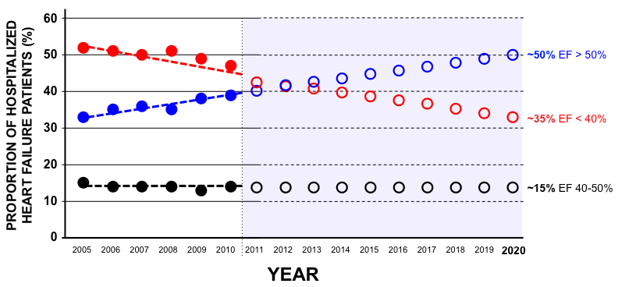
Hospitalized HFpEF: prevalence increasing
GWTG-HF: N=110,621 patients hospitalized with HF
P<0.0001 for trend of increased HFpEF prevalence
Oktay AA, Rich JD, Shah SJ. Curr Heart Fail Rep 2013
Based on Steinberg et al. Circulation 2012

Slide 5
Types of HFpEF
ENVIRONMENT, DIET
COMORBIDITIES
GENETIC SUSCEPTIBILITY
VULNERABLE HEART,
VULNERABLE PATIENT
HFpEF
EXERCISE INTOLERANCE
HFpEF
(Early HF)
VOLUME
OVERLOAD
HFpEF
PULMONARY HTN,
RV FAILURE
HFpEF
By 2020, 65% of hospitalized HF will have EF>40%
Shah SJ. JACC 2013

Slide 6
What is early HF?
Dyspnea and/or exercise intolerance due to underlying cardiac problem
No or minimal overt volume overload
Majority have a normal or near-normal LVEF
May have a normal BNP
Elevated LV filling pressure at rest or with volume loading, hand-grip, or exercise
Borlaug BA, et al. Circ Heart Fail 2010
Penicka M, et al. JACC 2010
Shah SJ. JACC 2013

Slide 7
How common is early HF in MESA?
28% of MESA ppt’s reported pedal edema at baseline
Pedal edema not associated with LV or RV systolic dysfunction on cardiac MRI
Pedal edema was associated with:
  Orthopnea (OR 1.66 [95% CI 1.30-2.12])
  PND (OR 1.95 [95% CI 1.21-2.68])
  Elevated NTproBNP (OR 1.80 [95% CI 1.21-2.68])
  Incident HF (adj. HR 1.43 [95% CI 1.02-1.99])
Yeboah J, et al. (unpublished data)

Slide 8
RATIONALE
This project addresses research gaps identified by 2011 NHLBI Working Group on HF Prevention:
  Determine the prevalence of early HF (i.e., transition from risk factors to HF)
  Elucidate the pathophysiology of early HF, particularly HFpEF
  Delineate the key antecedent risk factors and risk factor patterns associated with the transition from Stage B to Stage C HF
Notes:
Here’s where you can summarize the background and identify the key question(s) you are going to address;
It would be good state “impact”; also remember we have a final slide on impact where you can really reinforce it;

Slide 9
AIM 1
Prevalence of early HF
To determine the prevalence/subtype of early HF by assessing functional status (6MWT), physical activity (survey), symptoms, NTproBNP, echocardiography, arterial stiffness measures, and in a Wake Forest sub-sample, cardiopulmonary exercise testing.

Slide 10
CLINICAL, SYMPTOMATIC HF IS A SPECTRUM
Depends on: (1) type of clinical presentation; (2) MD threshold to hospitalize the patient vs. outpatient treatment
OUTPATIENT
Dyspnea on exertion due to myocardial problem with evidence of ⬇CO and/or
⬆PCWP at rest or with exertion
INPATIENT
CHF hospitalization due to overt volume overload and/or low output state
CLINICAL SPECTRUM
Traditional HF endpoint in epidemiology studies
HYPOTHESES:1) HF, when defined broadly to include exercise intolerance due to ⬇CO and/or ⬆LV filling pressure, is more common than previously recognized;
2) There are significant gender and race/ethnic differences in prevalence/subtype of early and all HF

Slide 11
AIM 2
Pathogenesis of early HF
To measure key physiologic parameters, risk factors, and novel biomarkers (ST2, gal-3, FGF23) concurrent to the assessment of HF status, and use the data from prior MESA exams to examine the associations between ideal CV health, risk factors, biomarkers, and changes in risk factors with all HF and early HFpEF specifically

Slide 12
Early HF pathogenesis
RISK FACTORS
CORONARY ENDOTHELIAL DYSFUNCTION
T-TUBULE
DISRUPTION
ARTERIAL STIFFENING
ABNORMAL
CARDIAC
MECHANICS
HFpEF
Paulus and Tschoppe. JACC 2013
Shah SJ, et al. Am J Physiol 2014

Slide 13
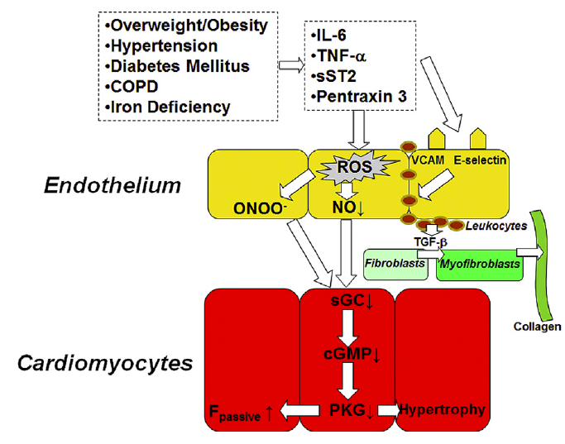
Adipose tissue: increased NP clearance
Obesity: reduced NP production
Paulus and Tschoppe
JACC 2013

Slide 14
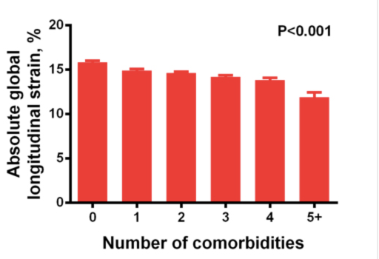
Risk factors and cardiac mechanics (HyperGEN, N=2150)
Longitudinal systolic function worsens
with increasing number
of risk factors
Diastolic function worsens
with increasing number
of risk factors
Number of risk factors
Number of risk factors
Selvaraj S…Shah SJ, et al. JAHA 2014

Slide 15
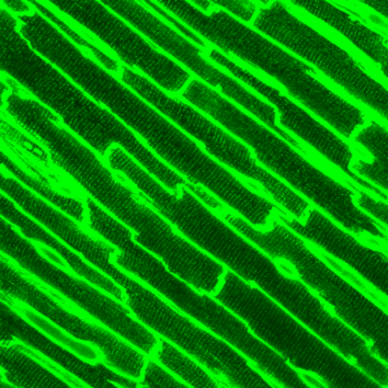
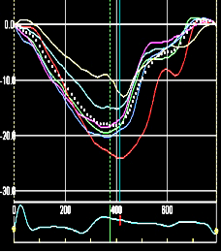
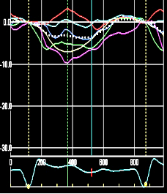
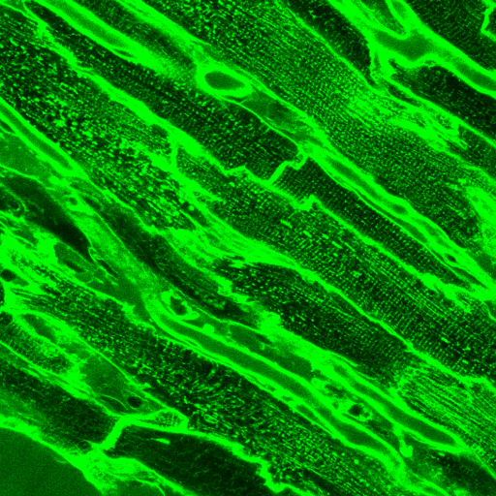
Ventricular-arterial interactions
Central aortic
waveform
Time-varying
wall stress
Confocal microscopy
(T-tubule staining)
Cardiac mechanics
(speckle-tracking echo)
NORMAL
Pressure
Systolic wall stress
Longitudinal strain
P_{f}
P_{b}
Time
Time
Time
aortic stiffness
reflected wave
time to peak
wall stress
T-tubule disruption
Abnormal Ca2+ cycling
Abnormal mechanics
HFpEF
Pressure
Systolic wall stress
Longitudinal strain
P_{f}
P_{b}
Time
Time
Time
Shah SJ, et al. Am J Physiol 2014; Shah SJ, et al. JACC 2012; Chirinos J, et al. JACC 2012

Slide 16
Ventricular-arterial interactions
Central aortic
waveform
Time-varying
wall stress
Confocal microscopy
(T-tubule staining)
Cardiac mechanics
(speckle-tracking echo)
NORMAL
Pressure
Systolic wall stress
Longitudinal strain
HYPOTHESIS: Risk factors (alone and in combination) have differential effects on cardiac mechanics, arterial stiffening, and the deleterious interplay between heart and arteries
P_{f}
P_{b}
Time
Time
Time
aortic stiffness
reflected wave
time to peak
wall stress
T-tubule disruption
Abnormal Ca2+ cycling
Abnormal mechanics
HFpEF
Pressure
Systolic wall stress
Longitudinal strain
P_{f}
P_{b}
Time
Time
Time
Shah SJ, et al. Am J Physiol 2014; Shah SJ, et al. JACC 2012; Chirinos J, et al. JACC 2012

Slide 17
Pathophysiologic contributors to HFpEF
Longitudinal systolic dysfunction
Diastolic dysfunction
Chronotropic incompetence
Extra-cardiac causes of volume overload
Autonomic dysfunction
HFpEF
Arterial stiffness
Endothelial dysfunction
Inflammation
Pulmonary hypertension / RV failure
Abnormal V-A coupling
Skeletal muscle abnormalities
Shah SJ, et al. Heart Fail Clin 2014

Slide 18
Pathophysiologic contributors to HFpEF
Longitudinal systolic dysfunction
Diastolic dysfunction
Chronotropic incompetence
Extra-cardiac causes of volume overload
Autonomic dysfunction
HFpEF
Arterial stiffness
Endothelial dysfunction
Inflammation
Pulmonary hypertension / RV failure
Abnormal V-A coupling
Skeletal muscle abnormalities
Shah SJ, et al. Heart Fail Clin 2014

Slide 19
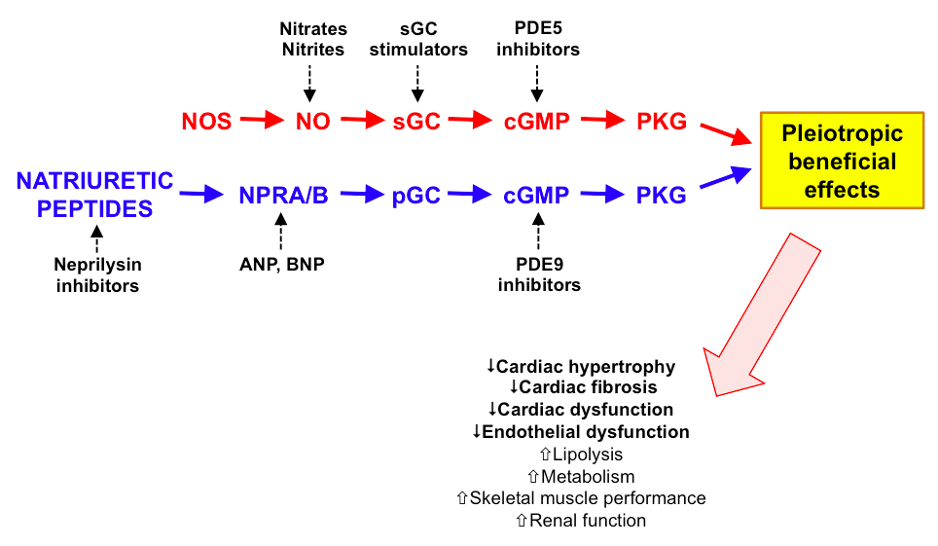
cGMP/PKG: deficient in HFpEF
Adipose tissue: increased NP clearance
Obesity: reduced NP production
Shah, Kitzman, Borlaug, van Heerebeek,
Zile, Kass, Paulus. Circulation 2016

Slide 20
AIM 3
Phenomics of early HF
To perform phenomics (machine learning analysis) of previously ascertained quantitative MESA data to define differential phenotype signatures (pheno-groups) and relate these pheno-groups to cardiac structure/function at Y15 and the prevalence and type of HF (e.g., early or overt HFpEF or HFrEF)

Slide 21
Traditional epidemiology of HF
1 OR 2 RISK FACTORS
or
RISK FACTOR SCORE
HEART FAILURE
Assumes HF is a homogenous syndrome
Ignores complex interactions between risk factors
Does not take advantage of wealth of high-density, quantitative phenotypic data

Slide 22
Multiple different risk factors, combinations of risk factors lead to abnormal myocardial structure/function
HFpEF
Multiple different (heterogeneous) clinical presentations / pathophysiologic phenotypes
Shah SJ, et al. Heart Fail Clin 2014

Slide 23


HEART FAILURE
RISK FACTOR
COMBINATIONS
HEART FAILURE
PATHOPHYSIOLOGIC
SUBTYPES
HYPOTHESIS: Specific HF risk factor phenotypic signatures are associated with specific
HF pathophysiologic subtypes
Shah SJ, et al. Heart Fail Clin 2014

Slide 24
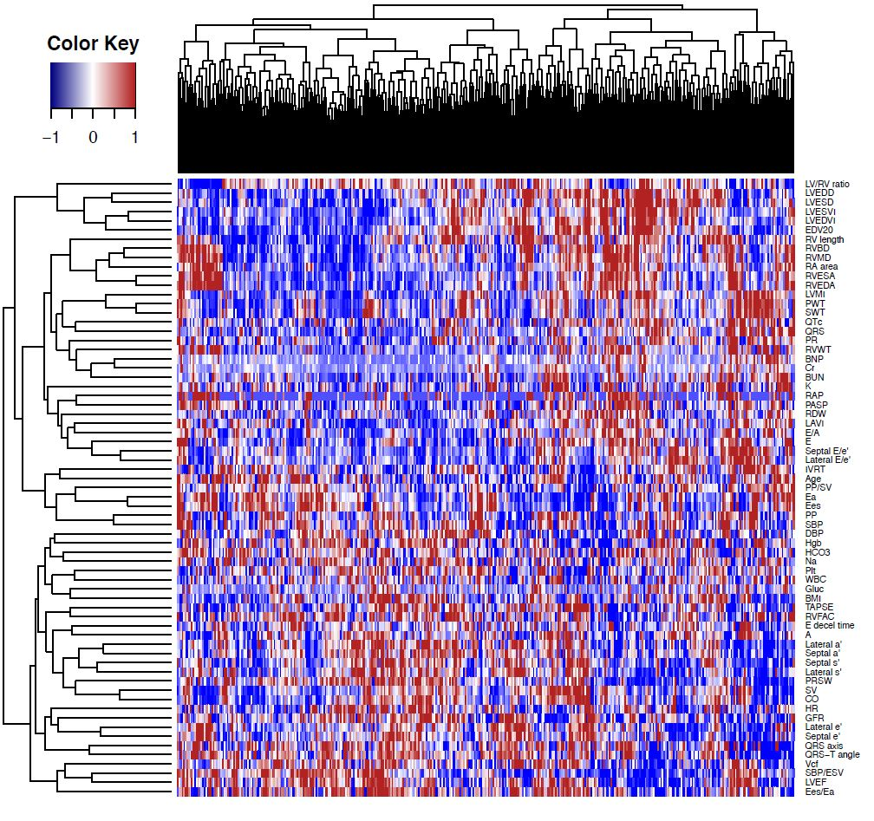
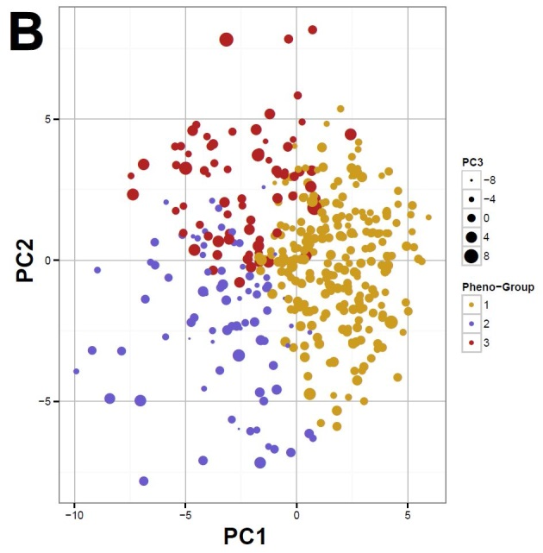
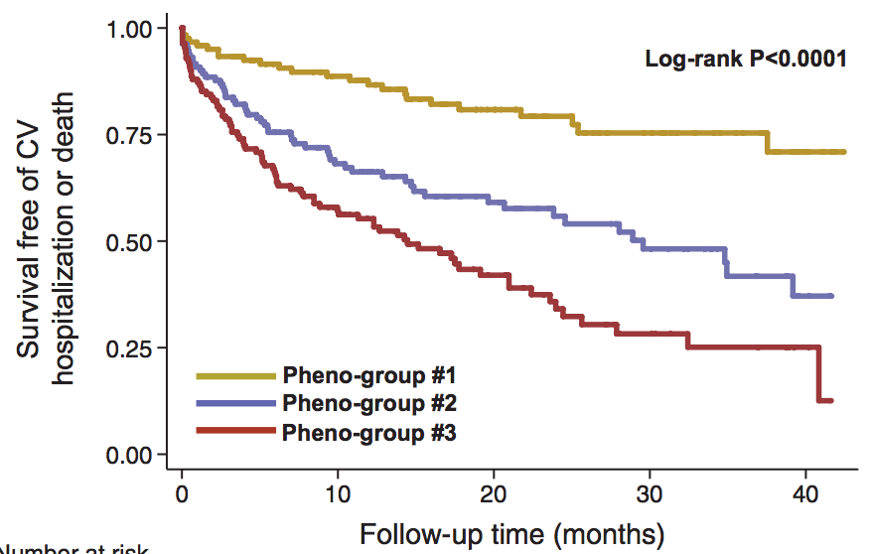
Phenomapping of HFpEF
Shah SJ, et al. Circulation 2015

Slide 25
Pheno-group classification:
Added prognostic value over MAGGIC risk score and BNP
Replicated prospectively in 107 additional HFpEF patients
Shah SJ, et al. Circulation 2015

Slide 26
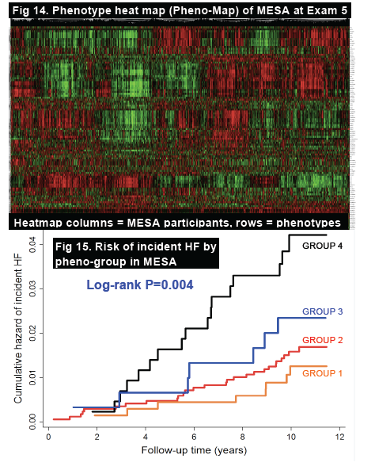
Phenomapping of HF in MESA
Analysis included in grant application (unpublished data)

Slide 27
MESA existing quantitative phenotype domains (pre-Y15)
Anthropomorphic data
Environmental data
  Diet, geocoding, pollution
Sleep questionnaire data
Biomarkers, laboratory data
Spirometry (lung function)
Electrocardiography
Arterial tonometry
Coronary CT
Cardiac MRI
Phenomics
analysis
Unique phenotype
signatures

Slide 28
METHODS (1)
All participants (N=3500?) will undergo contract exam, PLUS
  6-minute walk test
  Kansas City Cardiomyopathy Questionnaire (KCCQ12)
  PROMIS Dyspnea Questionnaire
  Physical Activity Survey (MESA TWPAS)

Slide 29
METHODS (2)
Laboratory Testing
  All: Serum NTproBNP, glucose, creatinine, urine microalbumin
  Case-cohort approach: novel biomarkers (ST2, galectin-3, FGF23) to be performed after exam 6
    Budgeted to run 1000 assays for each biomarker

Slide 30
METHODS (3)
Echocardiography with Doppler, tissue Doppler and speckle-tracking
  At rest
  Passive leg raise (preload)
  Bilateral cuff occlusion (afterload)
Arterial stiffness (Fukuda VaSera)
Cardiopulmonary exercise testing in a subset (n=300) to validate early HF dx, as CPEX is gold standard for evaluating exercise intolerance

Slide 31
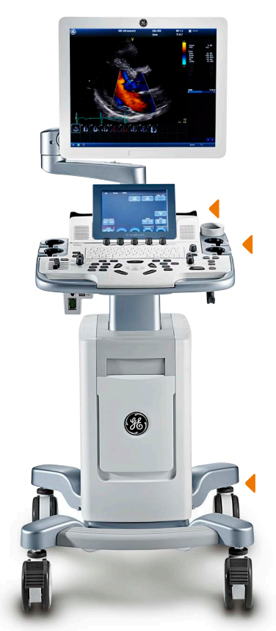
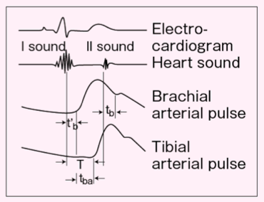
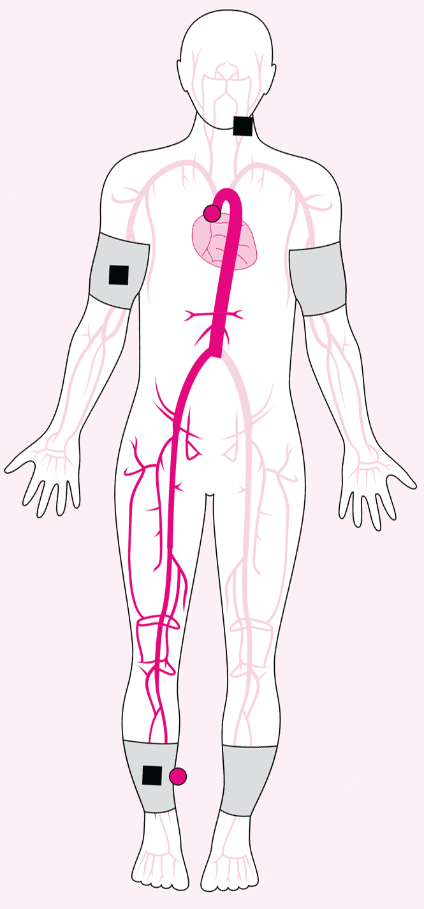
Fukuda
VaSera
(automated
PWV, ABI, HRV)
Vivid T8 cardiac ultrasound system
(tissue Doppler, speckle-tracking)

Slide 32
METHODS (3)
Definition of early HF:
  No prior HF hospitalization and
  Presence of HF symptoms or functional limitation suggestive of HF and
  NTproBNP or echo evidence of elevated LV filling pressure (at rest or with passive leg raise or bilateral cuff occlusion)
Notes:
Definition of early HF: We will define early HF based on the combination of: (1) symptoms and signs of HF and (2) objective abnormalities of cardiac structure and/or function on echocardiography. We will use a HF symptom survey to identify symptoms of HF in study participants. Signs of HF will include 6MWT distance significantly below age- and gender-specific norms; elevated NT-proBNP; and echocardiographic signs of HF, including elevated left atrial pressure (E/e’ ratio) or right atrial pressure (size and collapsibility of the inferior vena cava); increased pulmonary artery systolic pressure; and/or reduced cardiac output (estimated using the LV outflow tract velocity-time integral). Abnormalities in cardiac structure and function on echocardiography will include cardiac chamber dilation, LV or RV systolic dysfunction, LV hypertrophy, LV diastolic dysfunction, and/or overt LV systolic dysfunction (i.e,. reduced LVEF). We anticipate that participants with early HF have reduced physical activity (measured objectively using accelerometry) compared to those without early HF. The CPEX will be performed in 400 participants unselected for early HF (only excluding those with prior hospitalization for HF or ischemic heart disease in prior 6 months), and will be used to verify the diagnosis of early HF. This will allow us to determine the sensitivity and specificity of our symptom/NTproBNP/6MWT/echo-based early HF definition.

Slide 33
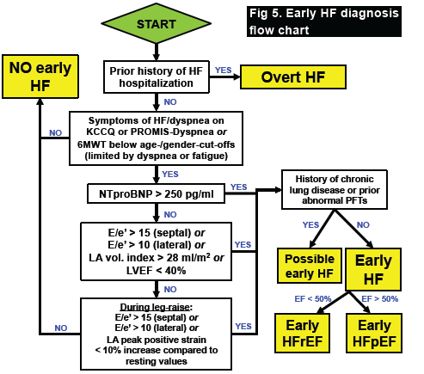
Approach to Early HF Classification

Slide 34
IMPACT
Clinical impact within the next 5 years:
  Characterization of the early HF syndrome, including prevalence data, diagnostic criteria, and clinical characteristics will help inform design of prevention and intervention trials
  Identification of patients at highest risk for transitioning from Stage B→C (early) HF

Slide 35

thank you!

Slide 36
Statistical analyses
Aims 1 and 2 will be analyzed using standard techniques (linear, logistic regression)
Aim 3: Phenomics analysis (phenomapping)
  Quantitative phenotypes standardized (mean 0, SD 1)
  Hierarchical cluster analysis for data visualization
  Model-based clustering with BIC penalty
  Principal components analysis
  Multinomial logistic regression with lasso penalty
  Internal and external validation/replication
Notes:
Definition of early HF: We will define early HF based on the combination of: (1) symptoms and signs of HF and (2) objective abnormalities of cardiac structure and/or function on echocardiography. We will use a HF symptom survey to identify symptoms of HF in study participants. Signs of HF will include 6MWT distance significantly below age- and gender-specific norms; elevated NT-proBNP; and echocardiographic signs of HF, including elevated left atrial pressure (E/e’ ratio) or right atrial pressure (size and collapsibility of the inferior vena cava); increased pulmonary artery systolic pressure; and/or reduced cardiac output (estimated using the LV outflow tract velocity-time integral). Abnormalities in cardiac structure and function on echocardiography will include cardiac chamber dilation, LV or RV systolic dysfunction, LV hypertrophy, LV diastolic dysfunction, and/or overt LV systolic dysfunction (i.e,. reduced LVEF). We anticipate that participants with early HF have reduced physical activity (measured objectively using accelerometry) compared to those without early HF. The CPEX will be performed in 400 participants unselected for early HF (only excluding those with prior hospitalization for HF or ischemic heart disease in prior 6 months), and will be used to verify the diagnosis of early HF. This will allow us to determine the sensitivity and specificity of our symptom/NTproBNP/6MWT/echo-based early HF definition.

Slide 37
Power calculations
Projected sample size = 3500
Aim 1: >90% probability of obtaining a 95% CI bounds of 8, 10% around our estimate of total HF prevalence of 9%
Aim 2: >80% power to detect OR for difference in early HF by gender and race/ethnicity in the range of 1.4-1.7 as well as major RFs such as obesity, diabetes, HTN and CKD
Aim 3: Estimated sample size of each pheno-group = 600; based on “best” vs. “worst” pheno-group (power = 0.8, alpha = 0.05) Minimal detectable difference:
  Global longitudinal strain: 1.5% (0.25%-units) difference
  Time-to-peak longitudinal wall stress: 3% (2.5 ms) difference
Notes:
Definition of early HF: We will define early HF based on the combination of: (1) symptoms and signs of HF and (2) objective abnormalities of cardiac structure and/or function on echocardiography. We will use a HF symptom survey to identify symptoms of HF in study participants. Signs of HF will include 6MWT distance significantly below age- and gender-specific norms; elevated NT-proBNP; and echocardiographic signs of HF, including elevated left atrial pressure (E/e’ ratio) or right atrial pressure (size and collapsibility of the inferior vena cava); increased pulmonary artery systolic pressure; and/or reduced cardiac output (estimated using the LV outflow tract velocity-time integral). Abnormalities in cardiac structure and function on echocardiography will include cardiac chamber dilation, LV or RV systolic dysfunction, LV hypertrophy, LV diastolic dysfunction, and/or overt LV systolic dysfunction (i.e,. reduced LVEF). We anticipate that participants with early HF have reduced physical activity (measured objectively using accelerometry) compared to those without early HF. The CPEX will be performed in 400 participants unselected for early HF (only excluding those with prior hospitalization for HF or ischemic heart disease in prior 6 months), and will be used to verify the diagnosis of early HF. This will allow us to determine the sensitivity and specificity of our symptom/NTproBNP/6MWT/echo-based early HF definition.

Slide 38
Advantages of conducting this project in MESA
Aim 1: Older, both genders, multi-ethnic cohort, with high RF burden; represents elderly population at risk for early HF, HFpEF
Aim 2: Accessible “population laboratory” in whom we can conduct high-density, quantitative CV phenotyping (at rest and with loading conditions)
Aim 3: Large amount of previously collected, quantitative phenotypic data in multiple domains for use in phenomics analyses

Slide 39
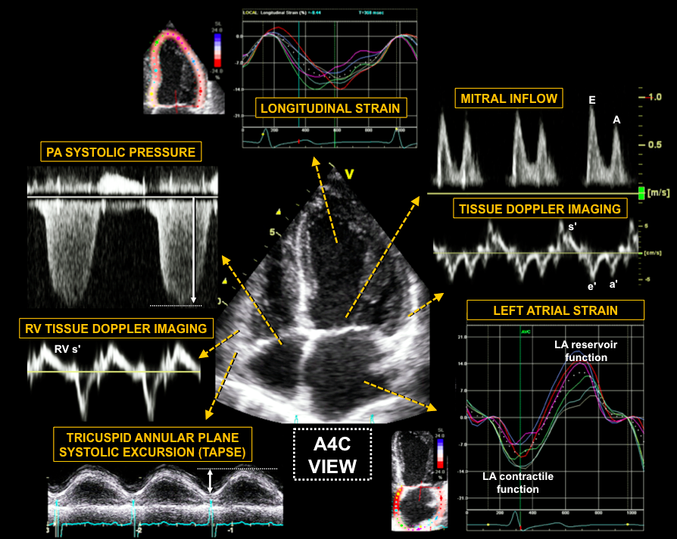

Slide 40
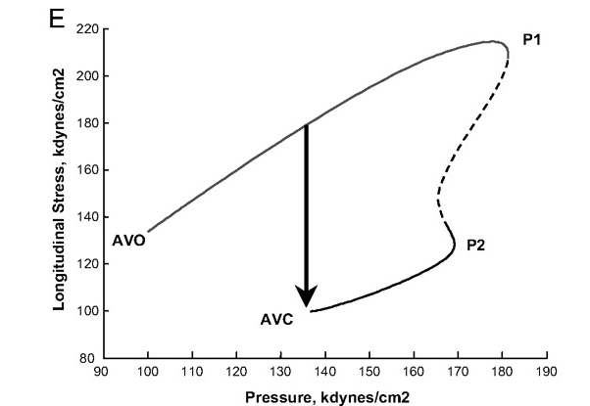
Time-varying myocardial pressure-stress relationships
`

Slide 41
Cardiac MRI in MESA
Characteristic | MRI (N=5090) | No MRI (N=1615) | P-value
Age (years) | 61.2 (10.0) | 63.5 (10.4) | <0.001
Male (%) | 47.1 | 45.0 | 0.153
African-American (%) | 25.1 | 32.4 | <0.001
BMI (kg/m²) | 27.7 (4.9) | 30.1 (6.5) | <0.001
SBP (mmHg) | 125.3 (21.2) | 129.3 (21.8) | <0.001
HR (bpm) | 62.8 (9.3) | 63.9 (10.1) | <0.001
Diabetes (%) | 11.5 | 15.5 | <0.001
CRP (mg/L) | 1.8 (0.8 to 4.0) | 2.2 (1.0 to 4.9) | <0.001
CAC score > 10 (%) | 40.2 | 45.0 | 0.001

Slide 42
Incident HF by MRI completion status
No MRI
MRI
Log-rank P<0.0001
Model | MRI (N=5090) | No MRI (N=1615) | p-value
Unadjusted | reference | 1.73 (1.28 to 2.33) | <0.001
Age-, race-, and sex-adjusted | reference | 1.44 (1.06 to 1.94) | 0.011

Slide 43
Hypotheses (Aim 1)
1a. HF, defined broadly to include exercise intolerance due to decreased cardiac output and/or increased LV filling pressure, is 1.5-fold higher than current NHANES-based estimates of HF prevalence in adults aged ≥60 (8%), and differs by gender and race/ethnicity.
1b. When HF is defined to include outpatient, inpatient HF, and early HF, the proportion of HF that is HFpEF exceeds current estimates (40-50%) and is ≥70%.

Slide 44
Hypotheses (AIM 2)
2a. Ideal CV health at baseline is associated with preserved CV structure/function 15 years later, while obesity and diabetes are associated with worse cardiac mechanics; CKD, HTN, and coronary atherosclerosis amplify these abnormalities through ventricular-arterial (V-A) interactions: increased aortic impedance and longitudinal wall stress, and increased time to peak wall stress.
2b. Abnormalities in cardiac mechanics and V-A interactions are associated with early HF.
2c. Increased slope of risk factor worsening (e.g., steeper weight rise, reduction in renal function) from Y0 to Y10 is associated with increased prevalence of HF, including early HF, by Y15.

Slide 45
Hypotheses (AIM 3)
3a. Year 15 cardiovascular structure/function will differ significantly among pheno-groups.
3b. Risk for HF and subtype of HF will differ significantly among pheno-groups, and pheno-group membership will be associated with HF independent of individual risk factors.

Slide 46
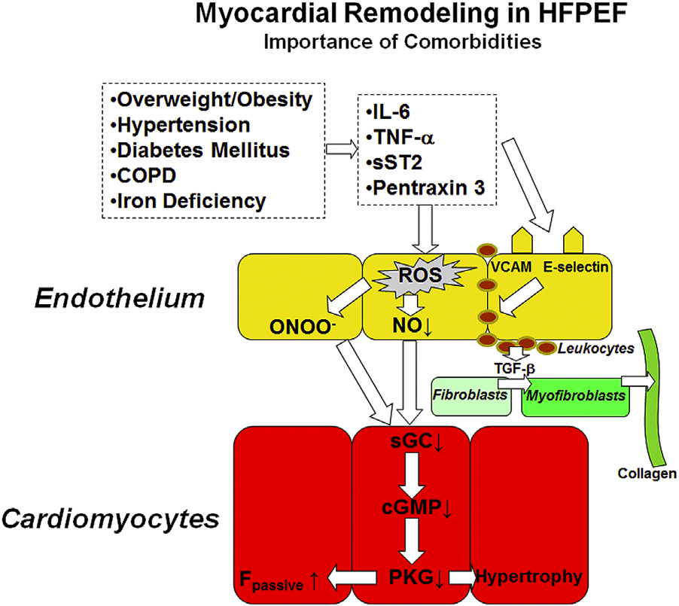
Paulus and Tschoppe. JACC 2013

Slide 47
Cardiomyocyte T-tubule disorganization = worse cardiac mechanics
SHR R² = 0.56, P<0.001
WKY R² = 0.14, P=0.10
Global longitudinal strain (%)
T-tubule organizational index
(~efficiency of myocyte Ca²⁺ handling)
Shah SJ, et al. Am J Physiol Heart Circ Physiol 2014

Slide 48
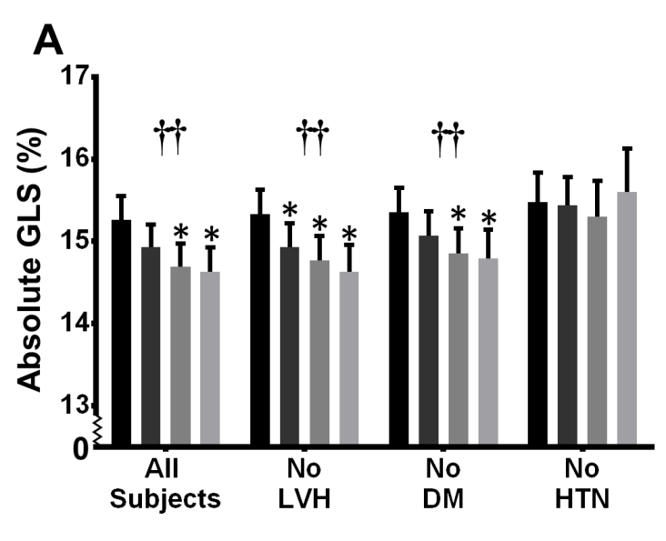
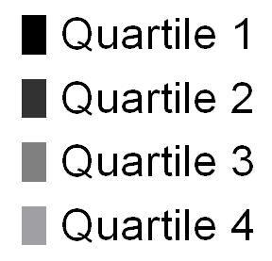
Endothelial dysfunction and cardiac mechanics (HyperGEN)
Quartile of albuminuria
Katz DH….Shah SJ.
Circulation 2014

Slide 49
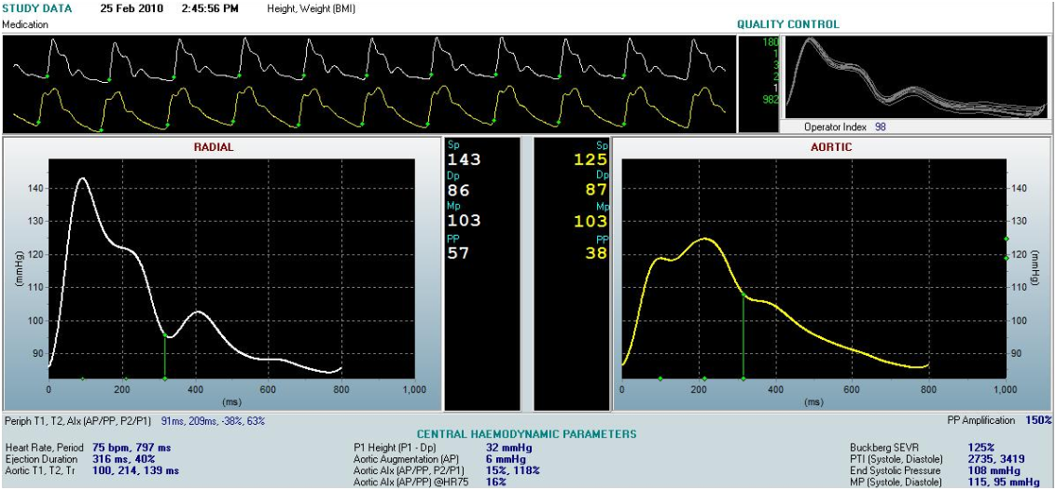
Arterial tonometry
Allows estimation of central aortic (~LV) pressure during LV ejection

Slide 50
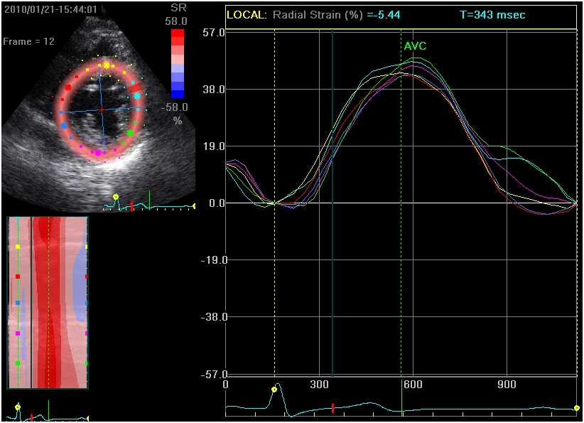
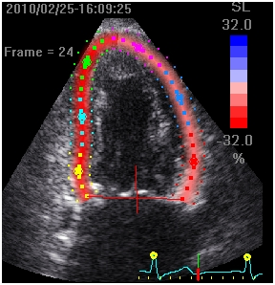
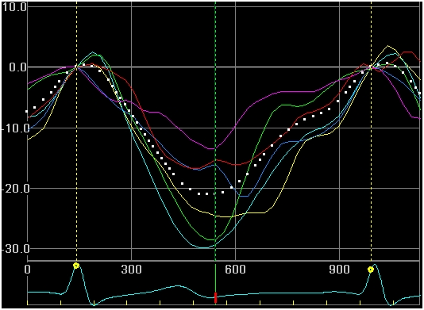
Speckle-tracking echo
Allows estimation of time-varying wall thickness and radius during LV ejection

Slide 51
Early HF: prevention & treatment
Prevention
Therapies
  Ivarbradine (I_{f} inhibition)
  Exercise training
  Ranolazine (late I_{Na} inhibition)
  Interatrial shunt devices (left atrial decompression)

Slide 52
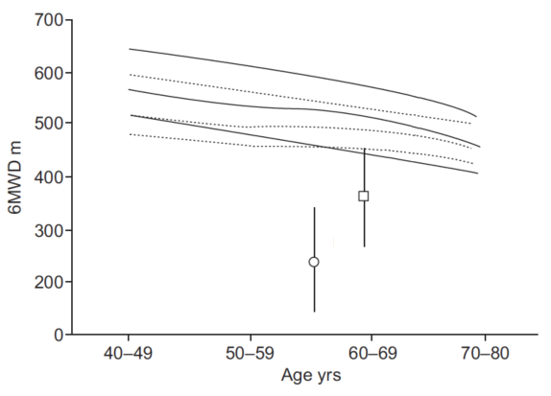
6MWT reference standard
(Six Minute Walk Distance Project; 444 participants from 10 countries)
10th percentile
NYHA II
NYHA III-IV
Casanova C, et al. Eur Respir J 2011

Slide 53
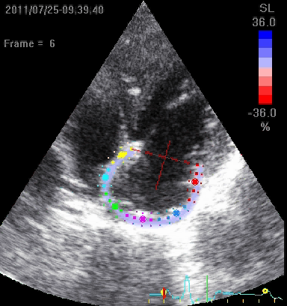
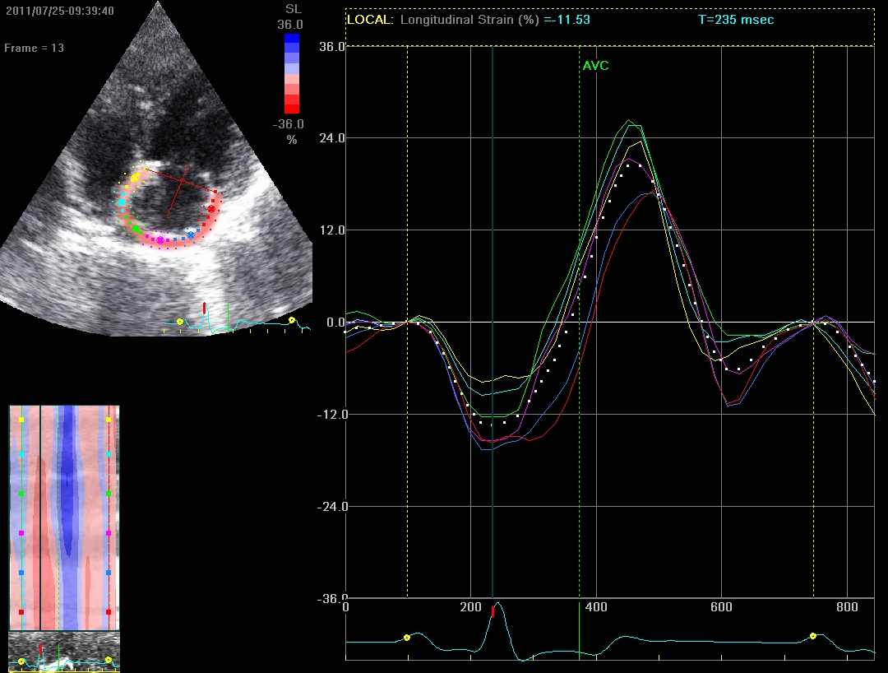
CONDUIT
(passive atrial
emptying)
RESERVOIR
(atrial filling)
BOOSTER
(atrial kick)

Slide 54
Abnormal LA mechanics in HFpEF
P=0.001
P=0.0009
LA reservoir strain > 31.2%
LA reservoir strain < 31.2%
LA strain is a better predictor of outcomes compared to
LV or RV longitudinal strain
Freed et al. Circ Cardiovasc Imaging 2016

Slide 55

Abnormal LA mechanics in HFpEF
LV diastolic dysfunction
LA
fibrosis
Atrial
fibrillation
Atrial myopathy
Chronic
LA pressure and volume overload
Pulmonary venous congestion
Pulmonary vasoconstriction
RV afterload
RV failure
ABNORMAL LA MECHANICS
Reduced atrial emptying
Decreased LV filling
Decreased cardiac output
Decreased peak VO₂
CONDUIT
RESERVOIR
BOOSTER
EXERCISE INTOLERANCE
ADVERSE OUTCOMES

Slide 56
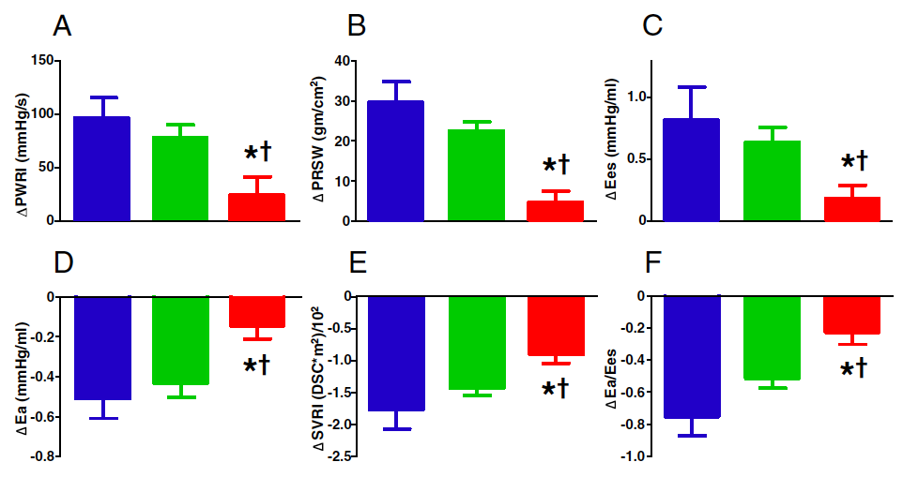
HFpEF: Global CV reserve dysfxn
HFpEF: evidence of impaired CV reserve at 20W exercise
Blue = Control
Green = HTN
Red = HFpEF
Borlaug B, et al. JACC 2010

Slide 57
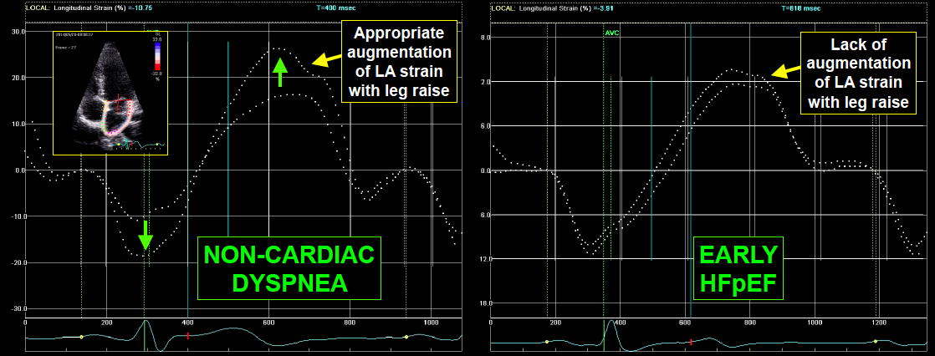
Effect of preload on LA strain
HFpEF vs. non-cardiac dyspnea

Slide 58
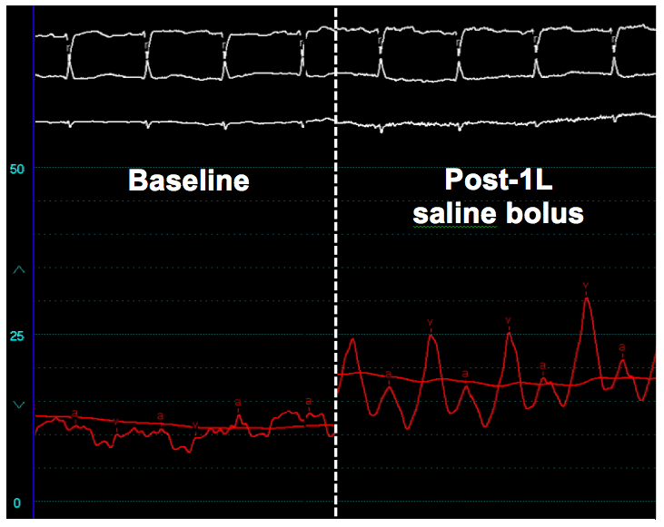
Volume challenge in a patient w/HFpEF
50
mmHg
25
mmHg
0
mmHg
PCWP (mmHg)
(No dynamic MR)

