Slide 1
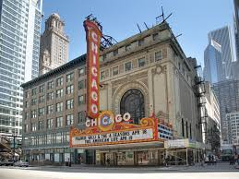
Six Minute Walk Test (6MWT)
MESA Exam 6 Training
Chicago, July 2016
Alain Bertoni MD MPH

Slide 2
Introduction I
The 6MWT measures the distance a participant is able to walk over 6 minutes on a flat surface at their own pace.
It is a measure of functional capacity in older community-dwelling adults
Was administered previously at some MESA field centers (Barr study)
Has been used to assess exercise capacity in chronic pulmonary disease and heart failure
The 6MWT distance significantly improves the prediction of incident HF even when including traditional risk factors and NTproBNP as model variables

Slide 3
Introduction II
Also using 6MWT as a “cardiopulmonary exercise test” to compare with the CPEX being performed in a subset of MESA participants at Wake Forest
The 6MWT correlates strongly with CPEX variables including peak VO2 and VE/VCO2 slope in HF patients
6MWT is similarly predictive of hospitalization and mortality in HF patients (as CPEX)

Slide 4
Contraindications
Absolute contraindications for the 6MWT include the following:
Unstable angina (chest pain) during the previous month
New or worsening symptoms of chest pain, shortening of breath, or fainting in past 8 weeks
Use of a wheelchair, crutches or walker
Relative contraindications include the following (assessed earlier in visit)
Resting heart rate of less than 50 or more than 110 at rest
Systolic blood pressure of more than 180 mm Hg
Diastolic blood pressure of more than 110 mm Hg
These are assessed at the beginning of the testing period and are documented on Item 1 of the 6MWT Form

Slide 5
Safety I
Test should occur in a location where an a rapid, appropriate response to an emergency is possible
Adverse events are rare, but it is useful to have typical medical supplies (e.g. albuterol, aspirin, oxygen)
Physicians are not required to be present during tests; however, it is helpful if testing occurs in a setting in which medical professionals (e.g., RNs) are available in the case of an emergency

Slide 6
Safety II
Reasons for immediately stopping a 6MWT include the following:
1 chest pain
2 intolerable dyspnea
3 leg cramps
4 staggering
5 diaphoresis
6 pale or ashen appearance
If a test is stopped for any of these reasons, the participant should sit or lie supine as appropriate depending on the severity or the event and the technician’s assessment of the severity of the event and the risk of syncope (fainting).
The following should be obtained based on the judgment of the technician: BP, pulse rate, oxygen saturation, and a physician evaluation. Oxygen should be administered as appropriate.

Slide 7
Safety III: Supplemental Oxygen
If the participant usually uses oxygen, then continue it for the 6MWT. If the patient uses oxygen for the walk, the technician should walk behind the patient carrying the oxygen source
If they use it only for exercise, do not use it for the 6MWT.
Measurements of pulse oximetry should be made after waiting at least 10 minutes after any change in oxygen delivery.

Slide 8
Safety IV
Low Pulse Oximetry results(<90%)
Is it real? The oximeter reading may be less accurate if a person is wearing nail polish, artificial nails, has cold hands, or has poor circulation, or very dark skin
If participant non-toxic appearing, talking without difficulty, then not likely hypoxic
IF the person appear cyanotic, is short of breath, has known significant lung disease- alert appropriate clinic staff

Slide 9
Equipment
Countdown timer (or stopwatch) (as back up) OR Notebook Computer with timer tool
Mechanical lap counter
Two small cones to mark the turnaround points
A chair that can be easily moved along the walking course
Worksheets on a clipboard
A source of oxygen (in case of emergency)
Sphygmomanometer (in case of emergency)
Telephone (in case of emergency)
Automated electronic defibrillator (on site)
Pulse oximeter - Devon Medical Handheld Pulse Oximeter PC-66

Slide 10
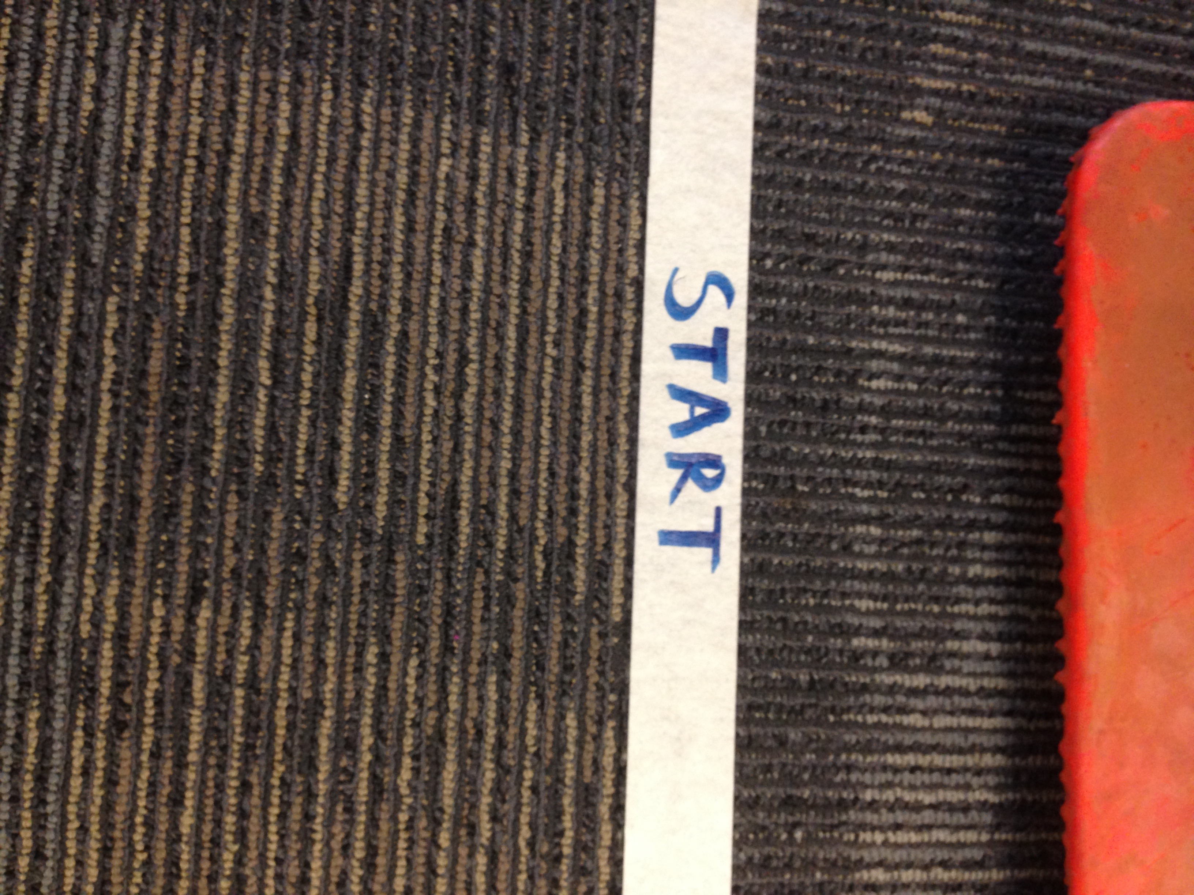
The Walkway
A 20 meter length course in a long, flat, straight corridor (appox 70 feet long) with a hard surface
Best if not frequently used by many people
Clearly labeled starting line (bright tape)

Slide 11
20 Meters (approx 66 feet)
Start
Turn
1 Full Lap= 40 Meters
Turn
Mark every 2 meters along the course (tape suggested) until end
Obvious marker (e.g. traffic cone) at Start and End

Slide 12
How long is 6 Minutes?
Which of the following songs comes closest?
Rappers Delight, Sugar Hill Gang
American Pie, Don McClean
Stairway To Heaven, Led Zepplin
Bohemian Rhapsody, Queen
Piano Man, Billy Joel

Slide 13
How long is 6 Minutes?
Which of the following songs comes closest?
Rappers Delight, Sugar Hill Gang (15 min)
American Pie, Don McClean (8 min 30 sec)
Stairway To Heaven, Led Zepplin (8 min)
Bohemian Rhapsody, Queen (6min 6 sec)
Piano Man, Billy Joel (5 min 22)

Slide 14
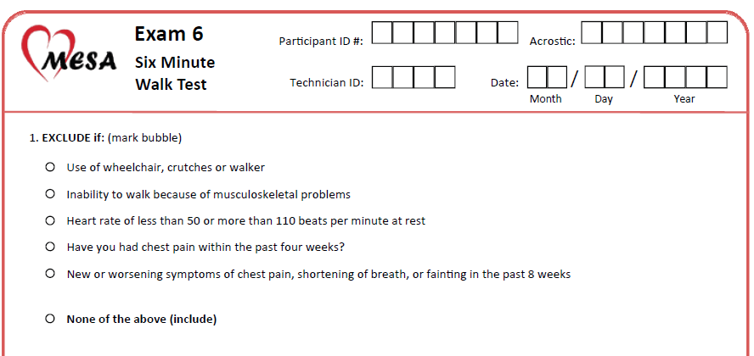
Form I
Interviewer Administered

Slide 15
Form II
Use Pulse Oximeter to measure heart rate and SpO2
If on oxygen, measure while participant is using it

Slide 16
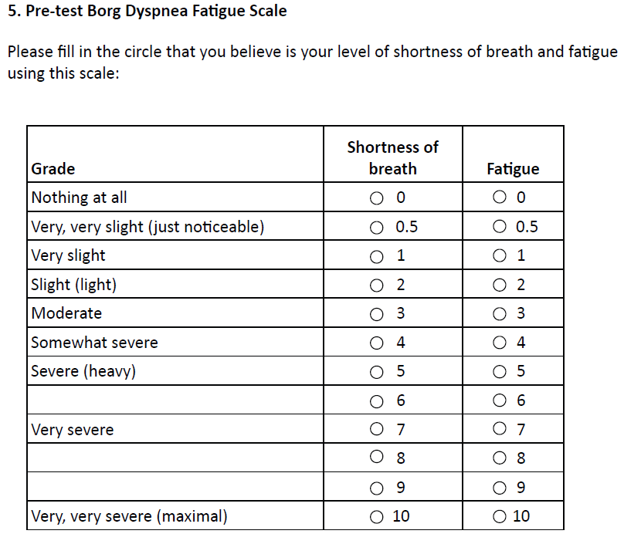

Slide 17
Times Should be 6 minutes apart!
Length of course is 20 meters

Slide 19
Form, Continued

Slide 20
Participant Preparation
Comfortable clothing should be worn.
Appropriate shoes for walking should be worn.
Patients should use their usual walking aids during the test (cane, walker, etc.).
The patient’s usual medical regimen should be continued.
A light meal is acceptable before early morning or early afternoon tests.
Patients should not have exercised vigorously within 2 hours of beginning the test.

Slide 21
Testing Procedure I
Testing should be performed about the same time of day to minimize intraday variability.
A “warm-up” period before the test should not be performed.
The participant should sit at rest in a chair, located near the starting position, for at least 10 minutes before the test starts.
During this time, check for contraindications , fill out form items, and make sure that clothing and shoes are appropriate.

Slide 22
Testing Procedure II
Set the lap counter to zero and the timer to 6 min. Assemble all necessary equipment (lap counter, timer, clipboard /notebook )
Instruct the participant using the script including doing a demonstration of turning around the cone briskly
Position the participant at the Start line, and stand near that line during the test
If participant needs oxygen tank held for them may hold it and walk with them

Slide 23
Testing Procedure III
During the test:
Do not talk to anyone.
Use an even tone of voice when using the phrases of encouragement
Watch the patient
Do not get distracted and lose count of the laps.
Each time the participant returns to the starting line, click the lap counter once (or mark the lap on the worksheet). Let the participant see you do it. Exaggerate the click using body language, like using a stopwatch at a race.

Slide 24
Script I
“The object of this test is to walk as far as possible for 6 minutes. You will walk back and forth in this hallway. Six minutes is a long time to walk, so you will be exerting yourself. You will probably get out of breath or become exhausted. You are permitted to slow down, to stop, and to rest as necessary. You may lean against the wall while resting, but resume walking as soon as you are able. You will be walking back and forth around the cones. You should pivot briskly around the cones and continue back the other way without hesitation. Now I’m going to show you. Please watch the way I turn without hesitation.”
“Are you ready to do that? I am going to use this counter to keep track of the number of laps you complete. I will click it each time you turn around at this starting line. Remember that the object is to walk AS FAR AS POSSIBLE for 6 minutes, but don’t run or jog. Start now, or whenever you are ready.”

Slide 25
Script II
When the timer shows 5 minutes, tell the participant the following (in even tones):
“You are doing well. You have 5 minutes to go.”
When the timer shows 4 minutes remaining, tell the participant the following:
“Keep up the good work. You have 4 minutes to go.”
When the timer shows 3 minutes remaining, tell the participant the following:
“You are doing well. You are halfway done.”
When the timer shows 2 minutes remaining, tell the participant the following:
“Keep up the good work. You have only 2 minutes left.”
When the timer shows only 1 minute remaining, tell the participant:
“You are doing well. You have only 1 minute to go.”
Do not use other words of encouragement (or body language to speed up).

Slide 26
Script III
If the participant stops walking during the test and needs a rest, say this (Do not stop the timer):“You can lean against the wall if you would like; then continue walking whenever you feel able.”
When the timer is 15 seconds from completion, say this: “In a moment I’m going to tell you to stop. When I do, just stop right where you are and I will come to you.”
When the timer rings (or buzzes), say: “Stop!”

Slide 27
At conclusion of 6MWT
Go to participant, note where they stopped, and record the additional distance covered
Offer chair where participant is standing if appear exhausted, or walk them to the chair
Ask post-test questions/ measure HR and Sp02 and complete form
Congratulate participant on good effort and offer a drink of water.

Slide 28
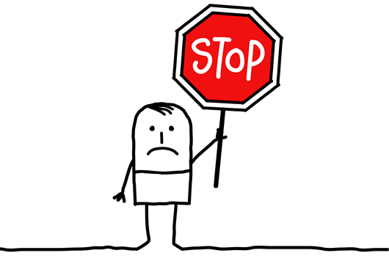
Participant Stops Test
If the participant stops before the 6 minutes are up and refuses to continue (or you decide that they should not continue), wheel the chair over for the patient to sit on, discontinue the walk, and note on the worksheet the distance, the time stopped (Item 7) and the reason for stopping prematurely (item 8)

Slide 29
Video

Slide 30
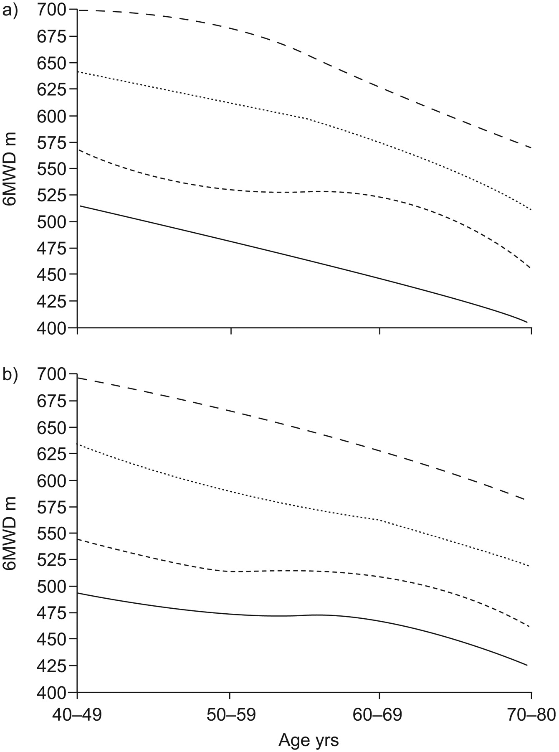
What is a normal result?
In one study,
444 healthy M/F aged 40-80, mean/St dev was
571 meters +/- 90m
Casanova et al, Eur Resp J 2011
Age-based reference curves for 6MWT distance in normal a) males and b) females divided into 10th (—–), 25th (-----), 50th (..........) and 75th (– – –) percentiles.

Slide 31
Factors reported to reduce 6MWT distance
Short height (shorter steps)
Older age, female gender
Obesity
Impaired cognition
Pulmonary and Cardiovascular disease
Musculoskeletal disorders (e.g. arthritis)

