Slide 1
Results Reporting for MESA Exam 6
Results Reporting for Multi-Ethnic Study of Atherosclerosis “MESA” Exam 6
Imene Benayache, M.D.
Johns Hopkins University

Slide 2
“Declare the past, diagnose the present, foretell the future.”
~Hippocrates.

Slide 3
Presentation
Introduction
Benefits of MESA participation
Objectives
The different types of results reporting
Timelines of reporting
Importance of results reporting
MESA Exam 6 Alerts
Immediate & urgent referrals
Conclusion

Slide 4
Introduction
Results are valued by participants and that they help maintain participant interest and participation in MESA
It plays a crucial role in participants retention over time (next slide)

Slide 5
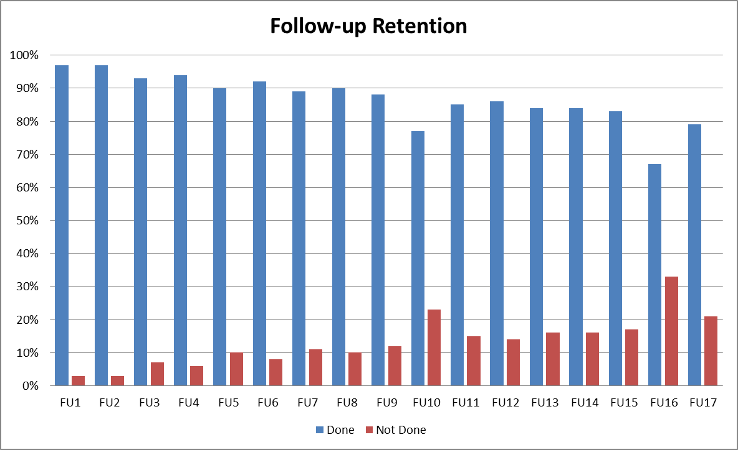
Benefits of MESA participation (1)

Slide 6
Benefits of MESA participation (2)
One of the MESA study participation benefits are the extensive medical tests along with the results reporting to them “participants” and their Physicians/Providers

Slide 7
Objectives
Notification of the participants within a reasonable time frame (4 weeks for lab results, 6 weeks for high tech results)
Reporting any significant findings to the ppt and his/her Primary Care Physician
Referral for urgent clinical abnormalities

Slide 8
The different type of results reporting (1)
The participants will get a total of three (3) results and sometimes alert letters or correspondence to them and their Primary Care Physician “PCP”/designated Physician

Slide 9
The different type of results reporting (2)
An Initial Report which summarizes the clinic visit including (Height, Weight, BMI, BP & HR and Oxygen Saturation)
A second report, referred to as “Lab letter” (including spirometry and blood assays such as lipids, fasting plasma glucose, etc.)
A third report called “High Technology letter” includes the results of (Lung CT, echo, heart rhythm monitor, and other procedures done during the visit).
***Finally: Alerts notifications in case of medical emergencies findings “Notifications and Referrals”

Slide 10
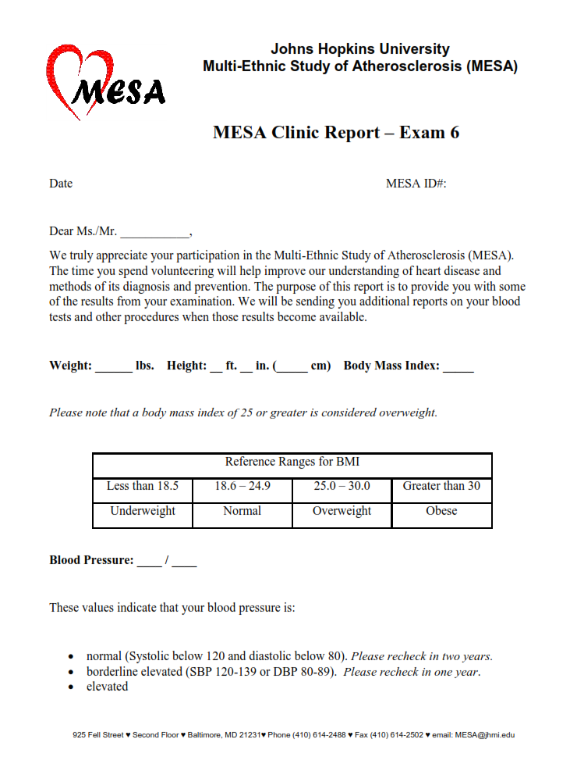
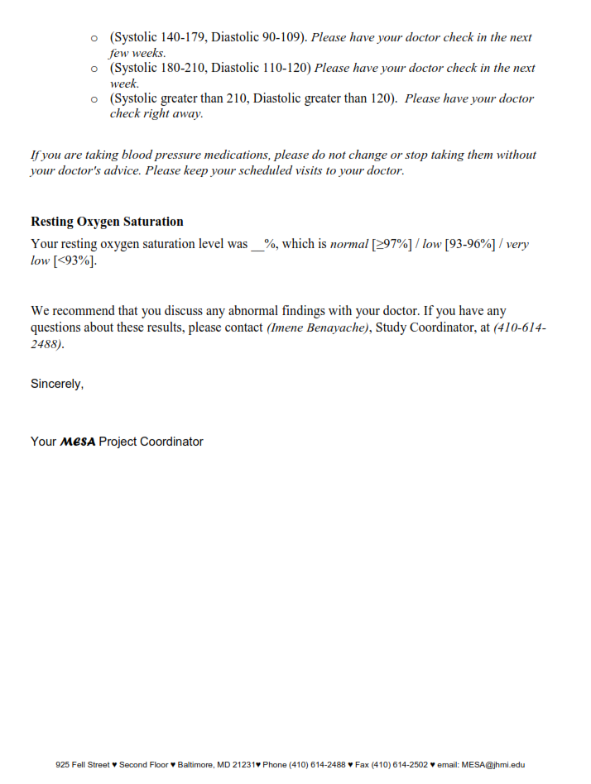
Initial Report “Exit Template”

Slide 11
Second Report “Lab Results Template”

Slide 12
Final Report “High Tech Template”

Slide 13
Timelines of results reporting
The aim is to get the results out within a reasonable time frame, as indicated below:
The Initial Report will be handed at the end of the exam day or mailed to the participant one to two weeks after the examination
A second report should be mailed within one month after the clinic visit
A third report should be mailed after one to two months after the completion of the examination

Slide 14
Importance of results reporting (1)
Reporting of selected test results to Participants “ppts” is one system for insuring that important results are not missed
To alleviate participants’ anxieties the results should be reported within a reasonable time frame
Enhances ppts sense of Safety and Medical follow-up since for some ppts this is the only time/opportunity they have to see a doctor and have laboratory & high tech tests done

Slide 15
Importance of results reporting (2)
Results should be provided in language understandable to the ppts
Most of the results gathered from tests must be disclosed to them as soon as they are available

Slide 16
MESA Exam 6 Alerts (1)
A follow-up system is implemented for abnormal tests and includes the following alerts:
Clinic Alerts (the day of the visit) for ↑or ↓ BP, ↓O2 Sat, Brain MRI abnormal finding, Echo cardiogram abnormalities, and Chest CT scan abnormalities
Reading Center Alerts &/Incidental findings including (heart monitoring patch after 14 days), Chest CT, Echo, MRI, Lab results…
The ppt is referred to his PCP or we will provide one for him/her

Slide 17
MESA Exam 6 Alerts (2)
Alerts: Any medical findings that may have adverse health consequences to the ppt if untreated (notify PI or Co-PI or send ppt to ER if not available)
Immediate referrals: Medical emergencies which require immediate notification of both ppt and his/her PCP
Occurs during clinic visit and ppt should go from FC to his/her PCP
Physician should be contacted by phone before ppt leaves the FC/clinic

Slide 18
MESA Exam 6 Alerts (3)
Urgent Referrals: Are made for abnormalities detected which require medical attention but not on an emergency basis
Should be done before ppt leaves the clinic (included in the initial report), or immediately upon receipt from Central lab
Urgent notification of the ppt’s Physician should be sent within the week

Slide 19
Immediate & Urgent Referrals (1)
Immediate |  | Urgent
Blood Pressure
SBP › 210
DBP › 120
 | 180 ‹SBP ‹ 211
 | 110 ‹DBP ‹ 121
Oxygen Sat (resting) ‹ 93%
ECG
 | Wide QRS tachycardia › 120 bpm & sustained for › 30 sec
 | Complete AV BLOCK
 | 2nd degree AV BLOCK, Mobitz II
 | Pause › 6 sec
 | Bradycardia ‹ 40 bpm & sustained for 30 sec
 | AFib/ Aflutter with HR ‹ 40 or ›180 pbm & sustained for 60 sec
 | AFib that is sustained for more than 6 min
 | Narrow QRS tachycardia › 180 bpm & sustained for 60 sec
 | Other abnormalities deemed imp by ECG Center

Slide 20
Immediate & Urgent Referrals (2)
Immediate | Urgent
Laboratory Results
 | Total cholesterol › 360 mg/dl
 | TG › 1000 mg/dl
 | Calculated LDL cholesterol ›260 mg/dl
 | Fasting glucose ‹ 50 mg/dl or ›400 mg/dl
 | Creatinine ›2.0 mg/dl
 | eGFR‹40

Slide 21
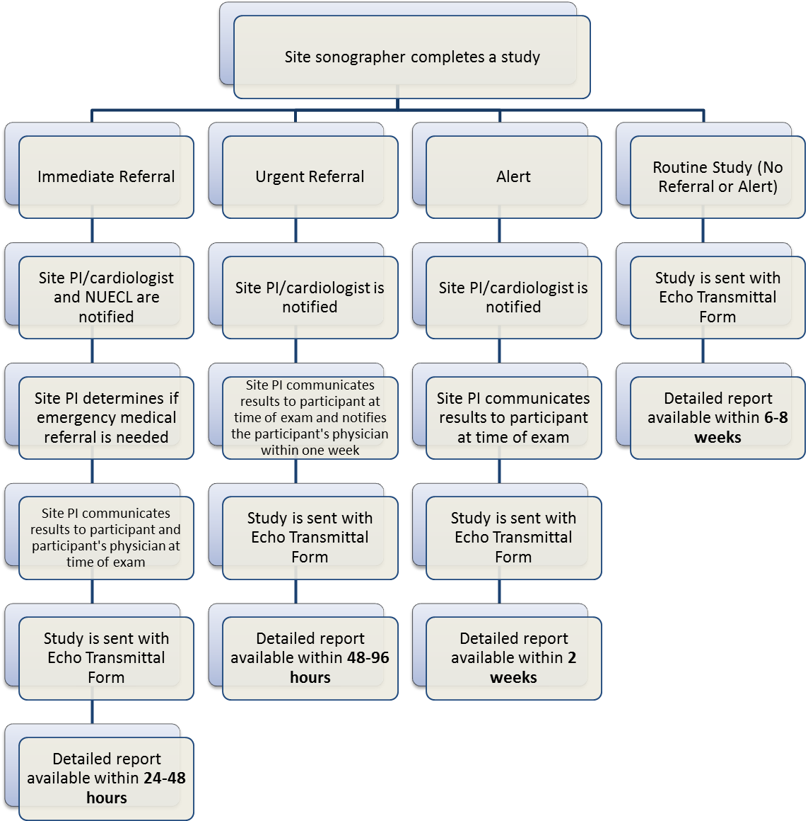
Immediate & Urgent Referrals (3)

Slide 22
Conclusion (1)
MESA Group adopts a consistent results reporting policy that accommodates the ppts and would allow them to make the right medical decision for their health
All the appropriate precautions to ensure the confidentiality of test results will be taken, including but not limited to:

Slide 23
Conclusion (2)
Not leaving test results on an answering machine, on voice mail, or a third party unless previously given permission to do so by the ppt
Not delivering test results via electronic mail
Not sending test results through the mail in any form other than a sealed envelope
Finally, it is important to acknowledge that MESA plays a key role by advancing science and providing ppts with tests results keeping their health in check periodically.

Slide 24
References
MESA EXAM 6 protocol
http://www.ama-assn.org/ama/pub/physician-resources/medical-ethics/code-medical-ethics/opinion8095.page?
http://www.ncbi.nlm.nih.gov/pmc/articles/PMC1831617/
Direct Reporting of Laboratory Test Results to Patients by Mail to Enhance Patient Safety

Slide 25
Hopkins Team:
Wendy Post, M.D: Principal Investigator
Erin Michos, M.D: CO-Investigator
Imene Benayache, M.D: Study Coordinator
Carol Christman: Research Coordinator
Yavette Morton: Research Coordinator
Sidnei McCrea: Exam Coordinator
Daniel Moorhead: Exam Coordinator
Jasina Wise: Scheduling Coordinator
Christine Mc Leod: Laboratory processor
Sonia Watkins: Laboratory processor

Slide 26
Questions?

Slide 27
Thank you!

