Slide 1
MESA Operations
Subcommittee Meeting

Slide 2
Operations Subcommittee Report
Retention
Follow-up calls
Participant Communications
Ongoing Ancillary Studies
Notes:
Update for Feb 2014

Slide 3
Follow-up Call Retention
85%
Retention = Completed / (Enrolled – Dead)
Notes:
Done. Final FU13 retention is 84%, FU14 is 83%, FU15 is 80%

Slide 4
Follow-up Retention by Ethnicity
85%
Retention = Completed / (Enrolled – Dead) except FU 15 (windowed)
Notes:
done

Slide 5
Follow-up Retention by Site
85%
Retention = Completed / (Enrolled – Dead) except FU 14 and 15 (windowed)
Notes:
Cut and paste

Slide 6
Lower Retention among Hispanics
Possible reasons
Emigration
Difficulty reaching/searching in home countries
Movement of all contacts
?occult deaths
Approaches
Continued efforts in home countries
Discuss approaches with HCHS
Possible contacts w/ DOH in Mexico, DR, PR?
Notes:
Update/Remove for Sept 2014

Slide 7
Follow-up 14 Completion (Overall)
Site | Window Closed Interview Done | All Interviews Done | % of FU14 Completed
WFU | 781 | 783 | 89%
Col | 767 | 846 | 94%
JHU | 700 | 739 | 93%
Minn | 756 | 759 | 85%
NWU | 854 | 935 | 97%
UCLA | 921 | 1026 | 99%
TOTAL | 4779 | 5088 | 93%
Notes:
Done. % of FU complete does not include drop outs.

Slide 8
Follow-up 14 Completion by Site
Notes:
Done. % of FU complete does not include drop outs.

Slide 9
Follow-up 15 Completion (Overall)
Site | Window Closed Interview Done | All Interviews Done | % of FU14 Completed
WFU | 320 | 332 | 38%
Col | 263 | 402 | 45%
JHU | 290 | 361 | 47%
Minn | 322 | 419 | 48%
NWU | 357 | 471 | 50%
UCLA | 387 | 664 | 65%
TOTAL | 1939 | 2649 | 49%
Notes:
Done. % of FU complete does not include drop outs.

Slide 10
Follow-up 14 – Air/Family Participants
 | Target | Interview Done | Complete
MESA Air – Recruited from MESA Family
Wake Forest | 40 | 40 (100%) | 40 (100%)
Columbia | 134 | 134 (100%) | 105 (78%)
Johns Hopkins | 43 | 43 (100%) | 35 (81%)
Minnesota | 77 | 77 (100%) | 56 (73%)
Northwestern | 143 | 143 (100%) | 113 (79%)
UCLA | 16 | 16 (100%) | 13 (81%)
MESA Air New Recruits
Columbia | 94 | 94 (100%) | 86 (91%)
UCLA | 149 | 149 (100%) | 137 (92%)
Notes:
Done.

Slide 11
Follow-up Retention
F/U 14 will finish in October 2014 (93% done)
Includes Medications Inventory and Residential History Review
F/U 15 started January 2014 (49% done)
Heterogeneity across sites in startup and completion rates
No Medications Inventory or Residential History Review.
FU 16 will start October 2015
Includes Medications Inventory, new questions for gout, food security, e-cigarette use, blood thinner/anticoagulant use
Notes:
EDIT?

Slide 12
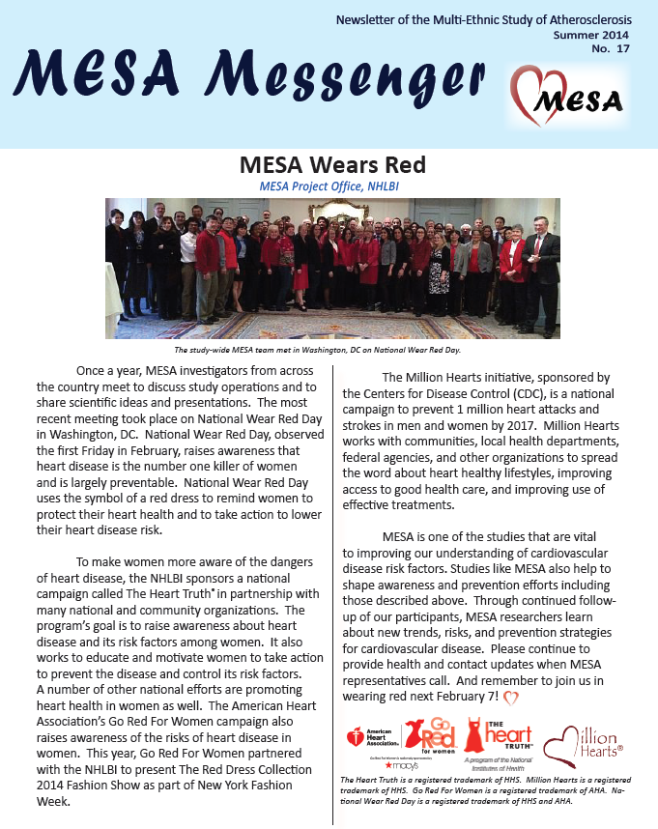
Newsletter
Mailed in July
Reformatted for greater participant appeal:
Full color
More graphics and pictures
More white space
Articles contained on a single page if possible, no skipping pages to continue
Next newsletter planned for early 2015
Notes:
done

Slide 13
Ancillary Studies
MESA Air?
MESA COPDII

Slide 14
Thank You!!!

