Slide 1
MESA Operations
Subcommittee Report

Slide 2
Operations Subcommittee Report
Timeline
Follow-up calls / Retention
Exam 6
Participant Relations Committee

Slide 3
MESA 3 Timeline
Exam 6 Sept 6, 2016 – March 30, 2018
Annual Follow-up phone calls run congruent with fiscal years

Slide 4
Follow-up Calls
Follow-up 16
Ended 7 months early in August 2015
Medications inventory, new questions for gout, food security, e-cigarette use, blood thinner/anticoagulant use
Follow-up 17
Started August 2015 (60% complete)
New MESA 3 follow-up schedule
Permission to send letter to Contacts with information about MESA and role as a Contact
Notes:
Add new unique FU17 questions

Slide 5
Follow-up Call Retention
85%
Retention = Completed / (Enrolled – Dead)

Slide 6
Follow-up Retention by Ethnicity
85%
Retention = Completed / (Enrolled – Dead) except FU 17 (windowed)
Notes:
done

Slide 7
Follow-up Retention by Site
85%
85%
Retention = Completed / (Enrolled – Dead) except FU 17 (windowed)
Notes:
Cut and paste

Slide 8
Follow-up 17 Completion by Site
Site Name | Follow-up Due | Contacts Made |  | Interviews Completed |  | Unable | Refused
Wake Forest | 436 | 384 | 88% | 320 | 73% | 53 | 10
Columbia | 437 | 373 | 85% | 321 | 73% | 47 | 5
Hopkins | 388 | 370 | 95% | 328 | 85% | 40 | 1
Minnesota | 448 | 426 | 95% | 378 | 84% | 44 | 4
NWU | 501 | 487 | 97% | 432 | 86% | 50 | 5
UCLA | 521 | 449 | 86% | 370 | 71% | 77 | 1
Total | 2731 | 2489 | 91% | 2149 | 79% | 311 | 26
Completed = Completed / (Enrolled – Dead – Dropped)
Notes:
UPDATE. % of FU complete does not include drop outs.

Slide 9
Retention
Follow-up 16
Low (expected/truncated)
Follow-up 17
All sites behind schedule
Particularly among minority groups
Important to focus on call completion now
“Limited” call (contacts, events) available
Notes:
Add new unique FU17 questions

Slide 10
Operations Subcommittee Report
Timeline
Follow-up calls / Retention
Exam 6
Participant Relations Committee

Slide 11
Exam 6
No longer: MESA Classic Exam (ancillaries)
Now: MESA Exam 6 = Core + Ancillaries
(particularly for ancillaries at all sites)

Slide 12
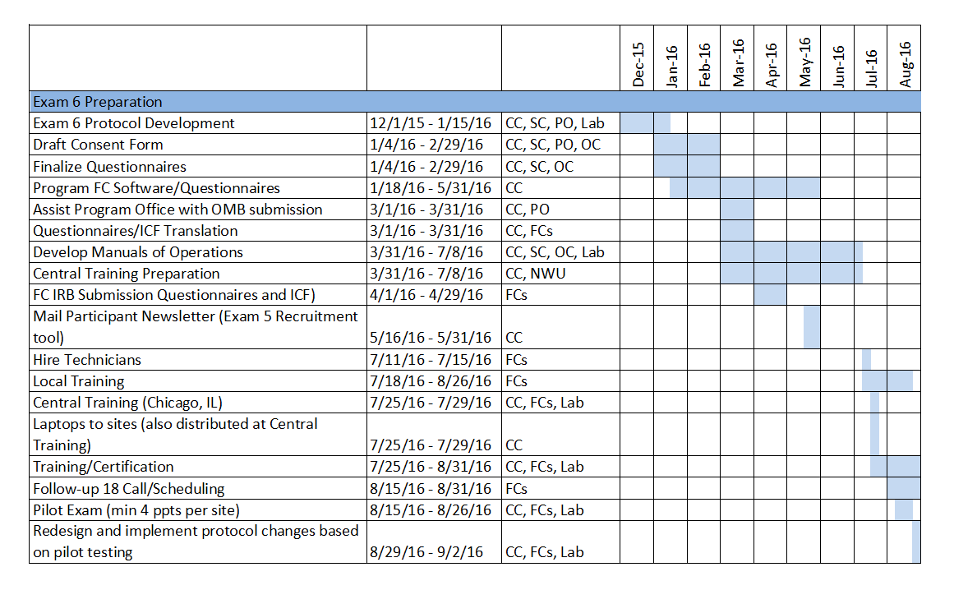
Exam 6 Preparation Timeline

Slide 13
Exam 6 Preparation Timeline

Slide 14
Exam 6 Core
#Participants | ~ 4000 ppts
Time Burden | Average duration: 90 minutes
Exam components | Consent/Check-in Seated blood pressure, pulse oximetry Anthropometry Phlebotomy Medical history (SF-12, PROMIS Physical Function) Personal history/demographics Medication Inventory

Slide 15
Exam 6 Ancillary Studies
PI | Sample | Title
Bertoni, Shah | All | Transition from risk factors to early HF
Barr | 2000 (All sites) | Pulmonary microvascular perfusion in MESA
Smith | 650 (All sites) | COPD in non-smokers
Heckbert | 1500 (All sites) | Atrial fibrillation & vascular disease of the brain
Hughes, Craft | 550 (Wake) | Cardiometabolic risk for Alzheimer's
Shea | 350 (CU) | HDL-mediated cholesterol efflux and carotid FDG PET

Slide 16
Exam 6 Components (~Day 1)
 | Time | Sample | Main or Ancillary
Reception/Consent | 15 | All | Main
Change Clothes | 5 | All | Main
Blood Pressure | 15 | All | Main
Pulse Oximetry | 0 | All | Main
Anthropometry | 10 | All | Main
Phlebotomy | 15 | All | Main
Urine Collection | 5 | All | MESA HF
Snack |  | All | Main
Echocardiography | 25 | All | MESA HF
Arterial Tonometry | 5 | All? | MESA HF
Spirometry | 20 | 2650 | MESA Lung/NonSmk
Lung CT | 30 | 2650 (1000 w/ contrast) | MESA Lung NonSmk
6 Minute Walk Test | 15 | All | MESA HF
Patch Application | 15 | 1500 | MESA AF

Slide 17
Exam 6 Questionnaires (~Day 1)
 | Time | Sample | Main or Ancillary
Medications | 10 | All | Main
Medical History | 10 | All | Main
Personal History | 5 | All | Main
Physical Activity | 15 | All | Main
HF Symptoms/Risk | 25 | All | MESA HF
Physical Activity | 15 | All | MESA HF
COPD Scores | 20 | 2650 | MESA Lung/NonSmk
Cognitive Function | 35 | 1500 | MESA AF
Additional Cognitive Function | 95 | 540 | Cognitive Function Testing
Patch Application | 15 | 1500 | MESA AF

Slide 18
Exam 6 – Other Visits
 | Time | Sample | Main or Ancillary
Lung CT | 30 | 2650 | MESA Lung/NonSmk
Brain MRI | 35 | 1500 | MESA AF
Carotid PET | 95 | 540 | Cognitive Function Testing
Patch Application | 15 | 1500 | MESA AF

Slide 19
Exam 6 Status
Consent Template
Reviewed by Steering, Operations, E6 Consent Committees
Current draft posted on MESA E6 Planning webpage
Forms and Content Committee is finalizing:
Study Questionnaires and completion forms
FU18 form packet

Slide 20
Exam 6 Status, ctd
High tech and lab results letters
Main text for letters is drafted, ready for Ops/PRC review
CC/Ops working with ancillary study PIs to understand reporting for specific tests/procedures
Safety reads for ECHO, CT

Slide 21
Thank You!!!

Slide 22
Participant Relations Committee
Letters to MESA Contacts
FU17 asks permission from participants to send letter or brochure to MESA Contacts (also added as an Exam 6 ICF item)
PRC drafted letter to inform MESA Contacts of their role in MESA
Participant Website Updates
Spanish/Chinese translations now available for main participant webpages
Article summaries and press releases are added monthly

Slide 23
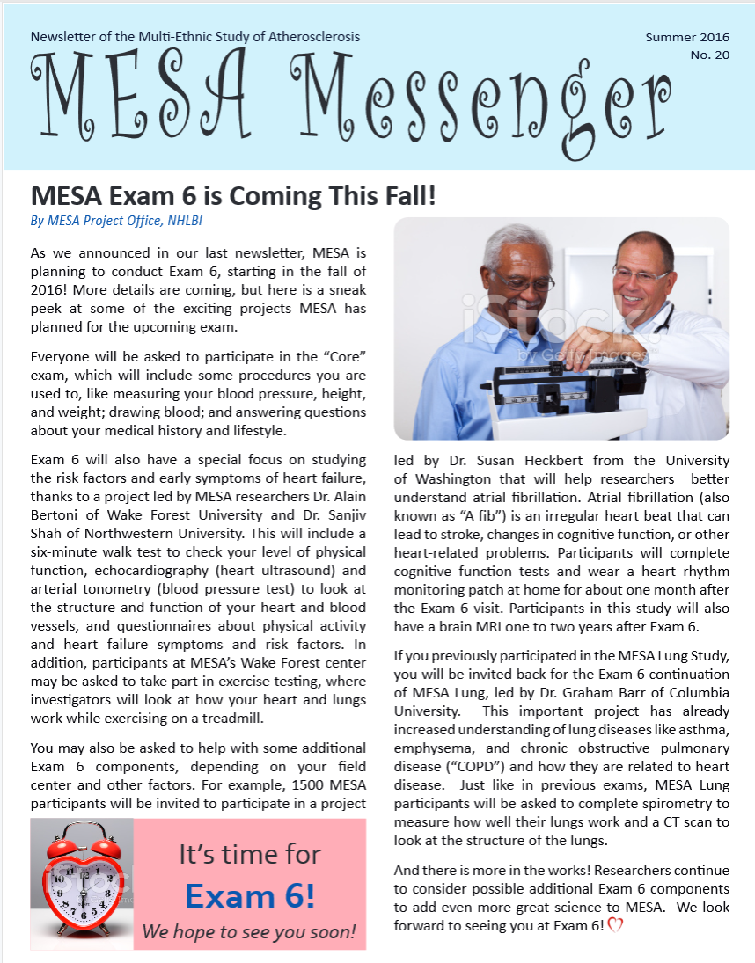
Participant Relations Committee
Newsletter
Mail in June 2016
Announces Exam 6 and planned ancillary study components
Next newsletter planned for November 2016
One newsletter per year planned for remainder of MESA 3 contract

