Slide 1
MESA Operations
Subcommittee Meeting

Slide 2
Operations Subcommittee Report
Retention
Follow-up calls
F/U 14 progress
Currently at 79%
F/U 15 launched
MESA Air Report
Participant Communications
Ancillary Studies Ongoing
Notes:
Update for Feb 2014

Slide 3
Follow-up Call Retention
Retention = Completed / (Enrolled – Dead)
Notes:
Final FU13 retention is 84%

Slide 4
Follow-up Retention by Ethnicity
Retention = Completed / (Enrolled – Dead) except FU 14 (windowed)
Notes:
Done

Slide 5
Follow-up Retention by Site
Retention = Completed / (Enrolled – Dead) except FU 14 (windowed)
Notes:
Done

Slide 6
Lower Retention among Hispanics
Possible reasons
Emigration
Difficulty reaching/searching in home countries
Movement of all contacts
Approaches
Continued efforts in home countries
Discuss approaches with HCHS
Possible contacts w/ DOH in Mexico, DR, PR?
Notes:
Update for Feb 2014

Slide 7
Follow-up 13 Completion
Expected* Contacts Made
3: Wake Forest 892 892 100%
4: Columbia 910 892 98%
5: Johns Hopkins 810 810 100%
6: Minnesota 907 899 99%
7: Northwestern 981 980 99%
8: UCLA 1055 1055 100%
TOTAL 5555 5528 99%
* Study dropouts not included in these numbers
Notes:
Done. Note: Study drop outs not included, contacts made includes incomplete calls

Slide 8
Follow-up 14 Completion (Closed Windows)
Expected* Contacts Made
3: Wake Forest 430 400 93%
4: Columbia 463 370 80%
5: Johns Hopkins 387 379 98%
6: Minnesota 447 372 83%
7: Northwestern 470 450 96%
8: UCLA 502 478 95%
TOTAL 2699 2449 91%
* Study dropouts not included in these numbers
Notes:
Done. Note: Study drop outs not included, contacts made includes incomplete calls

Slide 9
Follow-up 14 Completion (Overall)
Site | Window Closed Interview Done | All Interviews Done | Additional interviews done and not included in retention slide | % of FU14 Completed
WFU | 368 | 420 | 52 | 48%
Col | 365 | 429 | 64 | 48%
JHU | 372 | 376 | 4 | 47%
Minn | 343 | 357 | 14 | 40%
NWU | 448 | 473 | 25 | 49%
UCLA | 426 | 570 | 144 | 56%
TOTAL | 2340 | 2625 | 285 | 48%
Notes:
Done. % of FU complete does not include drop outs.

Slide 10
Follow-up 13 – Air/Family Participants
 | Target Cumulative | Completed Cumulative | Percent of Goal
MESA Air – Recruited from MESA Family
Wake Forest | 44 | 41 | 93%
Columbia | 137 | 94 | 69%
Johns Hopkins | 47 | 32 | 68%
Minnesota | 77 | 47 | 61%
Northwestern | 145 | 123 | 85%
UCLA | 16 | 12 | 75%
MESA Air New Recruits
Columbia | 94 | 86 | 91%
UCLA | 149 | 92 | 90%
Notes:
Update.

Slide 11
Follow-up 14 – Air/Family Participants
 | Target Cumulative | Completed Cumulative | Percent of Goal
MESA Air – Recruited from MESA Family
Wake Forest | 44 | 0 | 0%
Columbia | 137 | 44 | 58%
Johns Hopkins | 47 | 17 | 77%
Minnesota | 77 | 21 | 75%
Northwestern | 145 | 37 | 53%
UCLA | 16 | 2 | 13%
MESA Air New Recruits
Columbia | 94 | 57 | 61%
UCLA | 149 | 92 | 62%
Notes:
Done.

Slide 12
Follow-up Retention
F/U 14 has going well
Considerable heterogeneity across sites in startup and completion rates
Includes medications inventory and residential history review
F/U 15 started January 2014
Notes:
Update for Feb 2014

Slide 13
Common Retention Obstacles
Declining cognitive function
Hearing loss
Aging, health issues, and life events require all available time and energy
Cultural and Immigration issues
Search options less effective with dropping of land lines
Insufficient number of contact people
Notes:
Keep/remove for Feb 2014?

Slide 14
Approaches for 85%+ FU Retention
Revised Web Reports (for PIs and Coordinators) and Software Updates
Abbreviated FU call “Have you been hospitalized”
Letter/email asking the same (handwritten notes have been most effective)
Notes:
Keep/remove for Feb 2014?

Slide 15
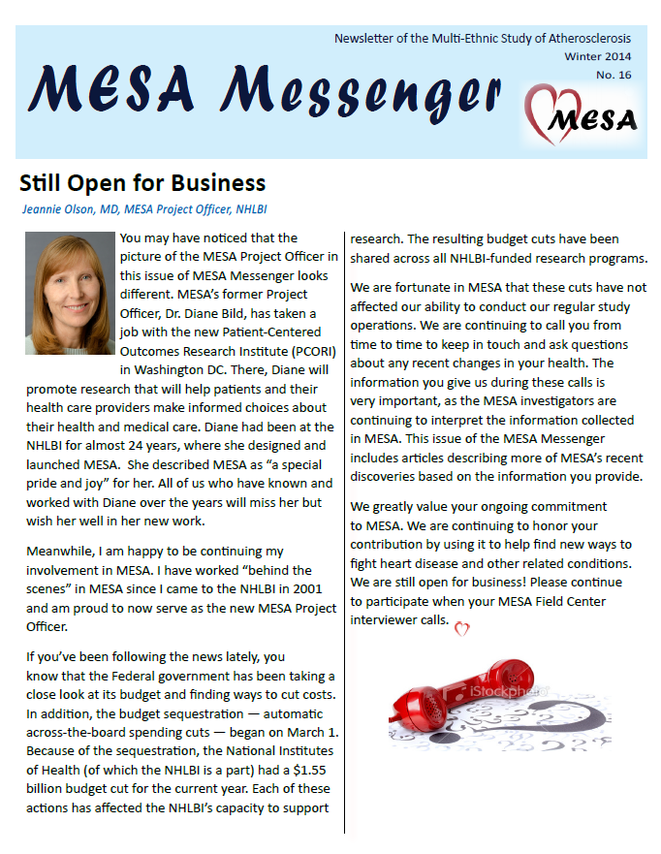
Newsletter
Mailed in December
Reformatted for greater participant appeal:
Full color
More graphics and pictures
More white space
Articles contained on a single page if possible, no skipping pages to continue
Next newsletter planned for Summer 2014
Notes:
done

Slide 16
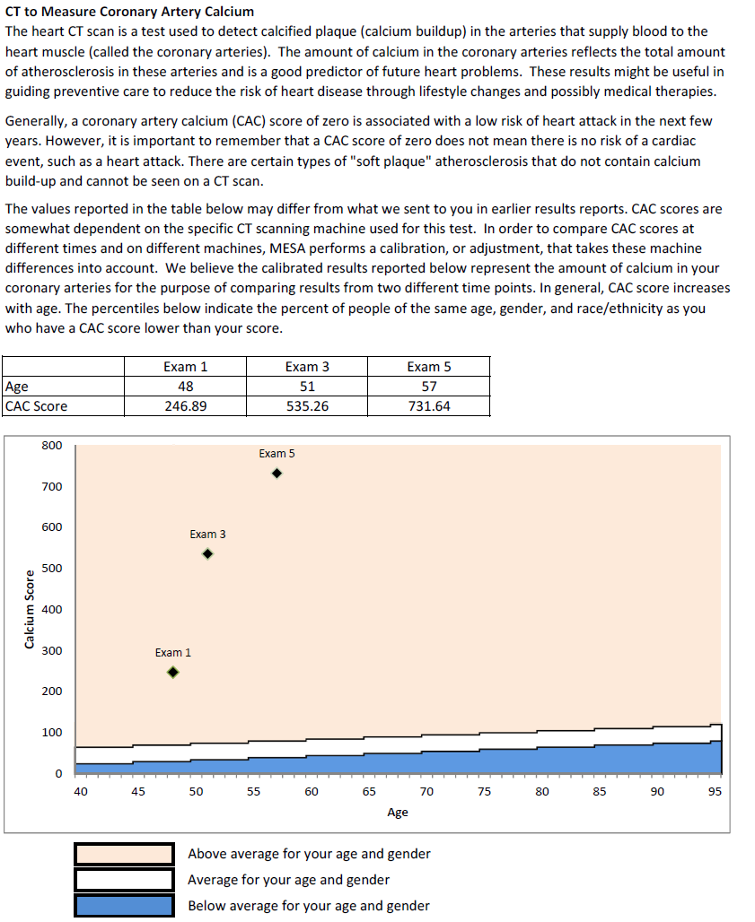
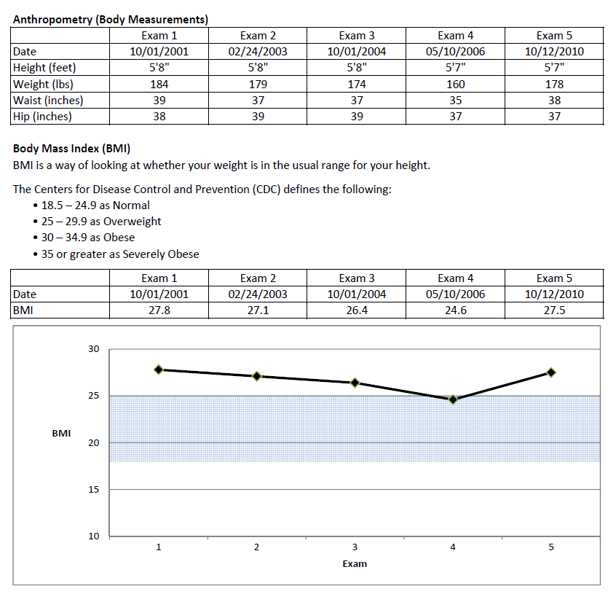
Participant Summary Report
Will send to homes in Jan 2014
Extremely effective retention tool
Notes:
done

Slide 17
Thank You!!!

